Slide 1

SPI Protocol
Sepehr Naimi
www.NicerLand.com

Slide 2
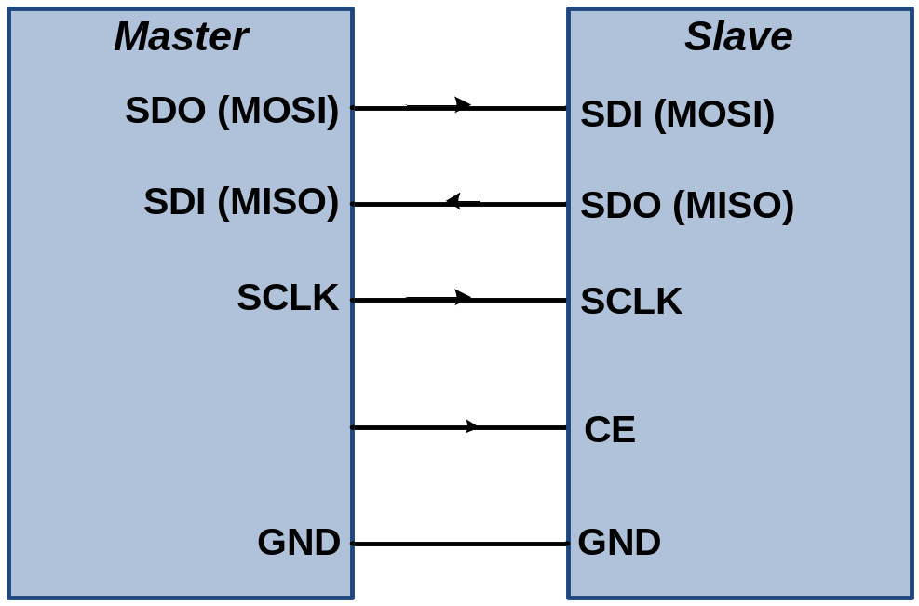
SPI Protocol
Synchronous
Full-duplex
Serial
Fast communication
For short distances
Pins
  SDO (Data Out)
  SDI (Data In)
  SCLK (shift clock)
  CE (chip enable)

Slide 3
Master vs. Slave
Master begins the communication by pulling down the CE pin of slave.
Master makes the clock for communication

Slide 4
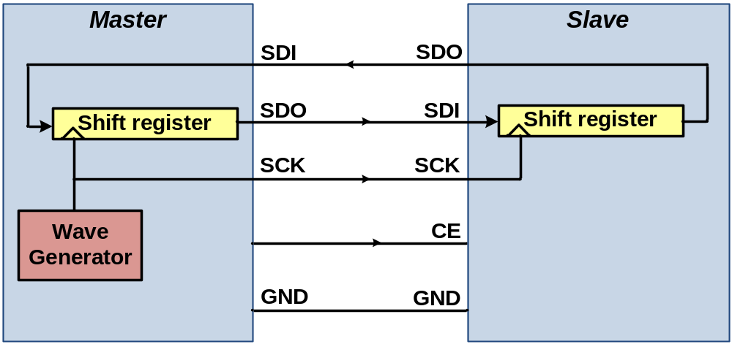
SPI internal circuit
A shift register in the master and another in the slave
By each clock, a bit is shifted out from the master’s shift register into the slave shift register and a bit is shifted from slave to master.

Slide 5
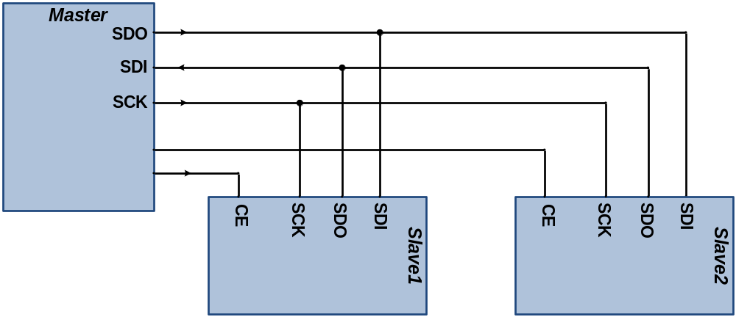
Multi-slave communication

Slide 6
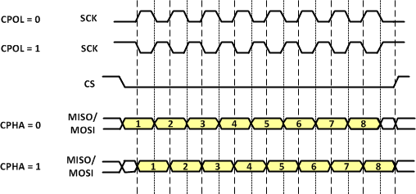
Polarity and Phase
Idle = 0
Idle = 1
CPOL | CPHA | Data Read and Change Time | SPI Mode
0 | 0 | Read on rising edge, changed on a falling edge | 0
0 | 1 | Read on falling edge, changed on a rising edge | 1
1 | 0 | Read on falling edge, changed on a rising edge | 2
1 | 1 | Read on rising edge, changed on a falling edge | 3

Slide 7
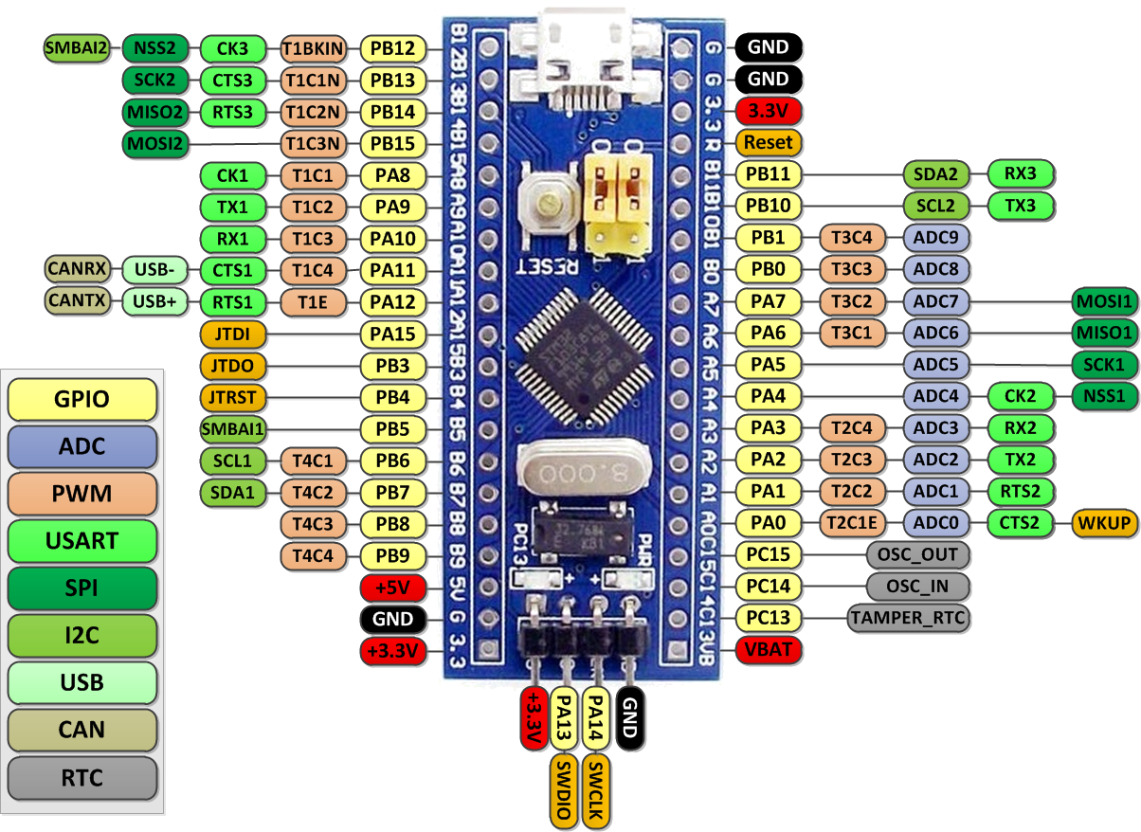
SPI pins in STM32F10x
SPI2
SPI1
MOSI (Master Out Slave In)
MISO (Master In Slave Out)

Slide 8

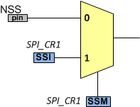
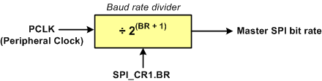
Field | Bit | Descriptions
BIDIMODE | 15 | Bidirectional data mode enable (0: 2-line unidirectional, 1: 1-line bidirectional)
BIDIOE | 14 | When BIDIMODE=1 (1-line bidirectional), the BIDIOE bit selects the direction of transfer (0: receive, 1: transmit)
CRCEN | 13 | Hardware CRC calculation enable (0: disabled, 1: enabled)
CRCNEXT | 12 | CRC transfer next (0: data transfer, 1: next transfer is CRC)
DFF | 11 | Data Frame format (0: 8-bit data frame, 1: 16-bit data frame)
RXONLY | 10 | Receive only (0: Both transmit & receive (Full-duplex), 1: Receive only)
SSM | 9 | Software Slave Management (0: NSS pin, 1: SSI bit) If the bit is set, the SSI bit manages the communication instead of the NSS pin.
SSI | 8 | Internal Slave Select
LSBFIRST | 7 | LSB First Enable 1 = Data is transferred least significant bit first. 0 = Data is transferred most significant bit first.
SPE | 6 | SPI System Enable bit 1 = Enables SPI port and configures pins as serial port pins 0 = Disables SPI port and configures these pins as I/O ports
BR | 5-3 | Baud rate control
MSTR | 2 | SPI Master/Slave mode Select bit. This bit selects master or slave mode. 1 = SPI in master mode 0 = SPI in slave mode
CPOL | 1 | SPI Clock Polarity bit 1 = Active-LOW clocks selected. In idle state SCK is high. 0 = Active-HIGH clocks selected. In idle state SCK is low.
CPHA | 0 | SPI Clock Phase bit 1 = Sampling of data occurs at even edges of the SCK clock. 0 = Sampling of data occurs at odd edges of the SCK clock.
BR | 0 | 1 | 2 | 3 | 4 | 5 | 6 | 7
Speed | PCLK/2 | PCLK/4 | PCLK/8 | PCLK/16 | PCLK/32 | PCLK/64 | PCLK/128 | PCLK/256

Slide 9
Example
Assuming that the PCLK2 (peripheral clock for APB2) is 72MHz, find the SPI_CR1 value to initialize the SPI device as a master device, with bit rate of 2.25MHz, with active-high clock, sampling on rising edge, and 8-bit data MSB first. Make the NSS pin free
Solution:
72MHz / 2.25MHz = 64 = 2⁶ ➔ BR = 5
SPI_CR1 | BIDIMODE | BIDIOE | CRCEN | CRCNEXT | DFF | RXONLY | SSM | SSI | LSBFIRST | SPE | BR | MSTR | CPOL | CPHA
 | 0 | 0 | 0 | 0 | 0 | 0 | 1 | 1 | 0 | 1 | 101 | 1 | 0 | 0
SPI_CR1 = 0x036C

Slide 10
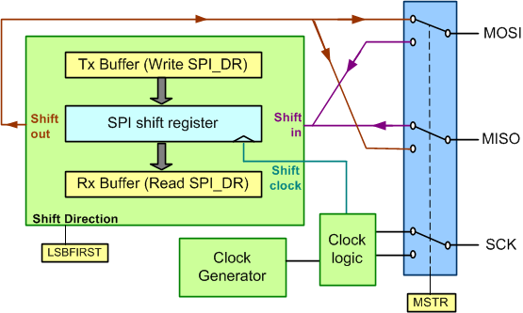
The MSTR bit and the role of pins

Slide 11
SPI Data Register (SPIx_DR)

Slide 12
Field | Bit | Description
BSY | 7 | Busy flag (0: not busy, 1: busy) The bit is set when the SPI module is transferring data or TX buffer is not empty. The flag is set and cleared by hardware.
OVR | 6 | Overrun (0: no overrun, 1: overrun occurred) The flag sets when a new data is received and the previous data is not read.
MODF | 5 | Mode fault (0: no mode fault occurred, 1: mode fault occurred) If the STM32 is in master mode and the NSS pin is pulled down with another device, STM32 goes to slave mode and the flag is set.
CRCERR | 4 | CRC Error (For more information, see the user manual.)
UDR | 3 | Underrun (0: no underrun, 1: underrun occurred) The flag sets if the STM32 is in slave mode and a SCLK clock is appeared while we have not loaded data to the data register (SPI_DR).
CHSIDE | 2 | Channel side (It is not used in SPI mode.)
TXE | 1 | Transmit buffer empty (0: not empty, 1: empty) The flag is set if the SPI transmit buffer is empty and it is ready to send another data.
RXNE | 0 | Receive buffer not empty (0: empty, 1: not empty) The flag is set if a new data is received.

Slide 13
Sending and Receiving as Master
Enable the clocks for SPI and GPIO.
Initialize MOSI and SCK as alternate function output push-pull (CNFx = 10) and make MISO an input pin.
Initialize SPI_CR1 with proper value:
Consider a GPIO pin for the CE pin
Make low the CE pin of the desired slave.
Load SP_DR to send data.
Monitor the SPI_SR register until the TXE is set (or RXNE is set).
Read SP_DR to get the received data.
Repeat steps 6 to 8 until all data are transferred.
Make the CE pin of the slave device high.

Slide 14
Sending ‘A’ to ‘Z’ via SPI
#include <stm32f10x.h>
void spi1_init(void);
uint8_t spi1_transfer(uint8_t d);
int main( ) {
RCC->APB2ENR |= 0xFC; /* enable clocks for GPIO */
spi1_init(); /* initialize the SPI module */
/*--- make the NSS pin of the slave low if needed ---*/
for(char c = 'A'; c <= 'Z'; c++) /* send characters ‘A’ to ‘Z’ */
spi1_transfer(c); /* send c through SPI */
/*--- make the NSS pin high ---*/
while(1)
{ }
}
/* The function initializes the SPI module */
void spi1_init()
{
RCC->APB2ENR |= 0xFC|(1<<12); /* enable clocks for GPIO and SPI1 */
GPIOA->CRL = 0xB4B44444; /* MOSI (PA7) and SCK(PA5): alt. func. out, MISO (PA6): input */
SPI1->CR1 = 0x35C; /* SPE = 1, BR = 3, FFD = 0, SSI and SSM = 1 */
}
/* The function sends a byte of data via SPI */
/* argument d: the byte to be sent */
/* return value: the received data */
uint8_t spi1_transfer(uint8_t d)
{
SPI1->DR = d; /* send the contents of d */
while((SPI1->SR&(1<<0)) == 0); /* wait until RXNE is set */
return SPI1->DR; /* return the received data */
}

Slide 15
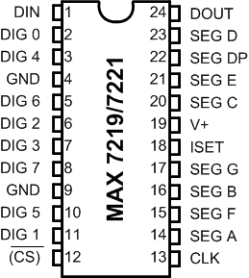
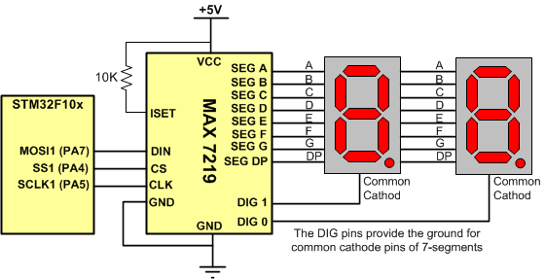
MAX7219/MAX7221
Drives 8-digit common cathode 7-segment
It has SPI bus

Slide 16
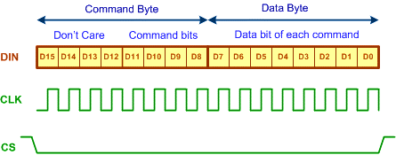
MAX7219/MAX7221 Packet Format

Slide 17

List of Commands in MAX7221/MAX7219
Set Scan limit (XB)
Command | D15-12 | D11 | D10 | D9 | D8 | Hex Code
No operation | X | 0 | 0 | 0 | 0 | X0
Set value of digit 0 | X | 0 | 0 | 0 | 1 | X1
Set value of digit 1 | X | 0 | 0 | 1 | 0 | X2
Set value of digit 2 | X | 0 | 0 | 1 | 1 | X3
Set value of digit 3 | X | 0 | 1 | 0 | 0 | X4
Set value of digit 4 | X | 0 | 1 | 0 | 1 | X5
Set value of digit 5 | X | 0 | 1 | 1 | 0 | X6
Set value of digit 6 | X | 0 | 1 | 1 | 1 | X7
Set value of digit 7 | X | 1 | 0 | 0 | 0 | X8
Set decoding mode | X | 1 | 0 | 0 | 1 | X9
Set intensity of light | X | 1 | 0 | 1 | 0 | XA
Set scan limit | X | 1 | 0 | 1 | 1 | XB
Turn on/off | X | 1 | 1 | 0 | 0 | XC
Display test | X | 1 | 1 | 1 | 1 | XF
Notes: X means don't care. Digits are designated as 0-7 to drive total of eight 7-segment LEDs.
Data | Meaning
0 | Scan digit 0
1 | Scan digits 0 and 1
2 | Scan digits 0, 1, and 2
3 | Scan digits 0 to 3
4 | Scan digits 0 to 4
5 | Scan digits 0 to 5
6 | Scan digits 0 to 6
7 | Scan digits 0 to 7
0: bypass decoding
1: decode

Slide 18

Example
What sequence of bytes should be sent to the MAX7219 in order to enable the decoding function for digit 0 and digit 2, and disable the decoding function for other digits?

Slide 19

Example
what sequence of numbers should be sent to the MAX7219 in order to write 5 on digit 2?

Slide 20

Example: Display 49 using 8-bit transfer
#include <stm32f10x.h>
void spi1_init(void);
uint8_t spi1_transfer(uint8_t d);
void max7219_send(uint8_t cmd, uint8_t data);
int main( ) {
RCC->APB2ENR |= 0xFC; /* enable clocks for GPIO */
spi1_init(); /* initialize the SPI module */
max7219_send(0x09, 0xFF); /* enable decoding for all digits */
max7219_send(0x0B, 1); /* 2 (1+1) digits */
max7219_send(0x0C, 0x01); /* turn on */
max7219_send(0x01, 9); /* show 9 on digit 1 */
max7219_send(0x02, 4); /* show 4 on digit 2 */
while(1) { }
}
/* The function initializes the SPI module */
void spi1_init()
{
RCC->APB2ENR |= 0xFC|(1<<12); /* enable clocks for GPIO and SPI1 */
GPIOA->CRL = 0xB4B34444; /* MOSI (PA7) and SCK(PA5): alt. func. out, PA4: output for CS */
SPI1->CR1 = 0x35C; /* SPE = 1, BR = 3, FFD = 0, SSI and SSM = 1 */
}
/* The function sends a byte of data through SPI */
uint8_t spi1_transfer(uint8_t d)
{
SPI1->DR = d; /* send the contents of d */
while((SPI1->SR&(1<<0)) == 0); /* wait until RXNE is set */
return SPI1->DR; /* return the received data */
}
void max7219_send(uint8_t cmd, uint8_t data)
{
GPIOA->BRR = (1<<4); /* Enable Chip Select */
spi1_transfer(cmd);
spi1_transfer(data);
GPIOA->BSRR = (1<<4); /* Disable Chip Select */
}

Slide 21


Example
After disabling the decoder, what sequence of numbers should be sent to the MAX7219 in order to write U on digit 1?

Slide 22

Example: Display 2U
#include <stm32f10x.h>
void spi1_init(void);
uint8_t spi1_transfer(uint8_t d);
void max7219_send(uint8_t cmd, uint8_t data);
int main( ) {
RCC->APB2ENR |= 0xFC; /* enable clocks for GPIO */
spi1_init(); /* initialize the SPI module */
max7219_send(0x09, 0x02); /* enable decoding for digit2 and disable for digit1 */
max7219_send(0x0B, 1); /* 2 (1+1) digits */
max7219_send(0x0C, 0x01); /* turn on */
max7219_send(0x01, 0x3E); /* show U on digit 1 */
max7219_send(0x02, 2); /* show 2 on digit 2 */
while(1) {
}
}

