Slide 1

Graphic LCDs
Chapter 18
Sepehr Naimi
www.NicerLand.com

Slide 2

Graphic LCDs
The screen of graphic LCDs is made of pixels.

Slide 3
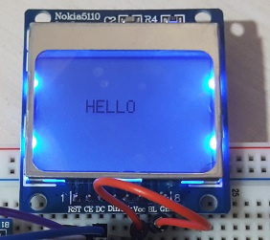

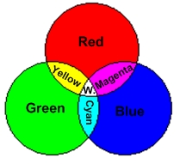
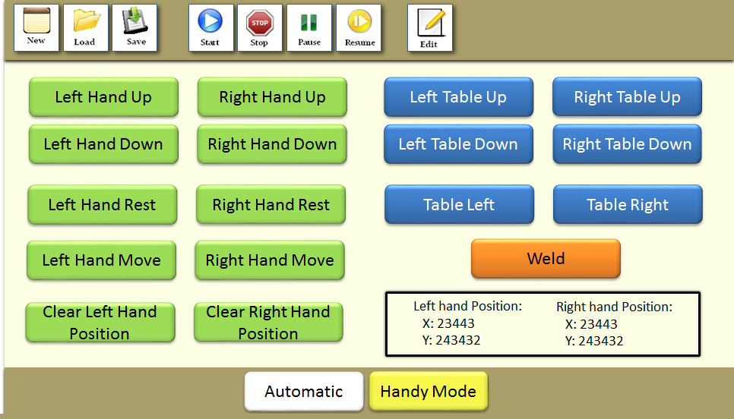
Graphic LCD characteristics
Monochrome vs. colored
Monochrome
  Pixels are either ON or OFF
Colored

Slide 4

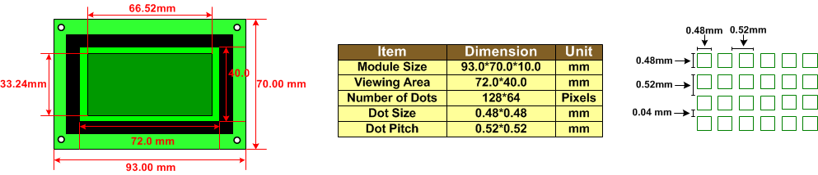
Graphic LCD Characteristics
Dot pitch and Dot size
GDM12864 128x64 mono-colored LCD

Slide 5
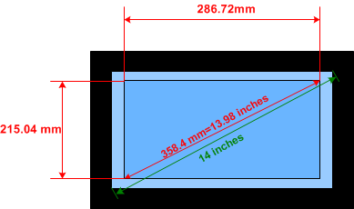
Graphic LCD Characteristics image diagonal size vs. advertised diagonal size
(image diagonal size)² = (number of horizontal pixels × dot pitch)²+ (number of vertical pixels × dot pitch)²
(image diagonal size)² = (1024 × 0.28 mm)² + (768 × 0.28 mm)² = 358.4 mm
Image diagonal size (inches) = 358.4 mm × 0.039 inch per mm = 13.98 inches

Slide 6

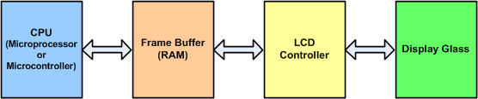
LCD Controller and Frame Buffer

Slide 7
Buffer size
Buffer size in a 640x480 256-color LCD is:
  2⁸ = 256 ➔ BPP = 8 bits
  (640 * 480 * 8) / 8 = 307200 bytes = 300KB
Buffer memory size (in byte) =
Horizontal Pixels × Vertical Pixels × BPP
8

Slide 8
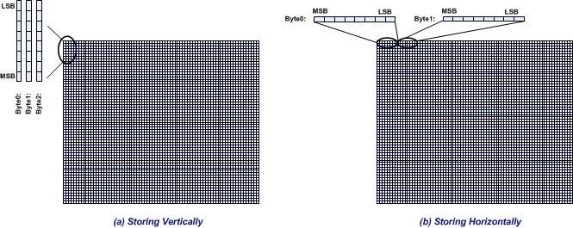
Storing pixels in the memory

Slide 9
Defining Font and displaying texts

Slide 10
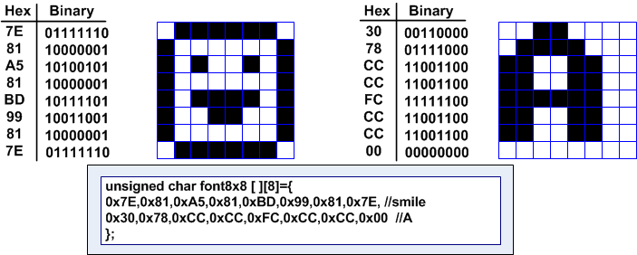
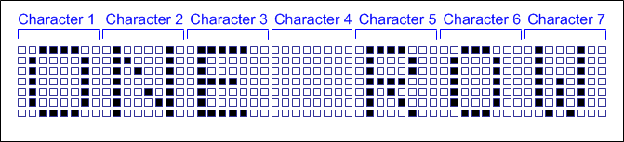
Font

Slide 11
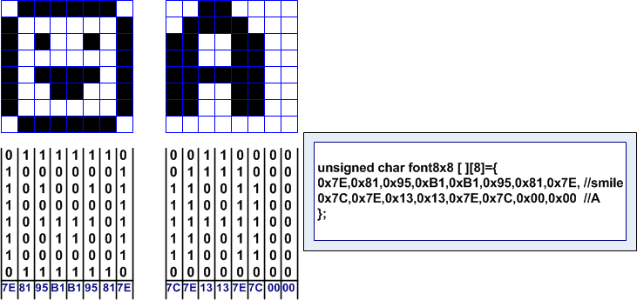
Horizontal vs. Vertical
Horizontal
Vertical

Slide 12
PCD8544 LCD (Nokia5110)

Slide 13
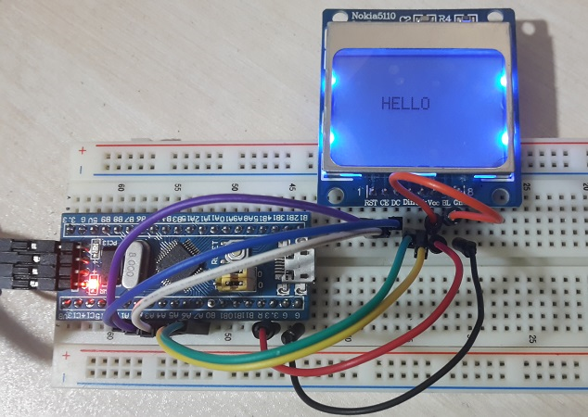
Specifications
84x48
Monochrome

Slide 14
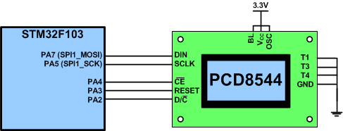
PCD8544 LCD (Nokia5110)
Power Pins: VCC (VDD) and GND (VSS)
BL (Backlight)
SPI pins: CE (SS), DIN (MOSI), and SCLK
D/C# (Data/Command#)
Reset#

Slide 15
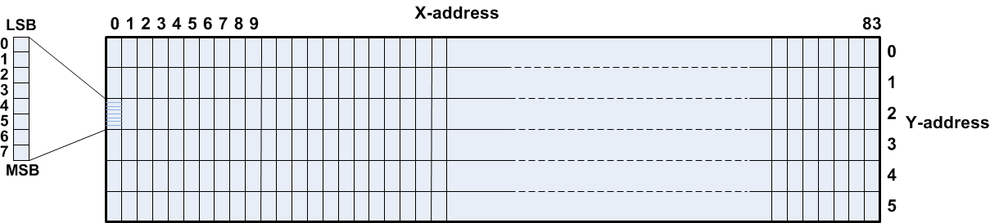
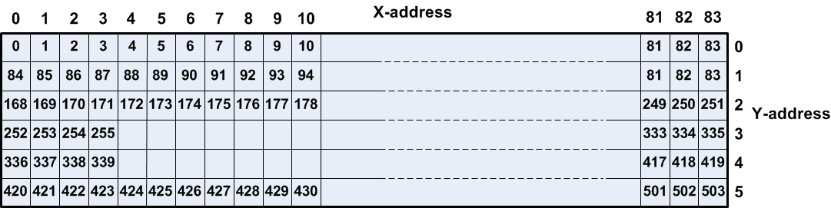
Storing 84x48 pixels in the DDRAM

Slide 16
Commands
Function set
Extended Commands
Basic Commands
D/C | D7 | D6 | D5 | D4 | D3 | D2 | D1 | D0
0 | 0 | 0 | 1 | 0 | 0 | PD | V | H
Bit | Usage | Description
H | Extended/Basic | 0: Basic, 1: Extended
V | Vertical/Horizontal | The bit chooses the direction of moving the address counting when auto increments. For common uses it is 0. (0: Horizontal, 1: Vertical)
PD | Power Down/Active | 0: Active, 1: Power down
Instruction | D/C | D7 | D6 | D5 | D4 | D3 | D2 | D1 | D0
Set Temperature Coefficient | 0 | 0 | 0 | 0 | 0 | 0 | 1 | TC1 | TC0
Set Bias | 0 | 0 | 0 | 0 | 1 | 0 | BS2 | BS1 | BS0
Set VOP | 0 | 1 | VOP6 | VOP5 | VOP4 | VOP3 | VOP2 | VOP1 | VOP0
Instruction | D/C | D7 | D6 | D5 | D4 | D3 | D2 | D1 | D0
Display Configuration | 0 | 0 | 0 | 0 | 0 | 1 | D | 0 | E
Set Y address of RAM | 0 | 0 | 1 | 0 | 0 | 0 | Y2 | Y1 | Y0
Set X address of RAM | 0 | 1 | X6 | X5 | X4 | X3 | X2 | X1 | X0
D | E | Display Mode
0 | 0 | Display blank
0 | 1 | All display segments on
1 | 0 | Normal mode
1 | 1 | Inverse video mode

Slide 17
PCD8544 Initialization
void glcd_init()
{
RCC->APB2ENR |= 0xFC|(1<<12); /* enable clocks for GPIO and SPI1 */
/* MOSI (PA7) and SCK(PA5): alt. func. out, PA4: output for CS */
GPIOA->CRL = 0xB4B33344;
SPI1->CR1 = 0x35C; /* SPE = 1, BR = 3, FFD = 0, SSI and SSM = 1 */
GPIOA->BSRR = (1<<GLCD_CS)|(1<<GLCD_RESET); /* make CS and RESET pins high */
delay_ms(10);
GPIOA->BRR = (1<<GLCD_RESET); /* reset the LCD (RESET = 0) */
delay_ms(70);
GPIOA->BSRR = (1<<GLCD_RESET); /* release the RESET pin */
glcd_cmd(0x21); /* switch to extended command mode */
glcd_cmd(0x06); /* set temp. coefficient 2 */
glcd_cmd(0x13); /* set LCD bias mode 1:48 */
glcd_cmd(0xC2); /* set VOP to 7V (VOP = 66) */
glcd_cmd(0x20); /* switch to basic mode */
glcd_cmd(0x0C); /* set lcd display to normal mode */
}

Slide 18
Displaying Characters using Font
const char font_table[][5] = {
{ 0x7e, 0x11, 0x11, 0x11, 0x7e }, /* A */
{ 0x7f, 0x49, 0x49, 0x49, 0x36 }, /* B */
{ 0x3e, 0x41, 0x41, 0x41, 0x22 }, /* C */
{ 0x7f, 0x41, 0x41, 0x22, 0x1c }, /* D */
{ 0x7f, 0x49, 0x49, 0x49, 0x41 }, /* E */
{ 0x7f, 0x09, 0x09, 0x09, 0x01 }, /* F */
{ 0x3e, 0x41, 0x49, 0x49, 0x7a }, /* G */
.....
};
void glcd_putchar(char c)
{
uint8_t i;
if((c < 'A')||(c > 'Z'))
return;
for (i = 0; i < 5; i++)
glcd_data(font_table[c-'A'][i]);
glcd_data(0); /* an empty column between chars */
}

Slide 19
Displaying “HELLO” on the LCD
void glcd_setCursor(uint8_t x, uint8_t y)
{
glcd_cmd(0x80 | x); /* set x */
glcd_cmd(0x40 | y); /* set y (bank) */
}
int main()
{
glcd_init(); /* initialize the lcd */
glcd_clear();
glcd_setCursor(20, 2); /* move cursor to 20, 2 */
glcd_putchar('H');
glcd_putchar('E');
glcd_putchar('L');
glcd_putchar('L');
glcd_putchar('O');
while(1)
{}
}

