Slide 1

DMA (Direct Memory Access)
Chapter 19
Sepehr Naimi
www.NicerLand.com

Slide 2
Copying data using 2 pointers and a for
#include <stm32f10x.h>
void copyContents(char *destP, char *srcP, uint16_t count)
{
while(count > 0)
{
*destP = *srcP;
destP++;
srcP++;
count--;
}
}
int main()
{
char source[10]="ABCDEDFHI";
char dest[10];
copyContents(dest, source, 10);
while(1);
}
It takes around 12 machine cycles to copy a byte

Slide 3
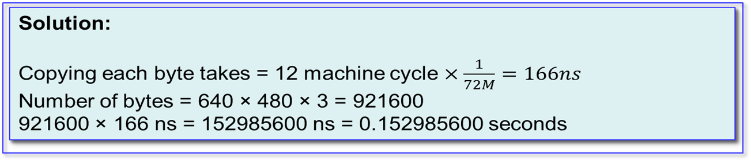
Example
A 640x480 picture is stored in the flash memory. Assuming that BPP is 24-bit and the CPU crystal is 72MHz, how long does it take to copy the picture from flash to memory?
Too time consuming!
No animation or movie
CPU becomes busy

Slide 4
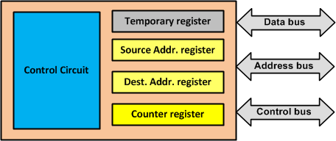
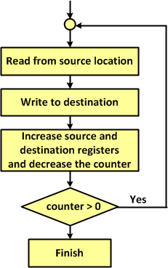
Copying using a simple hardware
(A simplified DMA)
The program initializes source, destination and counter registers. Then, the CPU sits idle until the data is copied.

Slide 5
In real DMA controllers
There are more than 1 channel for copying
Peripherals can ask the DMA to begin copying (they can send DMA request)

Slide 6
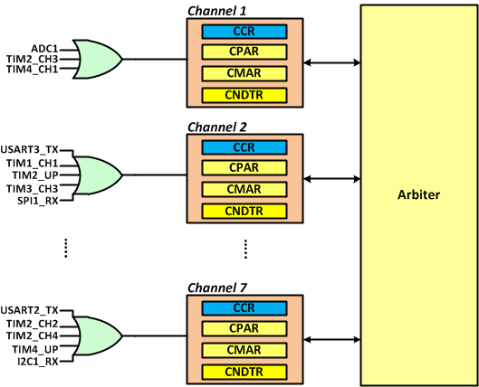
DMA1 in STM32F10x
In STM32F10x, DMA1 has 7 channels

Slide 7
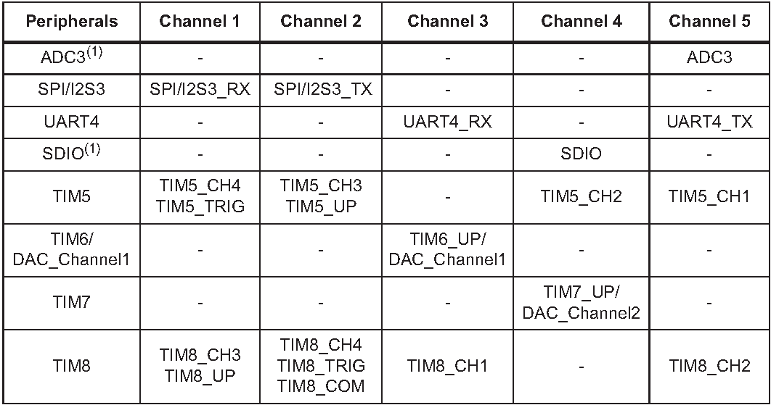
DMA2 in STM32F10x
DMA2 has 5 channels

Slide 8



DMA Channel Registers
CPAR (Channel Peripheral Address Register)
CMAR (Channel Memory Address Register)
CNDTR (Channel Number of Data Register)

Slide 9

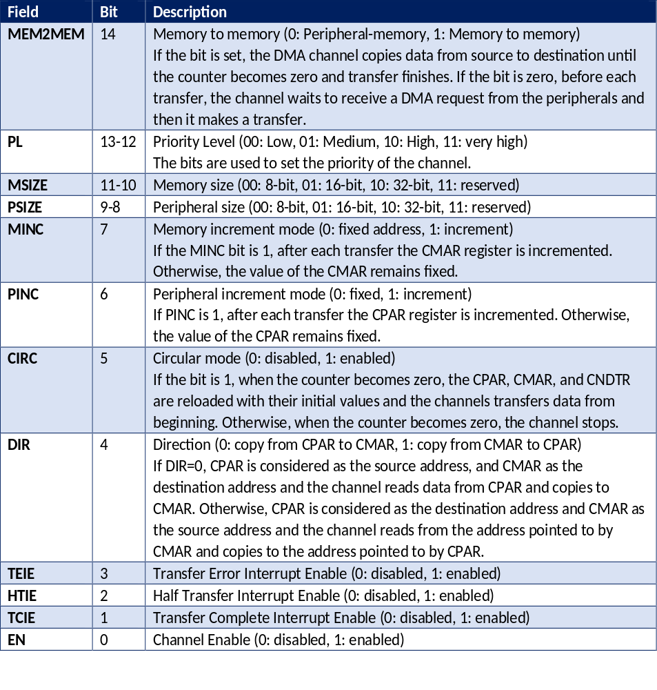
CCRn (Channel Control Register)
MSIZE | Mode | Read/write size | CMAR Increment | Alignment
00 | 8-bit | 8-bit | +1 | Byte
01 | 16-bit | 16-bit | +2 | Half-word
10 | 32-bit | 32-bit | +4 | word

Slide 10
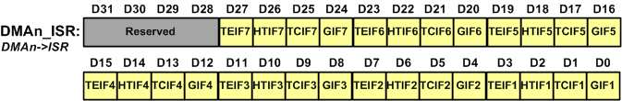
DMA_ISR (Interrupt Status Register)
Field | Description
TEIFx | Channel x Transfer-Error flag: the bit is set when there is an error.
HTIFx | Channel x Half-transfer complete flag: It is set when half of data is transferred.
TCIFx | Channel x Transfer-Complete flag: It is set when the transfer is completed.
GIFx | Channel x Global flag: It is set when any flags of the channel is set.

Slide 11

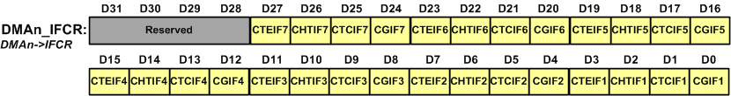
DMA_IFCR (Interrupt Flag Clear Register)
DMA1->IFCR = (1<<5); /* clear TCIF2 (bit 5 of DMA_ISR) */

Slide 12
Writing Programs for DMAs
Initialize CPAR and CMAR with source and destination addresses.
Initialize CNDTR with the number of data to be copied. The value of CNDTR is decremented after each transfer and the channel stops transferring when the CNDTR becomes zero.
Using the CCR register configure the channel priority, transfer direction, data size, memory and peripheral increment mode, circular mode, and the interrupts.
Enable the channel by setting the Enable bit of the CCR register.

Slide 13
Program 2: Copying data from memory to memory
#include <stm32f10x.h>
volatile char transmitComplete = 0;
int main( )
{
char source[10]="ABCDEFGHI";
char dest[10];
RCC->AHBENR = (1<<0); /* DMA clock enable (RCC_AHBENR_DMA1EN) */
DMA1_Channel1->CPAR = (uint32_t) source; /* CPAR = the addr. of source array */
DMA1_Channel1->CMAR = (uint32_t) dest; /* CMAR = the addr. of dest array */
DMA1_Channel1->CNDTR = 10; /* number of bytes to be copied = 10 */
DMA1_Channel1->CCR = (1<<14)|(1<<7)|(1<<6)|(1<<1); /* mem2mem=1, mem inc.=1, per. inc.=1, TCIE=1 */
DMA1_Channel1->CCR |= 1; /* enable the channel */
NVIC_EnableIRQ(DMA1_Channel1_IRQn); /* enable the int. for channel 1 */
while(transmitComplete == 0); /* wait until the trans. is complete */
while(1);
}
void DMA1_Channel1_IRQHandler(void) {
if((DMA1->ISR&(1<<1)) != 0) { /* is transmit complete */
DMA1->IFCR = 1<<1; /* clear the TCIF flag */
transmitComplete = 1; /* set the flag */
}
}

Slide 14
Program 3: Copying data from memory to memory
#include <stm32f10x.h>
volatile char transmitComplete = 0;
int main( ) {
long source[10]={0x11111111,0x22222222,0x33333333,
0x44444444,0x55555555,0x66666666,0x77777777,
0x88888888,0x99999999,0xaaaaaaaa};
long dest[10];
RCC->AHBENR = (1<<0); /* DMA clock enable */
DMA1_Channel1->CPAR = (uint32_t) source; /* CPAR = the addr. of source array */
DMA1_Channel1->CMAR = (uint32_t) dest; /* CMAR = the addr. of dest array */
DMA1_Channel1->CNDTR = 10; /* number of bytes to be copied = 10 */
DMA1_Channel1->CCR = (1<<14)|(1<<11)|(1<<9)|(1<<7)|(1<<6)|(1<<1); /* mem2mem=1,MSIZE=10 (32-bit), PSIZE=10 (32-bit), MInc=1, PInc=1, TCIE=1 */
DMA1_Channel1->CCR |= 1; /* enable the channel */
NVIC_EnableIRQ(DMA1_Channel1_IRQn); /* enable the int. for channel1 */
while(transmitComplete == 0); /* wait until the transmit complete */
while(1);
}
void DMA1_Channel1_IRQHandler(void)
{
if((DMA1->ISR&(1<<1)) != 0) /* is transmit complete */
{
DMA1->IFCR = 1<<1; /* clear the TCIF flag */
transmitComplete = 1; /* set the flag */
}
}

Slide 15
Using DMA for USART
Field | Bit | Description
DMAT | 7 | DMA enable Transmitter 0: Disable the DMA for USART transmit 1: Enable the DMA for USART transmit
DMAR | 6 | DMA enable receiver 0: the DMA for USART receive is disabled 1: the DMA for USART receive is enabled

Slide 16
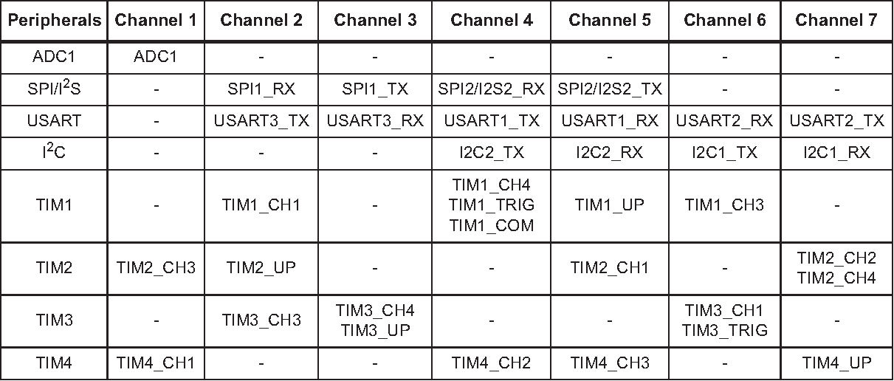
USART1 DMA Channels

Slide 17
Program 4: Sending data via USART1 using DMA
#include <stm32f10x.h>
int main()
{
char ourMsg[]="ABCDEFGHIJKL";
RCC->AHBENR = (1<<0); /* DMA1 clock enable */
RCC->APB2ENR |= 0xFC | (1<<14); //enable GPIO clocks
//USART1 init.
GPIOA->ODR |= (1<<10); /* pull-up PA10 */
GPIOA->CRH = 0x444448B4; /* RX1=input with pull-up, TX1=alt. func. output */
USART1->BRR = 7500; /* 72MHz/9600bps = 7500 */
USART1->CR1 = 0x200C; /* enable usart transmit and receive */
USART1->CR3 = (1<<7); /* DMA Trans. enable */
DMA1_Channel4->CPAR = (uint32_t) &USART1->DR; /* to USART1->DR */
DMA1_Channel4->CMAR = (uint32_t) ourMsg; /* from ourMsg array in mem. */
DMA1_Channel4->CNDTR = 12; /* copy 12 bytes */
DMA1_Channel4->CCR = (1<<7)|(1<<4); /* mem inc., read from mem */
DMA1_Channel4->CCR |= 1; /* enable channel 4 */
while(1)
{
}
}

