Slide 1

GPIO Ports in STM32F10x
Sepehr Naimi
www.NicerLand.com

Slide 2
Topics
ARM pin out
Reset Circuit
System Clock
I/O programming
The structure of I/O pins

Slide 3
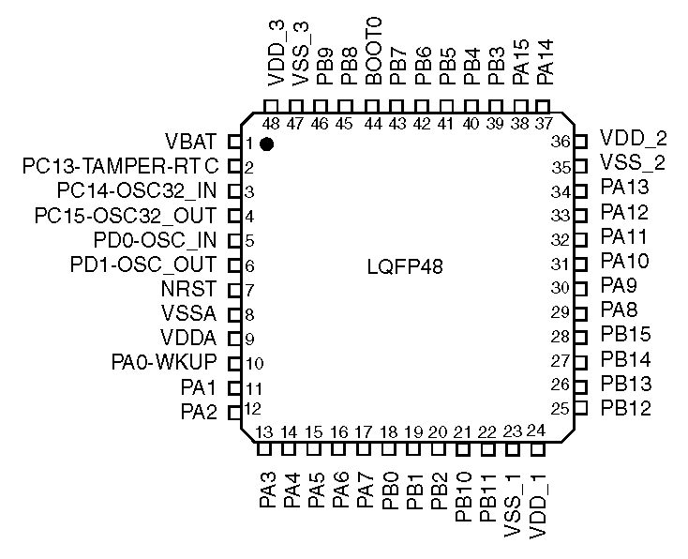
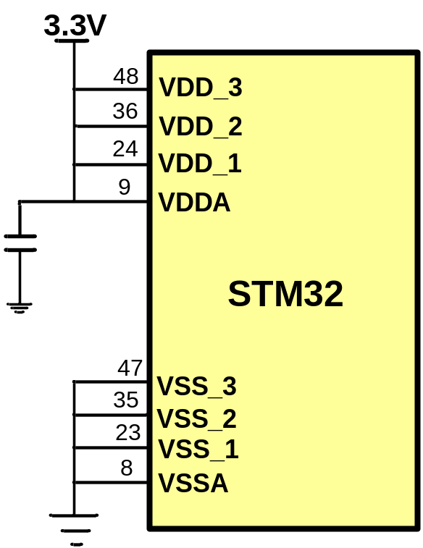
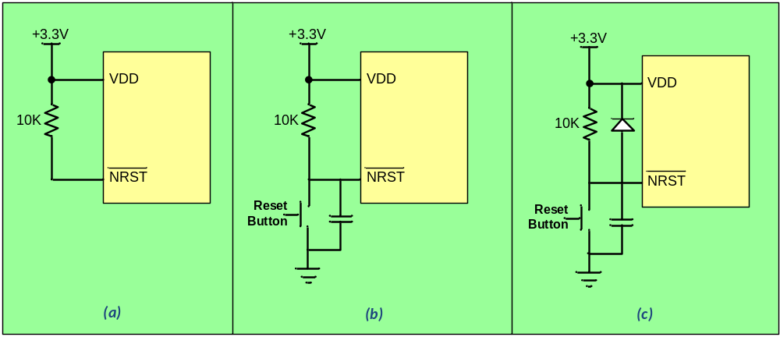
STM32F103C8 Pinout
Power supply pins
Reset
Oscillator pins

Slide 4
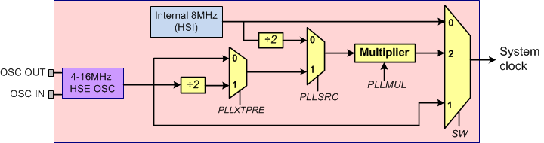
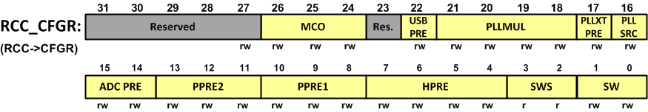
System Clock
PLLMUL | 0 | 1 | 2 | 3 | 4 | 5 | 6 | 7 | 8 | 9 | 10 | 11 | 12 | 13 | 14 | 15
Multiplication | X2 | X3 | X4 | X5 | X6 | X7 | X8 | X9 | X10 | X11 | X12 | X13 | X14 | X15 | X16

Slide 5
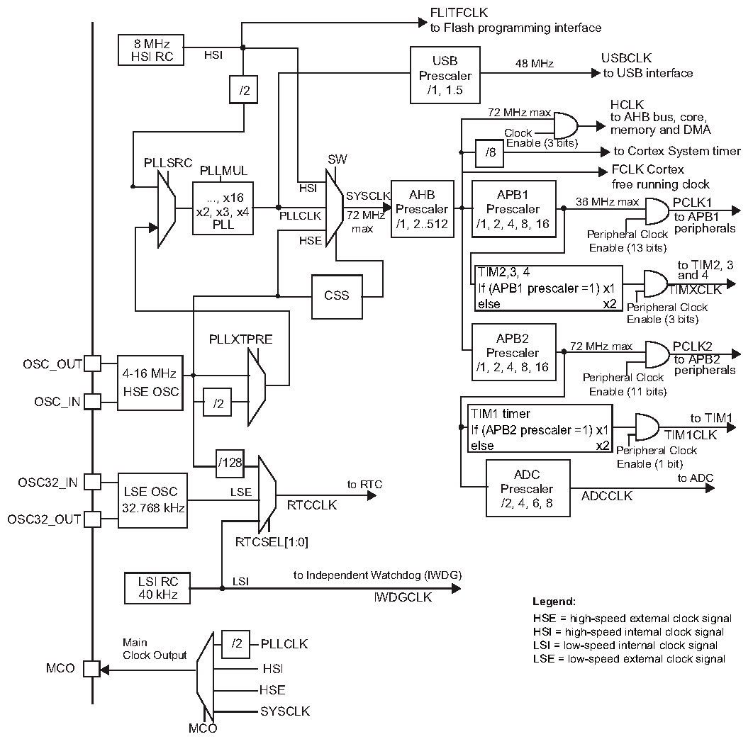
STM32F10X Clock

Slide 6
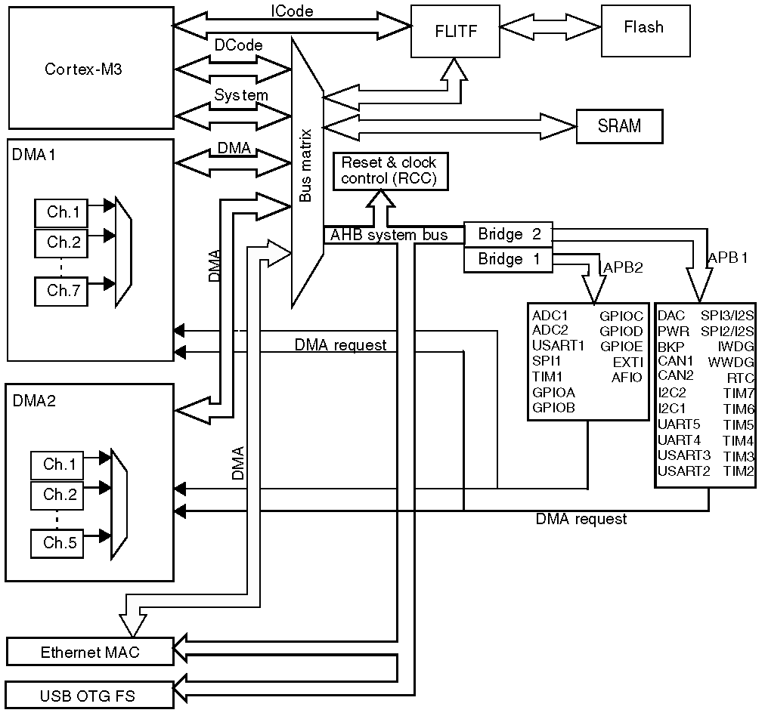
APB1, APB2, and AHB

Slide 7
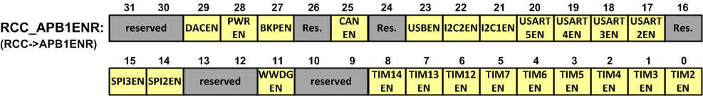
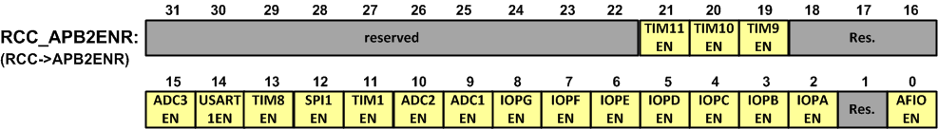
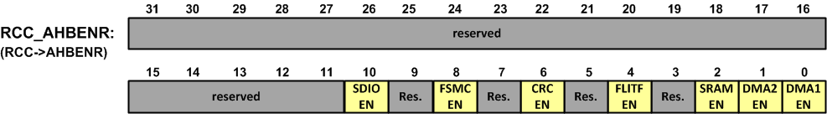
Enabling Clocks
Label | Description | Label | Description
IOPx | I/O port x clock enable | ADCnEN | ADCn clock enable
USARTnEN | USARTn clock enable | DACnEN | DACn clock enable
USBEN | USB clock enable | TIMnEN | TIMn timer clock enable
CANEN | CAN clock enable | SPInEN | SPI n clock enable
PWREN | Power interface clock enable | BKPEN | Backup interface clock enable
WWDG | Window watchdog clock enable | SDIOEN | SDIO clock enable
DMAnEN | DMAn clock enable | FSMCEN | FSMC clock enable
CRCEN | CRC clock enable | I2CnEN | I2Cn clock enable
Note: (0: clock disabled, 1: clock enabled)

Slide 8
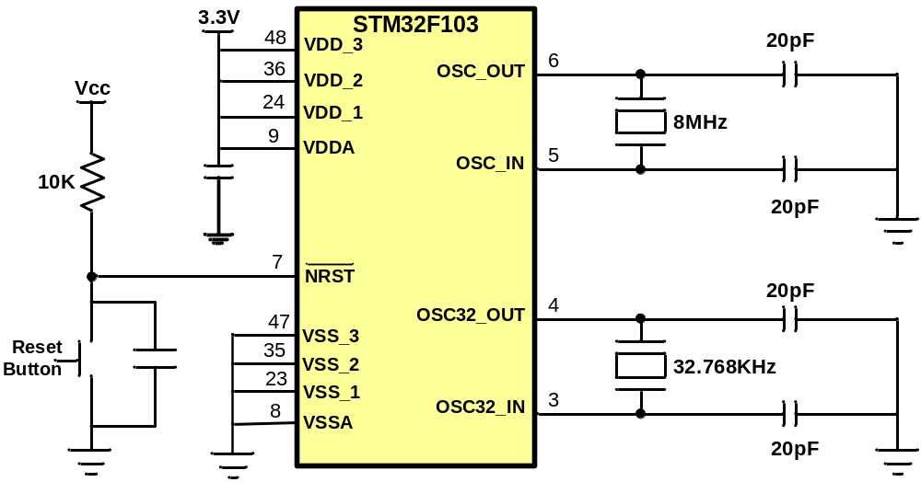
Reset, Power, and Crystals

Slide 9
GPIO pins
PORTA (PAn)
PORTB (PBn)
PORTC (PCn)
PORTD

Slide 10
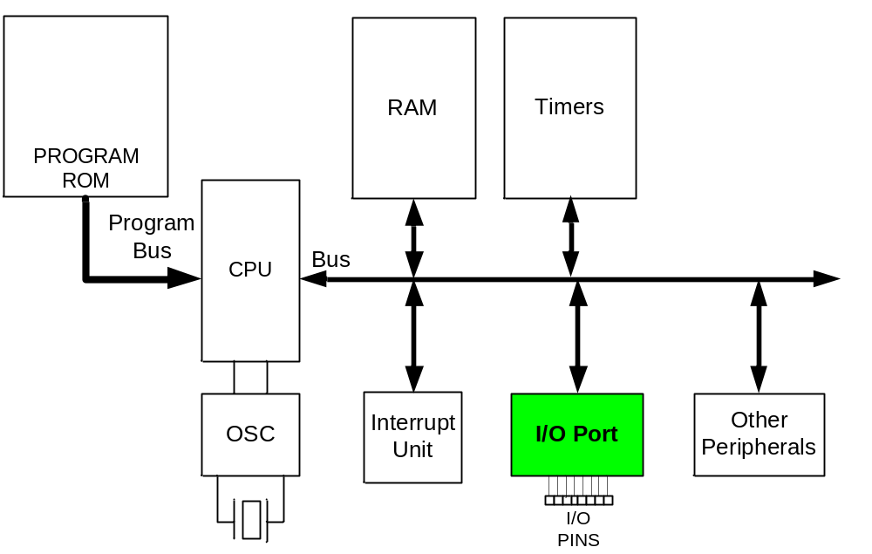
I/O unit in ARM

Slide 11
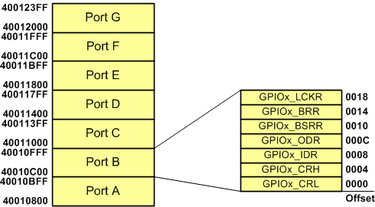
GPIO Registers

Slide 12
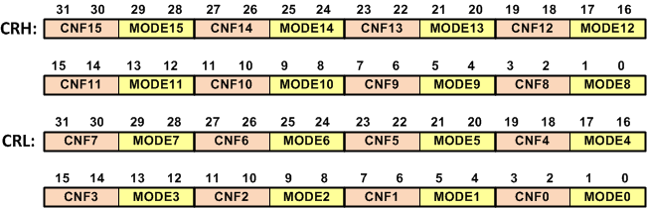
CRL and CRH (Configuration Registers)
Output (MODE>00)
CNFx bits
00 | General purpose output push-pull
01 | General purpose output Open-drain
10 | Alternate function output Push-pull
11 | Alternate function output Open-drain
MODEx bits | Direction | Max speed
00 | Input
01 | Output | 10 MHz
10 |  | 2 MHz
11 |  | 50 MHz
Input (MODE=00)
CNFx bits | Configuration | Description
00 | Analog mode | Select this mode when you use a pin as an ADC input.
01 | Floating input | In this mode, the pin is high-impedance.
10 | Input with pull-up/pull-down | The value of ODR chooses if the pull-up or pull-down resistor is enabled. (1: pull-up, 0:pull-down)
11 | reserved

Slide 13
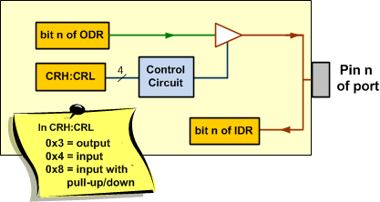
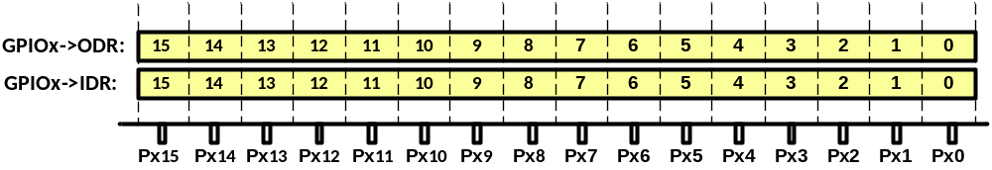
IDR (Input Data Reg.) and ODR (Output Data Reg.)

Slide 14
Toggle Port A
#include "stm32f10x.h“
void delay_ms(uint16_t t) {
volatile unsigned long l = 0;
for(uint16_t i = 0; i < t; i++)
for(l = 0; l < 6000; l++)
{ }
}
int main() {
RCC->APB2ENR |= 0xFC; //Enable the clocks for GPIO ports
GPIOA->CRL = 0x33333333; //PA0 to PA7 as outputs
GPIOA->CRH = 0x33333333; //PA8 to PA15 as outputs
while(1) {
GPIOA->ODR = 0x0000; //make all the pins of Port A low
delay_ms(1000); //wait 1000ms
GPIOA->ODR = 0xFFFF; //make all the pins of Port A high
delay_ms(1000); //wait 1000ms
}
}

Slide 15
Toggling PA2
#include <stm32f10x.h>
void delay_ms(uint16_t t);
int main()
{
RCC->APB2ENR |= 0xFC; /* Enable clocks for GPIO ports */
GPIOA->CRL = 0x44444344; /* PA2 as output */
while(1)
{
GPIOA->ODR ^= (1<<2); /* toggle PA2 */
delay_ms(1000);
}
}

Slide 16
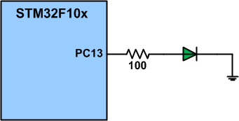
Toggling PC13
#include <stm32f10x.h>
void delay_ms(uint16_t t);
int main()
{
RCC->APB2ENR |= 0xFC; //Enable GPIO ports clocks
GPIOC->CRH = 0x44344444; //PC13 as output
while(1)
{
GPIOC->ODR ^= (1<<13); //toggle PC13
delay_ms(1000);
}
}

Slide 17

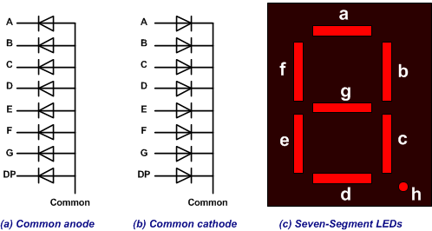
7-segment

Slide 18

Example: Display 1 on the 7-segment
A 7-segment is connected to PA0-PA7. Display 1 on the 7-segment.
CRL:
3 3 3 3 3 3 3 3
STM32F10X
ODR:
0 0 0 0 0 1 1 0
0
8
5
6
1
PORTA
#include <stm32f10x.h>
int main() {
RCC->APB2ENR |= 0xFC; //ENABLE GPIO clocks
GPIOA->CRL = 0x33333333; //PA0-PA7 as outputs
GPIOA->ODR = 0x06; //display 1
while(1) {
}
}
4
2
3

Slide 19

Example: Display 3 on the 7-segment
A 7-segment is connected to PA0-PA7. Display 3 on the 7-segment.
CRL:
3 3 3 3 3 3 3 3
STM32F10X
ODR:
0 1 0 0 1 1 1 1
0
8
5
6
1
PORTA
#include <stm32f10x.h>
int main() {
RCC->APB2ENR |= 0xFC; //ENABLE GPIO clocks
GPIOA->CRL = 0x33333333; //PA0-PA7 as outputs
GPIOA->ODR = 0x4F; //display 1
while(1) {
}
}
4
2
3

Slide 20

Make PA0 to PA4 on. Then, turn off in the reverse order
#include <stm32f10x.h>
void delay_ms(uint16_t t);
int main() {
RCC->APB2ENR |= 0xFC; //ENABLE clocks for GPIOs
GPIOA->CRL = 0x33333333; //PA0-PA7 as outputs
while(1) {
int8_t n;
for(n = 0; n <= 4; n++) //from 0 to 4
{
GPIOA->ODR |= (1<<n); //make PAn high
delay_ms(500);
}
for(n = 4; n >= 0; n --) //from 4 to 0
{
GPIOA->ODR &= ~(1<<n); //make PAn low
delay_ms(500);
}
}
}

Slide 21
Example: Input
The following code gets the data present at the pins of port A and sends it to port B indefinitely, after adding the value 5 to it:
#include <stm32f10x.h>
int main()
{
RCC->APB2ENR |= 0xFC; /* Enable GPIO ports clocks */
GPIOA->CRL = 0x33333333; /* PA0-PA7 as outputs */
GPIOA->CRH = 0x33333333; /* PA8-PA15 as outputs */
GPIOB->CRL = 0x44444444; /* PB0-PB7 as inputs */
GPIOB->CRH = 0x44444444; /* PB8-PB15 as inputs */
while(1)
{
GPIOA->ODR = GPIOB->IDR + 5;
/* read from port B and write to port A */
}
}

Slide 22
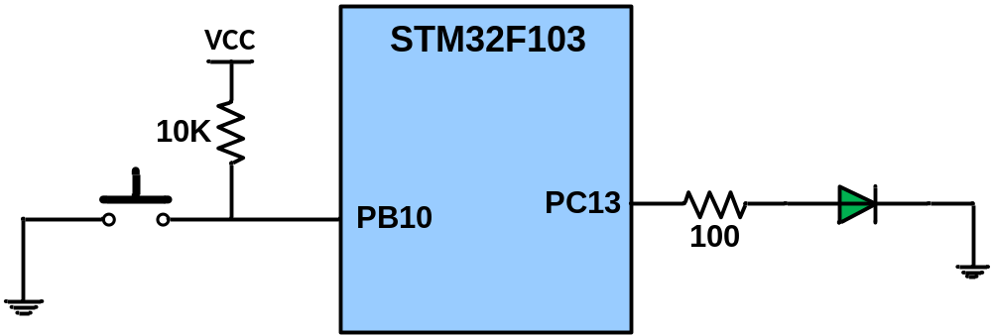
Example
A switch is connected to pin PB10 and an LED to pin PC13. Write a program to get the status of SW and send it to the LED.
#include <stm32f10x.h>
int main() {
RCC->APB2ENR |= 0xFC; /* Enable GPIO ports clocks */
GPIOB->CRH = 0x44444444; /* PB8-PB15 as inputs */
GPIOC->CRH = 0x44344444; /* PC13 as output */
while(1) {
if((GPIOB->IDR & (1<<10)) != 0) /* is PB10 high */
GPIOC->ODR |= (1 << 13); /* make PC13 high */
else
GPIOC->ODR &= ~(1 << 13); /* make PC13 low */
}
}

Slide 23
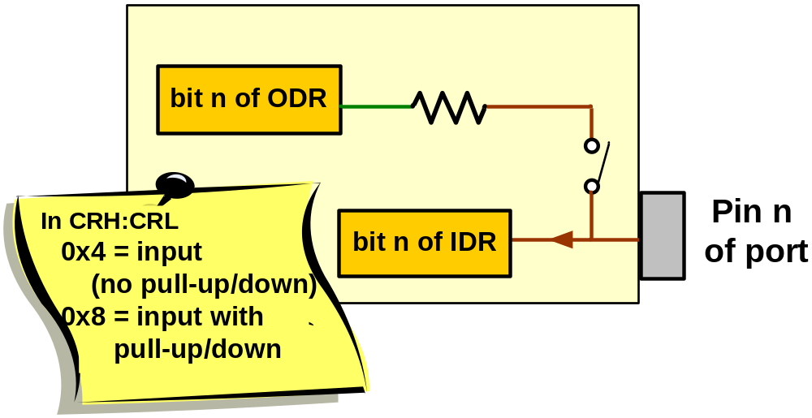
Internal Pull-up/Pull-down resistor

Slide 24
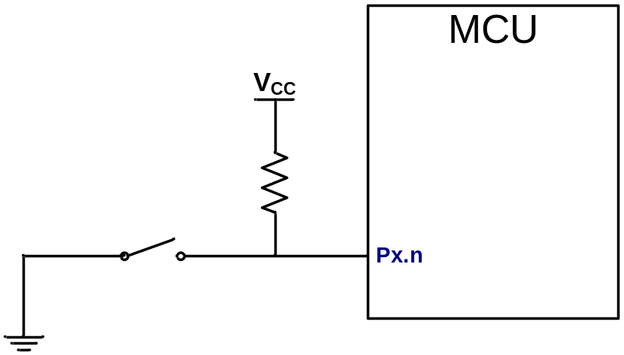
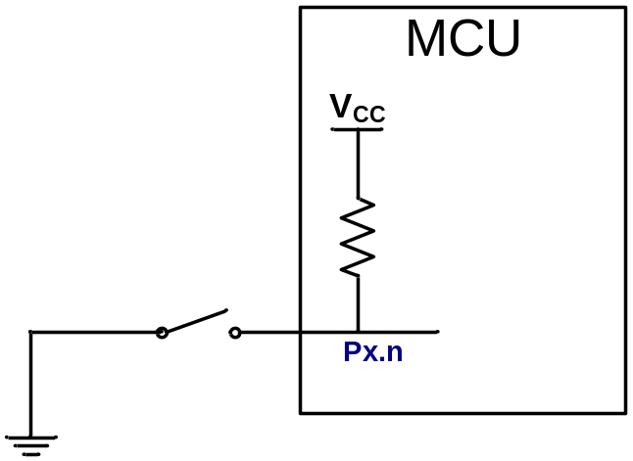
Using internal pull-up
CRH:CRL = 0x8
ODR = 1

Slide 25
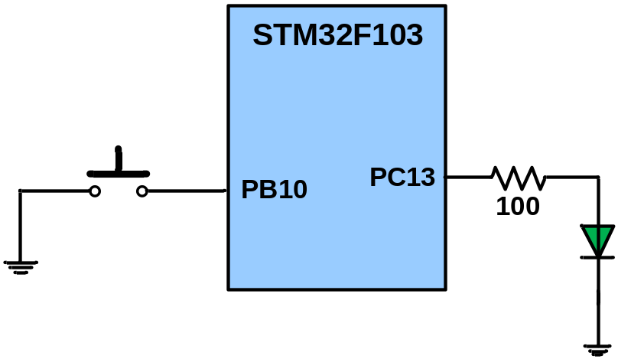
Example
A switch is connected to pin PB10 and an LED to pin PC13. Write a program to get the status of SW and send it to the LED.
#include <stm32f10x.h>
int main() {
RCC->APB2ENR |= 0xFC; /* Enable GPIO ports clocks */
GPIOB->CRH = 0x44444844; // pull-up PB10
GPIOB->ODR |= (1<<10); //set bit 10 of ODR to pull-up
GPIOC->CRH = 0x44344444; /* PC13 as output */
while(1) {
if((GPIOB->IDR & (1<<10)) != 0) /* is PB10 high */
GPIOC->ODR |= (1 << 13); /* make PC13 high */
else
GPIOC->ODR &= ~(1 << 13); /* make PC13 low */
}
}

Slide 26
Example
A switch is connected to pin PB10 and an LED to pin PC13. Write a program that toggles PC13 when the key is pressed.
#include <stm32f10x.h>
void delay_ms(uint16_t t);
int main() {
RCC->APB2ENR |= 0xFC; /* Enable GPIO ports clocks */
GPIOC->CRH = 0x44344444; /* PC13 as output */
GPIOA->CRL = 0x44444844; /* PA2 as input with pull-up */
GPIOA->ODR |= (1<<2); /* pull-up PA2 */
while(1) {
if((GPIOA->IDR&(1<<2)) == 0) /* is PA2 low? */
GPIOC->ODR ^= (1<<13); /* toggle PC13 */
else
GPIOC->ODR &= ~(1<<13);
delay_ms(500);
}
}

Slide 27
Clearing pins
BRR (Bit Reset Register)
Examples:
  GPIOB->BRR = 1<<5; //make PB5 low
  GPIOA->BRR = (1<<3)|(1<<5); /* make PA3 and PA5 low */

Slide 28
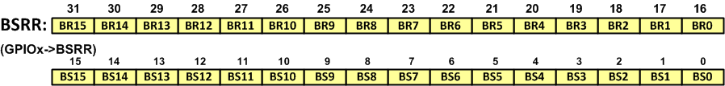
Setting & Clearing Pins
BSRR (Bit Set/Reset Register)
Examples:
  GPIOC->BSRR = (1<<5); //make PC5 high
  GPIOB->BSRR = (1<<5)|(1<<19); /*makes PB5 high and PB3 low */

Slide 29
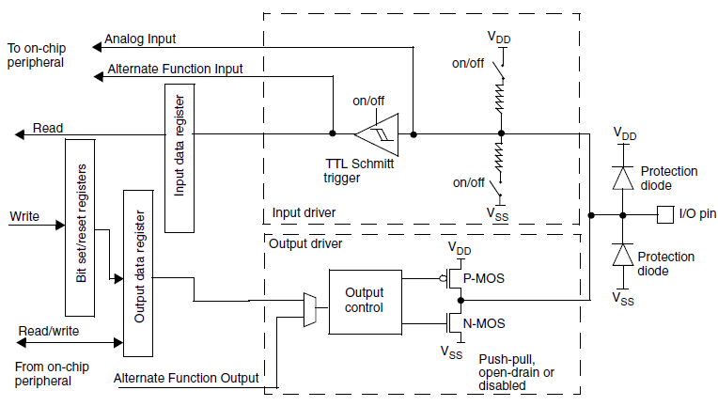
The structure of I/O pins
IDR
BRR
BSRR
ODR

Slide 30
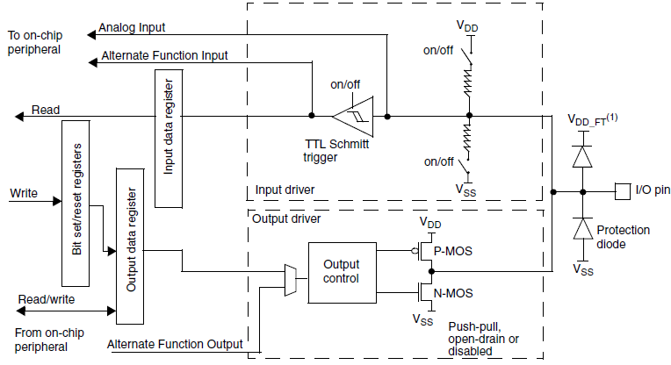
The structure of 5-volt tolerant I/O pins

Slide 31
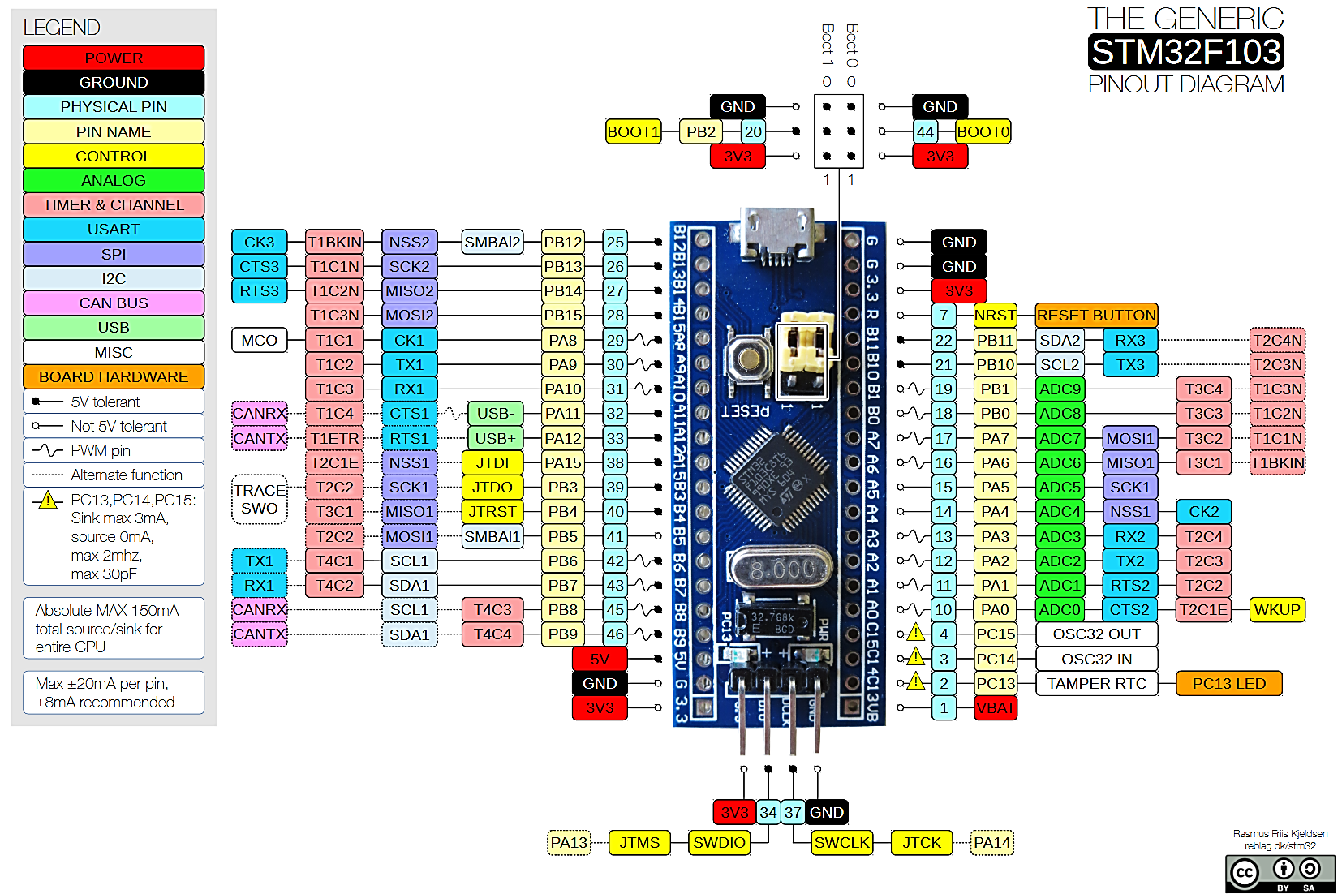
Electrical Characteristics

