Slide 1
Robotic Vacuum Cleaner
Students : Hiba Ghannam
Hawa’ Osama
Supervisor : Aladdin Masri

Slide 2
outline
Idea
Features
Application Scope
Hardware Components
Software Algorithms
Problems
Future development

Slide 3
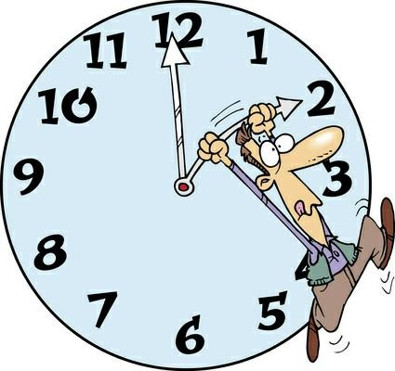
Idea cont…
most of the people are working and they did not have enough time to clean.

Slide 4

Idea cont…
From time to time technology come up and need to upgrade for easier human task.

Slide 5
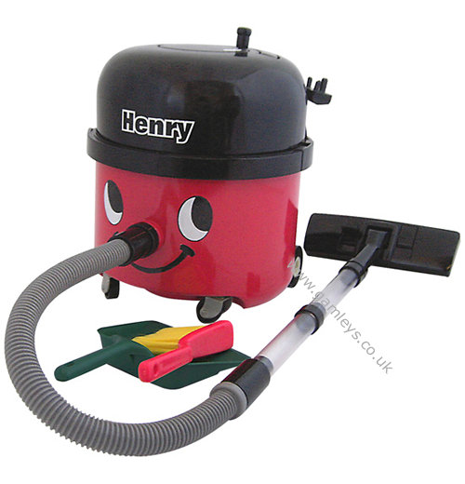
Idea
Most of us usually using a hand controlled vacuum for cleaning .Moreover, most of vacuum robots in the market are expensive and may be large in size

Slide 6
Idea cont…
Therefore…
This project is built to be one of the advantages for human to clean the floor within small period and more effective.

Slide 7
Features
Small size so it will enter a small area.
Low cost, cost of body, three sensors, microcontroller and one motors driver.

Slide 8
Features
A void any obstacle at any corner of a given area.

Slide 9
Features cont…
A void any obstacle at the center of a given area, which may be discrete or continuous.
Discrete Continuous

Slide 10
Features cont…
Four starting points , and this to avoid more obstacles through our algorithms.

Slide 11
Application Scope
Robotic Vacuum Cleaner is developed to make cleaning process easier especially for working people.
This Robotic Vacuum Cleaner is designed for specific area such as under beds.

Slide 12
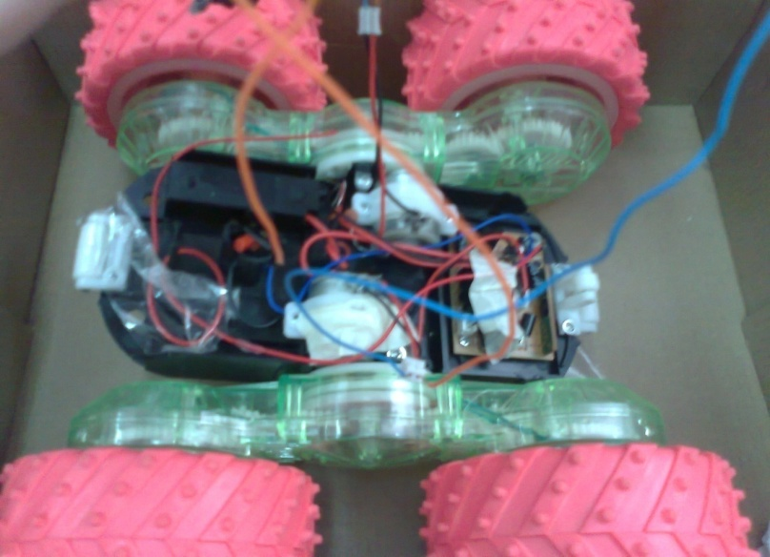
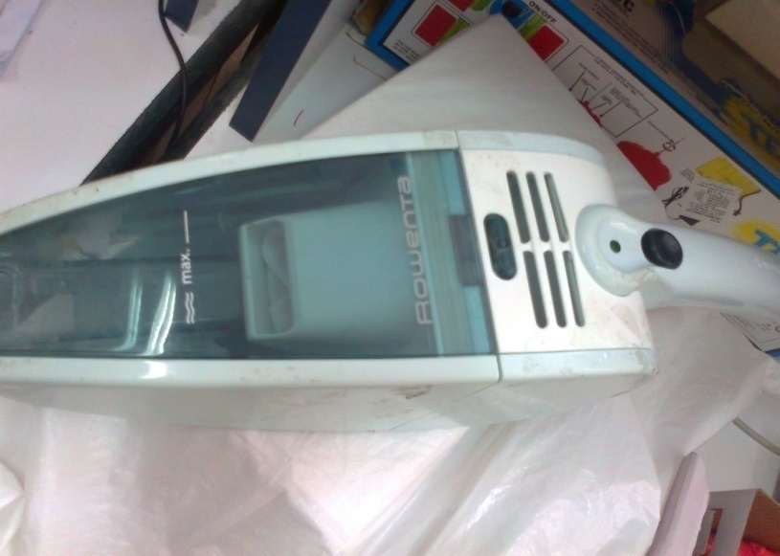
Hardware Components
Robot Body
Robot Body is the mechanical part of the robot which contains wheels and vacuum

Slide 13
Hardware Components cont…
Microcontroller
In our project we use Pic18f4620 microcontroller with 4MH frequency.
In our project we used port C to control movement and speed of motors and we connect also sensors to port A for using ADC.

Slide 14
Hardware Components cont…
DC Motors
In our project we use two dc motors with 500mA, each motor controls two wheels
hbridge L293B is used.
The motion has five states:
1.Forward
2.Backward
3.Left
4.Right
5.Circular direction

Slide 15
Hardware Components cont…
Sensors
Act as sensing component to the environment. For Vacuum Cleaner Robot, sensors are used to detect obstacles.
We used three sensors,
1.IR which is sharp type of family GP2Y0A21YK0F and its distance measuring range is10 to 80 cm
2.Ultrasonic type of Ez0 and it detects objects from 0-inches to 254-inches (6.45-meters) and provides sonar range information from 6-inches out to 254-inches with 1-inch resolution.

Slide 16
Hardware Components cont…
Power Supply
The main power supply in our circuit is rechargeable dc battery connected to mc7805ct regulator, and it provides 500mA to motors with 8V.

Slide 17
Software Algorithms
We classify the problems depends on the position of obstacles to four cases :
Case1 :continuous obstacles and nothing at the center
start
start
start
start

Slide 18
Software Algorithms cont…
Case2 :obstacles on one or both parallel sides. In this case, to clean all the areas between objects we have use only these starting points.
start
start
start
start

Slide 19
Software Algorithms cont…
Case3 : obstacle at the center with another obstacles from any previous case

Slide 20
Software Algorithms cont…
Two algorithms to solve previous problems
First algorithm: No obstacle at the center
This algorithm solve the first cases. The coming flow chart will illustrate the algorithm.

Slide 21
Software Algorithms cont…
First algorithm
Start
Read FD
Calibration FD
Yes
Is FD>10cm
No
Go Forward
Left Sensor
L S OR RS
Right Sensor
Read LD
Read RD
Calibration LD
Calibration RD
Yes
Is LD>10cm
No
Is RD>10cm
Yes
No
Turn Left 90◦
Turn 180◦
Turn Right 90◦
Turn 180◦
forward 10cm
forward 10cm
Forward and check
Turn 90◦ “s”
Turn 90◦ “s”

Slide 22
Software Algorithms cont…
First algorithm
Start
Forward and Check Algorithm
Read FD
Calibration FD
Yes
Is FD>10cm
No
Go Forward
Go Forward
Stop
Read LD
Finish
Calibration LD
Yes
Is LD>10cm
No
Turn Right 90◦
forward 10cm
Turn 90◦ opposite

Slide 23
Software Algorithms cont…
Example
Finish
start

Slide 24
Software Algorithms cont…
Second algorithm : An obstacle at the center of an area.
This algorithm is used to solve case three.
First we need to determine wither the obstacle in the middle of the room or not
Then it need to chick the type of the obstacle discrete or continuous.

Slide 25
Second Algorithm
Start
Turn on timer
Compute the distance for first line max=distance
Compute the distance for next line
If distance>max
Yes
No
Max=distance
Max=max
If distance<max
Yes
Yes
Obstacle in the middle
Obstacle in end of room

Slide 26
Algorithm to avoided obstacle in the middle
Obstacle in the middle
Compute the distance for next line
If distance>previous distance
Yes
Continue first algorithm
Yes
While left FD<10
no
Turn left
Move forward
Continue first algorithm

Slide 27
Problems
The problem of unavailable ICs like ultrasonic sensor which we used instead of it the IR.
The problem of find a suitable toy car that will carry the vacuum.
A problem that happened because of the vacuum weight, that caused a problems in turning the wheels

Slide 28
Problems cont…
Problem with motor and high current needed to operate them, and safety method needed to protect the basic circuit from the backward current.
Problem of dealing with sensor and floating value, some time sensor read wrong value so we put technique to ensure the sensor gives us right values

Slide 29
future development
Now we are working to make the robot smart enough to detect all objects in any position of room.
In the future we hope to make the robot smarter such that when the robot cleans any room it will save the information about obstacle and its location and if the user want to clean a room it just will restore information and will clean faster.
We hope to make the robot to clean tables such that it can detect edges and it will clean the tables without falling down.

Slide 30
THANK YOU!

