Slide 1

Myocardial infarction complications

Slide 2

AGENDA
01
04
01
Introduction
Algorithm
02
05
Dataset
Algorithm Evaluation
03
06
Data preparation
CONCLUSION

Slide 3

01 Introduction
Acute myocardial infarctions are one of the leading causes of death in the developed world, with prevalence approaching three million people worldwide. This activity reviews the
Presentation and evaluation

Slide 4
1.1 Motivation
accompany myocardial infarction is
associated with a higher mortality
rate in the first year after it

Slide 5

1.2 Complications
Disease course differed in patients with MI :
Myocardial infarction can occur without complications
Try to describe patients who suffer from two periods :
Acute complications
Subacute complications
Lead to disease exacerbation and even death
Even an experienced specialist cannot always predict the development of this complication

Slide 6
women

Slide 7
1.3 Goals
Predicting myocardial infarction complications
in order to implement the necessary preventive measures in a timely manner is an important task

Slide 8

1.4 Fixes
There are four possible time moments for complication prediction
the time of admission to hospital
the end of the first day (24 hours after admission to the hospital)
the end of the second day (48 hours after admission to the hospital)
the end of the third day (72 hours after admission to the hospital)

Slide 9

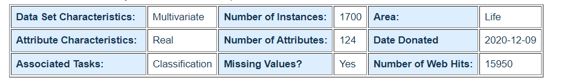
02 Dataset
Myocardial infarction complications Data Set

Slide 10
03 Data Preparation
Data preparation is the process of cleaning and transforming raw data prior to processing and analysis. It is an important step prior to processing and often involves reformatting data, making corrections to data and the combining of data sets to enrich data.

Slide 11
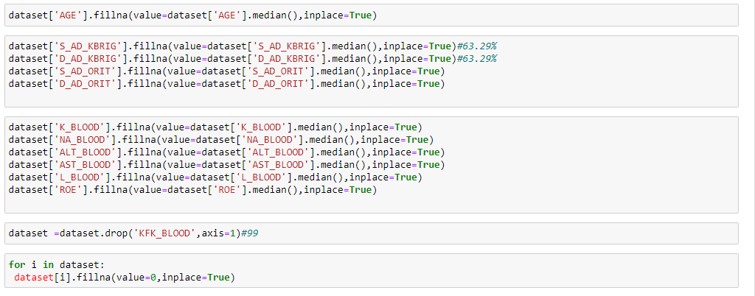
3.1 Data Cleaning

Slide 12
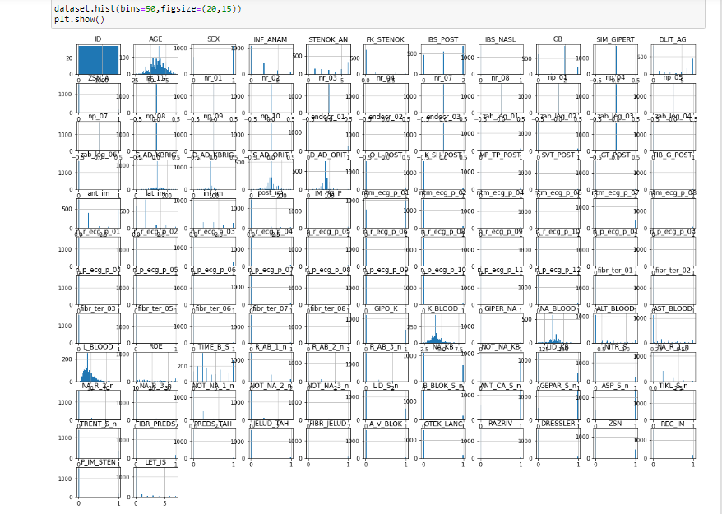
3.2 Data Scaling

Slide 13
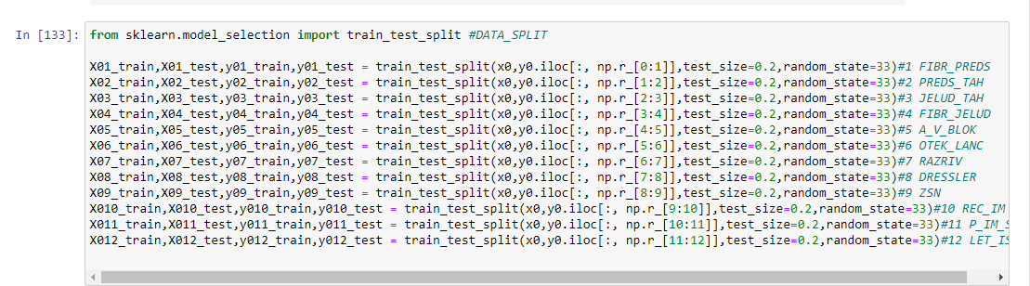
3.3 Data Split

Slide 14
04 Algorithm

Slide 15
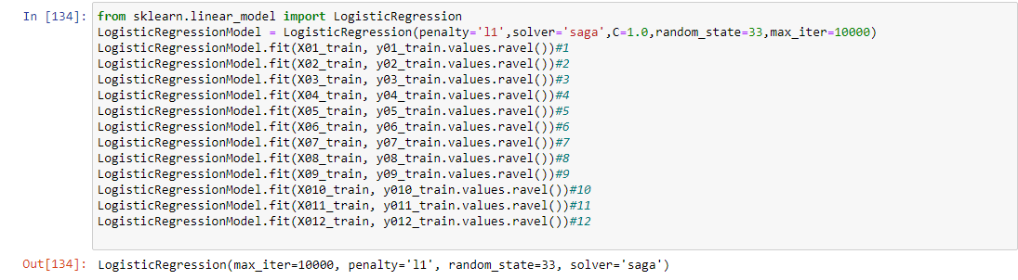
4.1 Logistic Regression

Slide 16
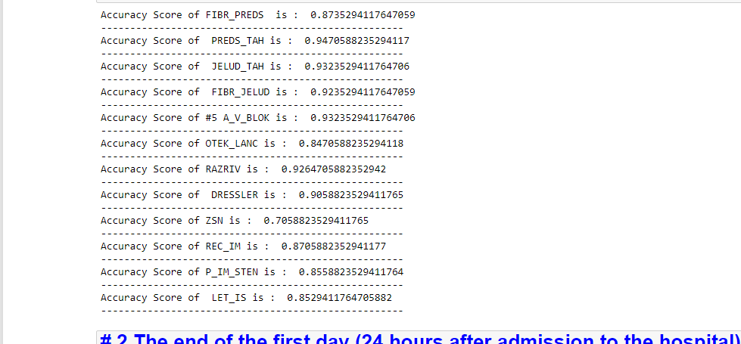
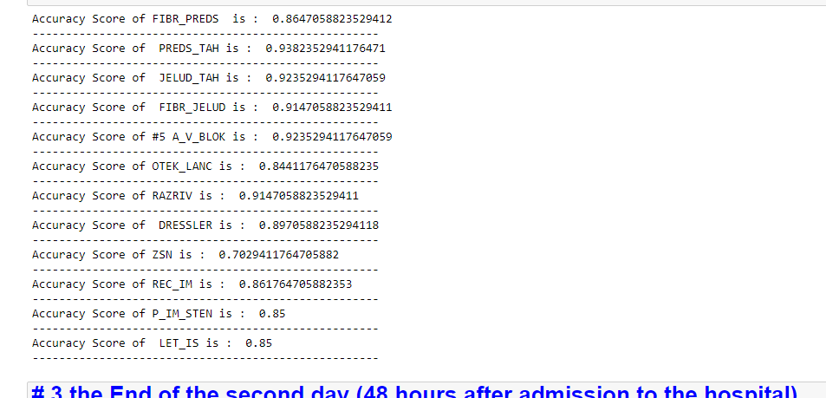
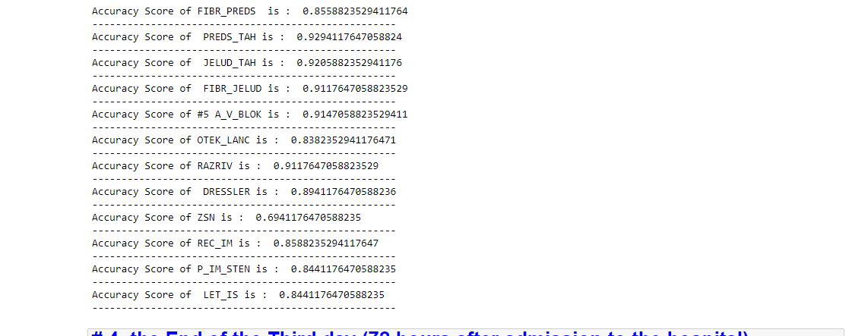
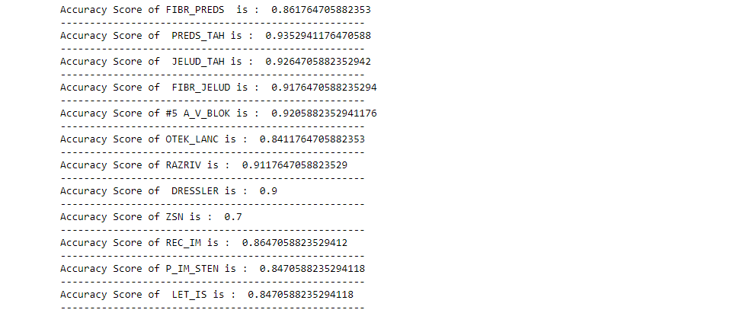
05 Algorithm Evaluation

Slide 17
06 Conclusion
With disease increasing, substantial research has focused on the development of prediction tools. We compare deep learning and
machine learning models to a baseline logistic regression using only ‘known’ risk factors in predicting incident myocardial infarction (MI) from harmonized EHR data

Slide 18
Thanks
ANY QUESTIONS ?

