Slide 1

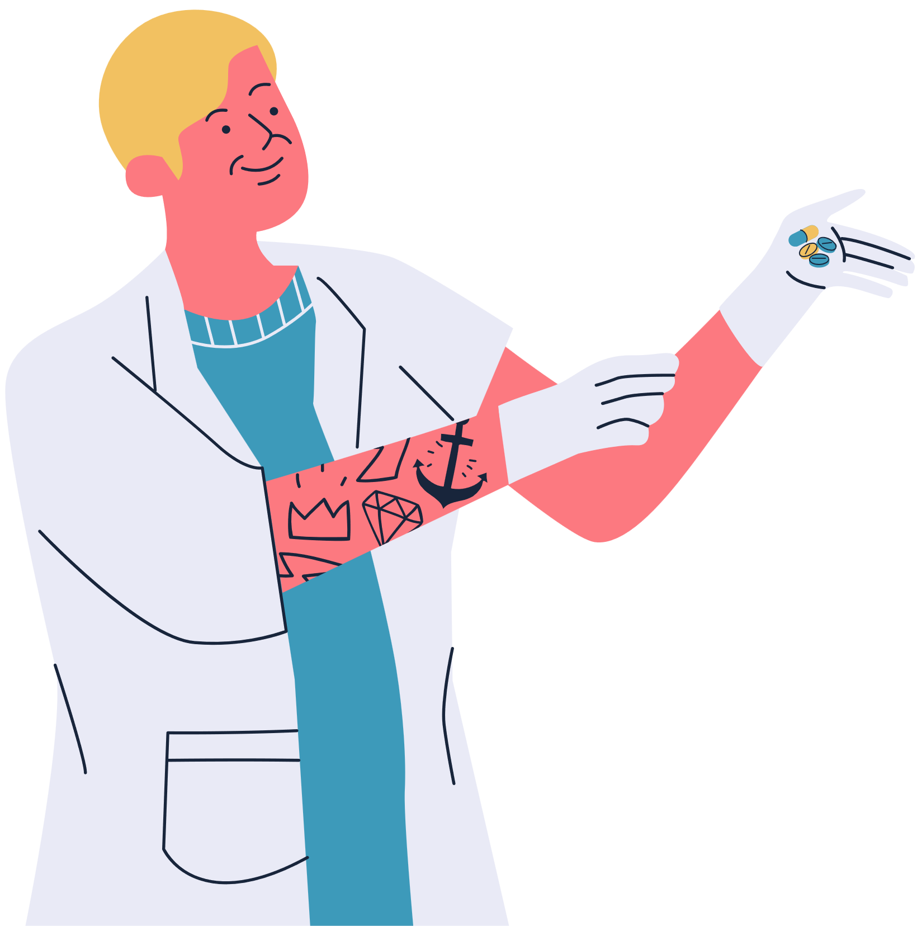
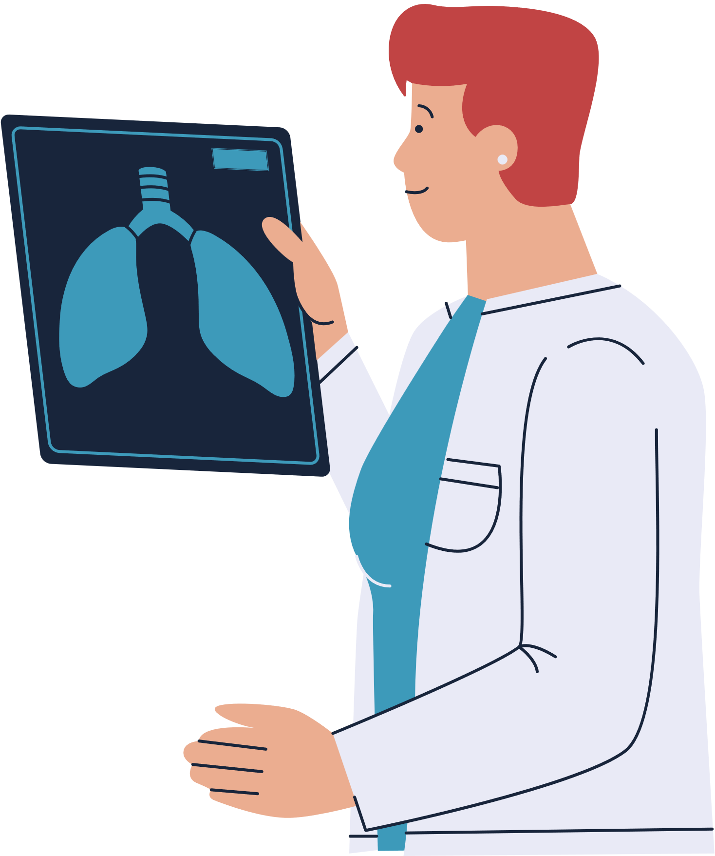
By Eng . Mohamed Elsayad
Al - Shefaa Hospital
THE FIRST VIRTUAL HOSPITAL POWERED BY
ARTIFICIAL INTELLIGENCE

Slide 2
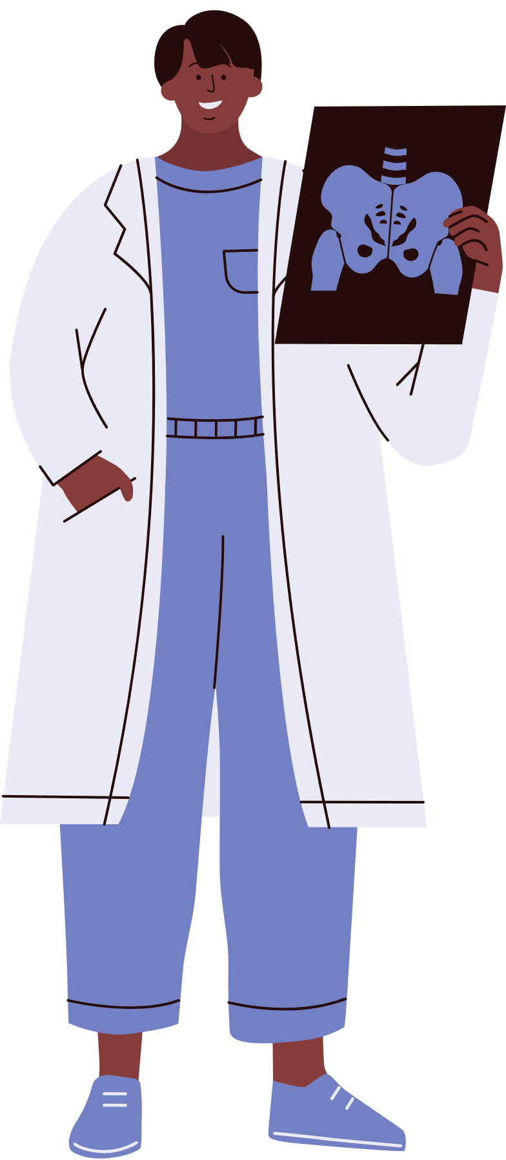
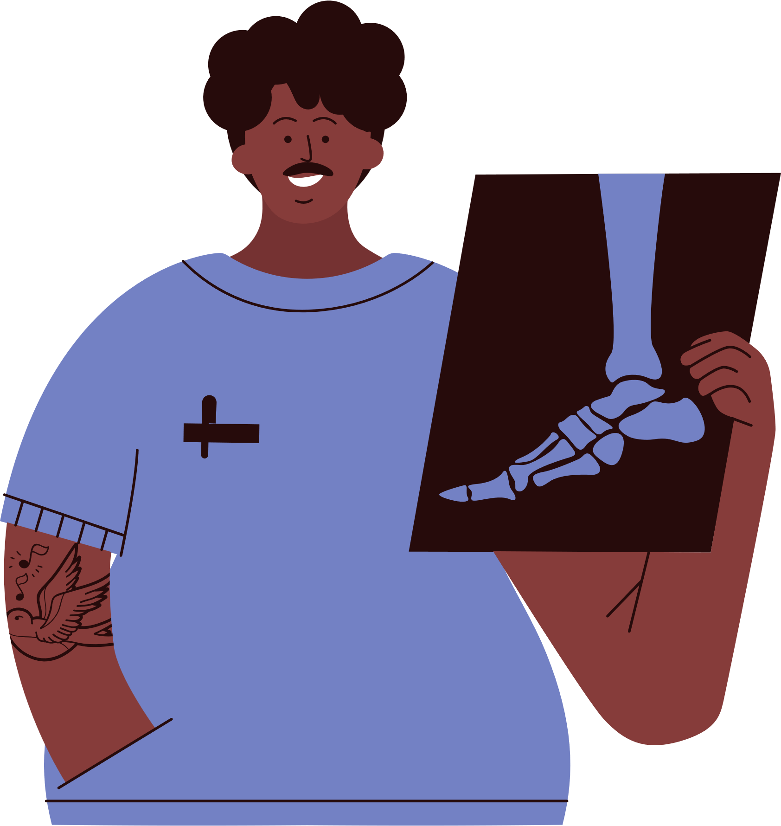

About Us
Al - Shefaa hospital is the first virtual hospital to diagnose four diseases, including diabetes, Hepatitis C, Breast cancer, and Alzheimer .
How?
By 3 Machine Learning models
and 1 Neural network model
Al-Shefaa Hosptal

Slide 3


Why?
The purpose of this project is to develop AI-based diagnostic tools for early detection of diabetes, hepatitis C, Breast cancer, and Alzheimer
disease using blood tests or MRI scans.
Would this project replace Diagnostic doctors?
Currently?, of course not, but we hope to be able to do that in the future
Al-Shefaa Hospital

Slide 4
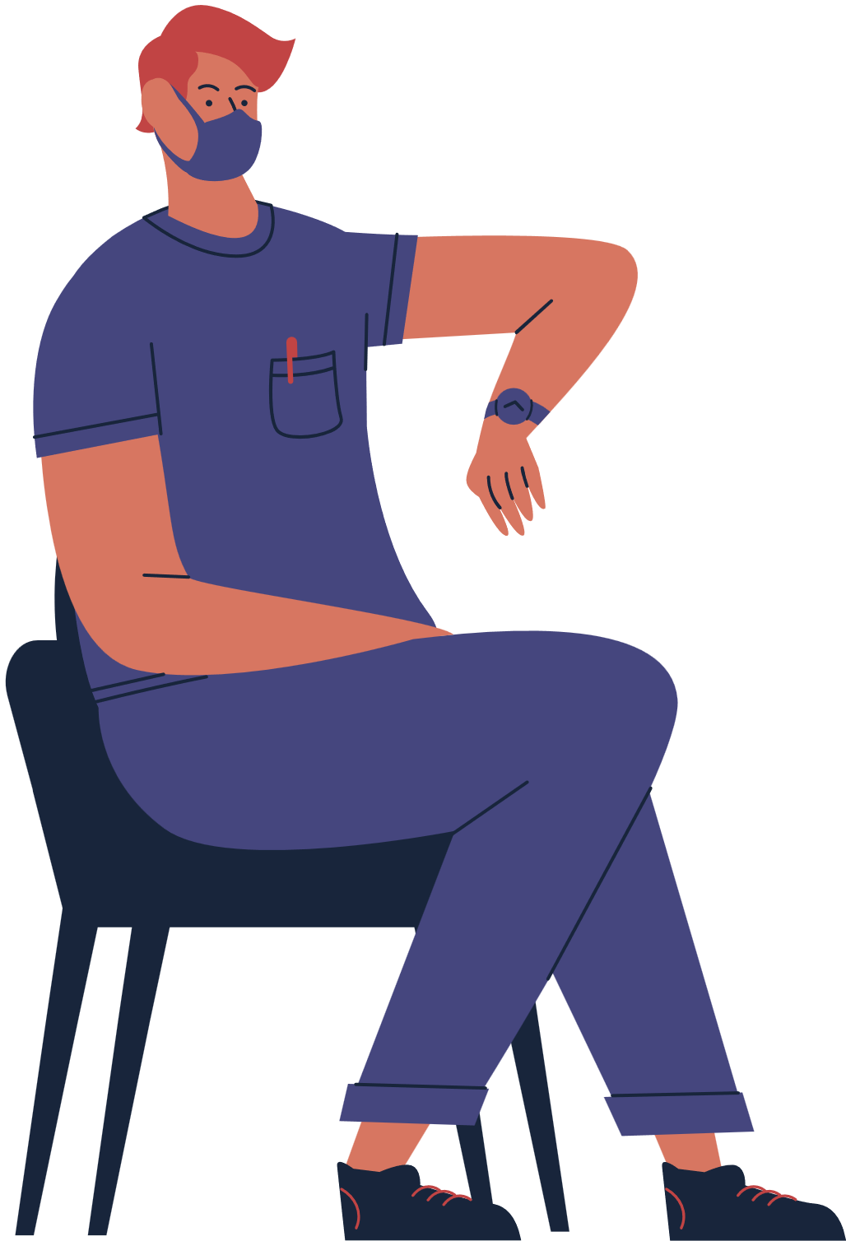
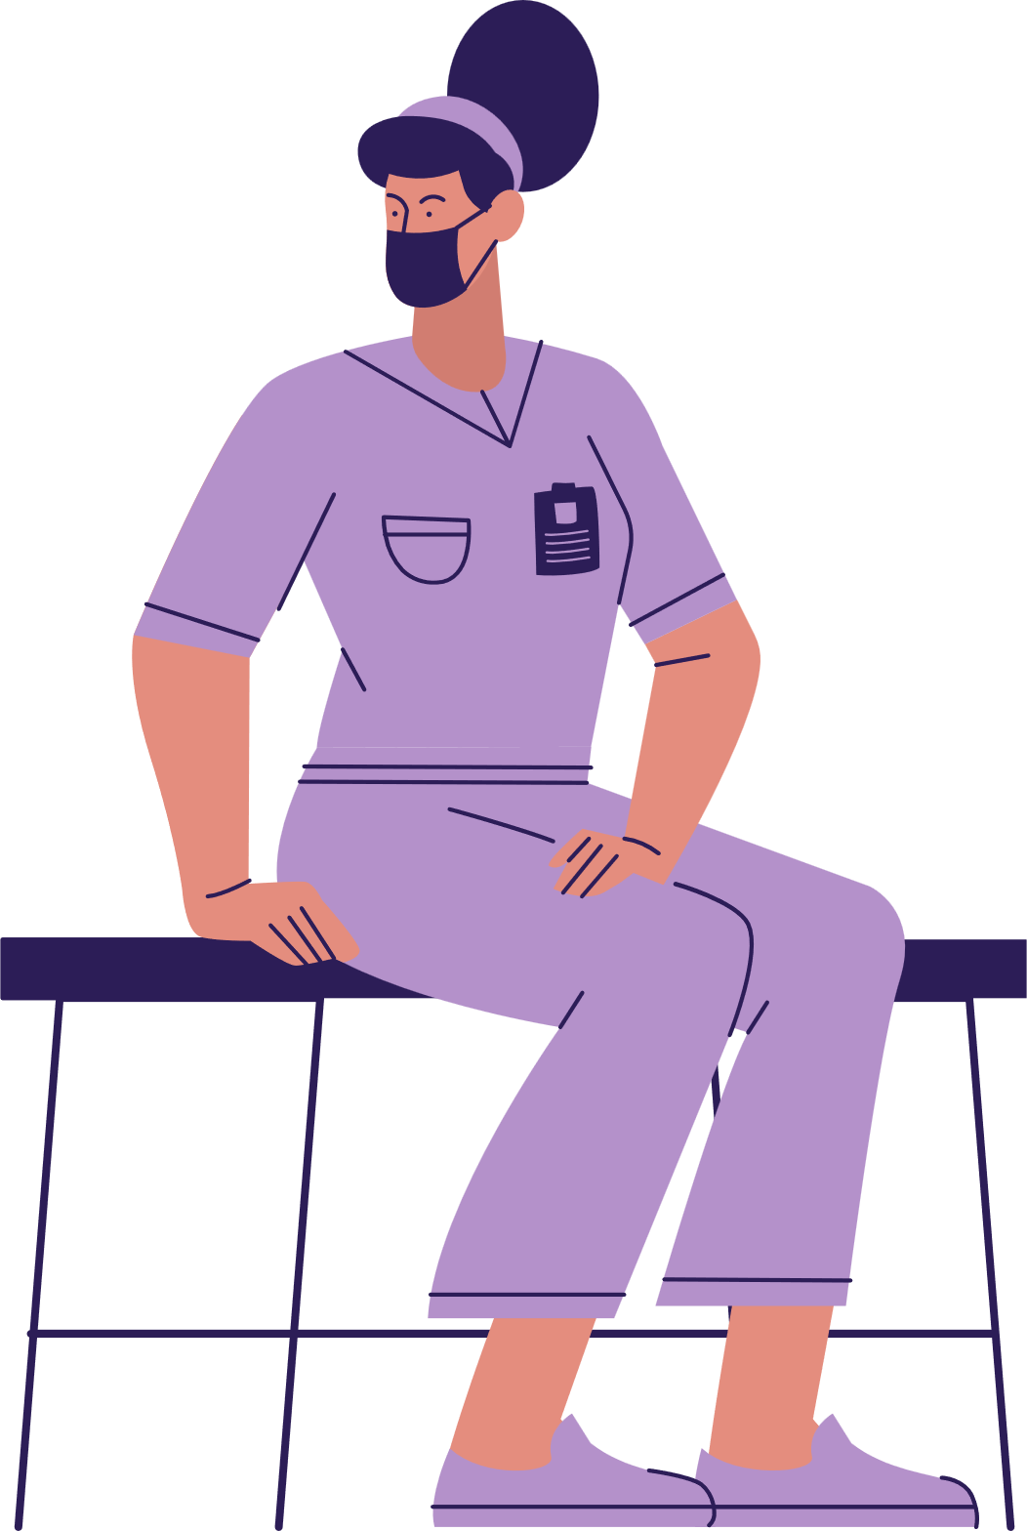
AI Models :
Breast Cancer
The algorithm I used is Decision Tree , the accuracy of model reached 95%
Diabetes
The algorithm I used is SVM , the accuracy of model reached 80%
Hepatitis C
The algorithm I used is SVM , the accuracy of model reached 93%
Alzheimer
The algorithm I used is NN , the accuracy of model reached 94%
Al-Shefaa Hospital

Slide 5

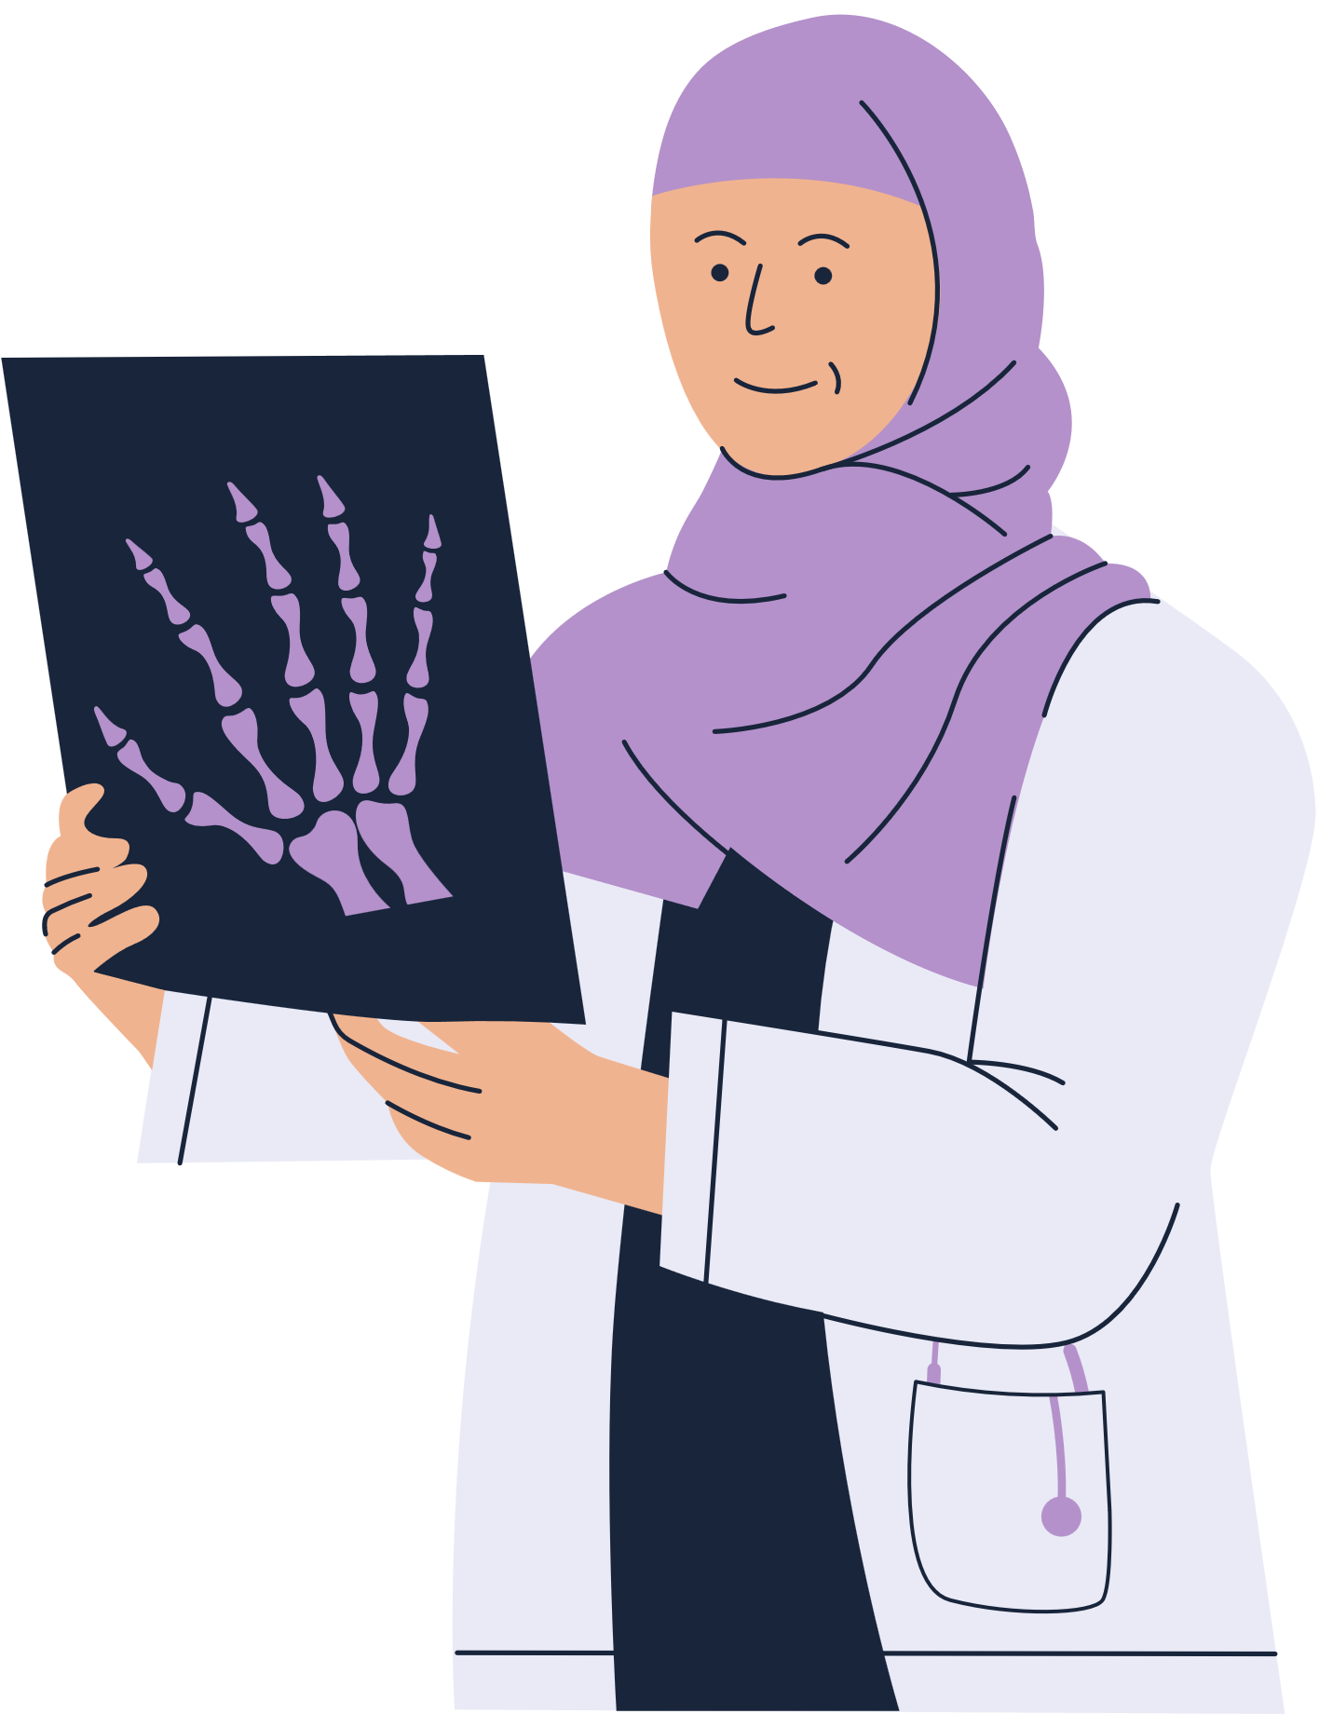
how you can use the website?
1-Visit alshefaahospital.com
2 - enter your results of blood tests or MRI
3 - then you can know Whether you are sick or not
Very simple!
Al-Shefaa Hospital

Slide 6


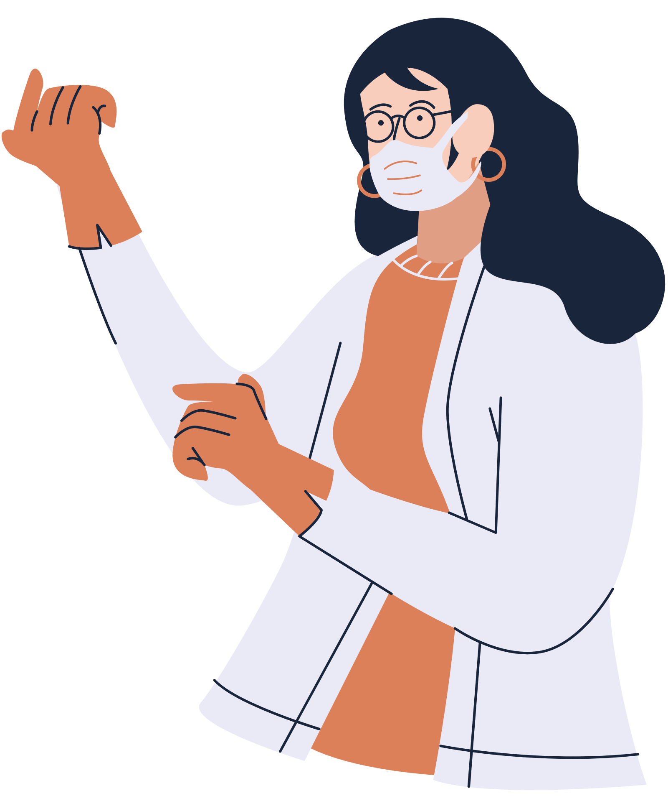

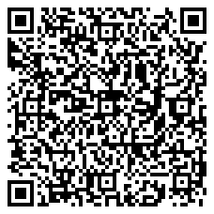
Thank you!
mohamedelsayad866@gmail.com
Egypt , Tanta
for more contacts :
Al-Shefaa Hospital

