Slide 1

World Bank POPULATION from 2000 to 2024

Slide 2
What Is the project About ?
This project is a comprehensive analysis of World Bank population data, tracking global demographic trends over several decades. It's not just about numbers—it's about understanding the story behind human population growth, distribution, and its implications for our future.

Slide 3
Why does this matter?
Because population dynamics directly impact economic growth, resource allocation, urban planning, and sustainability efforts worldwide. By analyzing this data, we can identify critical trends such as rapid urbanization, aging populations, and shifting growth centers—all crucial for policymakers, economists, and global strategists.

Slide 4
What did we discover?
Our analysis reveals striking insights: uneven population growth across regions, the rise of megacities, and demographic transitions that will redefine global economies in the coming decades. These findings help us anticipate future challenges and opportunities in areas like healthcare, education, and infrastructure development.
This project doesn’t just look at where we’ve been—it helps us prepare for where we’re headed.

Slide 5
Before we get to those fascinating insights, it's important to understand the raw material we started with. The journey from raw data to revelation was the most critical part of this project
To be honest the Raw-Data was too messy & it had the common issues that you meet in common with Raw-Data so it was….. Unorganized: Data points were scattered, making it difficult to get a clear timeline or regional comparison. Incomplete: We faced a significant number of empty cells and missing values, especially in earlier years for certain countries. This required careful handling to avoid skewed results.
Bloated with Irrelevant Columns: The dataset came loaded with columns that added no value to a population analysis. For example:

Slide 6
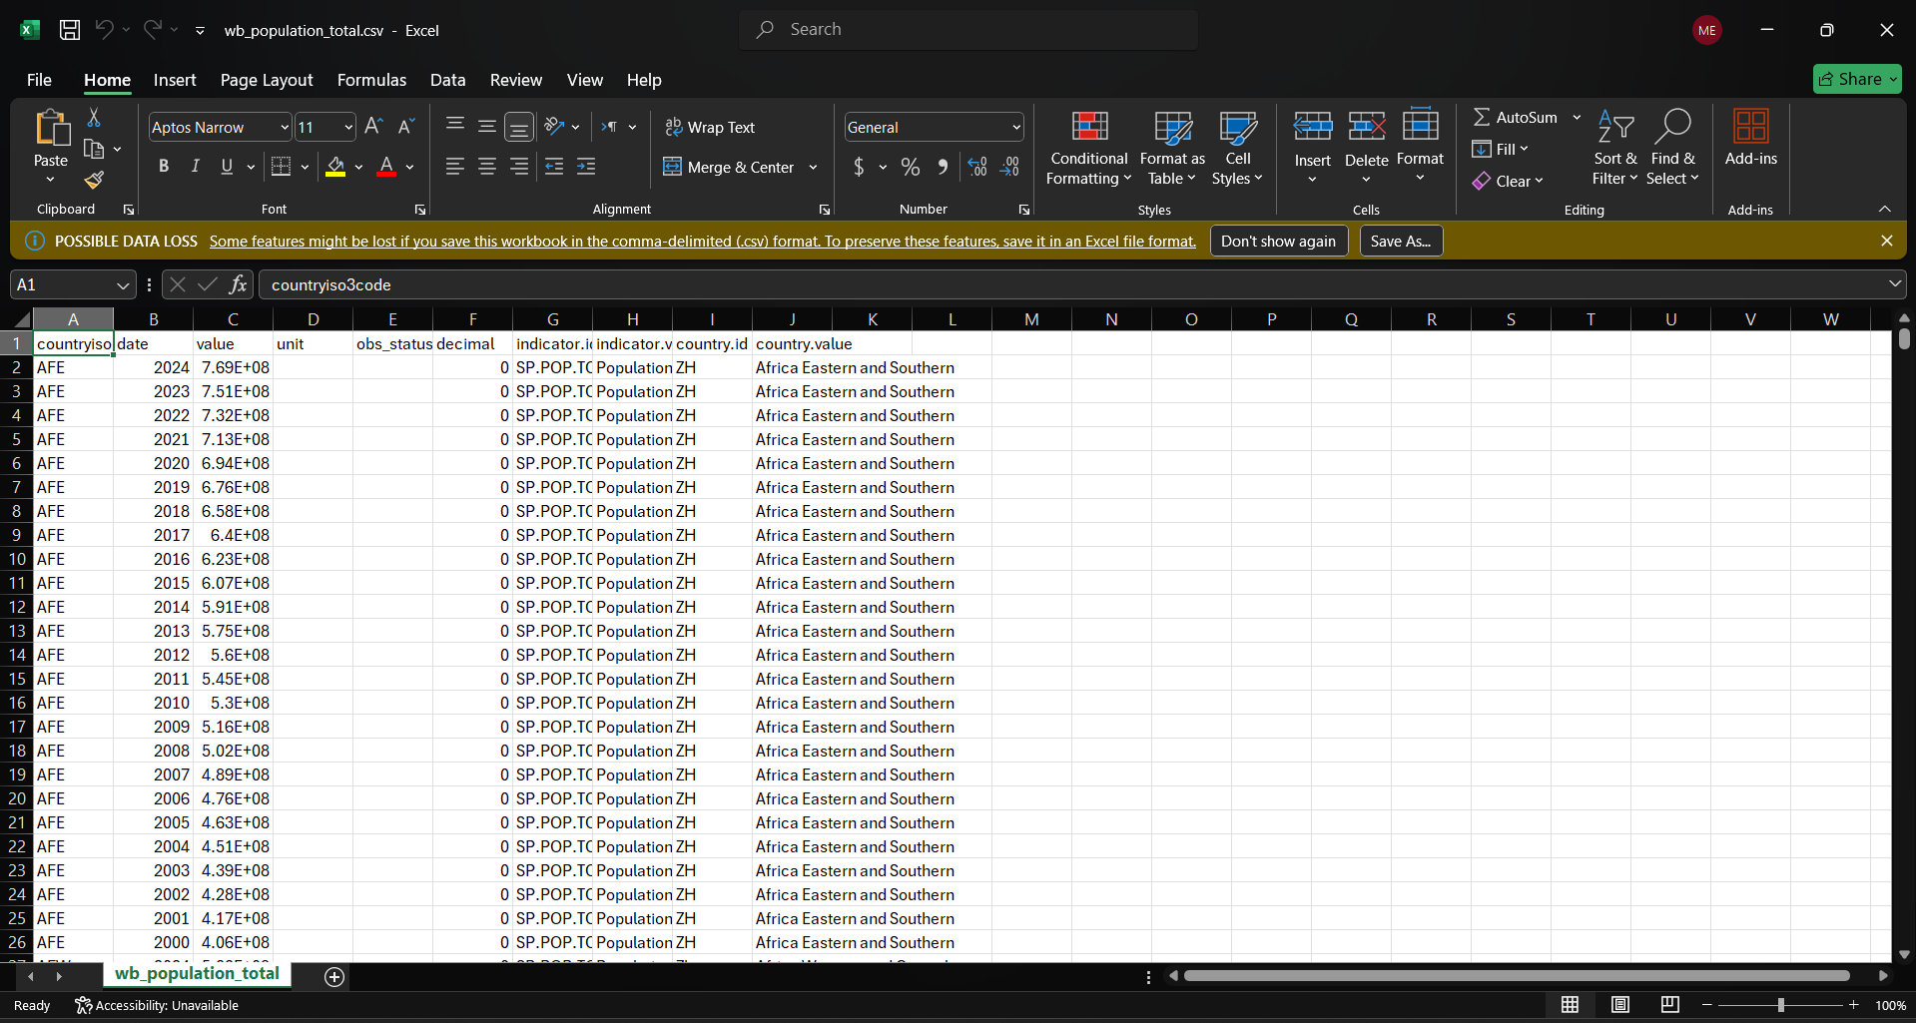
After collecting the data and notice the problems in Raw_data we move to the next step: Data Cleaning

Slide 7
Data Cleaning Steps :
Firs step We delete the unnecessary columns from the csv file for example : 1. unit : Unit of measure (often "number of people") . 2. obs_status : Power (if there is missing or advanced data). 3. decimal : Number of decimal places (most of the time it is 0 because the population is an integer).

Slide 8
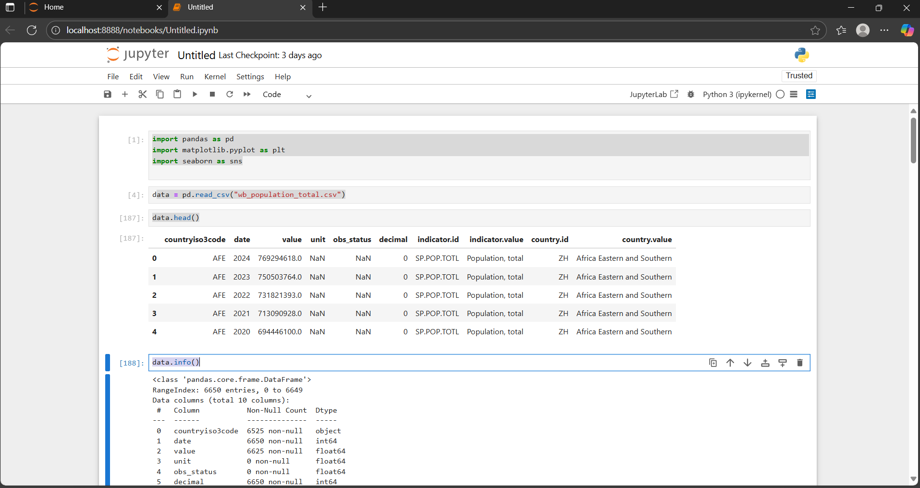
Next atep we transfer the data to jupyter notebook to continue the cleaning process:

Slide 9
Jupyter codes explanation and purposes:
1.import pandas as pd : This loads the Pandas library, which is used for working with structured data (tables, CSVs, Excel, etc.). We give it the nickname )pd) so we can use it quickly later. 2. import matplotlib.pyplot as plt : This loads Matplotlib’s pyplot module, which is used for making plots and charts. We give it the nickname (plt) so we can call plotting functions easily. 3. import seaborn as sns : This loads Seaborn, a visualization library built on top of Matplotlib. It makes charts more beautiful and easier to create. 4. data = pd.read_csv("wb_population_total.csv") : This reads the CSV file (wb_population_total.csv) into a Pandas DataFrame called (data). A DataFrame is like an Excel sheet in Python (rows & columns).

Slide 10
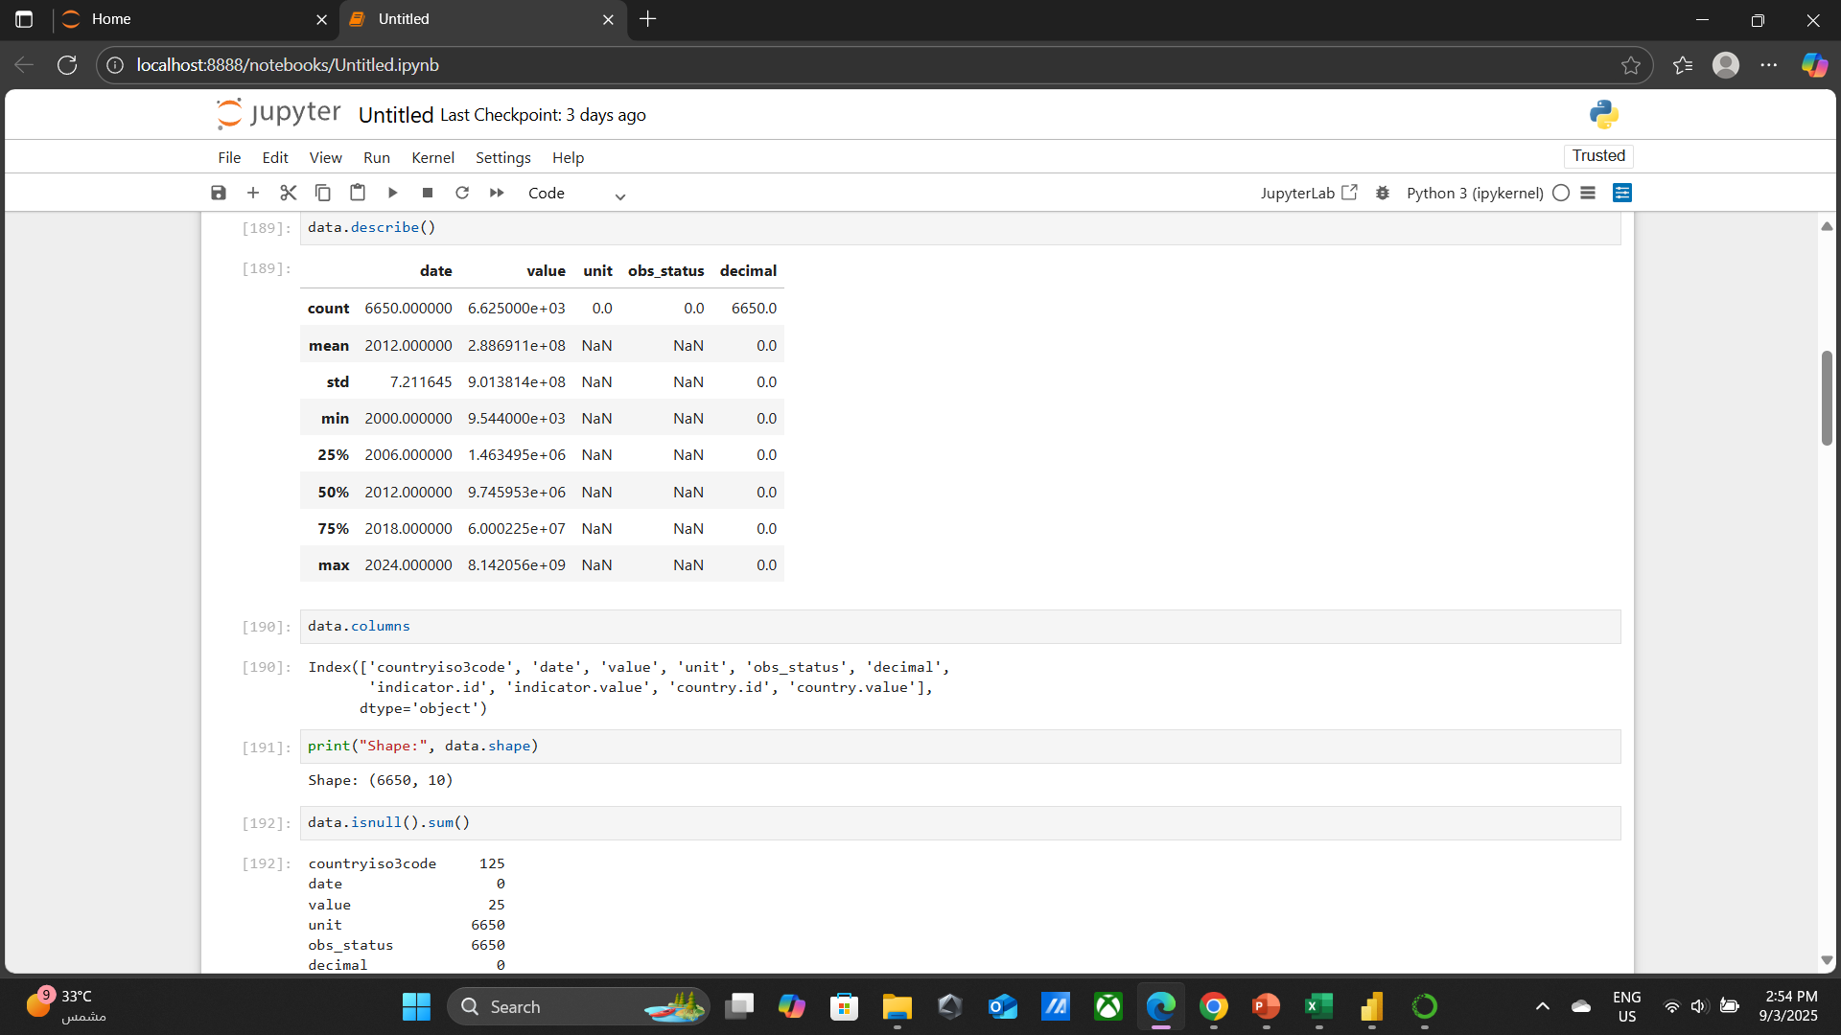
5. data.head() : . Displays the first 5 rows of the dataset.
Useful to take a quick look at the data’s structure and values.
6. data.info() : . Shows a summary of the dataset:
Number of rows and columns.
Column names.
Data types (int, float, object, etc.).
How many missing values are in each column.

Slide 11
7. data.describe() : Generates summary statistics for numeric columns (mean, min, max, quartiles, etc.). 8. data.columns : Displays the list of column names in the DataFrame. 9. print("Shape:", data.shape) : Prints the shape of the dataset → number of rows and columns (rows, columns). 10. data.isnull().sum() : Counts how many missing values (NaN) are in each column. 11. data = data.rename(columns={ ... }) : Renames specific columns to more readable names: → E.X: (date ) → (Year) (value) →( Population)
(obs_status )→ (Observation_Status)
(Countryiso3code) → (Country_Code)

Slide 12
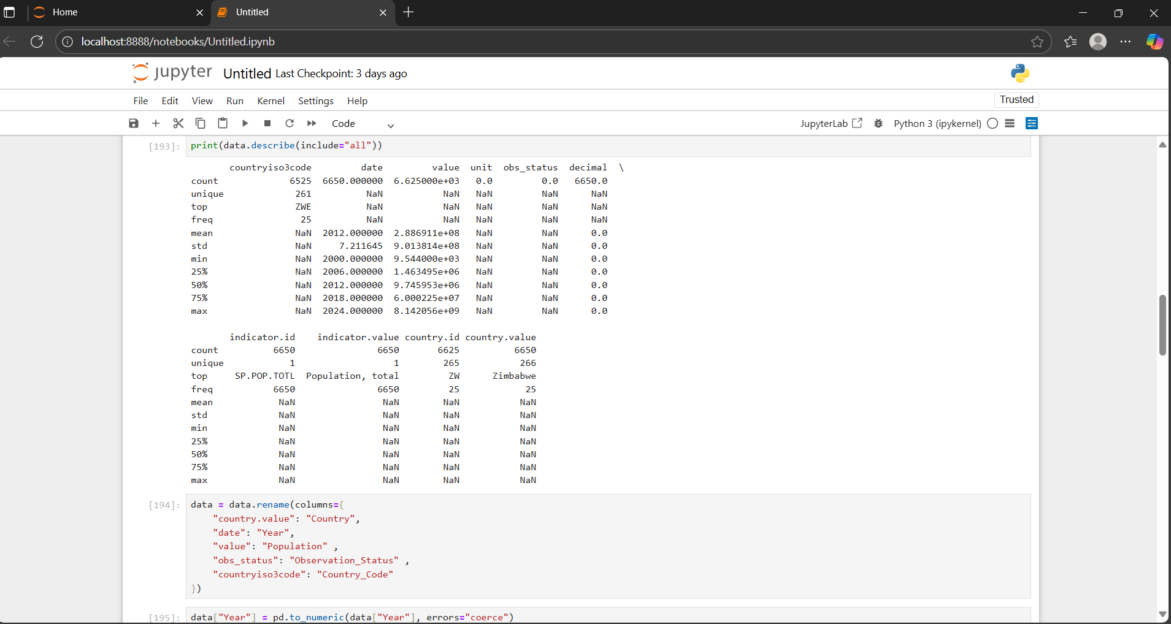
12. data["Year"] = pd.to_numeric(data["Year"], errors="coerce") : Converts the Year column to numbers (int/float) If there’s invalid data (like text), it turns into NAN (errors="coerce“)

Slide 13
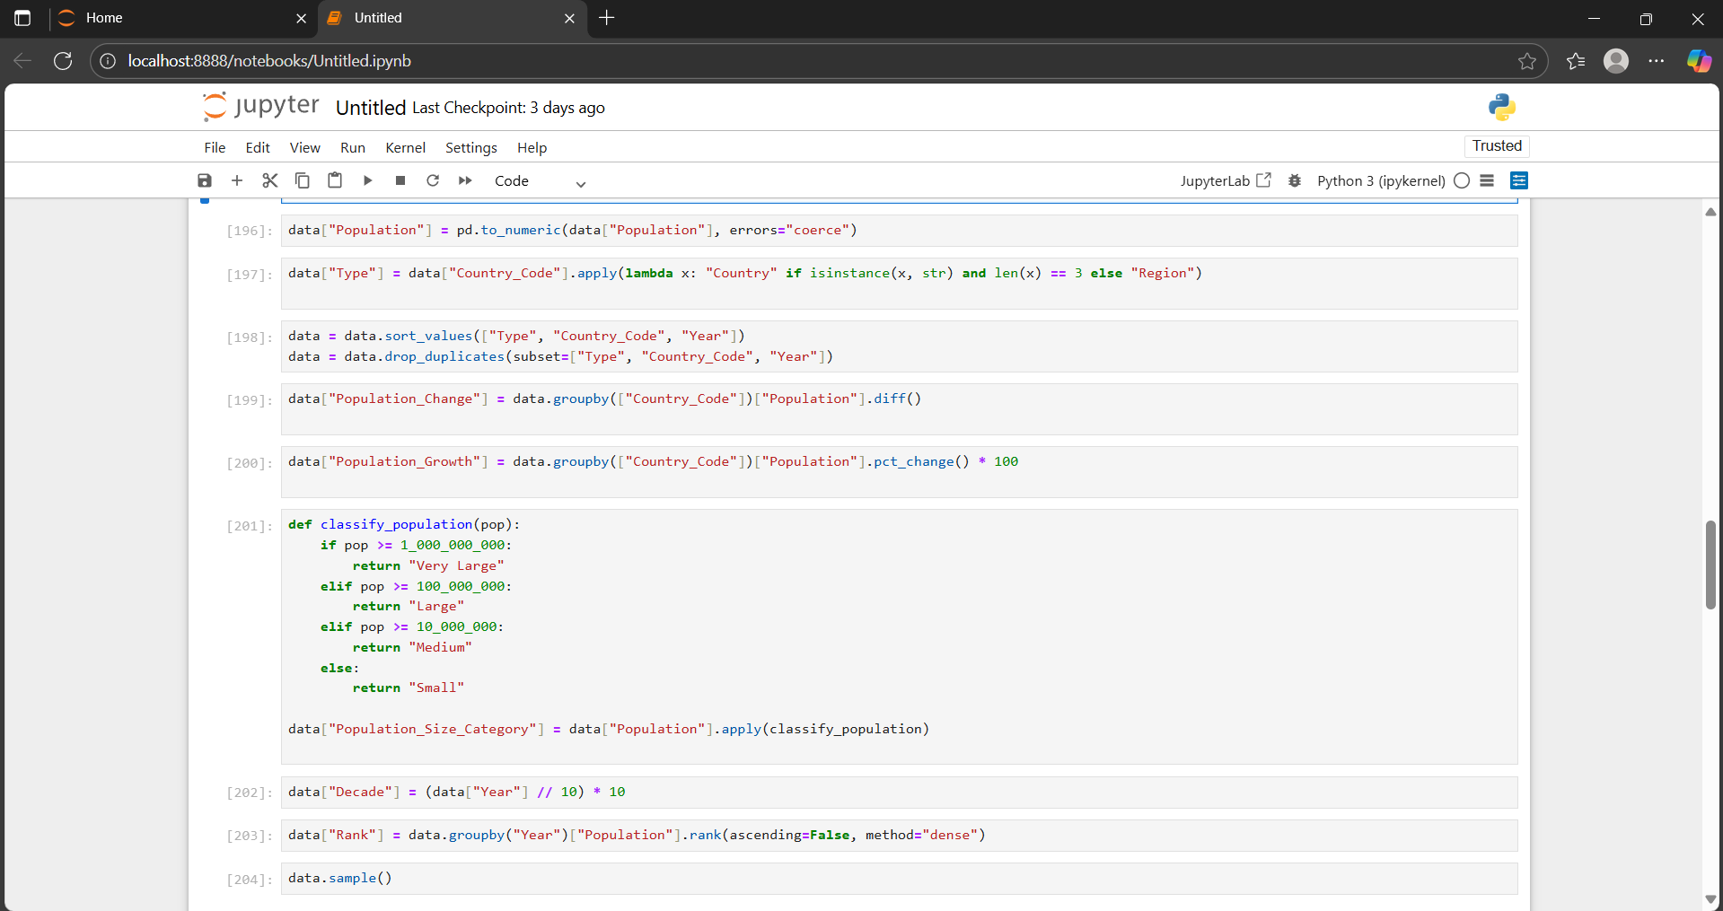

Slide 14
Otherwise → "Region"
13. data["Population"] = pd.to_numeric(data["Population"], errors="coerce"): Converts the Population column to numeric values If there are invalid (non-numeric) entries, they become NaN. 14. ["Type"] = data["Country_Code"].apply(lambda x: "Country" if isinstance(x, str) and len(x) == 3 else "Region") :Creates a new column called Type: If Country_Code is a string of 3 letters → label it as "Country" otherwise → "Region” 15. data = data.sort_values(["Type", "Country_Code", "Year"]) : Sorts the dataset by Type → Country_Code → Year to make sure values are ordered logically 16. data = data.drop_duplicates(subset=["Type", "Country_Code", "Year"]): Removes any duplicate rows that have the same Type, Country_Code, and Year. 17. data["Population_Change"] = data.groupby(["Country_Code"])["Population"].diff(): 18. data["Population_Growth"] = data.groupby(["Country_Code"])["Population"].pct_change() *100: Calculates the percentage growth rate of population per country/region.
Calculates the absolute change in population from one year to the next country/reigon formula: ΔPopulationt​ = population(t) – population(t-1)​

Slide 15
19. def classify_population(pop): ... Defines a function to classify countries by population size:
≥ 1,000,000,000 → "Very Large"
≥ 100,000,000 → "Large"
≥ 10,000,000 → "Medium"
Else → "Small"
20. data["Population_Size_Category"] = data["Population"].apply(classify_population): Applies the classification function to each row and creates a new column Population_Size_Category. 21. data["Decade"] = (data["Year"] // 10) * 10 : Creates a Decade column by grouping years into decades (e.g., 2000–2009 → 2000).
22. data["Rank"] = data.groupby("Year")["Population"].rank(ascending=False, method="dense"): Ranks countries within each year by population size. (dense)means if two countries tie, they get the same rank, and the next rank continues sequentially 23. data.sample() : Shows a random sample of rows from the dataset to quickly check results.

Slide 16
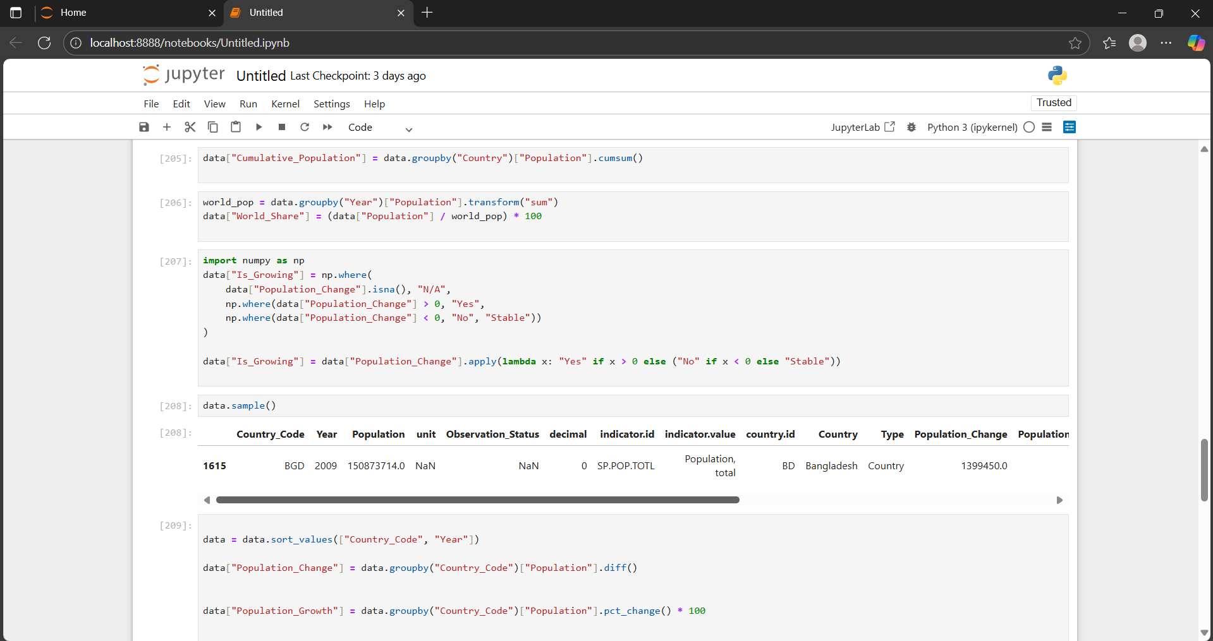

Slide 17
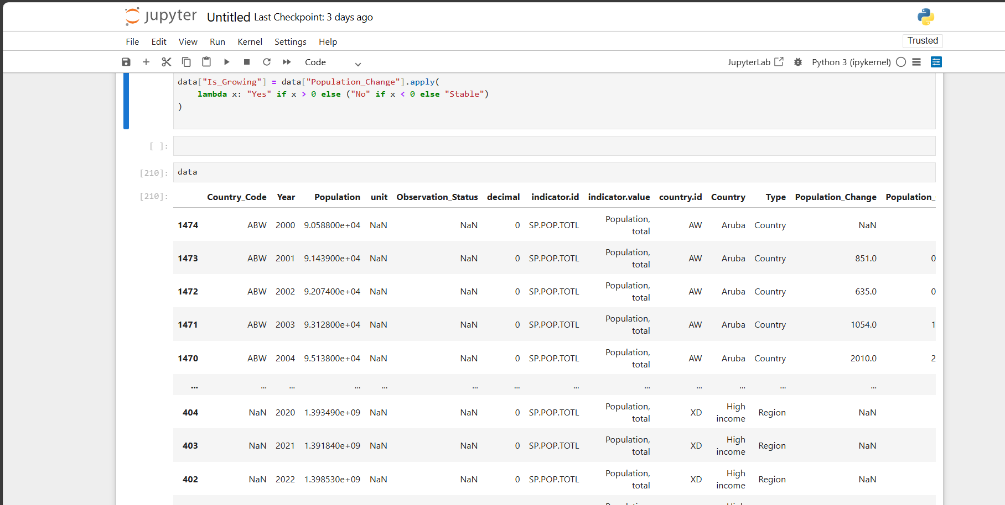
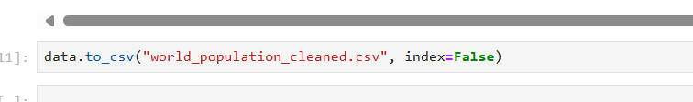

Slide 18
24. data["Cumulative_Population"] = data.groupby("Country")["Population"].cumsum() : Creates a cumulative sum of population for each country across years.
Example: if population was 5M in 2000 and 6M in 2001 → cumulative = 5M, then 11M.
25. world_pop = data.groupby("Year")["Population"].transform("sum"): Calculates the total world population per year. Transform("sum") keeps the same shape as the original DataFrame so it can be divided row by row. 26. data["World_Share"] = (data["Population"] / world_pop) * 100 Calculates each country’s share of the world population (%) for every year. 27. import numpy as np : Imports NumPy for handling numerical operations. 28. data = data.sort_values(["Country_Code", "Year"]) : Sorts the dataset by country code and year. 29. data["Population_Change"] = data.groupby("Country_Code")["Population"].diff() : Re-calculates the population change per country year-to-year. 30. data["Population_Growth"] = data.groupby("Country_Code")["Population"].pct_change() * 100 : Re-calculates the percentage population growth year-to-year per country. 31. data["Is_Growing"] = data["Population_Change"].apply(lambda x: "Yes" if x > 0 else ("No" if x < 0 else "Stable")): Final version of the Is_Growing column.

Slide 19
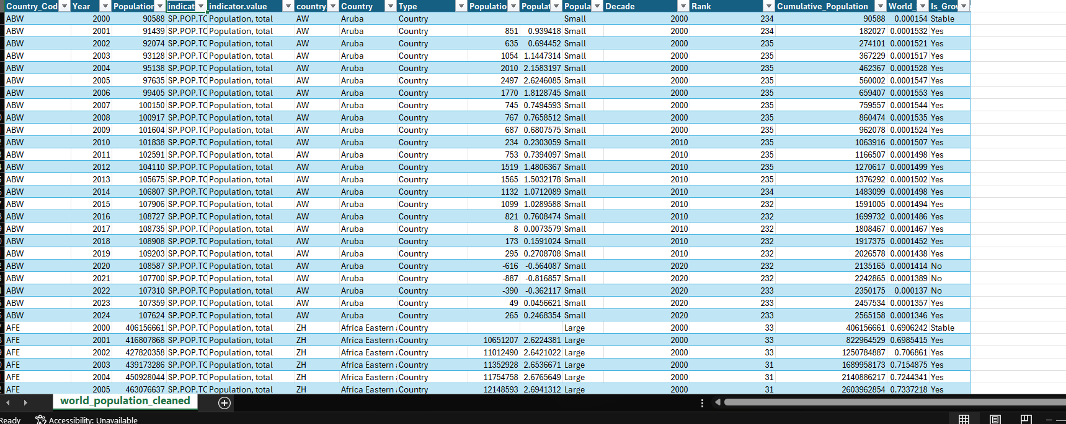
The data shape after the cleanibg process

Slide 20
Next step after cleaning the data and adding new calculated columns, the next crucial phase is :
Data visualization: What is Data Visualization?
Data Visualization is the art and science of representing information and data graphically. It uses visual elements like charts, graphs, and maps to communicate complex data relationships in a way that is intuitive, understandable, and actionable.
Think of it as translating a spreadsheet full of numbers into a universal visual language. The goal is to:
Reveal Patterns and Trends: Spot insights that are difficult to see in raw tables (e.g., a sudden population spike, a declining growth rate).
Tell a Story: Weave data points into a compelling narrative about what is happening and why.
Support Decision-Making: Provide a clear, evidence-based foundation for strategic choices.
Answer Business Questions Quickly: Allow viewers to grasp the key takeaways at a glance.
And we did thid process using )Bower BI).

Slide 21

But before visualization we must know what is the data tha we will visualize and how we do that ? First step we ask questions sabout the data topic and search for its answers : 1.What is the average of population change? 2. What is the average of population growth? 3.What is the sum of the cumulative population? 4.What is the lowest countries in world share ? 5.Top 5 countries by total population . 6.Highest decade in in population growth. 7. Highest decade in in population change 8.average world share . 9 top year in population growth and change 10. Highest country in rank…… And there is much more Question you can ask ……..

Slide 22
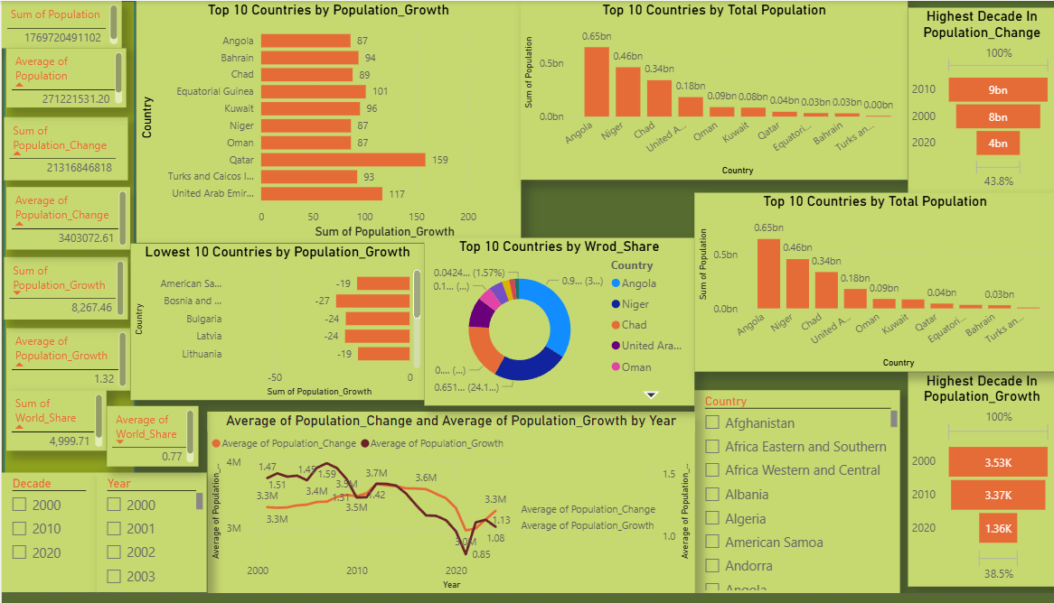

Slide 23
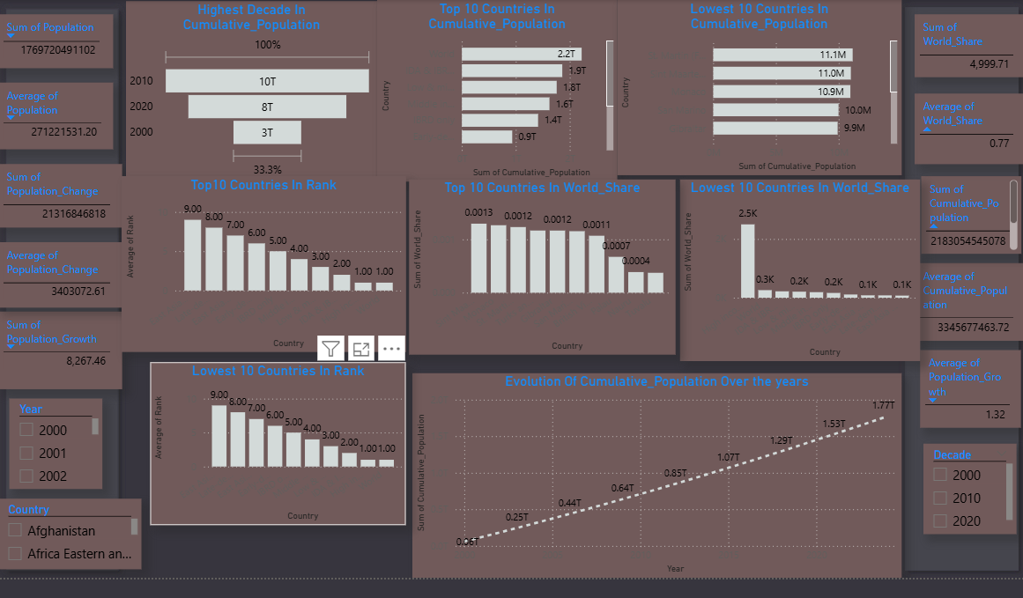

Slide 24






1.Average of population change 21316846818
2.Average of populationGrowth 1.32
3.Sum of cumulative population 2813054545078
4.The lowest 10 countries in world share from is : 1).Sint martin (dutch part) 0.65bn 2).Monaco 0.46 bn 3). Sint martin (French part) 0.34bn 4).Turks & Ciacos island 0.18bn 5).Gibraltar 0.9bn 6).San Marino 0.8bn 7).British Virgin island 0. 8).Palau 9).Nauru 10).Tuvalu

Slide 25


5.Top 5 counries in total population : 1).Angola 2).Niger 3).Chad 4).Unitd Arab Kingdom 5).Oman 6.Highest decade in in population growth. 2010 (9311616704) 7. Highest decade in in population change 2000 (3,53K) 8.average world share : 9 top year in population growth and change: 2007 is the highest year in population_growth(AVG 1.59) 2012 is the highest year in population_change (AVG 3.7 M) 10. Highest country in rank: Tuvalu (AVG rank 258.60)
8.Average of World_share 0.77

Slide 26
Highlights & Recommendations
Insights
Asymmetric Growth: Sub-Saharan Africa and South Asia continue to record the fastest population growth, while Europe and East Asia are experiencing slowdown or even decline.
Urbanization Pressure: Rapid growth in Africa and Asia will heavily strain infrastructure (transport, energy, water).
Aging Populations: Europe, Japan, and South Korea are entering population aging phases → requiring migration policies or extended retirement age.
Shifting World Share: India has overtaken China as the most populous country → with major economic and geopolitical consequences.
Global Inequality: Small nations (Tuvalu, Nauru, Palau) contribute almost nothing (<0.01%) to world population, while 5 countries account for more than half of global population.

Slide 27
Recommendations
For Governments:
Invest in education and healthcare in high-growth countries.
Develop migration policies to counterbalance aging in Europe and East Asia.
For Businesses:
Expand into African and Indian markets as future growth opportunities.
Invest in youth-focused industries (education, technology).
For NGOs / World Bank:
Support family planning programs in high-growth nations.
Finance sustainable infrastructure (renewable energy, water, transport).

Slide 28
Our analysis of World Bank population data shows that the world is not growing equally. Some regions are aging, others are booming, and a few are shrinking. Understanding these dynamics is not just about numbers—it’s about shaping policies, investments, and strategies for a sustainable future. The next decade will be defined by how governments, businesses, and global organizations respond to these demographic shifts.

Slide 29
And That’s All Thank You ANY QUESTIONS?

