Slide 1
📚
AI Documentation Assistant
Grounded, Offline Answers for SEPA Payment Gateway Support
Payments Engineering | Internal Tooling Proposal

Slide 2
The Problem
🔍
Documentation is scattered
SEPA runbooks live across Confluence exports, PDFs, and Word docs -- not one place to search.
⏱
Answers take too long
Engineers lose valuable time searching during incidents instead of resolving them.
⚠
High stakes, low margin for error
The SEPA Payment Gateway is Tier 1 -- Financial Critical. Slow or wrong answers are costly.

Slide 3
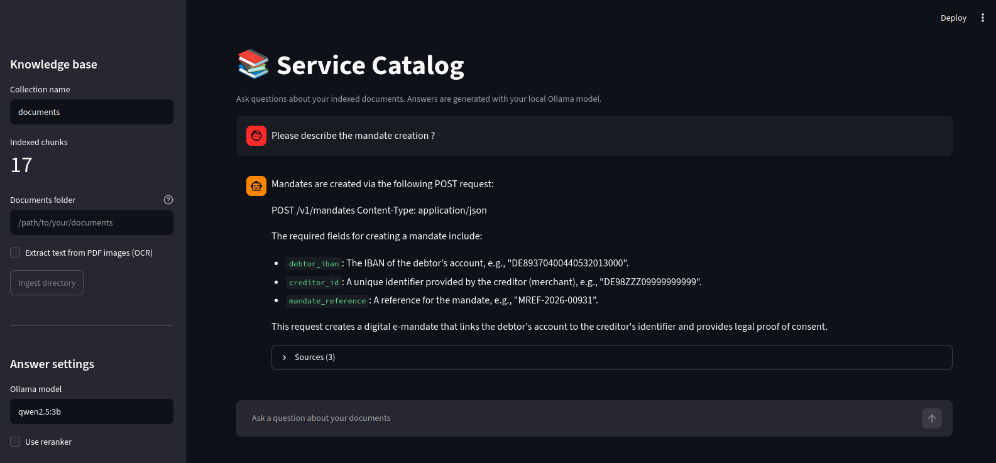
What We Built
Answers grounded in our own documentation -- not general internet knowledge
Every answer cites the source document it came from
Understands PDFs, Word docs, and Markdown -- including tables and diagrams
Runs entirely offline: no data ever leaves our infrastructure
Live in the browser -- ask, get a grounded answer with sources

Slide 4
How It Works
1
2
3
4
5
📄
✂
🔢
🔎
🤖
Documents
Parse & Chunk
Embed
Search & Rerank
Grounded Answer
Every company document is broken into searchable pieces, converted into numeric vectors, and matched against each question -- the AI answers only from what's actually retrieved.

Slide 5
Why It Runs Fully Offline
0
100%
$0
external API calls
data stays in-house
per-query cost
The SEPA Payment Gateway is classified Tier 1 -- Financial Critical. Sending transaction-adjacent documentation to a third-party API isn't a risk worth taking. Every model here runs on our own hardware.

Slide 6
See It In Action
“Please describe the mandate creation?” -- answered directly from our SEPA service documentation, with sources cited below.

Slide 7
Built With Engineering Rigor
Not a weekend demo -- every stage was tested against real documents before moving to the next.
📄
Robust Parsing
🎯
Accurate Retrieval
Handles PDFs, Word docs, and Markdown -- including tables, headers/footers, and embedded diagrams.
Chunking and deduplication logic tuned and stress-tested against real service documentation.
⭐
Grounded Answers
✅
Thoroughly Tested
A second-pass reranking step improves relevance before an answer is ever generated.
Every component validated with real files and edge cases -- not just the happy path.

Slide 8
What's Next
WORKING TODAY
NEXT STEPS
Multi-format ingestion (PDF, Word, Markdown)
Offline Q&A with cited sources
Web-based chat interface
Document upload directly from the browser
Multi-turn conversations (follow-up questions)
Ticketing system integration for auto-triage
Access control & human escalation rules
Automatic detection of documentation updates

Slide 9
What We're Asking For
→
A short pilot with a small group of on-call engineers
→
Feedback to help prioritize the roadmap
→
Shared compute to reduce response time beyond a single laptop
Thank you

