Slide 1
UNIVERSITÀ DEGLI STUDI DI GENOVA · DIBRIS · VIRTUAL REALITY FOR ROBOTICS
Few-Shot Gaussian Splatting withDiffusion-Based Data Augmentation
242
training runs
2
scenes: an outdoor object and an indoor room
3
augmentation strategies, 4 ratios, 3 seeds
4
controls, plus a depth prior that tests the mechanism
When does a generated photograph help a 3D reconstruction — and when does it start destroying one?
Mohamed Eyad · Advisors: Prof. Fabio Solari, Prof. Manuela Chessa
Notes:
[45s]
Good morning. My project asks one question: can AI-generated images replace photographs you never took, when you are reconstructing a 3D scene?
The short answer is yes, but only in a narrow window — and I spent most of the project working out where that window ends and why.
236 training runs, two scenes, and every number here is read straight out of the raw results files, not typed in by hand.

Slide 2
CONTENTS
Where this goes
• The problem — splatting without enough photographs
• The method — three ways to manufacture a view
• The grid — what was run
• The result — a sign change
• Why — and four controls
• A prediction, tested
• Limits
Notes:
[22s]
Quick map of the next fifteen minutes.
The problem, then the method and the pipeline, then the grid I ran. Then the result, which is a sign change. Then why it happens, and the controls that rule out the alternatives. A prediction I tested. And the limits.
The one thing to carry through: the same treatment can help or harm, and which one it does depends on how many real photographs you already have.

Slide 3
THE PROBLEM
3D Gaussian Splatting is excellent — given enough photographs
15.20
dB · 5 views
17.11
dB · 10 views
19.74
dB · 20 views
25.23
dB · 219 views (ceiling)
Cut truck from 219 photographs to five and held-out quality collapses.
A 10.04 dB gap. Photographs are expensive; a diffusion model generates images for free. Can generated views substitute for photographs that were never taken?
Notes:
[60s]
Gaussian Splatting reconstructs a 3D scene from photographs. Given enough of them it is excellent — 25.2 dB on this outdoor scene from 219 photos.
Cut it to five photos and it collapses to 15.2. That is a ten decibel gap.
Photographs are expensive to collect. A diffusion model generates images for free. So the question is whether free images can buy back that gap.

Slide 4
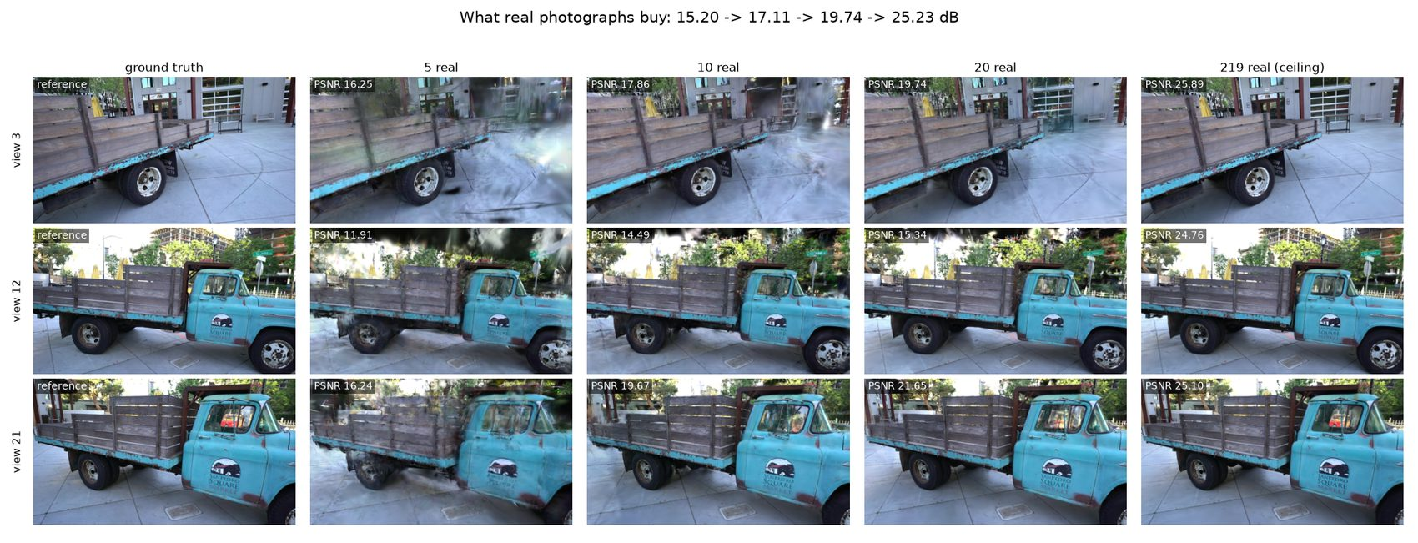
THE PROBLEM · WHAT IT LOOKS LIKE
Notes:
[40s]
This is the same held-out camera reconstructed from 5, 10, 20 and 219 photos.
The important thing is what fails at five views. The shape of the truck is broadly right. What costs the ten decibels is the haze, the floaters, and the surfaces the optimiser had no second view to pin down.
So the deficit is coverage, not detail. That matters later.

Slide 5
METHOD
Three ways to manufacture a training view
Inpainting
Mask a region of a real photograph and let the model refill it. Same camera, same framing — no new geometry at all.
Outpainting
Keep the focal length, enlarge the canvas. The camera does not move; the lens gets wider. Supplies peripheral content.
Pose-guided
Estimate depth, anchor it to the sparse SfM points, warp to a chosen new camera, and let diffusion fill the disocclusions. The only one supplying a genuinely new viewpoint.
Mask a region of a real photograph and let the model refill it. Same camera, same framing — no new geometry at all.
Keep the focal length, enlarge the canvas. The camera does not move; the lens gets wider. Supplies peripheral content.
Estimate depth, anchor it to the sparse SfM points, warp to a chosen new camera, and let diffusion fill the disocclusions. The only one supplying a genuinely new viewpoint.
Notes:
[60s]
I tested three strategies.
Inpainting masks part of a real photo and refills it. Same camera, same framing — no new geometry at all. It is the control, really.
Outpainting keeps the lens and enlarges the frame. The camera does not move; it just sees wider. That supplies peripheral content.
Pose-guided is the ambitious one. Estimate depth, warp the image to a new camera position I choose, and let diffusion fill the holes. It is the only one that invents a genuinely new viewpoint.
Each is generated at four ratios, three subset sizes, three seeds.

Slide 6
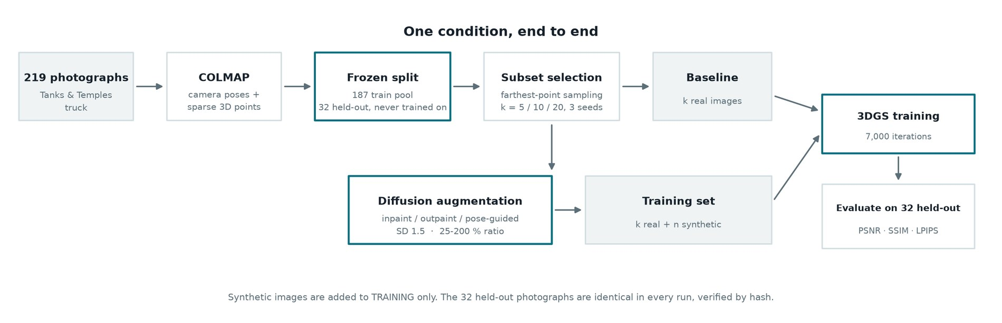
METHOD · THE PIPELINE
One condition, end to end
Notes:
[48s]
This is one condition, start to finish.
Two hundred and nineteen photographs go through COLMAP for camera poses and sparse points. Then the split, and this is the important box: thirty-two photographs are held out and never trained on, in any run, verified by hash.
From the training pool I select k views by farthest-point sampling — five, ten or twenty.
Then the fork. The top lane trains on those k real images. The bottom lane sends them through diffusion augmentation first, and trains on k real plus n synthetic.
Both lanes hit the same trainer for the same seven thousand iterations and are scored on the same thirty-two held-out photographs. The only thing that differs between the arms is what went into training.

Slide 7
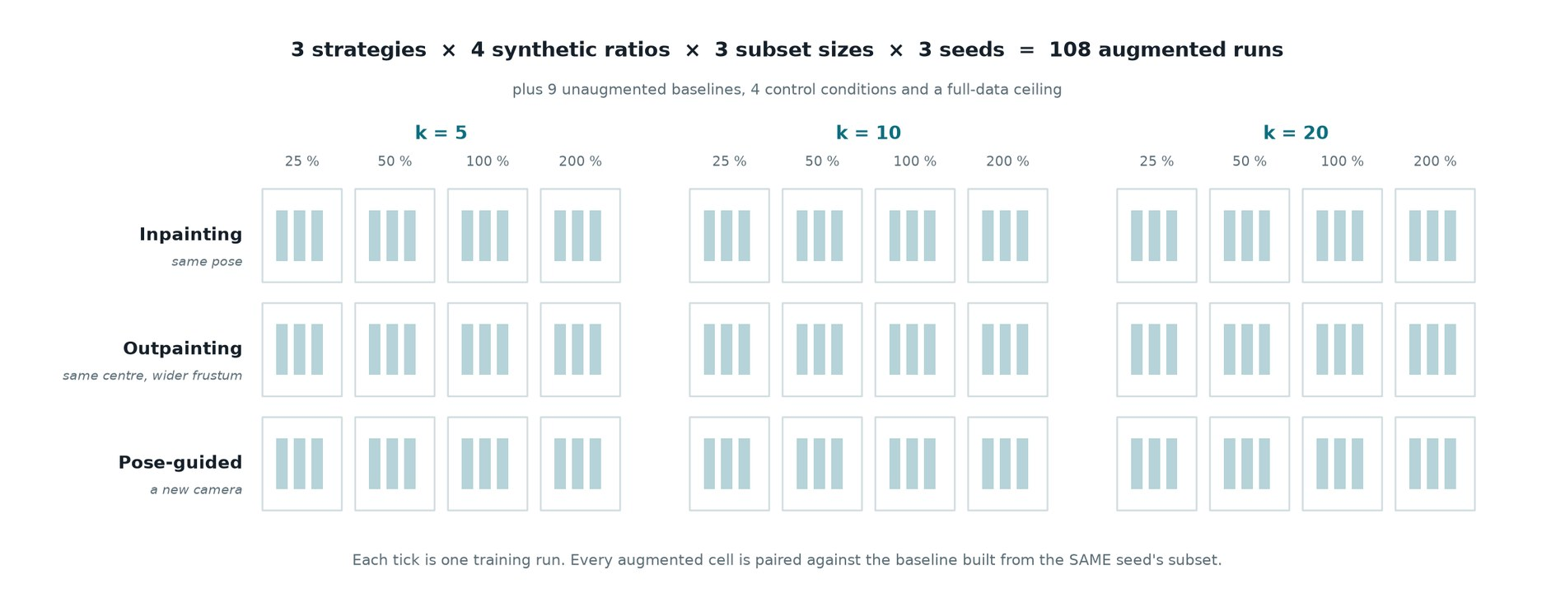
DESIGN · THE GRID
What was actually run
Notes:
[38s]
And this is the grid.
Three strategies, four synthetic ratios, three subset sizes, three seeds. A hundred and eight augmented runs, plus baselines, controls and a full-data ceiling.
Each tick in a cell is one training run.
The critical detail is the pairing. Every augmented cell is compared against the baseline built from the SAME seed's subset — so the luck of which five views got drawn cancels out, instead of being counted as an effect of augmentation.

Slide 8
DESIGN · RIGOUR
The measurement has to survive a 0.2 dB effect
• Frozen held-out split. Byte-identical test images in every run — verified by hash across all 242 of them.
• Measured noise floor. An identical configuration re-run three times varies by 0.039 dB.
• Farthest-point sampling. Subsets spread over the camera trajectory, not drawn at random.
Notes:
[55s]
The effects here are small, so the measurement has to be careful.
Every run of a scene is scored against byte-identical held-out images — I verify that by hash across all 236 runs.
Every augmented run is compared against its own seed's baseline. Which five photos you happen to draw matters enormously, and pairing cancels it.
And I measured the noise floor: the identical configuration run three times varies by 0.039 dB. So a 0.2 dB effect is real and a 0.03 dB effect is not.

Slide 9
RESULT
The same augmentation helps at five views and harms at twenty
k = 5
+0.285
k = 10
-0.003
k = 20
-0.618
Outpainting at 200%, paired within seed. The treatment is identical at every subset size — only the number of real photographs changes.
For scale: one extra real photograph between k = 5 and k = 10 is worth +1.91 dB total. Augmentation buys a fraction of a photograph, and only while photographs are scarce.
Notes:
[75s]
This is the main result.
Outpainting at the 200 percent ratio. At five real views it gains 0.285 dB. At ten it is zero. At twenty it LOSES 0.618.
The treatment is identical. The only thing that changed is how many real photographs it was added to.
PAUSE HERE. Let them look at the sign change.
For scale: five more real photographs are worth 1.9 dB. Augmentation buys you about a seventh of one photograph, and only while photographs are scarce.

Slide 10
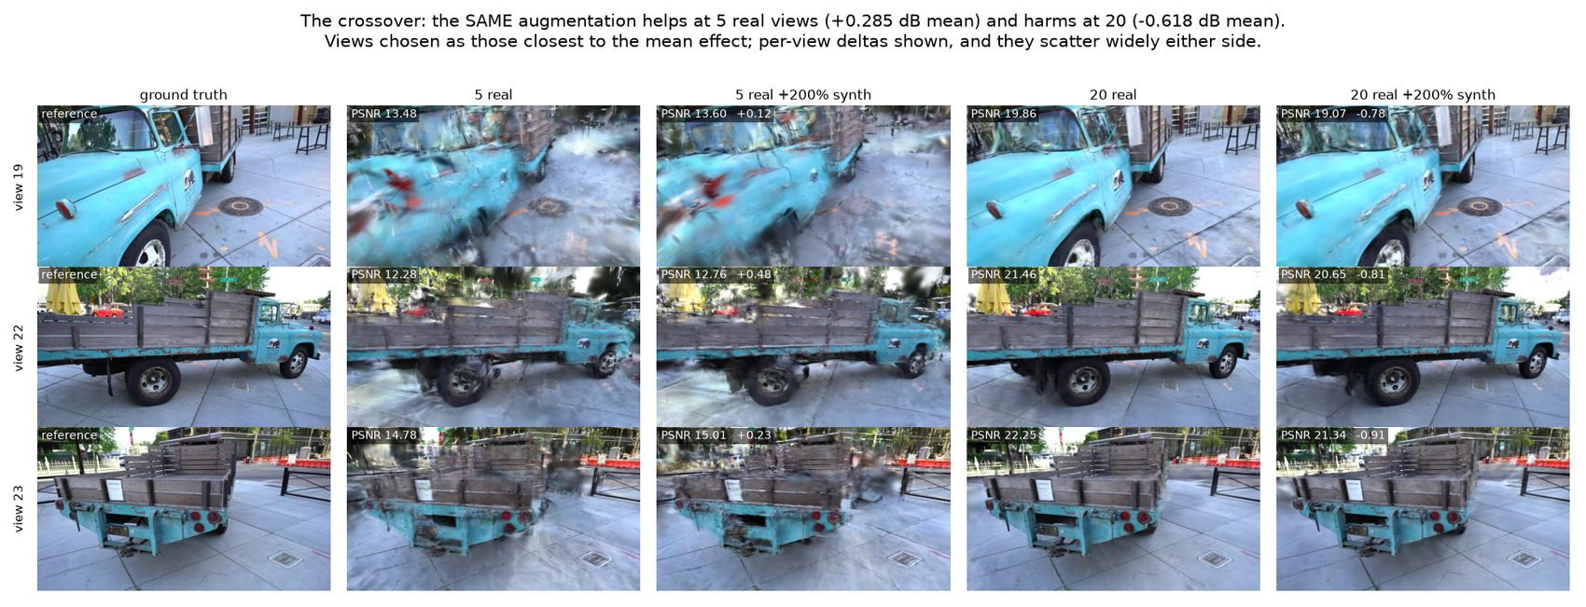
RESULT · WHAT IT LOOKS LIKE
Notes:
[40s]
The same thing visually. Left pair is five views, right pair is twenty.
One caution on this figure: per-view effects scatter several dB either side of the average. So I picked the views closest to the mean effect and printed the per-view number on each. Three arbitrary views can contradict the finding they are supposed to illustrate.

Slide 11
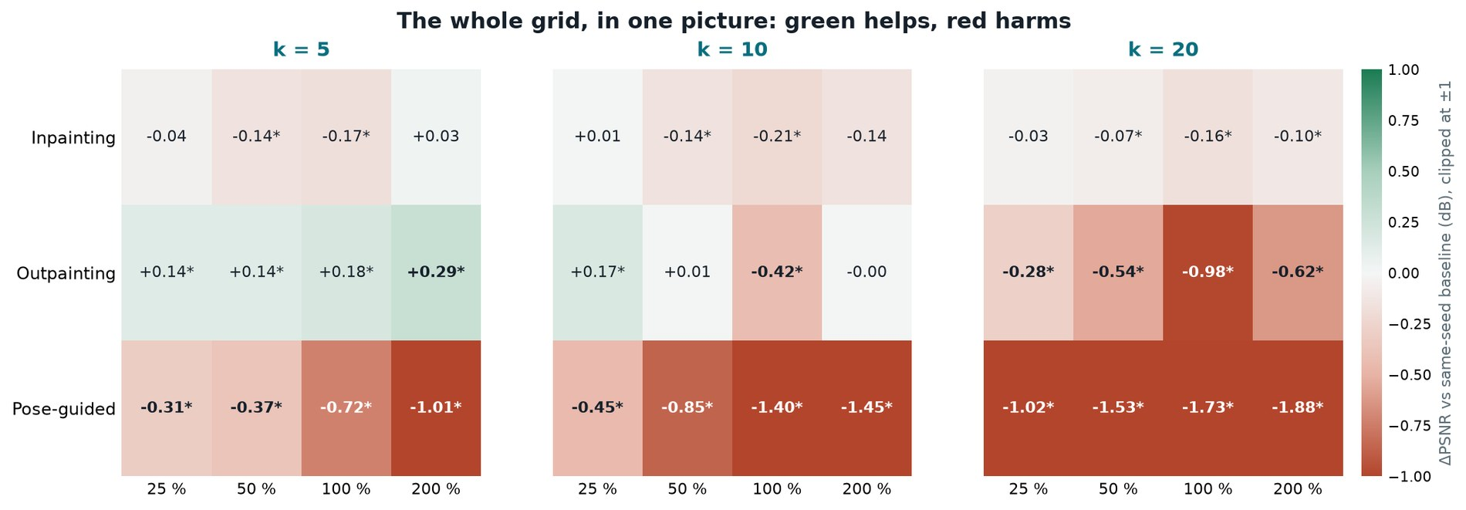
RESULT · THE WHOLE GRID
Every cell, in one picture
Notes:
[52s]
Here is the whole grid filled in. Green helps, red harms.
Read the middle row — outpainting — left to right across the three panels. Green at five views. Neutral at ten. Red at twenty.
That is the finding. Same treatment, same ratio, opposite sign.
The top row, inpainting, is flat everywhere — it reuses the camera pose exactly. The bottom row, pose-guided, is red everywhere and gets darker as k grows — it invents a whole new camera.
Colour is clipped at plus or minus one decibel, otherwise pose-guided's magnitude washes the crossover out.

Slide 12
GENERALISATION
It reproduces indoors
+0.989
dB at k = 5 — stronger than outdoors
-0.242
dB at k = 20 — the sign flip repeats
1.68
dB baseline scatter between seeds — the draw matters far more in a room
34 runs repeat the outpainting sweep on drjohnson — an indoor room, a different capture regime.
Indoors all three metrics move together; on truck SSIM moved slightly the other way. Three metrics agreeing is harder to get by chance than one.
Notes:
[45s]
The obvious worry is that this is one scene's quirk. So I repeated the sweep on an indoor room from a different dataset — different capture geometry, different scale.
Same sign flip. And indoors the effect is stronger at five views.
Note the third number: the baselines scatter 0.52 dB between seeds indoors, against 0.07 outdoors. Which five views you draw matters far more in a room. Without the paired design I could not have resolved the effect at all.

Slide 13
EXPLANATION
Two terms, one decaying and one constant
Coverage — decays
Scene content no real camera saw. Worth a lot at five views, very little at twenty — the value of a real photograph falls tenfold across that range.
Inconsistency — does not decay
A fabricated view contradicts the others — just as harmful at twenty views as at five, arguably worse against a better-determined geometry.
Scene content no real camera saw. Worth a lot at five views, very little at twenty — the value of a real photograph falls tenfold across that range.
A fabricated view contradicts the others — just as harmful at twenty views as at five, arguably worse against a better-determined geometry.
A decaying benefit plus a constant cost produces a sign change. Explanations are cheap — so this one was made to predict something that could fail.
Notes:
[65s]
Here is why the sign flips.
Every synthetic view gives you two things at once. Coverage — some part of the scene no real camera saw. And inconsistency — it is invented, so it disagrees with the real photographs.
Coverage DECAYS as you add real views. You have already seen that area.
Inconsistency does NOT decay. A contradiction is just as harmful at twenty views as at five. Arguably worse, because now it contradicts a better-determined geometry.
A shrinking benefit plus a constant cost gives you a sign change. That is the whole mechanism.
But that is just a story. So I made it predict things that could fail.

Slide 14
IS IT JUST THIS ONE MODEL?
A second checkpoint reverses in the same place
real views | SD 1.5 | Dreamshaper-8
5 | +0.285 | +0.193
10 | -0.003 | -0.163
20 | -0.618 | -0.825
Is the crossover a property of SD 1.5 rather than of augmentation? Dreamshaper-8 — same architecture, better photorealism — answers it.
Same reversal — and the better-looking model is worse everywhere, crossing over earlier.
A model finetuned to make each image more convincing has no reason to be more consistent between images.
Notes:
[55s]
First objection: maybe this is a quirk of Stable Diffusion 1.5.
So I swapped in Dreamshaper-8 — same architecture, same memory budget, but tuned for better photorealism.
It reverses in the same place. Positive at five, negative at twenty.
And here is the interesting part: the better-looking model is WORSE at every subset size. It even crosses over earlier.
A model tuned to make each image individually more convincing has no reason to be more consistent BETWEEN images. Which is the point — what a synthetic view contributes is coverage, not photorealism.

Slide 15
PREDICTION 1 · HELD
Constraint without a viewpoint should never cross over
+0.259
dB at k = 5
+0.163
dB at k = 10
+0.155
dB at k = 20 — still positive
+0.714
dB combined with outpainting at k = 5 — the largest gain in the study
If the harm is inconsistency, constraint without a new camera has no contradiction to accumulate — so it should never turn negative.
Monocular depth regularisation — a depth map per real photograph, scale-anchored to the sparse SfM points. Prior work (Chung et al. 2023), used here as a control.
Coverage crosses over; constraint does not. The two differ in exactly one respect — whether a camera is invented.
Notes:
[92s]
Second and sharper prediction.
If the harm comes from inventing a camera, then something that helps the geometry WITHOUT inventing a camera should never turn negative.
Depth regularisation is exactly that. A depth network predicts a depth map for each real photograph, anchored to true scale against the sparse reconstruction points. No camera is invented, no pixel is fabricated.
It is positive at every subset size — including twenty, where outpainting loses 0.6.
Coverage crosses over. Constraint does not. The two differ in exactly one respect, and it is the one the theory says matters.
And they compound: together at five views they reach 0.714 dB, the best result in the study — because they repair different deficiencies.
One more thing, and it is the strongest evidence I have. Train to thirty thousand iterations and the outpainting gain dies — minus 0.078, nothing. The depth prior at the same length is still plus 0.208, and the two together plus 0.469. Fabricated pixels lose their value to longer training. A geometric constraint does not.

Slide 16
CONCLUSION
What both scenes say together
• Augmentation is not free coverage. It helps only in the single digits, outdoors and indoors alike.
• The mechanism is invented camera pose. Four controls exclude image quality, hole content, warping and repetition.
• Constraint beats invention. A depth prior never crosses over, and still returns +0.208 dB at 30,000 iterations where outpainting is -0.078.
• The two are separable — and combining them beats either alone.
Notes:
[50s]
So, four things.
Augmentation is not free coverage. It helps only in the single digits.
The mechanism is pose novelty — four controls rule out image quality, hole content, warping artifacts, and mere repetition.
Constraint beats invention.
And the two are separable, which is why combining them beats either alone.
Practically: below about ten real views, use it. Above that, go and take more photographs.

Slide 17
LIMITATIONS
What this does not show
• Early stopping is load-bearing. The gain decays with training length: +0.285 → +0.045 → -0.078 dB at 7k, 15k, 30k. The depth prior does not.
• Two checkpoints, one architecture. SDXL needs ~6.5 GB and FLUX ~54 GB against this card's 4 GB.
• Three seeds, two scenes. A consistency check, not significance.
• The compounding is single-scene. On drjohnson the interaction is +0.075 ± 0.672 dB — additive, not super-additive.
Notes:
[88s]
The honest limits.
The biggest one is training length. I train for 7,000 iterations. I measured three points — the gain decays from plus 0.285, to plus 0.045 at fifteen thousand, to minus 0.078 at thirty thousand.
But — and this is the point — the plain baselines do not improve either. Flat from seven to fifteen thousand, and lower by thirty. With five photos, long training memorises them instead of learning the scene. So 30,000 is not better converged, it is over-trained, and 7,000 is a fair operating point. The augmentation gain is still conditional on early stopping — the depth prior is not.
Two things run against my own claim. At twenty views the prior is only plus 0.130 after long training, inside the noise. And the compounding is single-scene: on the indoor scene the two are additive, not super-additive.
Three seeds is a consistency check, not a significance test. Both diffusion checkpoints share an architecture, because SDXL and FLUX do not fit in four gigabytes.

Slide 18
IN ONE SENTENCE
Augmentation buys coverage, and pays for it in consistency.
At five views the coverage is worth the inconsistency. By twenty it is not.
242 runs · 2 scenes · every held-out set hash-verified identical within its scene · code and full report in the repository.
Notes:
[35s]
To close.
Augmentation buys coverage and pays for it in consistency. Whether that trade is worth taking depends entirely on how scarce your real photographs are.
At five views, worth it. By twenty, the same treatment is actively harmful.
Thank you — happy to take questions.

Slide 19
THANK YOU
Thank you
242
training runs, every number read programmatically from runs/*/results.json
2
scenes, an outdoor object and an indoor room
4
controls, plus a depth prior that tests the mechanism
Questions welcome.
Mohamed Eyad · code, runs and write-up: github.com/mohamedeyaad/fewshot-gaussian-splatting
Notes:
[12s]
Thank you — happy to take questions.

