Slide 1
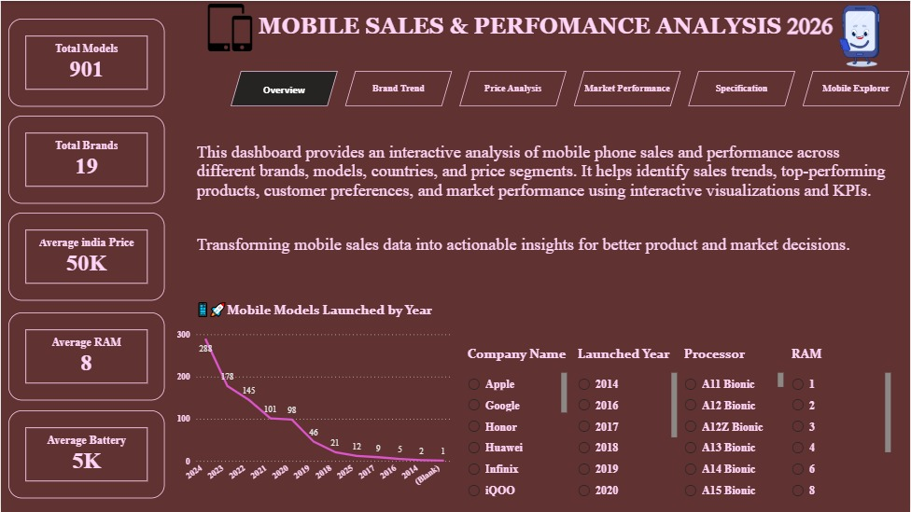
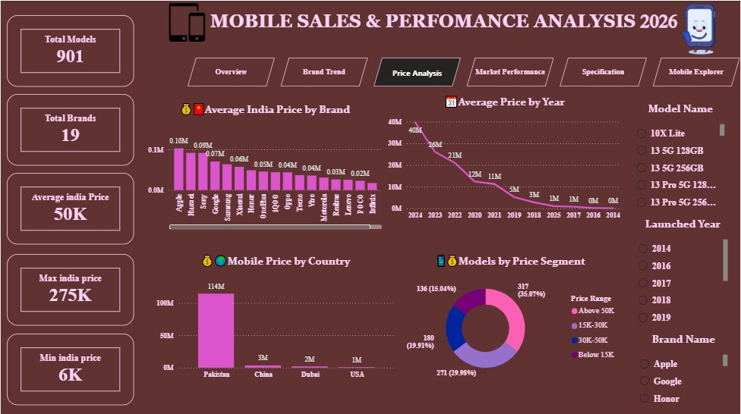
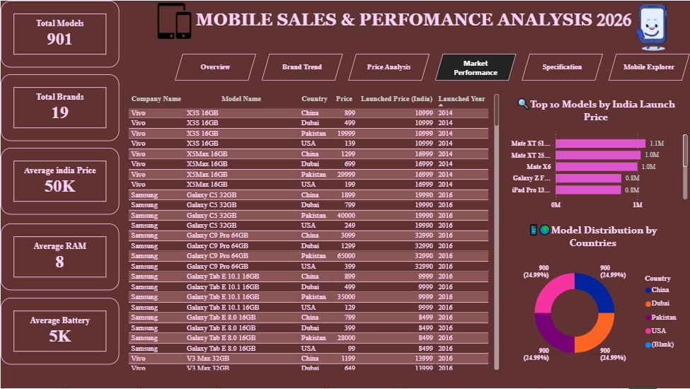
MOBILE SALES &
PERFORMANCE ANALYSIS
Interactive Power BI Dashboard • 2026
A business intelligence project for exploring mobile brands, launch trends,
pricing, market distribution and device specifications.
PROJECT PRESENTATION
Prepared by: Mohamed Baisel S
Tools: Power BI • Power Query • DAX • Excel
01

Slide 2
Executive Summary
What the dashboard covers and what a viewer can learn
Mobile models
Brands
Avg. India price
Avg. RAM
Avg. battery
901
19
₹50K
8 GB
5K
Models represented in the dashboard
Brand-level coverage
Dashboard KPI
Typical memory level shown
Dashboard KPI / capacity scale
Business questions addressed
• How are mobile models distributed across brands and launch years?
• How does India launch pricing vary by brand, year and price segment?
• Which countries appear in the product dataset and how do price totals differ?
• How are RAM, screen size, processor, battery and camera specifications distributed?
• How can a user drill into a specific model and inspect its detailed specifications?
Mobile Sales & Performance Analysis • Power BI Project
02

Slide 3
Dashboard Structure
Six analytical pages connected through navigation and interactive filters
Overview
Brand Trend
Price Analysis
High-level KPIs
Launch trend
Model launch by year
Brand model counts
Launch trend by year
Brand filtering
Average India price
Price by year
Price segments
Market Performance
Specification
Mobile Explorer
Launch-price table
Country distribution
Top models
RAM & screen size
Processor
Camera & battery
Model-level filters
Selected specifications
Detail table
Interaction design
Slicers + drill/filter interactions + page navigation + model-level exploration
Mobile Sales & Performance Analysis • Power BI Project
03

Slide 4
1. Overview Page
Executive view for quickly understanding the dataset and launch activity
What to present
• The dashboard begins with five KPI cards: model count, brand count, average India price, RAM and battery.
• The launch-year visual shows how the number of models varies by year.
• Brand, launch year and processor filters allow the overview to be narrowed to a specific slice.
• The page is designed as the starting point before moving into brand, price, market or specification analysis.
Models
Brands
901
19
Mobile Sales & Performance Analysis • Power BI Project
04

Slide 5
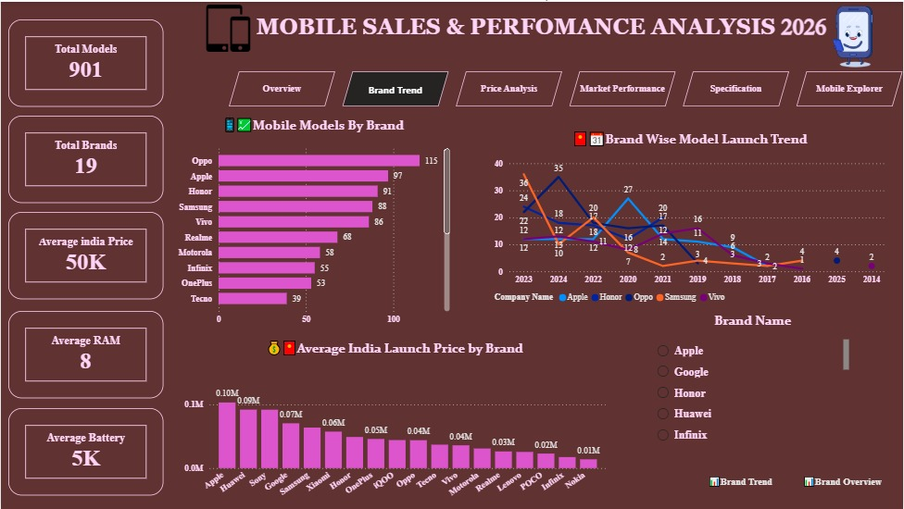
2. Brand Trend Analysis
Brand portfolio size and model-launch patterns across years
Visible dashboard observations
• Oppo has the largest model count visible in the brand ranking, followed by Apple, Honor, Samsung and Vivo.
• The line chart compares launch activity for multiple brands across the available years.
• The combination of a bar chart and time trend separates portfolio breadth from launch timing.
• Brand filtering can be used to move from the overall market view to an individual company.
Oppo models
Apple models
115
97
Mobile Sales & Performance Analysis • Power BI Project
05

Slide 6
3. Price Analysis
Understanding price positioning by brand, year, country and segment
Key observations from the dashboard
• The overall KPI shows an average India price of approximately ₹50K.
• The brand comparison shows substantial differences in average India launch price across the 19 brands.
• The year trend provides a view of how aggregated launch pricing changes across years.
• The price-segment donut groups models into four ranges: Below 15K, 15K–30K, 30K–50K and Above 50K.
• Country totals are displayed separately, helping identify how the dataset's price records are distributed.
Avg. India price
Price ranges
₹50K
4
Mobile Sales & Performance Analysis • Power BI Project
06

Slide 7
4. Market Performance
Combining detailed product records, country distribution and top launch-price records
How to explain this page
• The central table exposes row-level product information: company, model, country, price, India launch price and launch year.
• The right-side ranking highlights models with the highest aggregated India launch-price values in the current view.
• The donut shows the distribution of country records across China, Dubai, Pakistan, USA and blank values.
• This page connects granular records with summary visuals, making it useful for drill-down analysis.
Important presentation note
Price totals can reflect repeated country/model records, so describe them as dataset-level aggregates rather than direct sales revenue unless a sales-volume field is available.
Mobile Sales & Performance Analysis • Power BI Project
07

Slide 8
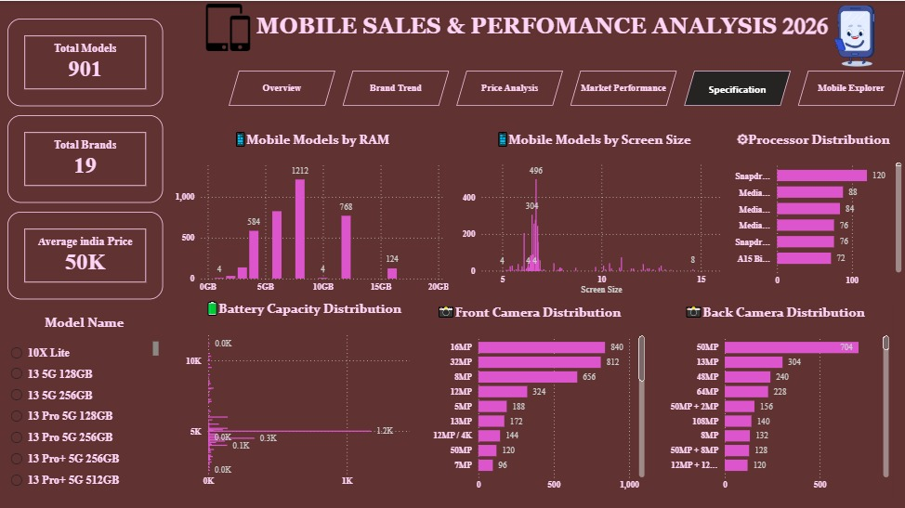
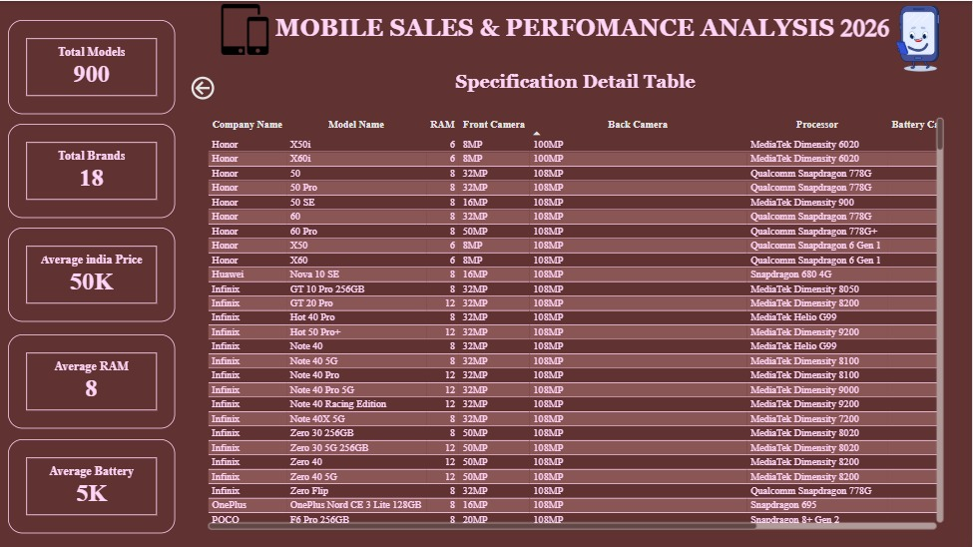
5. Specification Analysis
Comparing device hardware characteristics at portfolio level
Specification dimensions
Detail view
• RAM distribution identifies the most common memory configurations.
• Screen-size distribution shows the spread of display sizes.
• Processor distribution provides a portfolio-level view of processor families.
• Front and back camera visuals show the frequency of camera configurations.
• Battery capacity adds another hardware dimension for model comparison.
The second specification page provides a searchable model-level table with company, model, RAM, cameras, processor and battery fields.
08

Slide 9
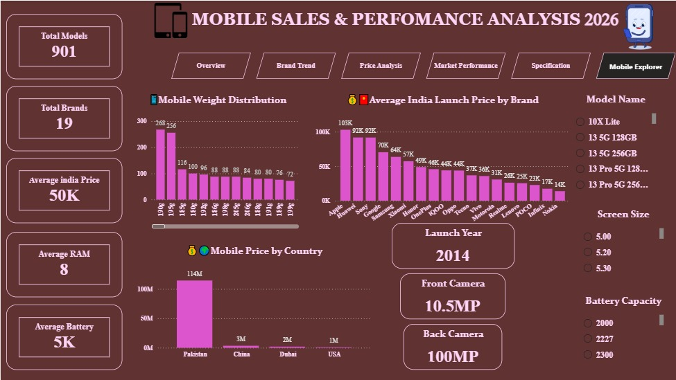
6. Mobile Explorer
Interactive model-level exploration for focused analysis
Example user journey
• Select a model from the Model Name slicer.
• Use launch year, screen size or battery capacity to narrow the selection.
• Read the selected model's launch year, front camera and back camera KPIs.
• Use the detail table to inspect the underlying product attributes.
Why this matters
It turns the dashboard from a static report into an interactive product exploration tool.
Mobile Sales & Performance Analysis • Power BI Project
09

Slide 10
Key Insights to Present
A concise story connecting the dashboard pages
Portfolio scale
Brand breadth
The dashboard covers 901 mobile models across 19 brands, enabling broad brand and product comparisons.
Oppo has the highest visible model count in the brand chart, while several other major brands form the next tier of portfolio size.
Price diversity
Launch activity
Average India launch prices vary widely by brand, showing distinct price-positioning patterns.
The launch-year trend reveals that model introductions are not evenly distributed across years.
Specification mix
Interactive analysis
RAM, screen size, processor, battery and camera configurations provide multiple dimensions for product comparison.
Slicers and model-level exploration let users move from market-level summaries to individual devices.
Mobile Sales & Performance Analysis • Power BI Project
10

Slide 11
Technical Implementation
How the Power BI solution was built
Data Preparation
Data Model
DAX
Power Query
Cleaning & shaping
Column transformations
Relationships
Dimensions & measures
Structured fields
KPIs
Average/aggregate measures
Filter-aware calculations
Visual Analytics
UX / Navigation
Drill-down
Bar & line charts
Donut charts
Tables & KPI cards
Buttons
Page navigation
Slicers & interactions
Model explorer
Detailed specification table
Focused filtering
Design principle: summarize first → compare next → drill into the individual model.
Mobile Sales & Performance Analysis • Power BI Project
11

Slide 12
Conclusion
From raw mobile product records to an interactive analytical experience
The project demonstrates how Power BI can transform a large mobile-product dataset into a structured decision-support dashboard.
• A single landing page provides the overall business context.
• Brand and launch analysis explains portfolio patterns over time.
• Price analysis provides a view of positioning, price ranges and country-level aggregates.
• Specification analysis supports hardware comparison across multiple attributes.
• Mobile Explorer enables users to move from high-level patterns to individual model details.
Models covered
Brands covered
Avg. India price
901
19
₹50K
Thank you
Mobile Sales & Performance Analysis • Power BI Project
12

