Slide 1


K.RAMAKRISHNAN COLLEGE OF TECHNOLOGY (AUTONOMOUS), TRICHY SECURE VOICE TRANSACTIONS USING MACHINE LEARNING AND IOT
PRESENTED BY,
KABILESHWARAN K (811721243022)
MELWIN AB (811721243027)
MOHAMED FAIZUL S (811721243030)
RAVIDHARSHEN MK (811721243043)
GUIDED BY,
Mrs.P.JASMINE JOSE M.E.,
ASSISTANT PROFESSOR/ AI

Slide 2
OBJECTIVE
To develop a secure and accessible voice-guided Android application for digital payments that integrates multi-layered user authentication—using voice recognition, RFID, and fingerprint verification—to ensure fraud prevention, hands-free convenience, and enhanced usability for all users, including those with disabilities.

Slide 3
EXISTING SYSTEM
Current systems rely heavily on manual input methods like PINs and touchscreens, which are time-consuming and difficult for users with visual or physical impairments.
Traditional authentication is prone to risks such as phishing, skimming, shoulder surfing, and unauthorized access due to reliance on PINs and passwords.
Most systems do not support secure, voice-enabled transactions or automated features like currency verification, limiting convenience and user experience.

Slide 4
PROPOSED SYSTEM
The system enables secure, hands-free digital transactions by integrating voice-based commands for authentication and payment processing, enhancing speed and usability.
It incorporates multi-layered authentication—voice PIN, RFID, and fingerprint verification—to ensure robust security and user-specific access.
Designed for accessibility, the application offers a fully voice-guided interface, making it ideal for users with disabilities and touch-restricted environments.

Slide 5
LITERATURE SURVEY
S. No | Title | Author Name | Year | Algorithm | Merits | Demerits
1. | Secure voice transaction system using multi-factor authentication | P. Babakhani, D. Sacker, F. Sivrikaya, and S. Albayrak | 2024 | The system uses Whisper, BERT, and voice biometrics for secure speech-based authentication and processes transactions through secure banking APIs. | Opinerium boosts engagement by prompting users to share personal opinions through subjective questions | The model excels with news but needs fine-tuning to perform well in other domains like social media or academia.
2. | Defense against ai-synthesized voice attacks | S.Rathi | 2022 | Spectrograms extract features to spot synthetic voice artifacts, while GANs with CNNs classify and detect AI-generated voices more accurately. | Effectively counters state-of-the-art voice synthesis tools through adversarial training. | Prone to a high false-positive rate with low-quality recordings.

Slide 6
LITERATURE SURVEY
S. No | Title | Author Name | Year | Algorithm | Merits | Demerits
3. | Notepal-a currency detector application for visually impaired | G. Kranthi Kumar, V. L. Durga Keerthi Pampani | 2023 | The system uses Random Forest for currency classification, OpenCV for image processing, and TTS for user-friendly audio output. | The system offers a practical currency recognition solution for visually impaired users. | System accuracy may drop due to poor lighting or low camera quality.
4. | Innovative currency identifier for the blind through audio output using deep learning | R. Maganti, J. Gutla, Y. Mallimpalli, S. Yellisetti | 2024 | The system uses CNN and ResNet, selecting ResNet for deployment due to its 90% accuracy and ability to overcome vanishing gradient issues. | The system achieves 90% accuracy using deep learning for robust currency recognition. | The system demands substantial computational resources for model training, which may not be feasible for all developers.

Slide 7
LITERATURE SURVEY
S. No | Title | Author name | Year | Algorithm | Merits | Demerits
5. | Implementation of the voice-based control and detection of the currency in atm transaction | N. Tejashwini | 2024 | The system uses Speech Recognition algorithms, like Google Speech-to-Text or DeepSpeech, to convert spoken commands. For currency detection, machine learning techniques, such as CNN or OCR, classify and identify currency notes. | The system enhances accessibility for visually impaired users, enabling hands-free ATM transactions via voice commands. | A major drawback is that background noise can reduce voice recognition accuracy, causing transaction errors.

Slide 8
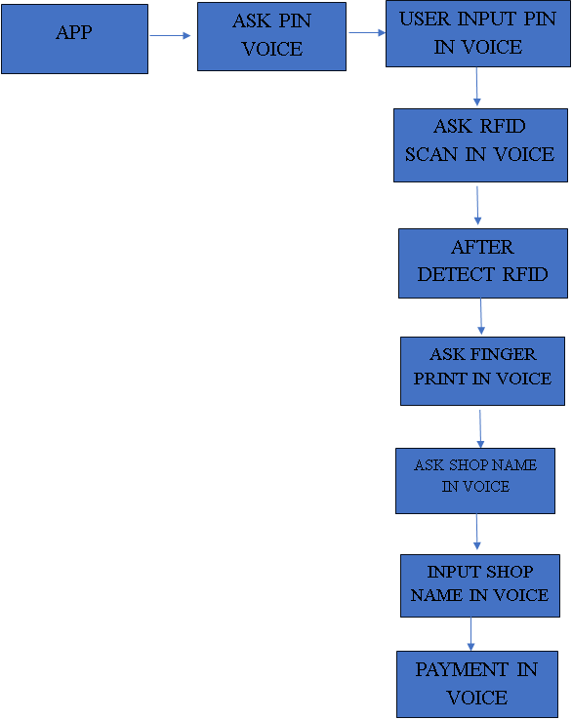
SYSTEM DESIGN

Slide 9
SYSTEM AND SOFTWARE SPECIFICATION
Hardware Requirements:
1.ESP8266-IoT
2.Power Supply
3.RFID Reader Fingerprint Module
4.Bluetooth Module
5.LCD Display Software Requirements: 1.Programming Language: JAVA,XML 2.Operating System:Windows 10/11 3.ARDUINO IDE

Slide 10
MODULES
Voice-Based PIN Verification Module
RFID Authentication Module
Fingerprint Authentication Module
Voice-Based Shop Name Input Module
Voice-Based Payment Input Module
Voice Response and Payment Confirmation Module

Slide 11
Voice-Based PIN Verification Module
The module initiates the first level of security by prompting the user to speak a predefined voice-based PIN to begin the authentication process.
It captures and authenticates the user's voice using voice biometrics to verify identity.
The system converts the spoken input into text to extract relevant commands or credentials, such as the PIN or transaction details.
It analyzes the voice command to identify transaction-specific information like payment amount or recipient.
The system verifies the transaction through additional security steps such as PIN verification, and proceeds to process the payment securely through a linked gateway.

Slide 12
Voice-Based PIN Verification Module
The user’s voice is recorded using the device’s built-in microphone and digitized into a format suitable for processing.
Key features of the speech signal are extracted using Mel-Frequency Cepstral Coefficients (MFCC), which capture important characteristics of human speech.
These features are passed into a Hidden Markov Model (HMM)-based Automatic Speech Recognition (ASR) system, which models the temporal sequence of sounds to recognize spoken words accurately.
Android’s built-in speech recognition API may also be used to convert speech into text for direct command interpretation.
The final step involves matching the recognized voice PIN with stored data and, if correct, securely forwarding the processed transaction to the payment gateway for execution.

Slide 13
RFID Authentication Module
After successful verification of the voice-based PIN, the system transitions to the second level of authentication using RFID technology.
The RFID authentication module is activated to initiate the identification process through a contactless medium.
It reads data from a user's RFID tag, which holds a unique identifier linked to their credentials.
The system cross-references this unique RFID identifier with entries stored in a secure internal database to validate the user's identity.
This additional layer of contactless verification enhances overall system security and is particularly effective in fast-paced or high-security environments.

Slide 14
RFID Authentication Module
The system connects with an external RFID reader through USB or Bluetooth, enabling hardware-level communication between the device and the RFID module.
When the user brings their RFID tag near the reader, the tag transmits its unique identifier wirelessly to the device.
The RFID reader captures this identifier and sends it to the application for processing.
The software module then queries the internal database to search for a match with the received RFID value.
If the identifier matches an authorized entry, the system confirms the user’s identity and allows access to proceed to the next stage of authentication or transaction.

Slide 15
Fingerprint Authentication Module
Acts as the third and final layer of authentication before allowing access to payment functions.
Prompts the user to scan their fingerprint using the device’s built-in biometric sensor.
Verifies the scanned fingerprint against a pre-registered biometric profile linked to the user's account.
Ensures that only the legitimate owner of the application can proceed to authorize any transactions.
Enhances overall security and privacy by combining fingerprint scanning with previous voice and RFID verifications.

Slide 16
Fingerprint Authentication Module
Upon registration, the user's fingerprint is scanned and converted into a unique set of biometric features which are securely stored in the device or app database.
During authentication, the fingerprint sensor captures a fresh image and extracts features for comparison.
These features are processed using a Support Vector Machine (SVM) algorithm, which is trained to classify fingerprint patterns accurately.
The SVM identifies the fingerprint by finding the optimal hyperplane that distinguishes the user’s fingerprint features from others.
If the match is successful, access is granted; otherwise, the transaction is blocked, ensuring a high-security threshold through fast and forgery-resistant biometric verification.

Slide 17
Voice-Based Shop Name Input Module
Initiates the transaction phase after all prior authentication steps (voice PIN, RFID, fingerprint) are successfully completed.
Prompts the user to provide the name of the shop where the payment is to be made.
Enables hands-free interaction by accepting the shop name via voice input instead of manual typing.
Reduces the chance of user input errors by allowing natural speech input.
Enhances user convenience and speed by streamlining the initial transaction detail entry process.

Slide 18
Voice-Based Shop Name Input Module
The system activates the microphone to capture the user’s spoken shop name.
Uses Android’s built-in speech recognition API to convert the voice input into corresponding text.
Processes and extracts the relevant keywords or shop name from the converted text.
Displays the interpreted shop name on the screen for the user to verify and confirm.
If the user confirms the accuracy of the text, the system proceeds to the next phase of the payment workflow.

Slide 19
Voice-Based Payment Input Module
Prompts the user to speak the payment amount after the shop name has been confirmed.
Enables a hands-free method for entering the payment value, enhancing accessibility and speed.
Converts the user's spoken amount into a numerical format suitable for transaction processing.
Validates the extracted amount to ensure it adheres to acceptable financial formats and system-defined limits.
Displays the interpreted amount back to the user for final confirmation before initiating the transaction.

Slide 20
Voice-Based Payment Input Module
Captures the voice input through the device’s microphone using speech recognition APIs.
Extracts unique features of the spoken amount such as pitch, cadence, and tone for accurate recognition.
Applies Dynamic Time Warping (DTW) to align and compare the spoken input with standard numeric patterns, correcting for variations in speech speed and accent.
Converts the matched voice pattern into numeric form, then validates it for correctness and transaction limits.
Presents the converted amount to the user for confirmation; if confirmed, the system proceeds with secure payment processing.

Slide 21
Voice Response and Payment Confirmation Module
Finalizes the transaction process by confirming the payment outcome to the user.
Uses voice-based feedback to deliver a clear status message, such as "Payment successful" or "Transaction failed.“
Reassures the user with a verbal confirmation, enhancing trust and closing the transaction loop effectively.
Can optionally include additional information such as transaction summaries or error details via voice.
Promotes user confidence and satisfaction by providing clear, immediate feedback on the transaction status.

Slide 22
Voice Response and Payment Confirmation Module
Captures and verifies all transaction details before initiating the final confirmation process.
Sends the validated data securely to the backend or integrated payment gateway using encrypted channels.
Uses Text-to-Speech (TTS) technology to convert system-generated messages into audible voice output.
Plays the voice message through the device’s speaker to notify the user of the transaction result.
Handles both successful and failed payment scenarios, ensuring the user is promptly and clearly informed in either case.

Slide 23
ADVANTAGES
Enhanced security with multi-layer authentication.
Convenient and hands-free user experience.
Prevention of fraud with biometric and voice PIN verification.
Increased accessibility for users with disabilities.
Faster transaction processing and immediate feedback.

Slide 24
APPLICATION
Enabling secure and convenient voice-activated payments on mobile devices.
Allowing users to authenticate and approve transactions using voice and biometric security.
Enabling users to make secure purchases by confirming payments with voice commands and biometric verification.
Integrating voice authentication for secure access to accounts, balance checks, and transactions.
Using voice and biometric authentication for secure access and payment approval in digital wallet apps.

Slide 25
CONCLUSION
The integration of voice-based transactions revolutionizes the way users interact with digital payment platforms, making payments more efficient and user-friendly.
By leveraging AI and voice recognition, the system significantly enhances security, reducing the risk of fraudulent activities in financial transactions.
The proposed system provides greater accessibility, enabling users with disabilities or those unfamiliar with traditional payment methods to perform transactions easily.
Overall, the project demonstrates a step forward in digital payment innovation, offering a convenient, secure, and inclusive alternative to conventional methods.

Slide 26
REFERENCES
K. Guravaiah, Y. S. Bhavadeesh, P. Shwejan, A. H. Vardhan, and S. Lavanya, “Third Eye: Object recognition and speech generation for visually impaired,” Procedia Computer Science, vol. 218, pp. 1144–1155, 2023.
S. Desai, A. Rajadhyaksha, A. Shetty, and S. Gharat, “CNN based counterfeit Indian currency recognition using generative adversarial network,” in Proc. Int. Conf. on Artificial Intelligence and Smart Systems (ICAIS), pp. 626–631, 2021.
C. Y. Gamage, J. R. M. Bogahawatte, U. K. T. Prasadika, and S. Sumathipala, “DNN based currency recognition system for visually impaired in Sinhala,” in Proc. 2nd Int. Conf. on Advancements in Computing (ICAC), pp. 422–427, 2020.

