Slide 1

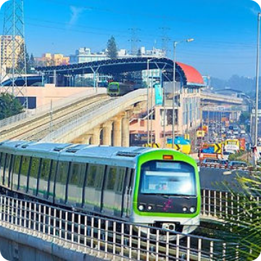
Case Study Intelligent Systems in Production
Early Warning of Air-Leak Failures in Metro Compressors
Explainable Anomaly Detection on the MetroPT-3 Dataset
TEAM MEMBERS
TARGET DATE
Group 6:
Fuad Obiedat
Abdennour Djeha
Mohamed Fares
Hady Nasser
2027-01-12

Slide 2



INDUSTRIAL CONTEXT
Problem Statement & Application
Air Production Unit (APU)
Unplanned Failures
Condition-Based Alarms
Feeds critical pneumatic subsystems including metro secondary suspension. Trains have no backup APU system.
Recurring air leaks trigger immediate vehicle removal, causing service disruption and passenger delay.
Transitioning fixed-interval schedule to explainable early-warning detection for maintenance staff.

Slide 3
DATA FOUNDATION
MetroPT-3 Dataset Breakdown
1.5M
15
4
Multivariate Sensor Readings
Analogue (7) & Digital (8) Signals
Maintenance Air-Leak Events
Timeframe: Feb–Aug 2020 • Source: UCI Machine Learning Repository (#791, CC BY 4.0)

Slide 4
LITERATURE CONTEXT
Related Work & Research Gap
Davari et al. (2021): Deep-learning anomaly detection for railway air production units.
Our Unique Contribution
Veloso et al. (2022): Initial MetroPT dataset benchmark publication (Scientific Data).
Establishing a leakage-free, chronological benchmark of simple vs. deep detectors specifically on MetroPT-3, evaluated with operational event-level KPIs (lead time, recall, false alarms) and SHAP explanations.
Jakobs et al. (2025): Interpretable rule mining focus on legacy MetroPT2 data.

Slide 5
PIPELINE
Methodology & Modeling Strategy
Phase 01
Phase 02
Phase 03
Phase 04
Data Prep
Feature Eng.
Detection
XAI & KPIs
Gap verification, fixed time window aggregation, normalization.
Duty-cycle metrics derived from motor current, COMP, and TP2/TP3 signals.
Threshold baseline vs Isolation Forest vs LSTM Autoencoder reconstruction.
SHAP feature attributions paired with event-level recall and lead time.

Slide 6
EXECUTION
Milestones & Delivery Schedule
Phase | Focus Area | Target Deadline
P1: Proposal | Team setup, GitHub repository, project scoping | 2026-10-16 (W1)
P2: Data Prep & EDA | Download, quality checks, failure-window labeling | 2026-11-06 (W4)
P3: Modeling | Feature engineering, baselines, LSTM autoencoder tuning | 2026-11-27 (W7)
P4: Evaluation & XAI | Event-level metrics, SHAP explanations, visualizations | 2026-12-18 (W10)
P5: Final Delivery | Final report, presentation, public clean code repository | 2027-01-15 (W14)

Slide 7
GOVERNANCE
Feasibility, Risks & Ethics
Compute Feasibility
Statistical Risk Mitigation
Ethics & Licensing
The 208 MB CSV dataset easily fits standard laptop hardware. No high-performance compute access barriers.
Only four labeled failures limit statistical power. We utilize chronological splits and report metric uncertainty.
Contains no personal data. Full compliance with CC BY 4.0 license guidelines and full attribution of code components.

Slide 8
METROPT-3 ANOMALY DETECTION
Questions & Discussion
Explore the repository or get in touch with our team for details on data processing and modeling.
https://github.com/mohamedfarez/IntelligentSystemsCaseStudy

