Slide 1
Early Warning of Air-Leak Failures in Metro Compressors
MDM2 CASE STUDY · INTELLIGENT SYSTEMS IN PRODUCTION
Explainable anomaly detection on the MetroPT-3 dataset · Milestone 2: literature review, data exploration and baseline
Group 6 · Fuad Obiedat · Abdennour Djeha · Mohamed Fares · Hady Nasser
TH Deggendorf · 03.11.2026
Notes:
Good morning. We are Group 6. Our case study is about early warning of air-leak failures in the compressor unit of Metro do Porto trains, using the public MetroPT-3 dataset. Today we present milestone 2: what the literature says, what we found in the data, and our first baseline.

Slide 2
One air leak takes the train out of service
THE PROBLEM
The Air Production Unit (APU) of a Metro do Porto train supplies compressed air to pneumatic consumers such as the secondary suspension.
Warn ≥ 2 hours ahead
Operator requirement for early detection
There is no redundant unit: a failure means immediate removal of the train. Maintenance today is fixed-interval.
Few false alarms
Every false alarm costs trust and staff time
Explain each alarm
Maintenance staff must see why it fired
Source: Veloso et al. (2022), Scientific Data 9:764
2
Notes:
The APU feeds systems like the secondary suspension. Because there is no backup unit, an air leak removes the train from service. The dataset paper by Veloso et al. states three operator requirements: detect failures at least two hours before the train becomes non-operational, keep false alarms low, and make alarms understandable. These three requirements drive everything in our project.

Slide 3
MetroPT-3: 1.5 million records, four failures
THE DATA
1,516,948
15
Feb–Aug
4
records, one every ~10 s
signals: 7 analogue, 8 digital
2020, one train
air leaks, from maintenance reports
# | Start | End
1 | 18 Apr 2020, 00:00 | 18 Apr, 23:59
2 | 29 May 2020, 23:30 | 30 May, 06:00
3 | 05 Jun 2020, 10:00 | 07 Jun, 14:30
4 | 15 Jul 2020, 14:30 | 15 Jul, 19:00
The data are unlabelled. Ground truth is only the list of four reported failures, so the task is unsupervised: learn normal behaviour, then flag deviations.
Source: Davari et al. (2021), MetroPT-3 Dataset, UCI · doi.org/10.24432/C5VW3R · CC BY 4.0
3
Notes:
MetroPT-3 has about 1.5 million records from 15 sensors, recorded from February to August 2020 on one train. Only four air leaks are documented by maintenance reports. Because there are no labels beyond these four events, we treat the problem as unsupervised anomaly detection: we learn what normal looks like and flag deviations.

Slide 4
Four questions, from general to specific
LITERATURE REVIEW
RQ1 · Strategy
RQ2 · Detection
RQ3 · Evaluation
RQ4 · The APU
Which PdM approach fits one non-redundant part with few failures?
Which detectors work with normal data only?
How to measure early warning and false alarms?
What has been done on this unit, and what gap remains?
29
verified sources, each checked against Crossref or arXiv and cited with a DOI or link · 20 read in full, 7 from abstracts
4
Notes:
Our review is guided by four research questions and moves from general to specific: maintenance strategies, anomaly detection in time series, evaluation, explainability, and finally the studies on this exact unit. We kept 29 sources and verified every one against Crossref or arXiv. Twenty we read in full; for seven we only had the abstract, and we say so in the report.

Slide 5
Four findings that shape our method
WHAT THE LITERATURE SAYS
Treat it as unsupervised anomaly detection
Simple detectors are often competitive
Labelling sensor streams is too costly; railway PdM is framed as time-series anomaly detection.
71 algorithms on 976 series: no clear winner, deep models “not (yet) competitive”.
Davari et al. (2021), Sensors
Schmidl et al. (2022), PVLDB
Point adjustment inflates scores
SHAP dominates explainable PdM
A random score reaches F1 0.969 with point adjustment, 0.216 without. Evaluate per event instead.
Most used in 102 PdM studies; additive attributions with a game-theory basis.
Kim et al. (2022), AAAI · Lavin & Ahmad (2015)
Cummins et al. (2024) · Lundberg & Lee (2017)
5
Notes:
Four findings shape our method. First, the railway survey by Davari et al. argues that labelling is too costly, so the task is unsupervised anomaly detection. Second, the large benchmark by Schmidl et al. tested 71 algorithms and found no clear winner; simple methods are almost as good as deep ones. Third, Kim et al. showed that point adjustment can make even a random score look excellent, so we evaluate per event. Fourth, SHAP is the most widely used explanation method in predictive maintenance.

Slide 6
Most work uses the 2022 data
STUDIES ON THIS UNIT
Study | Data | Method | Reported result
Barros (2020), MSc | APU 2020 | Peak rules, DBSCAN, AE | Best rule: 87.5 % detected, 37 % false alarms
Davari et al. (2021) | APU 2020 | Sparse AE, low-pass filter | Better than VAE (abstract)
Silva et al. (2023) | MetroPT 2022 | Adversarial AE, rules | 2 failures ≥ 2 h before LPS, no false alarm
Gama et al. (2024) | MetroPT 2022 | LSTM-AE, online rules | All train-removal failures found
Davari et al. (2024) | MetroPT-3 | LSTM-AE, SHAP | Closest work: better than sparse AE (abstract)
Jakobs et al. (2025) | MetroPT2 2022 | Conv. AE, rules | Perfect F1 on 2 failures; needs flow meter
García-Méndez (2025) | MetroPT 2022 | Supervised, streaming | F-measure above 98 %
AE = autoencoder · LPS = low-pressure signal (< 7 bar) · “abstract”: only the abstract was available
6
Notes:
Almost all studies on this unit come from one research group in Porto, and most of them use the newer 2022 data. Silva et al. use the same protocol as we do: train on the first month, test on the next two, and count a warning as early if it comes two hours before the low-pressure signal. The highlighted row is the closest prior work: Davari et al. 2024 already apply an LSTM autoencoder with SHAP to MetroPT-3. That is why we positioned our contribution differently, as the next slide shows.

Slide 7
Our contribution is the evaluation, not the model
RESEARCH GAP
G1 · MetroPT-3 is less explored
G2 · No simple baselines
Jakobs et al. (2025) recommend it as the harder dataset.
APU studies compare deep models with each other.
G3 · Inconsistent evaluation
G4 · Data quality not discussed
Cycles, windows or streams; two to four events; no common lead-time format.
Gaps and frozen logging in MetroPT-3 are not addressed.
We benchmark a threshold rule, Isolation Forest and an LSTM autoencoder under one chronological protocol, with event-level lead time and false alarms per day, on cleaned data, with open code.
7
Notes:
Since the closest work already combines an LSTM autoencoder with SHAP on MetroPT-3, we do not claim novelty for the model. We address four gaps. MetroPT-3 is less explored, and Jakobs et al. explicitly recommend it. The APU studies do not compare against simple baselines. Evaluation protocols differ from paper to paper. And data quality is not discussed. Our contribution is a fair, leakage-free benchmark of simple and deep detectors with operational metrics, on cleaned data, with reproducible code.

Slide 8
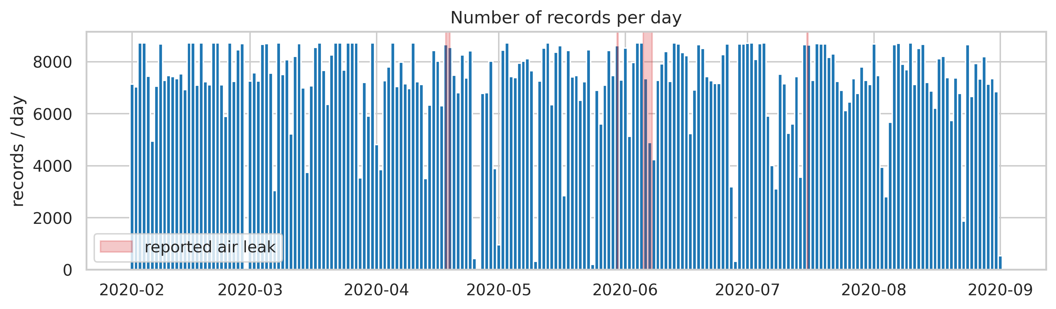
Clean on paper, gaps in practice
DATA EXPLORATION · 1 OF 4
0
missing values or duplicates
275 gaps
over 5 min: 37.8 days, 17.7 % of the period
9 frozen
segments: 7 days, 3.3 % of records
Median sampling 10 s · 29 February missing entirely · notebooks/01_EDA.ipynb
8
Notes:
At first sight the data look perfect: no missing values and no duplicates. But the record count per day shows a different picture. There are 275 gaps longer than five minutes, together almost 38 days, or 17.7 percent of the period. The 29th of February is missing completely. We also found nine frozen segments, where every sensor repeats the same value for at least 30 minutes; together about seven days.

Slide 9
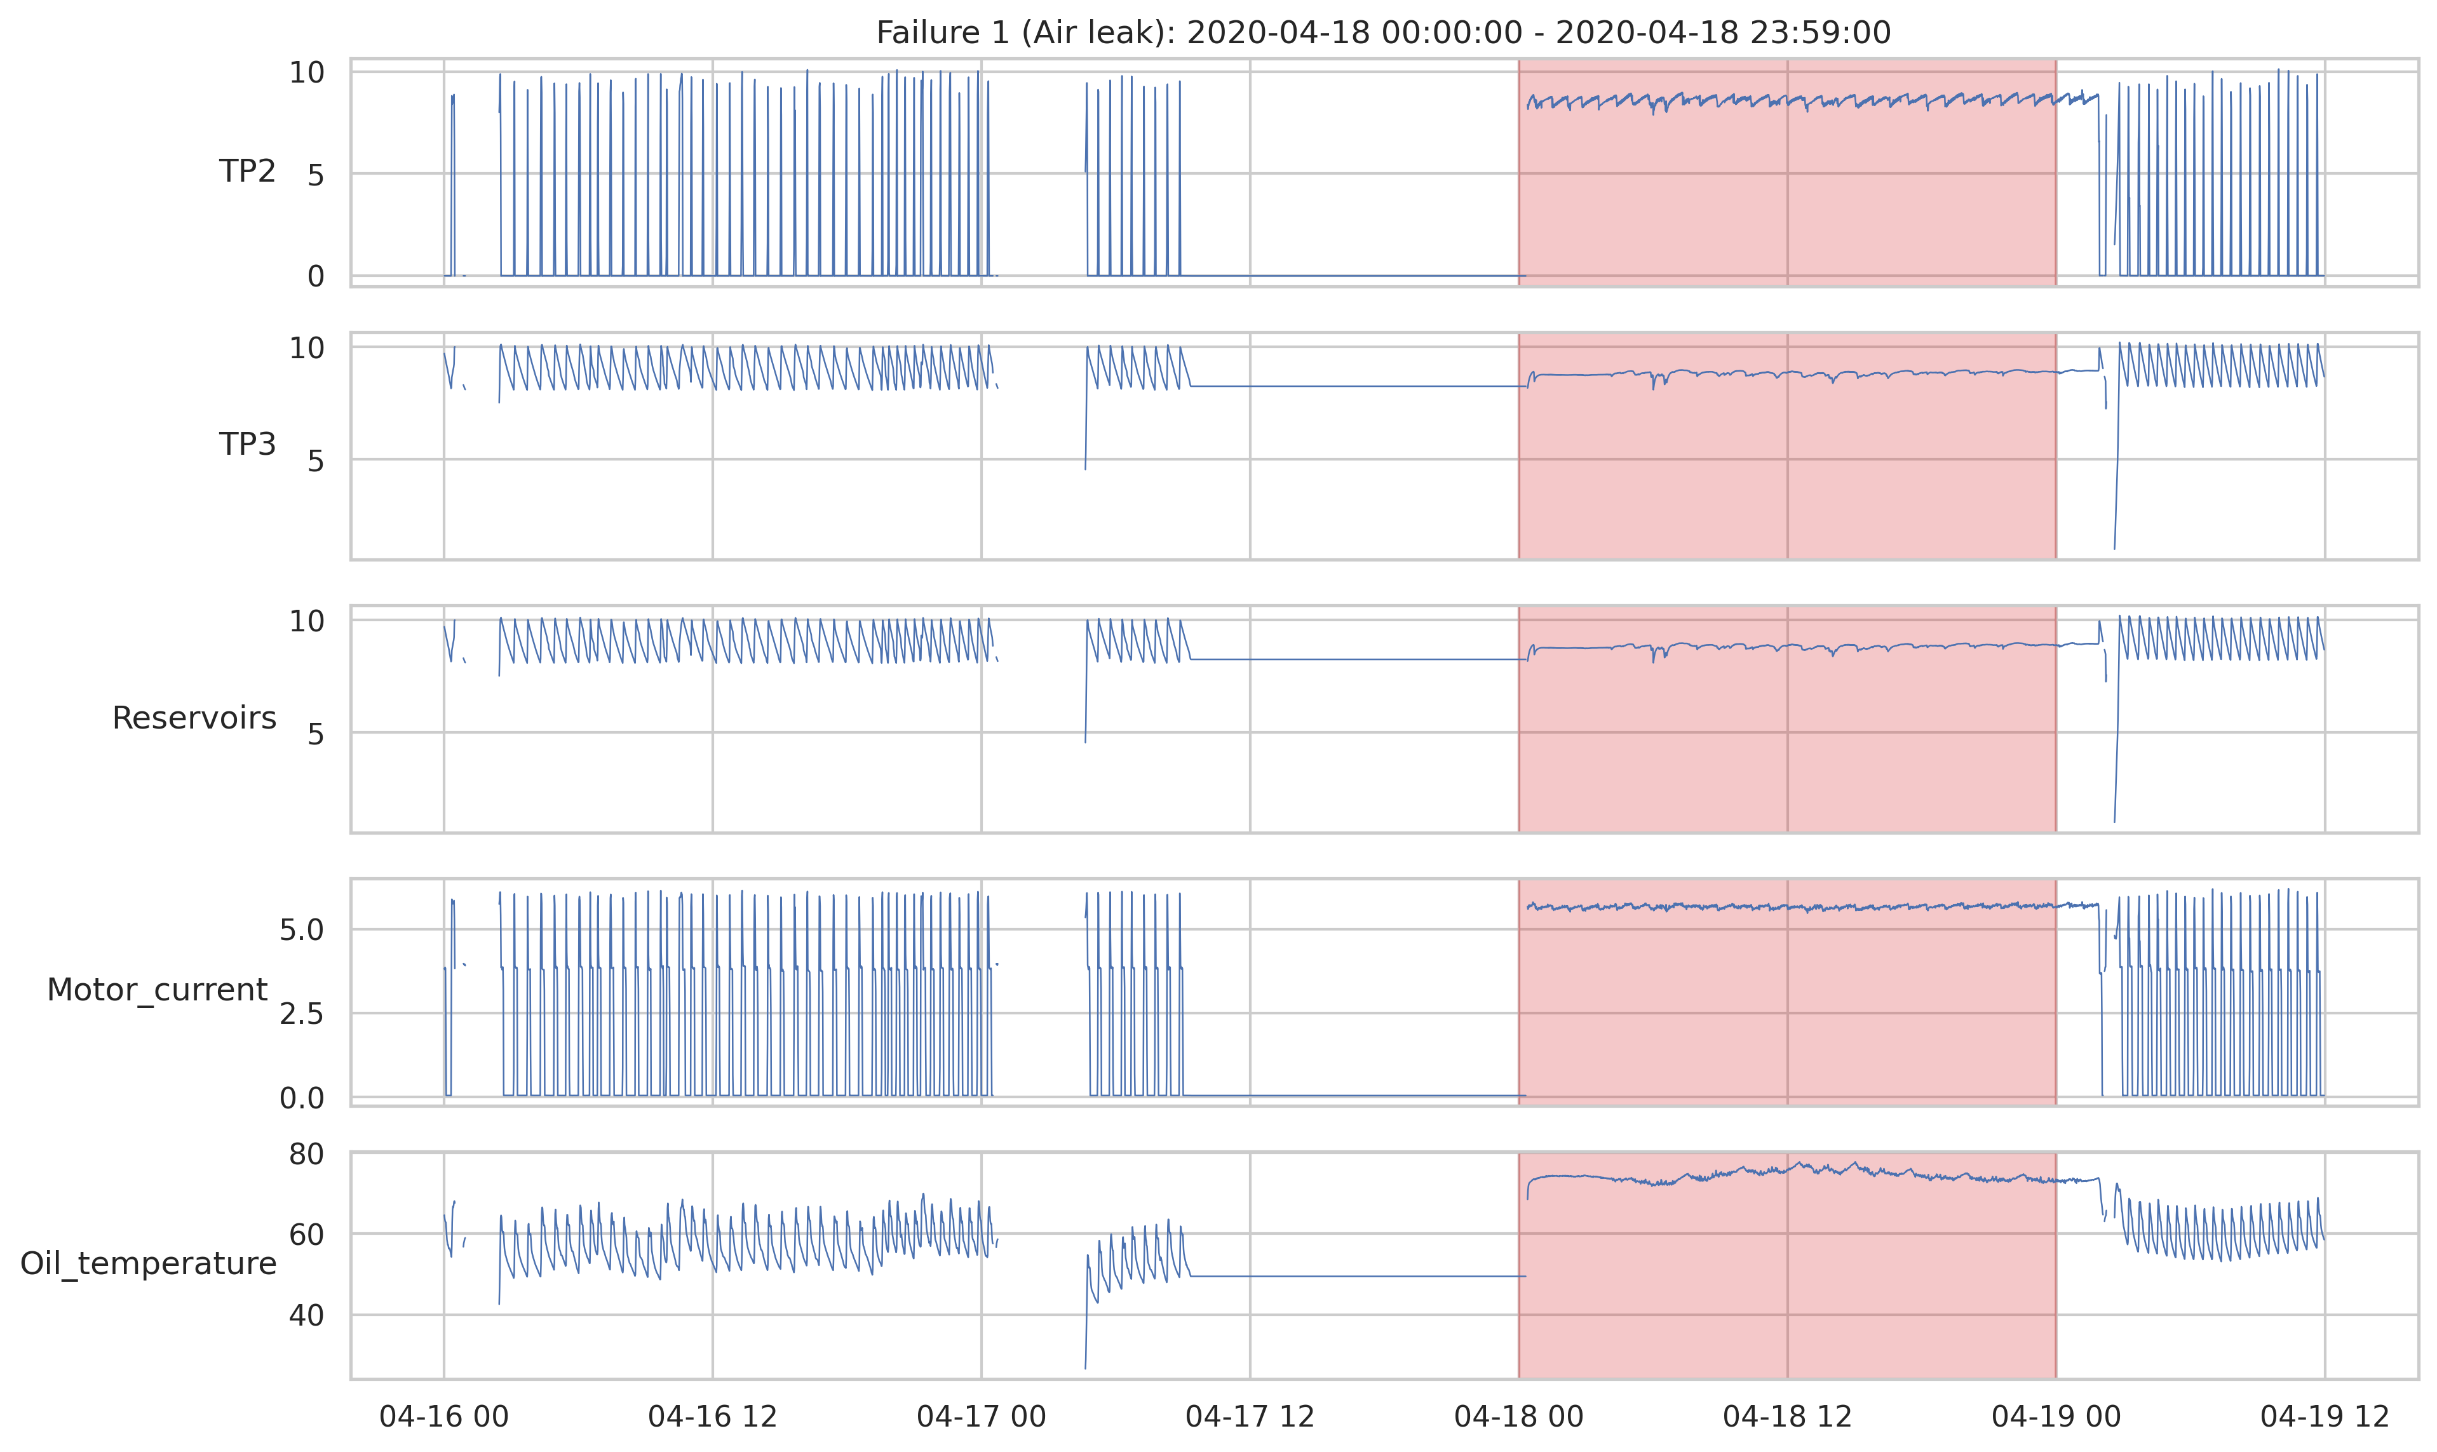
The logger froze right before failure 1
DATA EXPLORATION · 2 OF 4
From 17 Apr 09:20 to 18 Apr 00:18 all signals hold a constant value: the 15 hours before failure 1 (starts 18 Apr 00:00) carry no information.
The longest frozen segment, 22–25 June, lies between failures 3 and 4.
Why it matters: a flat line can look like normal or abnormal behaviour. We mask frozen segments before training and scoring.
Frozen = all analogue signals unchanged for ≥ 30 min · results/figures
9
Notes:
This zoom shows failure one. For about fifteen hours before the reported failure, every signal is flat. The compressor was not really standing still; the logger stopped updating. This is important because a model could learn the flat line as normal, or flag it as an anomaly for the wrong reason. The longest frozen segment is in late June. In the next stage we mask these segments.

Slide 10
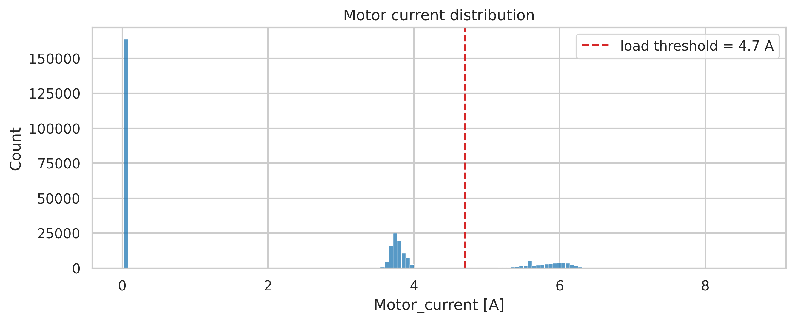
Motor current reveals three operating states
DATA EXPLORATION · 3 OF 4
State | Current
Off | ≈ 0 A
Offload | ≈ 3.8 A
Load | 5.4–6.3 A
The UCI page says about 4 A and 7 A. We use the data, not the description: load = current > 4.7 A.
Threshold set between the two upper peaks · src/config.py
10
Notes:
The histogram of motor current has three clear peaks: off near zero, offload around 3.8 ampere, and load between 5.4 and 6.3 ampere. The dataset description mentions 4 and 7 ampere, which does not match the data. So we set our own threshold at 4.7 ampere, between the two upper peaks. This gives us a reliable load flag, which we need for the next slide.

Slide 11
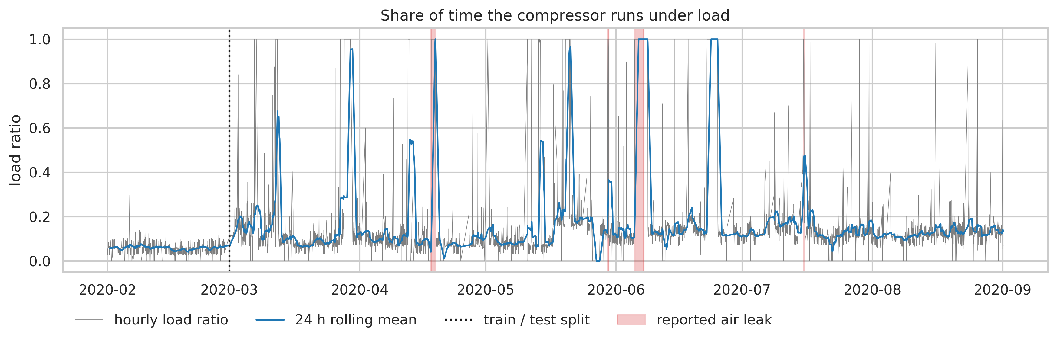
A leak shows as a compressor that never rests
DATA EXPLORATION · 4 OF 4
Share of time under load
0.145
0.161
0.975
normal
24 h before
during failure
The signal is strong during a failure but weak a day before, so early warning is hard.
February runs at a lower duty cycle and oil temperature: a shift between training and test months.
Load = motor current > 4.7 A · averages over all four failures · notebooks/01_EDA.ipynb
11
Notes:
With the load flag we can measure the duty cycle: how much of the time the compressor runs under load. Normally it is about 14.5 percent. During an air leak it jumps to 97.5 percent, because the compressor keeps running to hold pressure. But one day before the failure, it is only 16 percent, very close to normal. So the failure is easy to see once it happens, and hard to see early. We also see that February, our training month, runs cooler and with a lower duty cycle, so the model must handle a distribution shift.

Slide 12
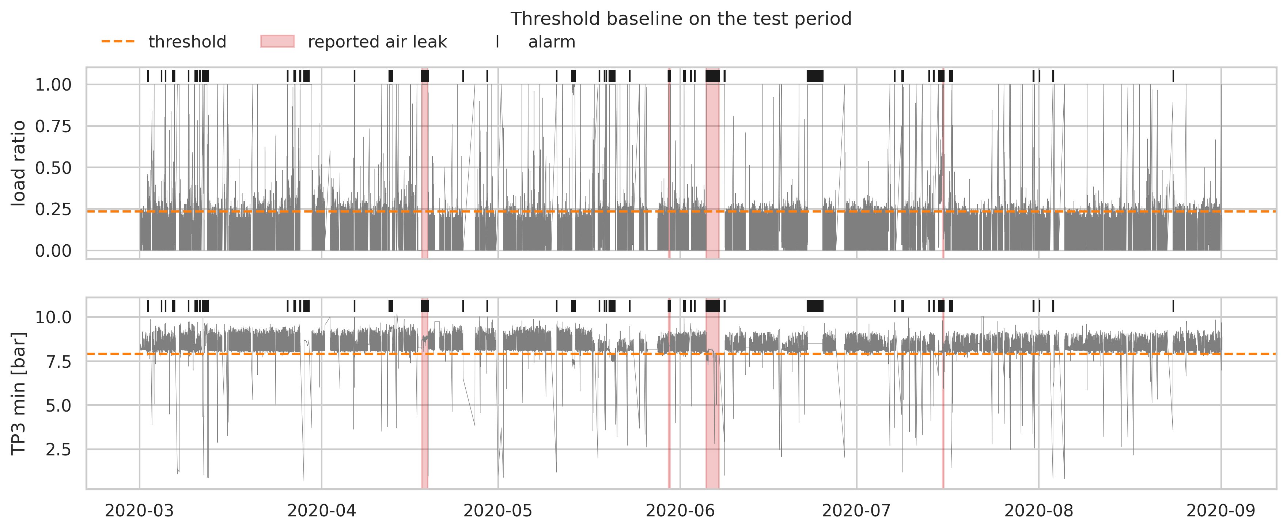
Simple rules catch every leak, but mostly late
FIRST RESULT · THRESHOLD BASELINE
4 / 4
1 / 4
failures detected
early (≥ 2 h)
45
0.48
false-alarm episodes, 0.24 / day
F1 (P 0.32, R 0.91)
Lead time: failure 4 +120 min; failures 1–3 late by 50, 20 and 20 min.
The longest false-alarm block falls inside a frozen segment.
10-min windows · ≥ 2 of 4 rules · 3 consecutive windows · 1 % / 99 % February quantiles · src/threshold_baseline.py
12
Notes:
Our first result is a simple threshold baseline. Limits come only from February, the training month. An alarm needs at least two of four rules to fire in three consecutive ten-minute windows. It detects all four failures, but only failure four early, two hours ahead. The other three are detected 20 to 50 minutes after the failure started. It produces 45 false-alarm episodes, about one every four days, and the longest one is inside a frozen segment, which confirms that data cleaning matters. This is the bar the learned models must beat.

Slide 13
From baseline to explained models
NEXT MILESTONE · 24 NOVEMBER
1
2
3
Preprocess
Isolation Forest
LSTM autoencoder
Mask frozen segments, gap-aware windows, scaling fit on February only
Fast, simple detector on window features
Learns normal sequences; reconstruction error as score
4
5
6
One alarm rule
Event-level evaluation
Explain with SHAP
Q3 + 3·IQR threshold plus low-pass filter for all models
Lead time before LPS, false alarms per day, no point adjustment
Which sensors drove each alarm
13
Notes:
For the next milestone we have six steps. First, preprocessing: we mask the frozen segments, build windows that do not cross gaps, and fit scaling on February only, to avoid leakage. Then we train an Isolation Forest and an LSTM autoencoder. All three detectors, including the baseline, use the same alarm rule, so the comparison is fair. We evaluate per event, with lead time before the low-pressure signal and false alarms per day. Finally, SHAP shows which sensors drove each alarm.

Slide 14
What we have so far
SUMMARY
29 verified sources and a clear gap: fair, event-level benchmark on MetroPT-3
Data issues found: 17.7 % gaps, 9 frozen segments, February shift
Baseline: 4/4 detected, 1/4 early, 0.24 false alarms per day
Questions?
github.com/mohamedfarez/IntelligentSystemsCaseStudy
Group 6 · TH Deggendorf
Notes:
To sum up: we reviewed and verified 29 sources and defined our contribution as a fair, event-level benchmark on MetroPT-3. The exploration showed real data issues: gaps, frozen logging and a shift in February. Our threshold baseline detects all four failures but only one early. All code and results are in our GitHub repository. Thank you, we are happy to take your questions.

