Slide 1
Early Warning of Air-Leak Failures in Metro Compressors
MDM2 CASE STUDY · INTELLIGENT SYSTEMS IN PRODUCTION
Methodology, phase 1: theoretical framework and system design
Group 6 · Fuad Obiedat · Abdennour Djeha · Mohamed Fares · Hady Nasser
TH Deggendorf · 24.11.2026
Notes:
Good morning. We are Group 6. Last time we presented the literature review, the data exploration and a first baseline. Today we present the first methodology phase: the theory behind our approach, how the system is designed, and a first prototype.

Slide 2
Milestone 2 left us with three findings
WHERE WE STAND
Contribution
Data issues
Baseline
A fair benchmark of simple and deep detectors with event-level metrics. The model itself is not new (Davari et al., 2024).
Gaps cover 17.7 % of the period, 9 frozen logging segments, and February differs from later months.
Threshold rules detect 4/4 failures but only 1 early, with 0.24 false alarms per day.
Today: the theory behind our method, the system design, and a first prototype.
2
Notes:
A short recap. Our contribution is a fair comparison, not a new model, because Davari et al. already used an LSTM autoencoder with SHAP on this dataset. The data have real quality issues. And a simple threshold baseline catches every failure, but mostly late. Today we explain the theory, the design, and our first prototype.

Slide 3
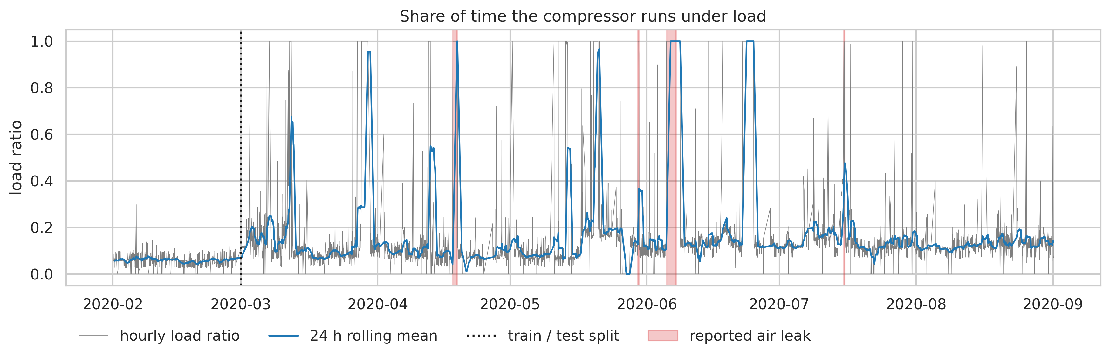
A leak makes the compressor work almost non-stop
THEORY · PHYSICAL BASIS
Below 8.2 bar the compressor runs under load to refill the reservoirs. A leak keeps the pressure low, so it runs under load far more often.
Share of time under load | Value
Normal operation | 0.145
24 h before failure | 0.161
During failure | 0.975
Strong signal during a leak, weak signal before it: we need detectors that combine several weak signs.
Load = motor current > 4.7 A · signal descriptions: UCI dataset page · notebook 01_EDA
3
Notes:
The theory starts with physics. When the pressure falls below 8.2 bar, the compressor runs under load to refill the reservoirs. A leak keeps pulling the pressure down, so the compressor almost never rests: 97.5 percent of the time during a failure, compared with 14.5 percent normally. One day before, it is only 16 percent. So one signal alone is not enough for early warning; we need detectors that combine several weak signs, such as pressures, current and temperature.

Slide 4
Learn normal from February, score every deviation
THEORY · DETECTION
Isolation
Reconstruction
Score → alarm
Random splits isolate a point. Anomalies need fewer splits: shorter path, higher score.
An LSTM autoencoder trained on normal sequences rebuilds unusual ones badly.
Threshold from training scores, then a low-pass filter against single spikes.
s = 2 ^ (−E[h(x)] / c(ψ))
e = mean ‖x − x̂‖²
τ = Q3 + 3·IQR
y = y + α(x − y) > 0.5
Liu et al. (2008)
Malhotra et al. (2016)
Silva et al. (2023) · Ribeiro et al. (2016)
No failure labels are used for training: the task is unsupervised (Davari et al., 2021).
4
Notes:
We have no labels for training, so we learn what normal looks like from February and score how far each later window deviates. We use two principles. Isolation Forest isolates points with random splits; unusual points need fewer splits. An LSTM autoencoder learns to rebuild normal sequences, so it rebuilds unusual ones badly, and the error is the score. For both, the threshold is Q3 plus three times the interquartile range of the training scores, as in Silva et al., and a low-pass filter from Ribeiro et al. removes single spikes.

Slide 5
Count failures, not time steps; explain every alarm
THEORY · EVALUATION AND EXPLANATION
Event-level evaluation
Shapley-value explanation
Point adjustment lets a random score reach F1 0.969 (0.216 without) (Kim et al., 2022).
SHAP splits a score into feature contributions: f(x) = φ₀ + Σ φⱼ (Lundberg & Lee, 2017).
We report per failure: detected, lead time to the reported start and to the first LPS signal, plus false alarms per day.
For each alarm: which signals push this window away from February. Most used method in explainable PdM (Cummins et al., 2024).
5
Notes:
Two more pieces of theory. First, evaluation. Kim et al. showed that the common point-adjustment trick lets even a random score look excellent. So we count failures: was it detected, how early compared with the reported start and with the first low-pressure signal, and how many false alarms per day. Second, explanation. SHAP splits an anomaly score into contributions of each feature, so for every alarm we can show which signals made the window look different from February.

Slide 6
A controlled benchmark: the detector is the only thing that changes
RESEARCH APPROACH
Threshold rule
Isolation Forest
LSTM autoencoder
Physics in four rules. Fully transparent lower bound.
Simple, fast multivariate detector.
Deep sequence model used in the APU literature.
Same data · same preprocessing · same alarm logic · same evaluation code.
Plus an ablation: the learned detectors again, without removing frozen segments.
6
Notes:
Our methodology is a controlled experiment. Three detectors of increasing complexity get exactly the same data, the same preprocessing, the same alarm logic and the same evaluation code. So if one is better, it is because of the detector, not because of a different setup. We add one ablation: we run the learned detectors again without removing the frozen segments, to measure how much our data cleaning matters.

Slide 7

Eight steps, most of them shared
METHODOLOGY · WORKFLOW
1
2
3
4
Load data
Remove frozen segments
10-min windows, gap-aware
Split in time, scale on Feb
5
6
7
8
Fit detector on February
Score each window
Threshold + low-pass filter
Event-level evaluation + SHAP
Blue = shared by all detectors · Orange = the only detector-specific steps. No test data is used before step 8.
7
Notes:
Here is the workflow. Steps one to four prepare the data once for everyone: load, remove frozen segments, build ten-minute windows that respect recording gaps, split in time and scale with February statistics only. Steps five and six are the only detector-specific parts. Steps seven and eight are again shared: the same threshold and filter, the same evaluation, and SHAP for the explanation. The test data is only touched at the end.

Slide 8
36 features in, score, alarm and reason out
METHODOLOGY · DATA AND INPUTS
Inputs per window
Outputs
Split
28 · mean, std, min, max of 7 analogue signals
Per window: anomaly score, alarm, top contributing features
Train: February 2020
Test: March–August, all 4 failures
7 · active share of digital signals
Per failure: detected, lead time
Same protocol as Silva et al. (2023)
1 · share of time under load
LPS is not an input. The low-pressure switch is already a symptom of the failure and is our reference for “early”. Using it as a feature would make the evaluation circular.
Source: MetroPT-3, UCI · doi.org/10.24432/C5VW3R · downloaded by script, never stored in the repository
8
Notes:
Each ten-minute window becomes 36 features: four statistics for each of the seven analogue signals, the active share of seven digital signals, and the share of time under load. The output is a score, an alarm and the features that explain it; per failure we report detection and lead time. We train on February and test on March to August, the same protocol as Silva et al. One important decision: the low-pressure switch is not an input, because it is already a symptom and it is our reference point for early warning.

Slide 9
Why these methods
METHODOLOGY · ALGORITHM CHOICE
Method | Reason for selection
Threshold rule | Encodes the leak physics directly; fully interpretable; the bar to beat
Isolation Forest | Needs only normal data, linear time, few parameters; simple methods are often competitive (Schmidl et al., 2022)
LSTM autoencoder | Captures time patterns; the standard detector for this unit, incl. MetroPT-3 (Davari et al., 2024)
Q3 + 3·IQR + filter | Uses training scores only; same rule for both learned detectors (Silva et al., 2023)
Kernel SHAP | Model-agnostic, so one explanation method for both detectors
Not chosen: supervised classifiers (only 4 failures) · adversarial autoencoders (best in Silva et al., but harder to train; not needed for a fair simple-vs-deep comparison).
9
Notes:
Why these methods? The threshold rule is physics in code and sets the bar. Isolation Forest needs only normal data, is fast, and the large benchmark by Schmidl et al. shows simple methods are often competitive. The LSTM autoencoder is the standard in the literature for this unit, which makes our results comparable. One shared threshold rule keeps the comparison fair, and Kernel SHAP works for any model. We did not choose supervised classifiers, because we have only four failures, and we did not choose adversarial models, because they are harder to train and not needed for our question.

Slide 10
Five layers, data flows one way
SYSTEM ARCHITECTURE
Data
UCI download · loading · quality checks
data_loading.py
Preprocessing
frozen mask · windows · split · scaler
preprocessing.py
Detectors
fit(train) · score(X)
detectors.py · threshold_baseline.py
Alarm logic
fit(train scores) · predict(scores)
alarm_logic.py
Evaluation · explanation
alarms → per-failure KPIs · SHAP
evaluation.py · explain.py (phase 2)
Each layer only sees the output of the layer above, so test data cannot leak into training, and every detector is judged by the same code.
10
Notes:
The system has five layers, each a small Python module. Data loading, preprocessing, detectors, alarm logic, and evaluation with explanation. Every detector has the same two methods, fit and score, so we can swap the Isolation Forest for the LSTM autoencoder without touching anything else. Data flows in one direction only, which makes leakage from the test period structurally impossible and guarantees that all detectors are evaluated by the same code.

Slide 11
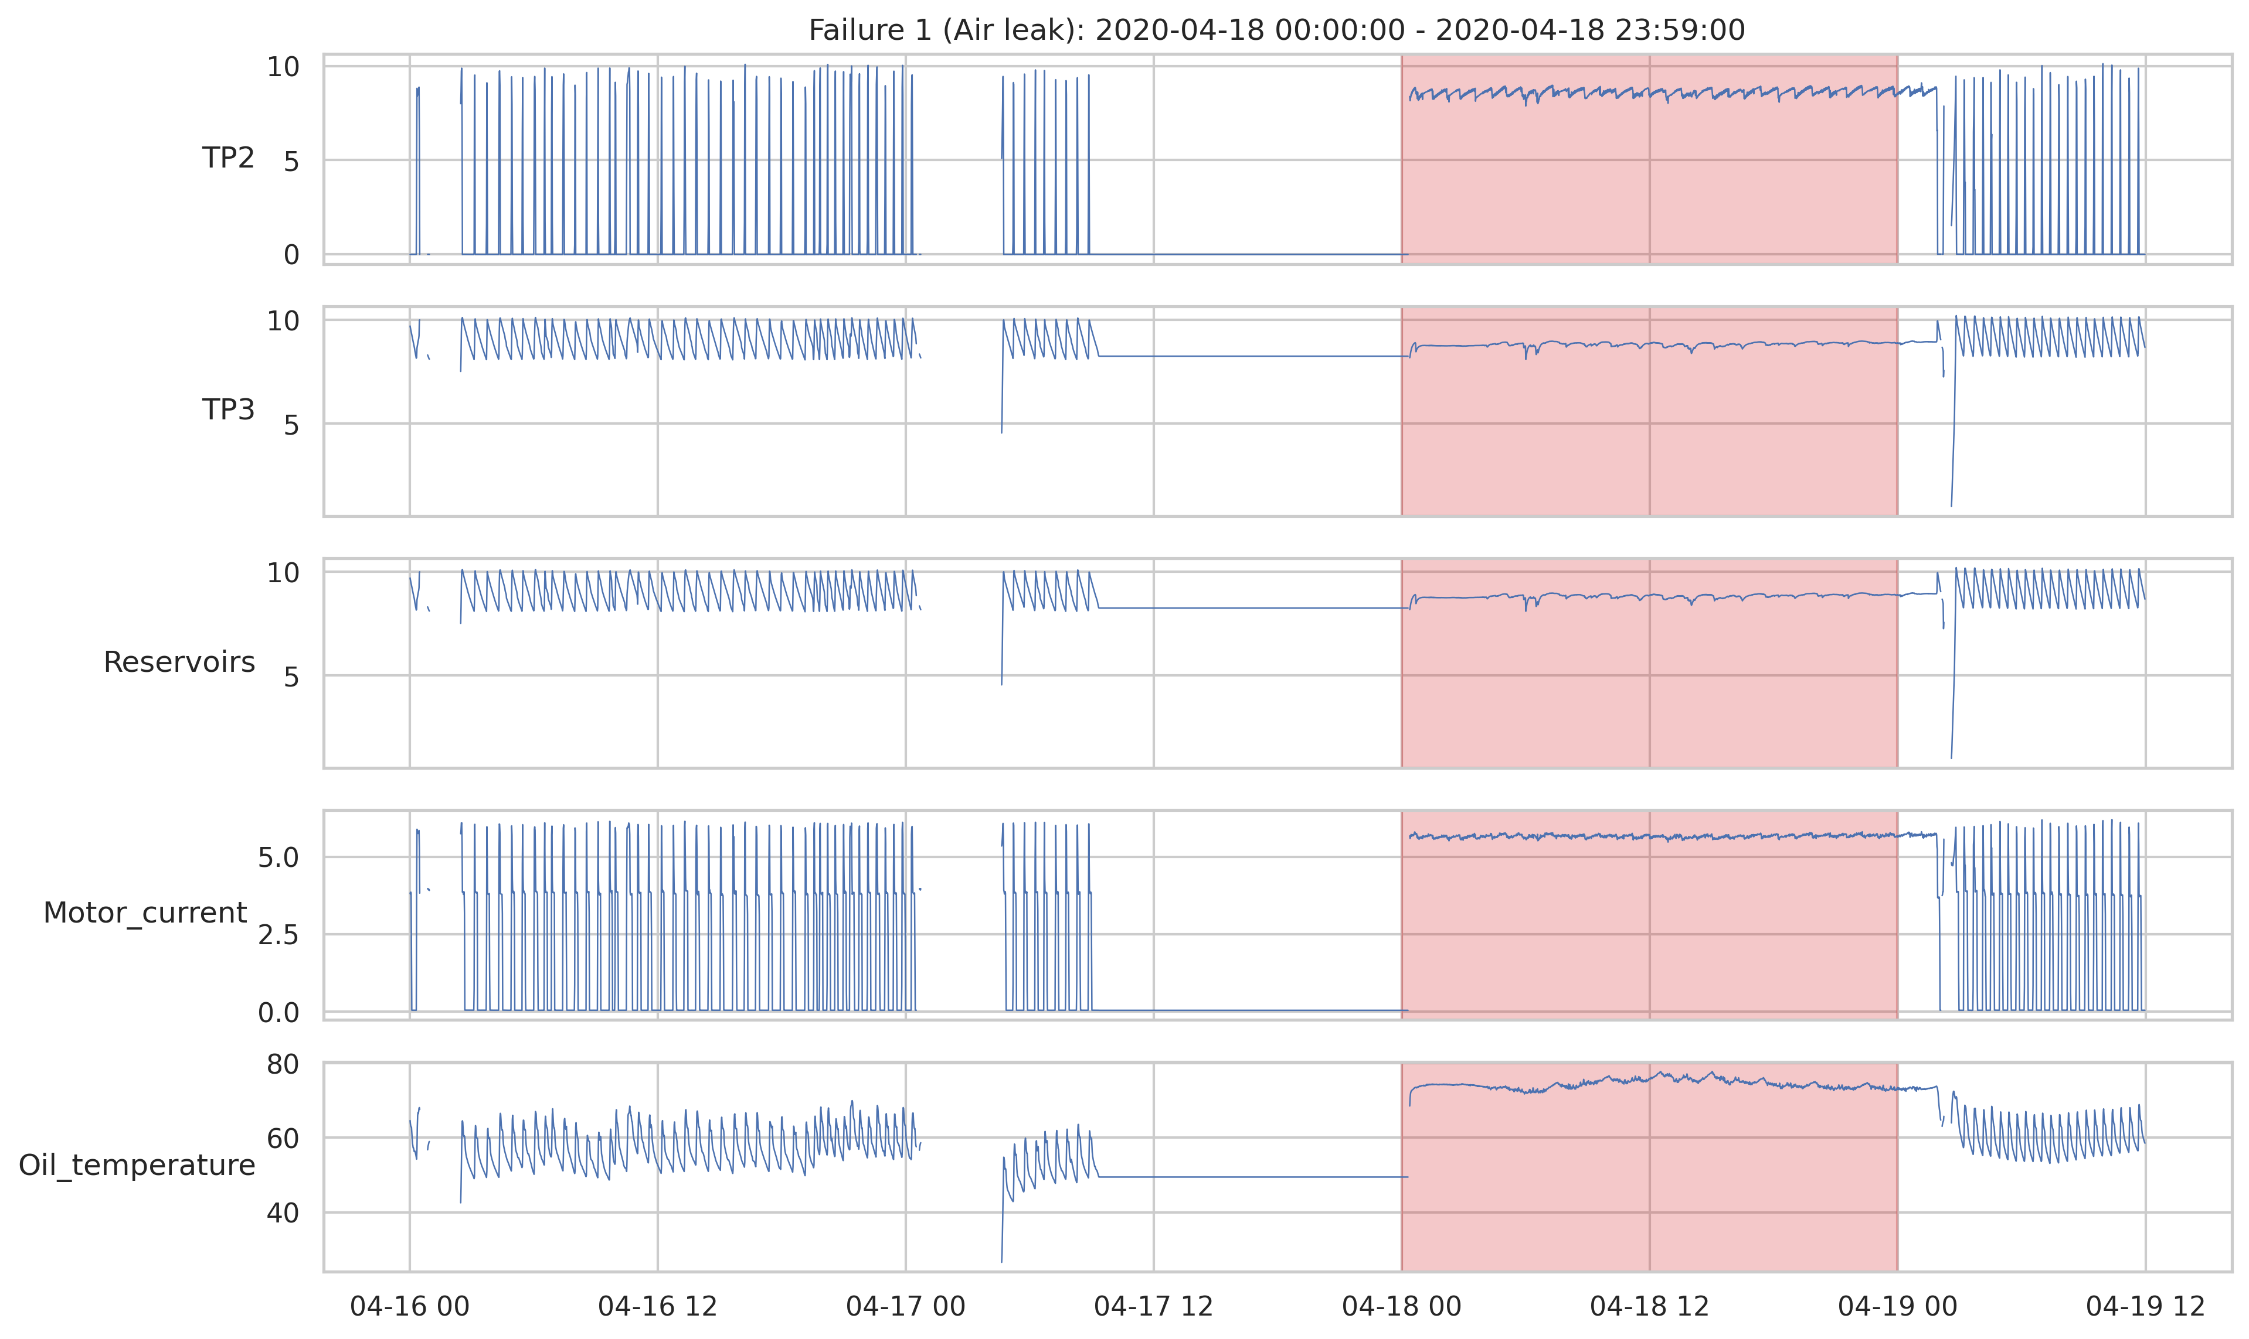
Pipeline and Isolation Forest are running
FIRST PROTOTYPE
Implemented: preprocessing, Isolation Forest (200 trees, sub-sample 256, seed 42), shared alarm logic and evaluation. Nothing tuned on the test period.
Verified: baseline results unchanged after refactoring; all simulated leaks found on a synthetic copy of the data.
Synthetic check: an unmasked frozen segment created a fake 120-min “early warning”. Cleaning is part of the method.
notebooks/02_preprocessing_iforest.ipynb · figure: frozen segment before failure 1 (real data)
11
Notes:
We already have a working prototype: the preprocessing pipeline, the Isolation Forest, the shared alarm logic and the shared evaluation. We checked it in two ways. The old baseline gives exactly the same numbers after we moved the evaluation into a shared module. And on a synthetic copy of the data with simulated leaks, every leak was found. The most interesting check: on the synthetic data, an unmasked frozen segment before the first leak looked like a two-hour early warning. It was the logger, not the machine. The real data has exactly this kind of segment before failure one, shown on the left, so data cleaning is part of our method.

Slide 12
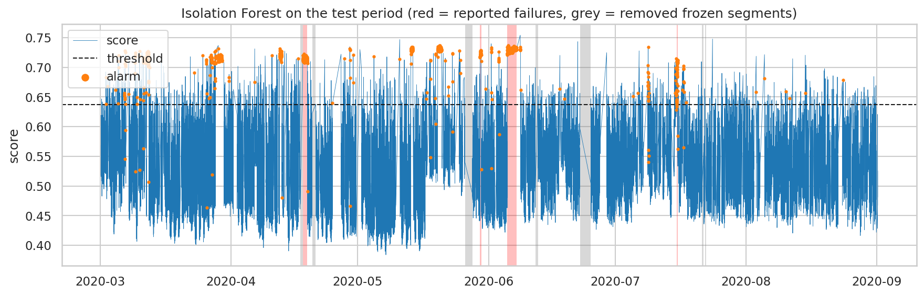
Isolation Forest reacts faster, but alarms twice as often
FIRST RESULTS ON METROPT-3
4 / 4
1 early
−20 → −5
0.25 → 0.52
detected, both models
failure 4, +120 min, both
median lead time, min
false alarms per day
Threshold rule → Isolation Forest · test Mar–Aug 2020 · horizon 2 h · window F1 0.48 → 0.58 · notebooks/02
12
Notes:
These are our first real results. Both the threshold rule and the Isolation Forest detect all four failures, and both warn two hours early only for failure four. The Isolation Forest reacts faster: the median delay drops from twenty to five minutes. But it raises about twice as many false alarms, one every two days instead of one every four days. Interestingly, the window-level F1 goes up from 0.48 to 0.58, so if we only looked at that number we would call the Isolation Forest clearly better. The event-level view shows the real cost for the maintenance team.

Slide 13
Three findings that shape phase 2
WHAT THE PROTOTYPE TAUGHT US
February shift
LPS is often silent
Cleaning pays off
Minimum compressor pressure sits 67 February std away in the test months. Most false alarms come from this shift.
No LPS activation near failures 1 and 2; at failure 3 only 34 h after the start. “2 h before LPS” alone would miss half the events.
Removing frozen segments raises window precision from 0.29 to 0.42; lead times stay the same.
Any fix will be justified from the training data, never chosen by looking at the test failures.
13
Notes:
The prototype taught us three things. First, the February shift is real and large: the minimum compressor pressure in the test months is 67 February standard deviations away, because in February the compressor stopped in almost every window. This explains most false alarms. Second, the low-pressure switch did not fire at all near failures one and two, and only 34 hours late at failure three. So the criterion of two hours before LPS alone cannot evaluate half of the events, which is why we report both reference points. Third, removing frozen segments raises precision from 0.29 to 0.42 without changing lead times. In phase two, any fix will be justified from the training data, never chosen by looking at the test failures.

Slide 14
What we assume, and what could go wrong
ASSUMPTIONS AND CHALLENGES
Assumptions
Challenges
February is normal. No reported failure in the training month.
Four failures: one failure = 25 points of recall, so we report per failure.
Reports are the ground truth. Start times are reported, not physical onset; one date differs between sources.
February shift: cooler, less load than summer; risk of false alarms.
Frozen data is a logger error, not machine behaviour.
Parameter choice: fixed in advance; sensitivity tested in phase 2, never tuned on test failures.
14
Notes:
Our main assumptions: February is normal, the maintenance reports are the ground truth, and frozen data is a logger error. Note that the reported start is not necessarily when the leak physically started, and the fourth failure even has two different dates in two sources. The main challenges: with four failures each one changes recall by 25 points, so we report every failure separately. February is cooler and less loaded than summer, which can create false alarms. And our parameters are fixed in advance; in phase two we test their sensitivity, but we never tune them on the test failures.

Slide 15
From design to full experiments
NEXT: METHODOLOGY PHASE 2
LSTM autoencoder: implement and train on February
SHAP module: explain every alarm
Experiments: detector comparison, frozen-segment ablation, parameter sensitivity
Questions?
github.com/mohamedfarez/IntelligentSystemsCaseStudy
Group 6 · TH Deggendorf
Notes:
In the second phase we implement the LSTM autoencoder and the SHAP module, and we run the full experiments: the three detectors against each other, the frozen-segment ablation, and the sensitivity of the main parameters. All code is in our repository. Thank you, we are happy to take your questions.

