Slide 1
Banking Network
System

Slide 2
Network Design
Use hierarchical Network Design With Redundancy included :
Having core
Distribution Layers
Access Layers

Slide 3
We have 4 floors ,each of them has 3 department
First Floor (Management , Research , Human Resources )
Second Floor (Marketing , Accounts , Finance )
Third Floor (Logistics , Customer , Guest )
Fourth Floor (Admin, ICT ,ServerRoom)

Slide 4
Each Department is in different VLAN
VLANs including 10,20,30….etc
Each VLAN has different subnetwork
Access and trunk ports

Slide 5
Configure the basic configuration of the devices:
Hostnames
Line Console and VTY passwords
Banner message
Disable domain IP lookup

Slide 6
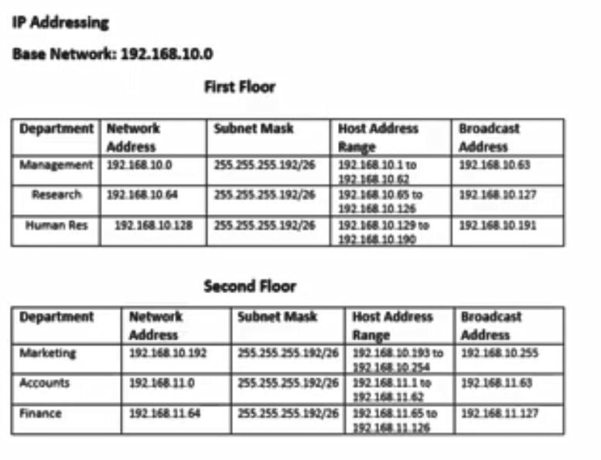
Planning of IP Addresses:

Slide 7
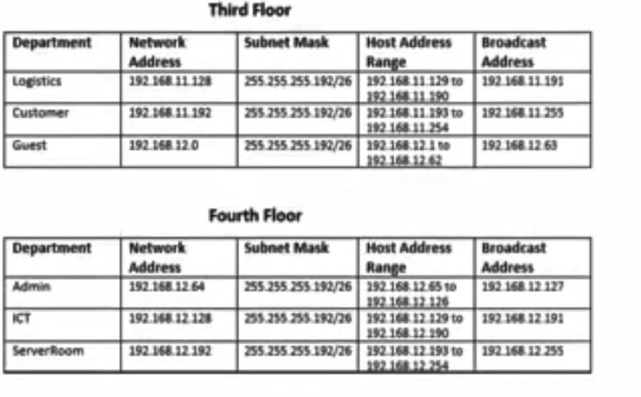

Slide 8
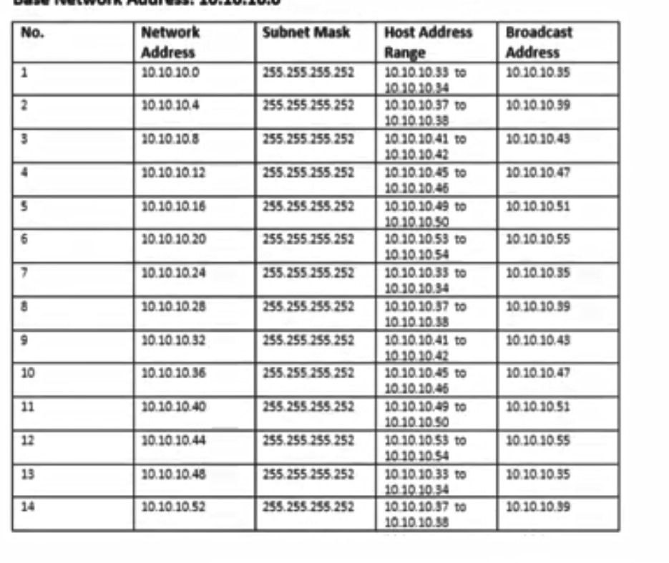

Slide 9
Configure Port-Security
Use Sticky command to obtain MAC address
Violation mode of the shutdown

Slide 10
Steps
Use OSPF as routing protocol on routers and L3 switches to advertise routes
Each department have wireless network for users
Static IP address to ServerRoom devices
DHCP server devices configuration and ip helper addresses because all devices take IP address dynamically
Inter-Vlan routing to allow all devices in all departments to communicate with each other
Test configuration

