Slide 1

1D Barcode Detection Project
Techniques and methods for automated barcode scanning
Notes:
AI-generated content may be incorrect. --- Image source: Microsoft 365 content library

Slide 2
Introduction
Notes:
Overview and Objectives

Slide 3
Executive Summary
Notes:
Project Overview

Slide 4

Project Overview
Image Processing Techniques
The system uses grayscale conversion, edge detection, thresholding, and morphological operations to isolate barcode regions effectively.
Contour Extraction and Validation
Contours are extracted and validated to accurately identify candidate barcode regions within the image.
Non-Maximum Suppression
NMS is applied to remove redundant barcode detections, ensuring precise identification of multiple barcodes.
Robustness and Applications
The system handles noise, partial overlaps, and orientations, making it practical for retail and logistics use cases.
Notes:
--- The executive summary provides a concise description of the pipeline designed to detect multiple 1D barcodes in a single image. It explains that the system uses OpenCV for image processing and contour analysis, combining grayscale conversion, gradient-based edge detection, thresholding, and morphological operations to isolate barcode regions. Contour extraction and validation ensure accurate candidate identification, while Non-Maximum Suppression (NMS) removes redundant detections. The system is robust against noise, partial overlaps, and varying orientations, making it suitable for practical applications in retail and logistics. Image source: Microsoft 365 content library

Slide 5
Background & Objectives
Notes:
Importance and Goals

Slide 6
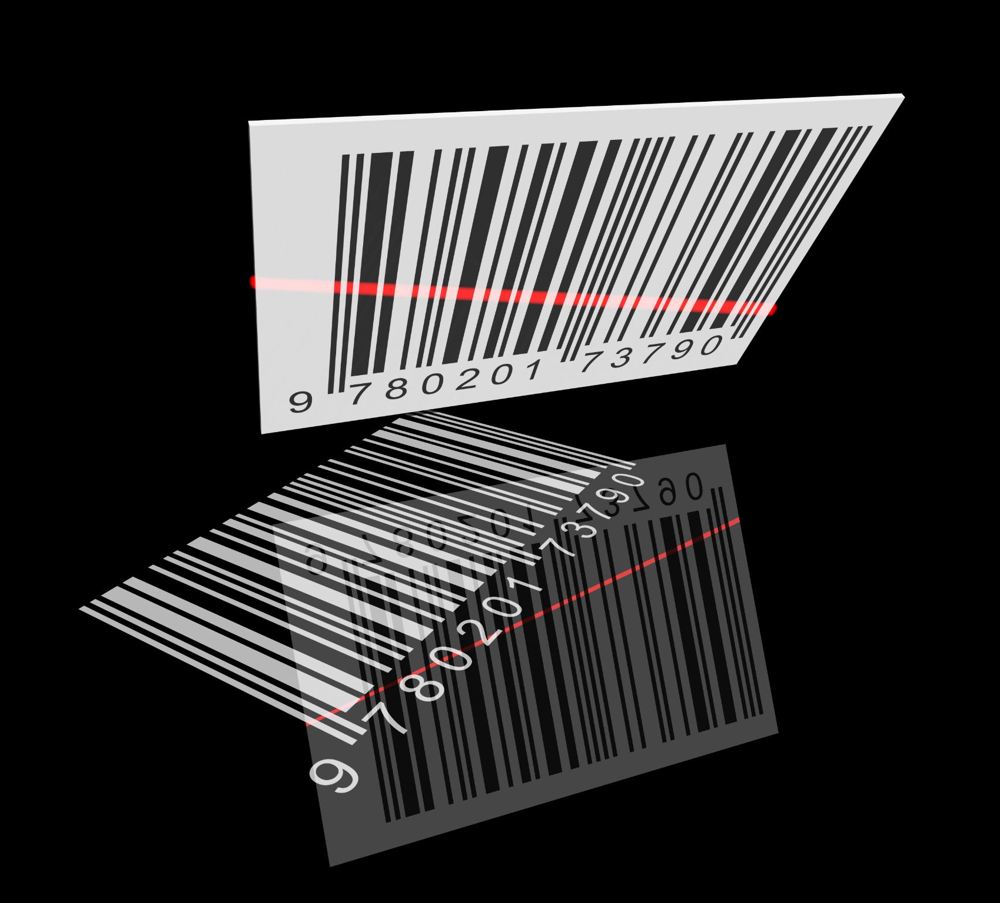
Importance and Goals
Critical Role of Barcode Detection
Barcode detection is essential for efficient inventory management and automation processes in various industries.
Comprehensive Detection Goals
Goals include detecting multiple barcodes, handling merged or stacked barcodes, filtering noise, and providing visual verification.
Use of Classical Computer Vision
The system relies on classical computer vision techniques to ensure transparency, reproducibility, and adaptability.
Notes:
--- This section explains why barcode detection is critical for inventory management and automation. It outlines the project goals: detect multiple barcodes in a single image, handle merged or stacked barcodes, filter out noise, and provide visual verification through bounding boxes. The emphasis is on creating a transparent and reproducible system using classical computer vision methods rather than machine learning, ensuring adaptability across different datasets and scenarios. Image source: Microsoft 365 content library

Slide 7
System Overview
Notes:
Inputs and Dependencies

Slide 8

Inputs and Dependencies
Barcode Format Support
The system supports multiple barcode formats including EAN-13, UPC, and Code 128 for versatile image processing.
Core Software Libraries
OpenCV and NumPy are essential dependencies used for image processing and numerical operations in the system.
Execution Environment
The system uses Google Colab for running and visualizing the barcode processing pipeline efficiently.
Modular Pipeline Design
The pipeline is modular, enabling easy adjustments for various barcode densities and image resolutions.
Notes:
--- The system processes images containing multiple barcodes, supporting formats such as EAN-13, UPC, and Code 128. It relies on OpenCV for image processing, NumPy for numerical operations, and Google Colab for execution and visualization. The overview also mentions that the pipeline is modular, allowing easy adjustments for different barcode densities and image resolutions. Image source: Microsoft 365 content library

Slide 9
Pipeline Architecture
Notes:
Stages of Processing

Slide 10

Stages of Processing
Image Loading and Preprocessing
Initial stage involves loading images followed by grayscale conversion and Gaussian blur to reduce noise.
Gradient Computation and Thresholding
Sobel operators compute image gradients, followed by Otsu's thresholding to segment barcode regions.
Morphological Operations and Contour Extraction
Noise is removed using morphological operations, then contours are extracted for potential barcode candidates.
Candidate Validation and Detection Refinement
Valid candidates undergo large contour splitting and non-maximum suppression to finalize barcode detection.
Notes:
--- The pipeline consists of several stages: Image Loading, Grayscale Conversion and Gaussian Blur, Gradient Computation using Sobel operators, Thresholding with Otsu's method, Morphological operations for noise removal, Contour Extraction, Candidate Validation, Large Contour Splitting for merged barcodes, and Non-Maximum Suppression for final detection. Each stage is designed to progressively refine the image and isolate barcode regions while minimizing false positives. Image source: Microsoft 365 content library

Slide 11
Step-by-Step Process
Notes:
Step 0: Imports, Step 1: Image Loading & Preview, Step 2: Preprocessing & Gradient, Step 3: Thresholding & Morphology, Step 4: Contour Detection & Candidate Buffering, Step 5: Validation Functions, Step 6: Final Detection & Visualization

Slide 12
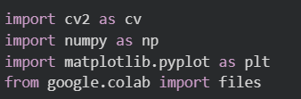
Step 0: Imports
Essential Libraries Imported
OpenCV, NumPy, and Matplotlib are imported for image processing, numerical operations, and visualization respectively.
Environment Setup Importance
Proper setup of the programming environment ensures smooth execution of all subsequent analysis steps.
Notes:
--- This step involves importing essential libraries such as OpenCV for image processing, NumPy for numerical operations, and Matplotlib for visualization. Proper environment setup ensures smooth execution of subsequent steps. Image source: Microsoft 365 content library

Slide 13
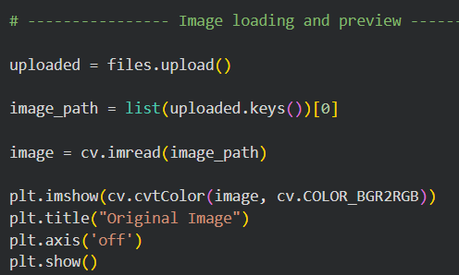
Step 1: Image Loading & Preview
Loading Image with OpenCV
The image is loaded using OpenCV's imread function to ensure correct input retrieval.
Verification by Preview
Displaying the image allows verification that the input was read correctly before further processing.
Dimension Check and Resizing
Checking image dimensions and resizing large images speeds up processing and optimizes performance.
Notes:
--- The image is loaded using OpenCV's imread function and displayed for verification. This step confirms that the input is correctly read and provides a baseline reference before processing. Key considerations include checking image dimensions and resizing large images for faster processing. Image source: Microsoft 365 content library

Slide 14
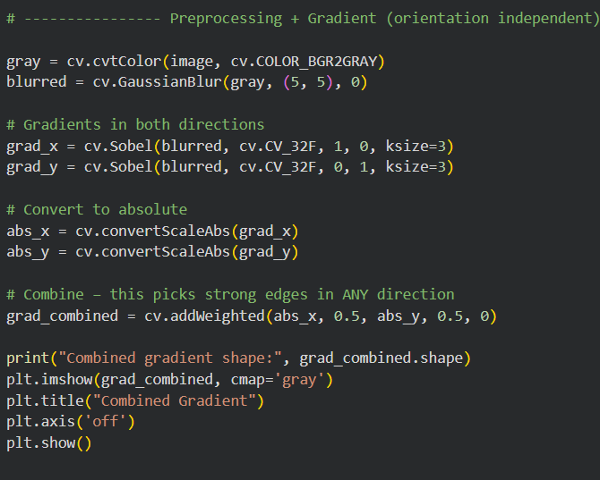
Step 2: Preprocessing & Gradient
Grayscale Conversion
Converting the image to grayscale simplifies processing by reducing color complexity and focusing on intensity.
Noise Reduction
Applying Gaussian blur smooths the image to reduce noise and improve edge detection accuracy.
Gradient Computation
Sobel operators calculate horizontal and vertical gradients to detect edges and highlight barcode stripes.
Notes:
--- The image is converted to grayscale to simplify processing, and Gaussian blur is applied to reduce noise. Sobel operators compute gradients in both horizontal and vertical directions, which are combined to create an orientation-independent edge map highlighting barcode stripes. Image source: Microsoft 365 content library

Slide 15
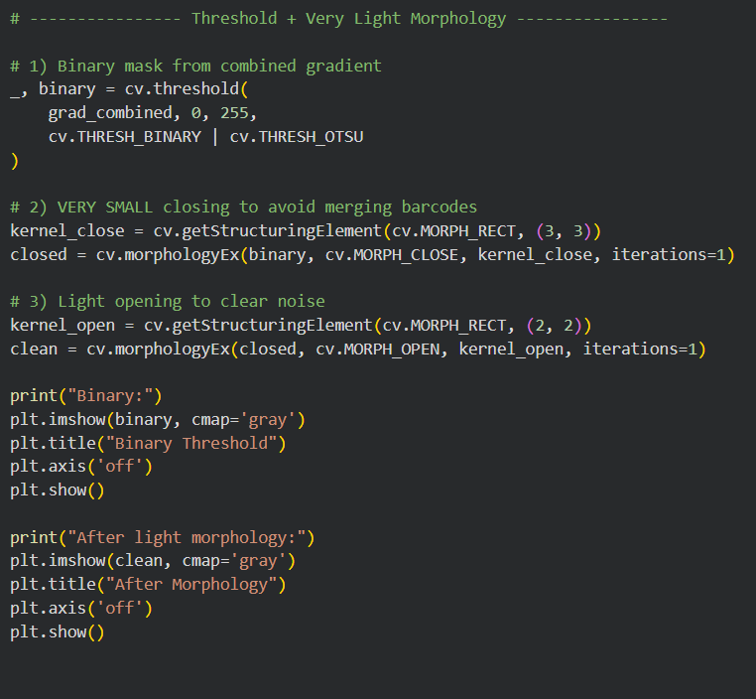
Step 3: Thresholding & Morphology
Otsu’s Thresholding
Otsu's method converts gradient images into binary masks highlighting barcode edges from the background.
Morphological Closing
Morphological closing fills small gaps within barcode stripes to create continuous edges.
Morphological Opening
Morphological opening removes isolated noise ensuring clean barcode masks for contour detection.
Notes:
--- Otsu's thresholding converts the gradient image into a binary mask, separating barcode edges from the background. Light morphological closing fills small gaps within barcode stripes, while opening removes isolated noise. These operations ensure clean masks for contour detection without merging adjacent barcodes. Image source: Microsoft 365 content library

Slide 16
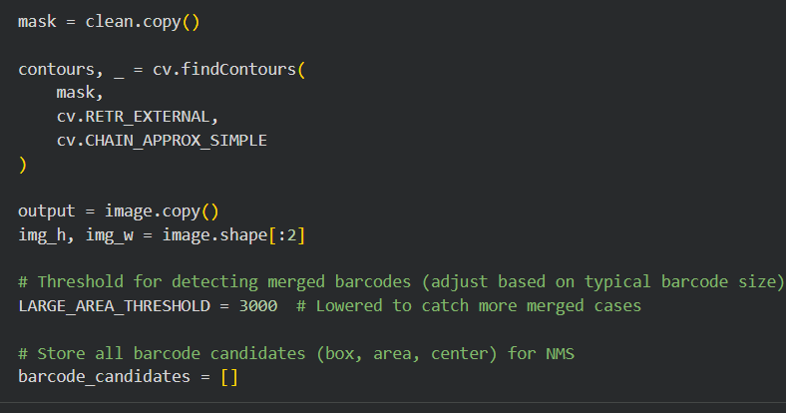
Step 4: Contour Detection & Candidate Buffering
Contour Extraction Method
Contours are extracted using external retrieval mode to prevent nested duplicate detection in the binary mask.
Contour Analysis Criteria
Each contour is assessed for size and aspect ratio to identify potential barcode regions accurately.
Candidate Region Buffering
Potential barcode regions are buffered to prepare for further validation and processing steps.
Large-Area Thresholding
Large-area thresholds help identify merged barcodes requiring specialized splitting strategies.
Notes:
--- Contours are extracted from the cleaned binary mask using external retrieval mode to avoid nested duplicates. Each contour is analyzed for size and aspect ratio, and potential barcode regions are buffered for further validation. Large-area thresholds help identify merged barcodes for specialized splitting strategies. Image source: Microsoft 365 content library

Slide 17

Step 5: Validation Functions
Contour Validation
Functions remove unrealistic contours based on size, aspect ratio, and shape to ensure accurate detection.
IoU and Distance Computation
Utilities compute Intersection over Union and center distances for Non-Maximum Suppression to reduce duplicates.
Barcode Splitting Techniques
Splitting merged barcodes is done using erosion, projection analysis, and watershed segmentation methods.
Notes:
--- Validation functions filter out unrealistic contours based on size, aspect ratio, and shape. Additional utilities compute Intersection over Union (IoU) and center distances for Non-Maximum Suppression. Splitting functions handle merged barcodes using erosion, projection analysis, and watershed segmentation. Image source: Microsoft 365 content library

Slide 18
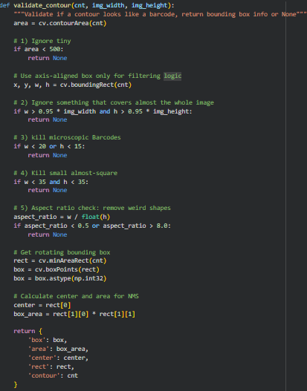
Contour Validation:
Purpose: Ensure detected contours represent valid barcodes before final visualization.
Key Checks:
Size and aspect ratio filtering to remove unrealistic shapes.
Eliminate tiny blobs and overly large regions.
Validate elongated structures typical of 1D barcodes.
Techniques Used:
Rotated bounding boxes for accurate orientation handling.
Intersection-over-Union (IoU) and center distance metrics for Non-Maximum Suppression.
Outcome:
Reduces false positives.
Guarantees each barcode is counted once.
Prepares candidates for splitting and decoding.
Notes:
--- Validation functions filter out unrealistic contours based on size, aspect ratio, and shape. Additional utilities compute Intersection over Union (IoU) and center distances for Non-Maximum Suppression. Splitting functions handle merged barcodes using erosion, projection analysis, and watershed segmentation. Image source: Microsoft 365 content library

Slide 19
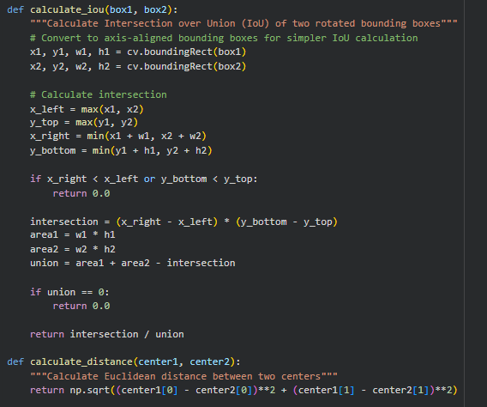
IoU and Distance Computation :
Purpose: Ensure accurate Non-Maximum Suppression (NMS) by evaluating overlap and proximity between detected barcode candidates.
Key Points:
Intersection over Union (IoU):
Measures overlap between bounding boxes.
Helps eliminate redundant detections.
Center Distance Metric:
Ensures candidates are not too close.
Prevents duplicate detections in clustered regions.
Outcome:
Improves precision by retaining distinct barcodes only.
Notes:
--- Validation functions filter out unrealistic contours based on size, aspect ratio, and shape. Additional utilities compute Intersection over Union (IoU) and center distances for Non-Maximum Suppression. Splitting functions handle merged barcodes using erosion, projection analysis, and watershed segmentation. Image source: Microsoft 365 content library

Slide 20
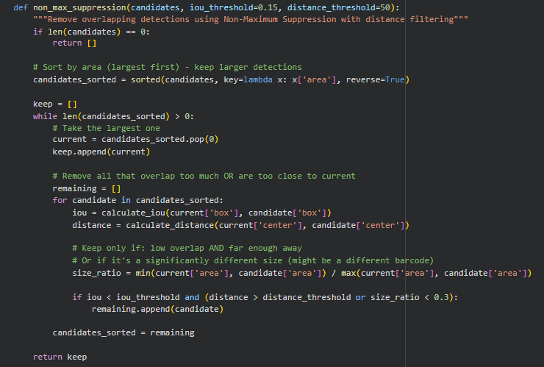
Non-Maximum Suppression :
Purpose: Visual representation of IoU and distance-based filtering during NMS.
Key Points:
Overlapping boxes are compared using IoU threshold (e.g., 0.15).
Close candidates are filtered using distance threshold (e.g., 50 px).
Combined approach ensures robust suppression of duplicates.
Notes:
--- Validation functions filter out unrealistic contours based on size, aspect ratio, and shape. Additional utilities compute Intersection over Union (IoU) and center distances for Non-Maximum Suppression. Splitting functions handle merged barcodes using erosion, projection analysis, and watershed segmentation. Image source: Microsoft 365 content library

Slide 21
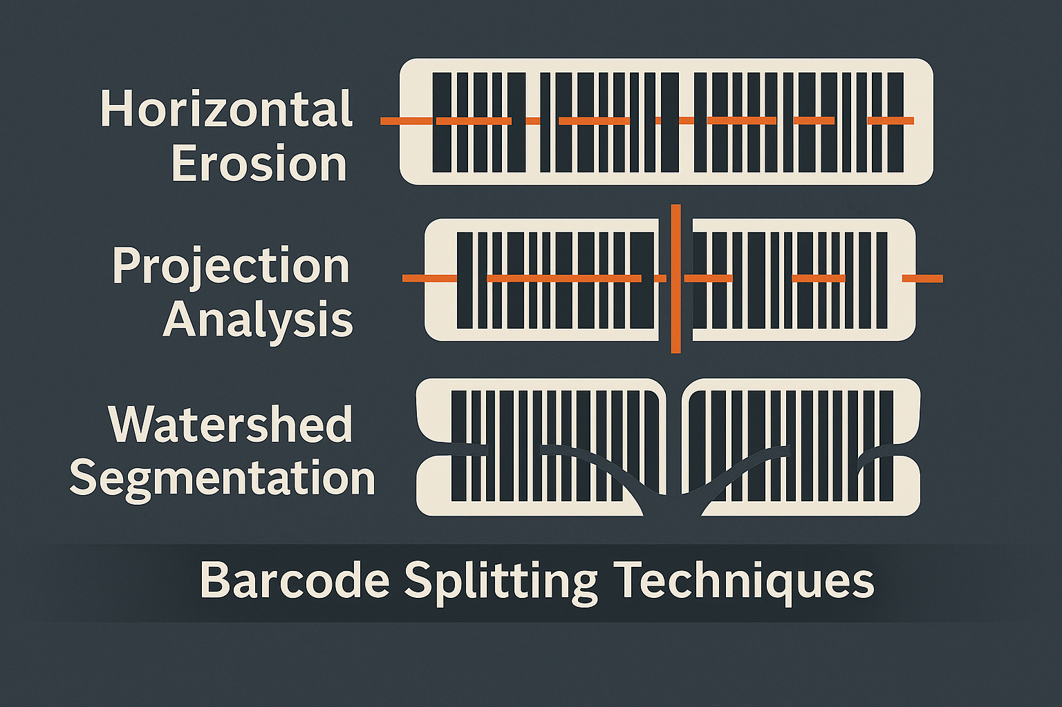
Barcode Splitting Techniques
Purpose: Handle merged or stacked barcodes by separating them into individual regions.
Techniques Used:
Horizontal Erosion:
Splits side-by-side barcodes.
Projection Analysis:
Horizontal and vertical projections for stacked barcodes.
Watershed Segmentation:
Separates overlapping regions using distance transform.
Outcome:
Improves detection accuracy in complex layouts.
Enables decoding of individual barcodes after splitting.
Notes:
--- Validation functions filter out unrealistic contours based on size, aspect ratio, and shape. Additional utilities compute Intersection over Union (IoU) and center distances for Non-Maximum Suppression. Splitting functions handle merged barcodes using erosion, projection analysis, and watershed segmentation. Image source: Microsoft 365 content library

Slide 22
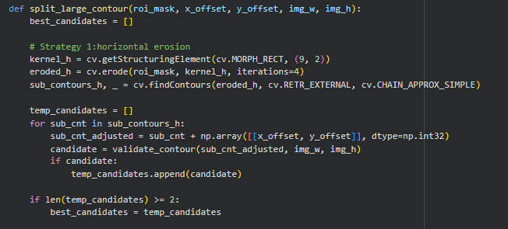
Barcode Splitting Techniques
Horizontal Erosion
Purpose: Handle barcodes placed side-by-side by breaking continuous regions into distinct segments.
Key Points:
Applies morphological erosion along the horizontal axis.
Reduces connectivity between adjacent barcode stripes.
Prepares candidates for contour extraction and validation.
Outcome: Ensures each barcode is isolated for accurate bounding box generation.
Notes:
--- Validation functions filter out unrealistic contours based on size, aspect ratio, and shape. Additional utilities compute Intersection over Union (IoU) and center distances for Non-Maximum Suppression. Splitting functions handle merged barcodes using erosion, projection analysis, and watershed segmentation. Image source: Microsoft 365 content library

Slide 23
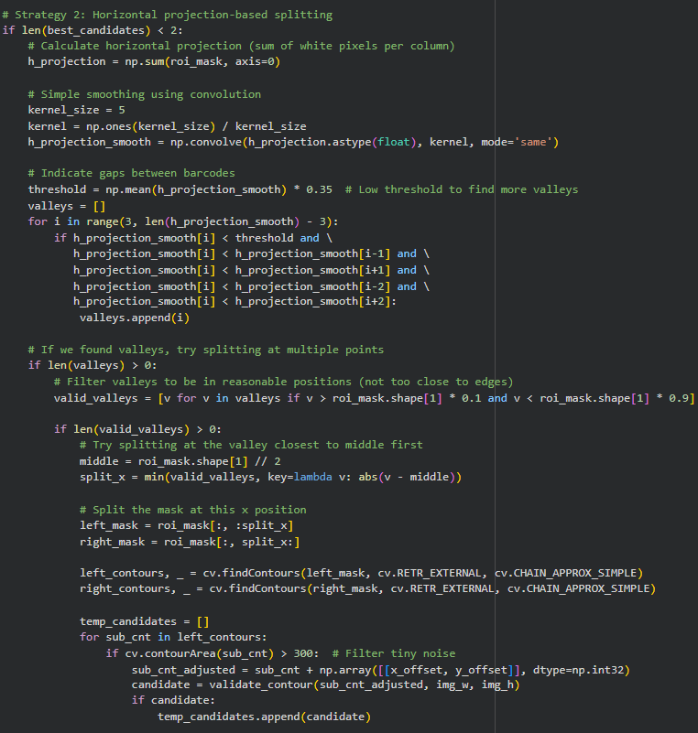
Barcode Splitting Techniques
Projection Analysis
Purpose: Separate stacked barcodes using intensity distribution patterns.
Key Points:
Computes horizontal and vertical projection profiles.
Detects valleys in intensity to identify segmentation points.
Works well for barcodes aligned vertically or horizontally.
Outcome: Provides clean segmentation for stacked barcode layouts without losing structural integrity.
Notes:
--- Validation functions filter out unrealistic contours based on size, aspect ratio, and shape. Additional utilities compute Intersection over Union (IoU) and center distances for Non-Maximum Suppression. Splitting functions handle merged barcodes using erosion, projection analysis, and watershed segmentation. Image source: Microsoft 365 content library

Slide 24
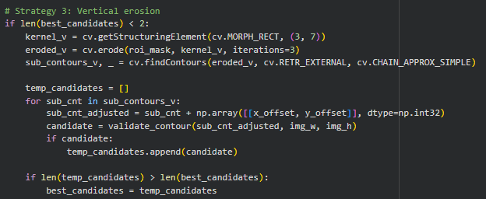
Barcode Splitting Techniques
Purpose: Separate stacked or vertically merged barcodes by reducing vertical connectivity.
Key Points:
Applies vertical morphological erosion using a tall kernel (e.g., 3×7).
Breaks continuous vertical structures to isolate individual barcode regions.
Extracts and validates contours after erosion for accurate segmentation.
Outcome: Improves detection of vertically aligned barcodes, enabling precise splitting and decoding.
Notes:
--- Validation functions filter out unrealistic contours based on size, aspect ratio, and shape. Additional utilities compute Intersection over Union (IoU) and center distances for Non-Maximum Suppression. Splitting functions handle merged barcodes using erosion, projection analysis, and watershed segmentation. Image source: Microsoft 365 content library

Slide 25
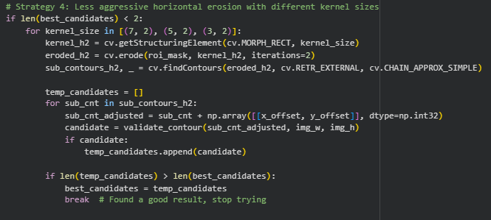
Barcode Splitting Techniques
Purpose: Handle horizontally merged barcodes using adaptive erosion techniques.
Key Points:
Performs horizontal erosion with multiple kernel sizes for fine-grained separation.
Iteratively tests kernel sizes and stops when optimal segmentation is achieved.
Validates contours after each iteration to ensure structural integrity.
Outcome: Ensures accurate isolation of side-by-side barcodes, reducing false positives and improving detection accuracy.
Notes:
--- Validation functions filter out unrealistic contours based on size, aspect ratio, and shape. Additional utilities compute Intersection over Union (IoU) and center distances for Non-Maximum Suppression. Splitting functions handle merged barcodes using erosion, projection analysis, and watershed segmentation. Image source: Microsoft 365 content library

Slide 26
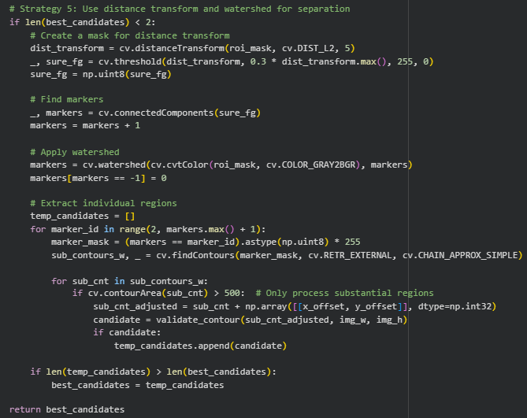
Barcode Splitting Techniques
Watershed Segmentation
Purpose: Split overlapping barcode regions where erosion and projection fail.
Key Points:
Uses distance transform to identify object centers.
Applies watershed algorithm to divide touching regions.
Handles complex overlaps and irregular barcode arrangements.
Outcome: Delivers precise segmentation for challenging barcode clusters, enabling reliable decoding.
Notes:
--- Validation functions filter out unrealistic contours based on size, aspect ratio, and shape. Additional utilities compute Intersection over Union (IoU) and center distances for Non-Maximum Suppression. Splitting functions handle merged barcodes using erosion, projection analysis, and watershed segmentation. Image source: Microsoft 365 content library

Slide 27
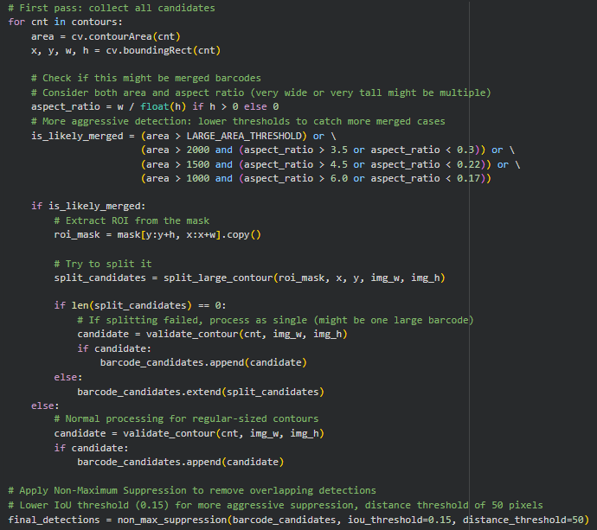
Step 6: Final Detection & Visualization
Non-Maximum Suppression Role
Non-Maximum Suppression eliminates overlapping barcode detections to ensure accurate counting of each barcode once.
Drawing Final Bounding Boxes
Bounding boxes are drawn on the original image around detected barcodes for easy visual verification of results.
Displaying Detection Count
The total count of detected barcodes is displayed clearly to provide summary information after detection process.
Notes:
--- After validation and splitting, Non-Maximum Suppression removes overlapping detections, ensuring each barcode is counted once. Final bounding boxes are drawn on the original image for visual verification, and the total count of detected barcodes is displayed. Image source: Microsoft 365 content library

Slide 28
Challenges
Notes:
Key Development Challenges

Slide 29

Key Development Challenges
Noise and Background Clutter
System performance was affected by noise and clutter, complicating accurate barcode detection in images.
Merged or Stacked Barcodes
Merged and stacked barcodes created challenges for correct separation and decoding in scanning processes.
False Positives from Non-Barcode Contours
Non-barcode shapes caused false positives, requiring refined detection algorithms to reduce errors.
Orientation Independence and Parameter Tuning
Ensuring detection was orientation independent and tuning parameters balanced precision and recall.
Notes:
--- The system faced challenges such as noise and background clutter, merged or stacked barcodes, false positives from non-barcode contours, and ensuring orientation independence. Parameter tuning was critical to balance precision and recall across diverse image conditions. Image source: Microsoft 365 content library

Slide 30
Future Work
Notes:
Barcode Decoding Strategies

Slide 31

Barcode Decoding Strategies
Library Integration
Integrating popular decoding libraries like ZBar or Pyzbar enhances barcode reading capabilities and accuracy.
Orientation Correction
Correcting barcode orientation before decoding improves scanning success rates and processing speed.
Checksum Validation
Implementing checksum validation ensures the accuracy and reliability of decoded barcode data.
Real-Time Detection
Real-time detection in video streams enables dynamic barcode scanning for large-scale and fast processing needs.
Notes:
--- Future enhancements include integrating decoding libraries like ZBar or Pyzbar, correcting orientation before decoding, and implementing checksum validation for accuracy. Additional goals involve real-time detection for video streams and optimization for large-scale processing. Image source: Microsoft 365 content library

Slide 32
Algorithms & Rationale
Notes:
Choice of Techniques

Slide 33

Choice of Techniques
Sobel Operators for Edges
Sobel operators efficiently detect gradients, enabling accurate edge extraction in the image processing pipeline.
Otsu's Adaptive Thresholding
Otsu's method adaptively determines threshold values to separate foreground from background effectively.
Morphological Noise Cleaning
Morphological operations remove noise without merging separate barcode elements in the image.
Contour Filtering and NMS
Contour filtering and Non-Maximum Suppression precisely localize barcodes and eliminate duplicate detections.
Notes:
--- The pipeline uses Sobel operators for gradient detection due to their efficiency and accuracy in edge extraction. Otsu's method provides adaptive thresholding, while morphological operations clean noise without merging barcodes. Contour filtering and NMS ensure precise localization and eliminate duplicates. Image source: Microsoft 365 content library

Slide 34
Usage Guide
Notes:
Running the Pipeline

Slide 35

Running the Pipeline
Installing Dependencies
Install essential libraries like OpenCV and NumPy to support image processing tasks within the pipeline.
Loading and Processing Images
Load input images and process them step-by-step using sequential execution in Google Colab notebooks.
Parameter Adjustment
Adjust thresholds and kernel sizes to optimize barcode detection based on image quality and barcode density.
Notes:
--- To run the pipeline, install dependencies such as OpenCV and NumPy, load the image, and execute steps sequentially in Google Colab. Adjust thresholds and kernel sizes based on barcode density and image resolution for optimal results. Image source: Microsoft 365 content library

Slide 36
Conclusion
Notes:
Achievements and Future Enhancements

Slide 37

Achievements and Future Enhancements
Robust Barcode Detection
Developed a barcode detection system that works regardless of barcode orientation and handles noisy images effectively.
Merged Barcode Separation
Successfully separated merged barcodes to improve detection accuracy and reduce false positives.
Future System Enhancements
Plans include integrating barcode decoding, optimizing system performance, and enabling real-time barcode detection.
Notes:
--- The project successfully developed a robust barcode detection system using classical image processing techniques. Key achievements include orientation-independent detection, noise handling, merged barcode separation, and false positive reduction. Future enhancements aim to integrate decoding, optimize performance, and extend functionality to real-time applications. Image source: Microsoft 365 content library

Slide 38
References
Notes:
Key Resources

Slide 39

Key Resources
OpenCV Documentation
Comprehensive online documentation for OpenCV, a popular computer vision library.
NumPy Documentation
Extensive documentation for NumPy, a fundamental package for scientific computing in Python.
Notes:
--- OpenCV Documentation: https://docs.opencv.org NumPy Documentation: https://numpy.org Image source: Microsoft 365 content library

