Slide 1
Peer Reach
Electronics and Electrical Communications Engineering Department
Faculty of Engineering
Cairo University
Prepared by
Student Name
Student ID
Mohamed Ahmed Abd Hakam
922647
John Gamil SaadAllah
9220239
Mohamed Hatem Ahmed Mahmoud
9220676
Omar Ayman Amin Mohamed
9220528
Mohamed Ahmed Mohamed Ahmed
9220652
Adham Ayman Awad Hamed
9231646
Advisor
Dr. Heba Mourad

Slide 2
Agenda
Problem Statement
System Model
Mobile Application
Security Framework
Demo
Scenarios
1
2
3
4
5
6
7
8
9
Objective
Hardware Components
Packet Design
Results

Slide 3
Problem Statement & Motivation
Problem Statement
Motivation
BLE works only over short distances.
No infrastructure-free multi-hop messaging.
No secure and reliable multi-hop communication.
Stay connected when there is no network.
Support communication during disasters.
Enable messaging in crowded places.

Slide 4
Objectives
1
Infrastructure-Free Messaging
Build a messaging system without internet or cellular networks.
2
Multi-Hop Communication
Enable messages to travel across multiple BLE devices.
3
Extended Coverage
Increase communication range using relay nodes and LoRa.
4
End-to-End Encryption
Keep messages secure from sender to receiver.
5
Privacy Protection
Preserve user privacy and anonymity.
6
Performance Evaluation
Measure reliability, latency, range, and overall system performance.

Slide 5
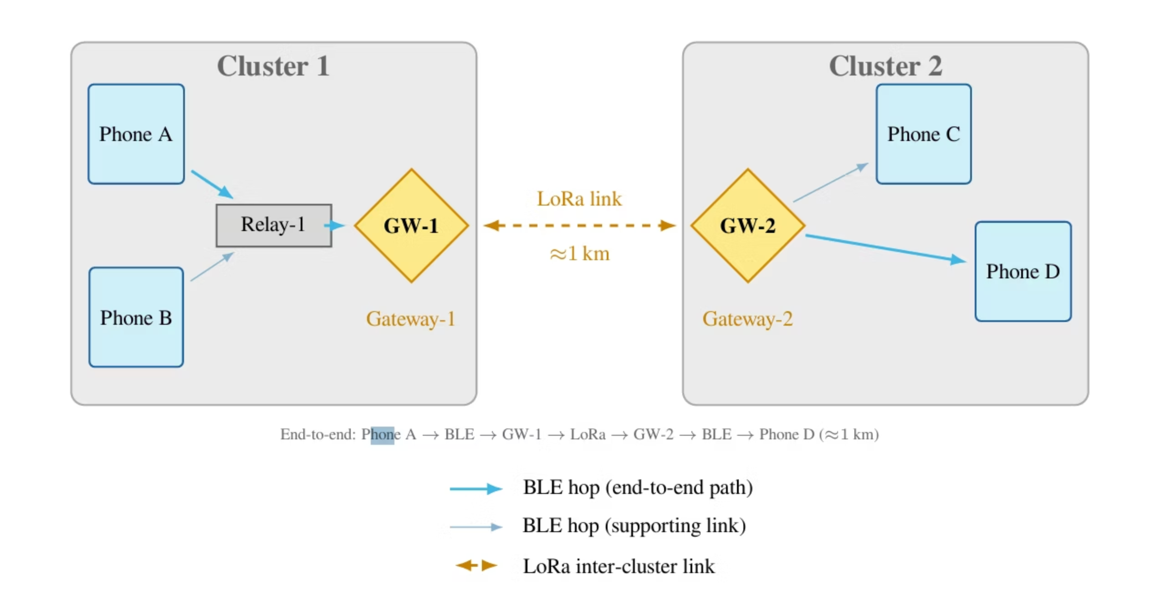
System Model
Multi-Hop Communication Across BLE Clusters
BLE Multi-Hop
LoRa Backhaul
End-to-End Message Delivery

Slide 6
Hardware Components
Android Phone
ESP32-S3
LoRa Module
BLE 5.0 Communication
Origin & Relay Node
End-to-End Encryption
Android Application
BLE-to-LoRa Bridge
Transparent Relay Node
BLE 5.0 + LoRa Support
Stateless Operation
Long-Range Communication
Up to 1.5 km
Tested 250 B Payload
Low-Power Transmission

Slide 7
Mobile Application
Home
Messaging
QR Pairing
"Simple and user-friendly interface for secure offline messaging."

Slide 8
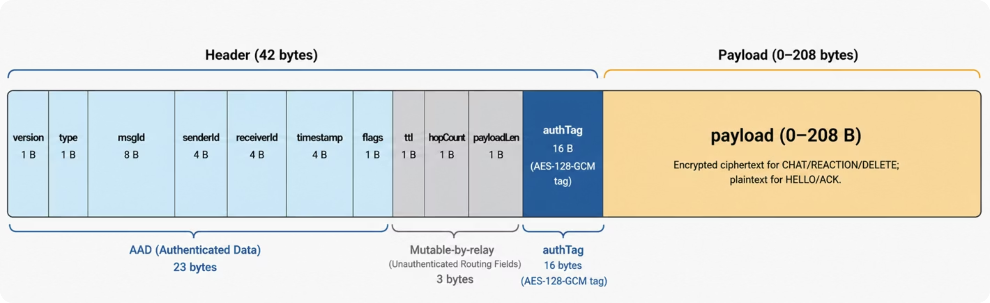
Packet Design

Slide 9
Security Framework
Confidentiality
Integrity
Authentication
Only the intended receiver can read messages.
Detect any message modification.
Verify communicating users.
Privacy
Availability
Protect user identity.
Communication continues without internet.

Slide 10
Security Against Attacks
Attack
Defense
The Silent Listener
End-to-End Encryption
The Curious Relay
No Shared Secret (Cannot Decrypt Messages)
Message Modification
Authentication Tag (AES-128-GCM)
Replay Attack
Message ID + Timestamp + Seen Message Cache

Slide 11

Results & Evaluation
📊 Chart / Graph Placeholder 1 — Insert primary performance figure or chart here.
📈 Chart / Graph Placeholder 2 — Insert secondary result figure here.
📉 Chart / Graph Placeholder 3 — Insert additional data visualization here.

Slide 12
Demonstration Scenarios
Network Formation
Node Joins the Mesh
Connection Loss & Recovery
Device automatically discovers nearby nodes and joins the BLE mesh network.
Communication resumes automatically when the device reconnects.

Slide 13
Demonstration Scenarios
Message Delivery
Long-Range Messaging
Encrypted Relay
Messages travel across multiple BLE hops and LoRa gateways to reach distant users.
Relay nodes forward encrypted messages without accessing their contents.

Slide 14
Demonstration Scenarios
Network Behavior
Node Leaves the Mesh
Neighbor tables update automatically when a device leaves the network.

Slide 15
Thank You
Questions & Discussion

