Slide 1
Electricia
Welcome to your online electronic shop

Slide 2
Outline
Introduction.
Functions and Non-Functions.
Use Case Diagram.
Sequence Diagram.

Slide 3
Introduction
An E-marketing Solution for Electronical Devices

Slide 4
Welcome to our website where you can buy an electronic device by easy and safe way. Our website is the best site to pay a device by easy way to search about it by different search alternatives. The site is divided into Parts such as (Most payed – Most viewed – The newest products) to help customer chose his device easier and faster. You can join our site by sign up and have an account to complete the payment processes. When you have an account you can add the products you want to pay later to your wish list and ADD TO CART system to buy many products at the same time. You can also contact with us to tell about any damage, problem or feedback about the site. By the comment service you can tell your opinion about the product to the company and the other customers. Also rating can give a feedback about product. This is our website briefly, we hope you like and enjoy.

Slide 5
Functions and Non-Functions
Functional Requirements

Slide 6
[*] means all users [*-v] means all roles
Functional Requirements | User | Description
Register as a Customer | Visitor[Anonymous user] | Allows [customer] to create a new account on the system.
Register as a Company | Visitor[Anonymous user] | Allows [comp] to create a new account on the system.
Login | [*-v] | Allows [*-v] to get into system using their accounts.
Logout | [*-v] | Allows [*-v] to get out of the system
Reset Password | [*-v] | Allows [*-v] to reset forgotten password.
Email confirmation | Customer, Company | Required to ensure account Reliability. [can be retrieved]
Change Password | [*-v] | Gives [*-v] the ability to change their password.
Change Email Address | [*-v] | Allows [*-v] to change their email address.
Announce a new product | Company | Company can announce about a specific product that will be released later. [Coming Soon]
Add a Product | Company | Allows [Comp] to Add a new Product to market.
Edit a Product | Company | Allows [Comp] to edit Product specification and data.
Notes:
[*] means all users => Company , Customer , Admin, Anonymous user. [*-v] means all roles => Company , Customer , Admin

Slide 7
[*] means all users [*-v] means all roles
Functional Requirements | User | Description
Edit Product Gallery | Company | Company can change images of a specific product to ensure Validity of Information they provide about product.
Report Product Image | customer | Customer can report an image that doesn't represent the product to the company.
Remove a Product | Company, Admin | Allows [Admin], [Comp] to Remove a product.
View Product | [*] | Allows [*] to view Specific product.
Rate Product | Customer | Allows [Cust] to Rate a product.
View Product Gallery | [*] | Allows [*] to view Product Gallery.
Choose Product color | Customer | Allows [Cust] to change the product color.
Remove comment | Customer | Allows [Cust] to Remove his comment on a product.
Contact us | Company, Customer , Visitors | Users can use it to Report an issue with website to the admin.
Like a comment | Customer | Allows [Cust] to Like a comment.
Dislike | Customer | Allows [Cust] to Dislike a comment.

Slide 8
[*] means all users [*-v] means all roles
Functional Requirements | User | Description
Remove Like/Dislike | Customer | Allows [Cust] to Cancel his like/Dislike on a comment.
Add product to wish list | Customer | Allows [Cust] to add products to wish list.
Clear the wishlist | Customer | Remove All Products in the wishlist.
Remove product form wishlist | Customer | Allows [Cust] to remove a product from wishlist.
Add product to Cart | Customer | Allows [Cust] to Add a product to the cart.
Remove product from cart. | Customer | Allows [Cust] to Remove a product from cart.
Clear the Cart | Customer | Remove All Products in the Cart
Calculate cart total [Auto] | Customer | Calculate the total price of products in the cart.
Edit customer | Customer, Admin[limited] | Allows a customer to change his data. Allows admin to change access methods of specific company underspecified terms.
Remove customer | Admin | Allows admin to Remove a customer [Permanent].

Slide 9
[*] means all users [*-v] means all roles
Functional Requirements | User | Description
Deactivate account | Company, Customer | Allows Companies and Customers to Deactivate their account and Permanent delete after a specific period of time varies from Customer to Company.
Edit a Company | Company, admin[limited] | Allows Company to change it's data. Allows admin to change access methods of specific company under specified terms.
Remove a Company | admin | Allows admin to remove a specific company.
Freeze account | admin | -Allows Admin to Freeze and account of any type (company or customer ). - freezing account will prevent account owner from login which leads to prevent making any modification to his account.
Change Language | [*] | Gives the ability to change the Language of the website.

Slide 10
Functions and Non-Functions
Nonfunctional Requirements

Slide 11
Function Name | Non-function (Constrains) | Description of Non-function
1.Add Product | - Company only. | Company only is has the permissions to add products.
 | - Product can’t be null or have a null data. | The product must be has a value.
 | - Can’t add an existing product. | If the product is exist then no permissions to add again.
 | - Data must be validated. | The data must be true and real.
2.Edit Product | - Can’t edit non-existing product. | The product want to edit must be stored before change it.
 | - Passed ID must be an integer and non-negative. | Not allowed an Alphabetic and Signs(only Numerical) IDs and must be non-negative.
 | - Data must be validated. | The data must be true and real.
3.Remove Product | - Can’t remove non-existing product. | The product most be stored before the deleting process.
4.Register As A Company | - Visitors. | The visitor company can register to the website.
 | - Data must be validated. | The data must be true and real.
 | - Must be verified. | Must check of the data that is true to continue registering.
5.Remove Company | - Can’t remove non-existing company. | The company want to delete it must be registered before in the site to can delete it.

Slide 12
Function Name | Non-function (Constrains) | Description of Non-function
6.Register As A Customer | - Data must be validated. | The data must be true and real.
 | - Data must be verified. | Must check of the data that is true to continue registering.
7.Remove Customer | - Everything is related a customer is delete when the customer removed. | Delete everything is related about customer when he is removed such as (comments-rates. Etc).
 | - Can’t remove non-existing customer. | The customer want to delete must be registered before in the site to can delete.
8.Add TO Cart | - Cart must be initialized in session before adding. | Must check of the validity and secure information about the cart before make any payment process.
 | - Product must be exist before adding to cart. | The product must be stored in the site to can add to cart to confirm payment process.
9.Remove From Cart | - Cart must be initialized. | Must check of the validity and secure information about the cart.
 | - Can’t remove un-added product. | The product must be stored in the site to can remove it.
10.Rate Product | - Can’t Rate un-existing product. | The product must be exist in the site to can give it a rate.
 | - Admin and companies can’t rate products. | The rate permissions are only for the customer who is payed the product.
 | - Rate a product only once. | No one of customers can rate any product more than one time.
 | - The rate value start from 1 to 5. | The rate is begin from one and end to five (no less or more).

Slide 13
Function Name | Non-function (Constrains) | Description of Non-function
11.Add Comment | - Customers can rate. | The customers have the permissions to rate (registered).
 | - Only one comment permitted per user on a specific product. | Every user allowed one comment only on the product to can give a good feedback about the product.
 | - Product can have many comments. | Each product can have more than one comment from different customers (one comment for each customer).
 | - Company can add comments to its products only. | Company can make comments on its products only to help users about their feedbacks.
 | - Customers can like or dislike comments of other customers only. (only once) | The customer have the permission to give another customers comment a like or dislike to rate her comment but can’t make on her comment.
12.Add To Wish List | - Can’t add more than 10 products. | The limit of the wish list is 10-products to can control the size of the stored data and the quantity are allowed to the same product.
 | - Wish List must be removed if the related user removed. | If the customer removed from the site everything is related with this customer will deleted as the wish list.
 | - Can’t add product to wish list twice. | Can’t reserve place for product in the wish list twice but the quantity are allowed for the product.
 | - Can’t add an existing product. | If the product was add before in the wish list then the customer can’t add it again.

Slide 14
Diagrams
Use Case Diagrams

Slide 15




Change Email
Login
Logout
Change Language
Email Confirmation
Search
View Product
View Gallery
Reset Password
System Users
User
Admin
Company
Customer

Slide 16
Freeze account
Edit company
Remove product
Edit Gallery
Admin
Company
Edit product
Remove Customer
Remove Company
Contact us
Desiccative Account
Add product
Edit Customer
Remove Product
Report Image
Add to cart
Rate
Customer
Remove from cart
Add comment
Clear Cart
like
Cancel
Like/dislike
Confirm
Remove from WL
Clear
Remove
Dislike
comment
Choose color
Add to wishlist

Slide 17
Diagrams
Sequence Diagrams

Slide 18
Log out
User

Slide 19
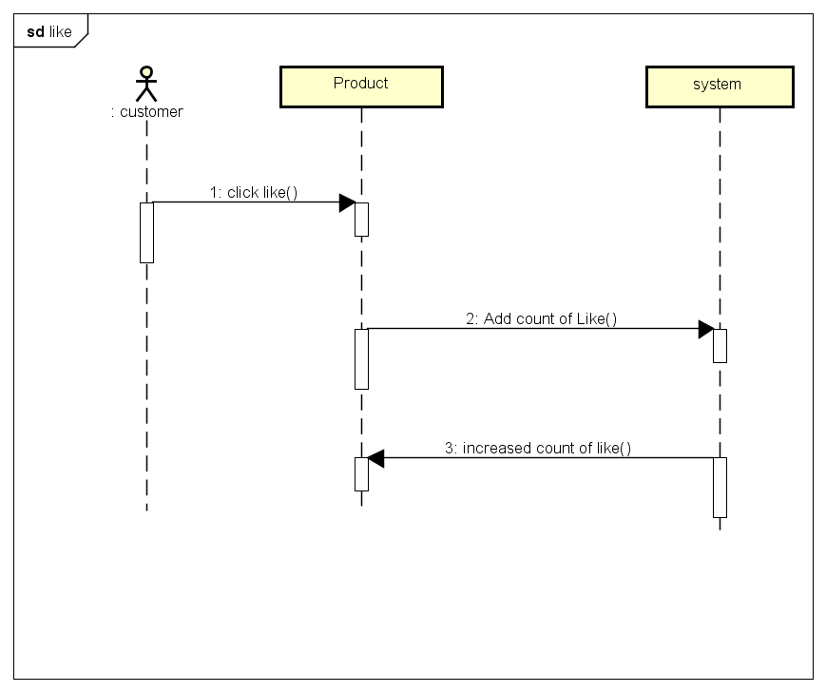
Customer

Slide 20
Customer

Slide 21
User

Slide 22
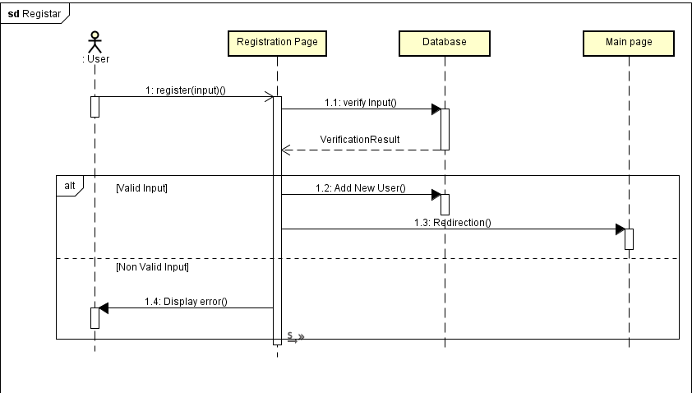
User

Slide 23
Customer

Slide 24
User

Slide 25
User

Slide 26
Customer

Slide 28
Admin

Slide 29
Company

Slide 30
Admin

Slide 31
Admin

Slide 32
Admin

Slide 34
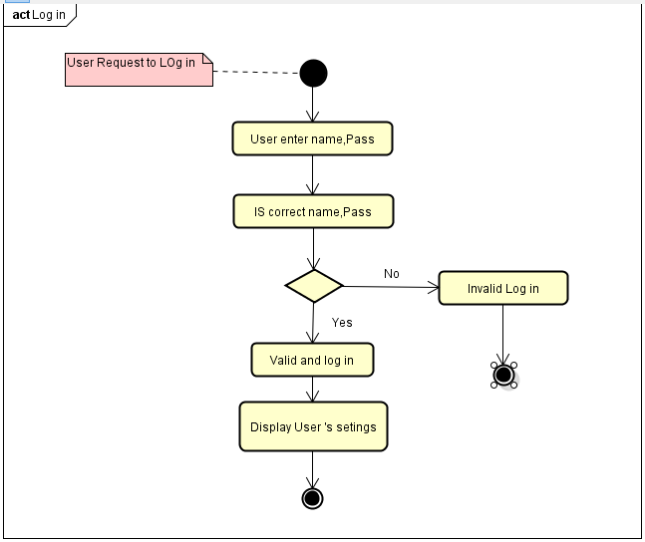

Slide 35
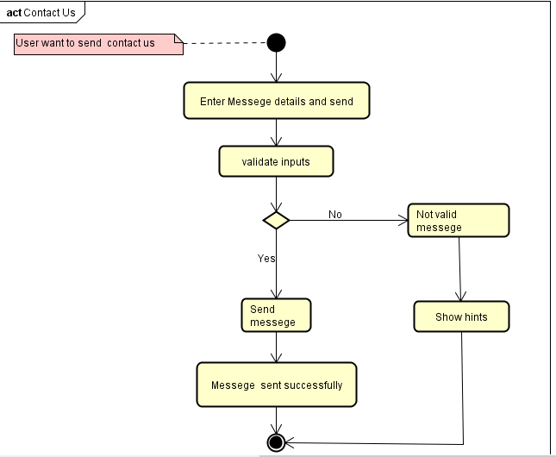

Slide 36
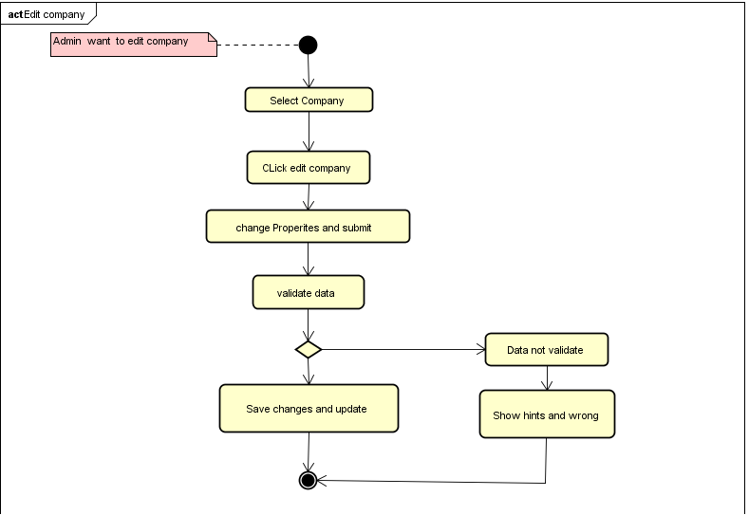

Slide 37
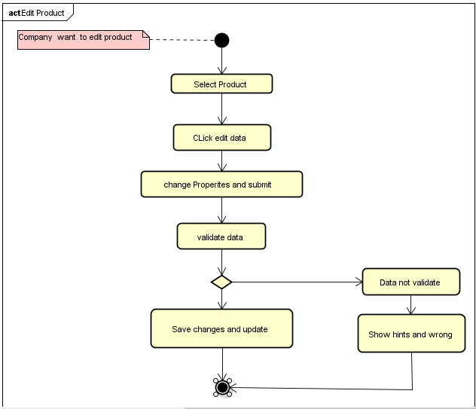

Slide 38
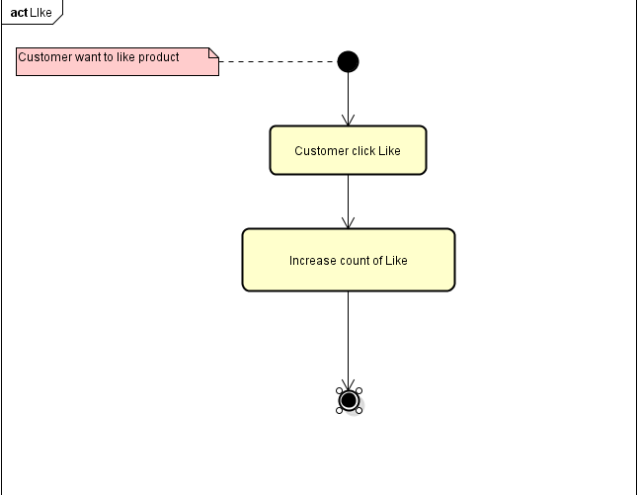

Slide 39
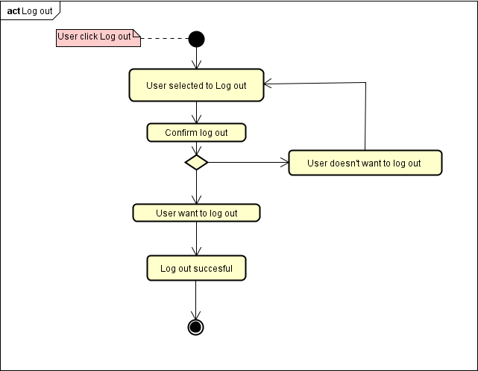

Slide 40
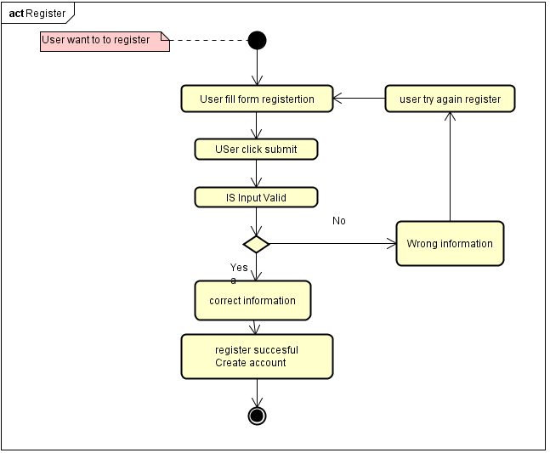

Slide 41
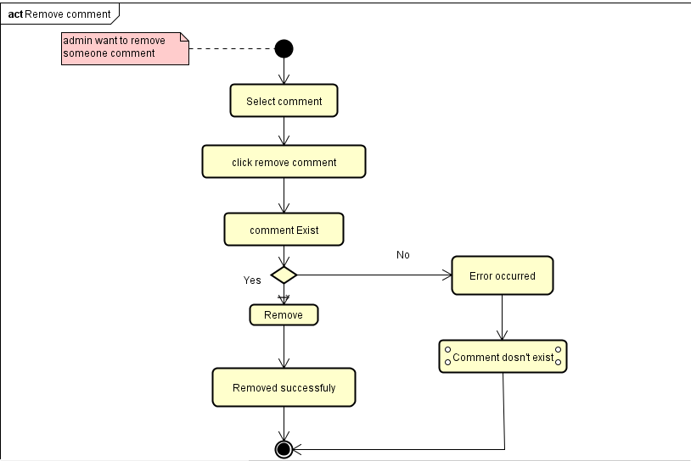

Slide 42
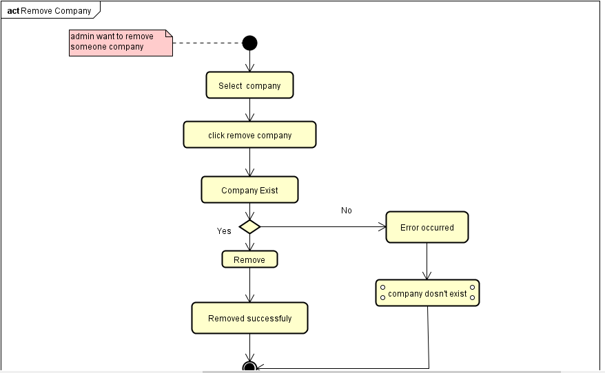

Slide 43
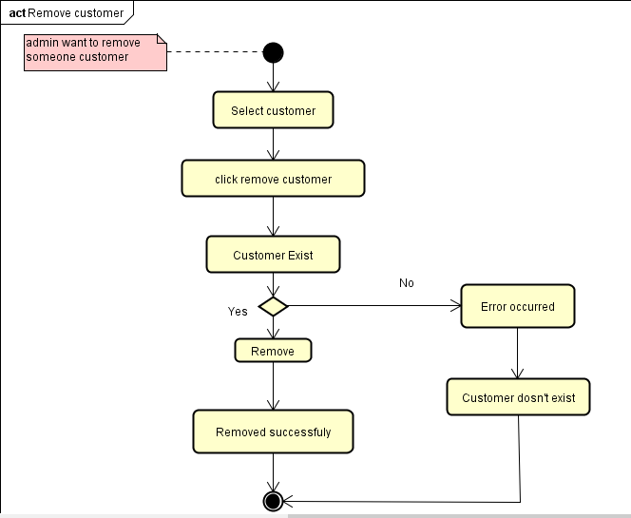

Slide 44
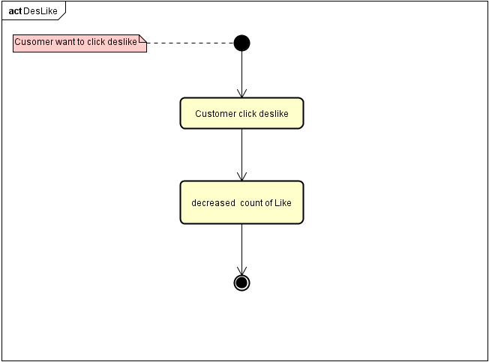

Slide 45
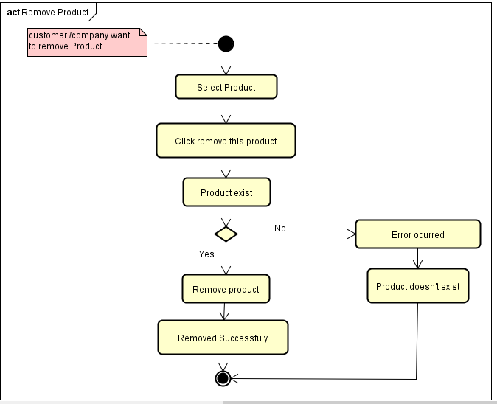

Slide 46
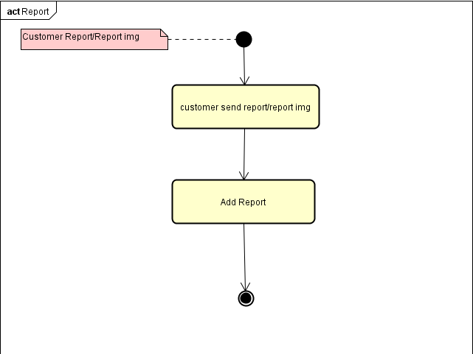

Slide 47
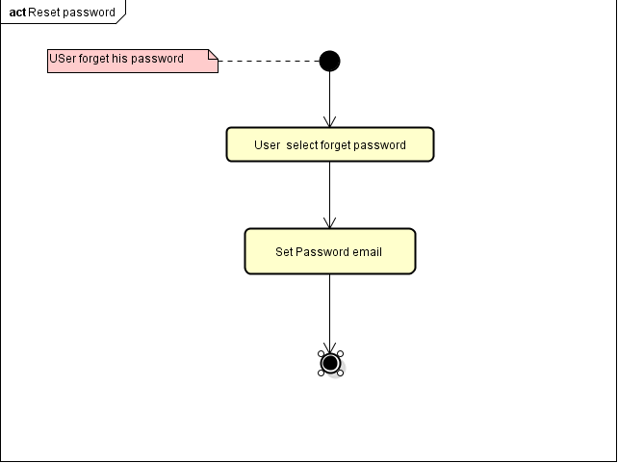

Slide 48
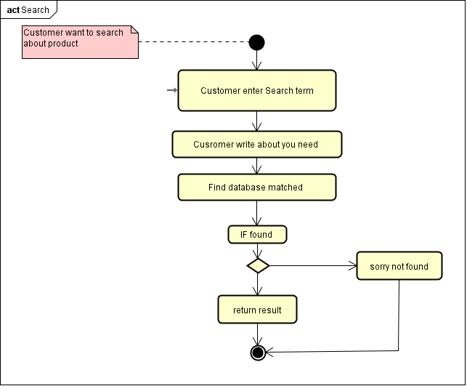

Slide 49
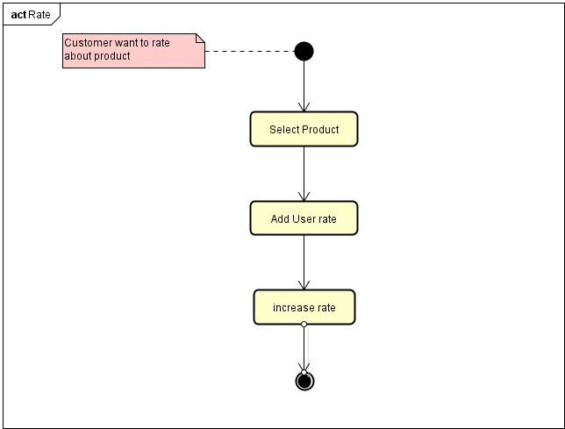

Slide 50
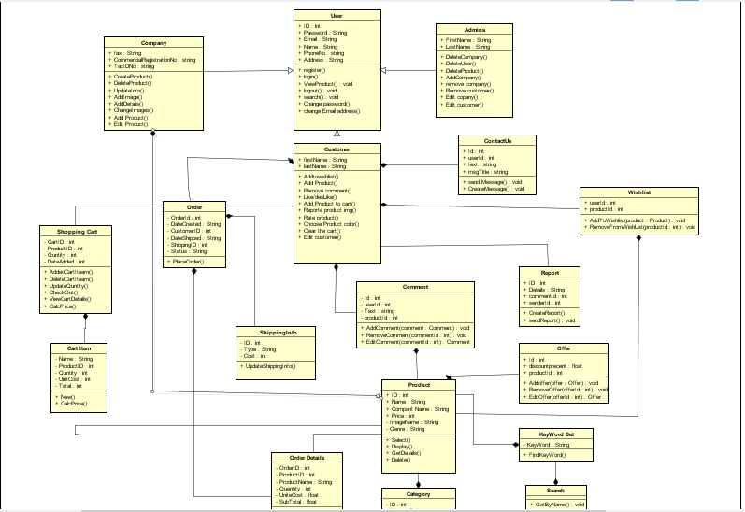

Slide 51
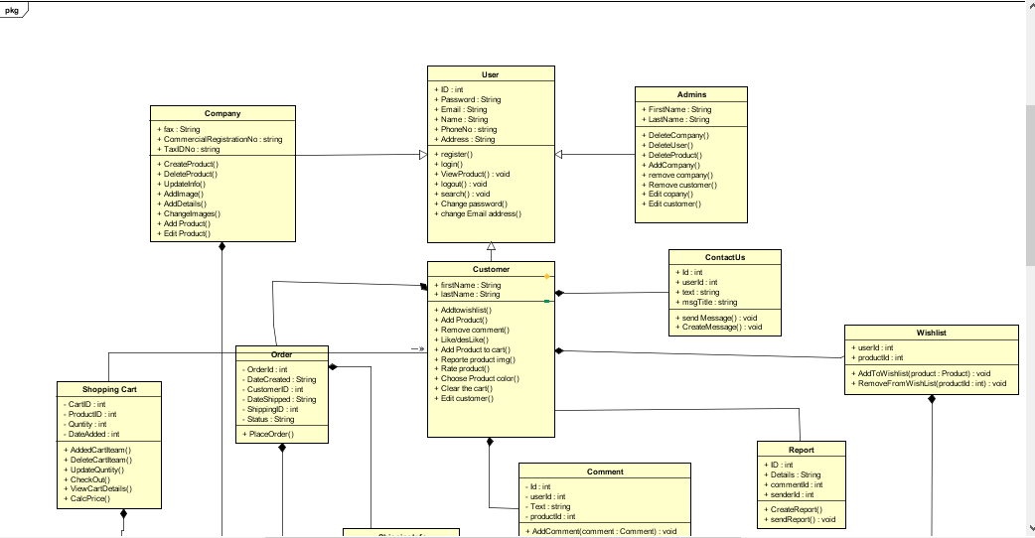

Slide 52
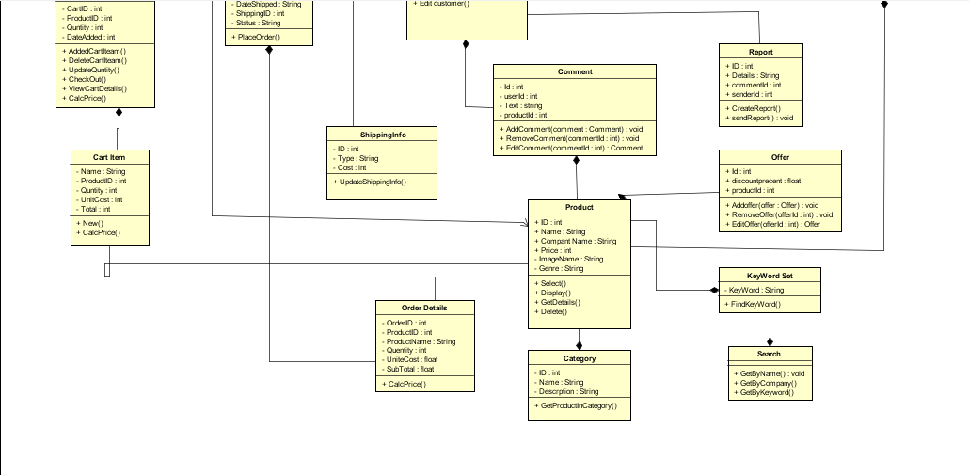

Slide 53
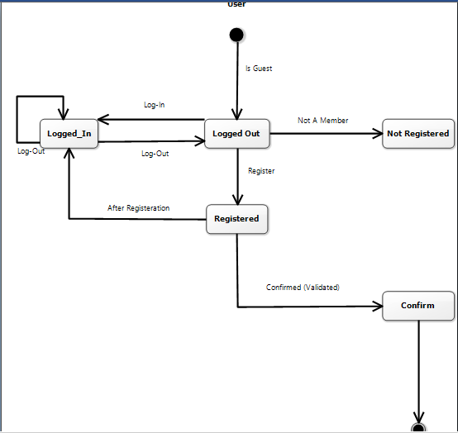

Slide 54
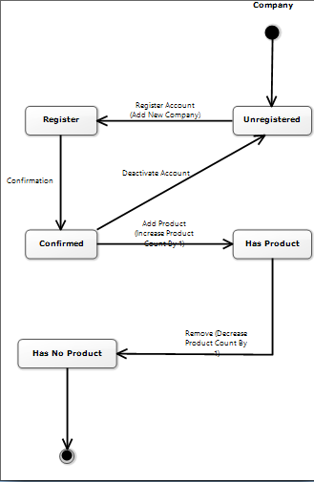

Slide 55
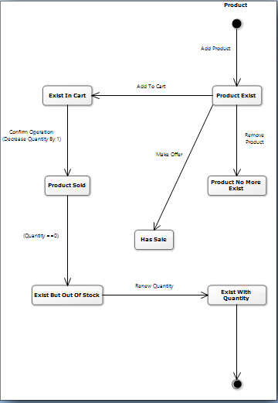

Slide 56
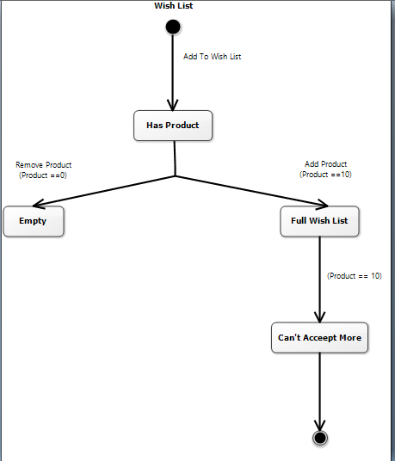

Slide 57
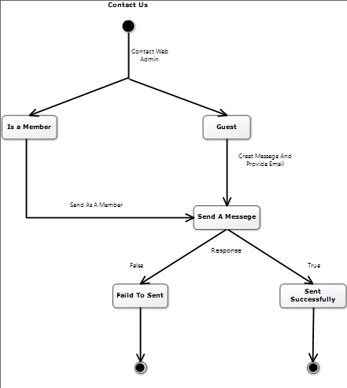

Slide 58
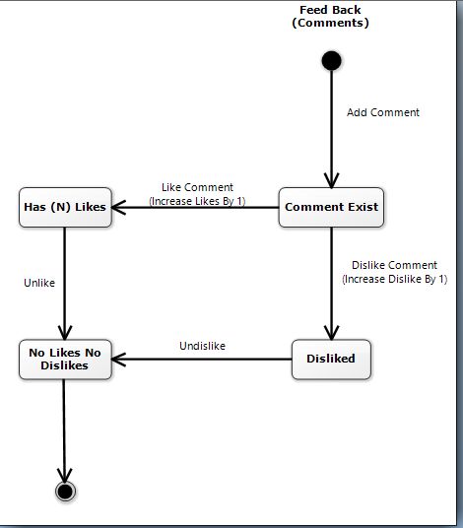

Slide 59
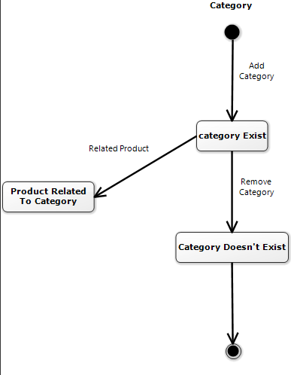

Slide 60
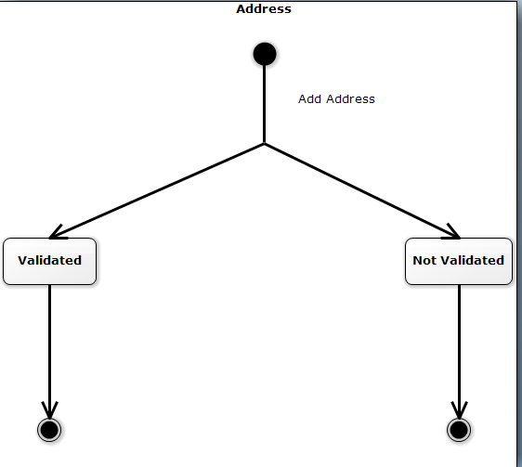

Slide 61
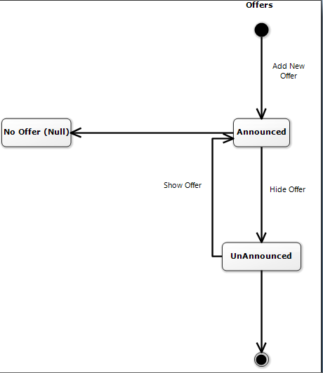

Slide 62
