Slide 1
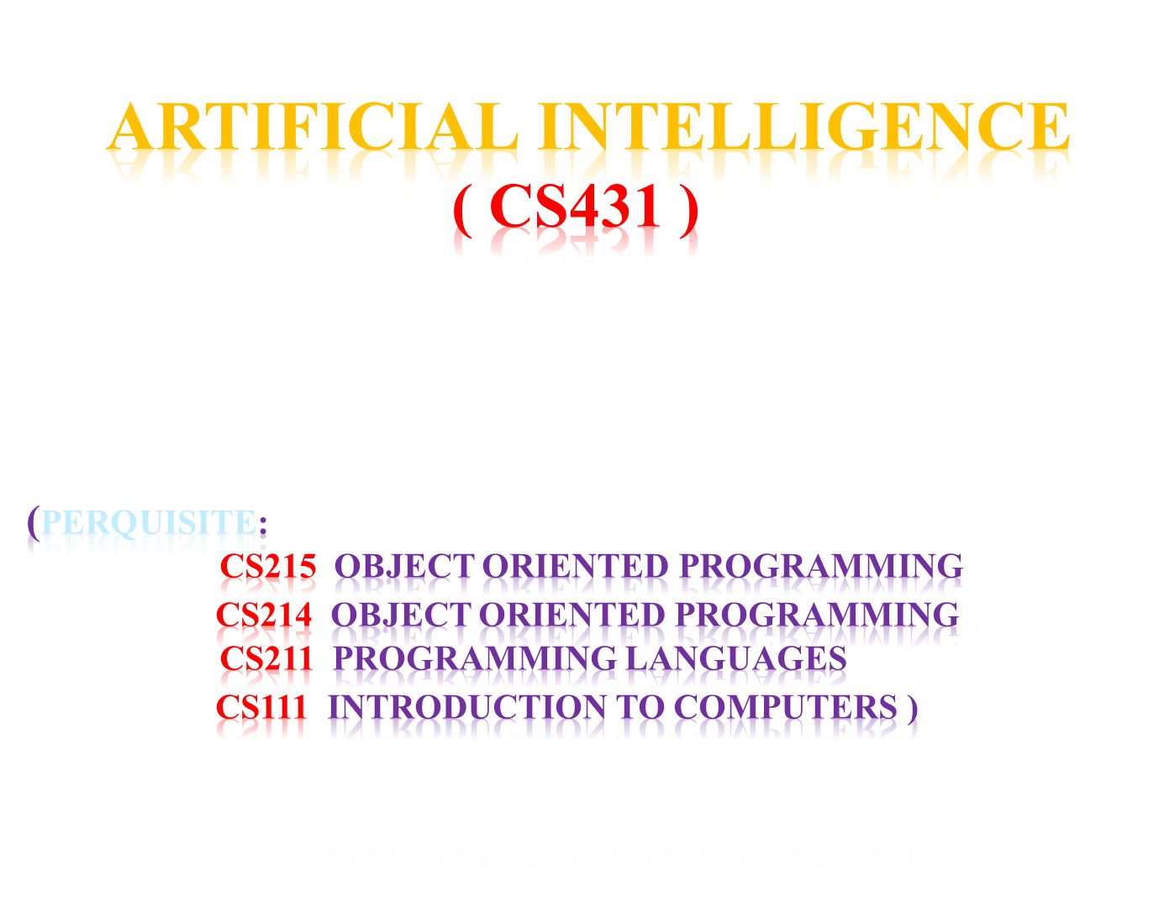

Slide 2

Objective: to illustrate the basic principles of AI
Reference : “Artificial Intelligence, A modern Approach ”
Stuart Ruessel & Peter Norving
Third Edition ( 20014)
User Group: ArtificialIntelligence_cs431@yahoogroups.com

Slide 3
Course Reference
The leading textbook in Artificial Intelligence
Used in over 1400 universities in over 125 out of 195 world countries (2019) countries( 64 %).
The 22nd most cited computer science publication on Citeseer (a scientific literature digital library and search engine developed in 1997 at the NEC Research Institute, Princeton, New Jersey , U.S.A)
Contents:
..\..\Electronic books\AI _modern approach_third eddition (2013).pdf

Slide 4
Course CS 431Evaluation Policy
5 % Lecture attendance, quizzes and conductance
10 % Section attendance ,quizzes and assignments
5 % Course presentation
20 % Midterm Exam
60 % Final Exam

Slide 5
CS 431 Course overview
Introduction and Agents (chapters 1,2)
Search (chapters 3,4,5,6)
Logic (chapters 7,8,9)
Planning (chapters 11,12)
Uncertainty (chapters 13,14)
Learning (chapters 18,20)
Natural Language Processing (chapter 22,23)

Slide 6
CS 431 Course Presentation
Choose one topic from slide 5
Prepare a power point presentation on this topic
End your presentation by an analysis of an AI movie that uses this selected topic
You could use an AI movie from the following file:
List of artificial intelligence films.docx

Slide 7
Lecture 1 Outlines
1.1 Introduction
1.2 What is AI?
1.3 A brief history of AI
1.4 AI state of the art
1.5 Robotics Basic Concepts

Slide 8
1.1 Introduction
AI Perspective
AI Main Topics
AI Branches
Origin of AI Tools
AI Overlap Tasks
AI Expression Equivalence
Problems of AI
Tools of AI research
Applications of artificial intelligence
AI Specialized languages

Slide 9
AI Perspective
Artificial intelligence (AI) is the intelligence of machines and the branch of computer science which aims to create it.
Major AI textbooks define artificial intelligence as "the study and design of intelligent agents,"
where an intelligent agent is a system that perceives its environment and takes actions which maximize its chances of success
John McCarthy, who coined the term in 1956,defines it as "the science and engineering of making intelligent machines"

Slide 10
AI Main Topics
reasoning
knowledge
planning
learning
communication
perception
ability to move and manipulate object

Slide 11
AI Foundations
AI inherited many ideas, viewpoints and techniques from other disciplines.
Psychology
Philosophy
To investigate human mind
AI
Theories of reasoning and learning
Linguistic
Mathematics
CS
The meaning and structure of language
Theories of logic probability, decision making and computation
Make AI a reality

Slide 12
Branches of Artificial Intelligence
Symbolic
Sub-symbolic
  Early cybernetics and brain simulation
  Nouvelle AI, Embodied AI, Situated AI, Behavior based AI, Embodied Embedded Cognition, Embodied cognitive science
  Computational intelligence (CI)
    Neural networks
    Fuzzy systems
    Evolutionary computation, including:
      Evolutionary algorithms
      Swarm (Bees) intelligence
    Artificial Immune Systems, Immunocomputing

Slide 13
Origin of AI Tools
Computer science
Psychology
Philosophy
Neuroscience
Cognitive science
Linguistics
Ontology
Operations research
Economics
Control theory
Probability
Optimization
Logic

Slide 14
AI Overlap Tasks
Robotics
Control systems
Scheduling
Data mining
Logistics
Speech recognition
Facial recognition

Slide 15
AI Expression Equivalence
AI is ≡ το:
Computational Intelligence (CI)
Synthetic Intelligence (SI)
Intelligent Systems (IS)
Computational Rationality (CR)

Slide 16
Problems of AI
    Deduction, reasoning, problem solving
    Knowledge representation
    Planning
    Learning
    Natural language processing
    Motion and manipulation
    Perception
    Social intelligence
    Creativity
    General intelligence

Slide 17
Tools of AI Research
    Search and optimization
    Logic
    Probabilistic methods for uncertain reasoning
    Classifiers and statistical learning methods
    Neural networks
    Control theory
    Specialized languages

Slide 18
Applications of Artificial Intelligence
Medical diagnosis
Stock trading
Robot control
law
Scientific discovery and toys

Slide 19
AI Specialized languages
IPL (Information Processing Language)
includes features intended to support programs that could perform general problem solving, including:
associations,
lists,
schemas (frames),
dynamic memory allocation,
data types,
recursion,
associative retrieval,
functions as arguments,
generators (streams),
cooperative multitasking

Slide 20
AI Specialized languages-contn
Lisp ( list processing language )
is a practical mathematical notation for computer programs based on lambda calculus (a formal system designed to investigate function definition, function application and recursion introduced by Alonzo Church and Stephen Cole Kleene in the 1930s as part of an investigation into the foundations of mathematics):
Linked lists are one of Lisp languages' major data structures, and Lisp source code is itself made up of lists.
As a result, Lisp programs can manipulate source code as a data structure, giving rise to the macro systems that allow programmers to create new syntax or even new domain-specific programming languages embedded in Lisp.

Slide 21
AI Specialized languages-contn
STRIPS (Stanford Research Institute Problem Solver) is an automated planner developed by Richard Fikes and Nils Nilsson in 1971).
a language for expressing automated planning problem instances:
It expresses an initial state, the goal states, and a set of actions.
For each action pre-conditions (what must be established before the action is performed) and post-conditions (what is established after the action is performed) are specified.

Slide 22
AI Specialized languages-contn
Planner (not an acronym)
is a hybrid between procedural and logical languages. It gives a procedural interpretation to logical sentences where implications are interpreted with pattern-directed inference.
Prolog ( Programming Logic Language )
expressed in terms of relations, and execution is triggered by running queries over these relations
AI applications are also often written in standard languages like C++ and languages designed for mathematics, such as Matlab and Lush (Lisp Universal Shell).

Slide 23
1.2 What is AI?
Views of AI fall into four categories:
AI View | Description
Thinking humanly | “The exciting new effort to make computers think…. machines with minds, in the full literal sense”
Thinking rationally ( correct behavior ) | “ The study of the computations that make it possible to perceive, reason, and act”
Acting humanly | “ The art of creating machines that perform functions that require intelligence when performed by people”
Acting rationally | “computational intelligence is the study of the design of intelligence agents”
These are our four wings to fly and have an AI application

Slide 24
Alternative Definitions of AI
“The exciting new effort to make computers think … machine with minds, … ” (Haugeland, 1985)
“The study of mental faculties through the use of computational models” (Charniak and McDermott, 1985)
“Activities that we associated with human thinking, activities such as decision-making, problem solving, learning … “ (Bellman, 1978)
“ The study of the computations that make it possible to perceive, reason, and act” (Winston, 1992)
“The art of creating machines that perform functions that require intelligence when performed by people” (Kurzweil, 1990)
“A field of study that seeks to explain and emulate intelligent behavior in terms of computational processes” (Schalkoff, 1990)
“The branch of computer science that is concerned with the automation of intelligent behavior” (Luger and Stubblefield, 1993)
“The study of how to make computers do things at which, at the moment, people are better” (Rich and Knight, 1991)

Slide 25
Thinking Humanly( cognitive modeling)
1960s "cognitive revolution": information-processing psychology
Requires scientific theories of internal activities of the brain
How to validate? Requires:
Predicting and testing behavior of human subjects (top-down) or
Direct identification from neurological data (bottom-up)
Both approaches (roughly, Cognitive Science and Cognitive Neuroscience) are now distinct from AI

Slide 26
Thinking Rationally ( laws of thought )
Aristotle: what are correct arguments/thought processes?
Several Greek schools developed various forms of logic: notation and rules of derivation for thoughts; may or may not have proceeded to the idea of mechanization
Direct line through mathematics and philosophy to modern AI
Problems:
  Not all intelligent behavior is mediated by logical discussion
  What is the purpose of thinking? What thoughts should I have?

Slide 27

Acting Humanly (Turing Test )
Turing (1950) "Computing machinery and intelligence":
"Can machines think?" → "Can machines behave intelligently?"
Operational test for intelligent behavior: the Imitation Game
Anticipated all major arguments against AI in following 50 years
Suggested major components of AI: knowledge, reasoning, language understanding, learning

Slide 28
Acting Rationally ( rational agent )
Rational behavior: doing the right thing
The right thing: which is expected to maximize goal achievement, given the available information
Doesn't necessarily involve thinking – e.g., blinking reflex –

Slide 29
Rational Agents
An agent is an entity that percept (sense) and act
Abstractly, an agent is a function from Percept histories to Actions:
[f : P* → A]
For any given class of environments and tasks, we seek the agent (or class of agents) with the best performance
computational limitations make perfect rationality unachievable → design best program for given machine resources

Slide 30
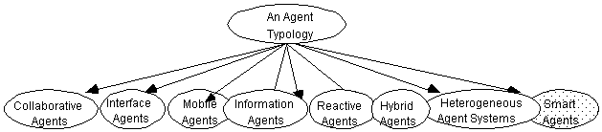
Software Intelligent Agents
Collaborative agents
Interface Agents
Mobile Agents
Information Agents
Reactive Agents
Smart Agents
Multi-Agents
Hybrid Agents
Heterogeneous Agents
……

Slide 31
1.3 AI pre-history
Philosophy Logic, methods of reasoning, mind as physical
system foundations of learning, language,
rationality
Mathematics Formal representation and proof algorithms,
computation, (un)decidability, (in)tractability, probability
Economics utility, decision theory
Neuroscience physical substrate for mental activity
Psychology phenomena of perception and motor control,
experimental techniques
Computer building fast computers
engineering
Control theory design systems that maximize an objective
function over time
Linguistics knowledge representation, grammar

Slide 32
Abridged history of AI
1943 McCulloch & Pitts: Boolean circuit model of brain
1950 Turing's "Computing Machinery and Intelligence"
1956 Dartmouth meeting: "Artificial Intelligence" adopted
1960s Early AI programs, including Samuel's checkers
program, Newell & Simon's Logic Theorist,
Gelernter's Geometry Engine
1965 Robinson's complete algorithm for logical reasoning
1966—73 AI discovers computational complexity
Neural network research almost disappears
1969—79 Early development of knowledge-based systems
1980-- AI becomes an industry
1986-- Neural networks return to popularity
1987-- AI becomes a science
1995-- The emergence of intelligent agents

Slide 33
1.4 AI State of the art
Deep Blue defeated the world chess champion Garry Kasparov in 1997
Proved a mathematical conjecture (Guising) unsolved for decades
No hands across America (driving autonomously 98% of the time from Pittsburgh to San Diego)
During the 1991 Gulf War, US forces deployed an AI logistics planning and scheduling program that involved up to 50,000 vehicles, cargo, and people
NASA's on-board autonomous planning program controlled the scheduling of operations for a spacecraft
Some programs solves crossword puzzles better than most humans

Slide 34
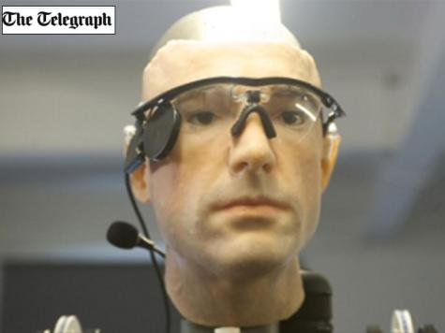
علماء يصنعون رجلا بمليون دولار
Jan 30, 2013
ركس صُنع باستخدام أحدث تقنية في مجال الأطراف والأعضاء الصناعية (ديلي تلغراف)

Slide 35
علماء يصنعون رجلا بمليون دولار
تمكن علماء من صنع إنسان من أطراف صناعية بلغت تكلفته مليون دولار. وقد صنع "ركس" -اسم مختصر لعبارة هيكل خارجي آلي- باستخدام أحدث تقنية في مجال الأطراف والأعضاء الصناعية في جميع أنحاء العالم. ومن مظهره الخارجي بذراعيه الآليتين وأعضائه الصناعية، يتبين أن العلم بدأ يلحق بركب الخيال العلمي في السباق الجاري لاستبدال بعض أجزاء الجسم ببدائل من صنع الإنسان.
ومن المعلوم أن المسلسل التلفزيوني الذي كان يذاع في سبعينيات القرن الماضي "ستيف أوستن رجل بستة ملايين دولار"، كان بطله الممثل الأميركي لي ماجورز قد تعرض لإصابة مروعة بعد تحطم مركبته الفضائية ورُكب له ذراع وساقان آليان وعين صناعية مقربة.
وتشمل مكونات "ركس" ذراعا تتحرك في نطاق 26 درجة، أقل من الذراع البشرية، تعلم نفسها ارتداء نظارات ترسل صورا إلى رقاقة صغيرة في شبكية العين التي ترسل بدورها نبضات إلكترونية إلى الدماغ، إضافة إلى قلب يعمل بالبطارية.
ولدى "ركس" كاحلان آليان أيضا يستخدمان محركا ونظاما نابضا لمحاكاة حركات عضلة بطة الرجل (الربلة) والعرقوب (الوتر الذي يربط عظم العقب بعضلة بطة الرجل) ابتكرهما الأستاذ هيو هر، الذي فقد ساقيْه إثر لسعة صقيع.

Slide 36
1.5 Robotics Basic Concepts
1.5.1 Robotics Scope
1.5.2 Robotics Design Issues
1.5.3 Robotics Applications

Slide 37
1.5.1 Robotics Scope
Is AI Engineering or Science?
Will robots take over the world?
What is a robot?
What are robots good at?
What tasks would you give robots?
What does building robots teach us about humans?
What subsystems make up a robot?
How do robots move?
What sensors might robots have?
What use are sensors?
What are some problems with control of robot actions?
How do you measures of performance of robot?
How are robots different from automated machinery?

Slide 38
Is AI Engineering or Science?
Construction ==> Engineering
  all scientific problems solved
  representative: Feigenbaum
Science ( Robotics are science as part of AI )
  more scientific principles to be discoverer
  representative: McCarthy

Slide 39
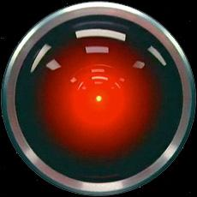
Will robots take over the world?
Which decisions can the machine make without human supervision?
May machine-intelligent systems make mistakes (at the same level as humans)?
May intelligent systems gamble when uncertain (as humans do)?
Can (or should) intelligent systems exhibit personality?
Can (or should) intelligent systems express emotion?
How much information should the machine display to the human operator?
HAL - 2001 Space Odyssey series is a science fiction series of four novels and two films created from 1968 to 1997

Slide 40
What is a robot?
Definition of a Robot
According to The Robot Institute of America (1979) :
"A reprogrammable, multifunctional manipulator designed to move materials, parts, tools, or specialized devices through various programmed motions for the performance of a variety of tasks."
According to the Webster dictionary:
"An automatic device that performs functions normally ascribed to humans or a machine in the form of a human (Webster, 1993)."
Notes:
Reference:
http://www.robotics.utexas.edu/rrg/learn_more/history/

Slide 41
Alternative terms for Robotics:
      UAV: unmanned aerial vehicle
      UGV: unmanned ground vehicle
      UUV: unmanned undersea vehicle
What makes a robot?
    sensors
    effectors/actuators
    locomotion system
    on-board computer system
    controllers for all of the above (smart methods everywhere)

Slide 42
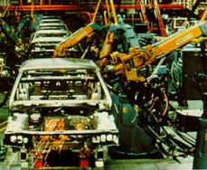

What are robots good at?
What is hard for humans is easy for robots.
  Repetitive tasks.
  Continuous operation.
  Complicated calculations.
  Refer to huge databases.
What is easy for a human is hard for robots.
  Reasoning.
  Adapting to new situations.
  Flexible to changing requirements.
  Integrating multiple sensors.
  Resolving conflicting data.
  Synthesizing unrelated information.
  Creativity.

Slide 43
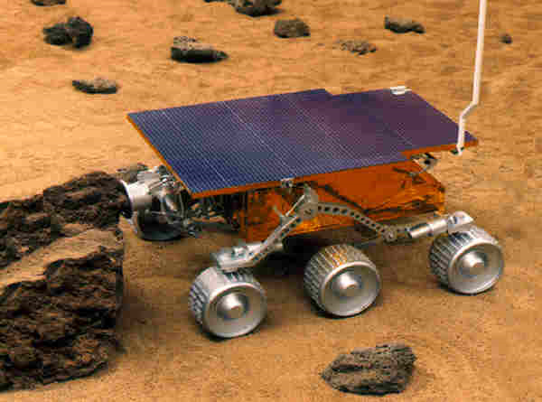
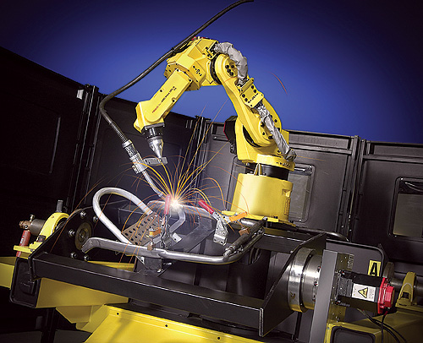
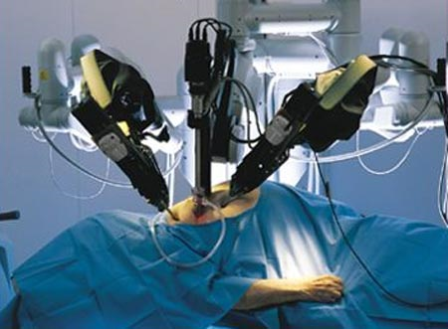
What tasks would you give robots?
Dangerous
  space exploration
  chemical spill cleanup
  disarming bombs
  disaster cleanup
Boring and/or repetitive
  welding car frames
  part pick and place
  manufacturing parts.
High precision or high speed
  electronics testing
  surgery
  precision machining.

Slide 44
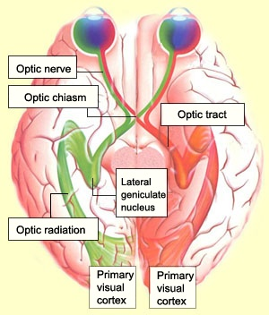
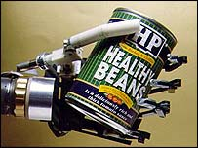
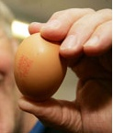
What does building robots teach us about humans?
How do our sensors work?
  eyes
  brain
How do we integrate sensors?
How does our muscular-skeletal system work?
  How do we grab and hold an object?
How does our brain process information?
What is nature of intelligence?
How do we make decisions?

Slide 45
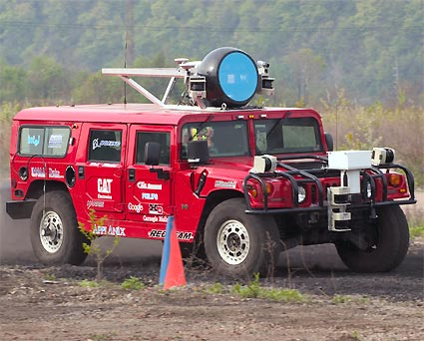
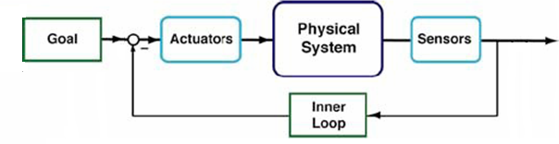
What subsystems make up a robot?
Action
  Stationary base
  Mobile
Sensors
Control
Power supply

Slide 46
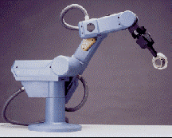
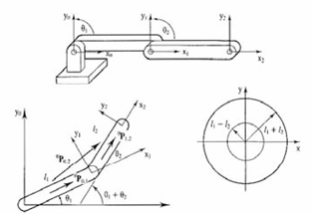
Action – do some function
Actuators
  Pneumatic ( working by Air)
  Hydraulic (use of pressurized liquids)
  electric solenoid
Motors
  Analog (continuous)
  Stepping (discrete increments)
Gears, belts, screws, levers
Manipulations

Slide 47
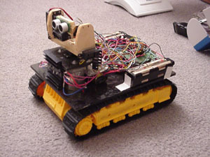
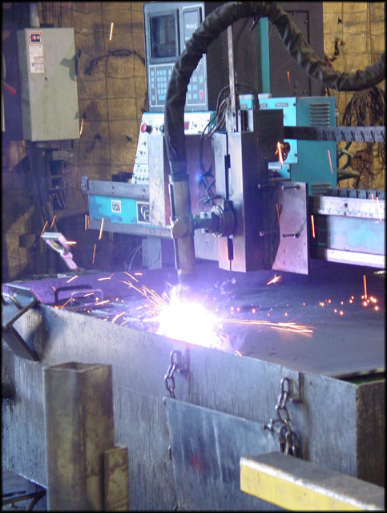
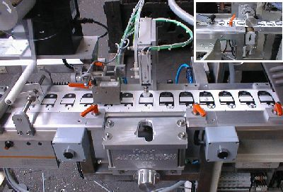
Three types of robot actions
Pick and place
  Moves items between points.
Continuous path control
  Moves along a programmable path
Sensory
  Employs sensors for feedback

Slide 48
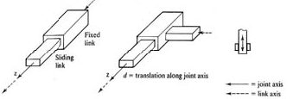

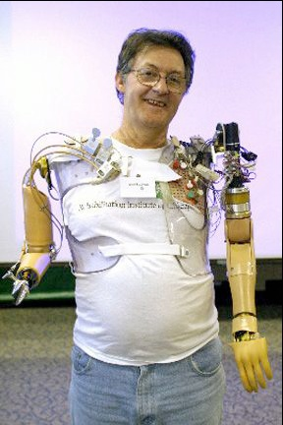
How do robots move?
Simple joints (2D)
  Prismatic — sliding along one axis
    square cylinder in square tube
  Revolute — rotating about one axis
Compound joints (3D)
  ball and socket = 3 revolute joints
  round cylinder in tube = 1 prismatic, 1 revolute
Degrees of freedom = Number of independent motions
  3 degrees of freedom: 2 translation, 1 rotation
  6 degrees of freedom: 3 translation, 3 rotation

Slide 49
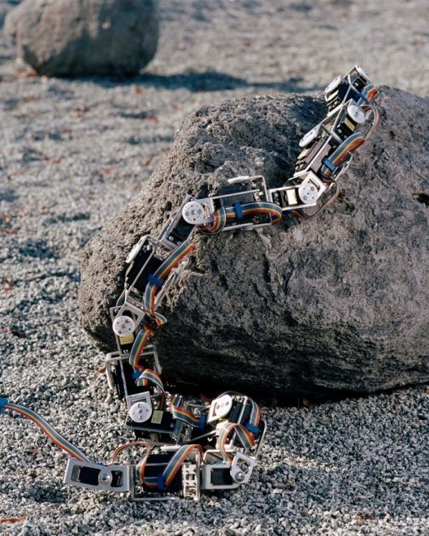
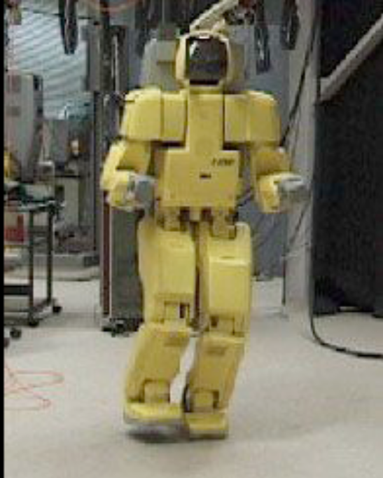
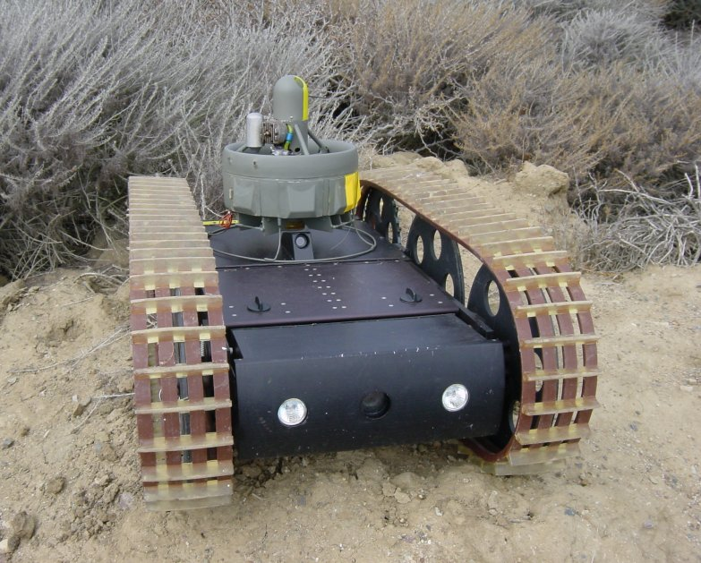
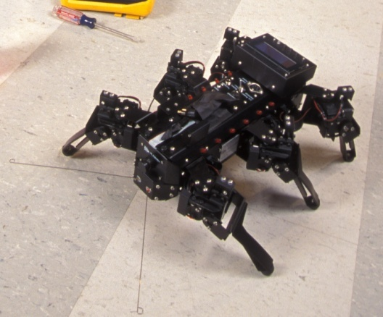
Mobility
Legs
Wheels
Tracks
Crawls
Rolls

Slide 50
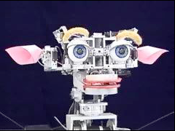
What sensors might robots have?
Optical
  Laser / radar
  3D
  Color spectrum
Pressure
Temperature
Chemical
Motion & Accelerometer
Acoustic
  Ultrasonic

Slide 51
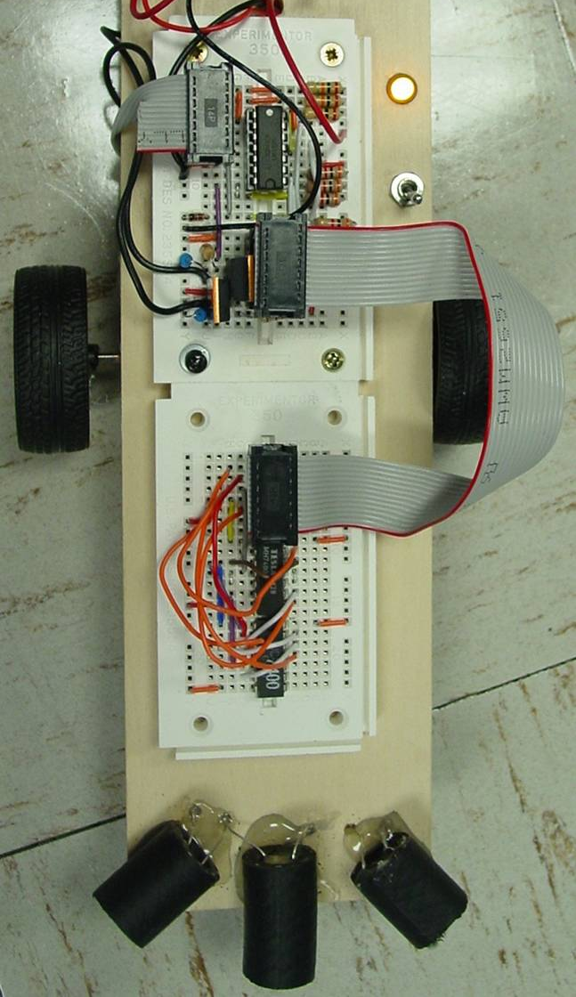
What use are sensors?
Uses sensors for feedback
  Closed-loop robots use sensors in conjunction with actuators to gain higher accuracy – servo motors.
  Uses include mobile robotics, telepresence, search and rescue, pick and place with machine vision.

Slide 52
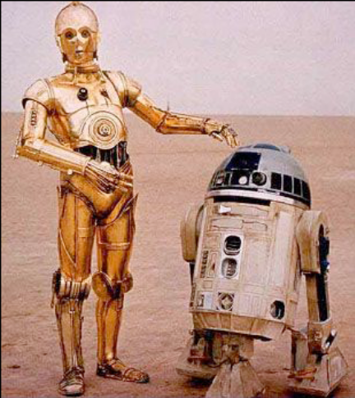
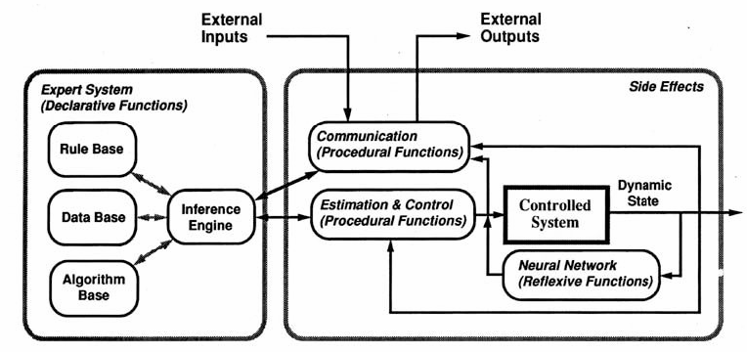
Uses sensors for Control - the Brain
Open loop, i.e., no feedback, deterministic
  Instructions
  Rules
Closed loop, i.e., feedback
  Learn
  Adapt

Slide 53
What are some problems with control of robot actions?
Joint play, compounded through N joints.
Accelerating masses produce vibration, elastic deformations in links.
Torques, stresses transmitted depending on end actuator loads.
Feedback loop creates instabilities.
  Delay between sensing and reaction.
Firmware and software problems
  Especially with more intelligent approaches

Slide 54
How do you measures of performance of robot?
Speed and acceleration
Resolution
Working volume
Accuracy
Cost
Plus all the kinds of evaluation functions we have talked about for any AI system.

Slide 55
Measures of Performance
Speed and acceleration
  Faster speed often reduces resolution or increases cost
  Varies depending on position, load.
  Speed can be limited by the task the robot performs (welding, cutting)
Resolution( measure of movement )
  Often a speed tradeoff
  The smallest movement the robot can make
Working volume (measure of theatre of operation )
  The space within which the robot operates.
  Larger volume costs more but can increase the capabilities of a robot

Slide 56
Performance (cont.)
Accuracy of Implementation
  The difference between the actual position of the robot and the programmed position
  Repeatability
    Will the robot always return to the same point under the same control conditions?
    Varies depending on position, load?
Cost
  Typically a tradeoff – improved performance on other metrics vs lower cost

Slide 57

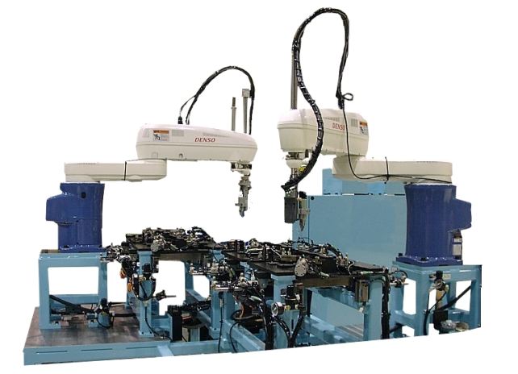
How are robots different from automated machinery?
Machinery is designed to carry out a specific task
  Bottling machine
  Dishwasher
  Paint sprayer
Robots are designed to carry out a variety of tasks
  Pick and place arms
  Mobile robots
  Computer Numerical Control machines

Slide 58
1.5.2 Robotics Design Issues
1.5.2.1 Robot Technology
1.5.2.2 Sensors and Actuators
1.5.2.3 Mobile Robot locomotion
1.5.3.4 Robot Control
1.5.3.5 Case Study: Line Following Robot

Slide 59
ROBOT SELECTION
Robot Must Be Matched Properly By Capabilities To Task Requirements.
Criteria For Robot Selection:
  Techinical Issues:
    Type: Nonservo, Servo, Servo-controlled
    Work Envelope: Rectangular, Cylindircal, Spherical, Jointed Arm, Scara
    Payload
    Cycle Time
    Repeatability
    Drive: Electric, Pneumatic, Hydraulic, Any Combination
    Unique Capabilities
  Non-technical Issues:
    Cost And Benefit Consideration
    Commonality Of Equipment
    Training And Maintenance Requirements
    Reliability
    Service
    “Systems” Help
    Safety

Slide 60
Why is Robotics hard?
(Technology Limitations)
      Sensors are limited and simple
      Manipulators (Effectors ) are limited and simple
      State (internal and external, but mostly external) is partially-observable
      Environment is dynamic (changing over time)
      Environment is full of potentially-useful information

Slide 61
Robotics Degree of Complexity
Grounding in reality
  not just planning in an abstract world
Situatedness (biological dynamics)
  tight connection with the environment
Embodiment
  having a body
Emergent behavior
  interaction with the environment
Scalability
  increasing task and environment complexity

Slide 62
1.5.2.1 Robot Technology
Robot technology is an applied science that is referred to as a combination of machine tools and computer applications.
Includes Such Diverse Fields As :
Machine Design,
Control Theory,
Microelectronics,
Computer Programming,
Artificial Intelligence,
Human Factors,
Production Theory.

Slide 63
Robot Technology General Characteristics
A specialized machine tools with a degree of flexibility that distinguishes them from fixed-purpose automation.
Is essentially a mechanical arm that is bolted to the floor, a machine, the ceiling, or, in some cases the wall fitted with its mechanical hand, and taught to do repetitive task in a controlled, ordered environment.
Ability to move mechanical arm to perform work.
Robot interface with their work environment once a mechanical hand has been attached to the robot’s tool-mounting plate.

Slide 64
Robot Technology Terminologies
work envelope: the set of points representing the maximum extent or reach of the robot hand or working tool in all directions.
Payload: The ability to carry, continously and satisfactorily, a given maximum weight at a given speed.
Velocity: The maximum speed at which the tip of a robot is capable of moving at full extension, expressed in inches or millimeters per second.
Cycle: Time it takes for the robot to complete one cycle of picking up a given object at a given height, moving it to a given distance, lowering it, releasing it, and returning to the starting point.
Accuracy: A robot’s ability to position the end effector at a specified point in space upon receiving a control command without previously having attained that position.
Repeatibility: The ability of a robot to return consistently to a previously defined and achieved location.
Resolution: The smallest incremental change in position that it make or its control system can measure.
Size: The physical size of a robot, which influences its capacity and its capabilities.

Slide 65
Basic Components of an Industrial Robot
The basic components of an industrial robot are the:
  manipulator
  the end effector (which is the end part of the manipulator).
  the power suplly
  the controller.
The manipulator, which is the robot’s arm, consists of segments jointed together with axes capable of motion in various directions allowing the robot to perform work.
The end effector which is a gripper tool, a special device, or fixture attached to the robot’s arm, actually performs the work.
Power supply provides and regulates the energy that is converted to motion by the robot actuator, and it may be either electric, pneumatic, or hydraulic.
The controller initiates, terminates, and coordinates the motion of sequences of a robot. also it accepts the necessary inputs to the robot and provides the outputs to interface with the outside world.

Slide 66
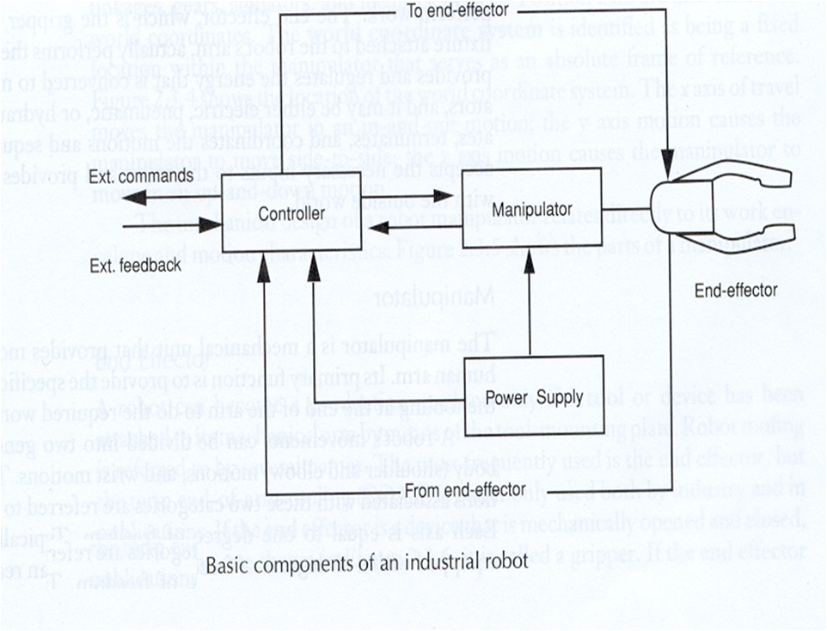

Slide 67
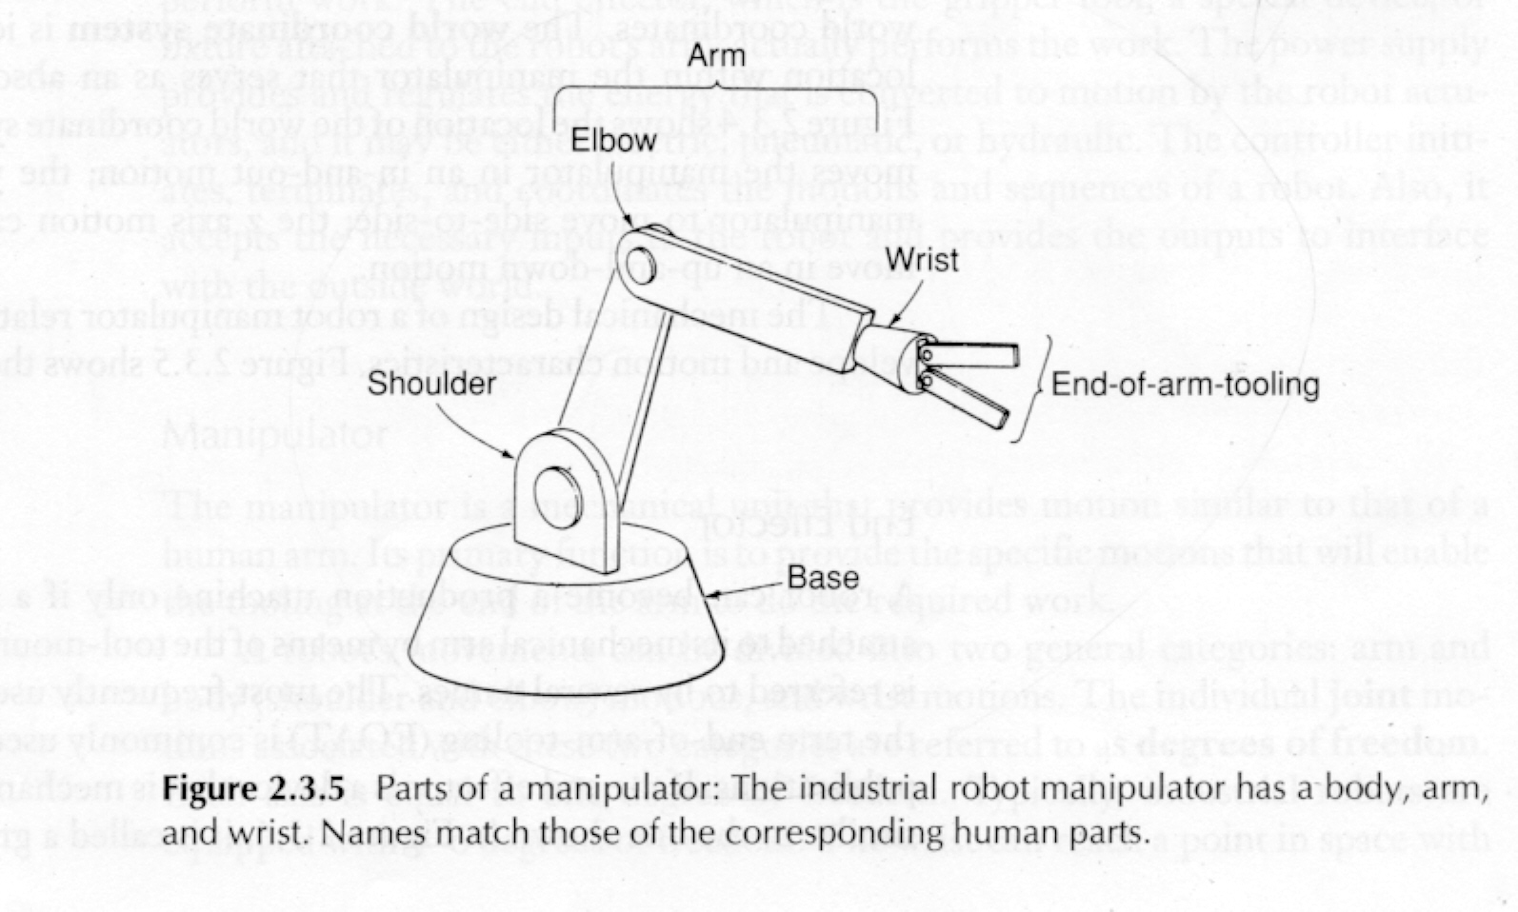

Slide 68
Robot Anatomy
Robot anatomy is concerned with the physical construction and characteristics of the body, arm, and wrist, which are components of robot manipulator.
Movements between the various components of the body, arm, and wrist are provided by a series of joints.
Attached to the robot wrist is the end effector (or end-of-arm tooling) that performs the work.
The end effector is not considered a part of the robot’s anatomy.

Slide 69
Robot Configurations
  industrial robots are available in a wide range of shapes, sizes, speeds, load capacities, and other capabilities.
  the vast majority of tody’s commercially available robots possess five distinct design configurations:
    Rectangular (or cartesian)
    Cylindirical (or post-type)
    Spherical (or polar)
    Jointed arm ( or articulated )
    Scara (selective complaince assembly robot arm)

Slide 70
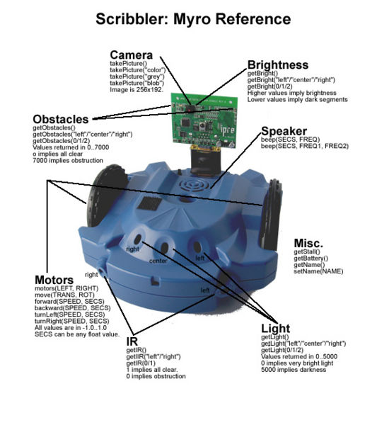
1.5.2.2 Robot Sensors & Actuators Example
The Scribbler is a fully programmable, intelligent robot with multiple sensor systems that let it interact with people and objects.
It navigates on its own as it explores its surroundings, and then reports back about what it senses using light and sound

Slide 71
The Scribbler Robot comes fully assembled with these systems:
A built-in BASIC Stamp® 2 microcontroller brain (inside)
3 photo resistor light sensors to detect bright light, or its absence
A pair of infrared emitter “headlights” and an infrared detector to see objects
A pair of infrared line sensors to follow lines or read bar codes
Two independent DC motors to drive the wheels
A built-in stall sensor to protect the motors (inside)
Three indicator LED lights that can be separately program-controlled
A speaker to play a wide range of sounds and musical notes
A Pen Port to insert a marker so the Scribbler can draw as it drives
A Programming Port that accepts a serial cable for a computer interface
Battery Cover – requires 6 standard, alkaline, or NiMH batteries

Slide 72
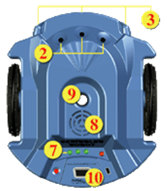
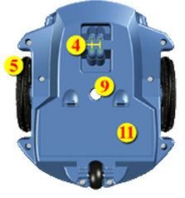
Scribbler Top & Bottom View

Slide 73
IR Obstacle Sensors
The Scribbler has two IR obstacle sensors (under the light sensors) that return a binary value of 0 or 1.
The robot actually has 1 IR receiver located in the center, and two emitters located on the left and right side of the emitter.

Slide 74
IR Obstacle Sensors-contn
Return value of 0
– IR light is bouncing back to the receiver (off of an obstacle. i.e. there is something in front of the emitter/detector)‏

Slide 75
IR Obstacle Sensors-contn
Return value of 1
means that infrared light is not bouncing back to the receiver, so nothing is in front of the emitter/detector.

Slide 76
IR Obstacle Sensors-contn
getIR() returns a list of two items [1,1]. You can also call getIR(“left”) to get just the left sensor, and similarly with getIR(“right”).
The function also accepts 0 and 1 as the parameter to select which sensor value to return.

Slide 77

Light Sensors (3)‏-contn
The scribbler has 3 light sensors pointing Left, Center and Right on the same side as the getIR sensors.
[45, 200, 430] = getLight()‏

Slide 78
Light Sensors (3)‏
Light sensor values range from 0 to 5000. Zero is very bright, 5000 is full dark.
getLight() returns a list of all 3 values.
getLight(“left” / “center” / “right”) or getLight(0/1/2) selects one value

Slide 79
Internal Scribbler Sensors
getBattery() - returns battery voltage
getStall() - returns stall condition (0 or 1)
to indicate condition of halt‏
getName() - returns the robot's name (can be changed with setName(“newName”)‏

Slide 80
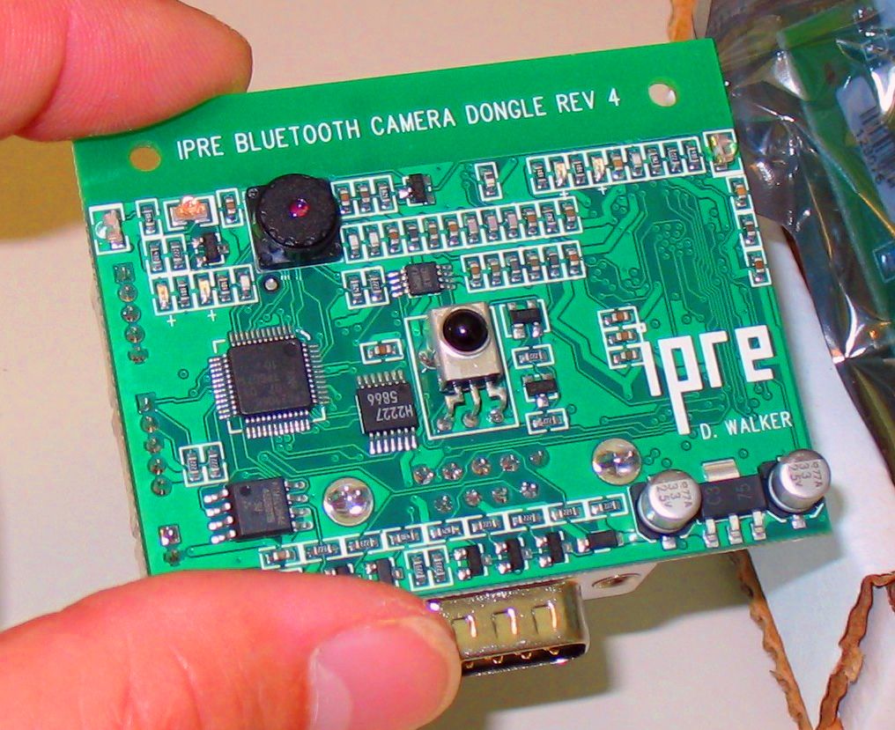
Fluke Built in Board
The Fluke add-on board has its own IR obstacle sensors and a camera.

Slide 81
Robot Actuators
Beep
Motors
LED Lights

Slide 82
Speaker command – Beep
beep() - issues a random beep
beep(1) – random beep for 1 second
beep(1,800) – Beep at 800Hz for 1 second
beep(1,440,880) – two tone beep at 440 & 880Hz for 1 second.

Slide 83
Robot Actuators - Motors
Two motors (left,right) that can be set to a power level between -1 and 1.
-1 is full reverse
0 is stopped
1 is full speed forward.
Controlled directly with the motors(left,right) function.

Slide 84
Robot Actuators – Motors – Utility Functions
These functions make it easier to use the motors to do simple things:
  Forward (speed, seconds) – Moves the robot forward at the specified speed for the specified seconds, and then stops.
  turnLeft (speed,seconds) – Turns the robot left at the specified speed and for the specified seconds, then stops.
  turnRight () and backward () are similar.

Slide 85
Robot Actuators – Motors – Utility Functions-contn
The previous functions would all start the robot, go for a certain amount of time, and then stop the robot automatically.
You can also start the robot moving without specifying how long it should do so:
  forward(speed), turnLeft(speed), backward(speed), turnRight(speed), stop()‏
  Very important to call the stop() function when you want the robot to stop!
  The wait(seconds) function can be used to specify how long the robot should travel:
  forward(0.85)‏
  wait(1.5)‏
  stop()‏

Slide 86
Motor commands – Translate & Rotate
Other functions exist:
  translate(speed)‏
  rotate(speed)‏
These functions allow you to add together different types of motion, allowing the robot to move forward -- translate(1) while also turning—rotate(0.5).
stop() is equivalent to translate(0); rotate(0)‏

Slide 87
LED commands – setLED()‏
The Scribbler robot has 3 green LED lights.
You can control these three lights with setLED(position, value).
Position is a number: 0, 1, or 2 or a string “left”, “center”, or “right”
Value is either 0 (“off”) or 1 (“on”)‏
The center light blinks continuously, so unless you keep setting it's value, it will just start blinking again.

Slide 88
LED commands – setLEDFront() and setLEDBack()‏
The Fluke board has 2 user controlled red LED lights.
One on the front (small, near the camera) and one on the back (large, near the white connector)‏
You can control these three lights with setLEDFront(value) and setLEDBack(value) functions.
Value is either 0 (“off”) or 1 (“on”)‏
The back LED is VERY bright! And you can set it to half power with a 0.5 value, or quarter power with 0.25.

Slide 89
1.5.2.3 Mobile Robot Locomotion
( Moving Robot Style)
  Classification of Wheels
  Fixed wheel
  Centered orientable wheel
  Off-centered orientable wheel
  Swedish wheel
Mobile Robot Locomotion
  Differential Drive
  Tricycle
  Synchronous Drive
  Omni-directional
  Ackerman Steering ( as in Car Drive )

Slide 90
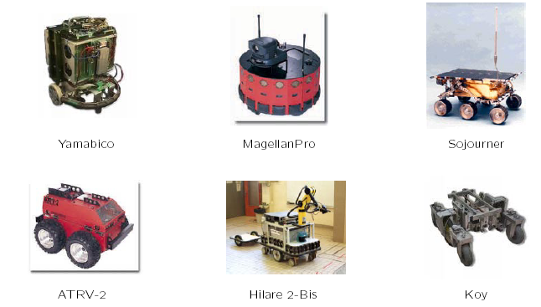
Kinematics Models of Wheeled Mobile Robots (WMR)

Slide 91
Wheeled Mobile Robots (WMR)-contn
Combination of various physical (hardware) and computational (software) components
A collection of subsystems:
  Locomotion: how the robot moves through its environment
  Sensing: how the robot measures properties of itself and its environment
  Control: how the robot generate physical actions
  Reasoning: how the robot maps measurements into actions
  Communication: how the robots communicate with each other or with an outside operator

Slide 92
Mobile Robot Locomotion
Locomotion — the process of causing an robot to move.
  In order to produce motion, forces must be applied to the robot
  Motor output, payload must be sufficient to do so
Dynamics – study of motion in which these forces are modeled
  Deals with the relationship between force and motions.
Kinematics – study of the mathematics of motion without considering the forces that affect the motion.
  Deals with the geometric relationships that govern the system
  Deals with the relationship between control parameters and the behavior of a system.

Slide 93
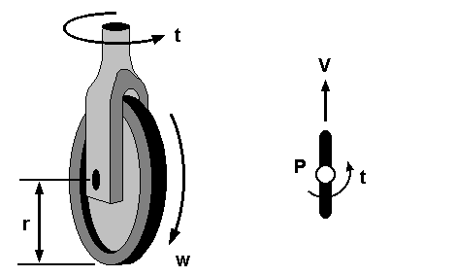
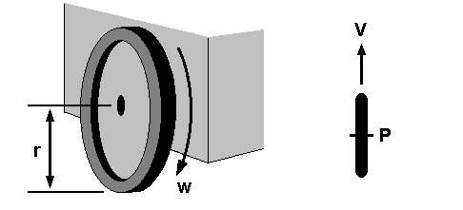
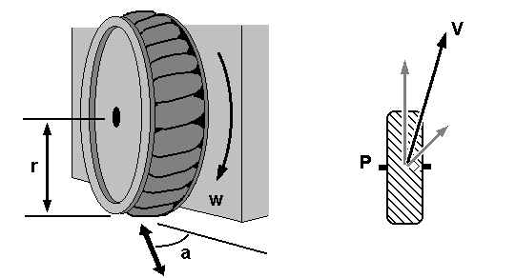
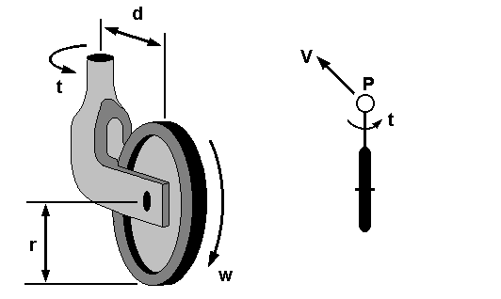
Wheel Types
Fixed wheel
Centered orientable wheel
Off-centered orientable wheel
(Castor wheel)
Swedish wheel:omnidirectional property

Slide 94
Mobile Robot Locomotion (Moving Styles)
Differential Drive
  two driving wheels (plus roller-ball for balance)
  simplest drive mechanism
  sensitive to the relative velocity of the two wheels (small error result in different trajectories, not just speed)
Tricycle
  Steering wheel with two rear wheels
  cannot turn ±90º
  limited radius of curvature
Synchronous Drive
Omni-directional
Car Drive (Ackerman Steering)

Slide 95
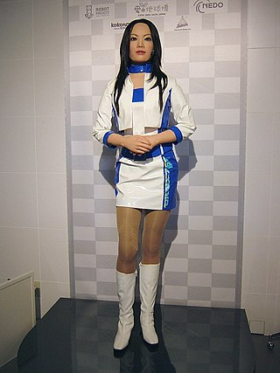

Android
1.5.2.4 Robot Control
My beloved….
Repliee Q2
is a type of android (humanoid robot) with strong visual human-likeness developed by Osaka University and manufactured by Kokoro Company Ltd. (the animatronics division of Sanrio). It was first unveiled at the 2003 International Robot Exhibition in Tokyo,
Notes:
One of the main aims of humanoid robotics is to develop robots that are capable of interacting naturally with people. However, to understand the essence of human interaction, it is crucial to investigate the contribution of behavior and appearance. The android’s motions must closely match human performance to avoid looking strange, including such autonomic responses as the shoulder movements involved in breathing. The researchers propose a method to implement motions that look human by mapping their three-dimensional appearance from a human performer to the android and then evaluating the verisimilitude of the visible motions using a motion capture system. It focused on copying a person’s moving joint angles to a robot.
They embed as many actuators as possible to provide many degree of freedom thus does not interfere with making the android look as human as possible.
They assumed the kinematics of the robot to be similar to a human body.
Reference:
http://www.ed.ams.eng.osaka-u.ac.jp/development/Humanoid/ReplieeQ2/ReplieeQ2_eng.htm
http://199.246.67.28/exnmedia/exn20050324-android.asf
Generating Natural Motion in an Android by Mapping Human Motion
Daisuke Matsui∗, Takashi Minato∗, Karl F. MacDorman†, and Hiroshi Ishiguro∗‡
∗Department of Adaptive Machine Systems, Graduate School of Engineering, Osaka University

Slide 96
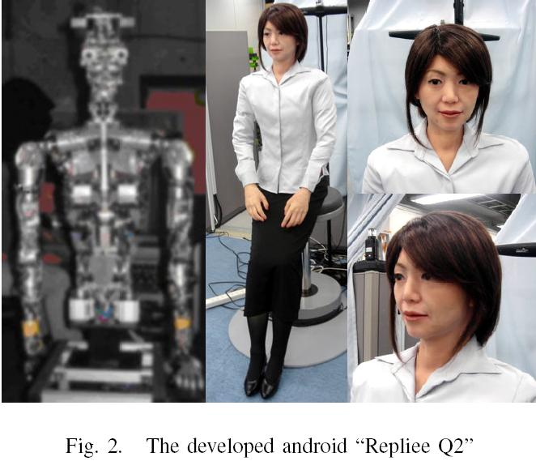
Notes:
The researchers transfer human motion measured by a motion capture system to the android by coping changes in the positions of body surfaces because the android’s appearance demands movements that look human bit its kinematics is sufficiently different that copying joint-angle information would not yield good results.
By comparing the similarity of the android’s visible movement enables us to develop more natural movements for the android.
Repliee Q2 is modeled after a Japanese woman. The standing height is about 160 cm. The skin is composed of a kind of silicone that has a humanlike feel and neutral temperature. The silicone skin covers the upper torso, neck, head and forearms with clothing covering other body parts. The soft skin gives the android a human look and enable natural interaction.
It has forty-two highly sensitive tactile sensors composed of peizo diaphragms are mounted under the android’s skin and clothes throughout the body except for the shins, calves and feet.

Slide 97
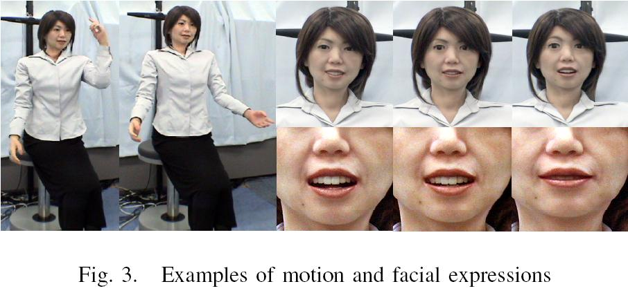

Slide 98
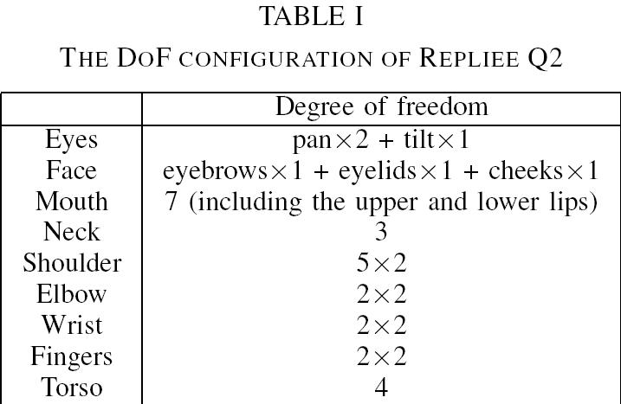
Notes:
The android is driven by air actuators that give it 42 degrees of freedom (DoFs) from the waist up which can generate a wide range of motions and gestures as well as various kinds of micro-motions such as the shoulder movements typically caused by human breathing.

Slide 99
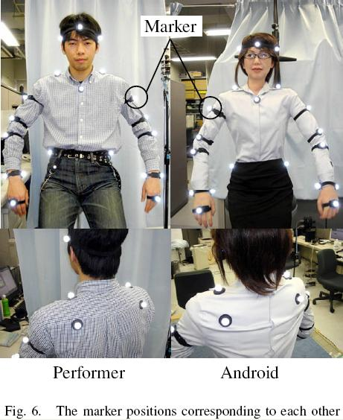
Notes:
This is an experiment to transfer human motion to the android Repliee Q2. They used 21 of the android’s 42 DoFs by excluding the 13 DoFs of the face, the 4 of the wrists, and the 4 of the fingers (n = 21). They used a Hawk Digital System, which can track more than 50 markers in real-time. The system is highly accurate with a measurement error of less than 1 mm. Twenty markers were attached to the performer and another 20 to the android as shown in Fig. 6 (m = 20). Because the android’s waist is fixed, the markers on the waist set the frame of reference for an android-centered coordinate space.

Slide 100
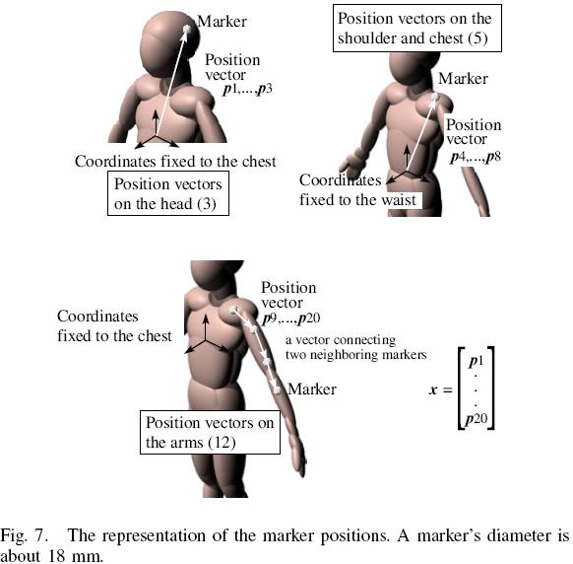
Notes:
To facilitate learning, they introduce a representation of the marker position as shown in Fig.7. The effect of waist motions are removed with respect to the markers on the head. To avoid accumulating the position errors at the end of the arms, vectors connecting neighboring pairs of markers represent the positions of the markers on the arms. They used arc tangents for the transformation T, in which the joint angle is an angle between two neighboring links where a link consists of a straight line between two markers.
There are 60 nodes in the input layer (20 markers × x, y, z), 300 in the hidden layer, and 21 in the output layer (for the 21 DoFs). Using 300 units in the hidden layer provided a good balance between computational efficiency and accuracy. Using significantly fewer units resulted in too much error, while using significantly more units provided only marginally higher accuracy but at the cost of slower convergence.

Slide 101
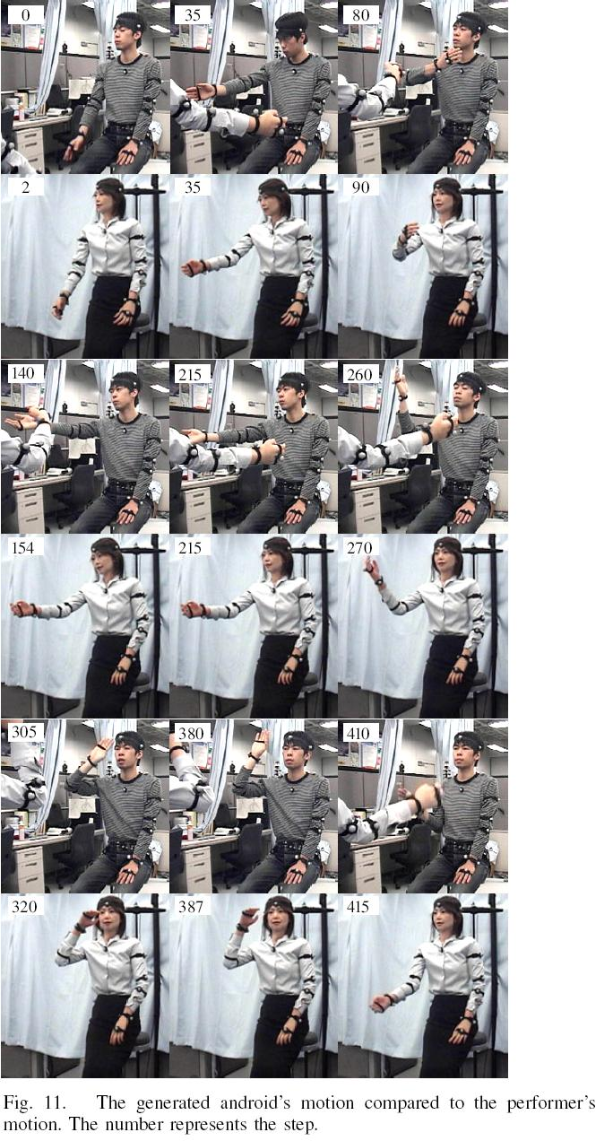
Different Design implies different behavior ( needed no of steps to perform an action)
Notes:
Fig. 11 shows the performer’s postures during a movement and the corresponding postures of the android.
The android followed the performer’s movement with some delay. The trajectories of the positions of the android’s markers are considered to be similar to those of the performer, but errors still remain, and they cannot be ignored. Researchers recognized that the android is making the same gesture as the performer, the quality of the movement is not the same.
There are few reasons that causing this problem:
The kinematics of the android is too complicated to represent with an ordinary neural network.
The method deals with a motion as a sequence of postures; it does not precisely reproduce higher order properties of motion such as velocity and acceleration because varying delays can occur between the performer’s movement and the android’s imitation of it.
The proposed method is limited by the speed of motion. The android has absolute physical limitations such as a fixed compliance and a maximum speed that is less than that of a typical human being.

Slide 102

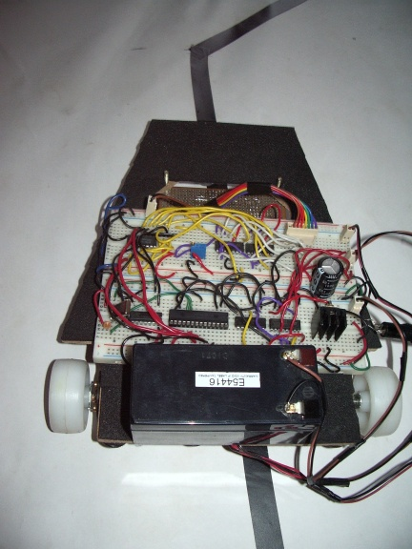

Slide 103
LFR Requirements
The robot must be capable of following a line.
It should be capable of taking various degrees of turns
It must be prepared of a situation that it runs into a territory which has no line to follow.
The robot must also be capable of following a line even if it has breaks.
The robot must be insensitive to environmental factors such as lighting and noise.
It must allow calibration of the line’s darkness threshold.
Scalability must be a primary concern in the design.
The color of the line must not be a factor as long as it is darker than the surroundings.

Slide 104
The Pic Microcontroller
(PIC 16F873)
Reduced Instruction Set Computer (RISC) Architecture
1 Word Instruction Length
Fixed Instruction Execution Time
3 Ports (A, B & C)
2 Ccp (Capture, Compare ) Modules
192 Bytes Data Ram & 128 Bytes of EPROM Data Memory
Upto 13 Interrupt Sources
3 Timers
Power Saving SLEEP Mode
A/D Convertor

Slide 105
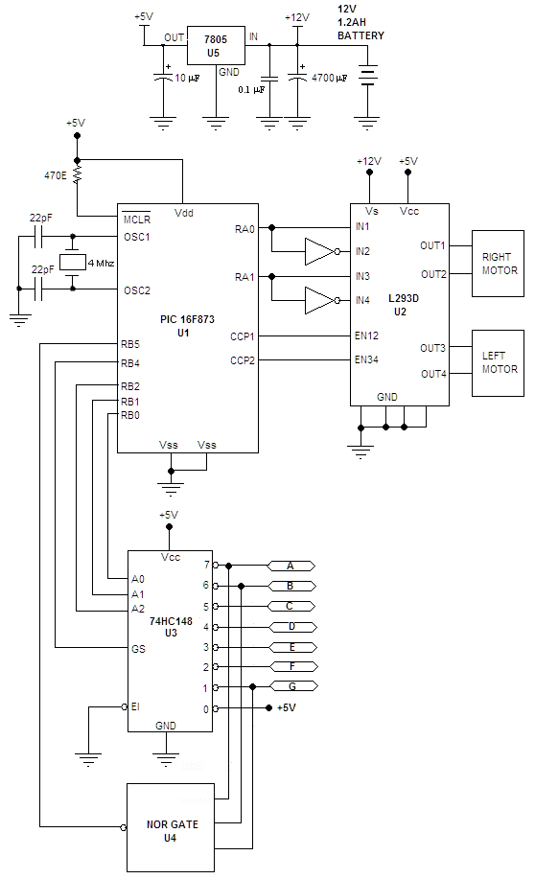
The Schematic Diagram

Slide 106
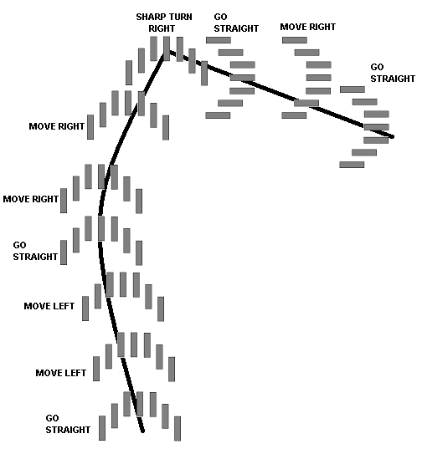
LFR Processes Involved

Slide 107
LFR Applications
Industrial automated equipment carriers
Automated cars.
Tour guides in museums and other similar applications.
Second wave robotic reconnaissance operations.

Slide 108
1.5.3 Robotics Applications
Early Robotics
Robot Generations
Robotics Today
Robotics Road Map

Slide 109
Early Robots
Early Robots: SHAKEY
      At Stanford Research Institute (late 1960s)
      Vision and contact sensors
      STRIPS planner
      Visual navigation in a special world
Early Robots: HILARE
      LAAS in Toulouse, France (late 1970s)
      Video, ultrasound, laser range-finder
      Still in use!
      Multi-level spatial representations

Slide 110
Robot Generations
The five generations of robot controllers after the high-tech inception in 1960 are as follows:
  First generation: repeating robots. these were generally pick and place robots, with mechanical sequences defining stop points.
  Second generation: hardwired controllers provided the first programmable units.
  Third generation: programmable logic controllers (plc), introduced in the industry over thirteen years ago, provided a microprocessor-based robotic controller that is easy to program.
  Fourth generation: when control beyond the plc is required, a microcomputer may control the entire system, including other programmable machinery in a robot work cell.
  Fifth generation: robot controller will involve complete artificial intelligence (AI), miniature sensors, and decision making capabilities.
an artificial biological robot might provide the force for sixth and higher generation robots.

Slide 111
Robotics Today
      Assembly and manufacturing (most numbers of robots, least autonomous)
      Materials handling
      Gophers (hospitals, security guards)
      Hazardous environments (Chernobyl)
      Remote environments (Pathfinder)
      Surgery (brain, hips)
      Tele-presence and virtual reality
      Entertainment

Slide 112
How to build a Robot
How to Make a Drone / UAV – Lesson 1: Terminology (435)
How to Make a Robot – Lesson 1: Getting Started (411)
How to Build a Simple Robot – Beetle Robot (391)
How To Build A Simple Robot (369)
How Do I Interpret DC Motor Specifications? (309)how to build a robot.docx
Litter-Robot II Basic Troubleshooting Guide (265)
How to Make a Robot – Lesson 10: Programming Your Robot (258)
Arduino 5 Minute Tutorials: Lesson 7 – Accelerometers, Gyros, IMUs (233)

Slide 113
Assignment #1
Prepare a survey on reasoning including:
definitions
theories
applications
problems and research areas
inter-relations with the AI Main Topics in slide #9
Assignment to be delivered in free hand, not less than 10 pages with hard copy of references. Due date is one week after conducting the last slide of lecture # 1

