Slide 1

Lecture 2

Slide 2
Lecture 2 Outlines
2.1 Agents and environments
2.2 Rationality
2.3 PEAS (Performance measure, Environment, Actuators, Sensors)
2.4 Environment types
2.5 Agent types
2.6 Applications of software Agents
2.7 More Examples on software Agents
2.8 Intelligent Agent Design

Slide 3
Agents
An agent is anything that can be viewed as perceiving its environment through sensors and acting upon that environment through actuators
Human agent:
eyes, ears, other organs for sensors
hands , legs, mouth, and other body parts for actuators
Robotic agent:
cameras and infrared range finders for sensors
various motors for actuator

Slide 4
History of Agent
The concept of an agent can be traced back to Hewitt's Actor Model (Hewitt, 1977) - "A self-contained, interactive and concurrently-executing object, possessing internal state and communication capability."
software agent systems are a direct evolution from Multi-Agent Systems (MAS). MAS evolved from Distributed Artificial Intelligence (DAI), Distributed Problem Solving (DPS) and Parallel AI (PAI), thus inheriting all characteristics (good and bad) from DAI and AI.
John Sculley’s 1987 “Knowledge Navigator” video portrayed an image of a relationship between end-users and agents. Being an ideal first, this field experienced a series of unsuccessful top-down implementations, instead of a piece-by-piece, bottom-up approach.

Slide 5
Capabilities of Intelligent Agents
ability to adapt
Adaptation implies sensing the environment and reconfiguring in response.
This can be achieved through:
the choice of alternative problem-solving-rules or algorithms
the discovery of problem solving strategies.
other aspects of an agent's internal construction, such as recruiting processor or storage resources.
ability to learn
Learning may proceed through trial-and-error, then it implies a capability of introspection and analysis of behavior and success.
Alternatively, learning may proceed by example and generalization, then it implies a capacity to abstract and generalize.

Slide 6
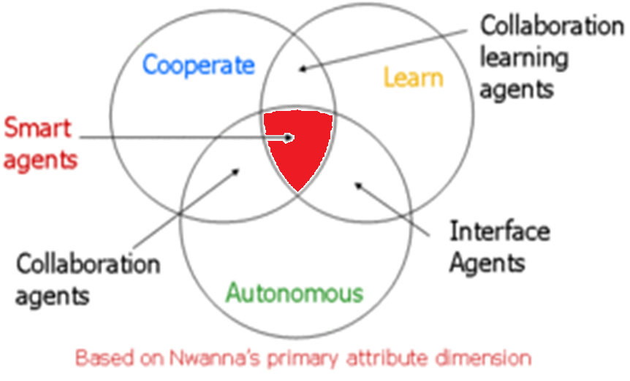
Nwana's Category of Software Agent

Slide 7

2.1 Agents and Environments
The agent function maps from Percept histories to Actions:
[ f : P* → A ]
The agent program runs on the physical architecture to produce f
agent = architecture + program

Slide 8
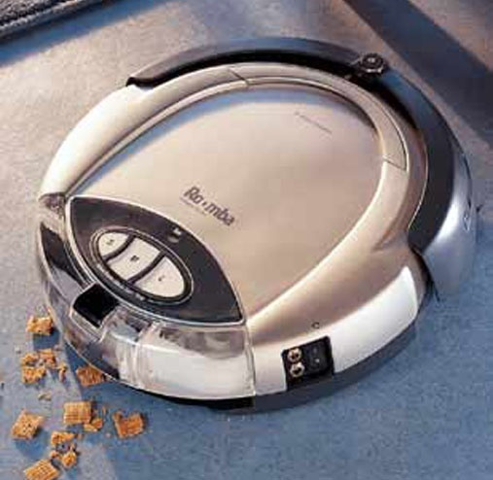
A Vacuum-cleaner agent
A
B
Percepts: location and contents, e.g., (A,dirty)
  (Idealization: locations are discrete)
Actions: move, clean, do nothing:
LEFT, RIGHT, SUCK, NOP

Slide 9
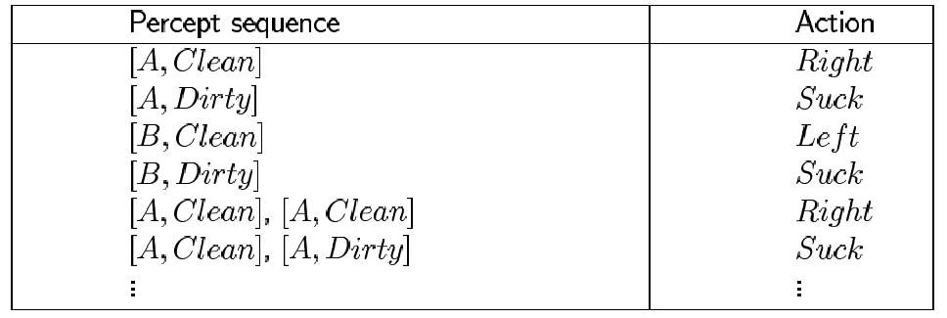
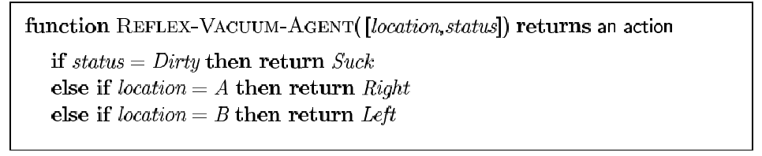
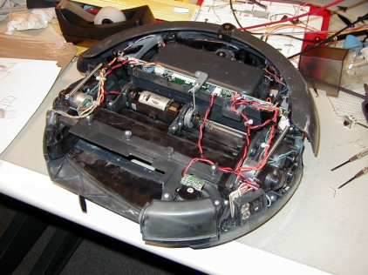
Vacuum-cleaner world: agent function

Slide 10
2.2 Rational Agents
An agent should strive to "do the right thing", based on what it can perceive and the actions it can perform.
The right action is the one that will cause the agent to be most successful
Performance measure: An objective criterion for success of an agent's behavior
e.g., performance measure of a vacuum-cleaner agent could be:
amount of dirt cleaned up,
amount of time taken,
amount of electricity consumed,
amount of noise generated

Slide 11
Rational agents-cont
Intelligent agents are often described schematically as an abstract functional system, similar to a computer program.
For this reason, intelligent agents are sometimes called abstract intelligent agents to distinguish them from their real world implementations as computer systems, biological systems, or organizations.
Some definitions of intelligent agents emphasize their autonomy, and so prefer the term autonomous intelligent agents.
Still others consider goal-directed behavior as the essence of rationality and so prefer the term rational agent.

Slide 12
Rational agents-cont
Rational Agent mechanism:
For each possible percept sequence, a rational agent should select an action that is expected to maximize its performance measure, given the evidence provided by the percept sequence and whatever built-in knowledge the agent has.

Slide 13
Rational agents-cont
Rationality is distinct from knowing every knowledge( it is not a matter of memory capacity )
Agents can perform actions in order to modify future percepts so as to obtain useful information (information gathering, exploration)
An agent is autonomous if its behavior is determined by its own experience (with ability to learn and adapt)

Slide 14
2.3 PEAS ( Task Environment Description)
PEAS: Performance measure, Environment, Actuators, Sensors
Must first specify the setting for intelligent agent design
Consider, e.g., the task of designing an automated taxi driver:
  Performance measure
  Actuators
  Sensors
  Environment

Slide 15
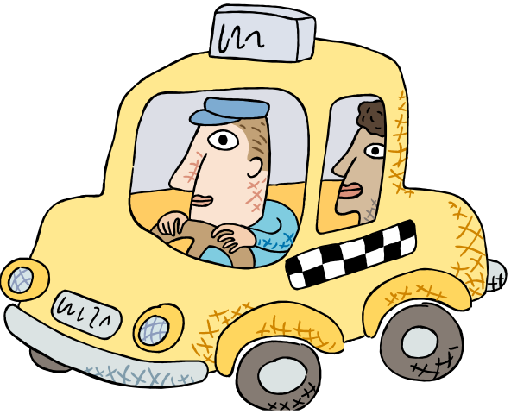
PEAS EXAMPLE 1:
Specifying an automated taxi driver
Performance measure:
  ?
Environment:
  ?
Actuators:
  ?
Sensors:
  ?

Slide 16
PEAS EXAMPLE 1: Specifying an automated taxi driver
Performance measure:
  safe, fast, legal, comfortable, maximize profits
Environment:
  ?
Actuators:
  ?
Sensors:
  ?

Slide 17
PEAS EXAMPLE 1 : Specifying an automated taxi driver
Performance measure:
  safe, fast, legal, comfortable, maximize profits
Environment:
  roads, other traffic, pedestrians, customers
Actuators:
  ?
Sensors:
  ?

Slide 18
PEAS EXAMPLE 1: Specifying an automated taxi driver
Performance measure:
  safe, fast, legal, comfortable, maximize profits
Environment:
  roads, other traffic, pedestrians, customers
Actuators:
  steering, accelerator, brake, signal, horn
Sensors:
  ?

Slide 19
PEAS: Specifying an automated taxi driver
Performance measure:
  safe, fast, legal, comfortable, maximize profits
Environment:
  roads, other traffic, pedestrians, customers
Actuators:
  steering, accelerator, brake, signal, horn
Sensors:
  cameras, sonar, speedometer, GPS

Slide 20

PEAS: Specifying an automated taxi driver
Reference: https://www.youtube.com/watch?v=dIxJ27Bmb1s

Slide 21
PEAS EXAMPLE 2
Agent: Medical Diagnosis System
Performance measure: Healthy patient, minimize costs, lawsuits
Environment: Patient, hospital, staff
Actuators: Screen display (questions, tests, diagnoses, treatments, referrals)
Sensors: Keyboard (entry of symptoms, findings, patient's answers)

Slide 22
PEAS EXAMPLE 3
Agent: Part-Picking Robot
Performance measure: Percentage of parts in correct bins
Environment: Conveyor belt with parts, bins
Actuators: Jointed arm and hand
Sensors: Camera, joint angle sensors

Slide 23
PEAS EXAMPLE 4
Agent: Interactive English tutor
Performance measure: Maximize student's score on test
Environment: Set of students
Actuators: Screen display (exercises, suggestions, corrections)
Sensors: Keyboard

Slide 24
https://youtu.be/nCHV2WhScrc

Slide 25
2.4 Environment types
Fully observable (vs. partially observable): An agent's sensors give it access to the complete state of the environment at each point in time.
Deterministic (vs. stochastic): The next state of the environment is completely determined by the current state and the action executed by the agent.
(If the environment is deterministic except for the actions of other agents, then the environment is strategic)
Periodic (vs. sequential): The agent's experience is divided into loosely connected modules (each period consists of the agent perceiving and then performing a single action)

Slide 26
Environment types-contn
Static (vs. dynamic): The environment is unchanged while an agent is studying its decision about action.
(The environment is semidynamic if the environment itself does not change with the passage of time but the agent's performance score does)
Discrete (vs. continuous): A limited number of distinct, clearly defined percepts and actions.
Single agent (vs. multivalent): An agent operating by itself in an environment.

Slide 27
2.5 Agent types
Russell & Norvig (2003) describe multiple types of agents and sub-agents as a first vision. For example:
Physical Agents - A physical agent is an entity which percepts through sensors and acts through actuators( as a traditional agent).
Temporal Agents - A temporal agent may use time based stored information to offer instructions or data acts to a computer program or human being and takes program inputs percepts to adjust its next behaviors.
Believable Agents - An agent exhibiting a personality via the use of an artificial character for the interaction to practically express believes ( believes against characters).

Slide 28
Agent types –contn
( second vision )
Also , some references classify agents into five classes based on their degree of perceived intelligence and capability:
simple reflex agents
model-based reflex agents
goal-based agents
utility-based agents
learning agents

Slide 29
2.5.1 Simple reflex agents
Acts only on the basis of the current percept. The agent function is based on the condition-action rule:
if condition then action rule
This agent function only succeeds when the environment is fully observable.
Some reflex agents can also contain information on their current state which allows them to disregard conditions whose actuators are already triggered ( self filtering ).

Slide 30

Simple reflex agents

Slide 31
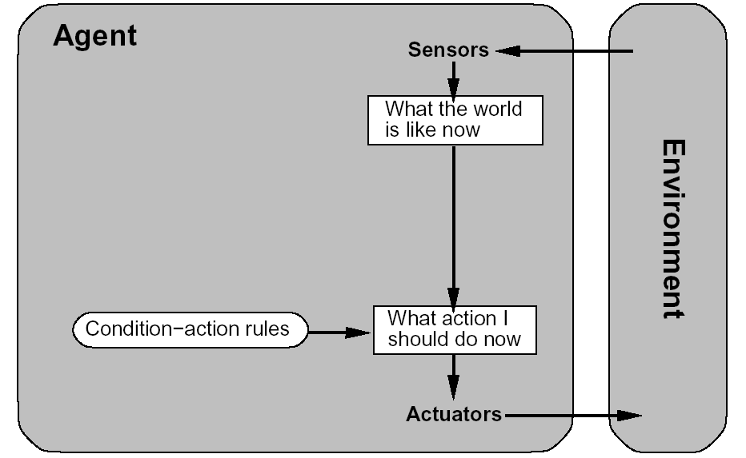
Simple reflex agent-contn
function REFLEX_VACUUM_AGENT( percept )
returns an action
(location,status) = UPDATE_STATE( percept )
if status = DIRTY then return SUCK;
else if location = A then return RIGHT;
else if location = B then return LEFT;

Slide 32
Simple reflex agent-contn
Implementation and properties
  function ReflexAgentWithState (percept) returns action
    static: state, description of current world state; rules, set of condition-action rules
    state ← Update-State (state, percept)
    rule ← Rule-Match (state, rules)
    action ← Rule-Action {rule}
    return action
Advantages
  Selection of best action based only on current state of world and rules
  Able to reason over past states of world
  Still efficient, somewhat more robust
Limitations and Disadvantages
  No way to express goals and preferences relative to goals
  Still limited range of applicability

Slide 33

2.5.2 Model-based reflex agents

Slide 34
Model-based reflex agents-contn
New

Slide 35
Model-based reflex agents-contn
Model-based agents can handle partially observable environments.
Its current state is stored inside the agent maintaining some kind of structure which describes the part of the world which cannot be seen.
This behavior requires information on how the world behaves and works. This additional information completes the “World View” model.

Slide 36
2.5.3 Utility-based agents
Goal-based agents only distinguish between goal states and non-goal states.
It is possible to define a measure of how desirable a particular state is.
This measure can be obtained through the use of a utility function which maps a state to a measure of the utility of the state.

Slide 37

Utility-based agents-contn

Slide 38
2.5.4 Goal-based agents
Goal-based agents are model-based agents which store informationregarding situations that are desirable.
This allows the agent a way to choose among multiple possibilities, selecting the one which reaches a goal state.

Slide 39

Goal-based agents-contn

Slide 40
Goal-based agents-contn
New

Slide 41
Goal-based agents-contn
Implementation and Properties
  Functional description
    Complete description using classical planning
    Requires more formal specification
Advantages
  Able to reason over goal, intermediate, and initial states
  Basis: automated reasoning
    One implementation: theorem proving (first-order logic)
    Powerful representation language and inference mechanism
Limitations and Disadvantages
  Efficiency limitations: can’t feasible solve many general problems
  No way to express preferences

Slide 42

2.5.5 Learning agents

Slide 43
Learning Agents Components
New components:
• Learning element – Makes improvements to performance element
• Performance element – Selects actions – Previously this was the whole agent
• Critic – Gives performance feedback to learning element – Needed because precepts don’t capture performance
• Problem generator – Suggests innovative actions

Slide 44
Intelligent software agents types
( Third Vision )
There are only four essential types of intelligent software agents:
Buyer agents or shopping bots
User or personal agents
Monitoring-and-surveillance agents
Data Mining agents

Slide 45
Buyer agents (shopping bots)
Buyer agents travel around the internet retrieving information about goods and services.
These agents, also known as 'shopping bots', work very efficiently for commodity products such as CDs, books, electronic components.
Amazon.com is a good example of a shopping bot. The website will offer you a list of books that you might like to buy on the basis of what you're buying now and what you have bought in the past.
Another example is used on eBay. At the bottom of its page there is a list of similar products that other customers who did the same search looked at. This is because it is assumed the user tastes are relatively similar and they will be interested in the same products.
This technology is known as collaborative filtering.

Slide 46
User agents (personal agents)
These are intelligent agents that take action on your behalf. In this category belong those intelligent agents that already perform, or will shortly perform, the following tasks:
Check your e-mail, sort it according to the user's order of preference, and alert you when important emails arrive.
Play computer games as your opponent or patrol game areas for you.
Assemble customized news reports for you. There are several versions of these, including newshub and CNN.
Find information for you on the subject of your choice.
Fill out forms on the Web automatically for you, storing your information for future reference (e.g. newshub).
Scan Web pages looking for and highlighting text that constitutes the "important" part of the information there
"Discuss" topics with you ranging from your deepest fears to sports

Slide 47
Monitoring-and-surveillance (predictive) agents
used to observe and report on equipment, usually computer systems ( some sort of activity in DSS applications ).
The agents may keep track of company inventory levels, observe competitors' prices and relay them back to the company, watch stock manipulation by insider trading and rumors.
For example, NASA's Jet Propulsion Laboratory has an agent that monitors inventory, planning, and scheduling equipment ordering to keep costs down, as well as food storage facilities. These agents usually monitor complex computer networks that can keep track of the configuration of each computer connected to the network.

Slide 48
Data mining agents
This agent uses information technology to find trends and patterns in plenty of information from many different sources.
The user can sort through this information in order to find whatever information they are seeking.
A data mining agent operates in a data warehouse discovering information. A 'data warehouse' brings together information from lots of different sources.
"Data mining" is the process of looking through the data warehouse to find information that you can use to take action, such as ways to increase sales or keep customers who are considering defecting.

Slide 49
Data mining agents-contn
'Classification' is one of the most common types of data mining, which finds patterns in information and categorizes them into different classes.
Data mining agents can also detect major shifts in trends or a key indicator and can detect the presence of new information and alert you to it.
For example, the agent may detect a degradation in the construction industry for an economy; based on this relayed information construction companies will be able to make intelligent decisions regarding the hiring/firing of employees or the purchase/lease of equipment in order to best suit their firm ( USA,2009 disaster).

Slide 50
2.6 Applications of software Agents
Agent software is used in a variety of contexts:
system administration,
information searching on the Internet,
current awareness services,
online shopping:
enrich the user's net browsing by suggesting additional hyperlinks, based on previous user behavior;
give added value to search engine searches;

Slide 51
Applications of software Agents-contn
to run searches on multiple databases, filter and assemble the results in an intelligent way;
to find the best price for a given product from online markets;
to engage in transactions and negotiations on behalf of the user;
to monitor databases on the WWW and provide a regular updating service;
to monitor Web site changes;

Slide 52
Applications of software Agents-contn
to compile a daily personalized newspaper;
to visit sites nominated by the user and download either the entire site or selected pages for offline viewing;
to discover other people with common interests;
to check and prioritize email, make decisions based on content and act on them.

Slide 53
2.7 More Examples on software Agents
BotSpot http://www.botspot.com/
gives many examples of bots and agents.
Autonomy Agentware http://www.agentware.com/index.html
Autonomy has developed a suite of products using agent technology to generate personalized , organized content from large bodies of unstructured online information.

Slide 54
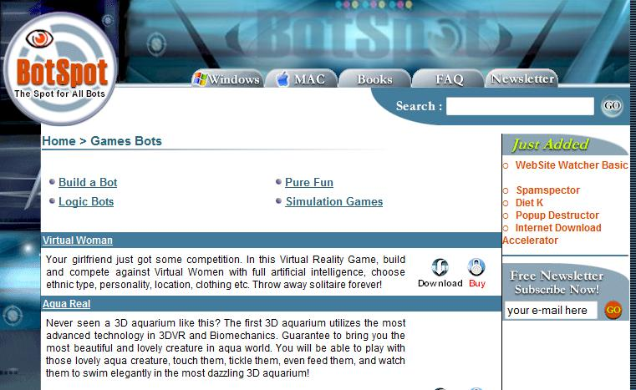

Slide 55


Slide 56
Examples on software Agents-contn
The Agentware software focuses on concepts occurring in text taking into account their frequency and context and adapts over time to improve on its recognition of the same concepts.
The technology is used in products for new media publishing and knowledge management such as Content Server, Daily Briefing, Knowledge Server, Knowledge Update, and Portal-in-a-Box.

Slide 57
Examples on software Agents-contn
LiveAgent(AgentSoft) http://www.agentsoft.com/liveagen.htm
A utility for creating personalized Java agents. The user goes through a regular Web browsing session. LiveAgent learns from this walk-through session and generates an agent that is capable of doing that activitiy by itself whenever the user wants.
CareerSite http://www.careersite.com/ is an example of the practical application of agent technology. It uses confidential candidate profiles and concept-based searches to link employers with job seekers.
In common with a number of other portal Live http://live.excite.com/

Slide 58
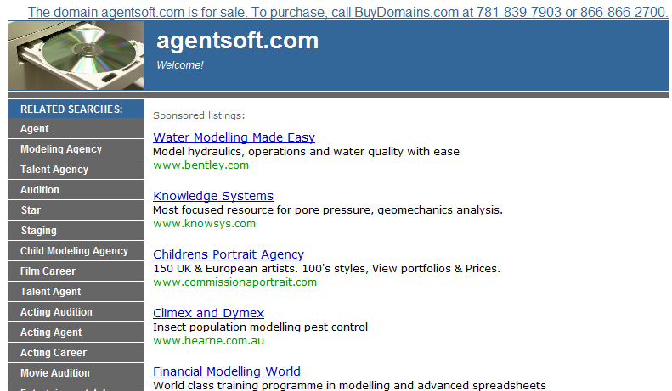

Slide 59


Slide 60
Examples on software Agents-contn
LiveAgent(AgentSoft) http://www.agentsoft.com/liveagen.htm
provides personalised entry to its information service.
On registering, the user is asked to fill in a form and thereafter at login, gets a personalised version of Excite's information service.
The personal profile is progressively added to by NewsTracker which learns more about the user's favorite topics as they respond to and rate the articles it returns.

Slide 61
Examples on software Agents-contn
Another example of agent technology on the Excite site is the Product Finder (http://www.jango.com/xsh/index.dcg?) employing Jango agent software which was designed specifically for shopping on the Net.
eWatch at http://www.ewatch.com/, is an example of an agent-based alerting service available through subscription.

Slide 62
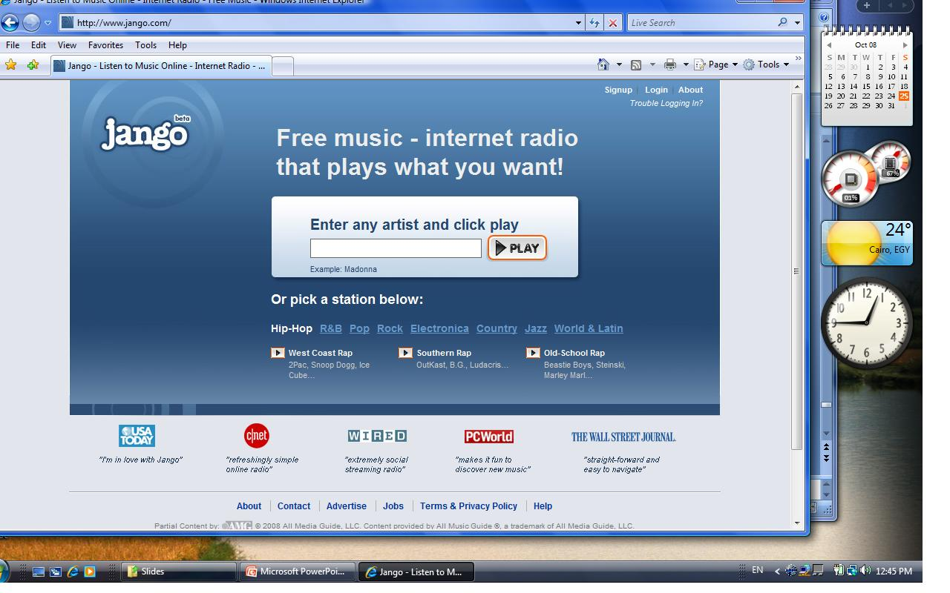

Slide 63
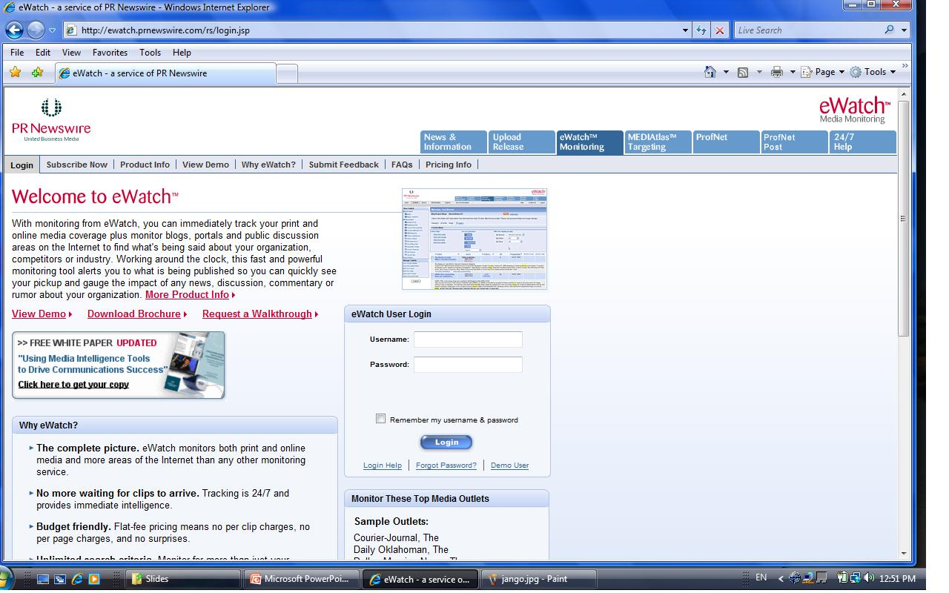

Slide 64
Examples on software Agents-contn
It monitors mailing lists, News groups, forums, and Web sites for information on insider trading, stock manipulation, rumors and anti-corporate activism.
WavePhone Newscast http://www.newscast.com/ delivers the eWatch information in real-time using push technology.

Slide 65


Slide 66
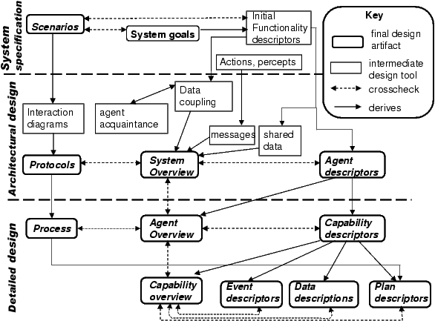
2.8 Intelligent Agent Design

Slide 67
For More Knowledge
Got to Automated Taxi Driver Case study.docx
Go to UGV case study
كيف يعمل محرك السيارة

Slide 68
Intelligent Agent Design issues
how tasks are scheduled and how synchronization of tasks is achieved ?
how tasks are prioritized by agents ?
how agents can collaborate, or recruit resources?
how agents can be re-instantiated in different environments, and how their internal state can be stored?
how the environment will be probed and how a change of environment leads to behavioral changes of the agents?
how messaging and communication can be achieved?
what hierarchies of agents are useful (e.g. task execution agents, scheduling agents, resource providers ...)?

Slide 69
Assignment #2
Prepare a survey on knowledge including:
definitions
theories
applications
problems and research areas
inter-relations with the AI Main Topics in slide # 9 of lecture # 1
Assignment to be delivered in free hand, not less than 10 pages with hard copy of references.
Due date is one week after conducting the last slide of lecture # 2

