Slide 1

Lecture 4

Slide 2
Outline
4.1 Best-first search
4.2 Greedy best-first search
4.3 A* search
4.4 Heuristics
4.5 Local search algorithms
4.5.1 Hill-climbing search
4.5.2 Simulated annealing search
4.5.3 Genetic algorithms

Slide 3
4.1 Best-first search
is a search algorithm which explores a graph by expanding the most promising node chosen according to some rule.
Judea Pearl described best-first search, as the simplest informed search algorithm; which estimate the promise of node n by a "heuristic evaluation function f(n) which, in general, may depend on:
the description of n,
the description of the goal,
the information gathered by the search up to that point
any extra knowledge about the problem domain."

Slide 4
Best-first search-contn
Other authors have used "best-first search" to refer specifically to a search with a heuristic that attempts to predict how close the end of a path is to a solution, so that paths which are judged to be closer to a solution are extended first. This specific type of search is called greedy best-first search .
Efficient selection of the current best candidate for extension is typically implemented using a priority queue.
Examples of best-first search algorithms include the A* search algorithm, and in turn, Dijkstra's algorithm (which can be considered a specialization of A*).
Best-first algorithms are often used for path finding in combinatorial search.

Slide 5
Best-first search algorithm
1. Start with OPEN containing just the initial state
2. Until a goal state is found or there is no node left on OPEN do:
Pick the best node on OPEN
Generate its successors
For each successor do:
a. If it has not been generated before ( new node ), evaluate it; add it to OPEN and record its parent
b. Otherwise ( old node ); change the parent if this new path is better than previous one.

Slide 6
Best-First Properties
Not complete, may follow infinite path if heuristic rates each state on such a path as the best option. Most reasonable heuristics will not cause this problem however.
Worst case time complexity is still O(bm).
where m is the maximum depth, b is the branching factor
Since must maintain a queue of all unexpanded states, space-complexity is also O(bm).
However, a good heuristic will avoid this worst-case behavior for most problems.

Slide 7

Example: Romania with step costs in km
Disadvantage: Does not find shortest path to goal (through all Rimnicu ) since it is only focused on the cost remaining rather than the total cost.

Slide 8
Greedy algorithm Concept
As an example , the greedy algorithm determines the minimum number of US coins to give while making change( e.g. 1.75 US dollar).
These are the steps, a human would take; to emulate a greedy algorithm. The coin of the highest value, less than the remaining change owed, is the local optimum[7 quarters equivalent to 1.75 US dollars rather than 175 cent ]
Note that in general the change-making problem requires dynamic programming to find an optimal solution;

Slide 9
4.2 Greedy best-first search
Evaluation function f(n) = h(n) (heuristic) = estimate of cost from n to goal
e.g., h_{SLD}(n) = Straight-line Distance in km from n to Bucharest
Greedy best-first search expands the node that appears to be closest to goal

Slide 10
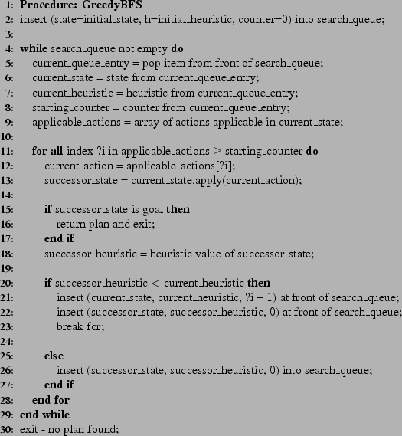
Pseudo-code for greedy best-first search( GBFS )

Slide 11

Greedy best-first search example

Slide 12

Greedy best-first search example-contn
MIN distance

Slide 13

Greedy best-first search example-contn

Slide 14

Greedy best-first search example-contn
Straight line distance= 366
Distance on map= 140 +99 + 211 = 450

Slide 15
Properties of Greedy best-first search
Complete? No – can get stuck in loops, e.g., Iasi → Neamt → Iasi → Neamt →
Time? O(b^{m}), but a good heuristic can give dramatic improvement
Space? O(b^{m}) -- keeps all nodes in memory
Optimal? No

Slide 16
4.3 A* search
( Enhanced Greedy Best First Search )
Idea: avoid expanding paths that are already expensive
Evaluation function f(n) = g(n) + h(n)
where:
g(n) = cost so far to reach n ( accumulative )
h(n) = estimated cost from n to goal
f(n) = estimated total cost of path through n to goal

Slide 17

A* search example
f(n) g(n) h(n)

Slide 18

A* search example-contn
MIN
total distance
=
+
14
0
g(n) from previous slide at Arad

Slide 19

A* search example-contn
=
MIN total distance
+
14
140
previous g(n) from previous slide at sibiu

Slide 20

A* search example-contn
back to next MIN total distance to generate its children
not MIN total distance

Slide 21

A* search example-contn
MIN total distance due to comparison of all children
418= 317 +101

Slide 22

A* search example-contn
Straight line distance = 366
Distance on map= 140 +80 + 97 + 101
= 418
MIN total distance
Previous g(n) is 317
+

Slide 23
Properties of A*
Complete? Yes
Time? Exponential
Space? Keeps all nodes in memory
Optimal? Yes

Slide 24
Assignment # 6
Use the greedy best first search algorithm to reach from Oradea to Bucharest
Use A* search algorithm to reach from Oradea to Bucharest
Compare between the two paths in (a) , (b) and give your comment

Slide 25
4.4 Heuristics
A heuristic h(n) is admissible if for every node n , h(n) ≤ h*(n), where h*(n) is the true cost to reach the goal state from n.
An admissible heuristic never overestimates the cost to reach the goal, i.e., it is optimistic
Example: h_{SLD}(n) [366] as an admissible heuristic never overestimates the actual road distance [450/418]
Theorem: If h(n) is admissible, A* using TREE-SEARCH is optimal

Slide 26

Admissible heuristics example
for the 8-puzzle:
h₁(n) = number of misplaced tiles
h₂(n) = total Manhattan distance
(i.e., no. of squares from desired location of each tile)
h₁(S) = ?
h₂(S) = ?

Slide 27
Admissible heuristics example-contn
for the 8-puzzle:
h₁(n) = number of misplaced tiles
h₂(n) = total Manhattan distance
(i.e., no. of squares from desired location of each tile)
h₁(S) = ? 8 because any tile that is out of place must be moved at least once
h₂(S) = ? 3+1+2+2+2+3+3+2 = 18
8 < 18

Slide 28

Consistent heuristics
A heuristic is consistent if for every node n, every successor n' of n generated by any action a,
h(n) ≤ c(n,a,n') + h(n')
If h is consistent, we have
f(n') = g(n') + h(n')
= g(n) + c(n,a,n') + h(n')
≥ g(n) + h(n)
= f(n)
i.e., f(n) is non-decreasing along any path.
Theorem: If h(n) is consistent, A* using GRAPH-SEARCH is optimal

Slide 29
4.5 Local search algorithms
In mathematics and computer science, an optimization problem is the problem of finding the best solution from all feasible solutions
In many optimization problems, the path to the goal is not so important; the goal state itself is the solution
State space = set of "complete" configurations
Find configuration satisfying constraints, e.g., n-queens
In such cases, we can use local search algorithms with the policy:
“keep a single "current" state, try to improve it “

Slide 30

n-queens example
( Local search algorithm )
Put n queens on an n × n board with no two queens on the same row, column, or diagonal

Slide 31
Local search algorithms
Hill-climbing Algorithm
Simulated annealing Algorithm
Genetic algorithms

Slide 32
4.5.1 Hill-climbing search
Hill climbing can be used to solve problems that have many solutions, some of which are better than others.
It starts with a random (potentially poor) solution, and iteratively makes small changes to the solution, each time improving it a little.
When the algorithm cannot see any improvement anymore ( freeze ), it terminates.
Ideally, at that point the current solution is close to optimal
but it is not guaranteed that hill climbing will ever come close to the optimal solution

Slide 33
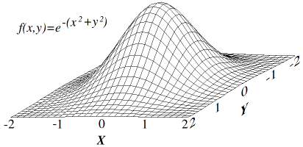
Hill-climbing search-contn
Hill climbing attempts to maximize (or minimize) a function f (x), where x are discrete states. These states are typically represented by vertices in a graph, where edges in the graph encode nearness or similarity of a graph.
Hill climbing will follow the graph from vertex to vertex, always locally increasing (or decreasing) the value of f, until a local maximum (or local minimum) x_{m} is reached.
Hill climbing can also operate on a continuous space: in that case, the algorithm is called gradient ascent (or gradient descent if the function is minimized).

Slide 34

Hill-climbing search algorithm
"Like climbing Everest in thick fog with amnesia(memory less )"

Slide 35

Hill-climbing search problem
depending on initial state, may get stuck in local maxima

Slide 36
4.5.2 Simulated annealing search
It is considered as an enhancement of the hill climbing search algorithm
It is a generic probabilistic meta-algorithm for the global optimization problem, namely locating a good approximation to the global minimum of a given function in a large search space.
For certain problems, simulated annealing may be more effective than exhaustive listing ,provided that the goal is merely to find an acceptably good solution in a fixed amount of time ( time constraint ), rather than the best possible solution.

Slide 37
Physics Concept
Annealing in metals
Heat the solid state metal to a high temperature
Cool it down very slowly according to a specific schedule.
If the heating temperature is sufficiently high to ensure random state and the cooling process is slow enough to ensure thermal equilibrium, then the atoms will place themselves in a pattern that corresponds to the global energy minimum of a perfect crystal.

Slide 38
Simulated annealing search-contn
By analogy with this physical process, each step of the SA algorithm replaces the current solution by a random "nearby" solution, chosen with a probability that depends on the difference between the corresponding function values and on a global parameter T (called the temperature), that is gradually decreased during the process.
The dependency is such that the current solution changes almost randomly when T is large, but increasingly "downhill" as T goes to zero.
The allowance for "uphill" moves saves the method from becoming stuck at local minima—which is the main disadvantage of the Hill-climbing search algorithm .

Slide 39

Simulated annealing search algorithm
Idea: escape local maxima by allowing some "bad" moves but gradually decrease their frequency

Slide 40
Properties of simulated annealing search
One can prove: If T decreases slowly enough, then simulated annealing search will find a global optimum with probability approaching 1
Widely used applications:
VLSI layout
Airline scheduling
The traveling salesman problem

Slide 41
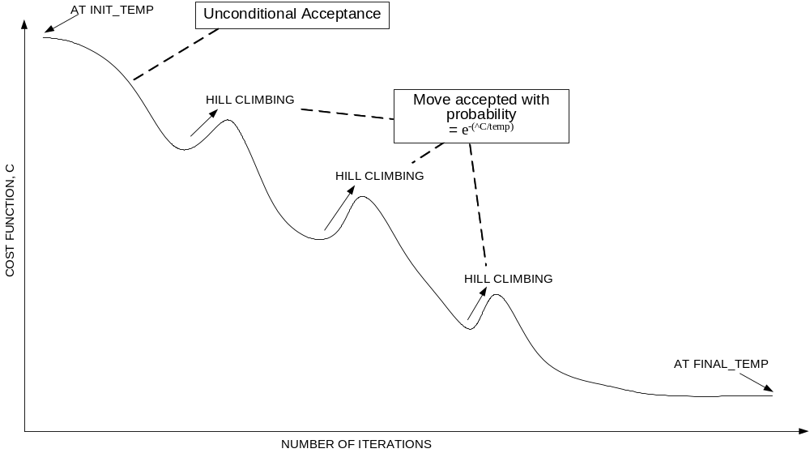
Convergence of simulated annealing

Slide 42
4.5.3 Genetic algorithms
A genetic algorithm (GA) is a search technique used in computing to find exact or approximate solutions to optimization and search problems.
Genetic algorithms are categorized as global search heuristics.
Genetic algorithms are a particular class of evolutionary algorithms (also known as evolutionary computation) that use techniques inspired by evolutionary biology such as inheritance, mutation, selection, and crossover (also called recombination).

Slide 43
Genetic algorithms-contn
A successor state is generated by combining two parent states
Start with k randomly generated states (population)
A state is represented as a string over a finite alphabet (often a string of 0s and 1s)
Evaluation function (fitness function). Higher values for better states.
Produce the next generation of states by selection, crossover, and mutation

Slide 44
Simple Generational Genetic Algorithm Pseudo code
Choose initial population
Evaluate the fitness of each individual in the population
Repeat until termination: (time limit or sufficient fitness achieved)
  Select best-ranking individuals to reproduce
  Breed new generation through crossover and/or mutation (genetic operations) and give birth to offspring
  Evaluate the individual fitnesses of the offspring
  Replace worst ranked part of population with offspring

Slide 45
Assignment # 7
Prepare a survey on Learning including:
definitions
theories
applications
problems and research areas
inter-relations with the AI Main Topics in slide # 9 of lecture # 1
Assignment to be delivered in free hand, not less than 10 pages with hard copy of references.
Due date is one week after conducting the last slide of lecture # 4

