Slide 1
Lecture 5
Learning

Slide 2
Contents
5.1 Introduction
5.1.1 Factors affecting learning
5.2 Machine Learning ( ML )
5.3 Decision Trees ( DT )
5.3.1 The decision tree representation
5.3.2 Expressiveness of decision trees
5.3.3 Making decision trees from examples
5.4 Artificial Neural Networks ( ANN )
5.4.1 Neural network structures
5.4.2 Single-layer feed-forward neural networks (perceptrons)
5.4.3 Multilayer feed-forward neural networks
5.4.4 Learning in multilayer networks
5.5 Support Vector Machines ( SVM )
5.6 Deep Learning ( DL )
5.6.1 Deep Learning & Natural Language Processing
5.6.2 Deep Learning & Commercial activity

Slide 3
5.1 INTRODUCTION
Learning is the process of acquiring new understanding, knowledge, behaviors, skills, values, attitudes, and preferences.
The ability to learn is possessed by humans, animals, and some machines; there is also evidence for some kind of learning in certain plants.
Some learning is immediate, brought by a single event (e.g. being burned by a hot stove), but much skill and knowledge accumulate from repeated experiences.
The changes made by learning often last a lifetime,

Slide 4
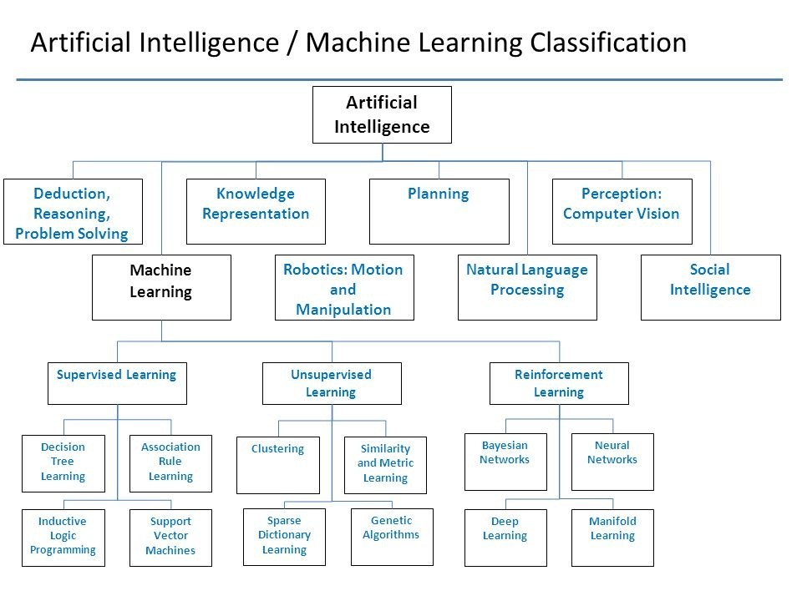
Ai & Learning
8
3
4
4
4

Slide 5
Factors Affecting Learning
External factors:
Inheritance
Status of students
Physical environment
Internal factors:
Goals or purposes
Motivational behavior
Interest
Attention
Drill or practice
Fatigue
Aptitude موهبة
Attitudeسلوك
Emotional conditions
Speed, Accuracy and retention
Learning activities
Testing
Guidance

Slide 6
Forms of Learning
Any component of an agent can be improved by learning from data. The improvements, and the techniques used to make them, depend on four major factors:
Which component is to be improved? ( see next slide )
What prior knowledge the agent already has?
What representation is used for the data and the component?
What feedback is available to learn from? ( see slide 8)

Slide 7
Components To Be Learned
The components of these agents include:
1. A direct mapping from conditions on the current state to actions.
2. A means to infer يستخلص\يستنبط relevant properties of the world from the percept sequence.
3. Information about the way the world evolves and about the results of possible actions the agent can take.
4. Utility information indicating the desirability of world states.
5. Action-value information indicating the desirability of actions.
6. Goals that describe classes of states whose achievement maximizes the agent’s utility.

Slide 8
5.2 Machine Learning
(Feedback To Learn From )
In unsupervised learning بدون اشراف وانما بالملاحظةthe agent learns patterns in the input even though no explicit feedback is supplied. The most common unsupervised learning task is clustering: detecting potentially useful clusters of input examples.
For example, a taxi agent might gradually develop a concept of “good traffic days” and “bad traffic days” without ever being given labeled examples of each by a teacher.
In reinforcement learning تعزيز\تقوية the agent learns from a series of reinforcements—rewards or punishments used for improving or increasing efficiency من خلال الجوائز او العقاب
For example:
the lack of a tip at the end of the journey gives the taxi agent an indication that it did something wrong.
It is up to the agent to decide which of the actions prior to the reinforcement were most responsible for it.
In supervised learning بإشراف من خلال امثلة the agent observes some example input–output pairs and learns a function that maps from input to output.
For example: Spam detection

Slide 9
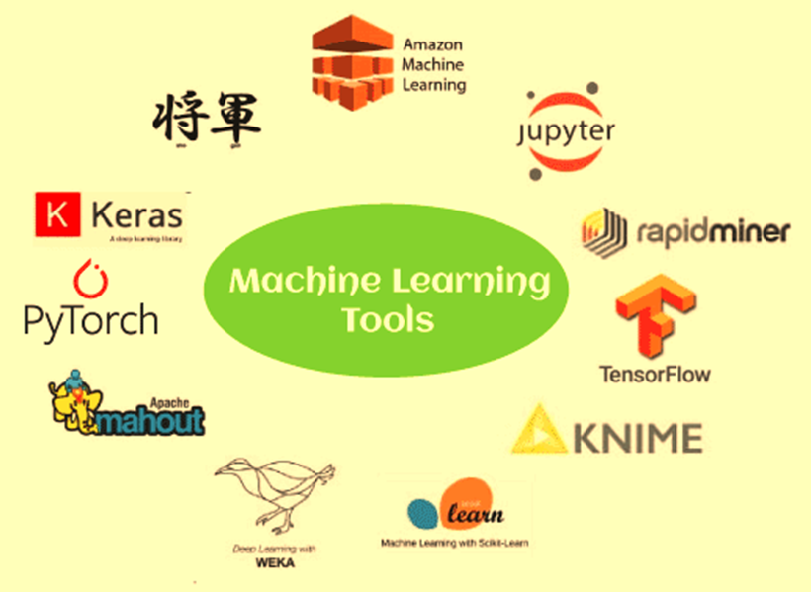
Most Popular m/c learning Tools visit:
Machine Learning Software Tools In 2024.docx

Slide 10
Machine Learning Real Examples
Example 1
If you have used Netflix, then you must know that it recommends you some movies or shows for watching based on what you have watched earlier. Machine Learning is used for this recommendation and to select the data which matches your choice. It uses the earlier data.
Example 2
The second example would be Facebook.
When you upload a photo on Facebook, it can recognize a person in that photo and suggest you, mutual friends. ML is used for these predictions. It uses data like your friend-list, photos available etc. and it makes predictions based on that.
Example 3
The third example is Software, which shows how you will look when you get older. This image processing also uses machine learning.

Slide 11
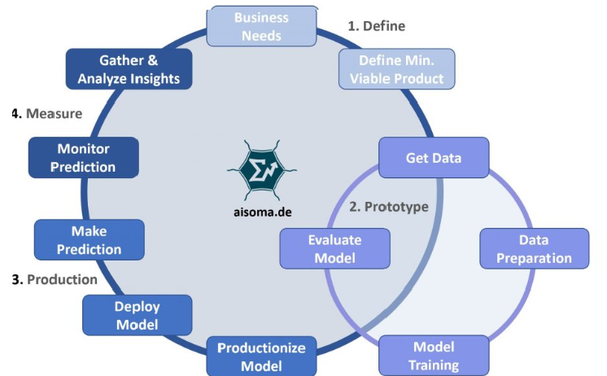
Machine Learning Workflow

Slide 12
Machine Learning Tasks
1. Classification: predict a class of an object (cat/dog from an image, male/female from user’s web activity, spam/ham from an email contents, etc)
2. Regression: predict a continuous value for an object (sales in the next month, price of a house with specific features, energy consumption for a household, etc)
Clustering: group similar objects together (find user groups different by their behavior on the site, cluster customers into meaningful groups, etc).
Dimensionality reduction: “compress” the data from a high-dimensional representation into a lower-dimensional one (useful for visualization or as an internal transformation for other ML algorithms)
5. Ranking: arrange a list of objects to maximize some utility
6. Recommendations: filter a small subset of objects from a large collection and recommend them to a user ( e.g. Netflix , increase sales and client loyalty, time spent on a service, cross-sale/up-sale, etc).

Slide 13
5.3 Learning Decision Trees
(Boolean Classification Technique)
Decision Trees (DTs) are a non-parametric supervised learning method used for classification and regression.
A decision tree represents a function that takes as input a vector of attribute values and returns a “decision”—a single output value. The input and output values can be discrete or continuous.
For problems where the inputs have discrete values and the output has exactly two possible values; this is Boolean classification, where each example input will be classified as true (a positive example) or false (a negative example).
A decision tree reaches its decision by performing a sequence of tests. Each internal node in the tree corresponds to a test of the value of one of the input attributes, A_{i}, and the branches from the node are labeled with the possible values of the attribute, A_{i} = v_{ik}.
Each leaf node in the tree specifies a value to be returned by the function.
Visit: Decision Tree Case Study.doc

Slide 14
Decision Tree example 1
Decision Trees are excellent tools for helping you to choose between several courses of action to take a decision.
Consider the following case study:
“Assume as a factory manager, you want to take a decision either:
(1) to produce a new product or
(2) to consolidate (combine) توطيد the old product of your manufacturing i.e. makes (something) physically stronger or more solid by Combining a number of things into a single more effective or coherent whole”.
Suppose your sales المبيعات, manufacturing التصنيع , production الانتاج and financial departments الادارة المالية feeds you with the date contained in the following table:

Slide 15
Decision | Possibility | Evaluation | Probability |  | Market Reaction | Values of Uncertain Outcomes | Total | Cost | Net Benefit | Final Decision
New Product | Thorough Development | Good | 0.4 | }1 | $ 1,000,000 | ? | ? | $150,000 | ? | Y/N
 |  | Moderate | 0.4 |  | $ 50,000 | ?
 |  | Poor | 0.2 |  | $ 2,000 | ?
 | Rapid Development | Good | 0.1 | }1 | $ 1,000,000 | ? | ? | $80,000 | ? | Y/N
 |  | Moderate | 0.2 |  | $ 50,000 | ?
 |  | Poor | 0.7 |  | $ 2,000 | ?
Consolidate Old Product | Strengthen Product | Good | 0.3 | }1 | $ 400,000 | ? | ? | $30,000 | ? | Y/N
 |  | Moderate | 0.4 |  | $ 20,000 | ?
 |  | Poor | 0.3` |  | $ 6,000 | ?
 | Reap Product | Good | 0.6 | }1 | $ 20,000 | ? | ? | $0 | ? | Y/N
 |  | Poor | 0.4 |  | $ 2,000 | ?

Slide 16
Decision Trees Example 2
Problem:
decide whether to wait for a table at a restaurant, based on the following attributes:
  Alternate: is there an alternative restaurant nearby?
  Bar: is there a comfortable bar area to wait in?
  Fri/Sat: is today Friday or Saturday?
  Hungry: are we hungry?
  Patrons: number of people in the restaurant (None, Some, Full)
  Price: price range ($, $$, $$$)
  Raining: is it raining outside?
  Reservation: have we made a reservation?
  Type: kind of restaurant (French, Italian, Thai, Burger)
  WaitEstimate: estimated waiting time (0-10, 10-30, 30-60, >60)

Slide 17
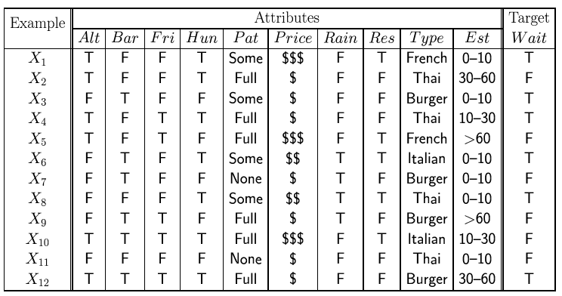
Attribute-based representations
Examples described by attribute values (Boolean, discrete, continuous)
e.g., situations where I will/won't wait for a table:
Classification of examples is positive (T) or negative (F)

Slide 18
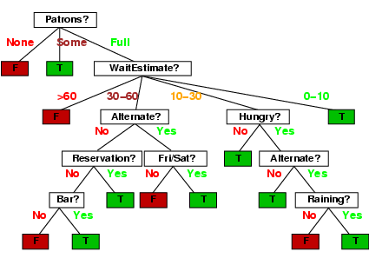
Decision trees
One possible representation for hypotheses
We imagine someone taking a sequence of decisions.
e.g., here is the “true” tree for deciding whether to wait:

Slide 19
Decision Trees Example 3
Let's assume we want to play badminton تنس الريشة on a particular day — say Saturday — how will you decide whether to play or not.
Let's say you go out and check if it's:
hot or cold,
check the speed of the wind and humidity,
how the weather is, i.e. is it sunny, cloudy, or rainy.
You take all these factors into account to decide if you want to play or not.

Slide 20
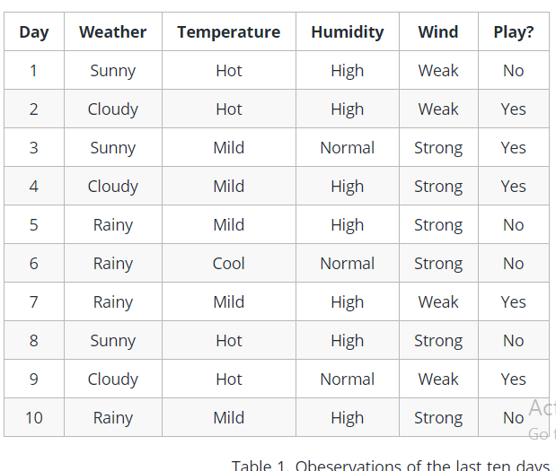
So, you calculate all these factors for the last ten days and form A lookup table like the one shown.
Decision Trees Example 3-contn

Slide 21
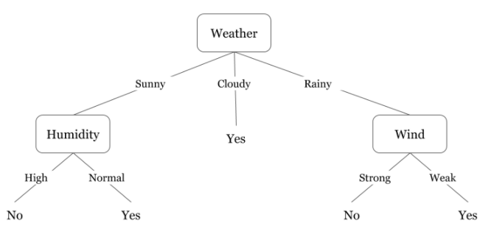
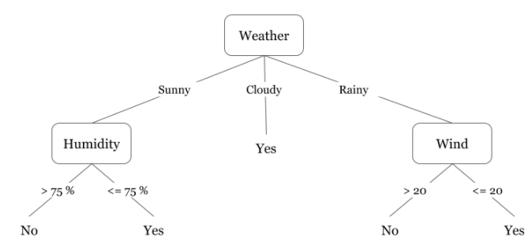
Decision Trees Example 3-contn
General solution
Specific solution with ranges

Slide 22
Decision Trees Practical Applications
Marketing:
Businesses can use decision trees to enhance the accuracy of their promotional campaigns by observing the performance of their competitors’ products and services.
Retention of Customers:
Companies use decision trees for customer retention through analyzing their behaviors and releasing new offers or products to suit those behaviors. By using decision tree models, companies can figure out the satisfaction levels of their customers as well.
Diagnosis of Diseases and Ailments الامراض
Decision trees can help physicians and medical professionals in identifying patients that are at a higher risk of developing serious conditions such as diabetes. The ability of decision trees to narrow down possibilities according to specific variables is quite helpful in such cases.
Detection of Frauds: الاحتيال
Companies can prevent fraud by using decision trees to identify fraudulent behavior beforehand. It can save companies a lot of resources, including time and money.

Slide 23
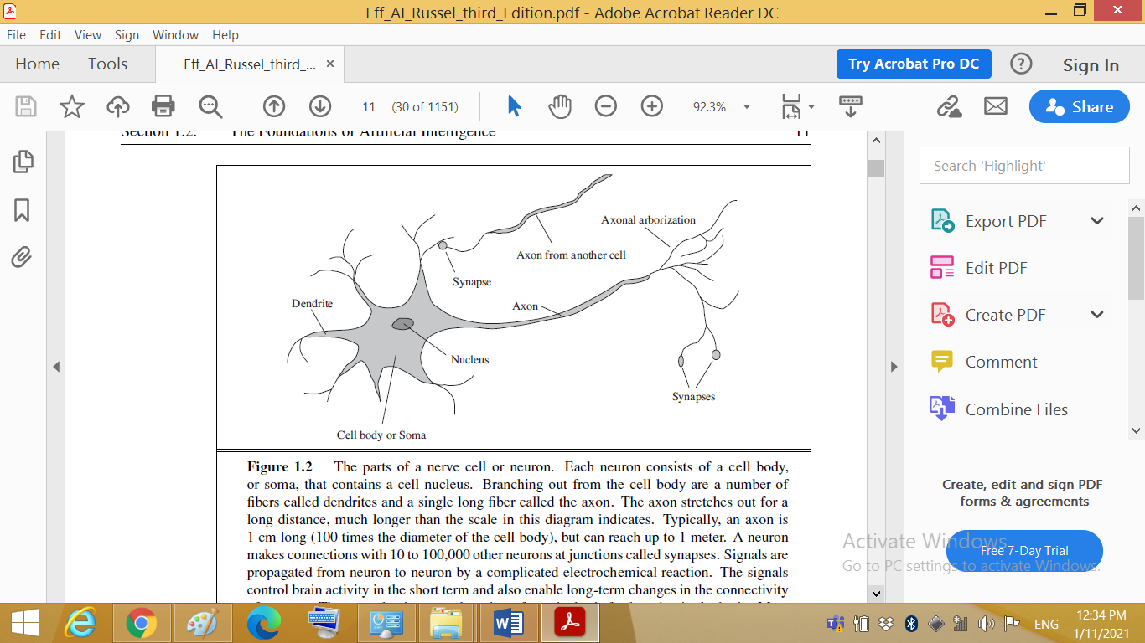
5.4 Artificial Neural Networks (ANN)
In machine learning, a neural network is a model inspired by the structure and function of biological neural networks in animal brains.
An ANN consists of connected units or nodes called artificial neurons, which loosely model the neurons in a brain. These are connected by edges, which model the synapses in a brain.
In neuroscience, the hypothesis that mental activity consists primarily of electrochemical activity in networks of brain cells is called neurons.
Each neuron consists of a cell body, or soma, that contains a cell nucleus. Branching out from the cell body are a number of fibers called dendrites and a single long fiber called the axon. The axon stretches out for a long distance, much longer than the scale in this diagram indicates.
Typically, an axon is 1 cm long (100 times the diameter of the cell body), but can reach up to 1 meter.
A neuron makes connections with 10 to 100,000 other neurons at junctions called synapses.
Signals are propagated from neuron to neuron by a complicated electrochemical reaction. The signals control brain activity in the short term and also enable long-term changes in the connectivity of neurons.

Slide 24
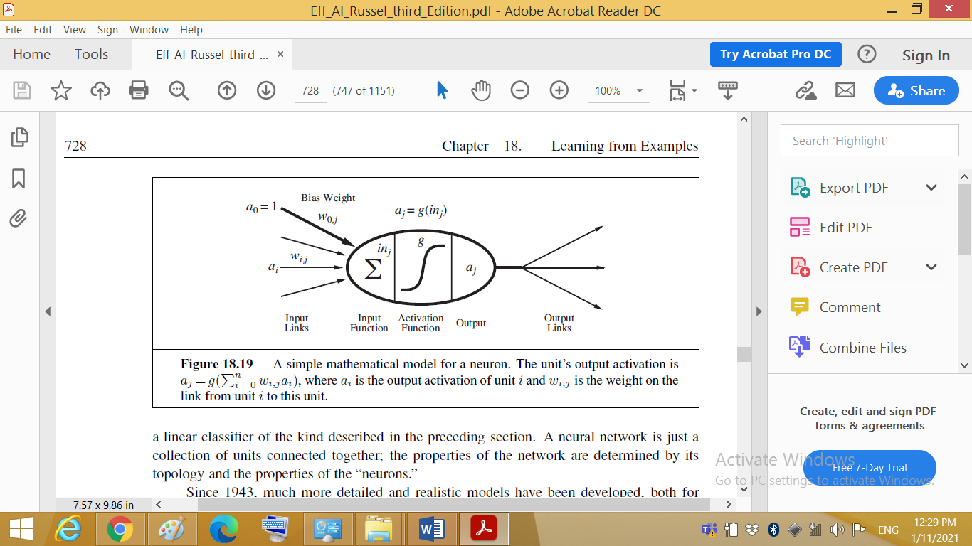
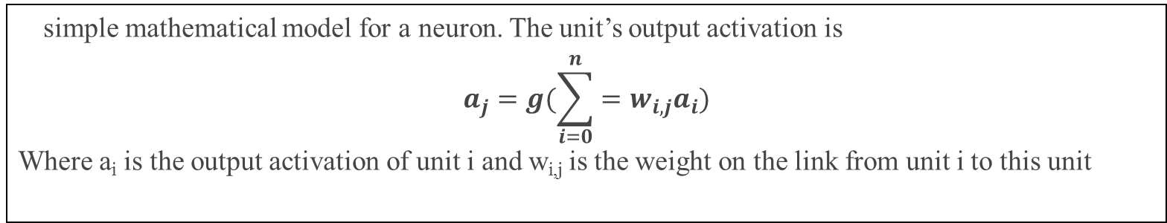
The basic unit: Neuron
A simple mathematical model for a neuron. The unit’s output activation is
$$a_{j}=g(\sum_{i=0}^{n}{=w_{i,j}a_{i}})$$
Where a_{i} is the output activation of unit i and w_{i,j} is the weight on the link from unit i to this unit.

Slide 25
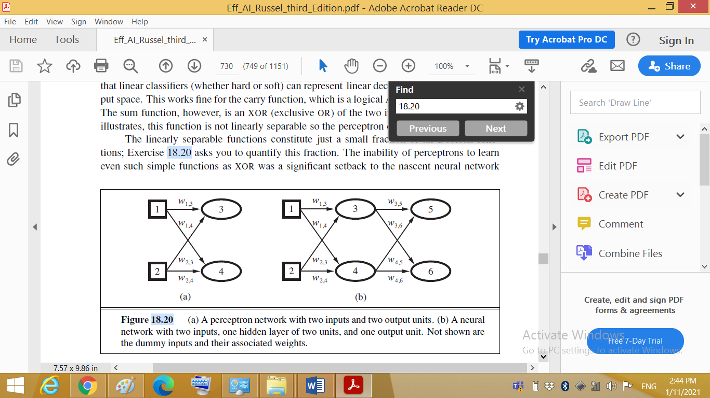
5.4.2 Single-layer feed-forward neural networks (perceptrons)
A network with all the inputs connected directly to the outputs is called a single-layer neural PERCEPTRON network, or a perceptron network.
2/0/2
2/2/2
Single-layer neural networks are limited in their ability to represent complex relationships in data, and they can only model linearly separable problems.
The limitations of the single layer network has led to the development of multi-layer feed-forward networks with one or more hidden layers, called multi-layer perceptron (MLP) networks.

Slide 26
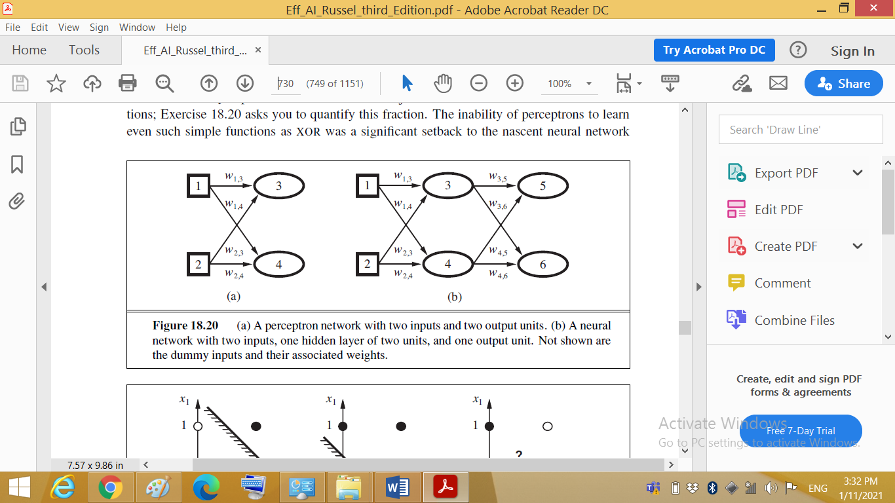
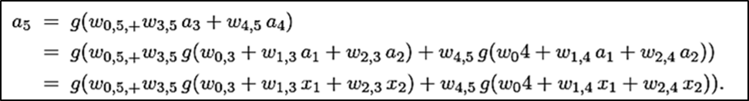
5.4.3 Multilayer feed-forward neural networks
Multi-layer Perceptron (MLP) Networks.
It is an interconnection of perceptrons in which data and calculations flow in a single direction, from the input data to the outputs. The number of layers in a neural network is the number of layers of perceptrons.
Consider the simple network which has two input units, two hidden units, and two output unit (2/2/2). (In addition, each unit has a dummy input fixed at 1.) Given an input vector x=(x₁, x₂), the activations of the input units are set to (a₁, a₂) = (x₁, x₂).
The output at unit 5 is given by:

Slide 27
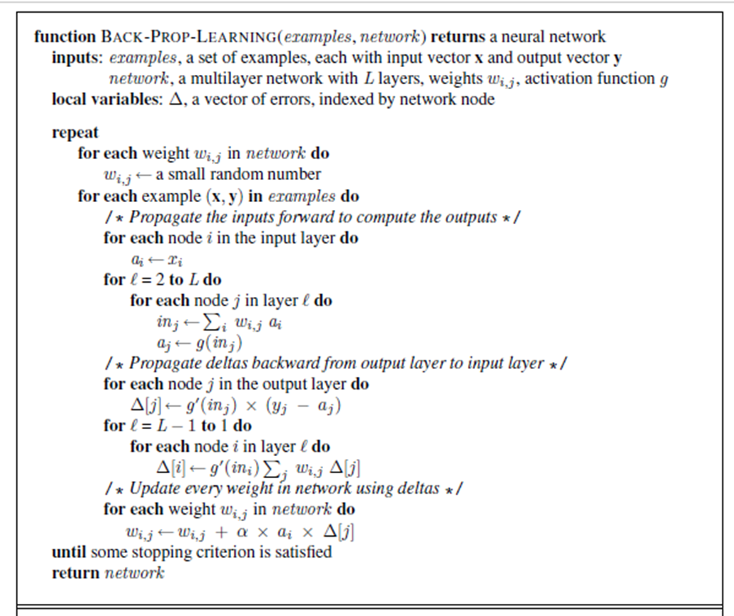
5.4.4 Learning in multilayer networks using the Backpropagation Algorithm
For derivation of the algorithm part 1, Visit:
videoplaybackpropagation part 1.mp4
For derivation of the algorithm part 2, Visit:
Neural network tutorial_ The back-propagation algorithm (Part 2).mp4

Slide 28
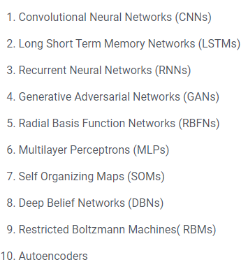
Most Popular Neural Networks Algorithms
Visit :
https://www.upgrad.com/blog/types-of-neural-networks/

Slide 29
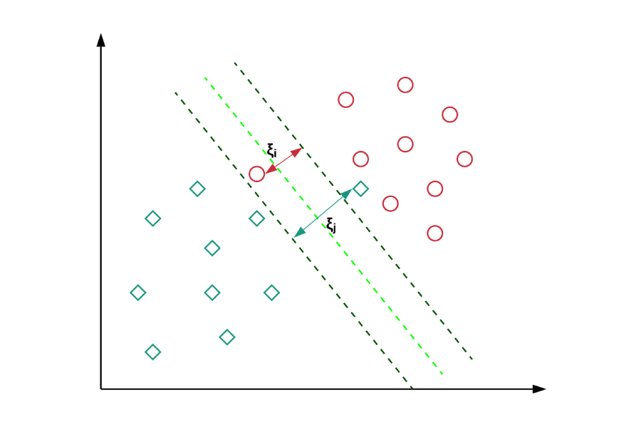
5.5 Support Vector Machines (SVM)
It is supervised learning models with associated learning algorithms
SVMs are used in applications like handwriting recognition, intrusion detection, face detection, email classification, gene classification, and in web pages.
A support vector machine (SVM) is used to solve complex classification, regression, and outlier detection problems by performing optimal data transformations that determine boundaries between data points based on predefined classes, labels, or outputs.
It can handle both classification and regression on linear and non-linear data.

Slide 30
Support Vector Machines (SVM) Fundamentals
SVMs are helpful in:
text and hypertext categorization, as their application can significantly reduce the need for labeled training instances.
Classification of images can also be performed using SVMs.
Classification of satellite data like SAR data using supervised SVM.
Hand-written characters can be recognized using SVM.
biological and other sciences. They have been used to classify proteins with up to 90% of the compounds classified correctly.
Visit:
Support Vector Machines (SVMs)_ A friendly introduction.mp4

Slide 31
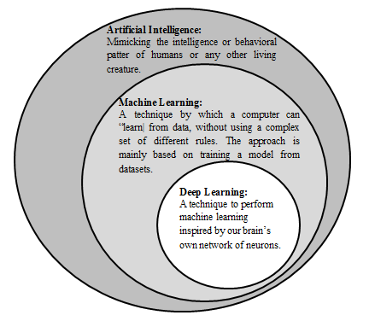
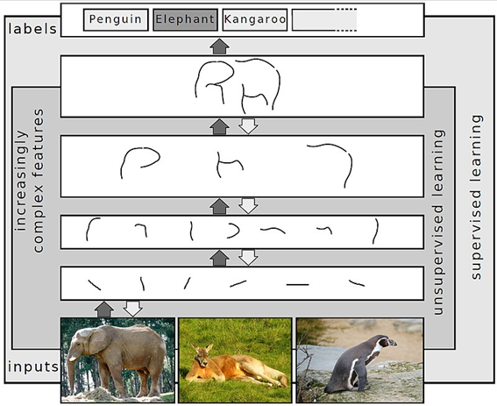
5.6 Deep Learning
(Neural Networks Based)
Deep learning is a class of machine learning algorithms that uses multiple layers to progressively extract higher-level features from the raw input. For example, in image processing, lower layers may identify edges, while higher layers may identify the concepts relevant to a human such as digits or letters or faces.

Slide 32
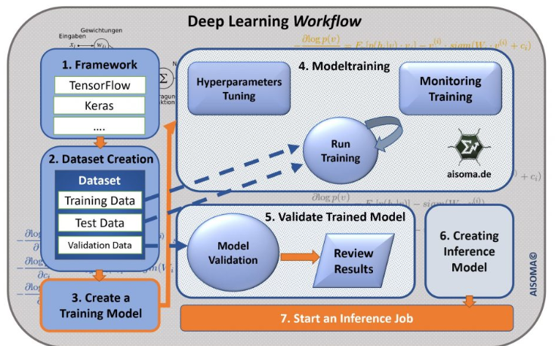

Slide 33
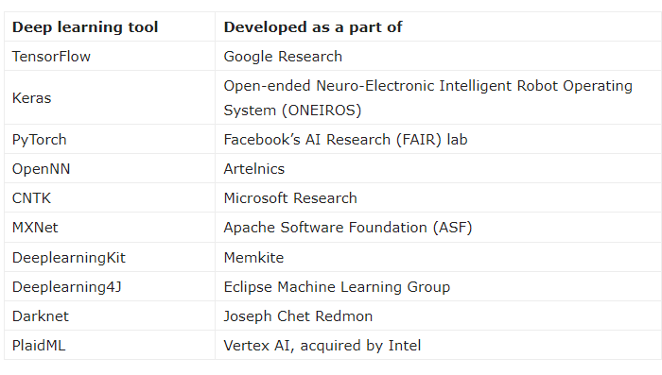
deep learning tools

Slide 34
What is Deep?
The adjective "deep" in deep learning refers to the use of multiple layers in the network. Early work showed that a linear perceptron cannot be a universal classifier, and then that a network with a nonpolynomial activation function with one hidden layer of unbounded width can on the other hand so be.
Deep learning is a modern variation which is concerned with an unbounded number of layers of bounded size, which permits practical application and optimized implementation, while retaining theoretical universality under mild conditions.
In deep learning the layers are also permitted to be heterogeneous and to deviate widely from biologically informed connectionist models, for the sake of efficiency, trainability and understandability, whence the "structured" part.

Slide 35
Deep Learning Applications
Deep-learning architectures such as deep neural networks, deep belief networks, recurrent neural networks and convolutional neural networks have been applied to fields including :
computer vision,
machine vision,
speech recognition,
natural language processing,
audio recognition,
social network filtering,
machine translation,
bioinformatics,
drug design,
medical image analysis,
material inspection and board game programs,
where they have produced results comparable to and in some cases surpassing human expert performance.

