Slide 1
Category review: Chips
June 2020
Retail Analytics
Brand note: If client logo is not required, use alternate title page layout right click slide thumbnail > Layout > Title

Slide 2
Notes:
To view Privacy video explaining how important data privacy is to Quantium, please click here: https://www.youtube.com/watch?v=Zq1QDAkoRzU
or here Q:\Company Reference\Brand & Design\Brand videos\Q Privacy.mp4
At Quantium, we believe that data is the behavioural footprint of humanity and that it has to be treated with the utmost care and responsibility.
Histories, attitudes, indeed lives are stored within it in ways that aren’t always apparent – and that’s what makes its potential so powerful.
To work with it responsibly, sensitively, we set ourselves the highest data privacy protection and governance standards.
We have spent 17 years perfecting privacy-by-design and secure-by-design principles. Central to this is not holding any personally identifiable information about people –
we neither receive it, and put the necessary protections in place to be unable to decipher it.
Every aspect of handling data is safeguarded: from its de-identification, to its encryption – data security is paramount and of the highest grade.
We pride ourselves on gaining the trust of iconic organisations around the world through years of securely working with their data,
and in turn the trust that builds with their stakeholders.

Slide 3
Executive summary
01
Task 1
Customers Segmentation
02
Task 2
Overview of Stores Revenue Overall -- Trial and Non-Trial Stores sales performance

Slide 4
01
Total Customers Number is 72636, there are 3 categories for our customers: Premium, Budget, and Mainstream.
The majority of customers belong to the Mainstream category, with 29,245 customers, accounting for 40%, followed by the Budget category, which has 24,471 customers (34%), and the Premium category, which has 18,921 customers (26%).
majority of revenue comes from the Mainstream category, with approximately $751K (39%), followed by the Budget category, which generated $676K (35%), and the Premium category, which contributed $506K (26%).
___________________________________________________________________
Our customer are distributed in 7 life stages which are: YOUNG SINGLES/COUPLES, MIDAGE SINGLES/COUPLES, NEW FAMILIES, OLDER FAMILIES, OLDER SINGLES/COUPLES, RETIREES and YOUNG FAMILIES.
Older singles/couples, Retirees and Older families are our top 3 valued life stages regarding the revenue amount, orders count and sold items number.
NEW FAMILIES is the lowest Life stage that buying our product.

Slide 5
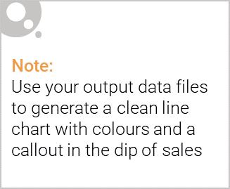
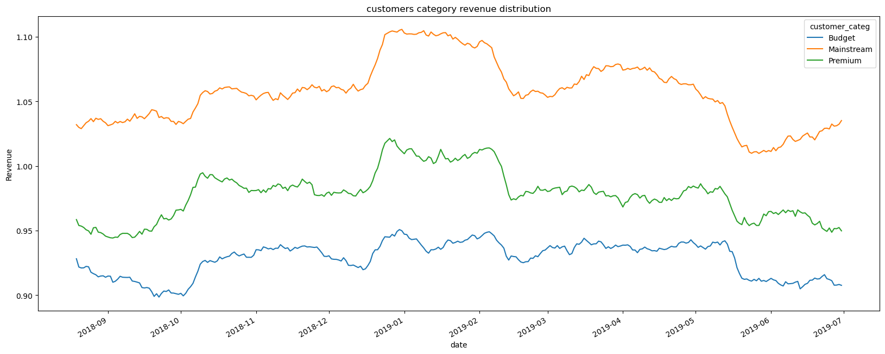
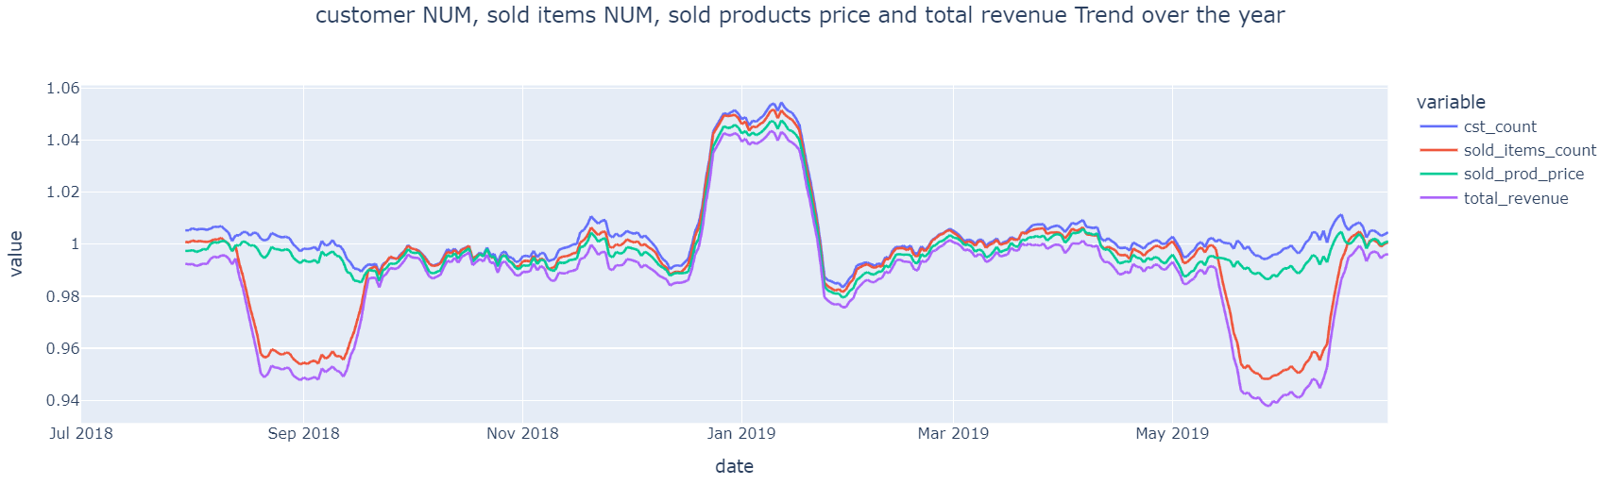
Overview: your key callout for the category should be included here

Slide 6


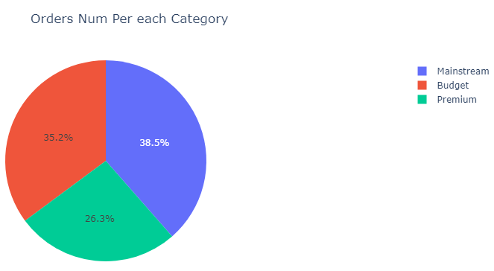
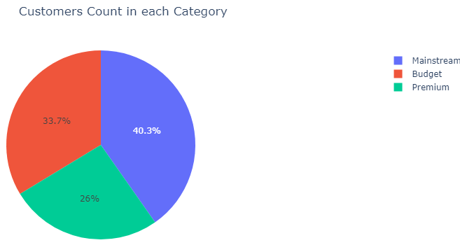
This slide will be commentary on affluence and its effect on consumer buying for the category of chips

Slide 7
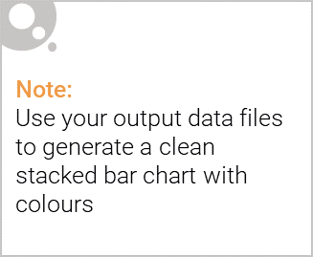
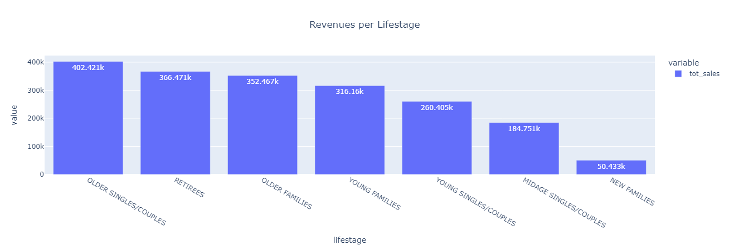
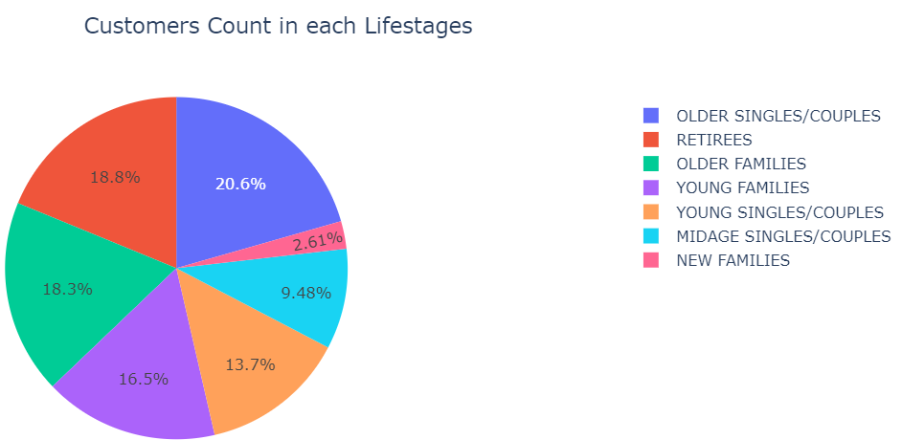
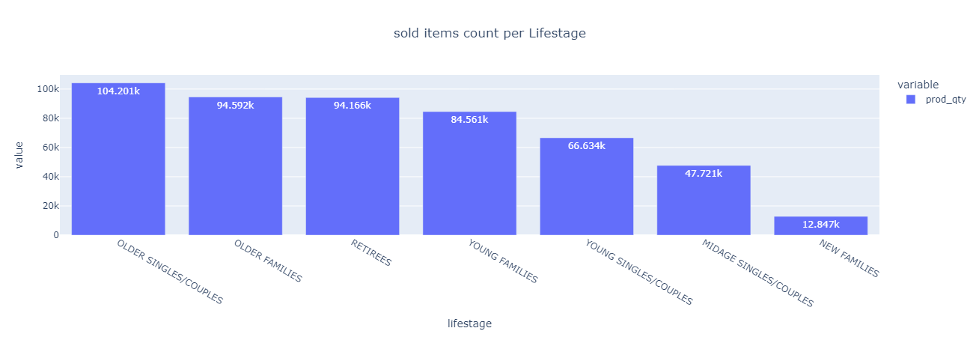
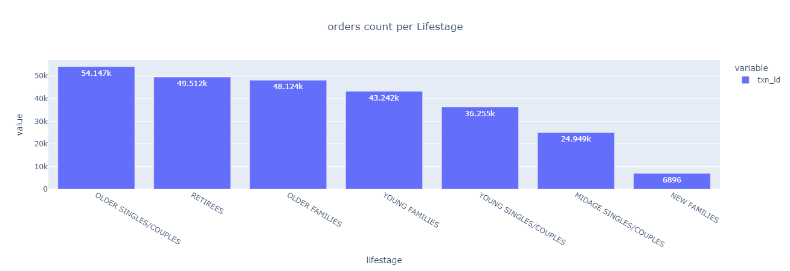
Editable (delete this)
Visualising the proportion of customers by affluence and life stage on this slide

Slide 8
02
Trial store performance
Revenue AVG for all Trials stores was $7.54 compared to $7.36 for all Non-Trials stores, reflection a 2.4% increase during the Trial period.
The Store No. 88 ranks 2nd in all_stores total revenues $4286, Store No. 86 ranks 64th by total revenues $2788, and Store No. 77 ranks 194th by $777 in total revenue during the trial period.
Store No. 88 ranks first in total trial stores revenue, customer frequency, and order count, followed by Store No. 86. Store No. 77 ranks 3rd during the trial period.

Slide 9
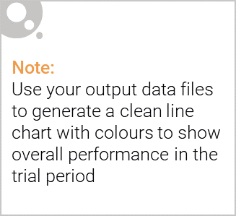
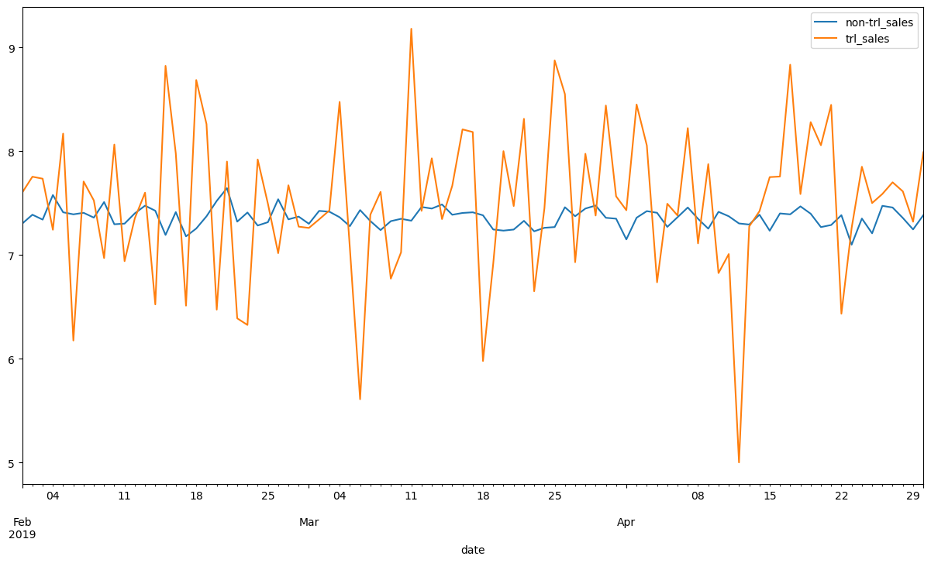
Explanation of the control store vs other stores

Slide 10
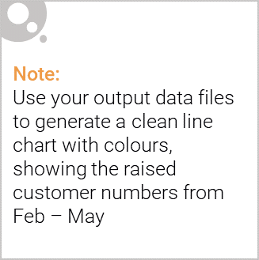
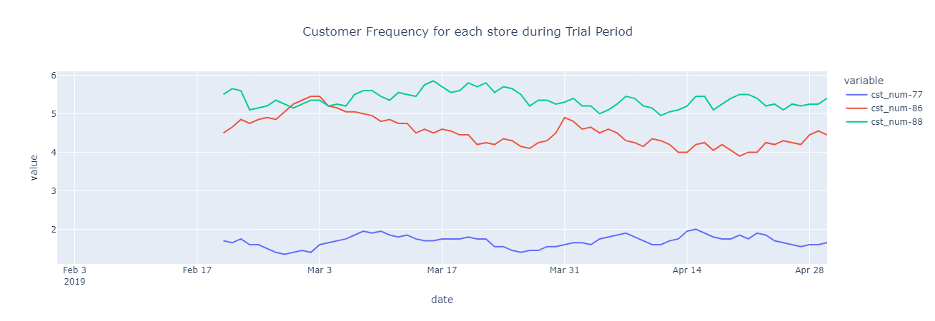
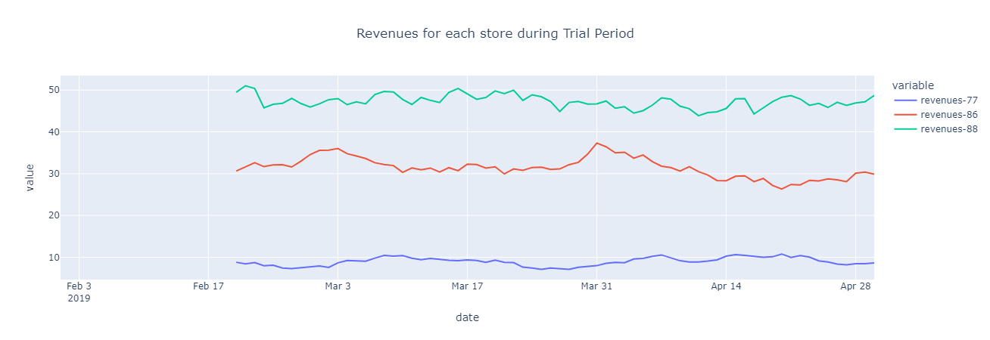
Call out of the performance in the trial store, determining if it was successful

