Slide 1

המכללה האקדמית תל-חי
החוג למדע המחשב
הצגת פרויקט סוף
בנושא:
אתר ליצרת מבחנים/שאלונים ושיתופם עם סטודנטים/אנשים
TGS: test generator site
מבצעים:
316 373הייב מוחמד תז 562
מנחה:
מר גדי שור
(COVIDסמסטר אביב תשף 2020 – (שנת
<number>
Notes:
<number>

Slide 2

About TGS:
Main issue:
As we all can see nowadays all the education industry has become more complicated, and hard either to students and teachers since covid-19 appeared in our life.
one of the many problems that covid-19 has exposed is the remote exams which requires from the teachers so many efforts to prepare them and test these exams.
How we can assist?!?
TGS:
TGS (test generator site) is a website that comes to assist teachers /users who want to create a survey/test and share it with their students, friends, coworkers, or any other users.
2

Slide 3


About TGS:
Why TGS?
TGS has been designed to be pretty easy and require almost 0% knowledge in technology, this design was introduced to fit both teachers that have weak knowledge in technology and those that have a
2

Slide 4
TGS used Technologies
The following Technologies was used to implement TGS:
HTML5 (client side) – used to describing the structure of Web pages.
CSS3 (client side)– used to describing the presentation of Web pages.
JavaScript (client side) – used to interact with web pages.
PHP (server side) – used for the server side development.
MySQL (server side) – used to store users data for a long term.
4

Slide 5
TGS Main Features:
TGS supports the following list of Features:
validating user existence in the system(a.k.a Login).
Create new exam/test.
Answer specific exam by entering exam id.
See users recent grades– requires Admin permissions.
Add new users to the system - requires Admin permissions.
Go back to the Login page (a.k.a
4

Slide 6

TGS usage demo:
Finally!! let's see what he talking about almost one hour.
TGS are hosted on 000webhost.com which offer an free webhosting for small sites:
site link:
http://tgstelhai.000webhostapp.com/
Log in info:
Username Password Isadmin
Admin admin yes
Telhai telhai no
Source code can be found in:
6

Slide 7
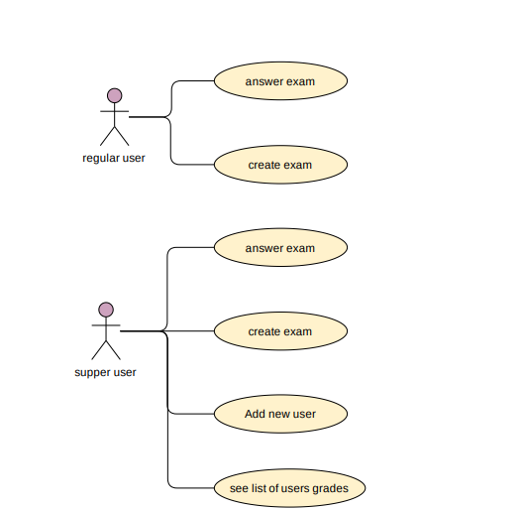
TGS use case diagram
<number>

Slide 8
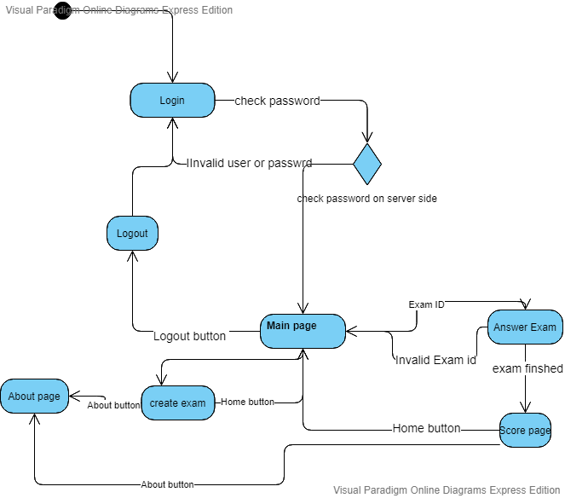
TGS Action diagram
<number>

Slide 9
TGS Main modules
TGS divided into two Main modules:
Regular User module:
Regular user module gives users the ability to
Create exams, and answer exams that crated by them or by another users.
Regular user module introduce the same UI as the super user UI with a small differants.
<number>

Slide 10
TGS Main modules
TGS divided into two Main modules:
Super user module:
Super user module gives users the ability to
Create exams, and answer exams that crated by them or by another users, in additional super user can add new users and see users recant grades.
<number>

Slide 11
TGS: Database schema
TGS Database Tables:
Users Table:
Username | Password | Isadmin
Admin | Admin | 1
Telhai | Telhai | 0
<number>

Slide 12
TGS: Database schema
Exams Table:
Exam ID | Exam text
33 | (q|a|a|a) (q|a|a|a)
34 | (q|aa)
<number>

Slide 13
TGS: Database schema
Grades table:
Exam_id | User_id | Score | Modify time
33 | Admin | 67 | 2020/06/8 12:45:33
<number>

Slide 14
TGS development process
TGS development process can be divided to two main stages:
First stage:
client side development
UI designing and style
Second stage:
Server side development.
Database design and creation.
14

Slide 15
TGS development – First stage – description
Client side development involved page design and style development and page interaction which uses the functionality of HTML and CSS and JavaScript.
1. first init the page basic template and the then use the css functionality to add some style to this page template, and at the end add JavaScript to allow user to interact with the web pages.
14

Slide 16
TGS development – First stage – ginned skills
Form the first stage development I have improved my web pages design and ginned very good experience with the front-end development especially that I don’t know any thing about front-end development before this project.
14

Slide 17
TGS development – second stage – description
Server side development involved page database design and serve the user requests which uses the functionality of PHP and MYSQL.
14

Slide 18
Thank you
14

