Slide 1
Synthetic Network Modeling: BA vs. ER
Comparing Scale-Free and Random Topologies
Mohamed Hussein
Web Topologies
Date

Slide 2
Introduction to Part 1
What is network science?
Importance of understanding network structures
Focus: BA and ER models

Slide 3
Synthetic Network Modeling
Barabási–Albert (BA) vs. Erdős–Rényi (ER)
Same number of nodes, same avg degree
Preferential attachment vs uniform randomness

Slide 4
Degree Distribution Analysis
Compute degree distribution P(k)
Normalize and bin data
Plot log–log distributions

Slide 5
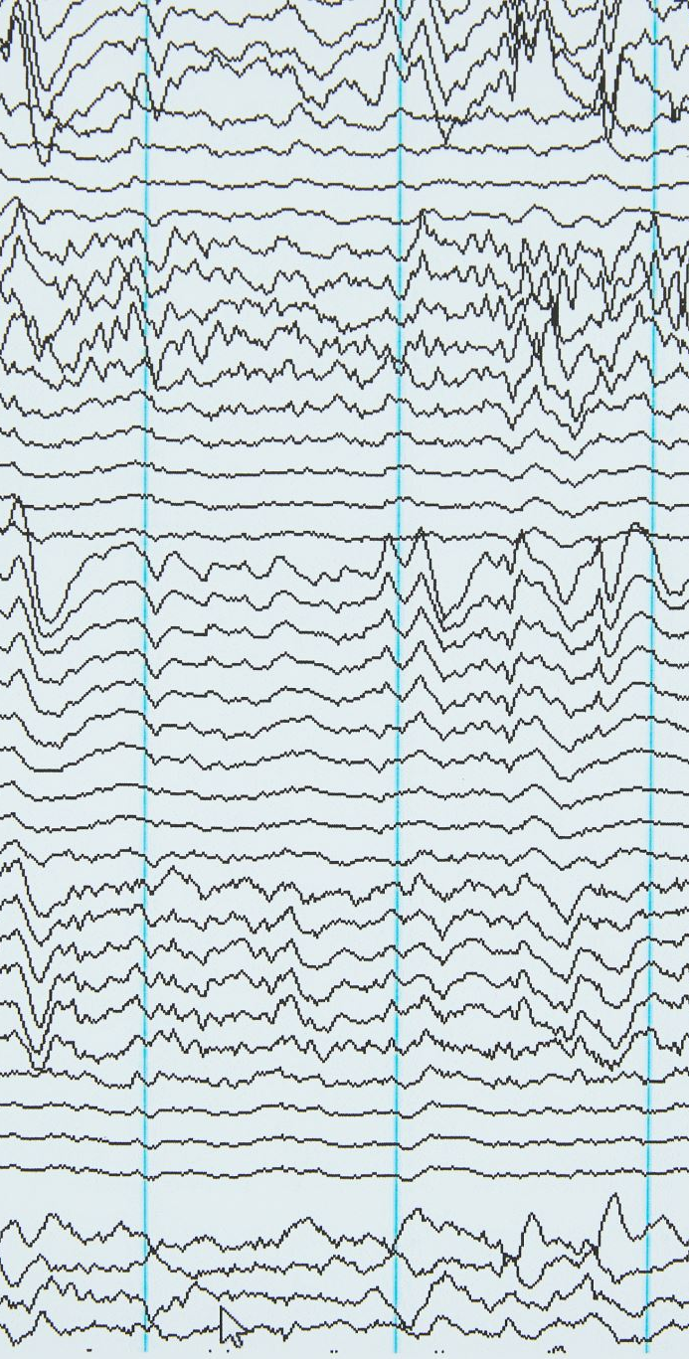
Power-Law Behavior in BA Model
BA log–log plot shows straight-line tail
Confirms power-law: P(k) ∝ k^-2
Exponent α ≈ 2

Slide 6
ER Model Comparison
ER plot peaks sharply at mean degree
No power-law tail
Poisson-like decay

Slide 7
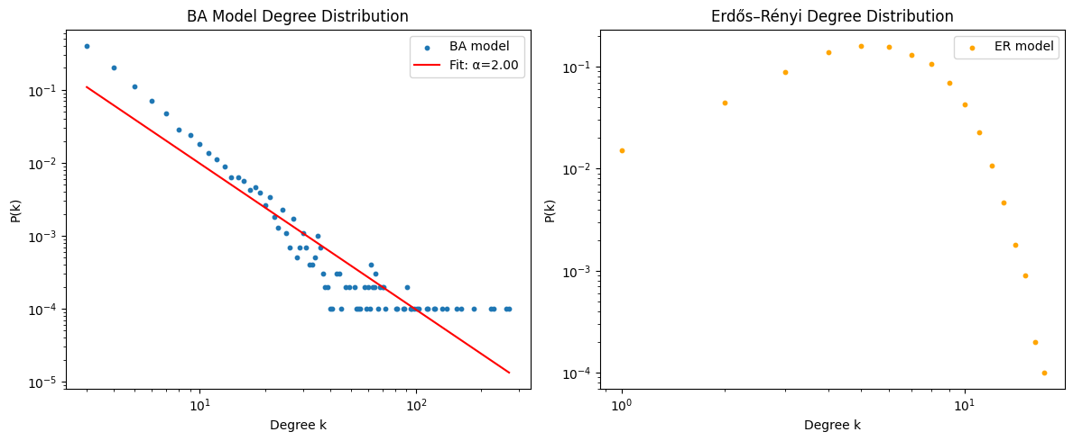
Visual Comparison of Distributions
Side-by-side plots: Blue = BA, Orange = ER
Highlight different tail behaviors

Slide 8
Key Insights from Modeling
BA: heavy-tailed, scale-free
ER: uniform, no hubs
Different topologies shown visually

Slide 9
Introduction to Part 2
From synthetic to real-world networks
Dataset: ca-GrQc co-authorship graph
Objective: Compare community detection methods

Slide 10
Dataset Overview
4158 nodes, 13,428 edges
Represents co-authorship in General Relativity
Expected to show scale-free properties

Slide 11
Task Objective
Use two algorithms for community detection
Visualize and compare communities

Slide 12
Methodology - Label Propagation
Unsupervised, fast
Nodes adopt majority neighbor labels
Pros: Speed; Cons: Non-deterministic

Slide 13
Methodology - Louvain Algorithm
Based on modularity optimization
Builds community hierarchy
Pros: Structured; Cons: Computational cost

Slide 14
System Overview
Streamlit dashboard
Upload → Choose method → Visualize

Slide 15
Preprocessing Steps
Ensure graph connectivity
Extract largest connected component
Spring layout used for visualization

Slide 16
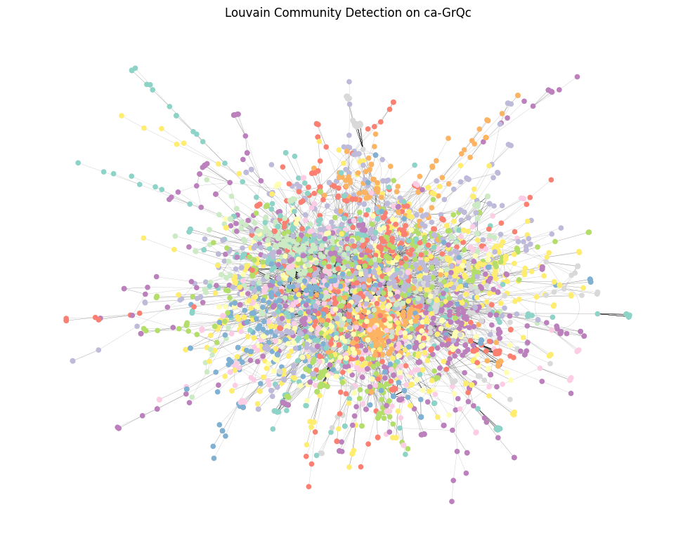
Louvain - Results
The center is densely packed, showing that many nodes (authors) are interconnected which is typical in a scientific collaboration network. Each unique color shows a community (a cluster of nodes more connected internally than with the rest of the network). The outer nodes are less connected, forming smaller satellite communities or acting as bridges.
Louvain optimizes modularity, so this structure shows a clear division into communities while preserving the overall connectedness of the graph.
The presence of many distinct color regions confirms the existence of multiple collaboration clusters (research groups or subfields).

Slide 17
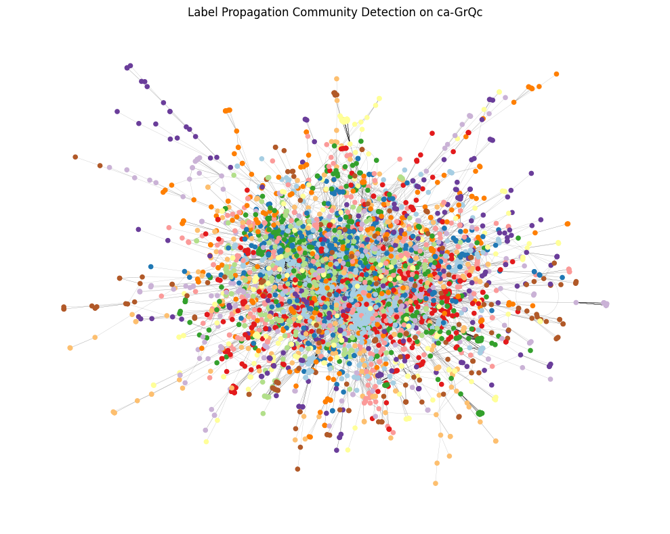
Label Propagation Results
Like the Louvain result, the center is densely connected, which reflects strong collaboration within the core network. The Label Propagation algorithm has produced a larger number of smaller communities, as seen by the higher diversity of node colors spread across the graph. Many outer nodes form isolated or peripheral communities which is a behavior often seen with label propagation due to its non-deterministic nature and local update rules.

Slide 18
Discussion
Louvain: Structured and interpretable
Label Propagation: Quick but noisy
Choose based on speed vs accuracy

Slide 19
Conclusion
BA and ca-GrQc both scale-free
Modeling vs real-world differences
Louvain preferred for structure

Slide 20
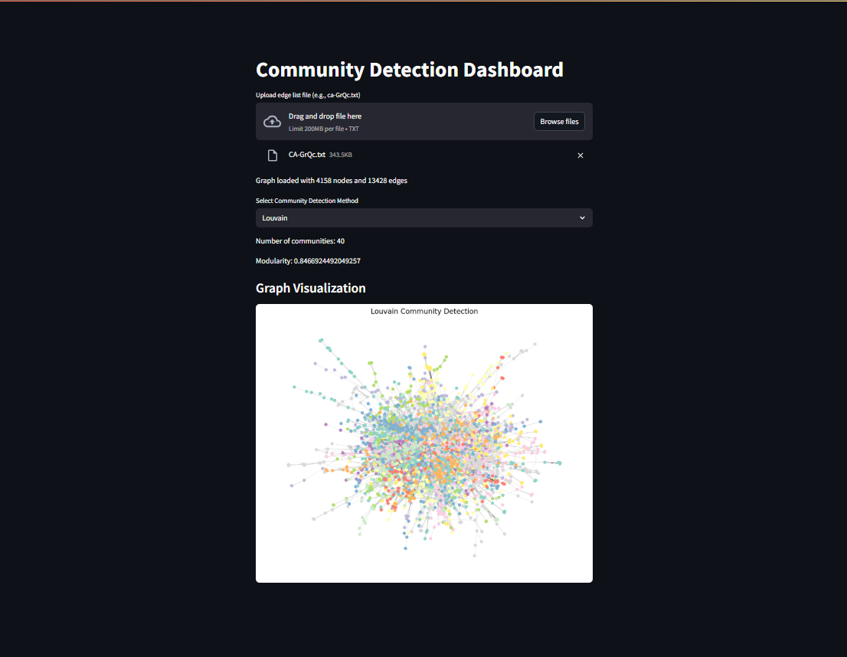
Demo screeenshot

Slide 21
Q&A
Thank you!
Any questions?

