Slide 1


Pacman
Mohamed Hussein 215348
Ahmed El Keshawy 218403

Slide 2

Introduction to Pac-Man
Pac-Man is an iconic arcade game developed by Namco and first released in Japan in 1980. Created by game designer Toru Iwatani, it quickly became a cultural phenomenon and is one of the most recognizable video games in the world.

Slide 3
AI and Pacman
Pac-Man has been a popular subject in AI research, with various algorithms and AI models developed to play the game. These studies often focus on pathfinding, decision-making, and strategy optimization, offering insights into more complex AI applications.

Slide 4
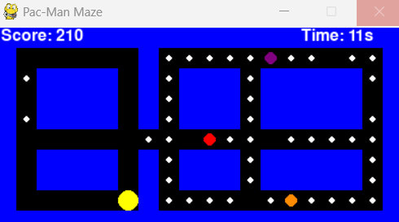
Gameplay Mechanics
The game is set in a maze where the player controls Pac-Man, navigating through to eat all dots while avoiding 3 different colored pellets that alternatively reduce time and score

Slide 5
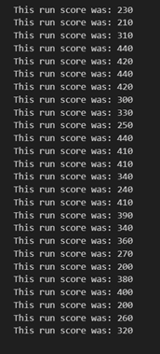
GUI for the Environment

Slide 6

Best Scores

Slide 7
Thank you

