Slide 1

DEPI Final Project
System Administration Consultation
Project Members
<<```
Hassan Moustafa
Mo’men El Sayed
Mohammed Ibrahim
Youssef Taher
>>```
Instructors
<<```
Eng. Mahmoud Zenhom
>>```

Slide 2



Project Objectives
1- Using the concepts of systems management and the basics of information systems management to develop and build the infrastructure for the required place
2- Implementing solutions based on the constraints facing the system such as financial resources and the number of users, etc.
3- Applying the best solution for the system to facilitate work performance and ensure data security
Project scope
Developing the system infrastructure and preparing a special room server for it
Providing data sharing with employees, each individually in his field and with specific powers, while providing complete data security and creating a backup system to ensure data retention

Slide 3
Introduction
This report outlines the improvements made to the IT infrastructure of the Civil Registry Government agency located in Alexandria, Egypt. The project aimed to enhance network security, improve system performance, and ensure compliance with government regulations. The agency was facing challenges such as outdated systems, lack of security protocols, and insufficient infrastructure to handle increasing demands.
We implemented several changes using Windows Server and Windows 10 through Hyper-V. These changes focused on user management, file sharing, network security, and system policies. Additionally, network

Slide 4
Scenario Overview
The Civil Registry Government agency is responsible for issuing certificates and ID cards to the local population. The current infrastructure includes:
Network: One router with a visible SSID and no advanced security settings.
Devices: Two PCs used by a small number of employees.
Servers: Cloud-based database connections, but unsecured.
Data Backup: No backup system in place.
Employees: Eight employees, only three of whom use PCs.
Our goal: was to address security vulnerabilities, improve the IT infrastructure, and establish a scalable system for future needs. Additionally, implementing network components such as switches and firewalls was critical for enhanced performance and security.

Slide 5
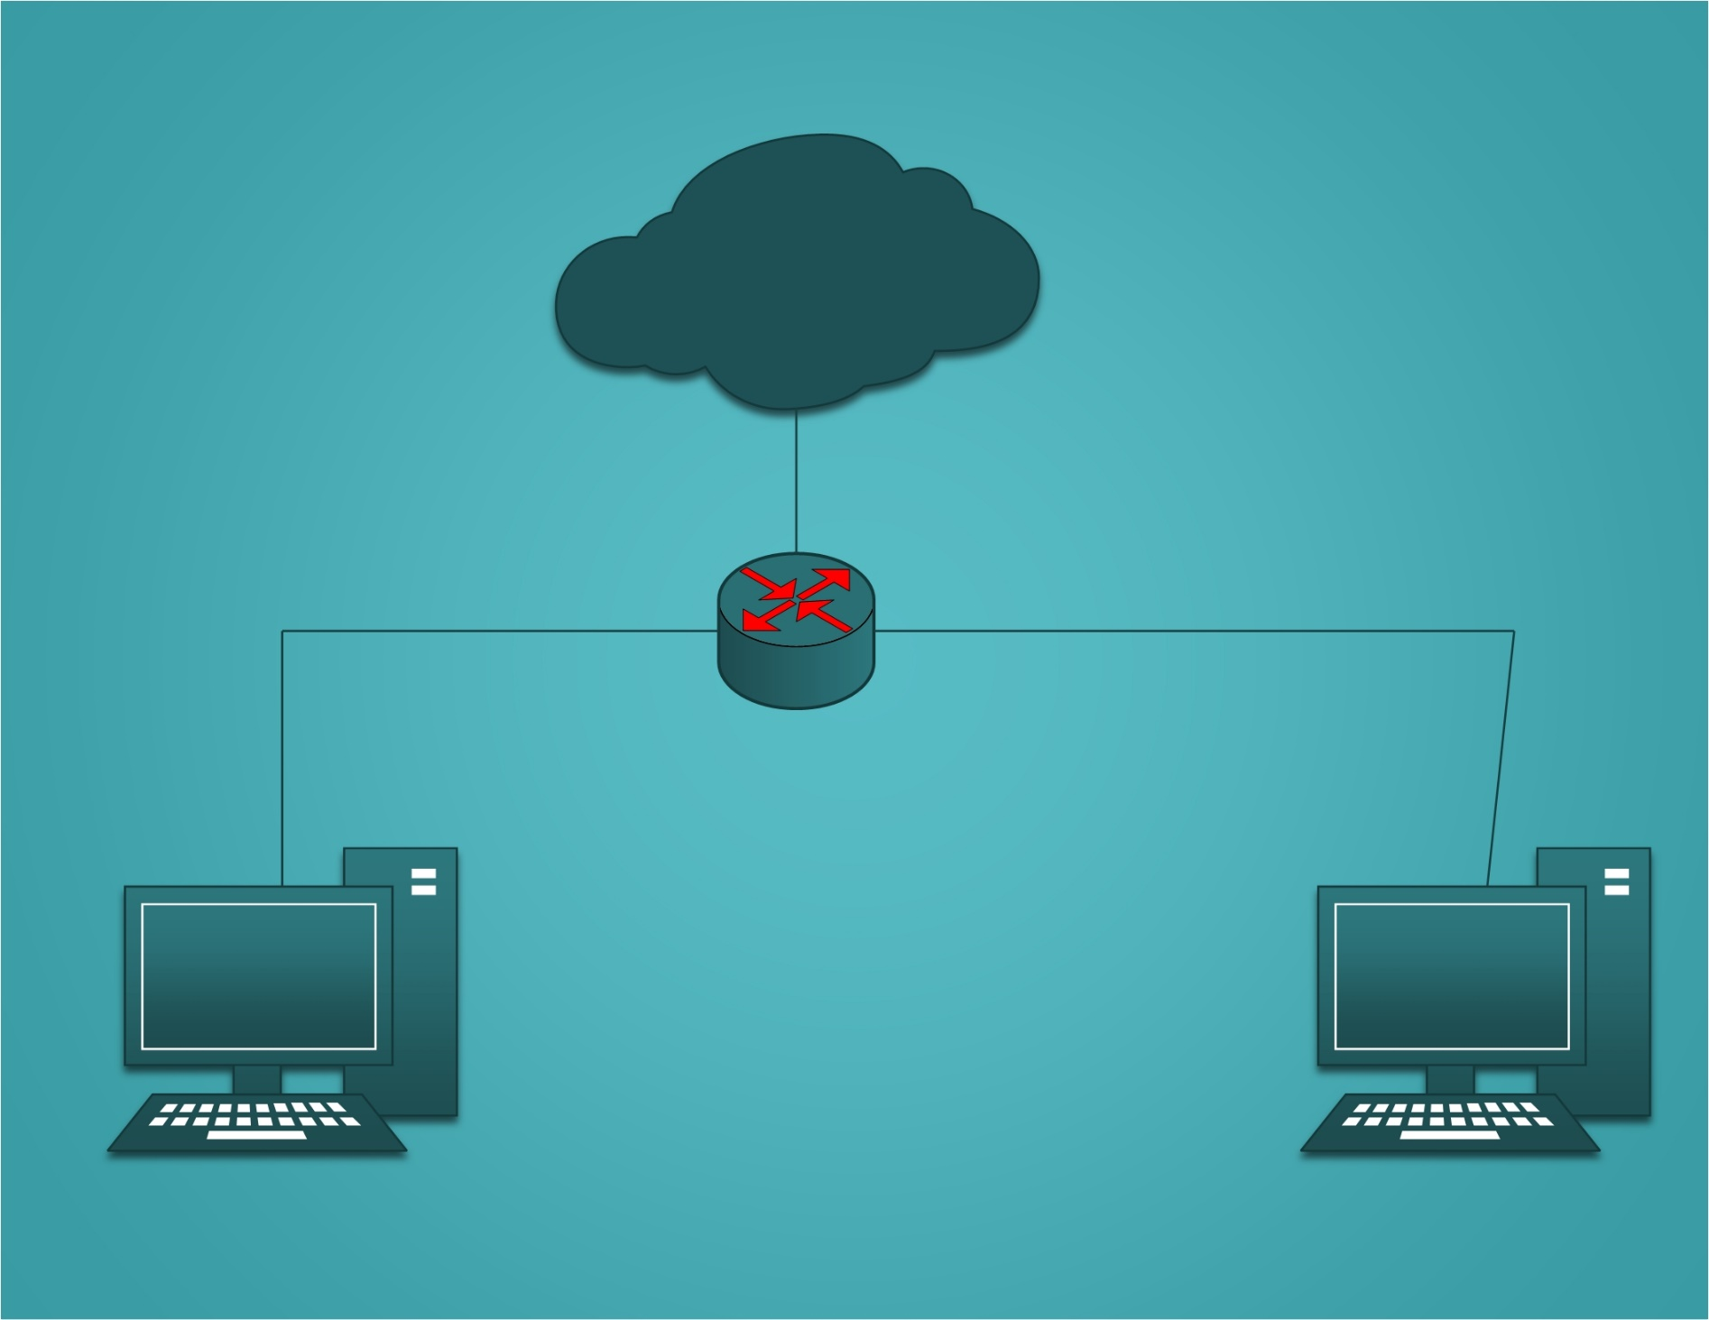
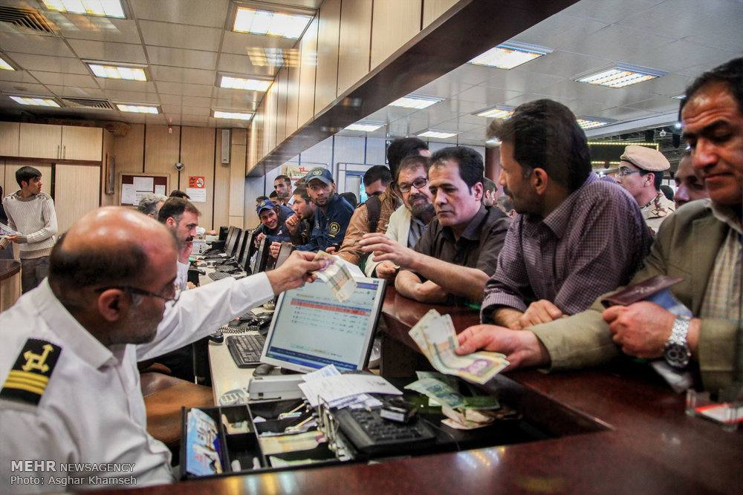
Civil Registry Government
Current infrastructure:
Network: 1-Router (Shown-SSID)
Devices: 2-PC (All_Valid)
Servers: Cloud Connections to data-base (Not_Secure_Connection)
Employees: 8- Employees (3-Use-PC)
Server Room: Not have any one
Data_backup: No Data backup

Slide 6
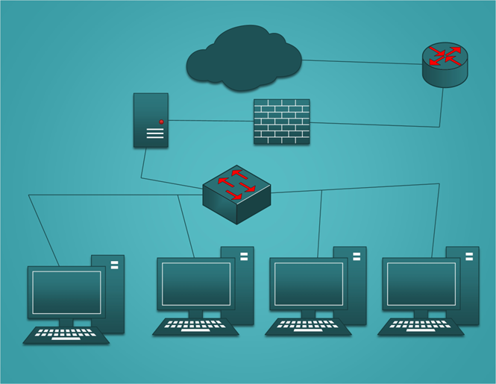
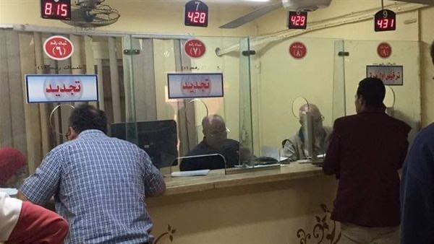
Recommended infrastructure:
Network: 1-Router (Hide-SSID) +1-Switch
Devices: 4-PC (Limited_Access)
Servers( AD+ FS): Server Bult in Civil Registry Government Go to Cloud Connections to data-base (Secure_Connection)
Employees: 8- Employees (4-Use-PC)
Server Room: Build a server room to install, set up and manage servers
Data_backup: Make incremintal backup

Slide 7
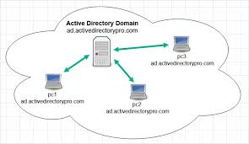
Active Directory
What is Active Directory?
Active Directory (AD) is a database and set of services that connect users with the network resources they need to get their work done.
The database (or directory) contains critical information about your environment, including what users and computers there are and who’s allowed to do what. For example, the database might list 100 user accounts with details like each person’s job title, phone number and password. It will also record their permissions.
The services control much of the activity that goes on in your IT environment. In particular, they make sure each person is who they claim to be (authentication), usually by checking the user ID and password they enter, and allow them to access only the data they’re allowed to use (authorization).

Slide 8
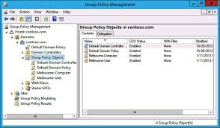
Group Policy
What is Group Policy?
Group Policy is a management feature in Microsoft's Active Directory (AD) that enables network and system administrators to configure and assign user and computer settings in an AD environment. Group Policy provides a centralized, policy-based approach to system management that can be applied at different AD container levels, such as domains, sites or organizational units (OUs).
Group Policy is often viewed as a security tool, and certainly a large portion of the settings apply to user and computer security. However, Group Policy also offers a variety of other options. For example, administrators can configure settings related to driver installation, folder redirection, network connections, shared folders, logon scripts, printers and much more.
Group Policy settings are specific to either users or computers. Computer settings are applied when a computer starts up, and user settings are applied when a user logs onto the system. Computer settings take precedence over user settings.

Slide 9
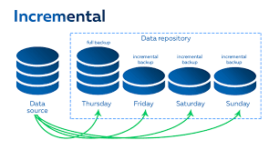
Backup solution
What Is Windows Server Incremental Backup and How Does It Work?
Incremental backup is a type of backup that only includes the changed or newly created files into the backup since the latest backup was taken before.

Slide 10

ID-Section
Name: Momen El Sayed
User-Name: momen
Password: M@men2090
Name: Mohammed Ibrahim
User-Name: mohammed Ibrahim
Password: Moh@mmed2090
Group Policy:
USB Device Policies
Internet Access Policies
Hide all partitions

Slide 11
Certificates-Section
Name: Omar mosoud
User-Name: omar mosoud
Password: @mar2090
Name: Hassan Mustafa
User-Name: hassan mustafa
Password: H@ssan2090
Group Policy:
USB Device Policies
Internet Access Policies
Hide all partitions

Slide 12
Employees
Name: Omar mosoud
User-Name: omar mosoud
Password: @mar2090
Name: Hassan Mustafa
User-Name: hassan mustafa
Password: H@ssan2090
Name: Momen El Sayed
User-Name: momen
Password: M@men2090
Name: Mohammed Ibrahim
User-Name: mohammed Ibrahim
Password: Moh@mmed2090

Slide 13

Let’s Go To Technical Work

