Slide 1
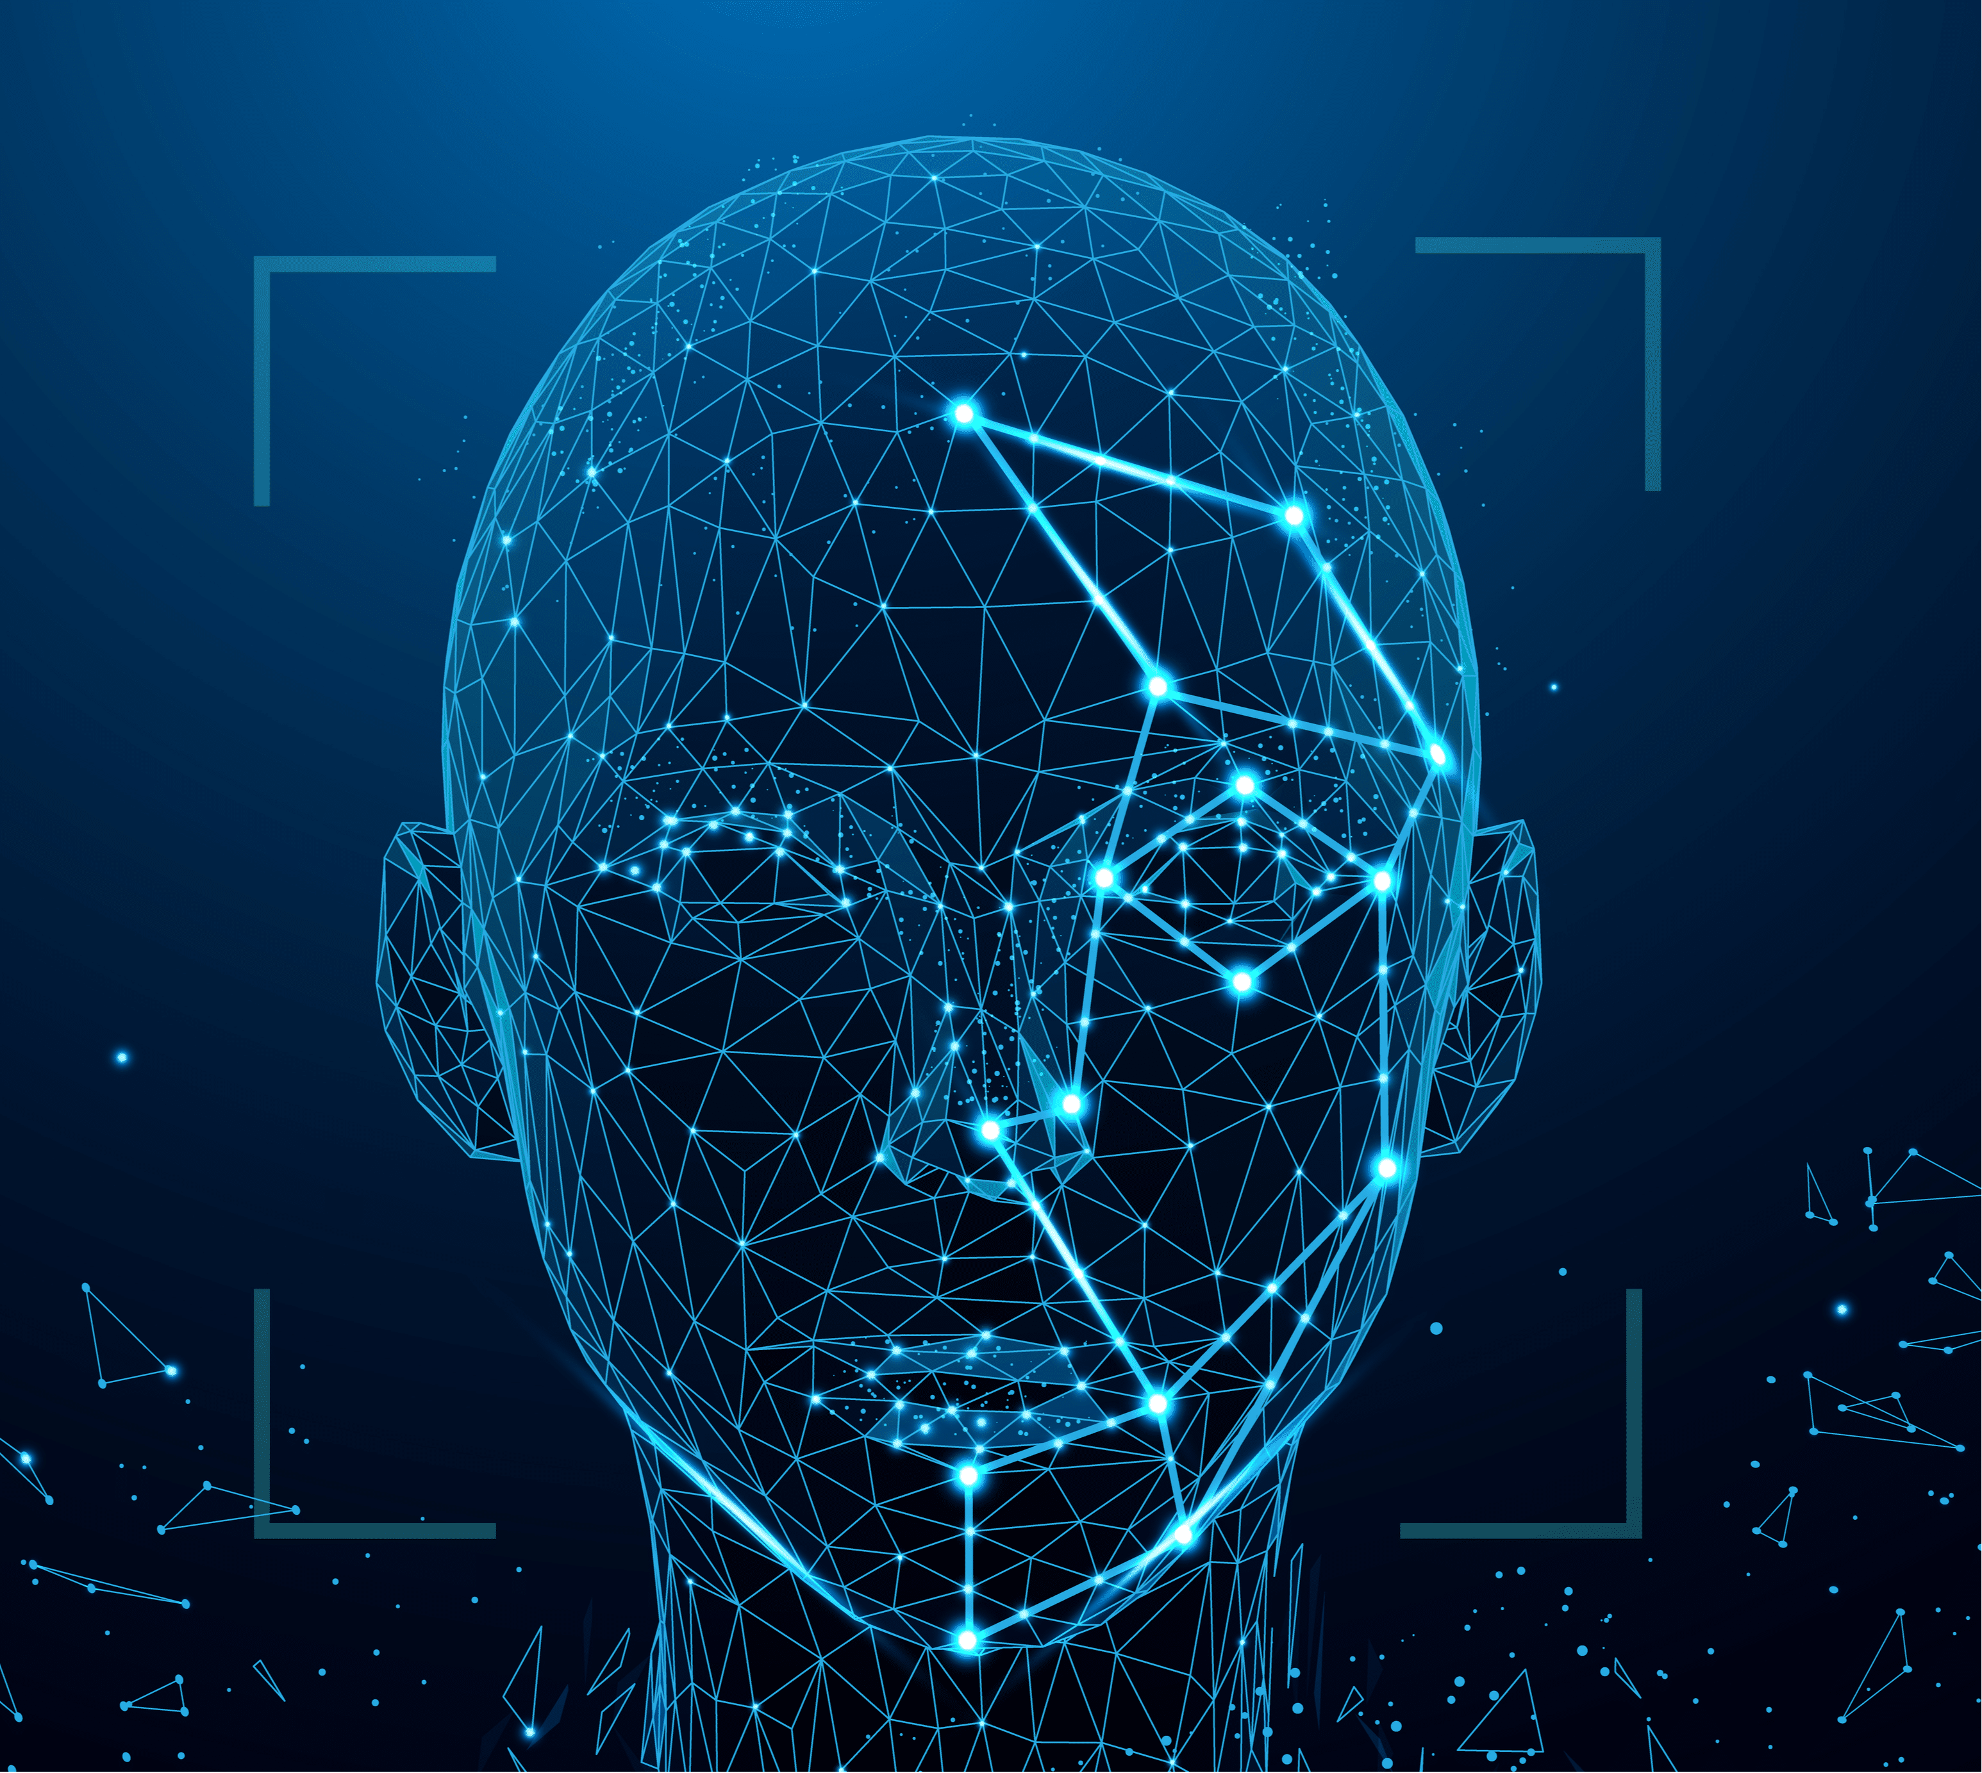
Face Recognition Using Local Binary Patterns Histograms (LBPH)
DHAMODHARAN S P 22CS018
HARSHINI R 22CS031
JANANI J 22CS034
NAVEENKUMAR T 22CS054
MOHAMED IRFAN S 22CSL07

Slide 2
Introduction
Face recognition is a critical technology in modern applications such as security, attendance systems, and personalization.
LBPH (Local Binary Patterns Histograms) is an efficient algorithm for facial feature extraction and matching.
This project aims to develop a real-time face recognition system using Python and OpenCV.

Slide 3
Objectives
Primary Goal: Build a complete face recognition pipeline from image capture to real-time recognition.
Key Objectives:
Create a labeled dataset by capturing images.
Train a face recognition model using LBPH.
Implement a real-time recognition system to detect and identify faces.

Slide 4
Methodology Overview
Step 1: Face detection using Haar cascades.
Step 2: Dataset creation by capturing images and storing them in a labeled format.
Step 3: Train the LBPH-based face recognition model.
Step 4: Use the trained model for real-time face recognition via webcam.
Libraries used: OpenCV, NumPy, and Python’s standard libraries.

Slide 5
LBPH Overview
What is LBPH?
Divides grayscale images into smaller regions.
Calculates binary patterns to extract texture features.
Combines histograms of patterns to create a feature vector.
Why LBPH?
Effective in varying lighting conditions.
Computationally efficient for small datasets.

Slide 6
Code: Image Capture
The capture_images(User) function:
Captures images from the webcam.
Detects faces using Haar cascades.
Saves detected face regions to the Faces folder with user-specific labels.
Highlights:
Detects faces with detectMultiScale().
Stores up to 300 images for training per user.

Slide 7
Code: Model Training
The train_model(label) function:
Loads captured images and their labels.
Extracts face regions and associates them with corresponding user IDs.
Trains the LBPH model using cv2.face.LBPHFaceRecognizer_create().
Saves the trained model as trained_model.xml.
Key Details:
Inputs: Images and labels.
Output: A trained LBPH model for recognition.

Slide 8
Code: Real-Time Recognition
The recognize_faces(recognizer, label) function:
Uses the webcam for real-time face detection and recognition.
Compares detected faces against the trained LBPH model.
Displays user names and confidence scores on recognized faces.
Key Details:
Confidence threshold ensures reliability.
Displays "Unrecognized" for unknown faces.

Slide 9
Dataset Preparation
Images are stored in a structured format in the Faces directory.
Each image is labeled with the user’s name and image count (e.g., User_0.jpg).
Dataset created using the capture_images() function.
Challenges:
Collecting diverse images under different lighting conditions.

Slide 10
Challenges
Handling variations in lighting and pose.
Differentiating similar-looking faces with limited data.
Maintaining recognition accuracy with small datasets.

Slide 11
Results and Observations
Outputs:
Recognized faces with user names and confidence levels.
Real-time recognition displayed in a live webcam feed.
Observations:
High accuracy for well-lit, frontal images.
Lower confidence for low-resolution or obscured faces.

Slide 12
Applications
Security and surveillance systems.
Attendance monitoring in schools or workplaces.
Personalized services in retail or hospitality industries.
Potential use in identifying missing persons or suspects.

Slide 13
Conclusion
Successfully implemented a real-time face recognition system using LBPH.
LBPH proves to be a simple yet effective algorithm for small-scale applications.
Future Scope:
Expand the dataset for improved accuracy.
Integrate with advanced algorithms like CNNs for better performance.

Slide 14
Thank you

