Slide 1

GRADUATION PROJECT · DATA ANALYTICS
Google Play Store Data Analysis
Interactive Excel Dashboard Using Python
Nouran Elkafoury · Mohammed Ismail · Mohammed Baker · Omar Samir

Slide 2
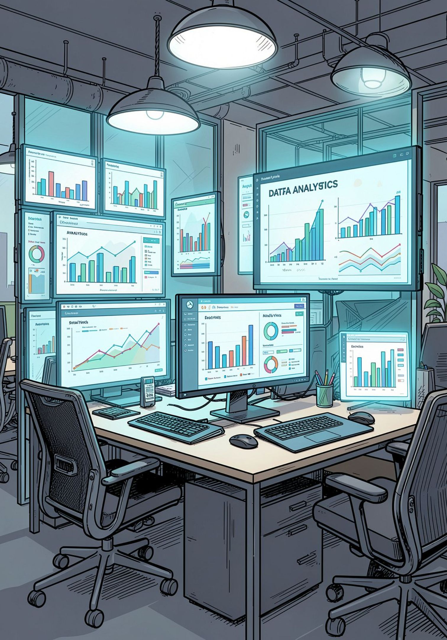




PROJECT OVERVIEW
What We Set Out to Build
This project analyzes Google Play Store application data to extract actionable business insights. Python handles data cleaning and preparation, while Microsoft Excel delivers an interactive dashboard with KPIs and visualizations.
Project Objective
Clean, structure, and visualize 9,635 Google Play Store apps to reveal trends in ratings, installs, and pricing.
Why This Data Matters
With billions of downloads across thousands of categories, Play Store data reveals real patterns in app performance and user behavior.
Business Value
Stakeholders can identify high-performing categories, optimize pricing, and benchmark app quality against market standards.
Expected Outcomes
A polished interactive dashboard, clean dataset, and data-driven insights ready for strategic decision-making.

Slide 3






METHODOLOGY
End-to-End Project Workflow
Six sequential stages transform raw data into interactive visual intelligence — each step builds on the last to ensure accuracy and clarity.
Raw Dataset
Python Cleaning
Google Play Store source data
Handle missing values and duplicates
Data Preparation
Excel Pivot Tables
Format and convert data types
Aggregate and summarize data
Interactive Dashboard
Business Insights
Charts, filters, and KPI cards
Actionable findings and recommendations

Slide 4










DATA
Dataset Overview
The dataset captures 9,635 Google Play Store applications across ten attributes — covering performance metrics, metadata, and user engagement signals.
App Name
Unique application title
Category
App classification (e.g., Games, Productivity)
Rating
User score from 1.0 to 5.0
Reviews
Total user reviews submitted
Installs
Cumulative download count
Price
Listed cost in USD
Content Rating
Age appropriateness classification
Android Version
Minimum OS requirement
Size
Application file size in MB
Last Update
Most recent version release date

Slide 5
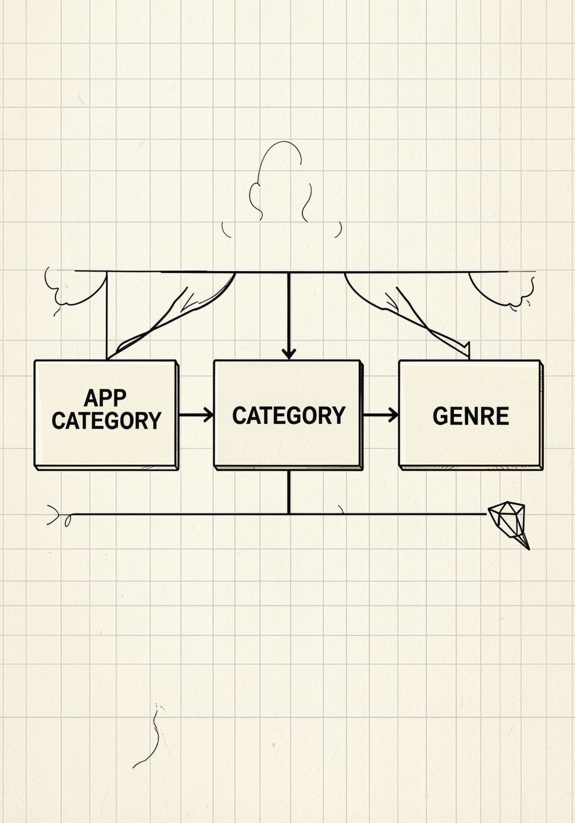
DATA ENGINEERING
Python Cleaning & Database Design
Python Data Cleaning
Relational Database Design
Python transforms the raw dataset into a reliable, analysis-ready foundation.
Three normalized entities form the logical data model.
Missing Values — Null entries identified and handled
Duplicate Records — Redundant rows detected and removed
Data Formatting — Standardized text, dates, and numeric fields
Data Type Conversion — Ensured correct types for analysis
APP
App Name, Rating, Reviews, Installs, Price, Size, Last Update
CATEGORY
Category Name, Description
GENRE
Genre Name, Sub-genre Classification

Slide 6
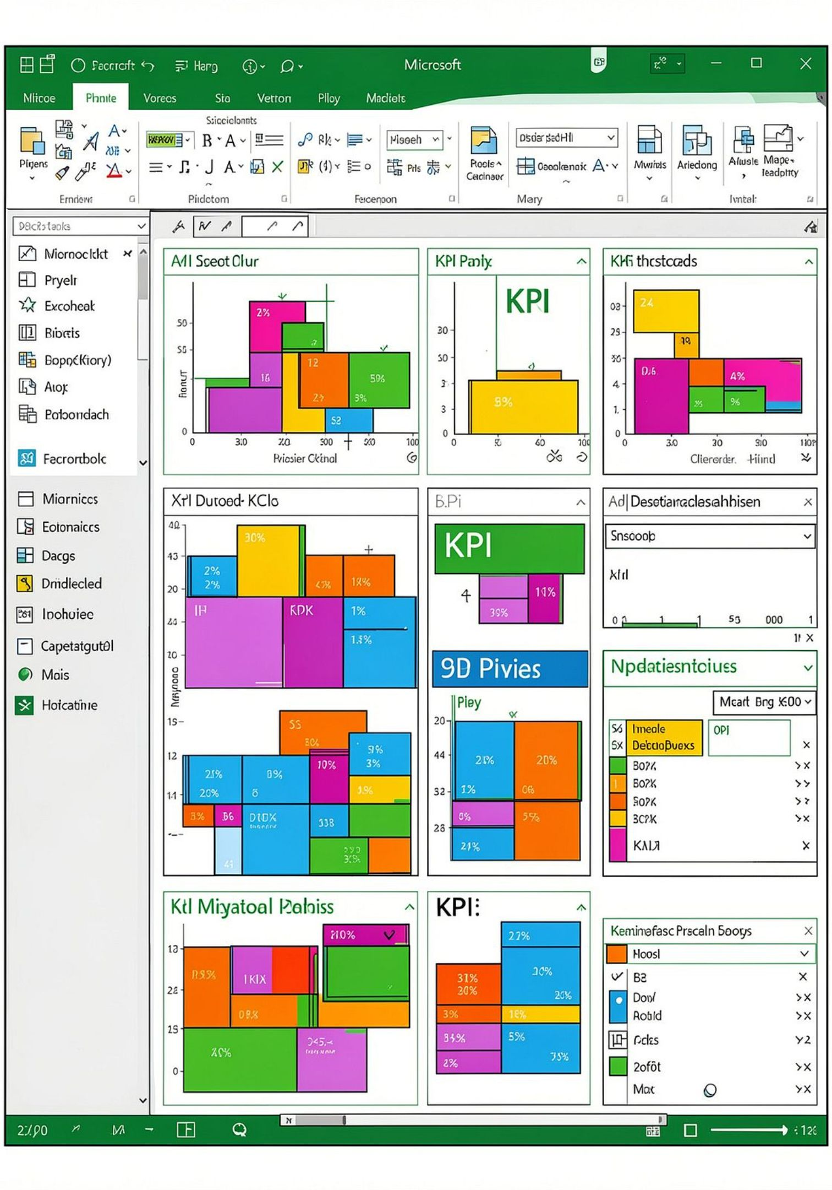
DASHBOARD
Interactive Excel Dashboard
The Excel dashboard combines KPI cards, Pivot Charts, and interactive slicers into a single navigable interface — enabling stakeholders to explore the data dynamically.
9,635
Total Apps
Applications analyzed across all categories
4.2
Average Rating
Mean user rating across the full dataset
75.1B
Total Installs
Combined downloads across all applications
$10,577
Total Price
Sum of all paid application prices

Slide 7
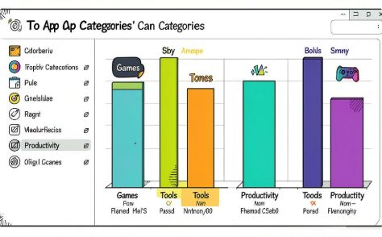
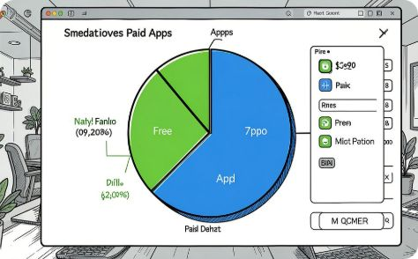
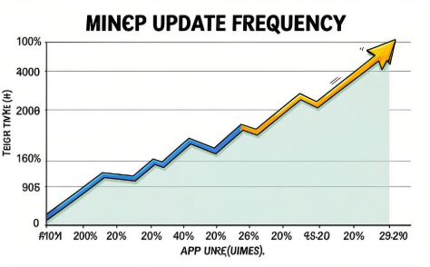
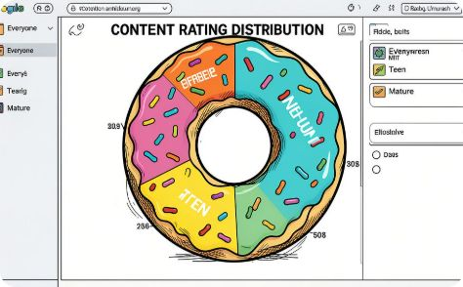
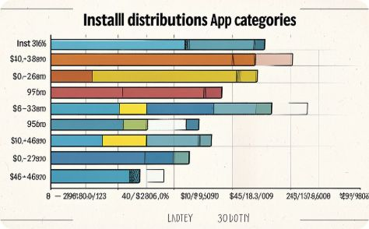
ANALYSIS
Dashboard Analysis
Five analytical views reveal the distribution and behavior of apps across the Google Play Store.
Top Categories
Paid vs. Free Apps
Applications Updated Over Time
Content Rating Distribution
Games, Tools, and Productivity dominate app volume and downloads.
The vast majority of apps are free, with paid apps representing a small but high-value segment.
Most apps target a general audience, with "Everyone" as the dominant rating.
Update activity reflects developer engagement and commitment to app quality.
Install Distribution
A small number of high-performing apps account for the majority of total installs.

Slide 8

INSIGHTS
Business Insights
🆓 Free Apps Dominate the Market
⭐ Higher Ratings Drive More Installs
📂 Popular Categories Concentrate Downloads
The overwhelming majority of apps are free — freemium and ad-supported models are the default strategy.
Apps with stronger ratings consistently attract more downloads, making quality a direct growth lever.
Games, Tools, and Entertainment capture the largest share of total installs across the store.
🔄 Regular Updates Signal Quality
📊 Dashboards Simplify Decision-Making
Frequently updated apps tend to maintain higher ratings and stronger user retention over time.
Interactive visualizations enable stakeholders to explore data and act on insights without technical expertise.

Slide 9

REFLECTION
Challenges & Conclusion
⚡ Challenges Encountered
✅ Key Conclusions
Missing Values
Duplicate Records
Python Prepared the Dataset
Excel Delivered the Dashboard
Null entries required careful handling to preserve dataset integrity.
Identifying and removing redundant rows was essential for accuracy.
Python's cleaning pipeline transformed raw data into a reliable, analysis-ready foundation.
Pivot Tables, Charts, and Slicers created a fully interactive business intelligence interface.
Data Formatting
Dashboard Design
Inconsistent text, numeric, and date formats required standardization.
Balancing visual clarity with analytical depth required iterative refinement.
Meaningful Insights Were Generated
The dashboard surfaces actionable findings on ratings, installs, pricing, and category trends.

Slide 10
Thank You
Questions?
We appreciate your time and attention. We welcome your questions and feedback.
Nouran Elkafoury
Mohammed Ismail
Mohammed Baker
Omar Samir
GOOGLE PLAY STORE DATA ANALYSIS
INTERACTIVE EXCEL DASHBOARD USING PYTHON

