Slide 1
ITF405 Integrated Information Systems
Submitted to
DR. Khaled Wassif
ENG. George Sami

Slide 2
Project Name: Fast Food Restaurant System
Group members:
Mohamed Ahmed Khalef
Ahmed Fathi Khalifa
Abd Elrahman Mostafa
Nourhan Ahmed Diaa
Marwa Mohamed Adel
Shymaa sayed
Heba Nasser

Slide 3
OverView:
It’s a simple desktop Application For Restaurant .
Which have two type of users Admin & Casher .
Admin : can add employee (casher) , Delete or edit casher salary and mange all of system .
Casher : reserve tables for customer , make a sells bill

Slide 4
Functions
Login option for individual users .
chosse type of users ( Admin or Cashier ).
Make BackUp .
Cashier page for mange sales opreations and create new bill.
Store for add new items and make orders if i need .
Sales report for calculate profit .
Registeration only for manager to add new employees , Suppliers and customers .
System Have LogFile for all Transactions .

Slide 5
Its Desktop Application
Only For Desktop users
Generats Orders
Mange restaurant
Features

Slide 6
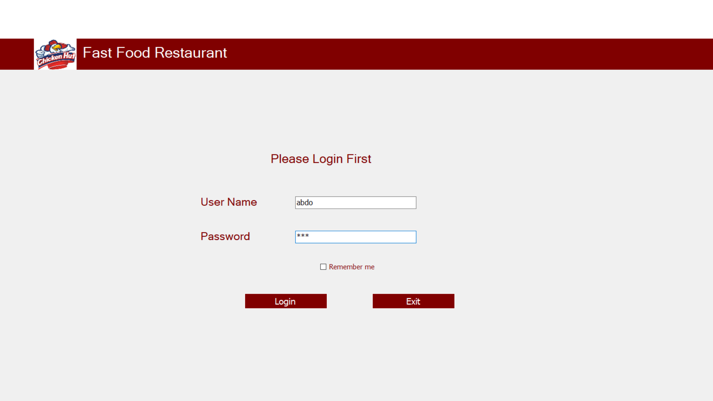
Login

Slide 7
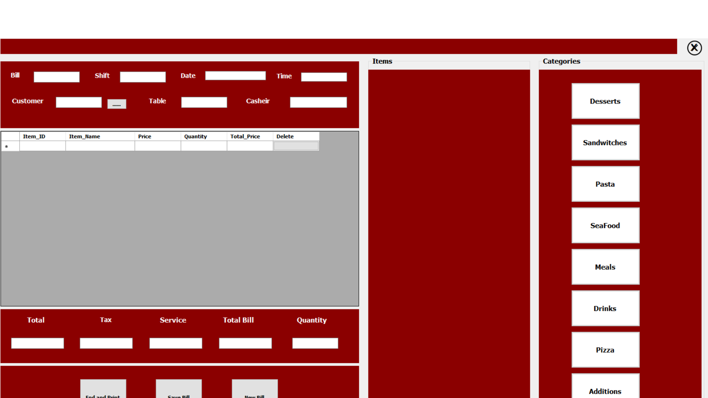
Cashier Page

Slide 8
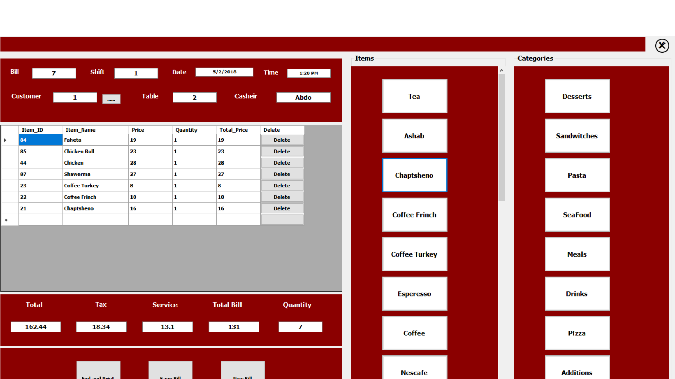

Slide 9
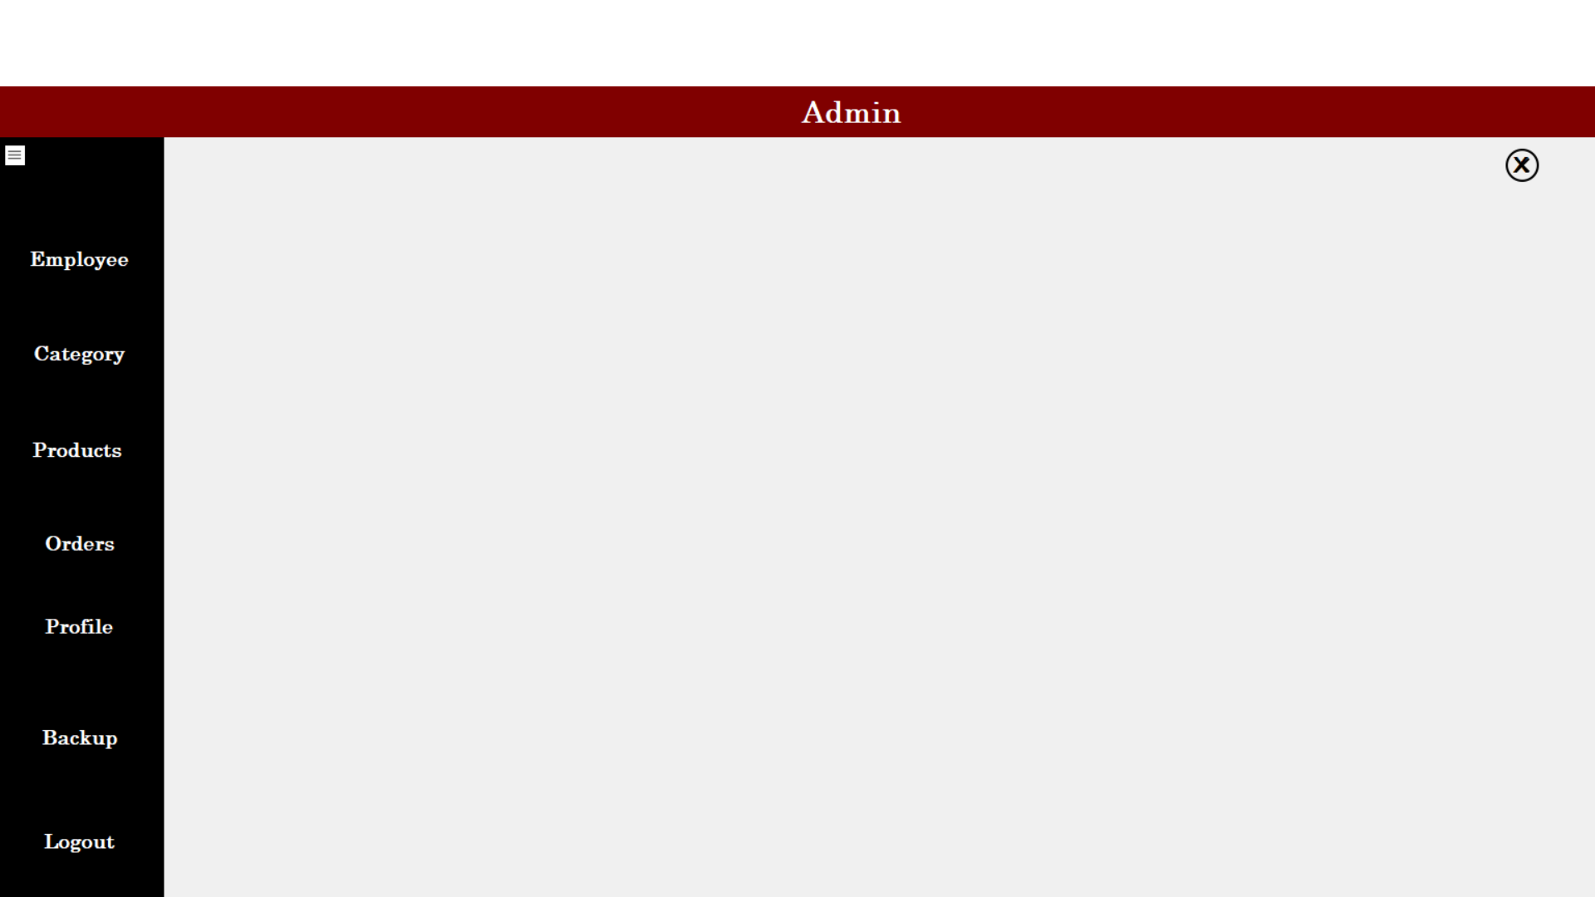
Admin panel

Slide 10
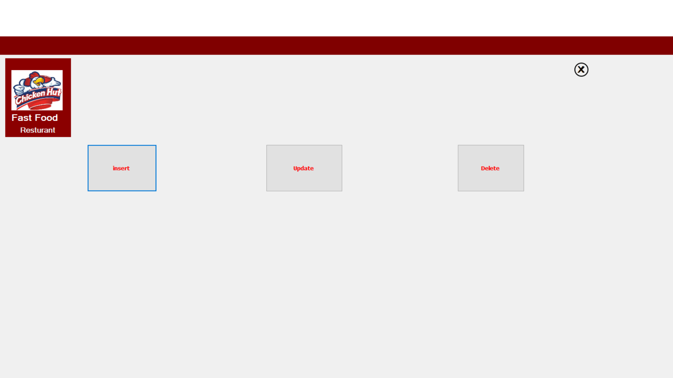
Select Operation

Slide 11
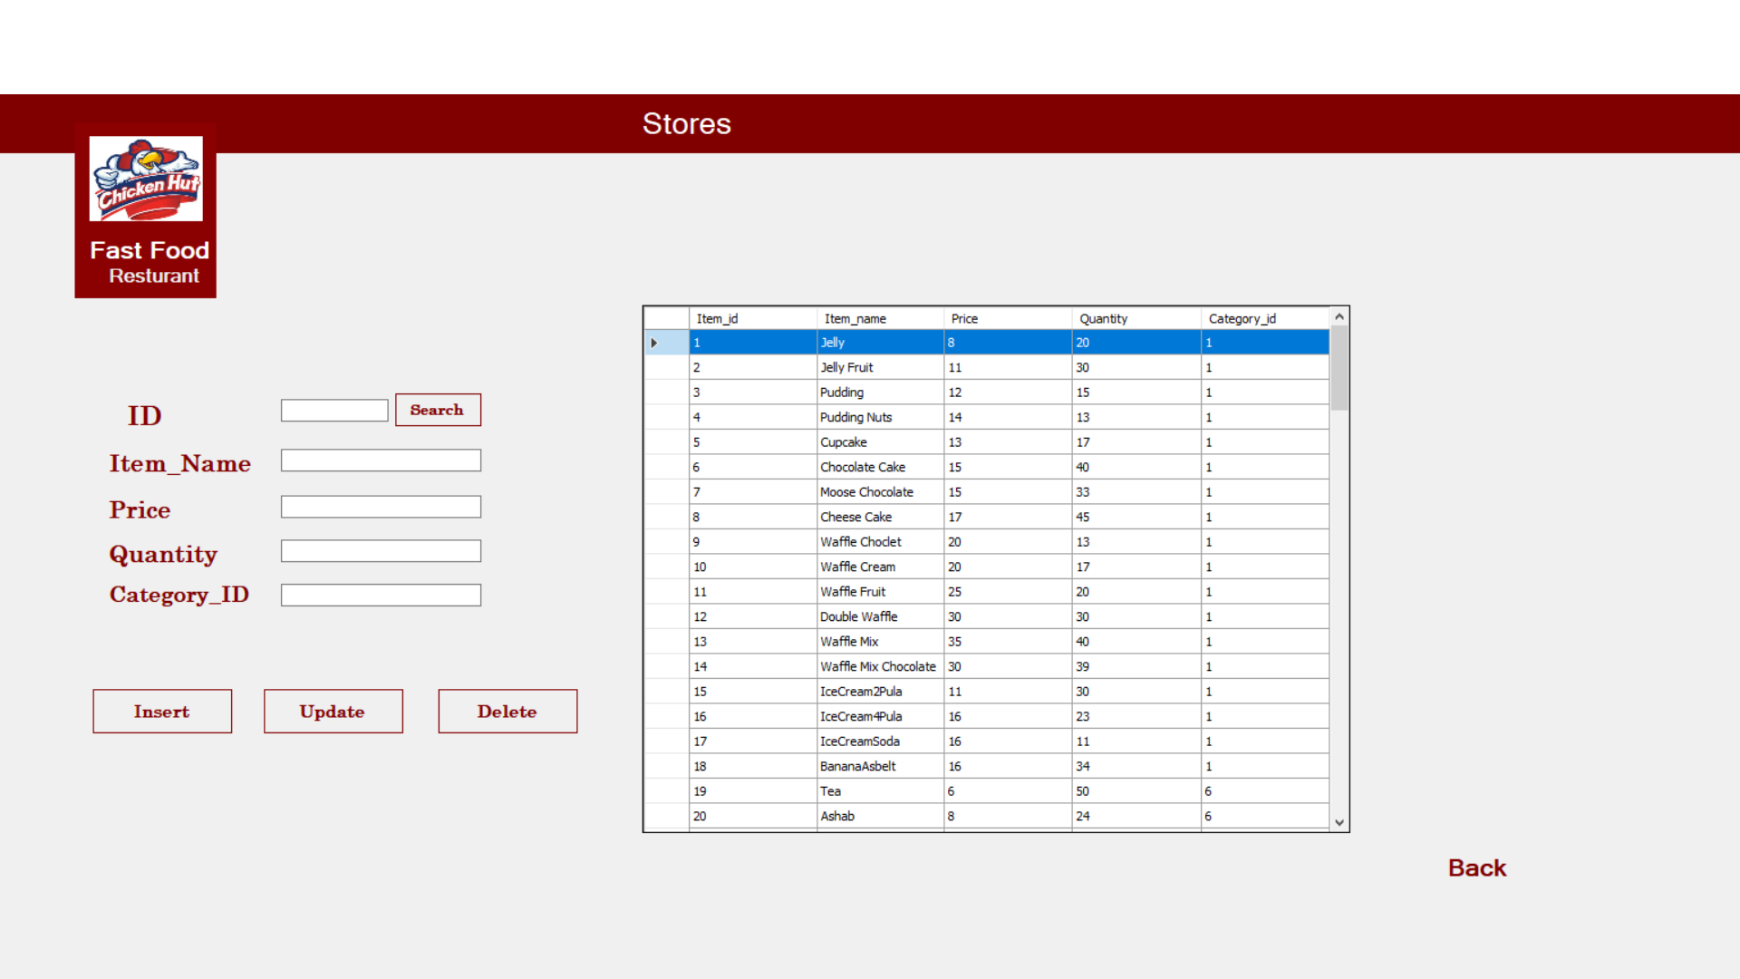
Stores

Slide 12
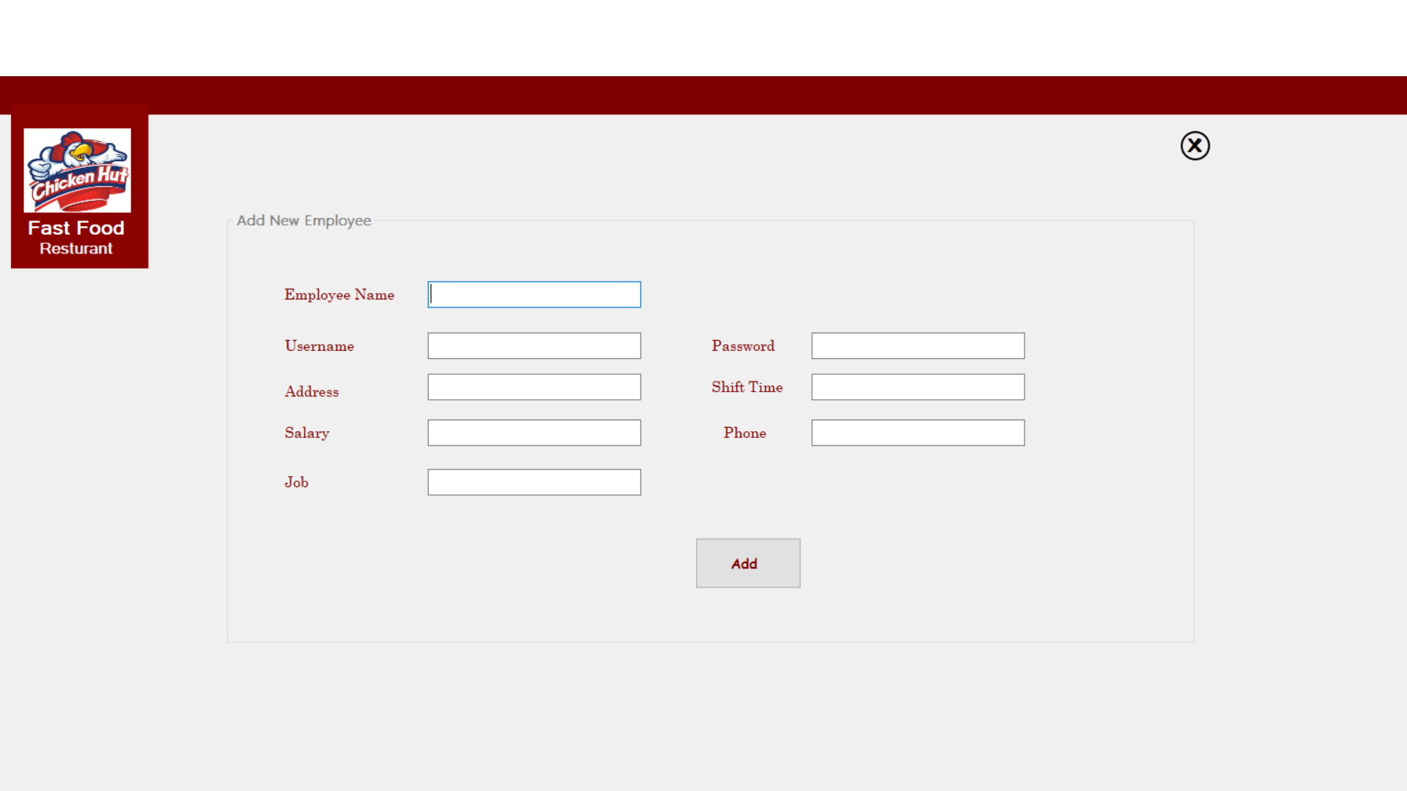
Add New Employee

Slide 13
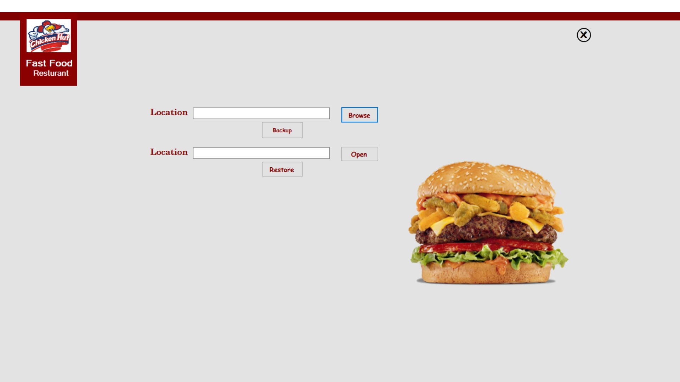
Backup

Slide 14
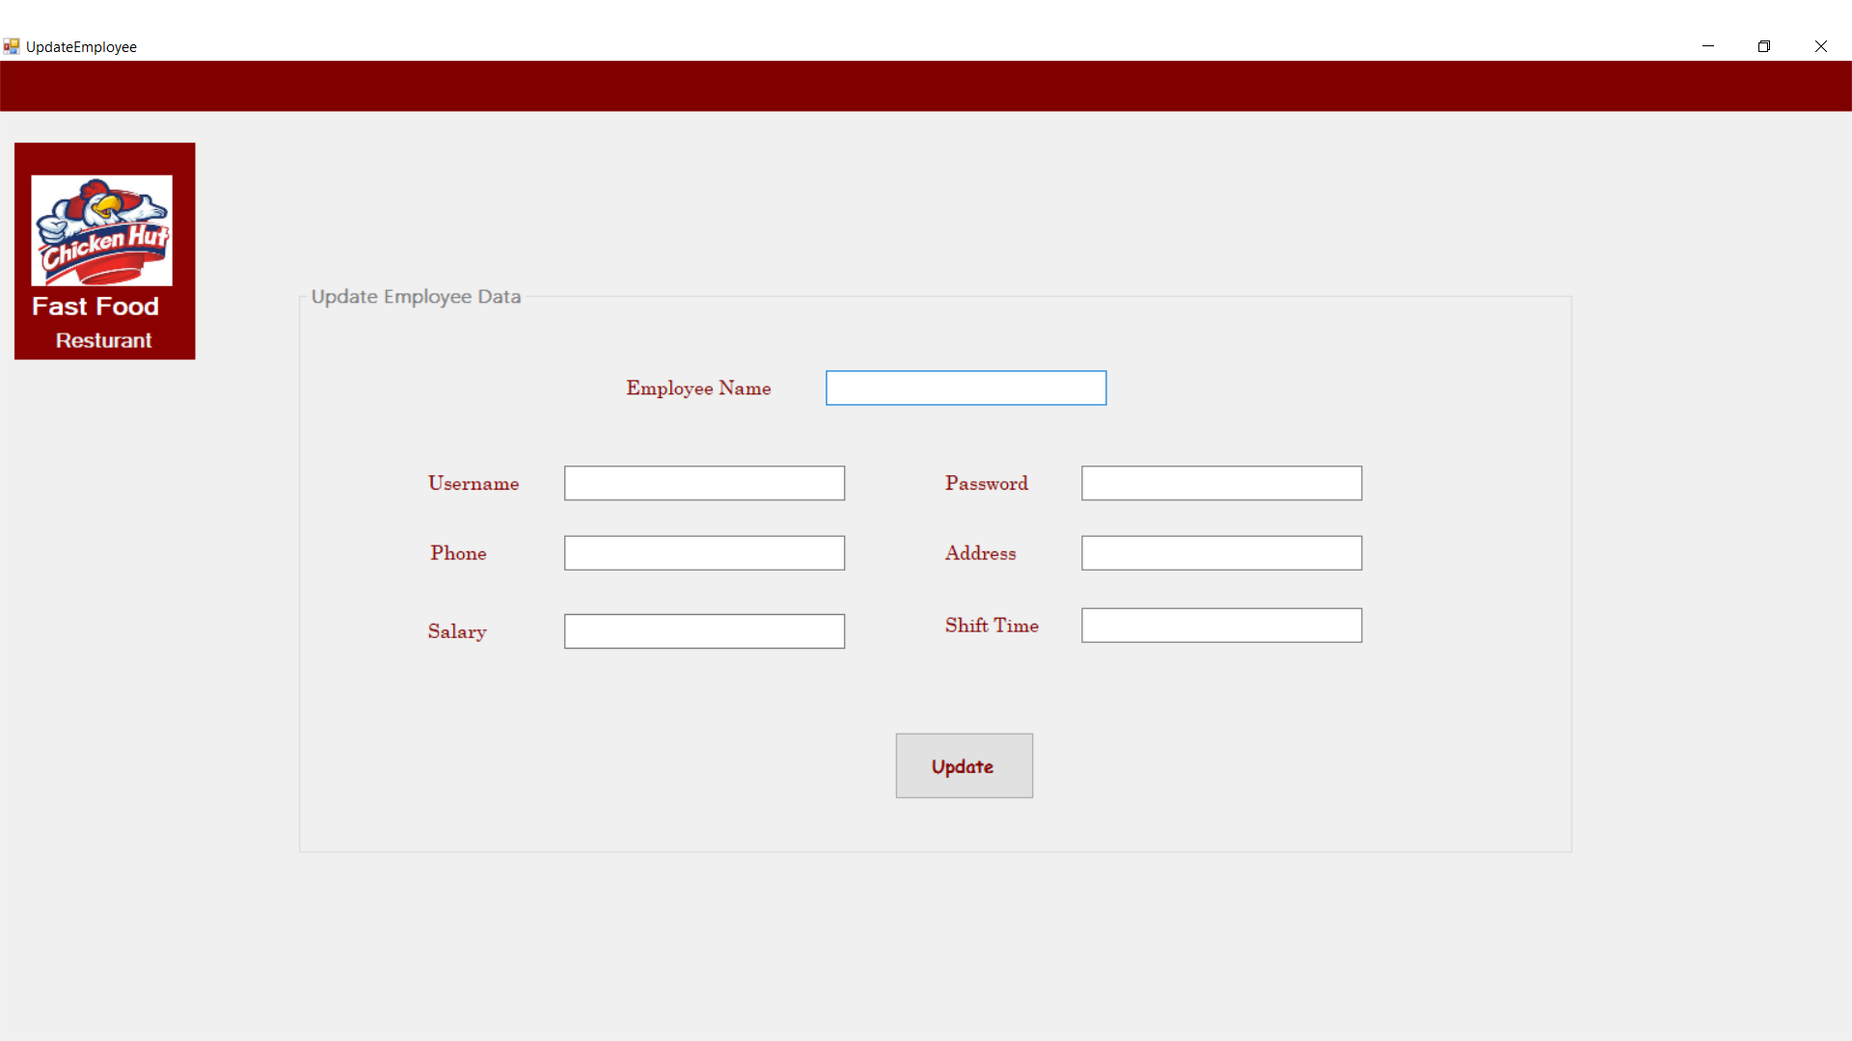
Update Employee

Slide 15
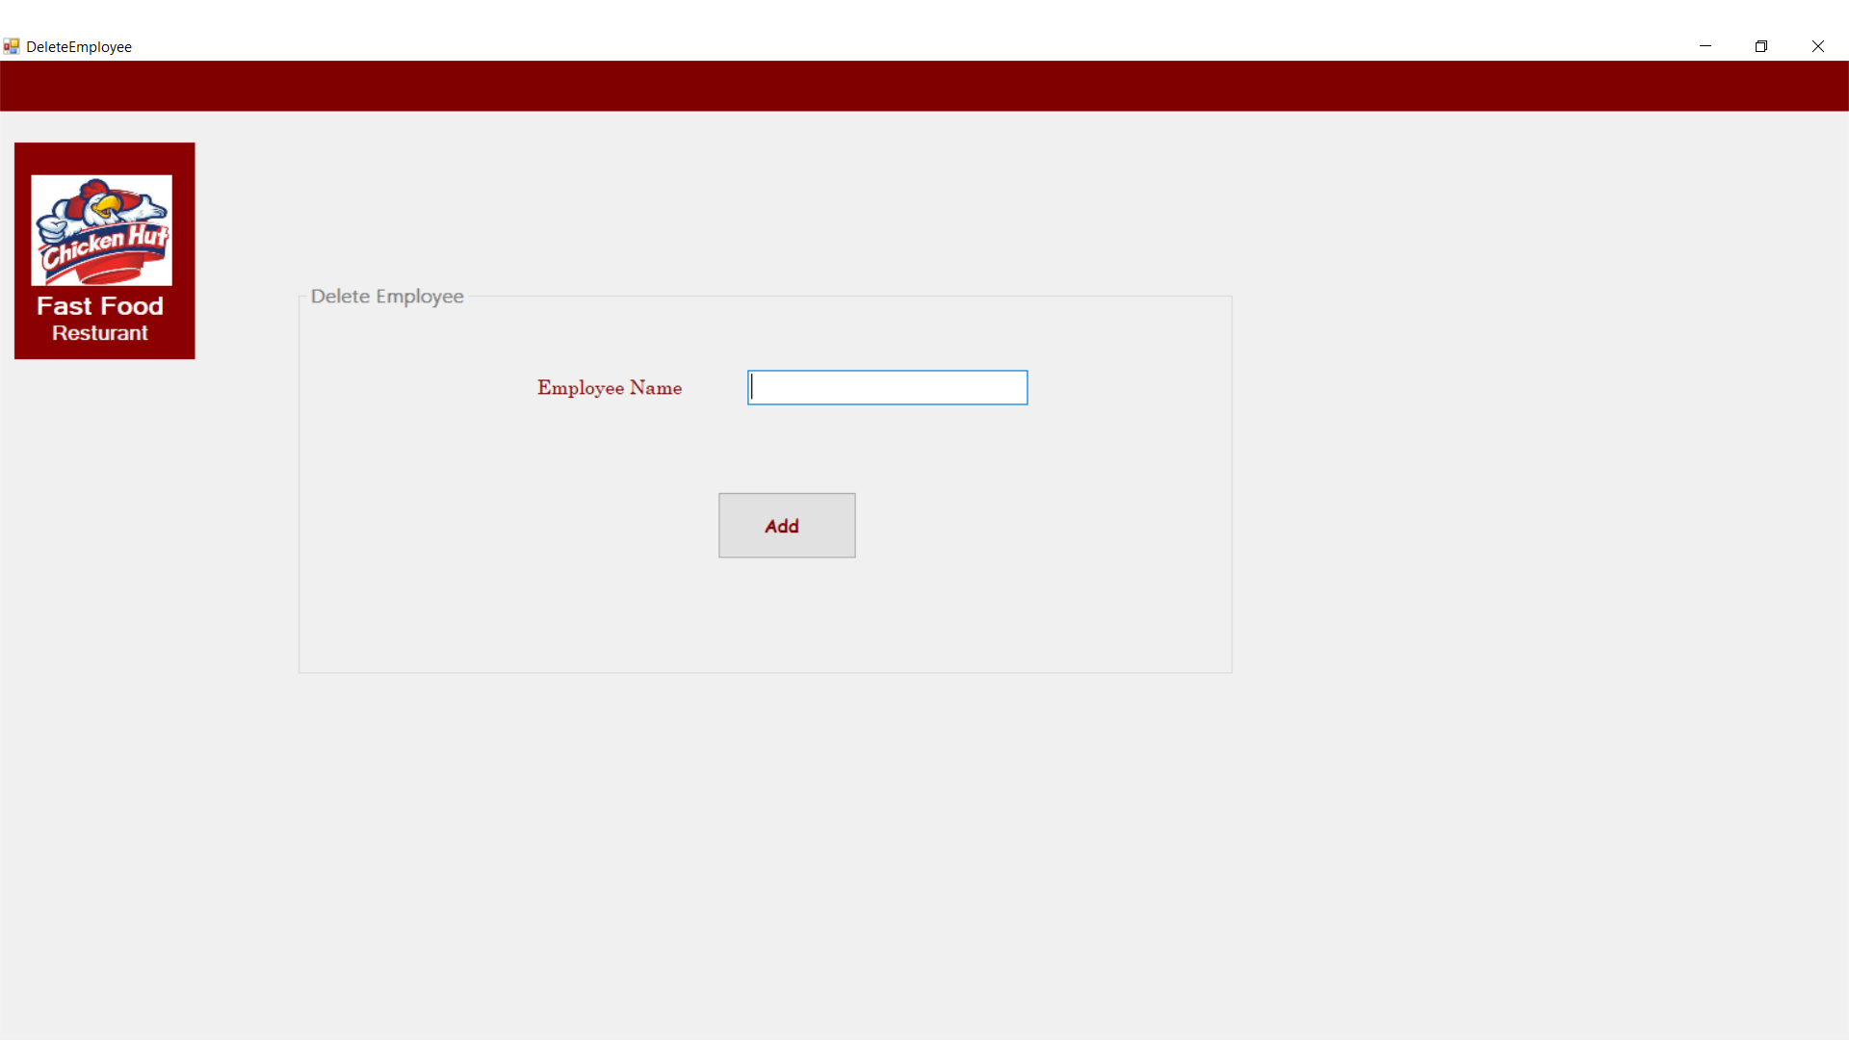
Delete Employee

Slide 16
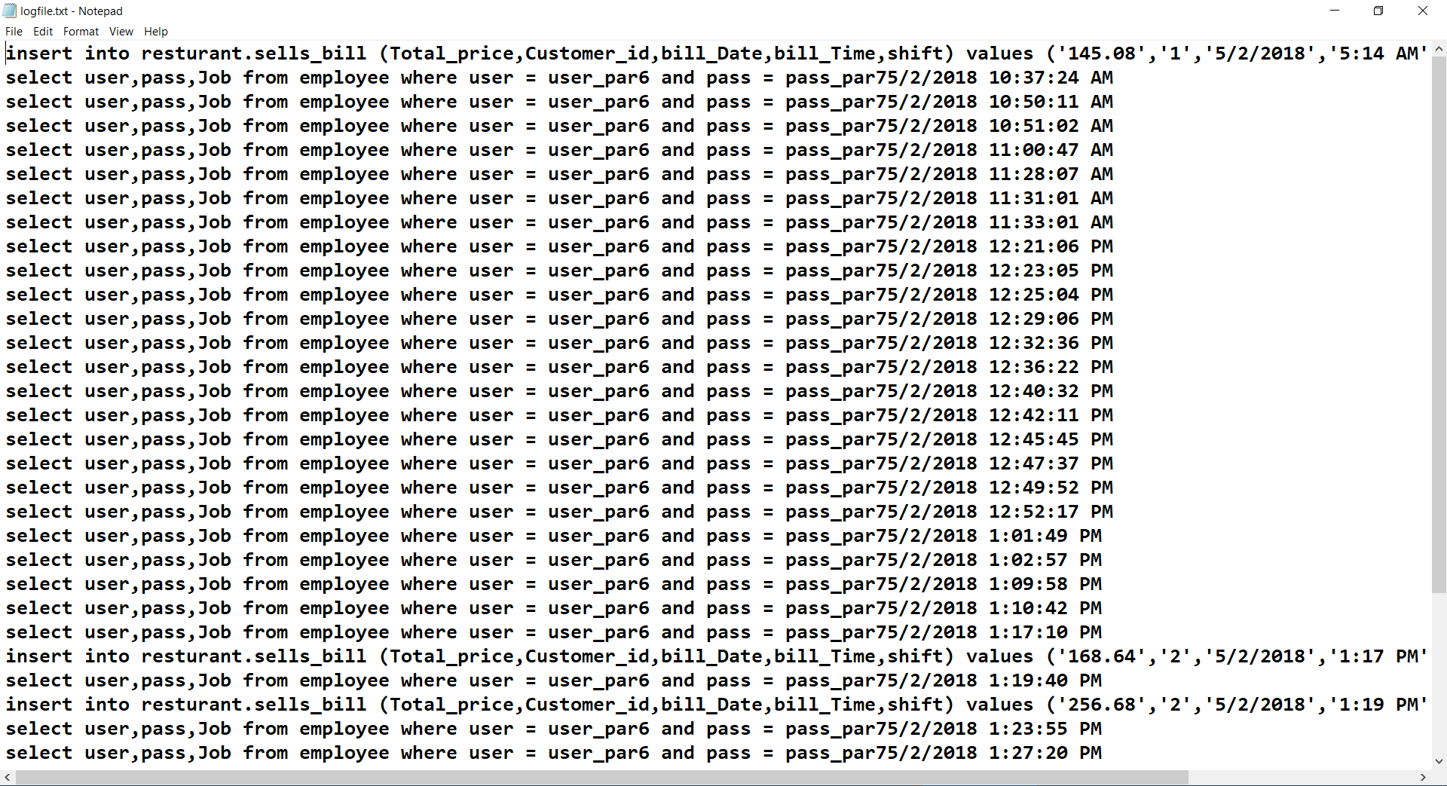
Log File

Slide 17
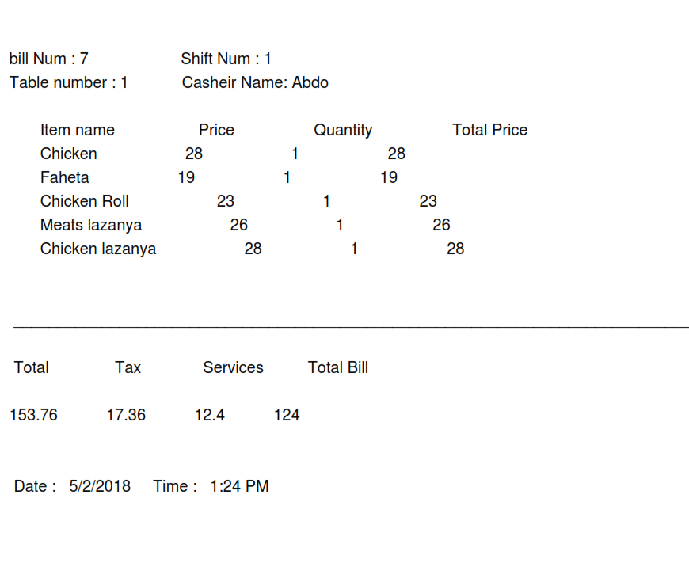
PDF Report

