Slide 1
🔒
ToledoMessage
Post-Quantum Secure Messaging Platform
Hybrid X3DH Key Agreement | Double Ratchet Protocol | ML-KEM-768 + X25519
.NET 10
Blazor WASM
SignalR
BouncyCastle
SQL Server
E2EE
Mohamed Khamis | University of Toledo | February 2026
1/18

Slide 2
Presentation Outline
01
Problem Statement & Motivation
10
Client-Side Security (Blazor WASM + IndexedDB)
02
System Architecture Overview
11
Database & Entity Model
03
Cryptographic Model — X3DH Key Agreement
12
Safety Number Verification
04
Cryptographic Model — Double Ratchet Protocol
13
Advanced Features
05
Post-Quantum Resistance (ML-KEM-768)
14
Security Analysis & Threat Model
06
Hybrid Signature Scheme (Ed25519 + ML-DSA-65)
15
Performance Benchmarks
07
Message Encryption Pipeline (AES-256-GCM)
16
Comparison with Existing Systems
08
End-to-End Message Flow
17
Conclusion & Future Work
09
Real-Time Communication (SignalR)
2/18

Slide 3
01 Problem Statement & Motivation
Quantum Computing Threat
Current messaging apps (Signal, WhatsApp) use classical Diffie-Hellman. Shor's algorithm will break these in the post-quantum era.
Our Solution: ToledoMessage
✓ Hybrid X3DH: X25519 + ML-KEM-768 key agreement
✓ Double Ratchet: forward secrecy per message
Centralized Key Management
Most platforms store encryption keys server-side, creating single points of compromise.
✓ AES-256-GCM: authenticated encryption
✓ Ed25519 + ML-DSA-65: hybrid digital signatures
✓ Zero-knowledge server: keys never leave the client
No Post-Quantum Hybrid Model
✓ Blazor WASM: full crypto in browser sandbox
Pure post-quantum schemes are unproven at scale. A hybrid classical + PQ approach provides defense-in-depth.
✓ Real-time via SignalR WebSockets
✓ Multi-device support with per-device keys
Browser-Based Crypto Limitations
✓ Safety number verification (Signal-style)
Running cryptographic operations in WebAssembly with secure client-side key storage is challenging.
✓ Disappearing messages with server-side enforcement
3/18

Slide 4
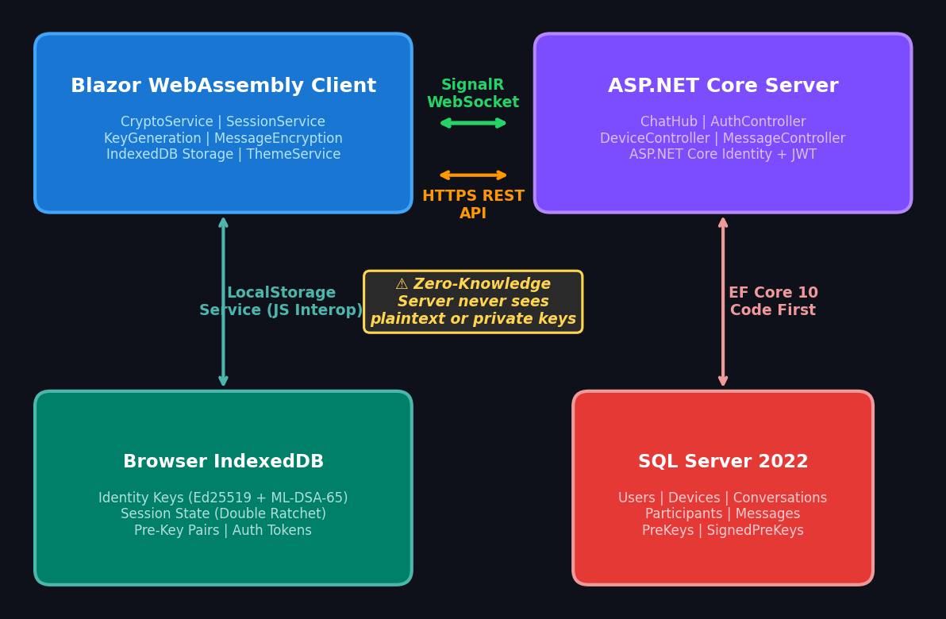
02 System Architecture Overview
4/18

Slide 5
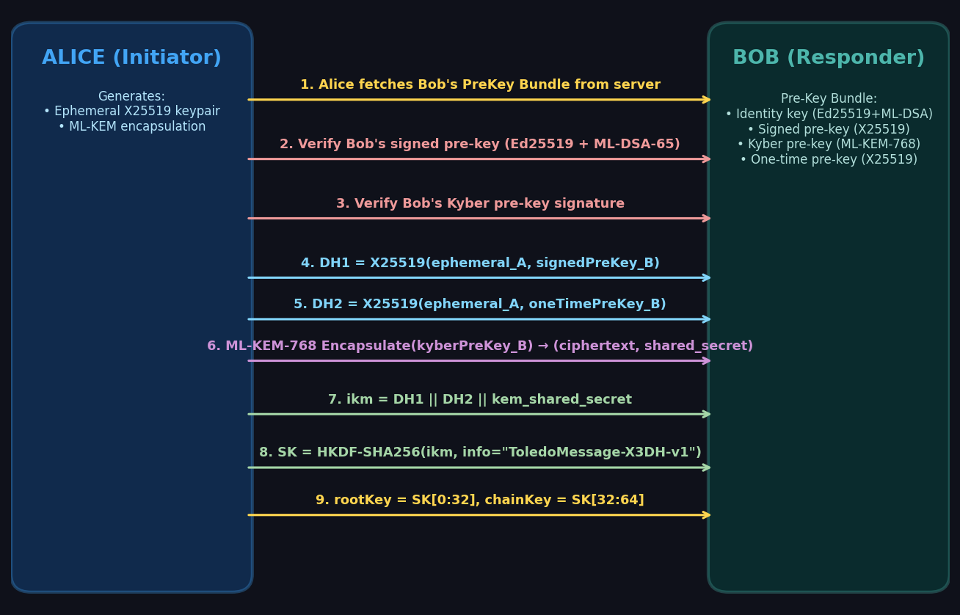
03 Hybrid X3DH Key Agreement Protocol
5/18

Slide 6
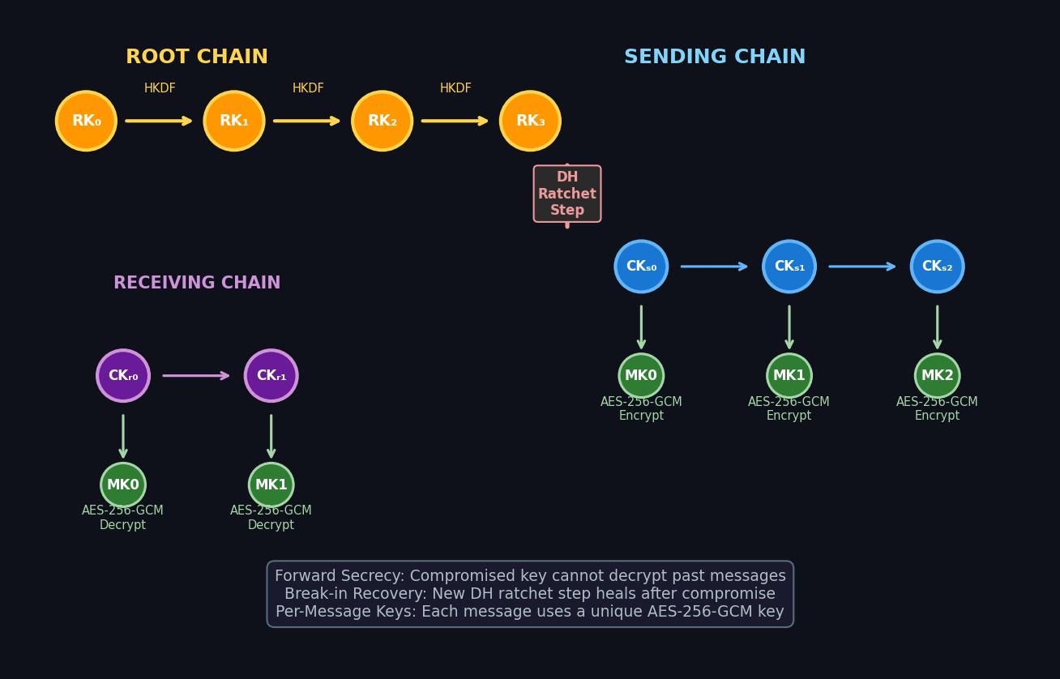
04 Double Ratchet Protocol
6/18

Slide 7
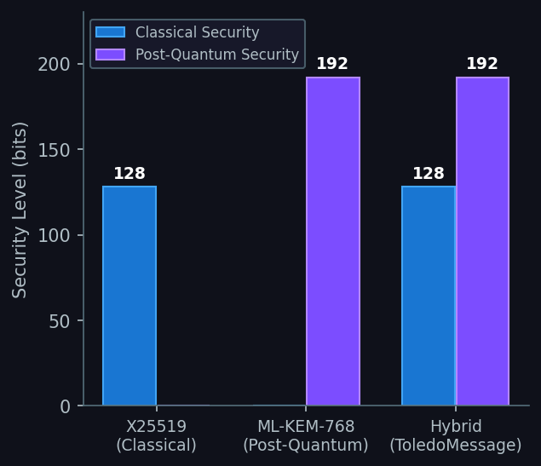
05 Post-Quantum Resistance: ML-KEM-768
What is ML-KEM-768?
NIST-standardized post-quantum Key Encapsulation Mechanism (formerly CRYSTALS-Kyber). Based on Module-LWE problem.
Why Hybrid?
Classical X25519 provides proven security today. ML-KEM-768 adds quantum resistance. Compromising BOTH is required to break the system.
Key Sizes
Public Key: 1,184 bytes | Ciphertext: 1,088 bytes Shared Secret: 32 bytes | Security Level: NIST Level 3
Integration Point
During X3DH: Alice encapsulates against Bob's Kyber pre-key. The KEM shared secret is mixed into the HKDF derivation alongside the X25519 DH outputs.
7/18

Slide 8
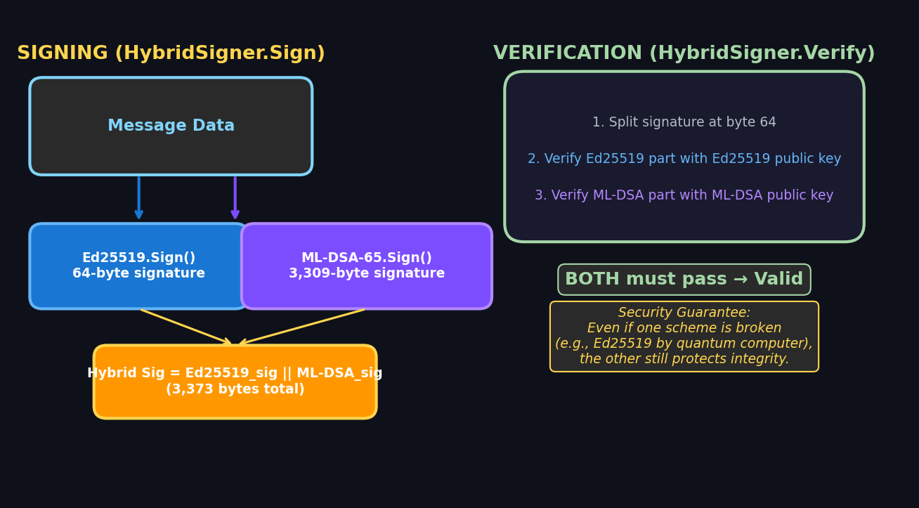
06 Hybrid Signature Scheme
Ed25519 (Classical) + ML-DSA-65 (Post-Quantum, formerly Dilithium)
8/18

Slide 9
07 Message Encryption: AES-256-GCM
1
Derive Message Key
Wire Format (AeadCipher class)
Double Ratchet produces a unique 32-byte message key (MK) for each message
Encryption:
plaintext bytes → UTF-8 encoded
2
Generate Nonce
nonce = SecureRandom(12 bytes)
12-byte random nonce (IV) generated via SecureRandom for each encryption
(ciphertext, tag) = AES-GCM(key, nonce, plaintext)
output = nonce || ciphertext || tag
return Base64Encode(output)
3
Encrypt
AES-256-GCM(key=MK, nonce=IV, plaintext) Produces ciphertext + 16-byte auth tag
Decryption:
data = Base64Decode(input)
nonce = data[0:12]
4
Package
ciphertext = data[12 : len-16]
tag = data[len-16 : len]
Output = nonce(12) || ciphertext || tag(16) Base64-encoded for transport
plaintext = AES-GCM-Decrypt(key, nonce, ct, tag)
Key Properties:
5
Delete Key
• 256-bit key (from Double Ratchet MK)
Message key is immediately discarded after use — never reused
• 96-bit nonce (random per message)
• 128-bit authentication tag
• Authenticated Associated Data supported
9/18

Slide 10
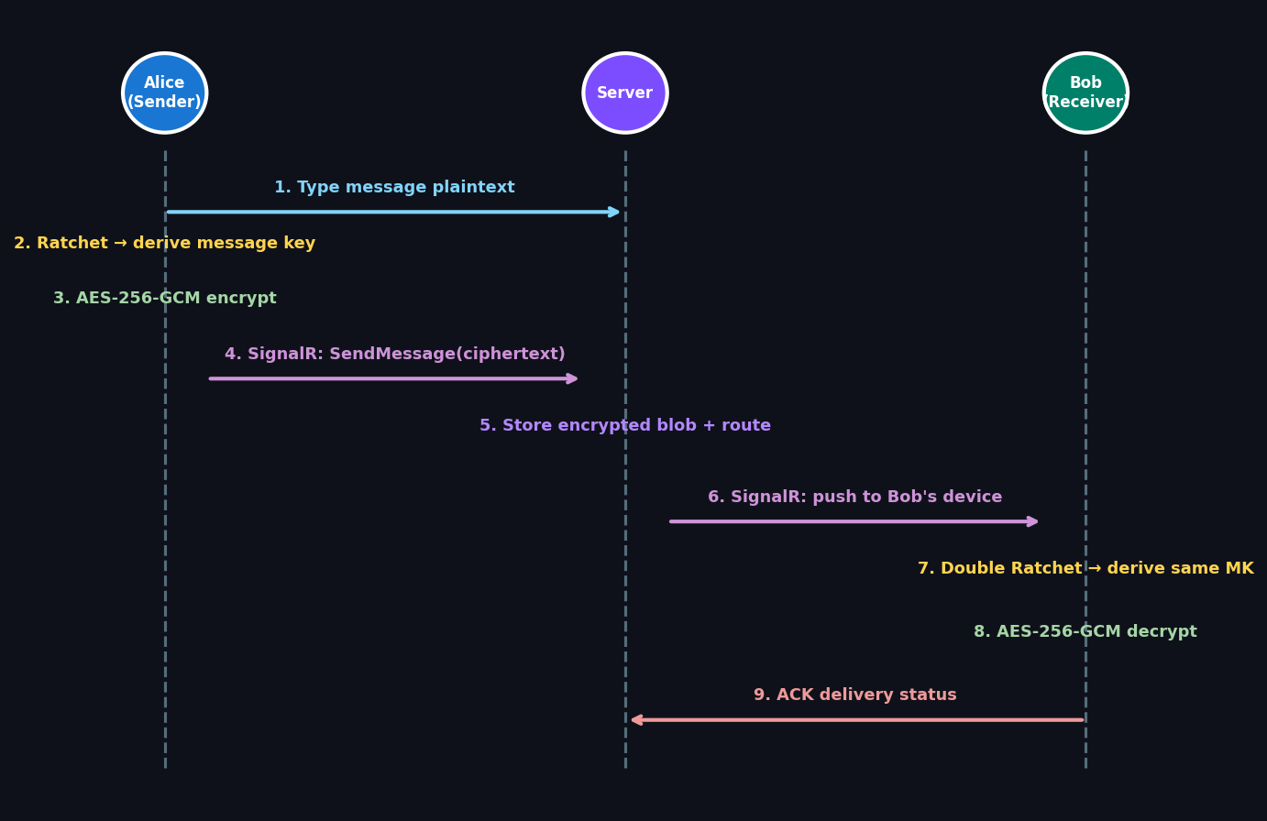
08 End-to-End Message Flow
10/18

Slide 11
09 Real-Time Communication: SignalR Hub
RegisterDevice()
Maps deviceId → SignalR connectionId for targeted message delivery
Message Lifecycle
SendMessage()
Receives encrypted envelope, stores in DB, routes to recipient's connected devices
⏳ Sending
Client encrypts & sends
AcknowledgeDelivery()
Updates message status to Delivered, notifies sender in real-time
▼
✓ Sent
Server received & stored
AcknowledgeRead()
Updates message status to Read, blue-tick confirmation to sender
▼
✓✓ Delivered
SendTypingIndicator()
Broadcasts typing status to conversation participants
Recipient device received
▼
AddParticipant()
Admin adds user to group conversation, broadcasts update to all members
✓✓ Read
Recipient opened message
RemoveParticipant()
Admin removes user from group, cleans up participant records
11/18

Slide 12
10 Client-Side Security Model
LocalStorageService
Encrypted IndexedDB storage via JS Interop. Binary key-value with optional encryption-at-rest.
KeyGenerationService
Generates identity keys (Ed25519 + ML-DSA-65), signed pre-keys, Kyber pre-keys, one-time pre-keys. Batches of 10 pre-keys per registration.
SessionService
Manages Double Ratchet session state per peer. Tracks root keys, chain keys, message counters.
CryptoService
Orchestrates encryption/decryption. Handles X3DH initiation and session establishment.
MessageEncryptionService
Encrypts for all of recipient's devices. Each device gets a unique ciphertext.
FingerprintService
Computes safety numbers from identity keys. Enables out-of-band verification.
PreKeyReplenishmentService
Monitors pre-key count on server. Auto-generates new batches when depleted.
12/18

Slide 13
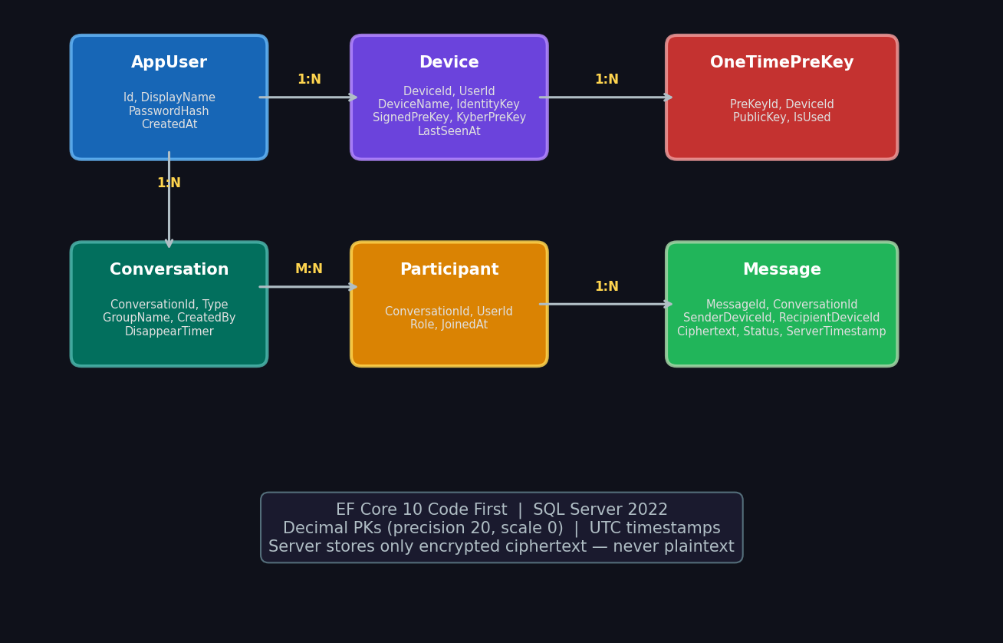
11 Database & Entity Model
13/18

Slide 14
12 Safety Number Verification
1. Collect Identity Keys
Gather both parties' Ed25519 + ML-DSA-65 public identity keys from local storage
Safety Number Display
Safety Number
2. SHA-256 Hash
37291 04823 19457 82634 50918 73246 61582 39047 84619 25703
Concatenate and hash: SHA256(localKey || remoteKey) Produces 32-byte fingerprint digest
3. Numeric Encoding
Convert hash to human-readable numeric groups (e.g., "37291 04823 19457 ...")
4. Compare Out-of-Band
Users compare numbers in person or via trusted channel (phone call, video chat)
✓ Verified
Key Change Warning: If identity keys change, safety number changes and users are alerted to re-verify.
5. Mark Verified
Store verification flag per conversation in IndexedDB. Show green verified badge.
14/18

Slide 15
13 Advanced Features
📱 Multi-Device Support
⏰ Disappearing Messages
Each device has independent identity & pre-keys. Messages encrypted separately per device. Server routes to all active devices.
Configurable timer: 5min, 1h, 24h, 7 days. Server-side enforcement with MessageExpiryService. Automatic cleanup after expiration.
👥 Group Messaging
🔄 Pre-Key Replenishment
Fan-out encryption: sender encrypts for each participant's devices individually. Admin role for participant management.
Auto-detects when one-time pre-keys run low. Generates and uploads fresh batches of 10. Ensures X3DH sessions always available.
🎨 Responsive UI + Themes
⌨ Real-Time Typing Indicators
7 messenger-inspired themes (WhatsApp, Telegram, Signal). CSS custom properties + data-theme selectors. Mobile-first responsive with hamburger nav.
SignalR broadcasts typing status. Auto-clears after 3-second timeout. Non-blocking, failure-tolerant.
15/18

Slide 16
14 Security Analysis & Threat Model
Threat
Mitigation
Status
Man-in-the-Middle
X3DH mutual authentication + safety numbers
✅
Server Compromise
E2EE: server only sees ciphertext, never plaintext
✅
Key Compromise (past)
Forward secrecy via Double Ratchet DH steps
✅
Key Compromise (future)
Break-in recovery: new DH ratchet heals session
✅
Quantum Computer Attack
ML-KEM-768 + ML-DSA-65 post-quantum primitives
✅
Replay Attack
Unique nonce per message + message counters
✅
Device Theft
Keys stored in browser IndexedDB, session-bound
⚠
Metadata Leakage
Server sees routing metadata (who talks to whom)
⚠
16/18

Slide 17
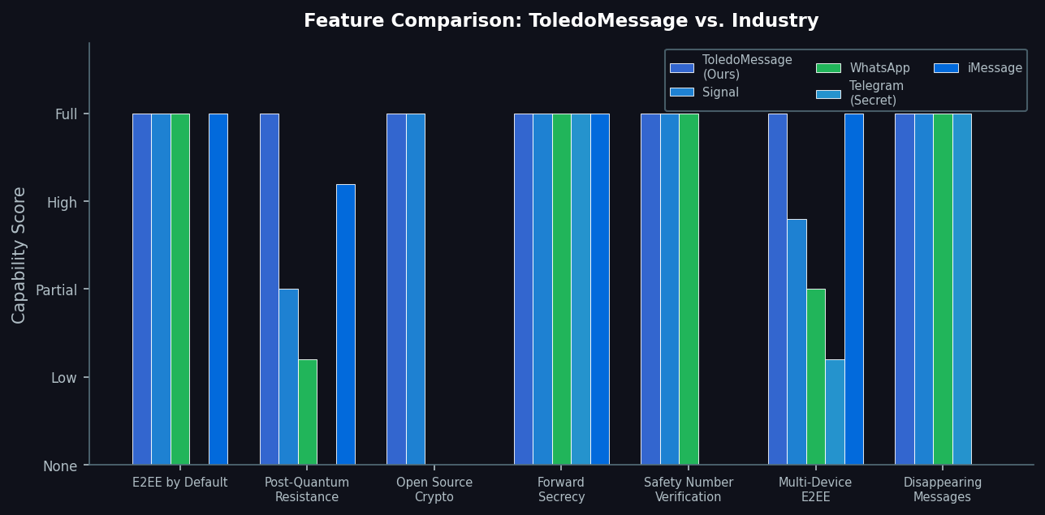
15-16 Performance & Comparison
17/18

Slide 18
17 Conclusion & Future Work
Key Contributions
Future Work
✓ First Blazor WASM messenger with hybrid post-quantum E2EE
▶ Mobile native apps (MAUI / Flutter)
✓ Novel integration of ML-KEM-768 into X3DH key agreement
▶ File & media encrypted transfer
✓ Full Double Ratchet with per-message AES-256-GCM keys
▶ Voice/video calls with SRTP
✓ Hybrid signature scheme (Ed25519 + ML-DSA-65)
▶ Multi-device sync via Sesame protocol
✓ Zero-knowledge server architecture — keys never leave client
▶ Formal security proofs (ProVerif/Tamarin)
✓ Multi-device E2EE with independent key material per device
▶ Hardware security module (HSM) integration
✓ 65 comprehensive unit tests covering all crypto primitives
▶ Decentralized architecture (Matrix federation)
Secure today. Quantum-resistant tomorrow.
Thank you! | Questions? | github.com/ToledoMessage
18/18

