Slide 1
Sales Forecasting
By: Mohamed Kharma

Slide 2

Importance
The way sales forecasting helps businesses is by providing them with information that help them to:
Make informed decisions and plan for the future
Make better plans by targeting specific market
Avoid waste
Optimizes inventory by predicting sales
Improves supply chain management
Increases revenue for the business

Slide 3
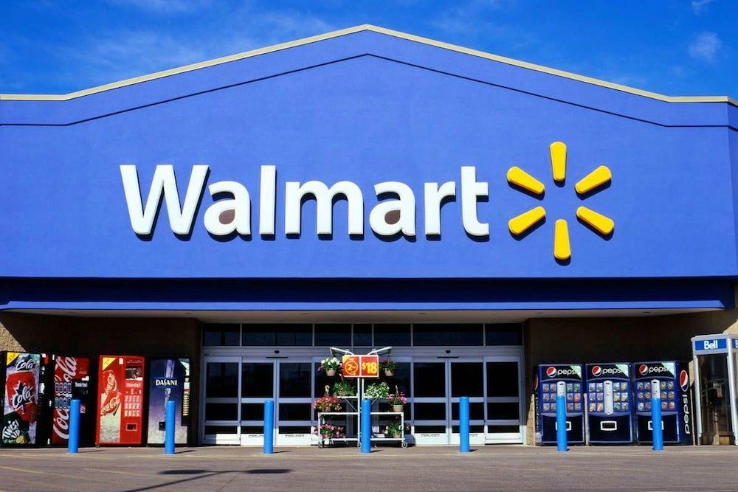
Dataset
For this project, I will be forecasting Walmart sales using different type of machine learning models.
The dataset I am using is Walmart Sales dataset, which is a public dataset available on Kaggle.
The dataset contains:
A historical data that covers walmart sales from 2010-02-05 to 2012-11-01
There are sales data available for 45 stores of Walmart located in different areas

Slide 4
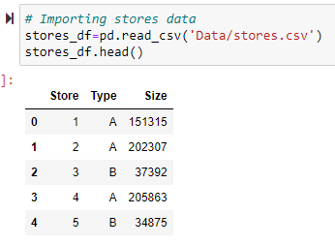
Available Data
stores.csv - This file contains anonymized information about 45 stores, indicating the type and size of store
The Stores Data File contains the following attributes:
Store - store number
Type - there is 3 types, store type can be A, B or C
Size - size of the store
45 Data rows

Slide 5
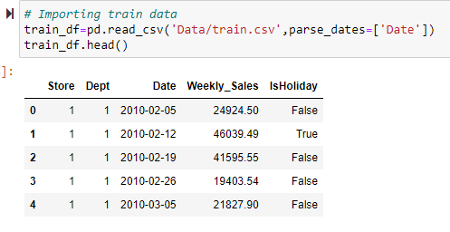
Available Data
train.csv - CSV Data file containing following attributes
Store - the store number
Dept - the department number
Date - the week
Weekly_Sales - sales for the given department in the given store
IsHoliday - whether the week is a special holiday week
115064 Data rows

Slide 6
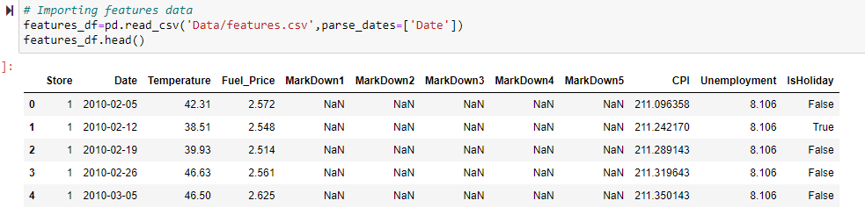
Available Data
features.csv : This file contains additional data related to the store,, and regional activities for the given dates.
It contains the following:
Store
Date
Temperature
Fuel_Price
MarkDown
CPI
Unemployment
IsHoliday
8190 Data rows

Slide 7
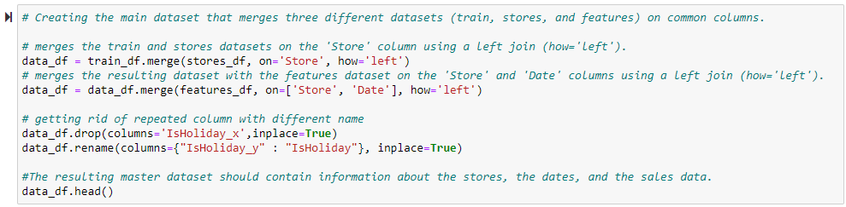
Merging Datasets
To merge the datasets into one main dataset:
The train and stores datasets were first merged together
The resulting dataset was then merged with the features dataset
The 'Date' attribute was set as the new index of the main dataset,
The 'Date' column was split into 'Year', 'Month', and 'Week' columns.
Lastly, repeated columns were deleted

Slide 8
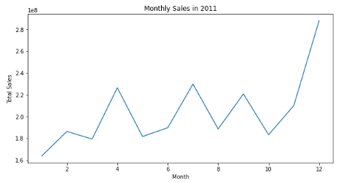
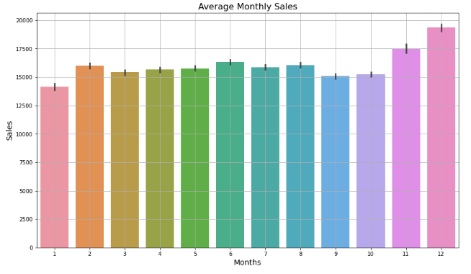
Trends & Seasonality
Looking at these graphs, we can see that sales tend to spike the most in November and December. So, there is a seasonality factor present in the data.

Slide 9
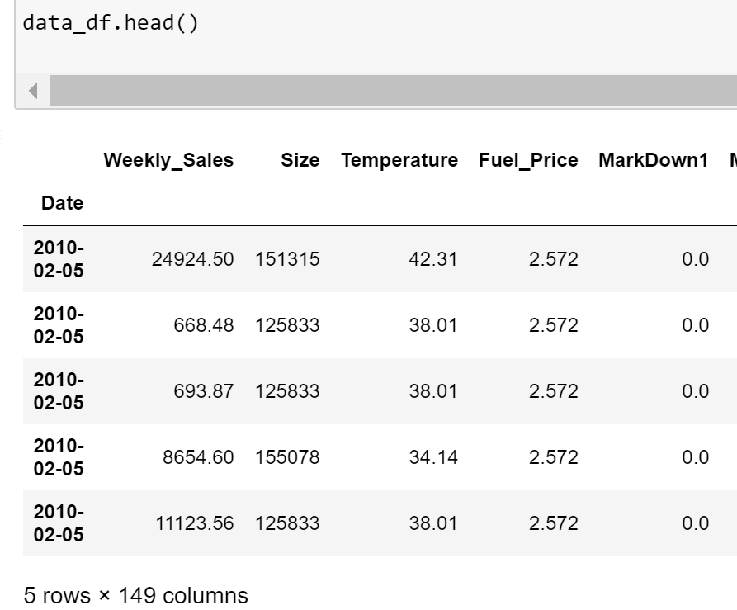
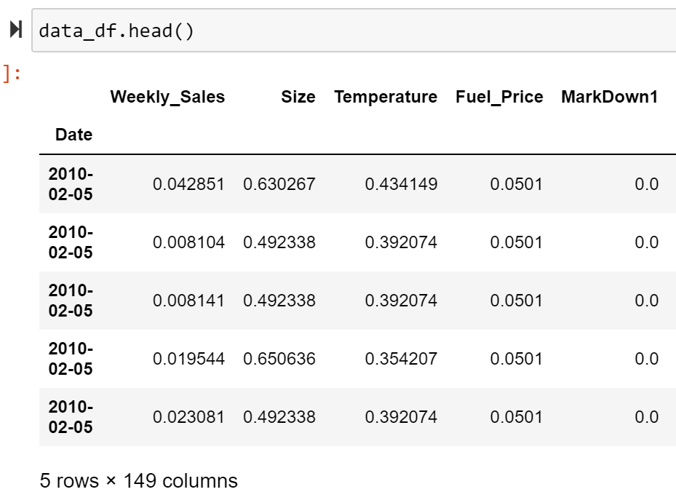

Data Normalization
Using MinMaxScaler, numerical columns were normalized in the range of 0 to 1
Before After

Slide 10
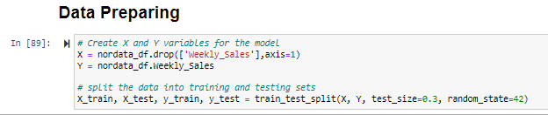

Machine Learning Models
Dataset was splitted into 70% for training and 30% for testing
And the Target feature is: Weekly_Sales
After normalizing the dataset, I used the following 3 machine learning models to predict the weekly sales of Walmart:
Linear Regression Model
Random Forest Model
K Neighbors Model

Slide 11

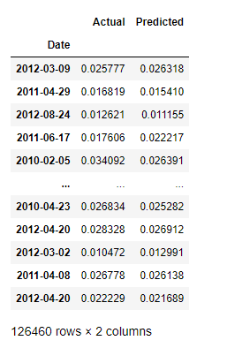
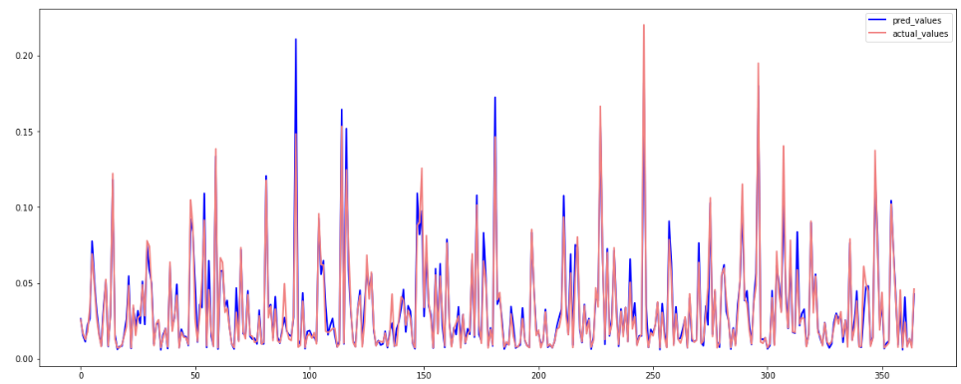
Linear Regression Model
After running the model on the normalized dataset, it predicted weekly sales with an accuracy of: 91%

Slide 12

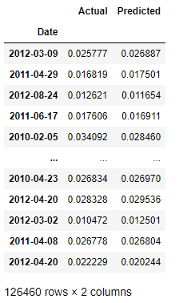
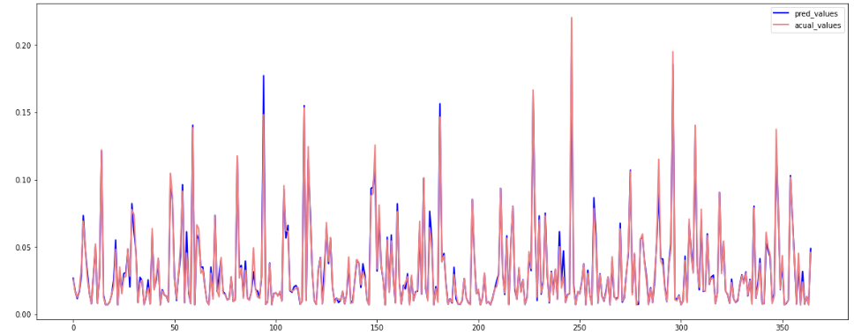
Random Forest Model
After running the model on the normalized dataset, it predicted weekly sales with an accuracy of: 97%

Slide 13

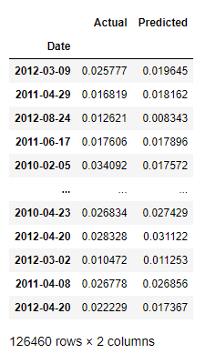
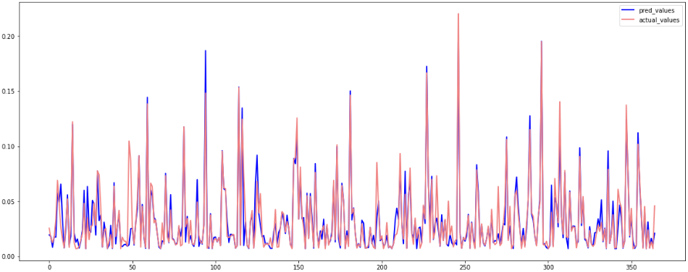
K Neighbors Model
After running the model on the normalized dataset, it predicted weekly sales with an accuracy of: 87%

Slide 14
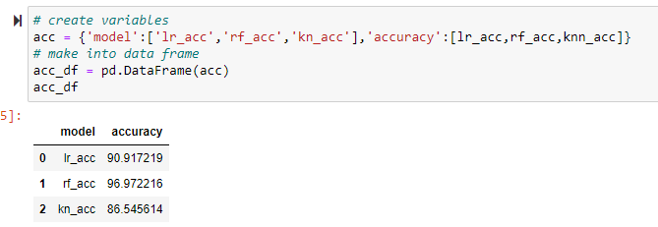
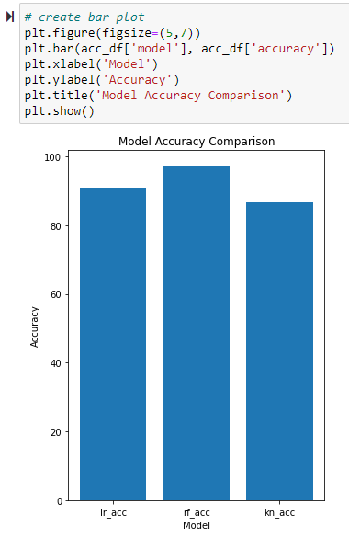
Comparing Models
Looking at the Chart, we see that:
Random Forest Model has the most accuracy at predicting the sales for the dataset
K Neighbor Model has the least accuracy at predicting the sales for the dataset

Slide 15
THANK YOU !

