Slide 1
Attitude Controller
Waypoint
LOS guidance
Φ_des
e_cross
Mx
Flying taxi
PID
PID
u
v
X_req
φ
w
e_along
ϴ_des
My
p
Y_req
PID
PID
q
ϴ
r
Ѱ_des
Mz
φ
PID
ϴ
Ѱ
Ѱ
X
Y
Altitude Controller
X
Y
Z_req
ΔT_allmotors
Z
PID
Z

Slide 2
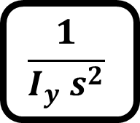
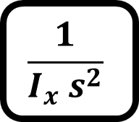

G_phi
Mx
$$\frac{1}{I_{x} s^{2}}$$
Φ_des
PID
φ
φ
G_th
My
$$\frac{1}{I_{y} s^{2}}$$
ϴ_des
PID
ϴ
ϴ
G_psi
Mz
$$\frac{1}{I_{z} s^{2}}$$
Ѱ_des
PID
Ѱ
Ѱ

Slide 3
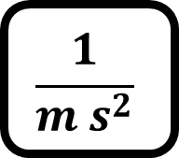
G_Z
ΔT_allmotors
$$\frac{1}{m s^{2}}$$
Z_des
PID
Z
Z

Slide 4

K
e_alongtrack
R
S
e_crosstrack
K-1
$$α_{k}$$
Current position
Y
X

Slide 5
LOS guidance
e_cross
PID
Φ_des
X_req
e_along
PID
Y_req
ϴ_des
Ѱ_des
X
Y

Slide 6
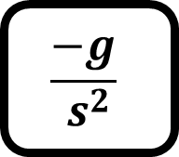
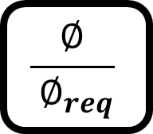

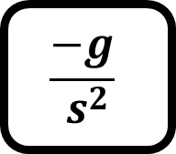

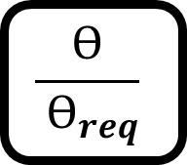
G_X
$$θ_{req}$$
$$\frac{ϴ}{ ϴ_{req}}$$
ϴ
$$\frac{−g}{ s^{2}}$$
X_des
PID
X
X
G_Y
$$∅_{req}$$
$$\frac{∅}{ ∅_{req}}$$
φ
$$\frac{−g}{ s^{2}}$$
Y_des
PID
Y
Y

Slide 7
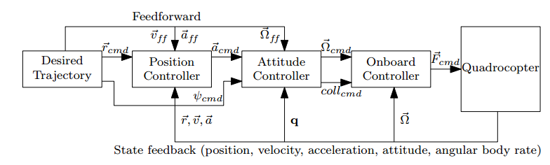

Slide 8
X_req
V_x_req
Accel_x_req
P
PI
-
X_estimated
V_x_estimated
D
Required
Roll angle
Y_req
V_y_req
Accel_y_req
P
PI
Required
Pitch angle
-
Y_estimated
D
Required
Thrust
V_y_estimated
Z_req
V_z_req
Required
heading
P
PI
-
Accel_z_req
Z_estimated
V_z_estimated
D

Slide 9
phi_req
phidot_req
Torque_x_req
P
PI
-
phi_estimated
phidot_estimated
D
pitch_req
pitdot_req
Torque_y_req
P
PI
-
pitch_estimsted
pitchdot_estimated
D
yaw_req
yawdot_req
Torque_z_req
P
PI
-
Yaw_estimated
yawdot_estimated
D
Required Thrust

Slide 10
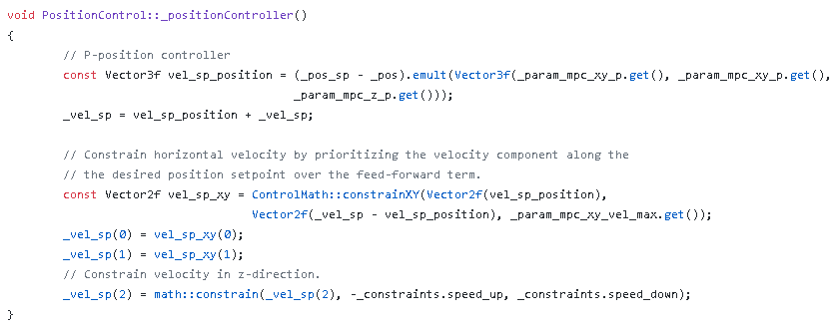

Slide 11

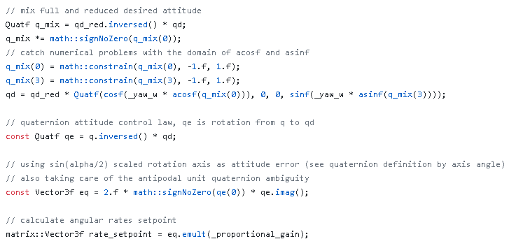
Control Law of Outer Loop of attitude controller

