Slide 1







Autonomous Air transportation
AC Design
Using Vision Navigation
Flight test
Autopilot
Introduction
Implementation
Computer Vision
Supervised by: Asst. Prof. Osama Saaid

Slide 2

Mission
AC Design
Autonomous air transportation using vision navigation

Slide 3
Why Quad-plane?
POC | Fixed-wing | Multi-copter | Quad-plane
Vertical takeoff and landing | No | Yes | Yes
Comfortable | Yes | No | Yes
Power consumption | Low | High | Low
Cruise speed | High | Low | High
Endurance | Long | Short | Long
Range | Long | Short | Long
AC Design

Slide 4
Scaled model
Why?!
A 1/100 scaled model based on payload
AC Design
A full scaled model
A 1/100 scaled model
80 kg passenger
20 kg luggage
20 kg navigation equipment
1.2 kg
1/100

Slide 5
Mission
Payload
Payload | total estimated weight (gm)
Passenger | 200
Chair | 100
electronics | 300
Rasperry pi 2 | 42
XPAL power supply | 517
Pixhawk | 38
Jetson Kit | 431
RP Lidar A1 | 190
ZED camera | 159
Total mass | 2000 gm
AC Design

Slide 6
Payload optimization
Payload | weight (gm) | Optimized payload | Optimized weight
Passenger | 200 | Passenger | 200
Chair | 123 | Chair | 123
electronics | 300 | Electronics | 300
Rasperry pi 2 | 42 | - | 0
XPAL power supply | 517 | - | 0
Pixhawk | 38 | Pixhawk | 38
Jetson Kit | 431 | Mini Jetson Kit | 150
RP Lidar A1 | 190 | - | 0
ZED camera | 159 | ZED camera | 159
Total mass | 2000 gm | Total mass | 970 gm
AC Design

Slide 7
Sizing
Mission
Main payload
AC Design
VTOL Propulsion system
New Payload
MTOM
Fixed-wing
sizing

Slide 8
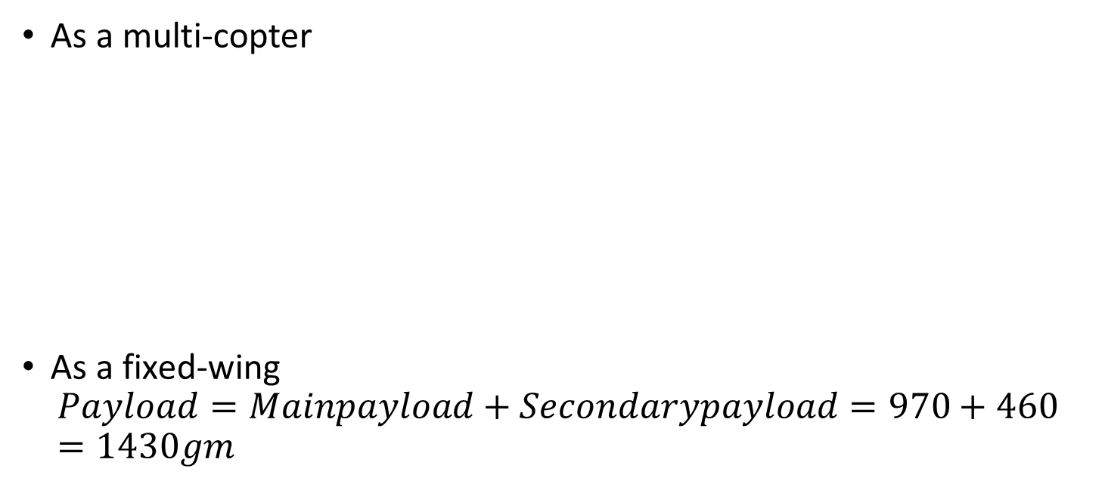
Sizing
As a multi-copter
As a fixed-wing
$$Payload=Mainpayload+Secondarypayload=970+460=1430gm$$
component | Mass of a piece | No of pieces | Total mass
VTOL motors | 71 | 4 | 284
VTOL propellers | 19 | 4 | 76
VTOL ESC | 25 | 4 | 100
Total mass | - | - | 460 gm

Slide 9
Propulsion system selection
AC Design
Autonomous air transportation using vision navigation

Slide 10
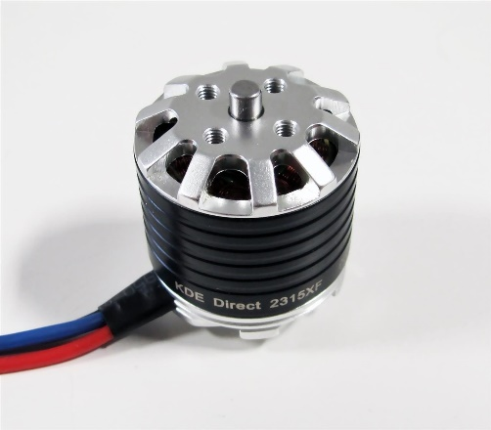
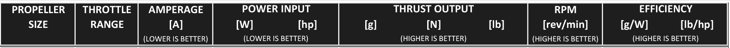
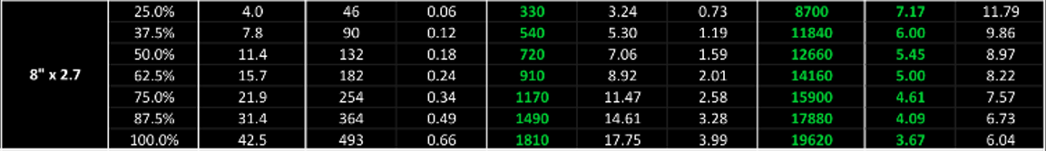
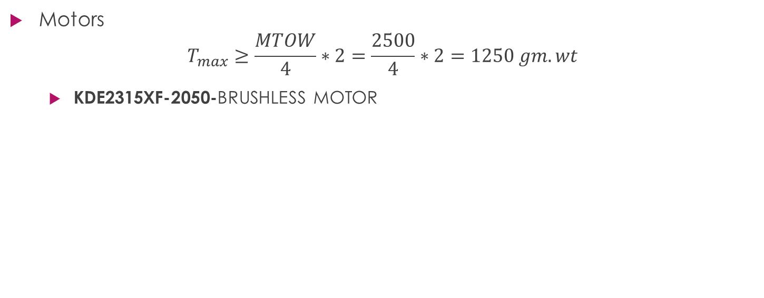
VTOL
Motors
$$T_{max}≥\frac{MTOW}{4}∗2=\frac{2500}{4}∗2=1250 gm.wt$$
KDE2315XF-2050-BRUSHLESS MOTOR

Slide 11
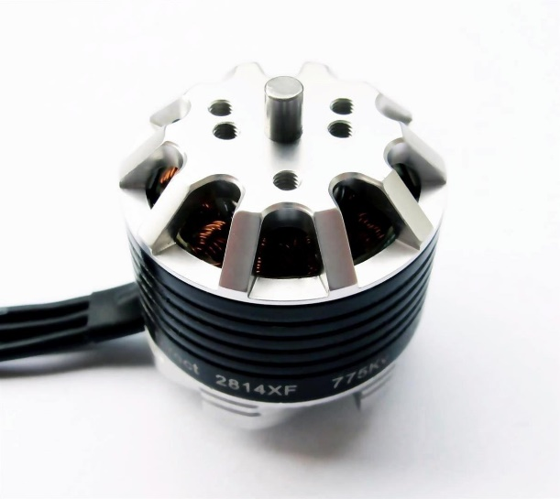
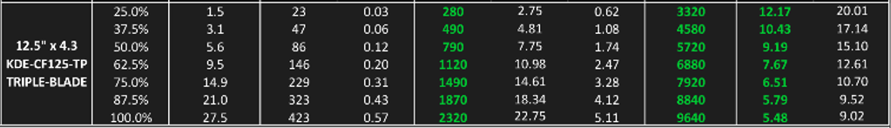
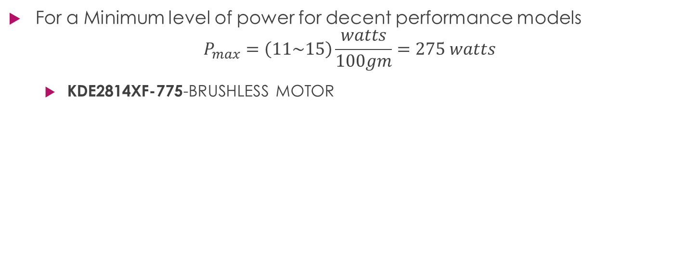
Cruise
For a Minimum level of power for decent performance models
$$P_{max}=\left(11\sim 15\right)\frac{watts}{100gm}=275 watts$$
KDE2814XF-775-BRUSHLESS MOTOR

Slide 12
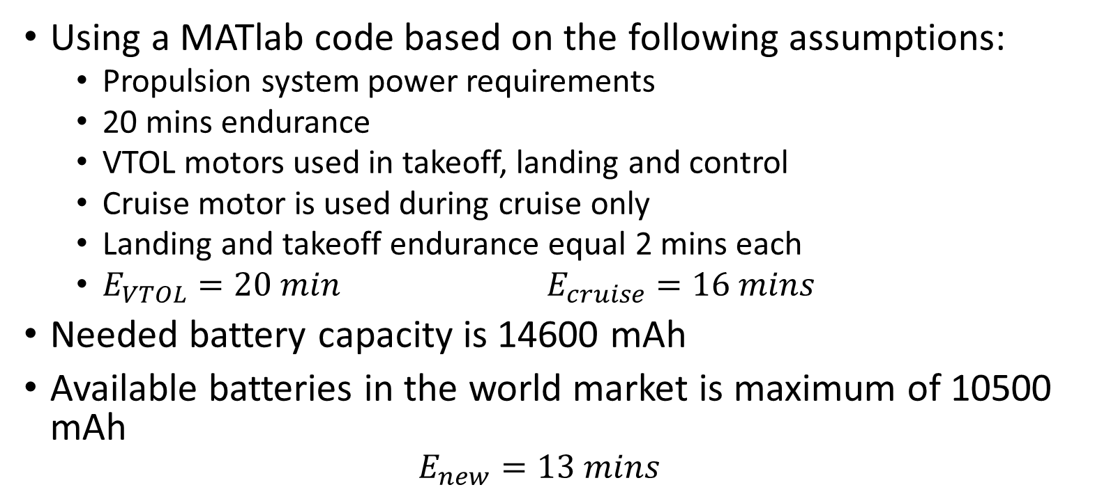
Battery
Using a MATlab code based on the following assumptions:
Propulsion system power requirements
20 mins endurance
VTOL motors used in takeoff, landing and control
Cruise motor is used during cruise only
Landing and takeoff endurance equal 2 mins each
$E_{VTOL}=20 min$ $E_{cruise}=16 mins$
Needed battery capacity is 14600 mAh
Available batteries in the world market is maximum of 10500 mAh
$$E_{new}=13 mins$$
AC Design

Slide 13
Due to limited resources
AC Design
Autonomous air transportation using vision navigation

Slide 14
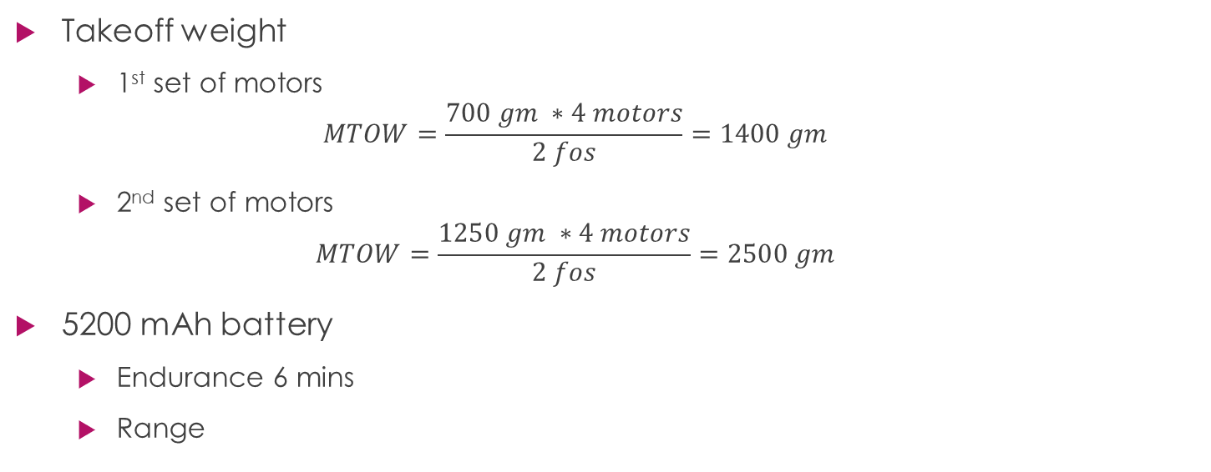
Propulsion system limitations
Takeoff weight
1st set of motors
$$MTOW=\frac{700 gm ∗4 motors}{2 fos}=1400 gm$$
2nd set of motors
$$MTOW=\frac{1250 gm ∗4 motors}{2 fos}=2500 gm$$
5200 mAh battery
Endurance 6 mins
Range
AC Design

Slide 15
Mechanical design
AC Design
Autonomous air transportation using vision navigation

Slide 16
Machining constraints
Available machines
Laser cutter
Only cuts foam and wood sheets with maximum size of (80*50 cm)
CNC foam forming
Forms wings form foam using hot wire with moderate accuracy
3D printer (20*10*20 cm)
AC Design

Slide 17
Building a 3D mechanical model
Why SolidWorks
Steps to build a mechanical design
Define components geometry and mass properties
Define CG location resulted from XFLR5 analysis
Define geometric dimensions resulted from XFLR5 analysis
Define components position constraints (cameras, lidars and PIX4)
Take wiring clearance inconsideration
AC Design

Slide 18
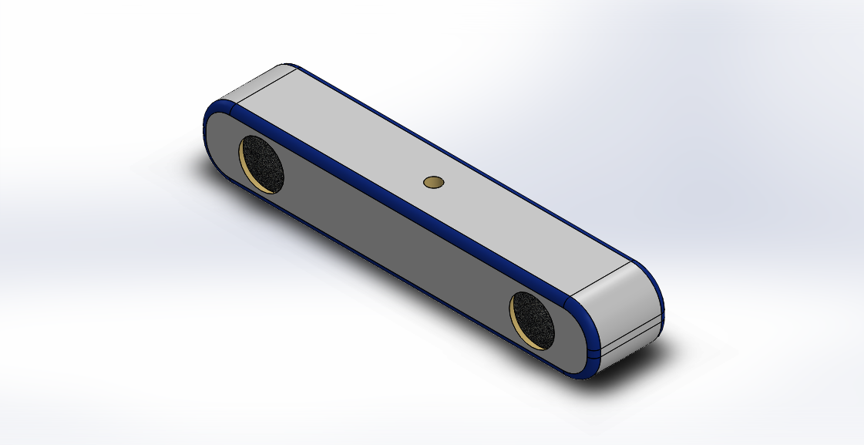
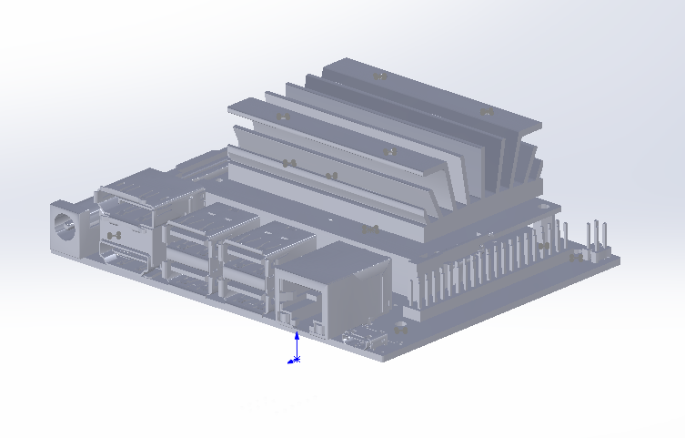
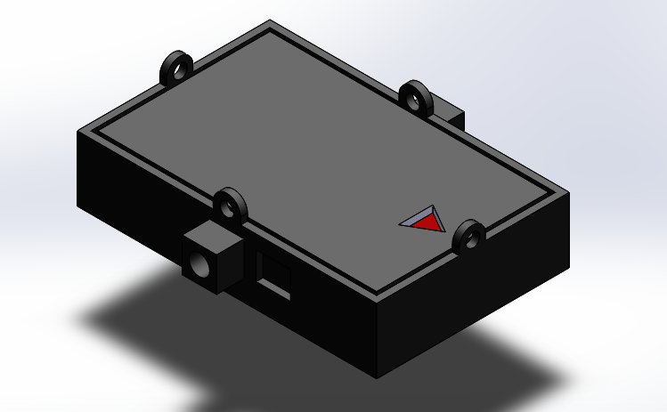
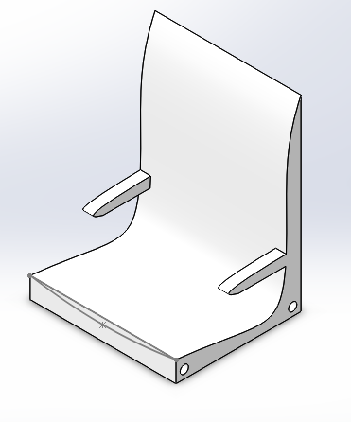
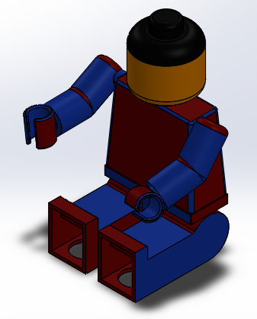
Payload
AC Design

Slide 19
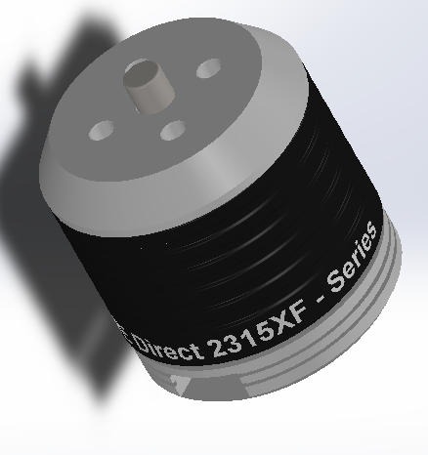
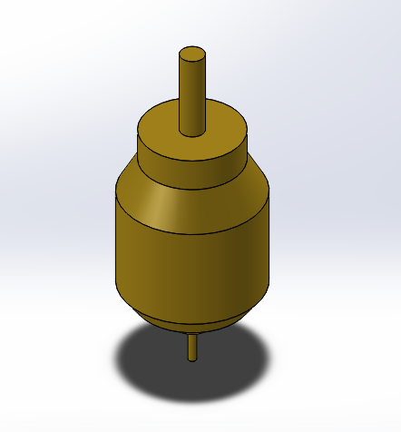
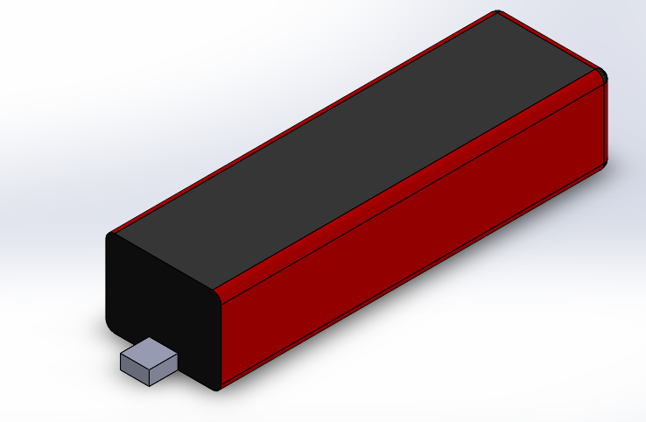
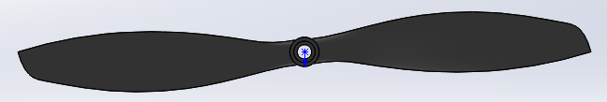
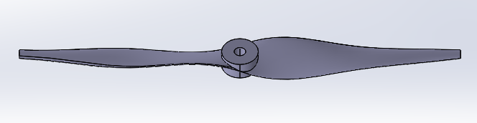
Propulsion system
AC Design

Slide 20
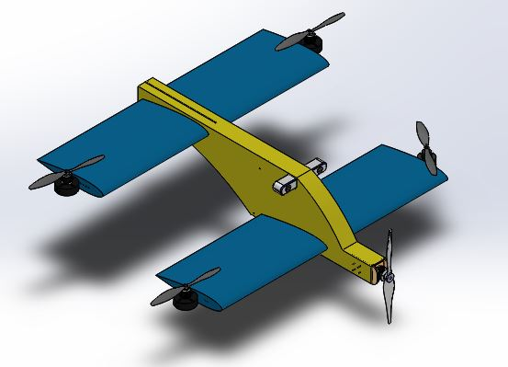
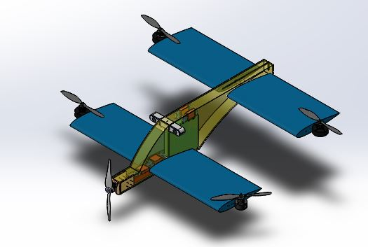
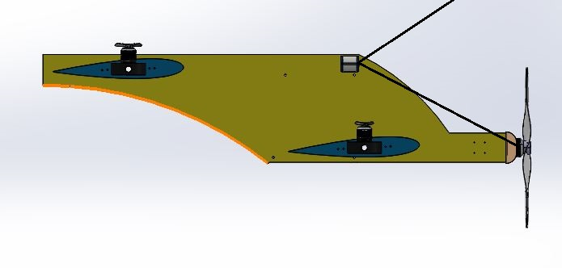
Design iterations
1st iteration
AC Design

Slide 21
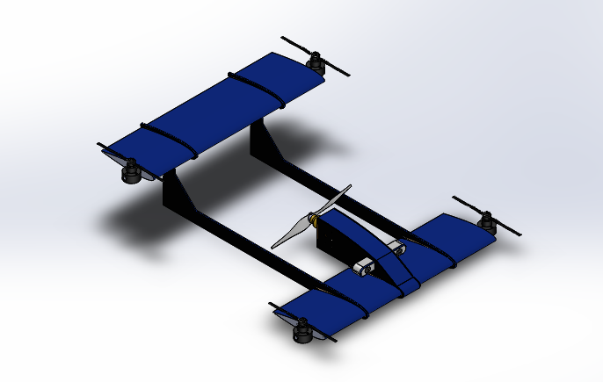
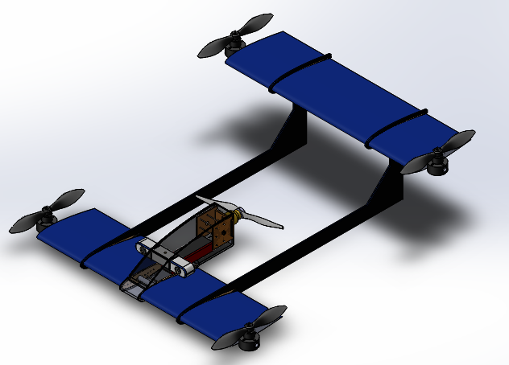
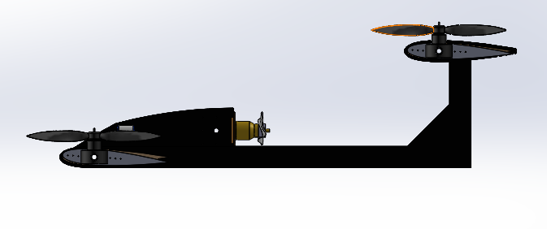
Design iterations
2nd iteration
AC Design

Slide 22
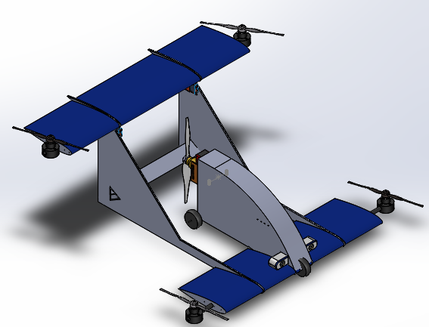
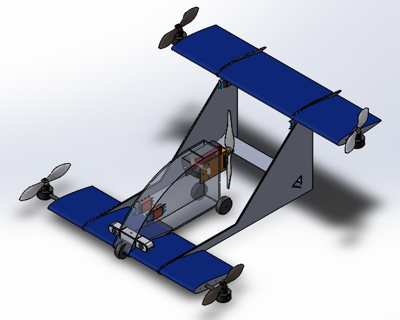
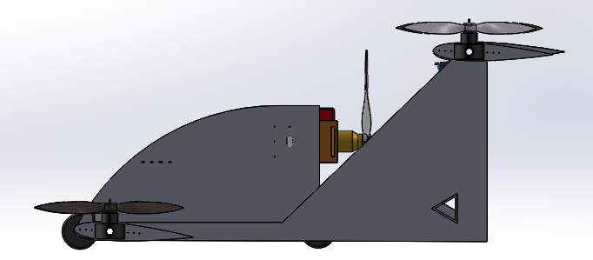
Design iterations
3rd iteration
AC Design

Slide 23
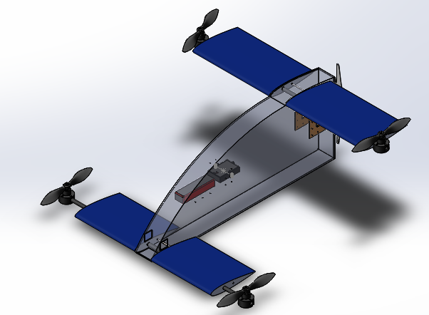
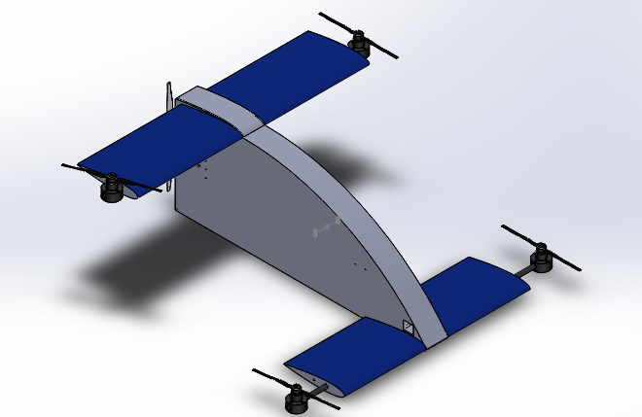
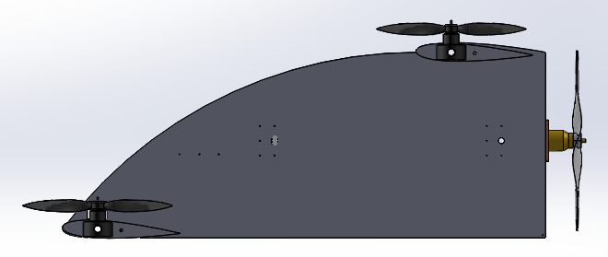
Design iterations
4th iteration
AC Design

Slide 24
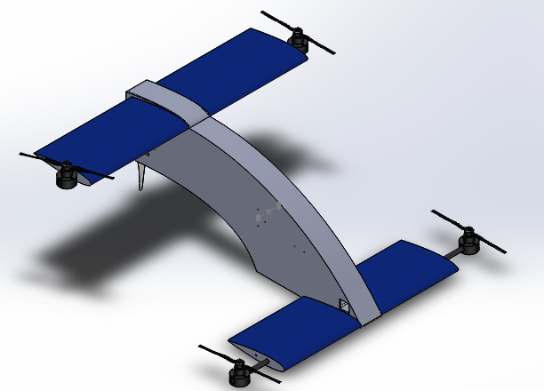
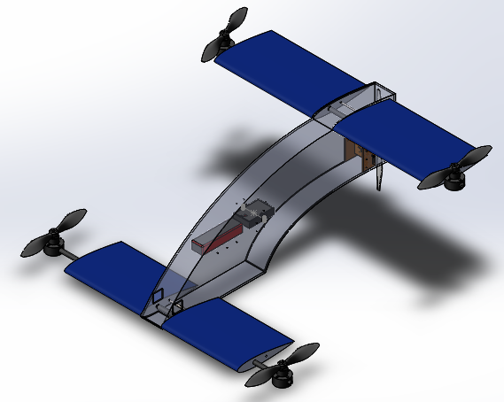
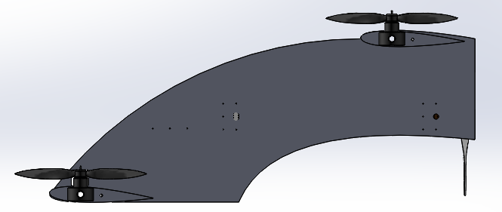
Design iterations
6th iteration
AC Design

Slide 25
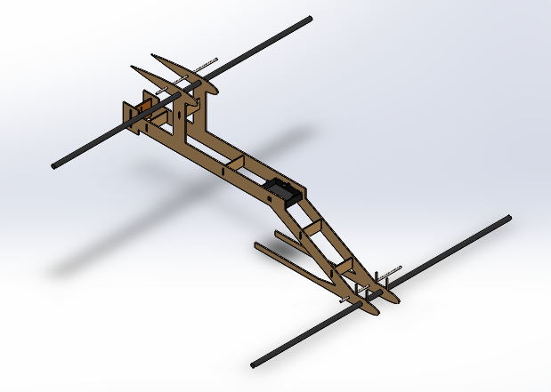
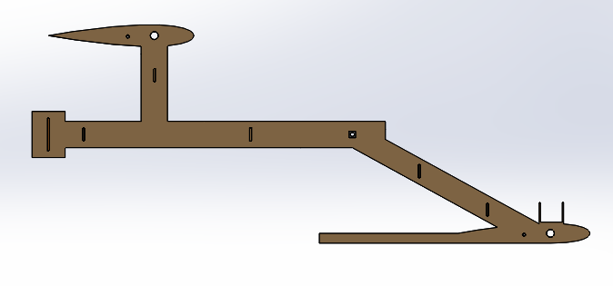
Design iterations
7th iteration
AC Design

Slide 26
Design iterations
8th iteration
AC Design

Slide 27
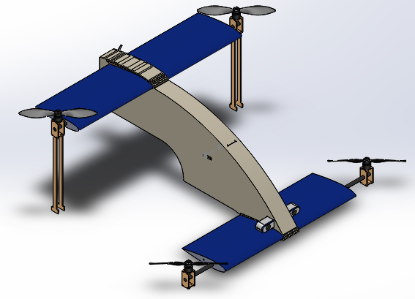
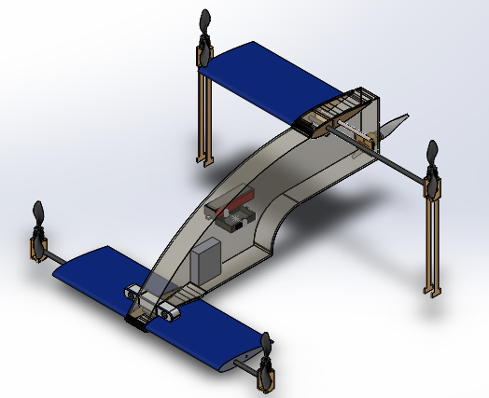
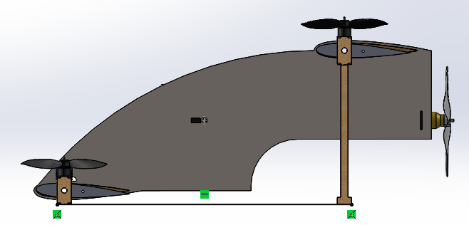
Design iterations
9th iteration
AC Design

Slide 28
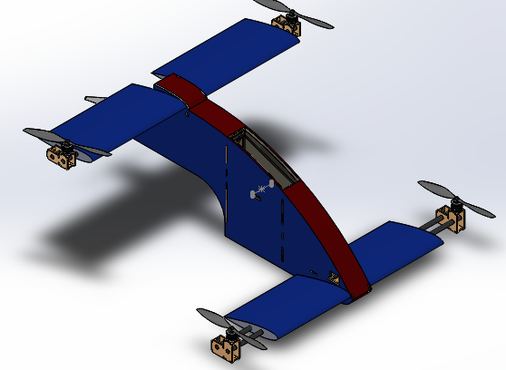
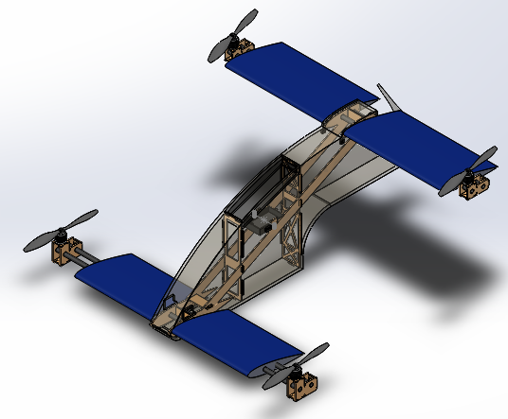
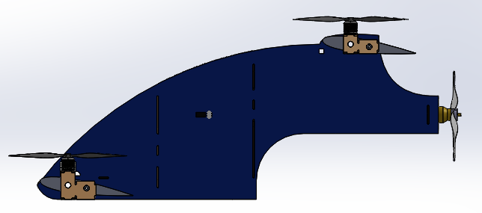
Design iterations
10th iteration
AC Design

Slide 29
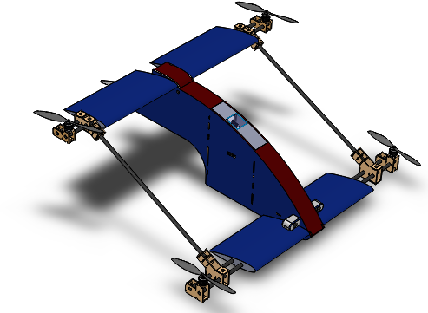
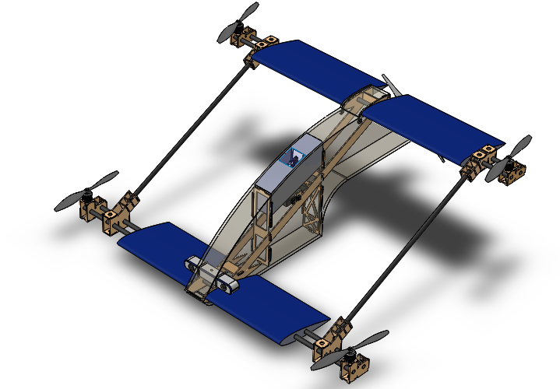
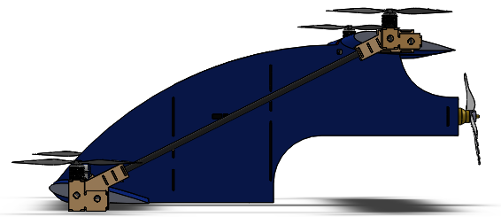
Design iterations
11th iteration
AC Design

