Slide 1







Autonomous Air transportation
AC Design
Using Vision Navigation
Flight test
Autopilot
Introduction
Implementation
Computer Vision
Supervised by: Asst. Prof. Osama Saaid

Slide 2
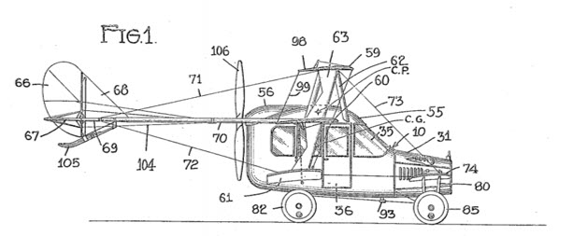
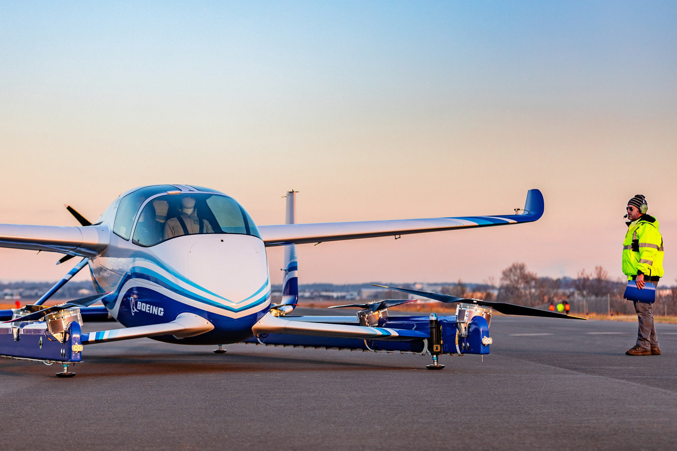
Flying Taxi
a flying vehicle with a range of 50 to 120 miles, carrying one to four passengers, and cruising at an altitude of 3,000 to 5,000 feet.
Introduction

Slide 3
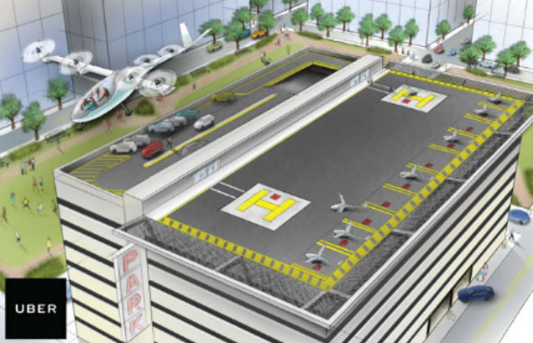
Why attractive idea
Traffic jam problem
Infrastructure cost
Reduce emission and improve safety
Obstacles we need to pass
Introduction
Energy limitations
The public is ready to fly aboard an air taxi with no pilot
Our current air traffic control systems doesn’t accommodate air taxies

Slide 4

Flying taxi categories
Passenger drone:
Electric or hybrid electric
Move people or cargo
Manually piloted, remotely piloted or fully autonomous
Cover short to medium range up to 65 miles
will take flight by 2020
Introduction

Slide 5
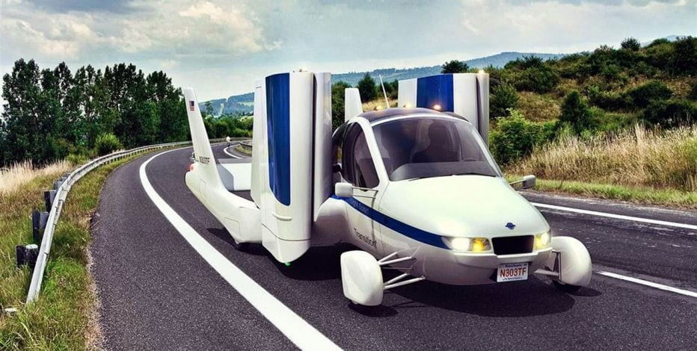
Flying taxi categories
Traditional flying cars:
Can be driven in car configuration to the airport then change it to airplane mode
Need licensed pilot
Cover medium to long range
will take flight by 2020-2022
Introduction

Slide 6
Flying taxi categories
revolutionary vehicles:
combine a passenger drone and traditional flying car
Fully autonomous vehicle
Cover long range (greater than 200 miles)
Have advanced VTOL capability
It could take until 2025 before they become a reality
Introduction

Slide 7
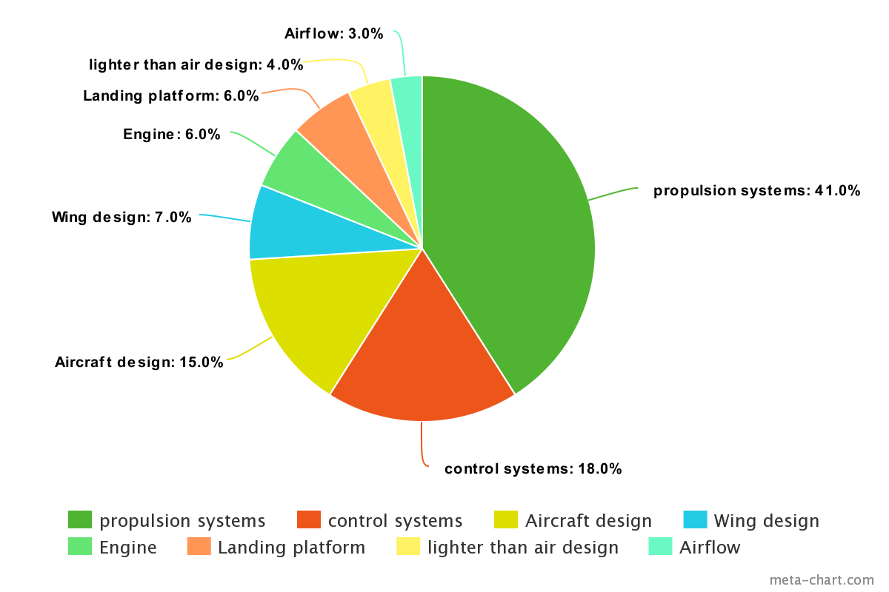
Technology areas dominating air taxi technology
Introduction

Slide 8






The key players in the flying car space
Introduction

Slide 9
The key players in the flying car space
Boeing flying taxi:
Has completed the first test of its autonomous electric VTOL
Introduction

Slide 10
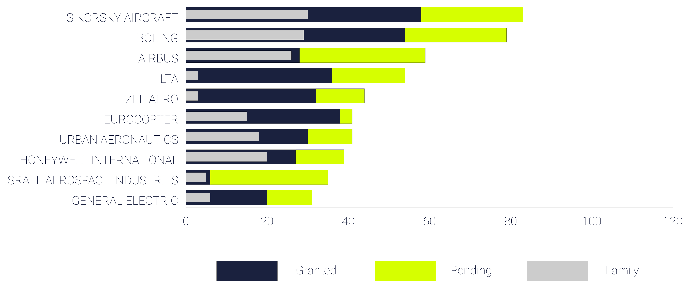
The key players in the flying car space
Patent portfolio:
Introduction

Slide 11
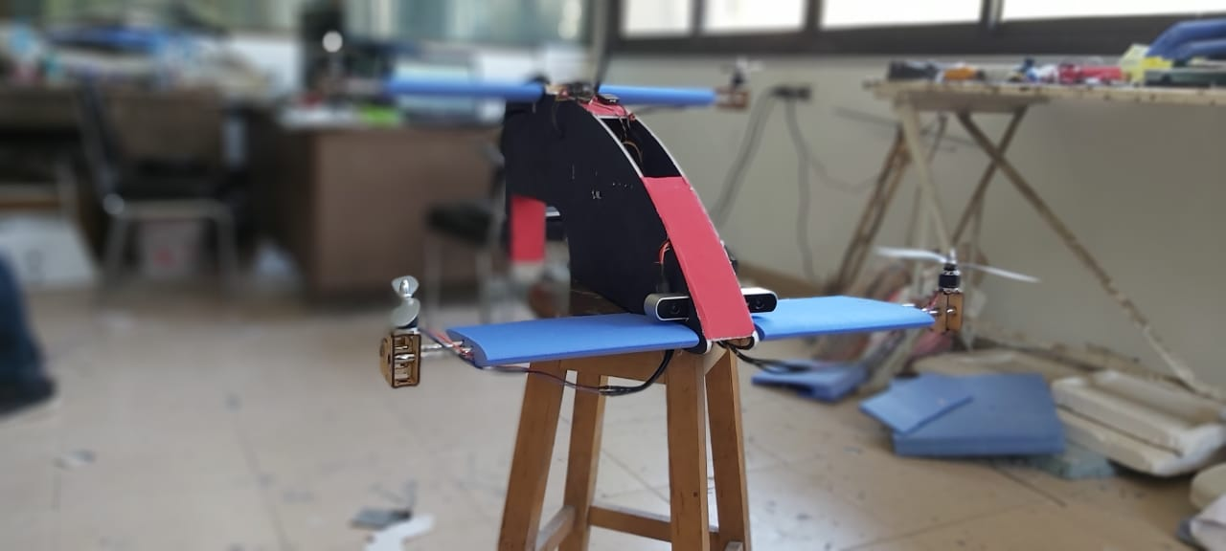
Our prototype
Introduction

Slide 12
AC Design

Slide 13
Autopilot

Slide 14
Computer Vision

Slide 15
Implementation

Slide 16
Flight test

