Slide 1
Attitude Controller
Waypoint
LOS guidance
Φ_des
e_cross
Mx
Flying taxi
PID
PID
u
v
X_req
φ
w
e_along
ϴ_des
My
p
Y_req
PID
PID
q
ϴ
r
Ѱ_des
Mz
φ
PID
ϴ
Ѱ
Ѱ
X
Y
Altitude Controller
X
Y
Z_req
ΔT_allmotors
Z
PID
Z

Slide 2
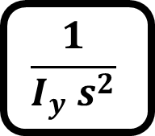
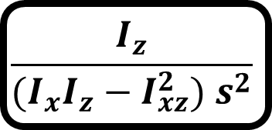
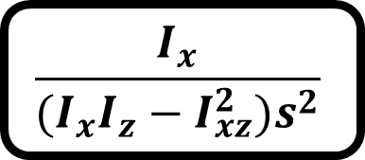
G_phi
Mx
$$\frac{I_{z}}{(I_{x}I_{z}−I_{xz}^{2}) s^{2}}$$
Φ_des
PID
φ
φ
G_th
My
$$\frac{1}{I_{y} s^{2}}$$
ϴ_des
PID
ϴ
ϴ
G_psi
Mz
$$\frac{I_{x}}{(I_{x}I_{z}−I_{xz}^{2})s^{2}}$$
Ѱ_des
PID
Ѱ
Ѱ

Slide 3
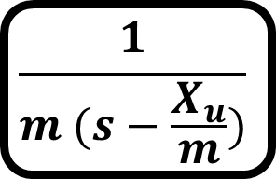
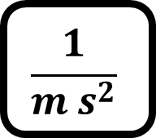
G_Z
ΔT_allmotors
$$\frac{1}{m s^{2}}$$
Z_des
PID
Z
Z
G_u
ΔX_pusher
$$\frac{1}{m (s−\frac{X_{u}}{m})}$$
Δu_des = 0
PID
Δu
Δu

Slide 4

K
e_alongtrack
R
S
e_crosstrack
K-1
$$α_{k}$$
Current position
Y
X

Slide 5
LOS guidance
e_cross
PID
Φ_des
X_req
e_along
PID
Y_req
ϴ_des
Ѱ_des
X
Y

Slide 6
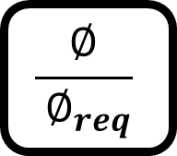


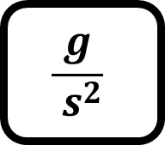




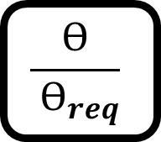



G_ealong
$$e_{alongtrack}^{desired}=0$$
$$θ_{req}$$
$$\frac{ϴ}{ ϴ_{req}}$$
ϴ
$$\frac{g}{ s^{2}}$$
PID
$$e_{alongtrack}$$
$$e_{alongtrack}$$
G_ecross
$$e_{crosstrack}^{desired}=0$$
$$∅_{req}$$
$$\frac{∅}{ ∅_{req}}$$
φ
$$\frac{g}{ s^{2}}$$
PID
$$e_{crosstrack}$$
$$e_{crosstrack}$$

Slide 7
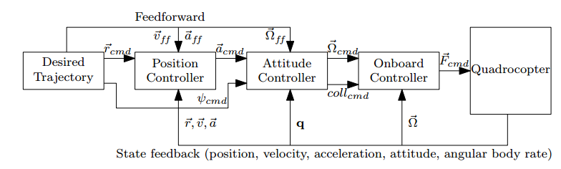

Slide 8
X_req
V_x_req
Accel_x_req
P
PI
-
X_estimated
V_x_estimated
D
Required
Roll angle
Y_req
V_y_req
Accel_y_req
P
PI
Required
Pitch angle
-
Y_estimated
D
Required
Thrust
V_y_estimated
Z_req
V_z_req
Required
heading
P
PI
-
Accel_z_req
Z_estimated
V_z_estimated
D

Slide 9
phi_req
phidot_req
Torque_x_req
P
PI
-
phi_estimated
phidot_estimated
D
pitch_req
pitdot_req
Torque_y_req
P
PI
-
pitch_estimsted
pitchdot_estimated
D
yaw_req
yawdot_req
Torque_z_req
P
PI
-
Yaw_estimated
yawdot_estimated
D
Required Thrust

Slide 10
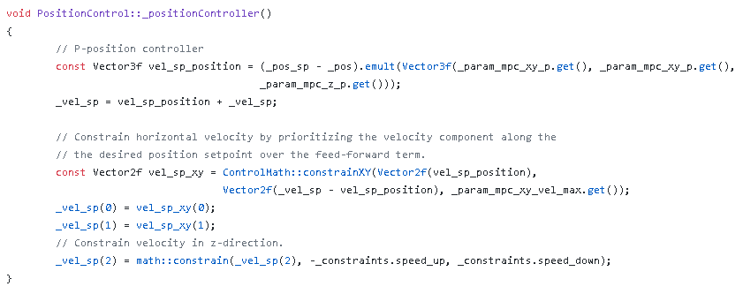

Slide 11

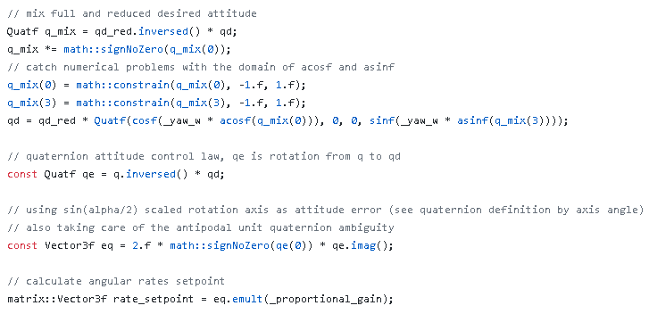
Control Law of Outer Loop of attitude controller

Slide 12
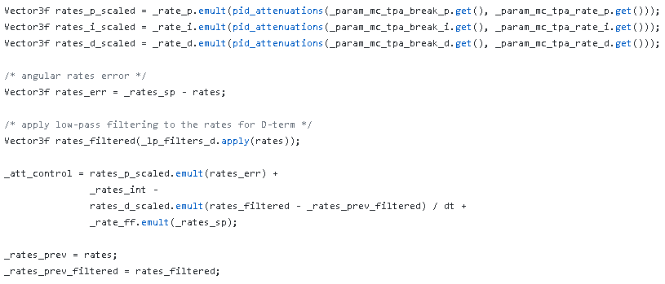

Slide 13
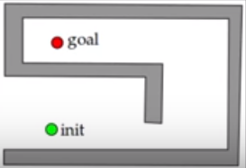
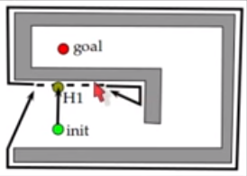

Slide 14
Jetson
Updated Trajectory (waypoints contains position setpoint)
Visual odometry
Pusher motor control_action
Global Obstacle avoidance
Vision software
Pusher motor controller(cruise speed controller)
PX4
PWMs
Flying taxi
states
MAVLink
EKF
MAVLink
Original waypoints (Mission)
PIXHAWK
Map
ZED stereo camera

Slide 15
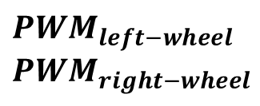

Control Software
Position Controller
Unicycle model
Differential drive controller
desired trajectory (simple square)
desired v , omega
desired $$ω_{left−wheel}$$
$$ω_{right−wheel}$$
$${PWM}_{left−wheel}$$
$${PWM}_{right−wheel}$$

Slide 16
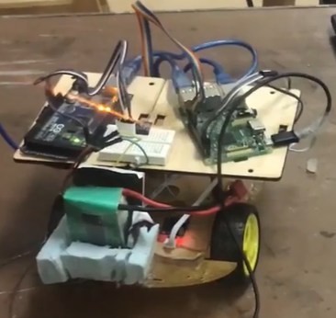
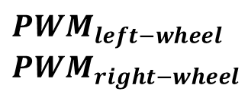
$${PWM}_{left−wheel}$$
$${PWM}_{right−wheel}$$
desired trajectory (simple square)
Control Software
DD robot
states
EKF (sensor fusion)
Encoders
IMU

