Slide 1
Attitude Controller
Waypoint
LOS guidance
Φ_des
e_cross
Mx
Flying taxi
P
PID
u
v
X_req
φ
w
e_along
ϴ_des
My
p
Y_req
P
PID
q
ϴ
r
Ѱ_des
Mz
φ
PID
ϴ
Ѱ
Ѱ
X
Y
Altitude Controller
X
Y
Z_req
ΔT_allmotors
Z
PID
Z

Slide 2

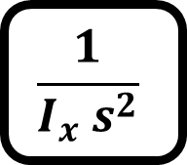
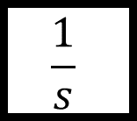





$$\dot{G_{φ}}$$
$$φ_{des}$$
$${\dot{φ}}_{des}$$
$$\dot{φ}$$
$$φ$$
Mx
$$\frac{1}{I_{x} s^{2}}$$
P
PID
$$\frac{1}{s}$$
$$\dot{φ}$$

Slide 4

K
e_alongtrack
R
S
e_crosstrack
K-1
$$α_{k}$$
Current position
Y
X

Slide 5
LOS guidance
e_cross
PID
Φ_des
X_req
e_along
PID
Y_req
ϴ_des
Ѱ_des
X
Y

Slide 6

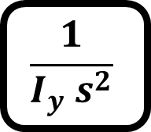





$$\dot{G_{θ}}$$
$$θ_{des}$$
$${\dot{θ}}_{des}$$
$$\dot{θ}$$
$$θ$$
My
$$\frac{1}{I_{y} s^{2}}$$
P
PID
$$\frac{1}{s}$$
$$\dot{θ}$$

Slide 7






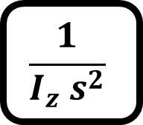

$$\dot{G_{z}}$$
$$ψ_{des}$$
$${\dot{ψ}}_{des}$$
$$\dot{z}$$
$$ψ$$
$$M_{z}$$
$$\frac{1}{I_{z} s^{2}}$$
P
PID
$$\frac{1}{s}$$
$$\dot{ψ}$$

Slide 8





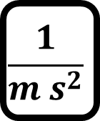

$$\dot{G_{z}}$$
$$Z_{des}$$
$${\dot{z}}_{des}$$
$$\dot{z}$$
$$z$$
$$∆T_{AllMotosr}$$
$$\frac{1}{m s^{2}}$$
P
PID
$$\frac{1}{s}$$
$$\dot{z}$$

