Slide 1
Phone book

Slide 2
Team members
1. Mohamed Mamdouh Mohamed Khalil 2. Omar Mostafa Taha
3. Afaf Abdelwahab Abdelkader 4.Omar Shaaban
5.Yasmin Attia

Slide 3

introduction
In this project the user can add number to phone book by entering his name and his number, can delete an specific number , can search for specific number and display it , and can display all numbers in the phone book .
We using files to save all names and numbers.

Slide 4
This project consist of 6 functions
Insert new number in the phone book
Delete any number
Save all changes in the file
Display specific number
Display all numbers in phone book.
Remove all names and numbers

Slide 5
Basic idea of each function

Slide 6
The insert function
In this function we allows the user to enter his name and his number then save them in the array and in the file.
The user can save all changes after adding new number by choosing save function.

Slide 7
Save changes function
This function is used to save all changes that user does in the file he should confirm that he want to save this changes before being permanently modified

Slide 8
The delete function
In this function the user can enters the name that he wants to delete. After entering the name if the name is exist in the phone book it will be deleted and if it is not exist in the phone book will display a message that the number not found.

Slide 9
The query function
In this function the user can enters the name that he wants to display it if the name is exist in the phone book , the number of this name it will be displayed.

Slide 10
The Display function
This function display all entries in the phone book . If the user choose this function , each name and its number will be displayed.

Slide 11
Remove all function
In this function user wants to remove all entries in the phone book and also it deletes all names and numbers from the file

Slide 12
Screens for the output

Slide 13
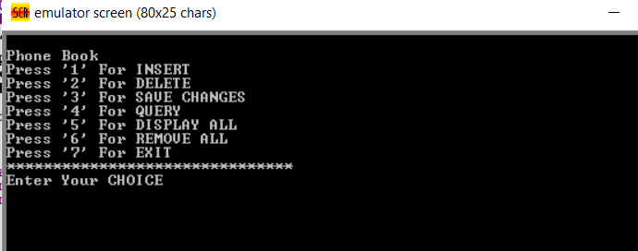
Starting screen for the program

Slide 14
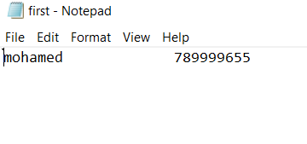
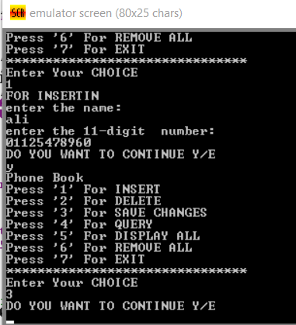
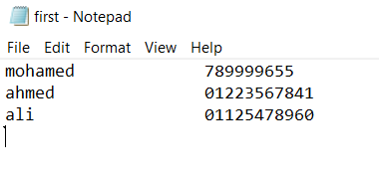
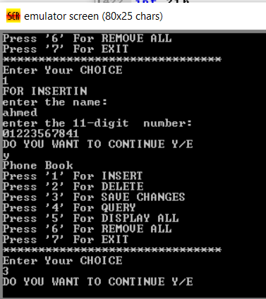
Screen for the file before and after adding numbers

Slide 15
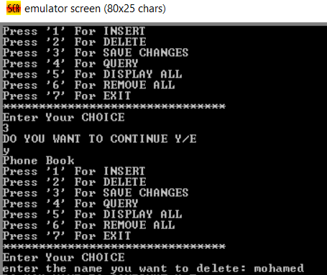
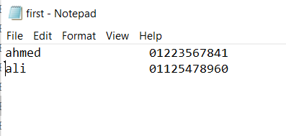
Screen for the file after deleting number

Slide 16
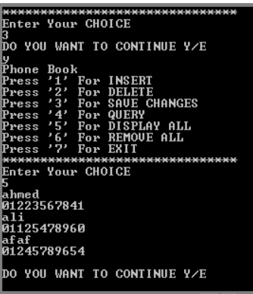
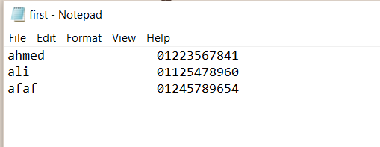
Display all numbers in the file

Slide 17
GitHub link
https://github.com/mohamedmamdouh22/Assembly_project

Slide 18
thank you

