Slide 1


Student enrollment

Slide 2


Team members
Mohamed Mamdouh Mohamed
Omar Mostafa taha
Omar shaaban
Ahmed Ali
Afaf Abdelwahab Abdelkader

Slide 3
content
GUI
using python tkinter to build our GUI.
Database
using SQLite to create our database.

Slide 4
Database consist of 3 tables
Students table.
Courses table.
Instructors table.

Slide 5
Attributes of each table
Students and instructors tables attributes:
First name
Last name
Phone
Email
Address
Gender
Date of birthday

Slide 6
Attributes of each table
Courses table attributes:
Course name
Description
Number of students

Slide 7
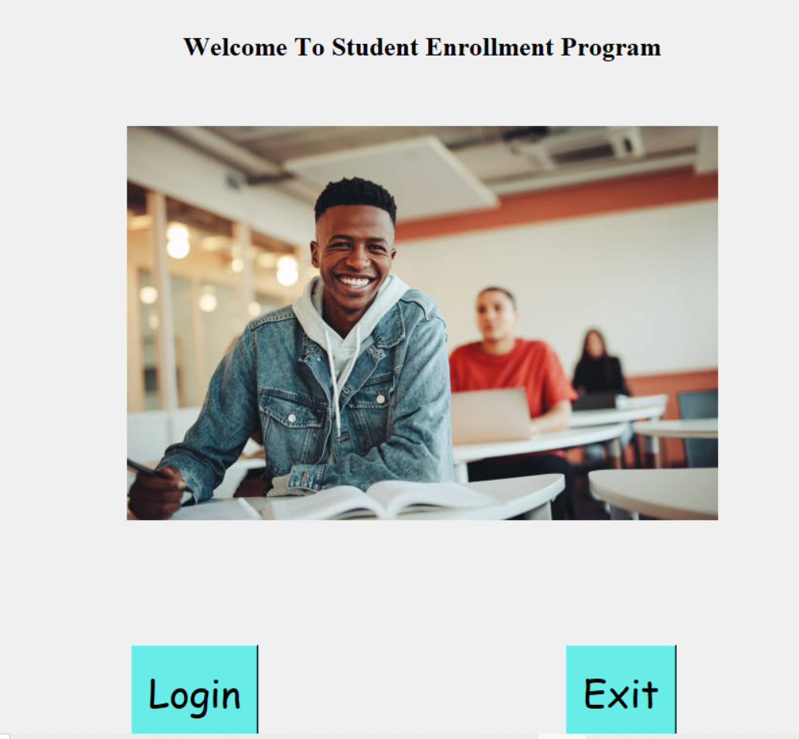
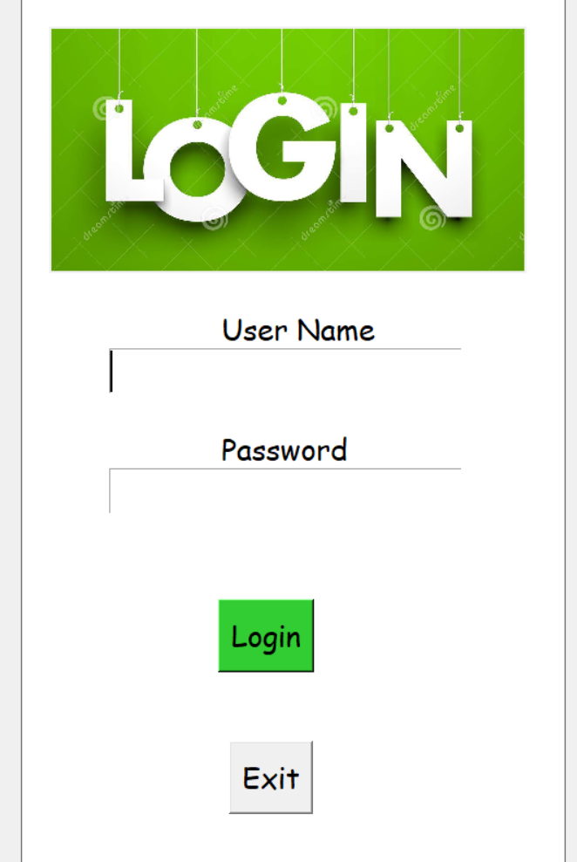
Screenshots:

Slide 8
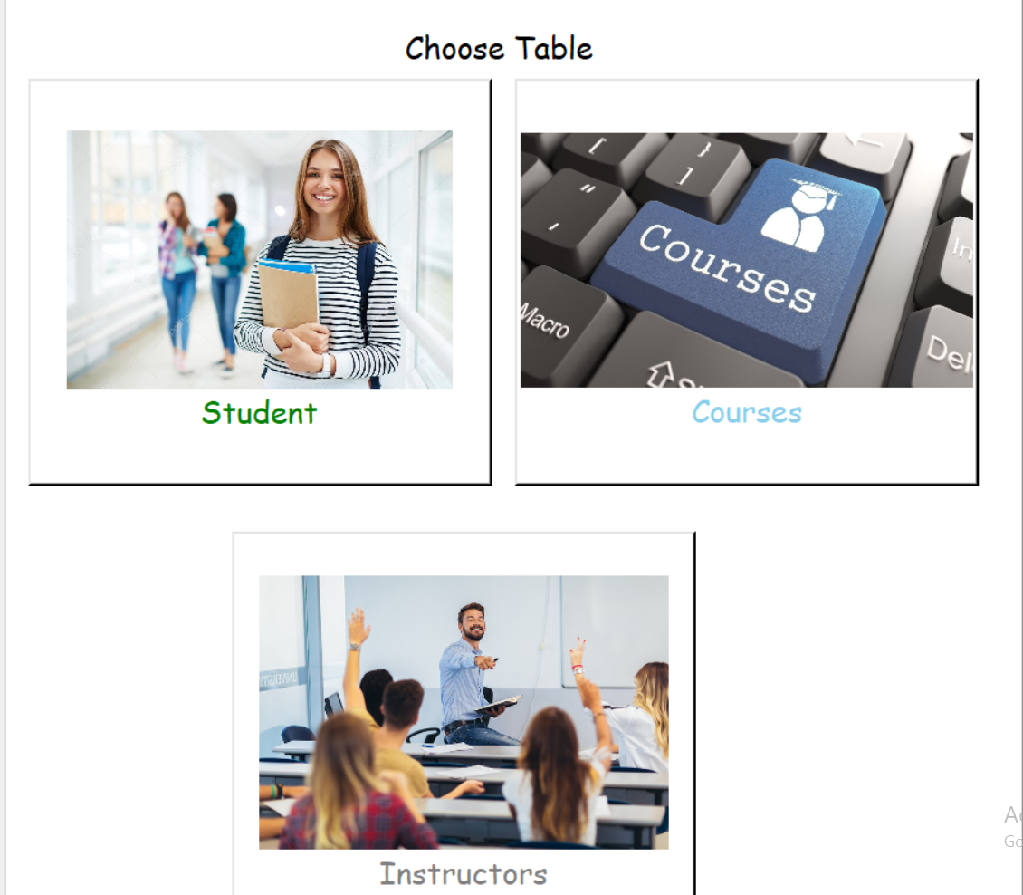
Screenshots:

Slide 9
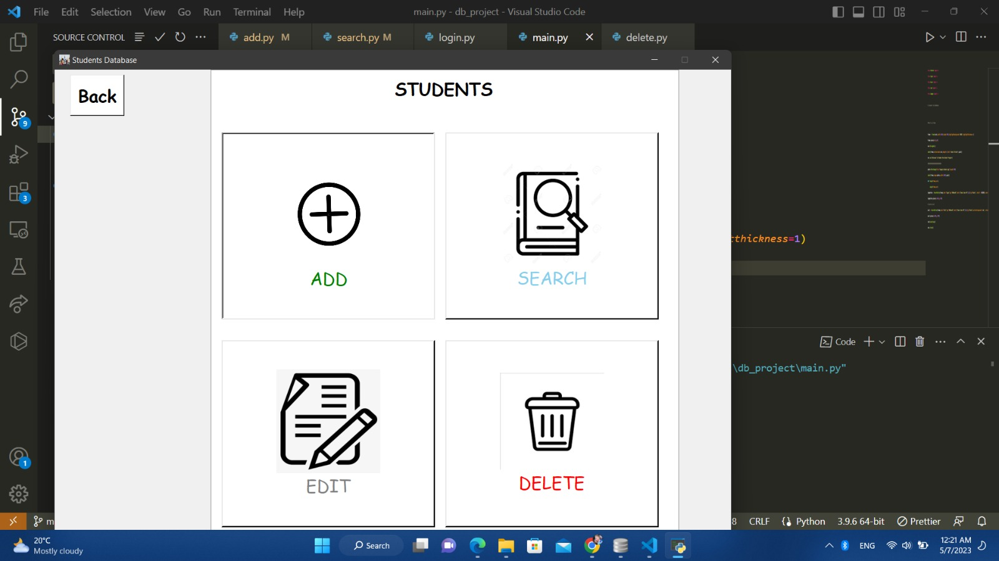
Screenshots:

Slide 10
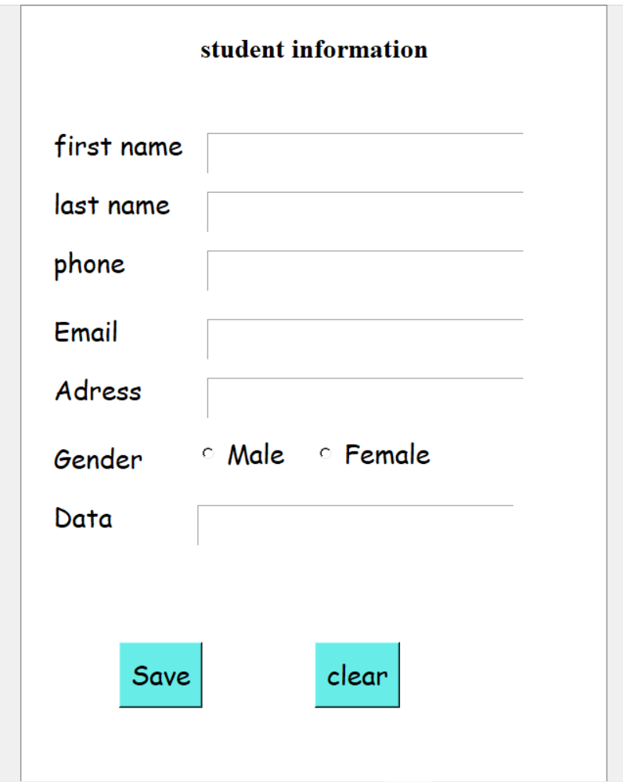
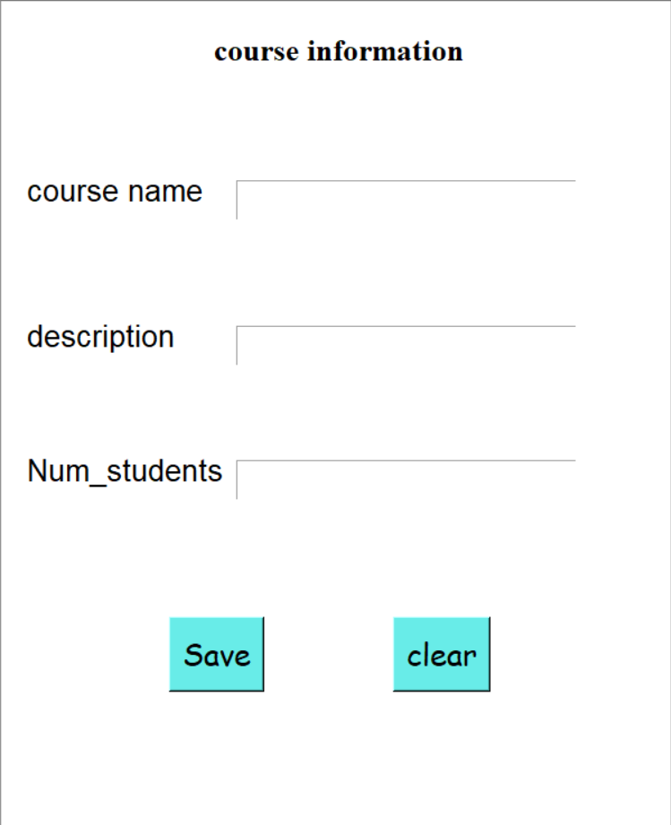
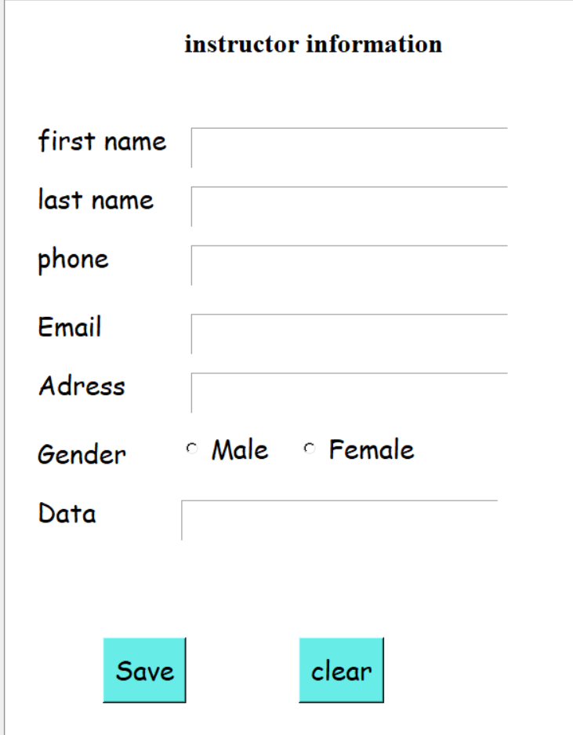
Screenshots:

Slide 11
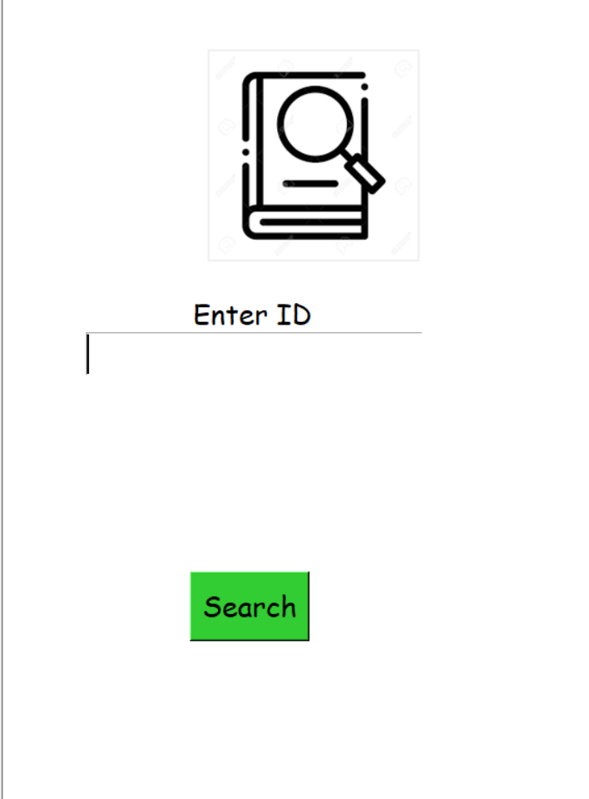
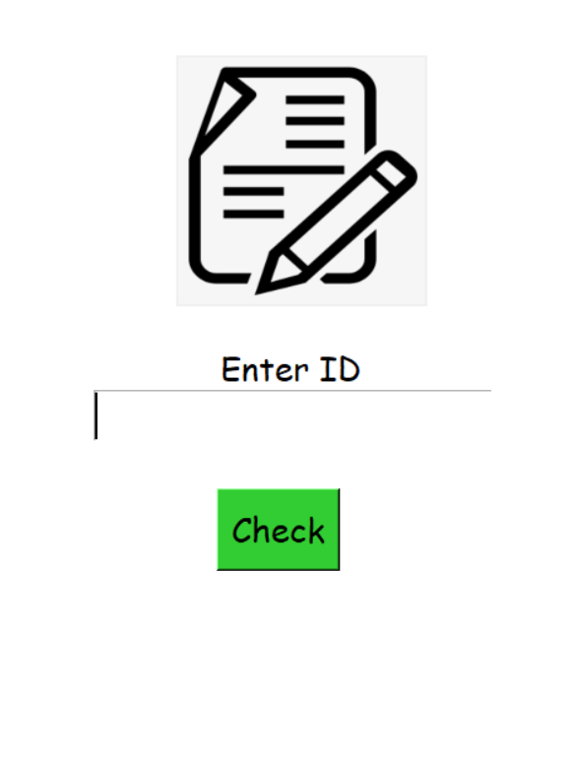
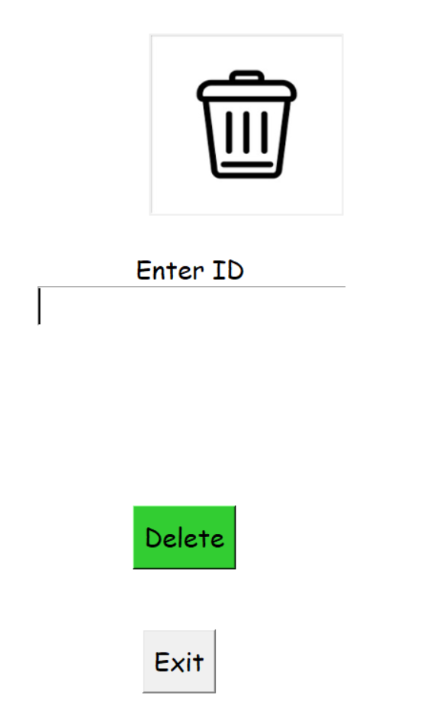
Screenshots:

Slide 12
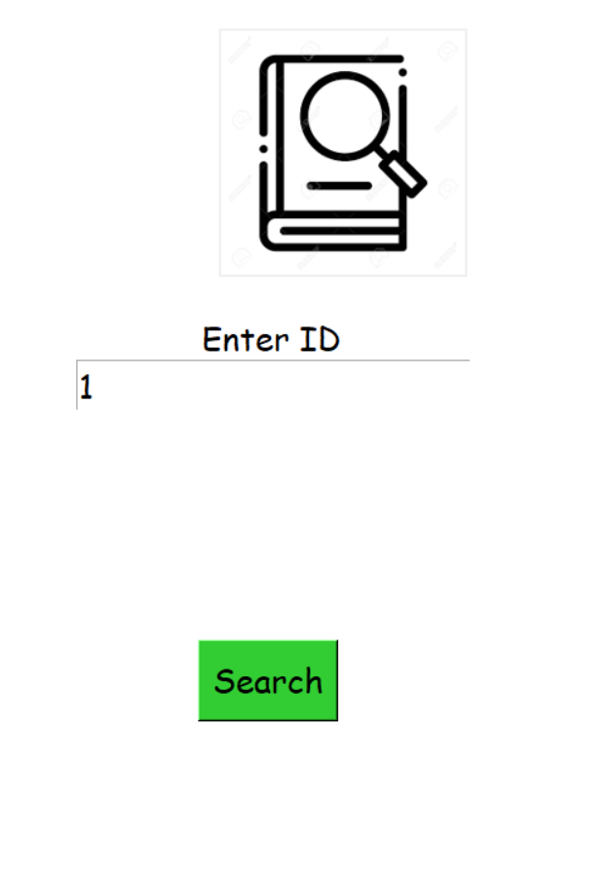
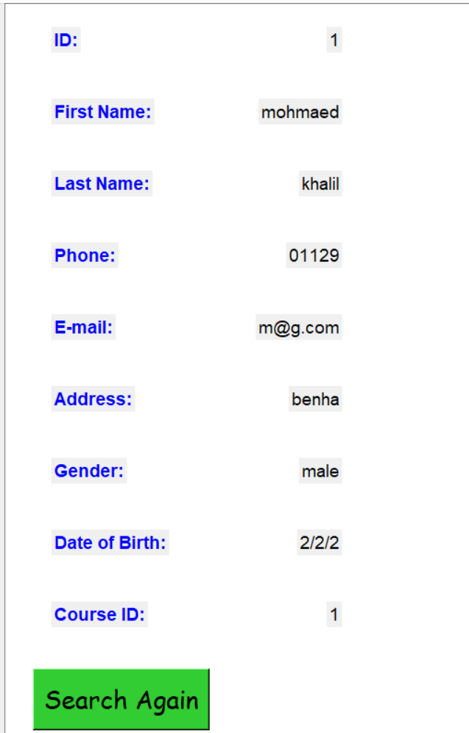
Screenshots:

