Slide 1







<Future Tech Review>
<Mohamed Nader Ibrahim>
<2022-03-16>

Slide 2



OUTLINE
Executive Summary
Introduction
Methodology
Results
Visualization – Charts
Dashboard
Discussion
Findings & Implications
Conclusion
Appendix

Slide 3

EXECUTIVE SUMMARY
The most popular technologies are web-based one such as JavaScript, HTML.
Among all web-based frame works, the hottest areas area React.js and jQuery.
Windows and Linux still dominate all developing platforms.
For mobile platform, Android wins by no contest.
Although MySQL is still the most used database, MongoDB and PostgreSQL show increasing trend of applying in the future.

Slide 4

INTRODUCTION
The technology market changes quickly every year.
It is important to catch-up with the latest technology in each field.
The comparison between current & next year technology trend will provide great inside into the market.
The study consist of 4 main parts:
Top language using
Top database using
Top platform using
Top web frame using

Slide 5

METHODOLOGY
The technology trend is studied by comparing current and future technology usage.
The data was from the ‘Stack Overflow Developer Survey 2019’.
Different type of charts, such as bar, line, pie, tree-map … will be used to visualize the result.
The IBM dashboard is used to analyses data and create visualization.

Slide 6

RESULTS
The results consists of 4 main parts:
Programming language trend
Database trend
Platform trend
Web frame trend

Slide 7
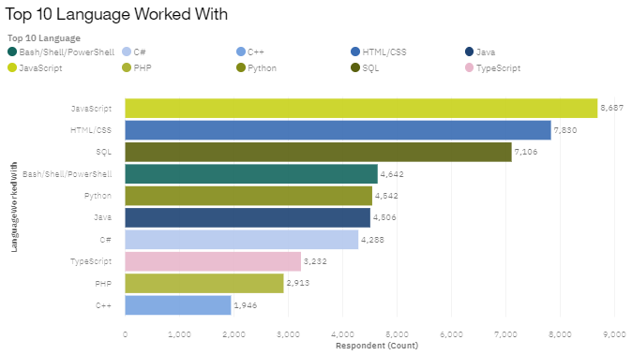
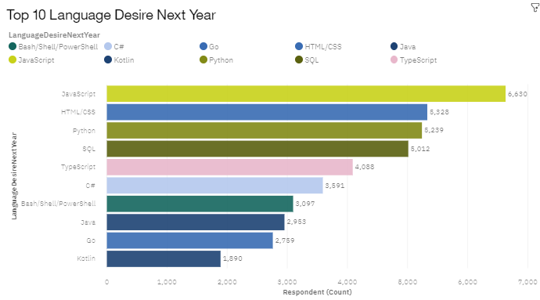
PROGRAMMING LANGUAGE TRENDS
Current Year
Next Year

Slide 8
PROGRAMMING LANGUAGE TRENDS - FINDINGS & IMPLICATIONS
Findings
JavaScript & HTML/CSS are top programming languages for both current and future trend.
Python moves from 5th position to 3rd position in top 10.
C++ and PHP area disappearing from top 10.
Implications
Web programming languages still stay dominance in near future.
Python & data science is becoming more and more important.
Legacy language such as C++, PHP … are gradually falling out of interest.

Slide 9
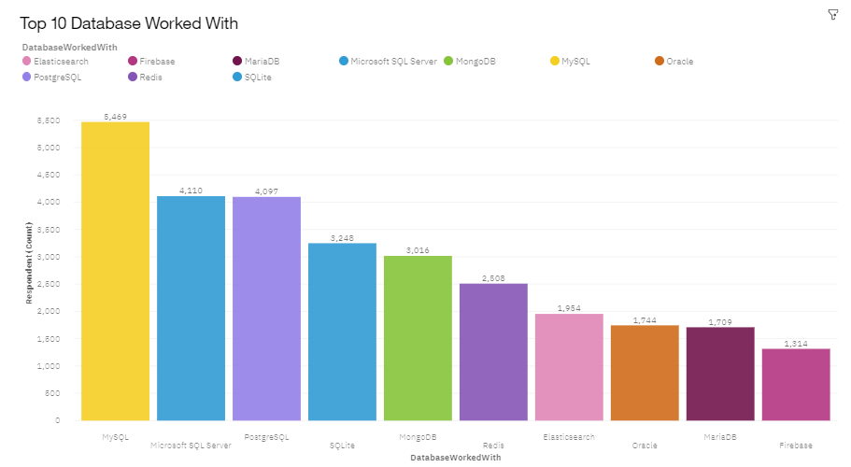
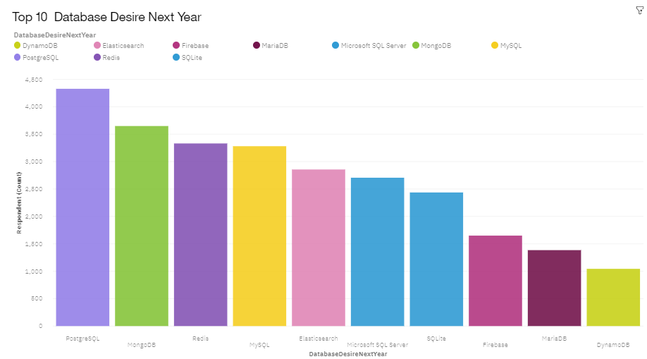
DATABASE TRENDS
Current Year
Next Year

Slide 10
DATABASE TRENDS - FINDINGS & IMPLICATIONS
Findings
MongoDB & Redis quickly moves up to No.2 and No.3
PostgreSQL moves from No.3 to No.1
MS SQL server drops from No.2 to No.5
Oracle disappear from top
Implications
Open source database becomes more and more popular compared with commercial one.
Non-relational database see increasingly usage in the future.
Relational database still takes a leading position in the near future.

Slide 11
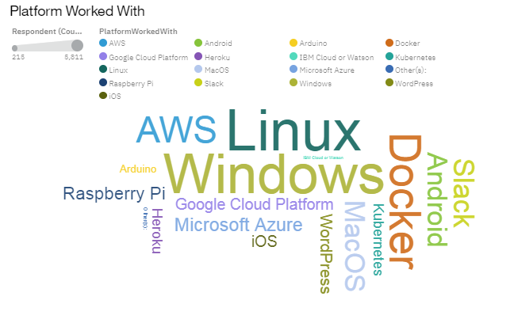
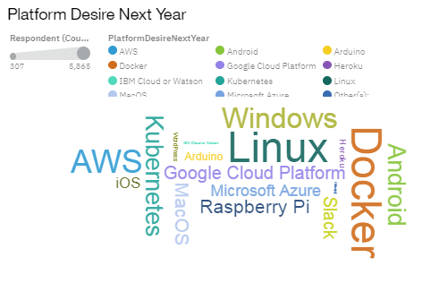
PLATFORM TRENDS
Current Year
Next Year

Slide 12
PLATFORM TRENDS - FINDINGS & IMPLICATIONS
Findings
Windows and Linux still dominates the platform trend.
Android is No.1 in mobile platform.
Cloud platform such as Kubernetes, Docker, AWS is getting more and more market share.
Implications
Windows and Linux are still main developing platform in a foreseeable future.
The transformation to cloud computing is a non-reversible process.

Slide 13
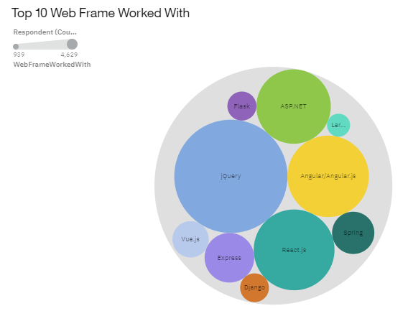
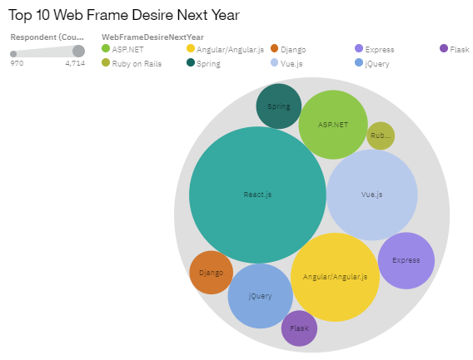
WEB FRAME TRENDS
Current Year
Next Year

Slide 14
WEB FRAME TRENDS - FINDINGS & IMPLICATIONS
Findings
jQuery decreases from No.1 to No.4.
React.js moves up from No.3 to No.1
Vue.js moves from No.9 to No.3.
Angular.js stays at same position.
Implications
jQuery quickly loses market share show lack of interest in its future development.
React.js and Vue.js becomes the new standard for web frame development.

Slide 15
DASHBOARD
<https://jp-tok.dataplatform.cloud.ibm.com/dashboards/83cb3014-ee84-4967-abe7-525506654097/view/4013f07d3cb710ec54e5c0e407917e0f2b34225ab5bb8156d5d47b490b692097a9691493c87a42528b110460f7ba405cce>

Slide 16
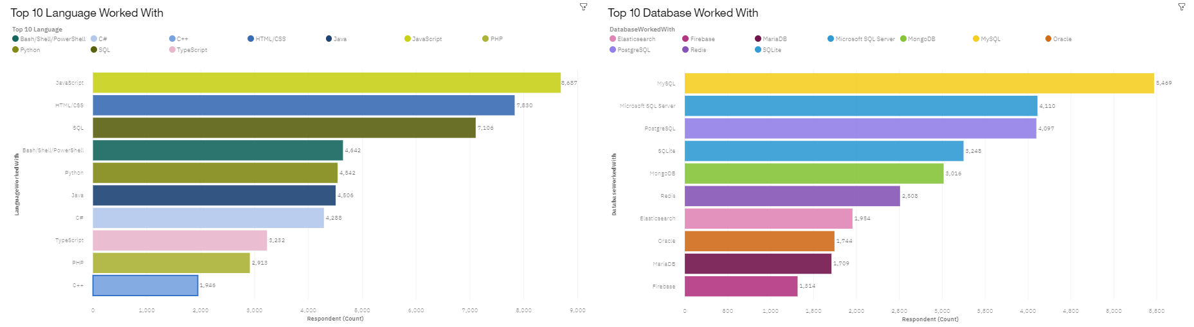
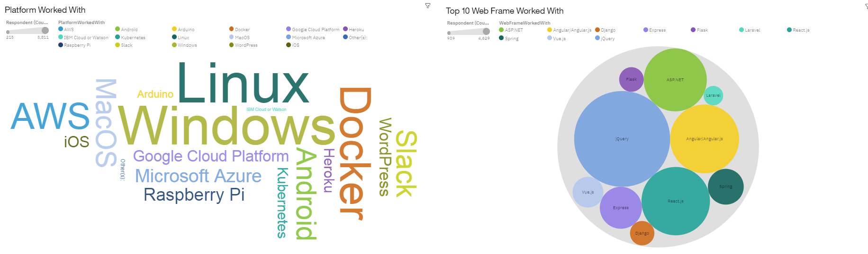
DASHBOARD TAB 1

Slide 17
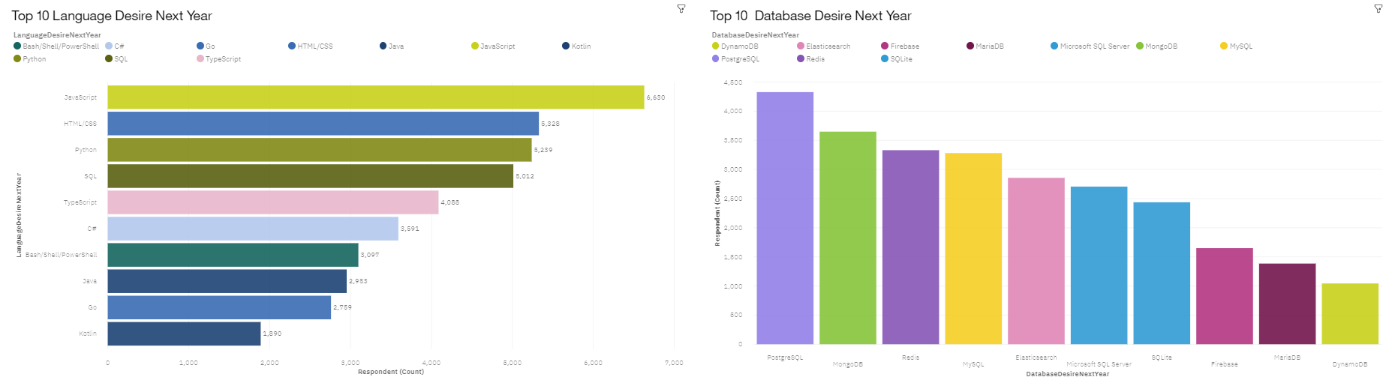
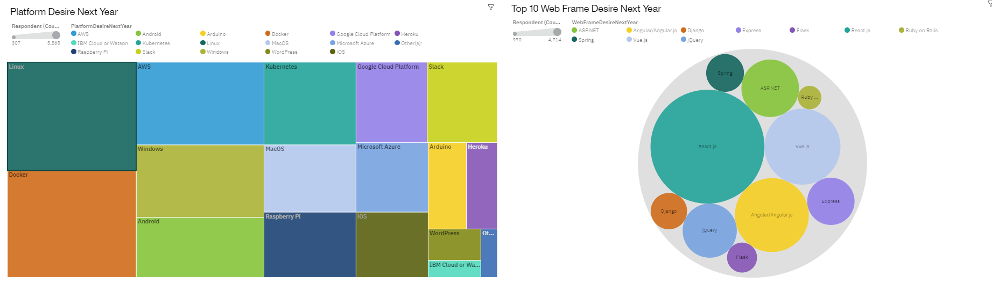
DASHBOARD TAB 2

Slide 18
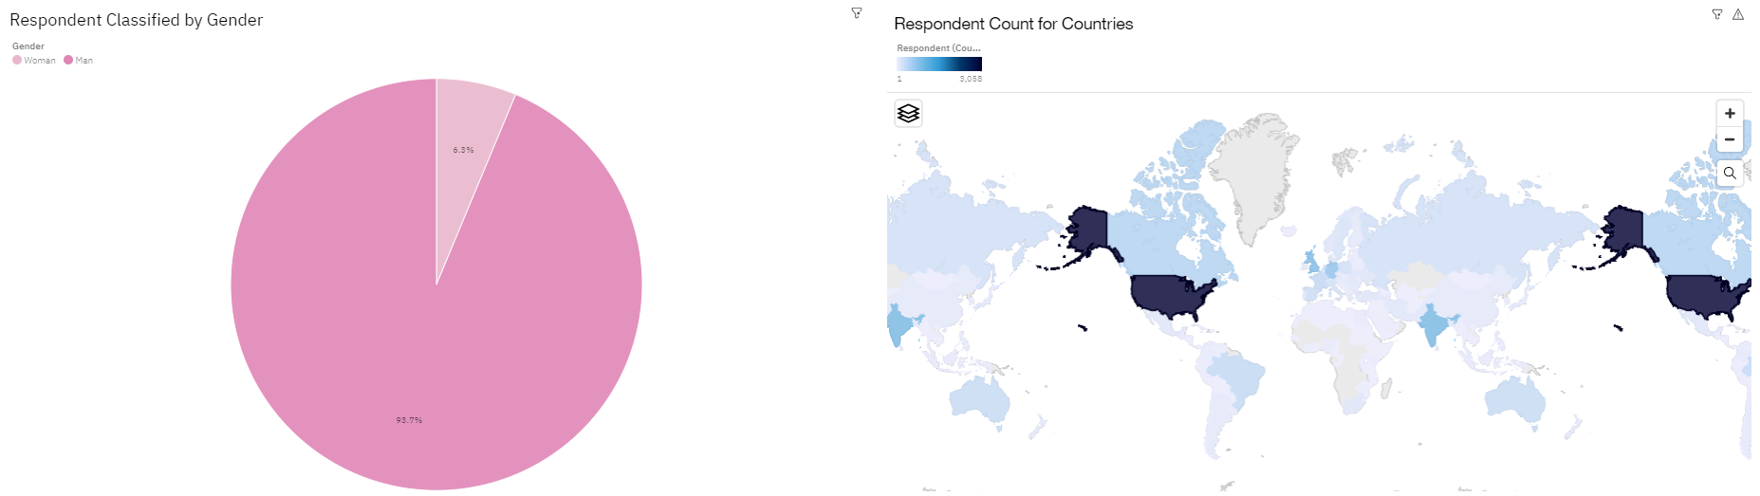
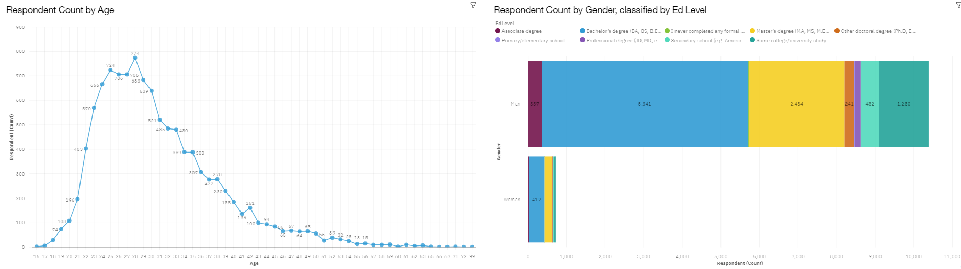
DASHBOARD TAB 3

Slide 19
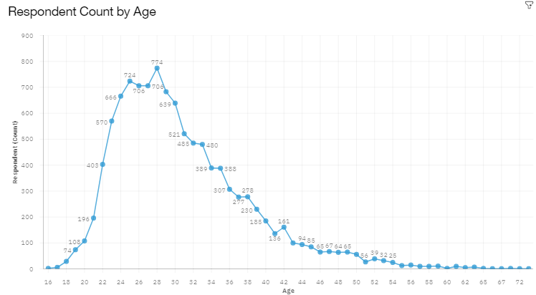
DISCUSSION
Majority of respondents are at young age (20, 30s) ➔ this could skew the result in favor of new technology.

Slide 20
OVERALL FINDINGS & IMPLICATIONS
Findings
Web based language stays at No.1
Non-relational database moves to No.2 & No.3
Cloud-based platform moves to No.1
React.js stays at No.1 on web framework.
Implications
Web based application is taking over the traditional application.
Non-relational database sees increasing adoption.
Cloud-based services become top-choice for platform development.

Slide 21

CONCLUSION
To stay relevant in the technology field, it’s important to learn web-based language & non-relational database.
Among web framework, React.js is the best to learn for your future.
Cloud-based service is the right direction for IT investment.

Slide 22
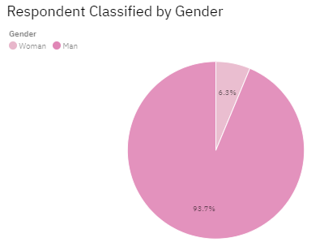

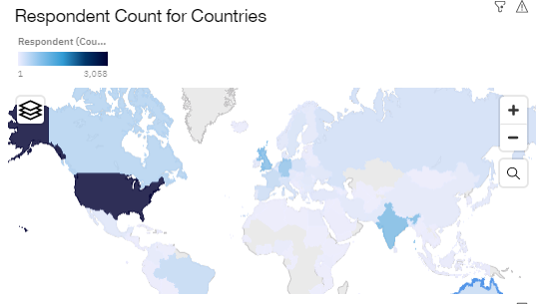
APPENDIX

Slide 23
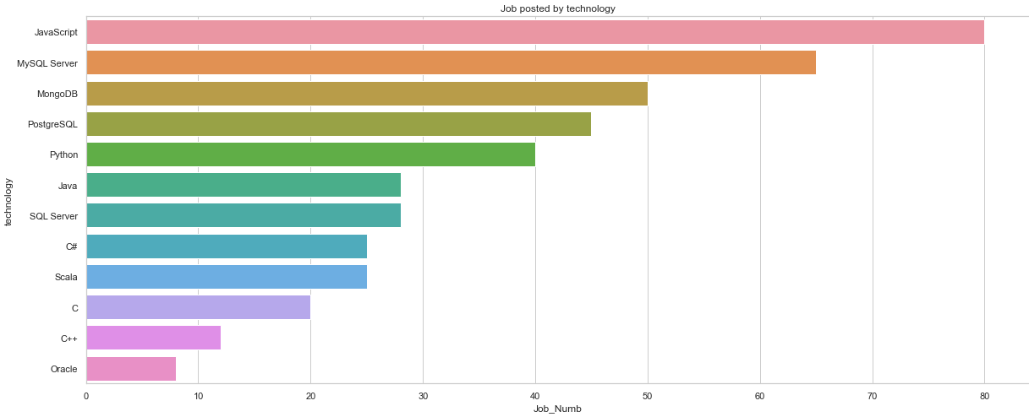
GITHUB JOB POSTINGS

Slide 24
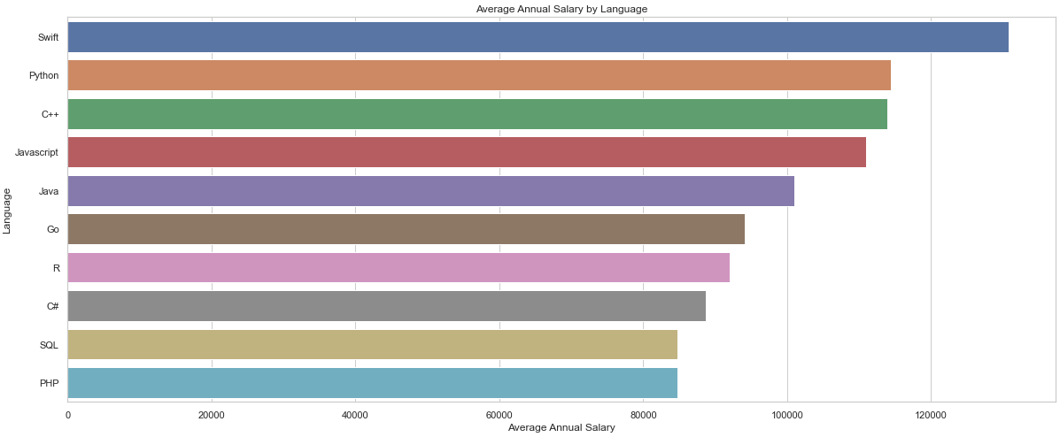
POPULAR LANGUAGES
In Module 1 you have collected the job postings data using web scraping in a file named “popular-languages.csv”. Present that data using a bar chart here. Order the bar chart in the descending order of salary.

