Slide 1
PULSE
Your Egyptian coach at home — 100% free
pulse.geddo.online

Slide 2
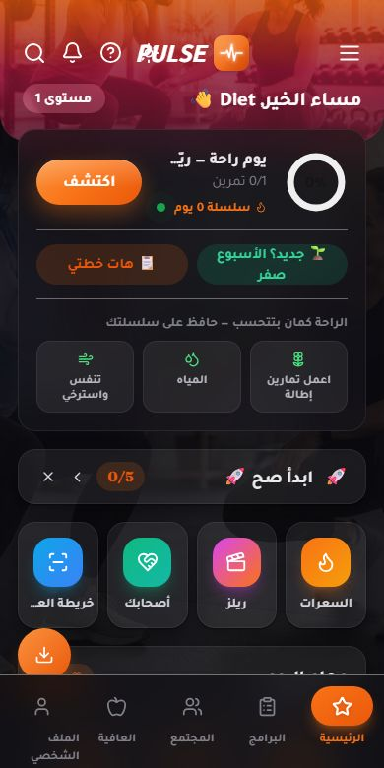
1 / 8
Your day, one calm screen
Today's workout, one tap to start
Daily quests with XP rewards
Streaks, freezes and a lucky wheel
The user chooses what shows — pin anything
pulse.geddo.online

Slide 3
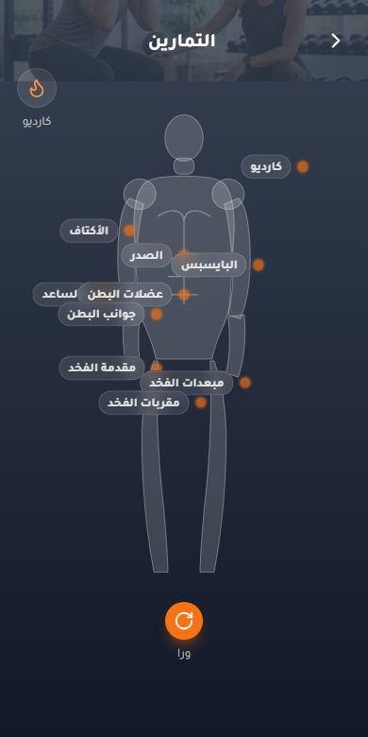
2 / 8
Tap a muscle, get a session
Interactive body map, front & back
Video form guide for every exercise
Animated figures show the movement
Log sets — PR celebrations
pulse.geddo.online

Slide 4
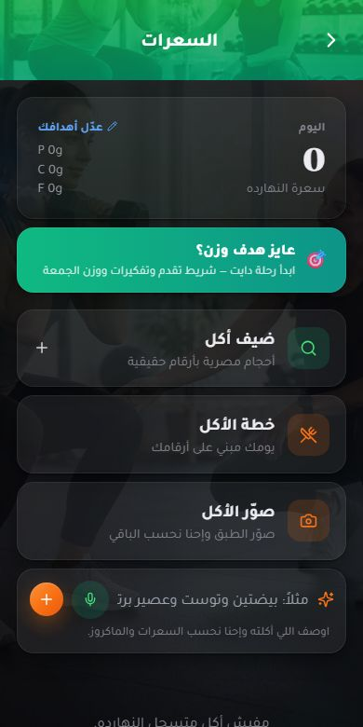
3 / 8
Calories with Egyptian food
154 Egyptian foods with real macros
Log by VOICE — "I ate koshari"
Scan any barcode: score for your goal
Snap a meal photo — AI estimates it
pulse.geddo.online

Slide 5
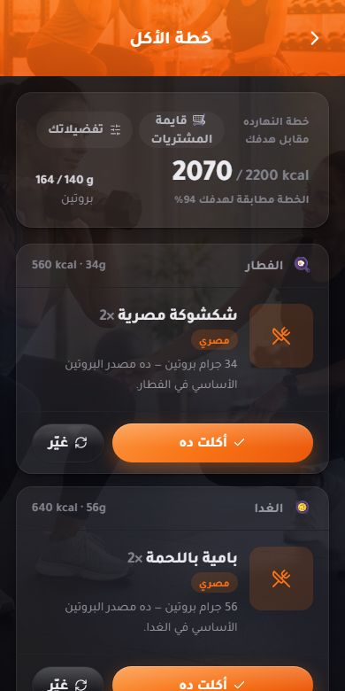
4 / 8
A meal plan that explains itself
Built from the user's goal and body
Every plate says WHY it's there
Training days get +200 kcal automatically
Swap any dish, grocery list included
pulse.geddo.online

Slide 6
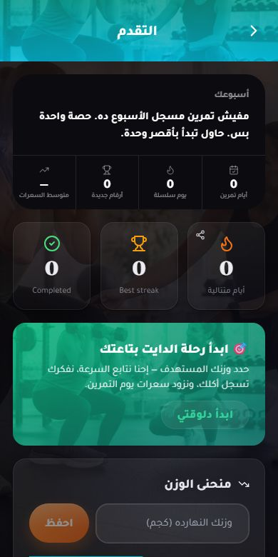
5 / 8
Progress & the Diet Journey
Set a target weight — progress bar to it
On-track / behind vs a healthy pace
Smart nudges: log food, Friday weigh-in
Reach the goal: celebration + 300 XP
pulse.geddo.online

Slide 7
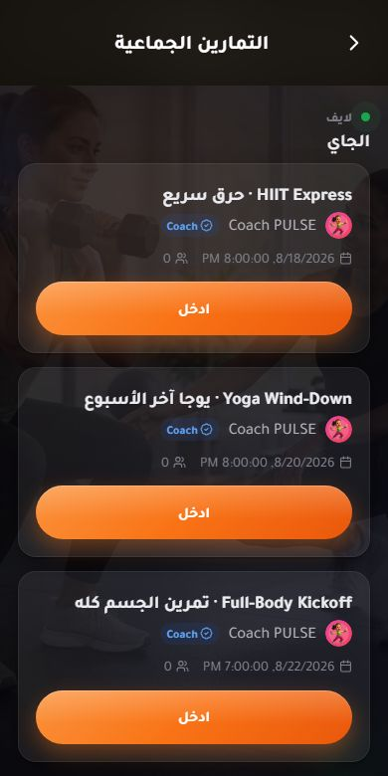
6 / 8
Live classes, together
Coach-hosted rooms with synced video
Shared countdown timer for everyone
Live reactions, text chat & voice notes
Weekly schedule: full-body, burn, yoga
pulse.geddo.online

Slide 8
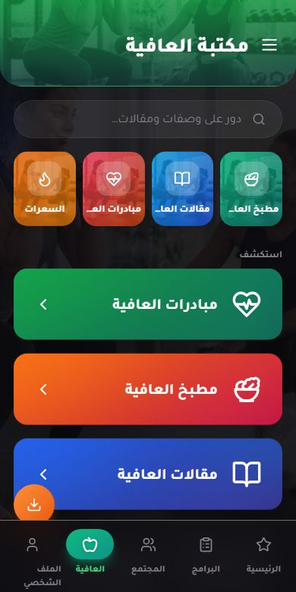
7 / 8
Wellness library in Arabic
120+ health articles, hand-written Arabic
90+ healthy recipes with macros
Sleep, stress, sugar, joints
Curated short videos
pulse.geddo.online

Slide 9
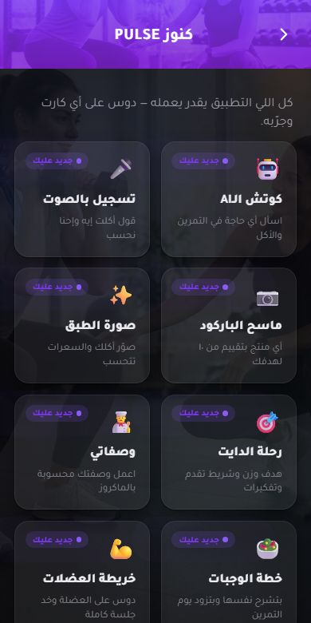
8 / 8
And a whole treasure chest more
AI coach answering in Egyptian Arabic
Weekly leagues, 1v1 duels, challenges
Community feed, buddies and cheering
Web push + email re-engagement
pulse.geddo.online

Slide 10
All of it. Free.
No card, no subscription — installs from the browser as an app
pulse.geddo.online

