Slide 1
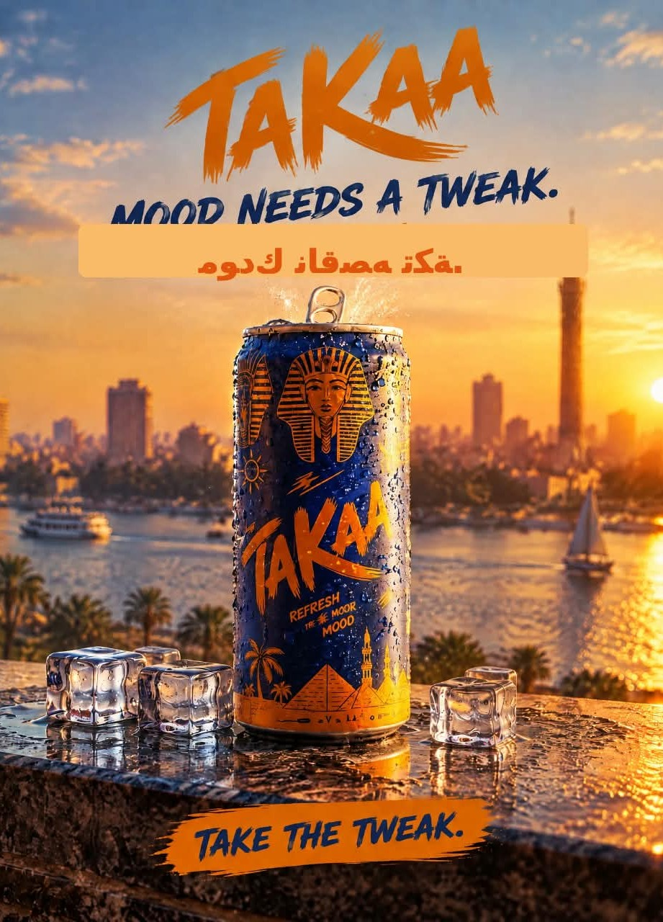
ENERGY DRINK · EGYPTIAN LIFESTYLE BRAND
TAKAA
Your mood needs
a tweak.
Take the Tweak.
Created by Mohamed Mostafa Taher
TAKE THE TWEAK • TAKE THE TWEAK • TAKE THE TWEAK • TAKE THE TWEAK • TAKE THE TWEAK • TAKE THE TWEAK
Notes:
Opening line: your mood needs a tweak, not a reset.

Slide 2
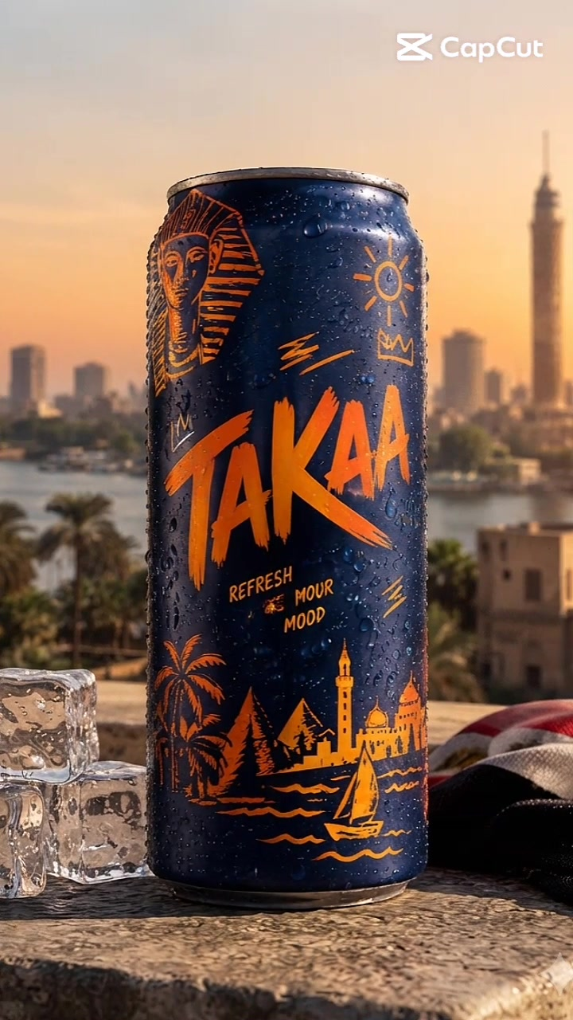
Concept brand by Mohamed
WHO IS TAKAA?
Your mood doesn't need a reset.
Just a tweak.
THE IDEA
A concept Egyptian energy-drink brand built on one idea: small tweaks, big mood shifts.
THE VIBE
Pyramids, felucca boats and the Cairo skyline at golden hour. Ice and condensation for a cold-refresh feel.
THE LOOK
Deep navy + warm orange. A hand-drawn logotype that sounds like the brand: young, loud, fast.

Slide 3
S
THE PLAN: SOSTAC
Six steps from idea to results.
S
S
A
O
T
C
SITUATION
STRATEGY
ACTION
OBJECTIVES
TACTICS
CONTROL
Where are we now?
How do we get there?
The plan to execute it
Where do we want to be?
The details of the strategy
How we measure and adjust
SOSTAC® is a planning framework by PR Smith. Market data checked October 2026.

Slide 4
S
SITUATION
S
Egypt's energy-drink shelf is crowded, price-sensitive and shifting.
~4.9×
14.5%
23.9M
$2.61B
Red Bull vs Sting shelf price per 250 ml can: EGP 55.99 vs EGP 11.50
Annual urban inflation in Egypt, August 2026. Shoppers watch every pound
Instagram users in Egypt, June 2026. The biggest group is aged 18–24
Middle East energy-drink market in 2026, growing about 5% a year
So what? A price-squeezed market and a young, Instagram-first audience: a new brand wins on story and identity, not on price or scale.
Sources: Carrefour Egypt online prices (Oct 2026); CAPMAS via Trading Economics (Aug 2026); NapoleonCat (Jun 2026); Mordor Intelligence (2026).
S
O
S
T
A
C

Slide 5
S
SITUATION
S
Competitors: strong brands, but none owns an Egyptian mood.
BRAND | OWNER | WHERE IT STANDS IN EGYPT | TAKAA'S OPENING (OUR READ)
Red Bull | Red Bull GmbH, Austria. Distributed in Egypt by Mansour Group since 2008 | Market leader on most brand KPIs (Sagaci). EGP 55.99 for a 250 ml can online | A global, sports-led voice, not an everyday Egyptian one
Sting | PepsiCo. Launched in Egypt in 2014 | EGP 11.50 for 250 ml. Preference rose from 22% to 57% between early 2022 and Sept 2023 (Sagaci) | Wins on price, says little about identity
Monster | Monster Beverage Corporation, USA | One of the global giants active across the region | Action-sports energy, not daily-life mood
Power Horse | Power Horse Energy Drinks, Austria | Priced above Sting, in the premium tier | Imported feel, little local storytelling
Hype | Hype Energy Drinks | Priced above Sting, in the premium tier | Limited Egyptian cultural link
Sources: Carrefour Egypt online prices (Oct 2026); Sagaci Research (latest public brand-tracker data, Sept 2023); Kenresearch. "Opening" column is our read.
S
O
S
T
A
C

Slide 6
S
SITUATION
S
SWOT: a sharp identity, a small start.
STRENGTHS
WEAKNESSES
• A distinct Egyptian look: navy, orange, Cairo landmarks
• One clear line: "Take the Tweak."
• Content already built: carousel, AI film, CapCut edit
• New concept brand: no awareness or distribution yet
• Cannot match Sting on price or Red Bull on scale
• Starting audience is small
OPPORTUNITIES
THREATS
• Price-sensitive shoppers open to new options
• Retail shelves reshuffled after the 2024 boycotts
• Short-form video is cheap to produce and test
• Sting's price pressure
• Red Bull's brand strength
• Inflation at 14.5% (Aug 2026) squeezes spending
S
O
S
T
A
C

Slide 7
O
OBJECTIVES
O
Objectives: five goals for the first 90 days.
SELL
SERVE
SPEAK
SAVE
SIZZLE
2,000
< 1 hr
500K
Capped
20
first-time trials
average reply time on DMs and comments
video views and 5,000 followers
cost per trial, set before launch
pieces of user-made content
Proposed targets. They are set against a zero-follower start and get validated once real baseline data comes in.
Framework: the 5 Ss (Sell, Serve, Speak, Save, Sizzle).
S
O
S
T
A
C

Slide 8
S
STRATEGY
S
Positioning: the small lift for everyday Egyptian moods.
EGYPTIAN EVERYDAY MOOD ↑
TARGET
TAKAA
Urban Egyptians 18–34: students, office workers and commuters. 18–24 is the biggest Instagram age group in Egypt (8.7M users, Jun 2026).
POSITION
Monster
The mood-tweak drink. A small lift with Egyptian soul, priced between value and premium.
Hype
Sting
Red Bull
PROMISE
Power Horse
PRICE →
"Refresh the mood, not the whole day."
Illustrative map, our read
S
O
S
T
A
C

Slide 9
S
STRATEGY
S
Content strategy: the foundation under every post.
TARGET AUDIENCE
POSITIONING
NARRATIVE
Urban Egyptians 18–34 with daily mood dips: tired mornings, traffic, deadlines.
The mood-tweak drink: a small lift, Egyptian soul, mid-priced.
Same day. New mood. A relatable dip, then one switch.
CONTENT PILLARS
MANIFESTO
Mood Moments
Cairo Golden Hour
The Switch
Behind the Tweak
"We don't reset your day. We tweak your mood."
Framework adapted from the Content Marketing series by @learnwithmazen1.
S
O
S
T
A
C

Slide 10
T
TACTICS
T
Content plan: what, where and when.
OBJECTIVES
CHANNEL
FORMATS
DISTRIBUTION
Awareness first, then first-time trials (slide 7).
Instagram first (23.9M users in Egypt), plus TikTok and Pinterest.
8-slide carousels, a 50-sec AI film, 17-sec CapCut Reels, stories.
4 organic posts a week, plus paid boosts on the best 3-second holds.
REPURPOSING
BUDGET
TIMELINE
One film becomes three 15-sec cuts, stills for carousels and Pinterest pins.
Proposed split on slide 16.
12 weeks: foundation, launch, scale (slide 15).
Framework adapted from the Content Marketing series by @learnwithmazen1.
S
O
S
T
A
C

Slide 11
T
TACTICS
T
Content creation: six steps, already tested on TAKAA.
1
2
3
4
5
6
Research
Ideation
Copywriting
Design & video
Optimization
Feedback & review
Pinterest, Reels and TikTok trend scan
"5 Signs Your Mood Needs a Tweak"
"Take the Tweak." and one clear CTA
Carousel, AI film and CapCut edit
Test one hook at a time, keep the 3-sec winners
Comments and DMs shape the next batch
Framework adapted from the Content Marketing series by @learnwithmazen1.
S
O
S
T
A
C

Slide 12
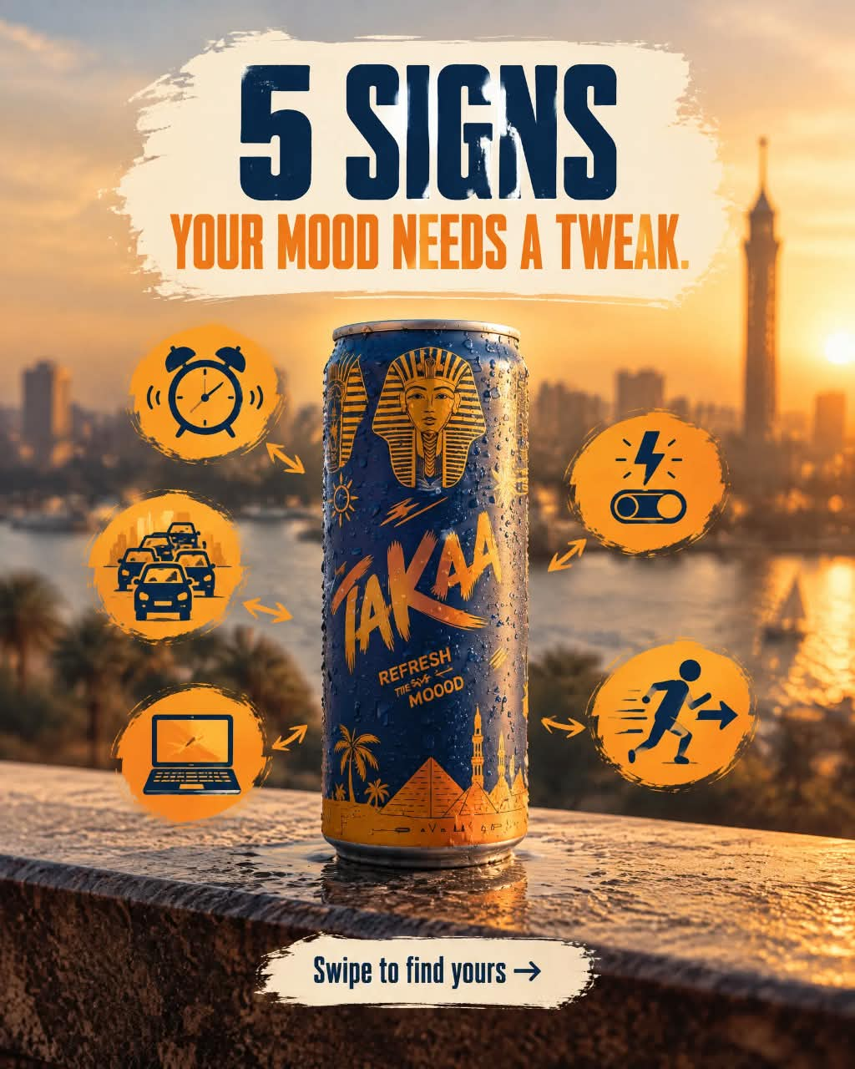
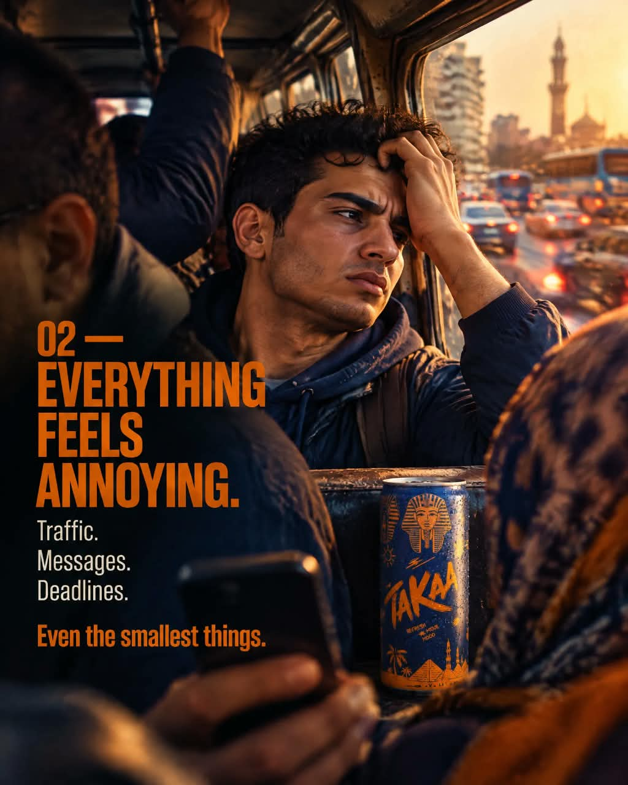
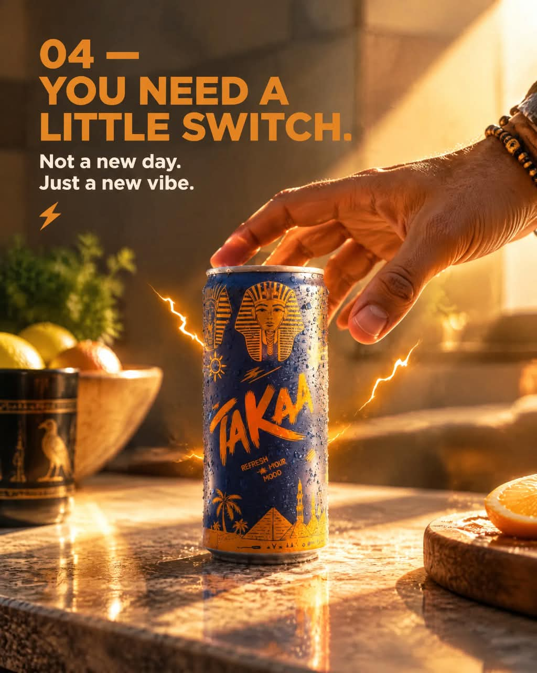
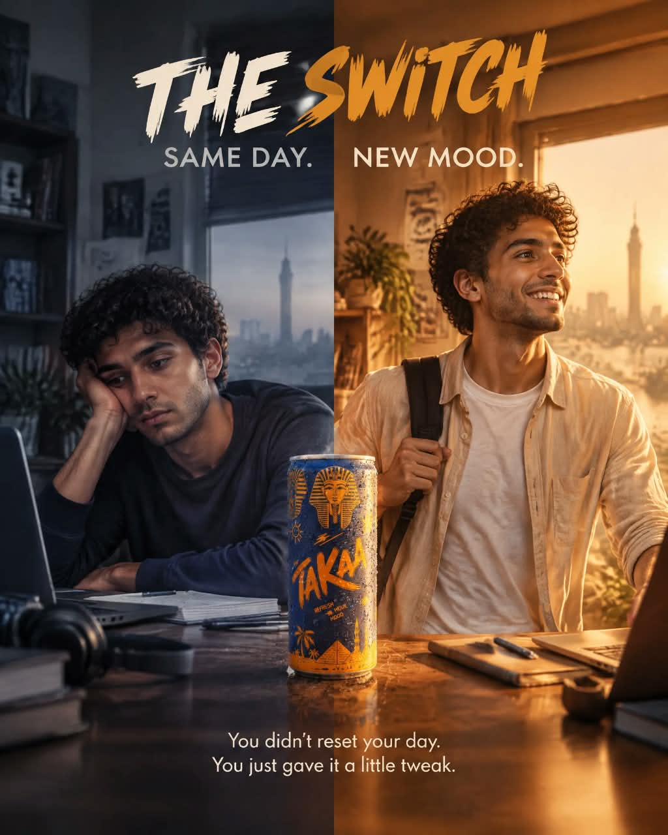
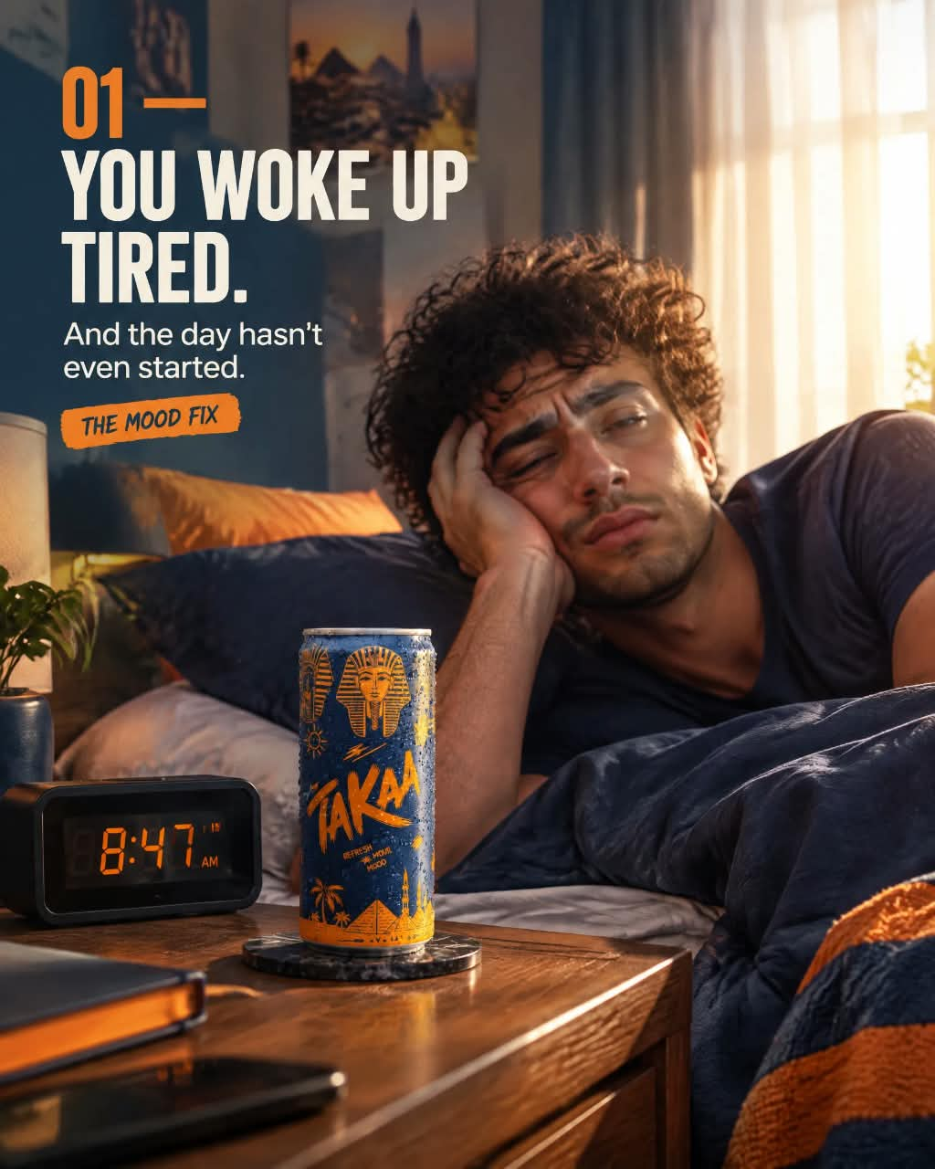
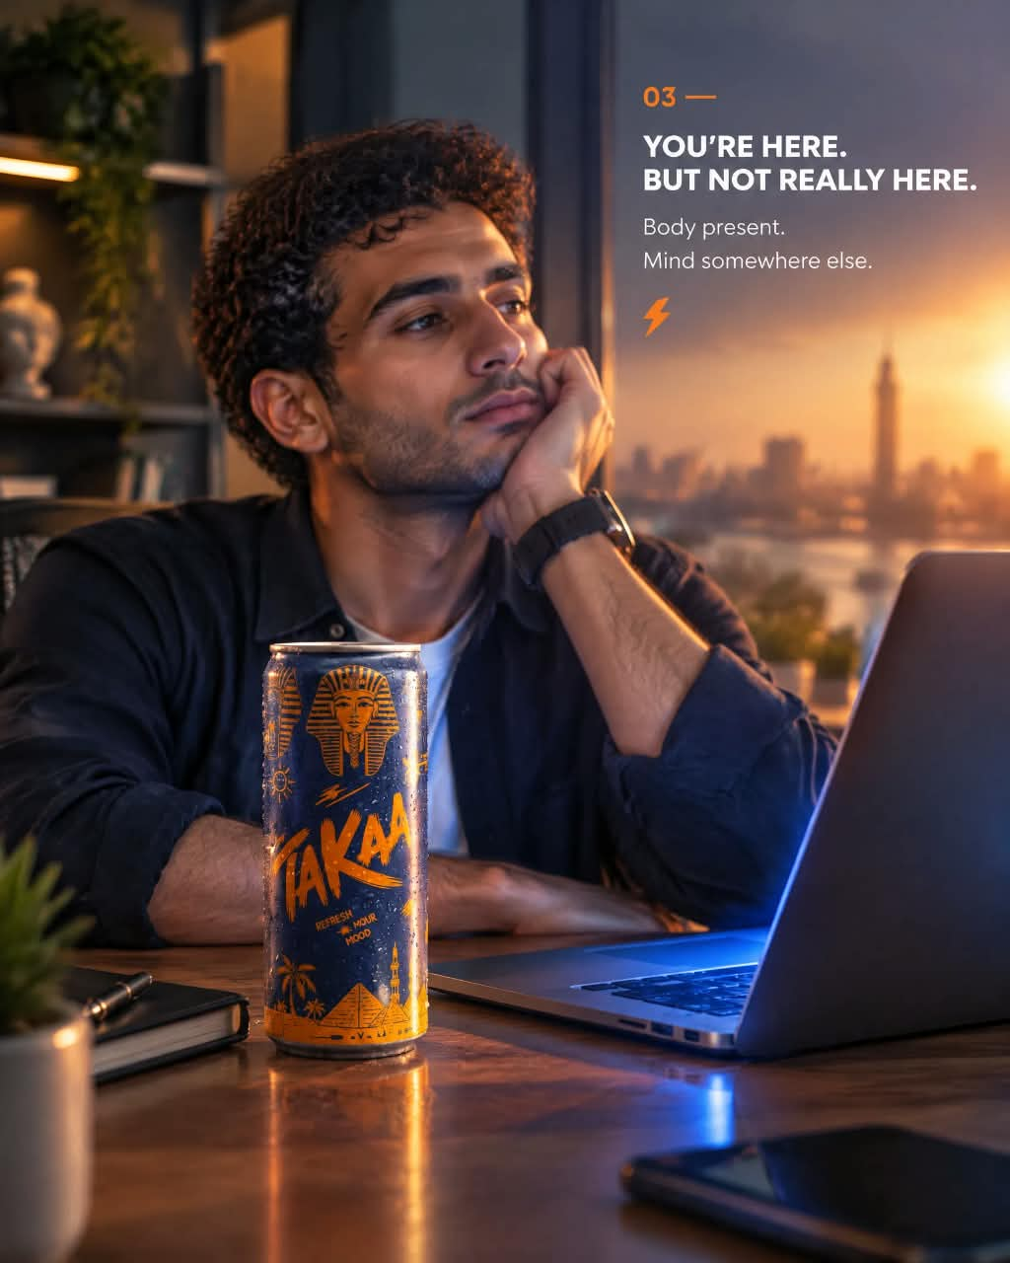
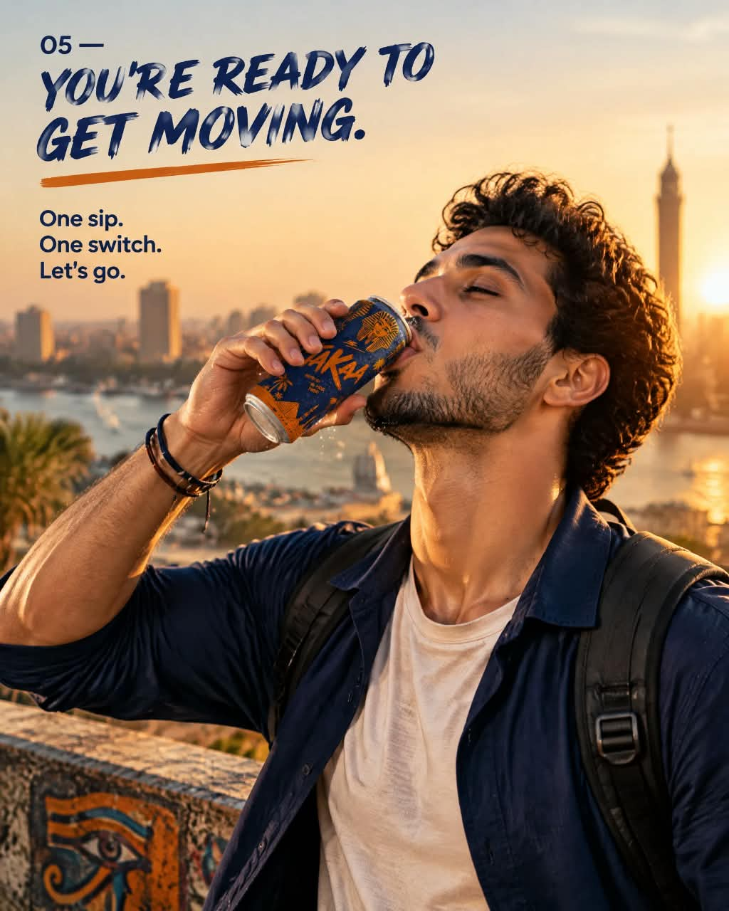
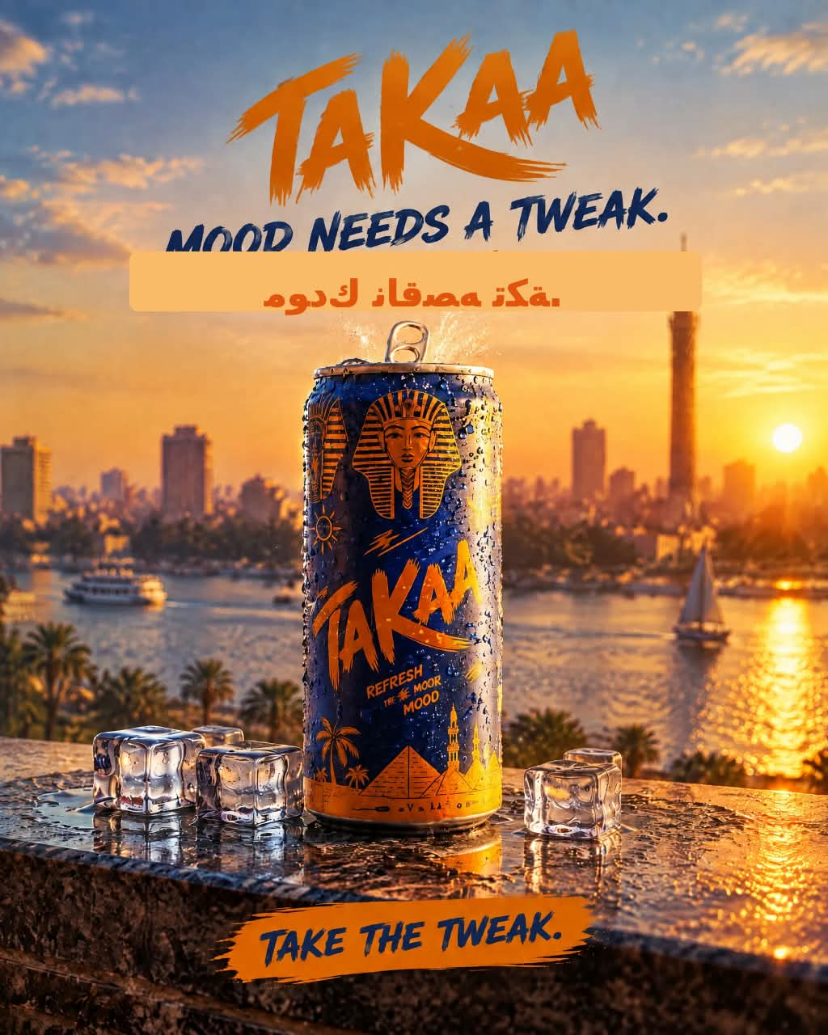
5 SIGNS YOUR MOOD NEEDS A TWEAK
An 8-slide carousel · live on Instagram
You woke up tired
Everything is annoying
Here, but not really
Need a little switch
Ready to move
THE SWITCH: same day. new mood.
View the live post →
1080×1350 · Canva + AI visuals · one navy/orange grade
S
O
S
T
A
C

Slide 13

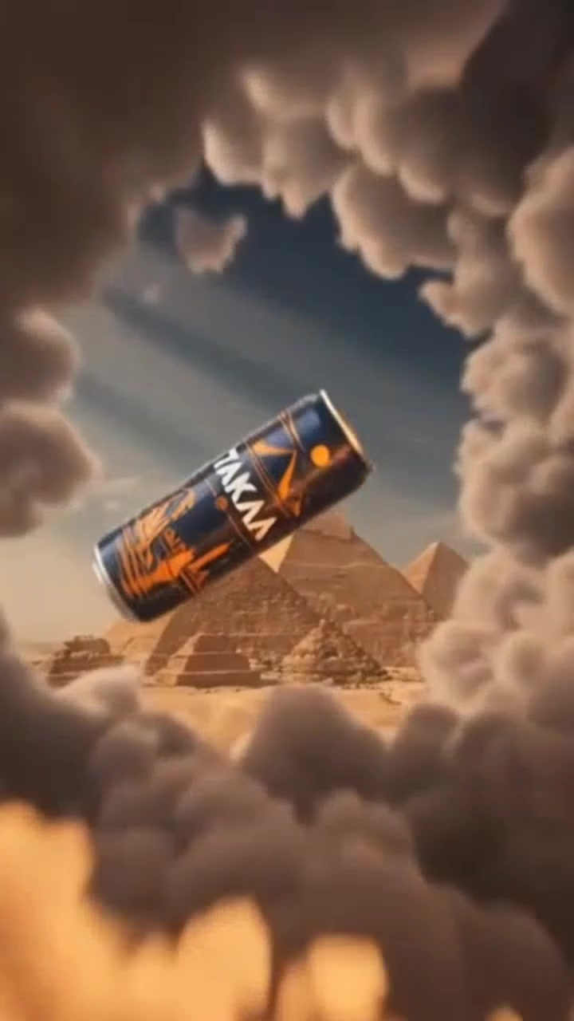
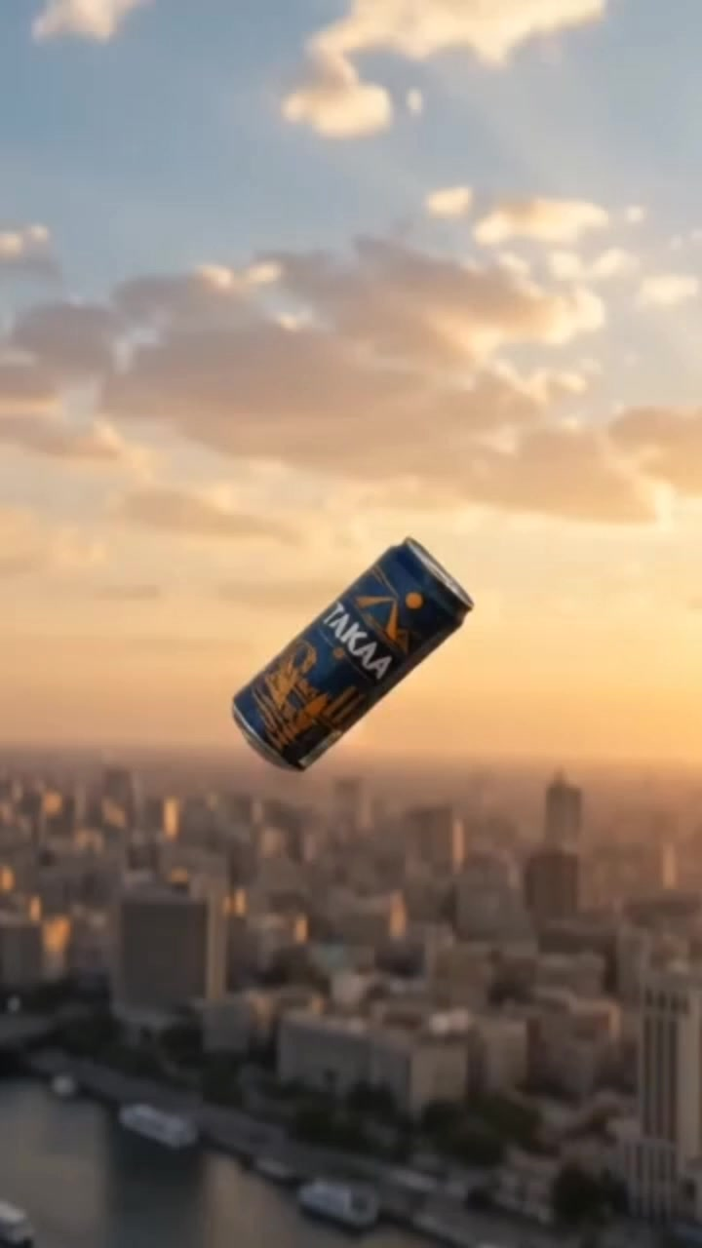
AI COMMERCIAL
One can.
All of Cairo.
The can floats past the skyline, the pyramids and the Nile, then lands in a golden-hour splash. It closes on the logo card and tagline.
Pinterest
Product floats through scenery
Reels
Golden-hour rooftop reveals
TikTok
Whoosh cuts: landmark to product
▶ WATCH THE FILM · 9:16 · 50 SEC

Slide 14
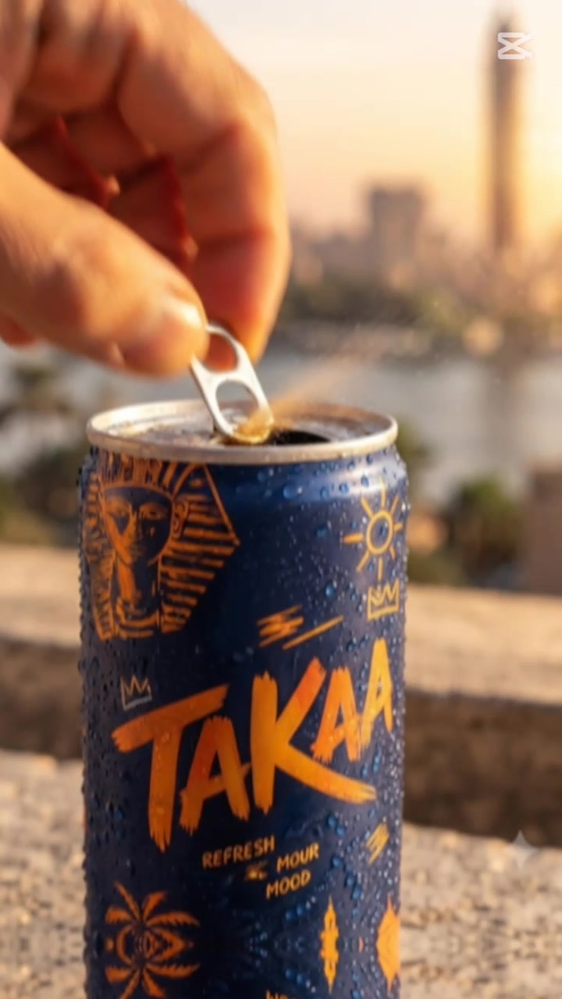
CAPCUT TEMPLATE
A trending template.
A TAKAA edit.
We picked a viral product pop-reveal template and kept its rhythm: snap zooms and the can-opening beat.
1
Swapped the stock product for the real TAKAA can and label.
2
Cairo rooftop at sunset replaces the generic backdrop.
3
Added ice and condensation for the cold-refresh look.
Take the Tweak.
S
O
S
T
A
C

Slide 15
A
ACTION
A
Action: a 12-week roadmap.
FOUNDATION
LAUNCH
SCALE
W1
W2
W3
W4
W5
W6
W7
W8
W9
W10
W11
W12
Foundation: page, identity, content bank
Content production
Organic launch: 4 posts a week
Paid boosts on top performers
Creators and UGC seeding
Review and scale winners
S
O
S
T
A
C

Slide 16
A
ACTION
A
Budget: where the money goes.
Paid social
40%
Boosts on the best organic posts, plus retargeting
Production
30%
AI film, carousels and CapCut edits
100%
Creators & UGC
15%
Seeding with micro-creators
Sampling & events
10%
Trial packs at campuses and offices
Contingency
5%
Room to react to what the data says
Proposed split. Amounts are set once the real budget is confirmed.
S
O
S
T
A
C

Slide 17
C
CONTROL
C
Control: what we track, and what we do about it.
3-SEC HOLD RATE
ENGAGEMENT RATE
VIDEO VIEWS
35%+
4%+
500K
Do people stop scrolling?
Likes, comments, saves, shares
Awareness
FOLLOWERS
COST PER TRIAL
FIRST TRIALS
5,000
Capped
2,000
Audience built
Efficiency of paid spend
The sales signal
Every week: test one variable, scale the winners, pause the losers, brief the next batch.
All targets are proposed and get validated against real baseline data. Sources: Instagram Insights, TikTok Analytics.
S
O
S
T
A
C

Slide 18
TAKE THE
TWEAK.
Mohamed Mostafa Taher
Creative Marketing · Digital Marketing × AI Creativity
Page
instagram.com/mohamedostafa5
Carousel
instagram.com/p/DdHJzz-jGrm
TAKE THE TWEAK • TAKE THE TWEAK • TAKE THE TWEAK • TAKE THE TWEAK • TAKE THE TWEAK • TAKE THE TWEAK

