Slide 1
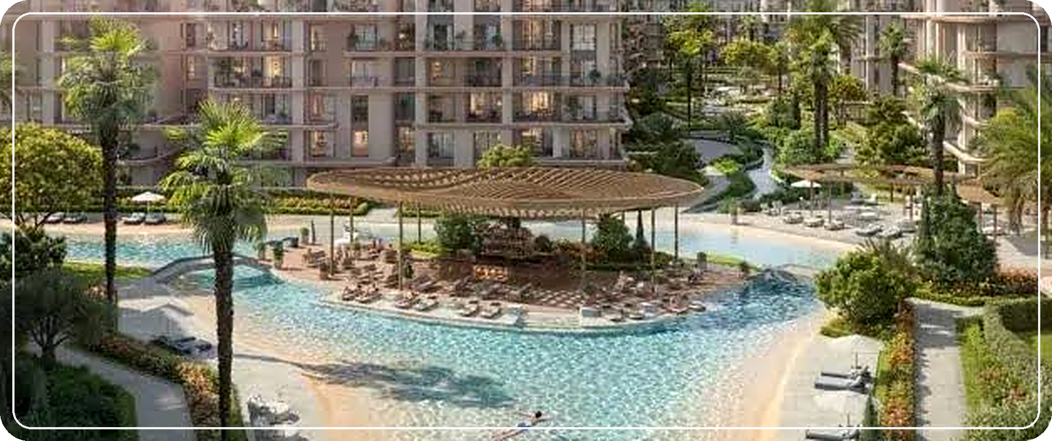
MT
MOHAMED MOSTAFA TAHER SALEM
CREATIVE MARKETER
The Lakes
Live around water.
THE LAKES | SODIC EAST
ILLUSTRATIVE RENDER
عيش على الميّه
SODIC East | Full marketing & creative plan
October 2026
CONCEPT PLAN - NOT COMMISSIONED

Slide 2
The offer in four numbers.
02 EXECUTIVE SUMMARY
1.5%
10 yrs
50,000
6.7M
Down payment
Installments
EOI (EGP)
1 Bed, starting from
UPDATE
OPPORTUNITY
The plan now uses the 1.5% down payment (the earlier sales kit text said 0%).
A swimmable lagoon (3,000 m2), a big sports club and working LRT and monorail nearby.
CHALLENGE
STRATEGY
Talala (Madinet Masr) sells fully finished units in the same area. The Lakes is Flexi Plus.
Lead with the water lifestyle, close with the 1.5% start, and move every lead to WhatsApp.

Slide 3
The numbers behind the offer.
03 THE NUMBERS
Unit type | Starting price | 1.5% down | Monthly (illustr.) | Size band m2 | EGP per m2 (indic.)
1 Bed | 6.7M | 100.5k | 55.0k | 60-82 | 82-112k
2 Bed | 10.9M | 163.5k | 89.5k | 121-130 | 84-90k
2 Bed + Nanny | 11.2M | 168.0k | 91.9k | 120-133 | 84-93k
3 Bed | 13.2M | 198.0k | 108.3k | 147-155 | 85-90k
3 Bed + Nanny | 14.1M | 211.5k | 115.7k | 153-164 | 86-92k
3 Bed Duplex | 17.7M | 265.5k | 145.3k | 148-209 | 85-120k
4 Bed + Nanny | 17.5M | 262.5k | 143.6k | 166-199 | 88-105k
Illustrative math: 98.5% paid in 120 equal installments, no interest or escalation. The real schedule and EOI treatment come from the developer. Per-m2 uses the unit-size band from the floor plans.

Slide 4
What the sales kit confirms.
04 PROJECT FACTS
SODIC East master plan and The Lakes phase.
655 feddan
6,000 units
3,000 m2
9,000 m2
SODIC East master plan
20,000 residents expected
Swimmable lagoon, sandy shore
Total water features
18%
110K m2
+90%
100%
Footprint
Commercial area
Units with water-feature views
Units with green, open views

Slide 5

Between two main roads. On the rail map.
05 LOCATION & TRANSPORT
10 min
30 min
35 min
35 min
LRT station
Monorail station
Cairo airport
90th Street
Distances are from the sales kit. Between Suez Road and Ismailia Road, next to El Shorouk.
LRT is operating (first phase opened 2022) and serves El Shorouk and New Heliopolis.
East Nile Monorail: passenger service started 6 May 2026; the full 22-station line opened 27 June 2026.
The nearby metro line is still planned.

Slide 6
Who else is selling nearby.
06 COMPETITOR MAP
Official: Zawya, Daily News Egypt. Broker figures (Enjaz, Bayut, Nawy, realestate-capsule) change often.
Project | Developer | Area | What is known
The Lakes | SODIC | New Heliopolis | 1.5% down, 10 yrs, EOI 50K, Flexi Plus, lagoon 3,000 m2
Talala | Madinet Masr | New Heliopolis | 491 feddan, 4,174 fully finished units in phase 1 (official). Brokers: 5% down, 2 Bed 8.9-12.7M
Mayan El Shorouk | STM | El Shorouk | Broker: 2 Bed from 5.7M, 10% down, 10 yrs
Sarai | Madinet Masr | New Cairo | Lagoon of 50,000 m2 (Nawy)
Hyde Park / iCity | Hyde Park / Mountain View | New Cairo | Crystal lagoon and beach park concepts (listings)

Slide 7
The Lakes vs Talala.
07 HEAD TO HEAD
Talala is the closest rival by location and price band. Broker data is marked.
Factor | The Lakes (SODIC) | Talala (Madinet Masr)
Down payment | 1.5% | 5% (brokers)
Finishing | Flexi Plus: core works done, owner finishes | Fully finished (official)
Scale | Phase of about 65 feddan (broker) | 491 feddan, 4,174 units in phase 1
Entry price | 1 Bed from 6.7M | 1 Bed 4.1M-9.3M (broker, Feb 2026)
Delivery | 2030 (brokers; confirm) | Within 4.5 years of Aug 2025 launch (official)
Hero feature | Swimmable lagoon, island cafe, sports club | Large integrated community

Slide 8
Strengths, gaps, openings, threats.
08 SWOT
STRENGTHS
WEAKNESSES
SODIC brand
Swimmable lagoon
1.5% down
Club
Sasaki master plan, EDSA lagoon design
Not delivered yet (2030 per brokers)
Owner pays finishing, AC and heaters
Price above finished rivals
OPPORTUNITIES
THREATS
LRT and monorail working
Long-installment demand
Strong video content on a small budget
Talala scale
Other lagoons
Real estate ad rules
Price changes

Slide 9
Four buyers to test.
09 AUDIENCE HYPOTHESES
Hypotheses from the unit mix. Validate with ad and WhatsApp data.
01
02
03
04
First-home couple
Remote-working pair
Growing family
Garden and terrace lover
1 Bed, about 55K/month (illustr.). Message: start with 1.5%.
2 Bed, about 89K/month. Reading nook and working pod.
3 Bed + Nanny, about 116K/month. Club, school nearby, kids areas.
Ground-floor garden 39-108 m2 or top-floor terrace up to 100 m2.

Slide 10
Three routes. One big idea.
10 CREATIVE PLATFORM
LEAD ROUTE
SUPPORT
CONVERT
A
B
C
A Day on the Water
Your Terrace, Your View
Start with 1.5%
يوم كامل على الميّه
تراسك على المنظر
ابدأ بـ ‎1.5%‎ بس
Dawn terrace, lagoon, work pod, club, island cafe, lit path. Brand film and reel series.
Every unit has a terrace (kit). POV videos "from my terrace". Great for retargeting.
Payment-led carousels and calculators. Must show finishing costs to stay honest.

Slide 11
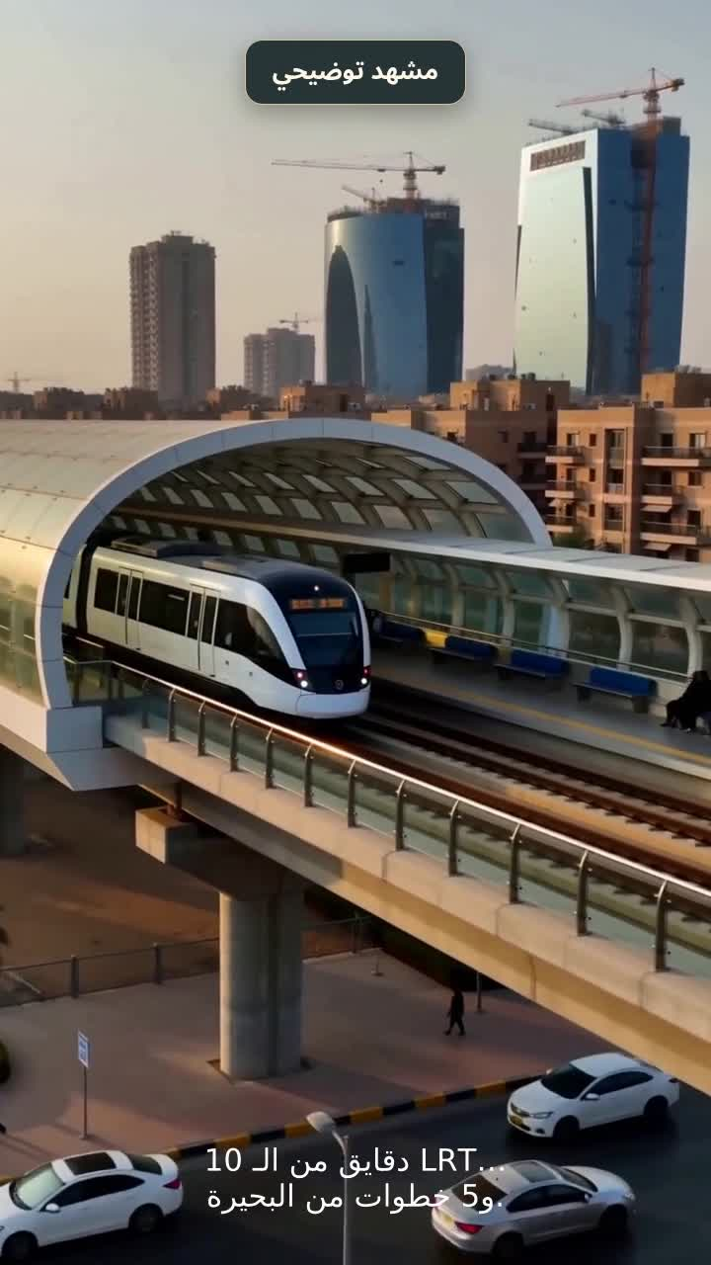
A Day on the Water.
11 HERO FILM, 60 SECONDS
Six beats. Every claim comes from the sales kit.
0-5s
Dawn
Coffee on the terrace. Hook: "Your morning starts on the water."
5-20s
Lagoon
3,000 m2 swimmable lagoon, sandy shore, island cafe.
20-35s
Calm
Reading nook, working pod, walking paths.
35-45s
Reach
Sports club close by. 10 min to the LRT station.
45-55s
Offer
From 6.7M, 1.5% down, 10 years.
55-60s
CTA
Comment LAKES. Disclaimer on screen.

Slide 12






Content that repeats.
12 SOCIAL-FIRST SERIES
Series are easier to produce than one-offs and train the audience to return.
Lagoon Diaries
Unit Walkthrough
Numbers Explained
15s daily moments on the water.
60s tour per unit type.
What 1.5% down means in EGP.
Neighbourhood Check
Flexi Plus Explained
Ask the Planner
LRT, monorail, roads, club.
What is included and what is not.
Short Q&A reels.

Slide 13
Persona, hook, format.
13 AD CREATIVE MATRIX
Test one variable at a time. Winner = highest 3-second hold rate, then lowest cost per qualified lead.
Persona | Hook | Format | CTA
First-home couple | "1 Bed from 6.7M. Start with 1.5%." | Carousel + reel | Comment LAKES
Remote workers | "A corner to work. A corner to read." | Reel | WhatsApp
Family | "Club, kids areas, school nearby." | 60s film | Book a viewing
Garden / terrace | "A garden up to 108 m2." | Photo + reel | Send me the plans

Slide 14
Eight scenes to generate.
14 AI VIDEO SHOT LIST
Keep Terrano style: terracotta, curved balconies, 5 floors. Mark every AI scene "illustrative".
1
Lagoon aerial
2
Island cafe
3
Terrace POV
4
Private garden
Turquoise swimmable lagoon, sandy shore, golden hour.
Wooden decks, pavilion, soft light.
Morning coffee, green water garden view.
Ground floor garden meets water channel.
5
Family path
6
Quiet corner
7
Lobby
8
Night
Walking and cycling, no cars in frame.
Reading nook and working pod.
Residents lounge, warm wood and stone.
Buildings reflected in the lagoon.

Slide 15

From first view to EOI.
15 FUNNEL & WHATSAPP FLOW
Awareness
Reels and film
WHATSAPP SCRIPT
1. Welcome: "Welcome to The Lakes. How many bedrooms do you need?"
2. Qualify: budget, unit type, garden or terrace, viewing date.
3. Send: prices "starting from", 1.5% down, 10 years, finishing note.
4. Follow up: 24 hours, then 3 days.
5. Close: explain EOI terms. No fake urgency.
Consideration
Carousels, walkthroughs
Lead
WhatsApp conversation
EOI
Viewing, then 50,000 EGP

Slide 16
Where the budget goes (proposal).
16 MEDIA PLAN
Meta 50%
Click-to-WhatsApp and lead forms. Main source of leads.
TikTok & YouTube 15%
Reach for the series content.
Retargeting 10%
Video viewers, WhatsApp openers, site visitors.
Production 15%
AI scenes and editing.
Test reserve 10%
10% for what wins in week 2.
The total budget comes from the client. Percentages are a starting hypothesis.

Slide 17
From launch to viewings.
17 FOUR-WEEK PLAN
1
2
3
4
WEEK 1
WEEK 2
WEEK 3
WEEK 4
Awareness
Interest
Consideration
Conversion
Hero film, lagoon reel, "8 numbers" carousel, test 3 hooks.
Persona carousels, terrace POV, start Click-to-WhatsApp.
Flexi Plus explained, club video, retargeting.
Day-on-the-water film, numbers reel, viewing offer.

Slide 18
What we measure.
18 KPIS & TARGETS
Targets are set after a 2-week baseline. Starting hypotheses only.
KPI | Why it matters | Starting rule
3-second hold rate | Hook strength | Under 30%: change the hook
CTR | Ad appeal | Under 1%: change image or text
Cost per WhatsApp lead | Spend efficiency | Compare across ads weekly
Qualified lead % | Lead quality | Low: tighten targeting and questions
First response time | Sales speed | Over 1 hour: add auto-reply
Viewings and EOI | Real outcome | The campaign goal

Slide 19

Say it right.
19 COMPLIANCE
Say "starting from"
Prices change. Never "fixed price".
1
Say "views of water features"
Not "all units on the water".
2
Real estate ads are checked. Accuracy protects the brand.
Say "Flexi Plus: you choose finishing"
Not "fully finished". AC, heaters, kitchen units and sanitary ware are not included.
3
Say "planned" for the metro
LRT and monorail are operating; the metro line is planned.
4
Add the disclaimer
Images are illustrative. SODIC reserves the right to make alterations. Never promise returns.
5

Slide 20
What to confirm first.
20 RISKS & OPEN QUESTIONS
Item | Why it matters | Action
Down payment 1.5% | The kit text said 0% | Confirm the final plan and its date
EOI terms (50,000 EGP) | Deducted? Refundable? | Get the written terms
Delivery date | Brokers say 2030 | Official date per building
Club membership | Included or paid? | Ask the developer
Maintenance fees | Part of total cost | Get the figure
Image rights | Use of renders and maps | Written approval

Slide 21
Where the facts come from.
21 RESEARCH SOURCES
SODIC "The Lakes - Sales Kit": project facts, areas, finishing, distances.
Zawya and Daily News Egypt (Aug 2025): Talala launch figures.
1
2
Alstom press release (6 May 2026) and Ahram Online (26 June 2026): monorail.
Wikipedia and Egypt Independent: Cairo LRT.
3
4
Property Finder, Siva Properties, Enjaz, Bayut, Nawy: broker data (delivery, down payment, rival prices). Not official; checked 11 Oct 2026.
Your own numbers (1.5% down, 10 years, EOI 50,000, price list) were used for the offer slides.
5
6

Slide 22




MT
PREPARED BY
Mohamed Mostafa Taher Salem
Ideas into impact.
Let's talk about the next brief.
mohamedostafataher@gmail.com
WhatsApp +20 111 009 5403
mohamedmostafa-one.vercel.app
youtube.com/@mohamedmostafacreative
Instagram @mohamedostafa5

