Slide 1

ASSIGNMENT 12
Facebook Page Creation
& Optimization
وش جديد مصطفي للأثاث والتنجيد
Mohamed Mostafa Taher Salem
Student ID: 21172333

Slide 2

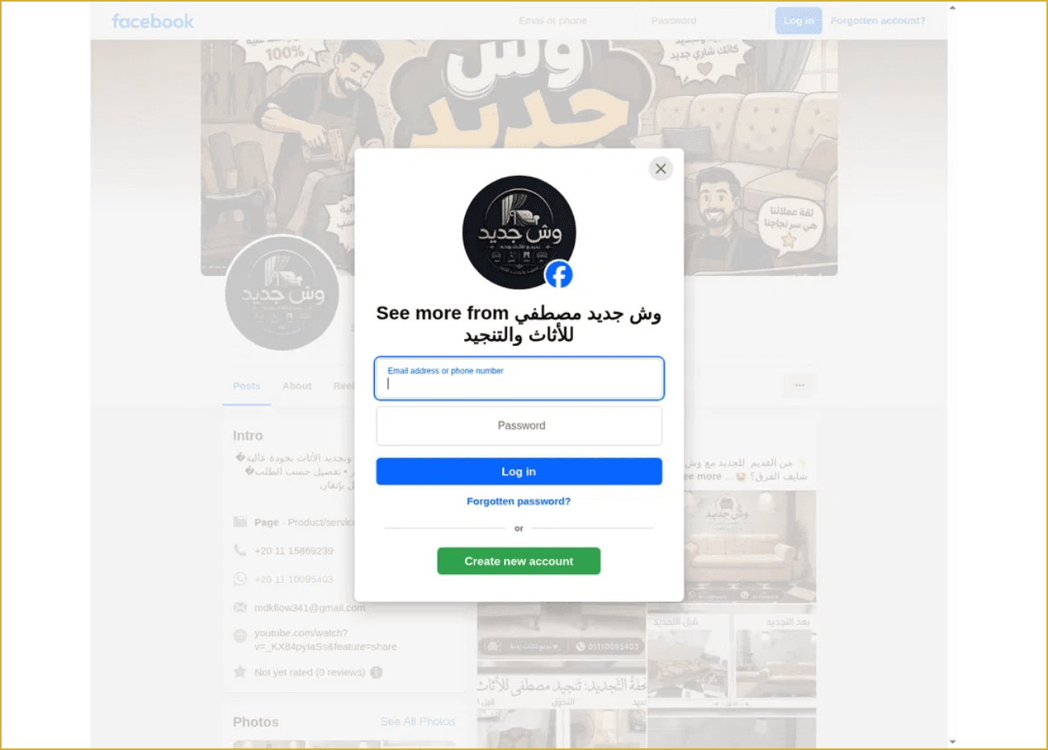
Facebook Page Details & Assignment Evidence
Page name
وش جديد مصطفي للأثاث والتنجيد
Category & audience
Product/service · 520 followers · 16 following
Services
انتريهات، ركن، ستائر، تفصيل حسب الطلب
Contact details
+20 11 15869239
+20 11 10095403
mdkflow341@gmail.com
Page status
Visible portfolio photos, YouTube link, and “Not yet
rated (0 reviews)”.

Slide 3

Assignment Summary & Page Link
وش جديد مصطفي للأثاث والتنجيد
Clickable Facebook Page Link
Open the Facebook Page
Copy this URL:
https://www.facebook.com/share/1LkCKcGVww/
This assignment documents the creation of a Facebook Page for an upholstery and furniture renovation service. The page includes a business identity, service information, contact channels, portfolio photos, and a public link for customers.
Student: Mohamed Mostafa Taher Salem | ID: 21172333
Category: Product/service
Followers: 520
Contact: Phone + Email

