Slide 1

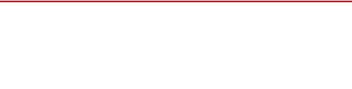
Assignment 5 – Content Strategy
Comprehensive Social Media & Digital Marketing Plan (2024–2025)
Prepared by: Mohamed Mostafa Taher Salem
Student ID: 21172333
Target Market: Egypt | Fashion Retail

Slide 2
SMART Objectives (2024–2025)
Increase Instagram Engagement Rate: Raise engagement from 2.1% to 4.5% within 4 months through interactive Reels, polls, and UGC campaigns.
Boost Website Traffic from Social Media: Expand monthly e-commerce traffic from Facebook & IG by 35% in 6 months using shoppable links and promo offers.
Drive Online Sales Growth: Achieve a 20% increase in online sales during key retail seasons (White Friday, University Back-to-School) in 3 months.
Expand Brand Monthly Reach: Reach 2.5 million unique Egyptian youth per month on TikTok and Instagram within 5 months via viral video trends.
Grow Social Media Follower Base: Gain 100,000 active Egyptian followers on TikTok and Instagram combined over the next 6 months.

Slide 3
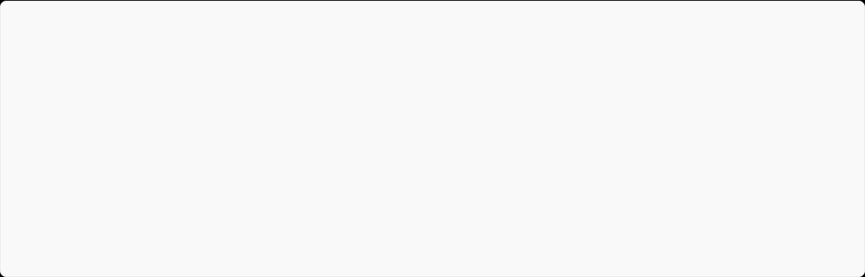




Buyer Persona Card
DEMOGRAPHICS
SHOPPING BEHAVIOR
21 Y/O | Cairo, Egypt
Geography & GIS Student
Limited Monthly Budget
Buys fashion online, tracks discount codes, seeks stylish budget outfits.
PAIN POINTS
GOALS & DESIRES
Tight student budget, needs good material quality, fast delivery & easy returns.
Look trendy at university, find affordable sales, smooth digital shopping experience.
Mohamed Mostafa
PREFERRED PLATFORMS
PREFERRED FORMATS
Target Audience
Instagram, TikTok, Facebook, WhatsApp
Reels, Short Videos, Outfit Ideas, Discounts & Carousels

Slide 4
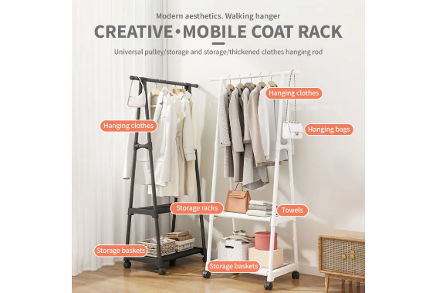
Social Media Content Audit
Visual Identity: High-quality global studio imagery, clean aesthetic, recognizable brand color palette.
Inconsistent Posting (Key Weakness): H&M Egypt frequently suffers from long periods without regular posts, reducing algorithmic visibility and audience engagement.
Posting Frequency: Irregular schedule (0 to 2 posts per week), missing peak Egyptian engagement hours.
Content Types: Heavy reliance on static global catalog photos; lack of localized video content and Egyptian creators.

Slide 5
Competitive Analysis (Egypt Market)
Brand | Frequency | Content Quality | Engagement | Offers & Discounts | Reels & UGC
H&M Egypt | Irregular (1-2/wk) | High (Global) | Moderate | Seasonal Sales | Low (Needs boost)
Zara Egypt | Daily (1-2/day) | Editorial / Premium | High | Minimal | Medium (Minimalist)
LC Waikiki | High (2-3/day) | Commercial / Local | High | Very Heavy Offers | High (Family focus)
Defacto Egypt | Frequent (1-2/day) | Casual / Youth | Moderate-High | Frequent Student Deals | High (TikTok Reels)
Mango Egypt | Moderate (3-4/wk) | Premium Fashion | Moderate | Mid-Season Sales | Moderate (Influencers)

Slide 6

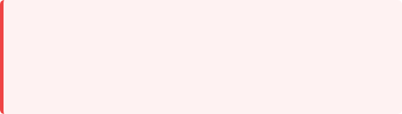
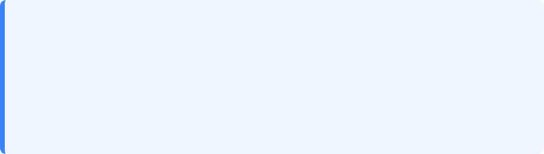

Digital Marketing SWOT Analysis
Strengths
Weaknesses
▪
Strong global brand equity and recognition.
▪
Inconsistent local posting schedule.
▪
Established e-commerce site & mobile app in Egypt.
▪
Limited hyper-local Egyptian dialect content.
▪
Wide range of sustainable & affordable fashion.
▪
Slower adaptation to rapid TikTok fashion trends.
Opportunities
Threats
▪
Growing online shopping adoption among university students.
▪
Aggressive digital promotional pricing by LC Waikiki & Defacto.
▪
Leveraging micro-influencer haul and styling Reels.
▪
Local Egyptian fast-fashion brands gaining popularity.
▪
Dedicated student discounts & back-to-university deals.
▪
Macroeconomic currency fluctuations impacting purchasing power.

Slide 7
Content Gap Analysis
Student Offers & Bundles: Lack of targeted campaigns addressing university students with budget-friendly outfit packages.
User-Generated Content (UGC): Absence of re-posted authentic customer reviews, outfit try-on hauls, and student street style.
Fashion Education & Styling Tips: Opportunity to create "How-to-Style 1 Piece in 3 Ways" short-form video reels.
Behind The Scenes (BTS): Missing human touch showing store launches, photo shoots, and sustainability initiatives.
Localized Seasonal Campaigns: Need stronger focus on key Egyptian cultural moments (Ramadan, White Friday, Summer Coast, University Start).

Slide 8
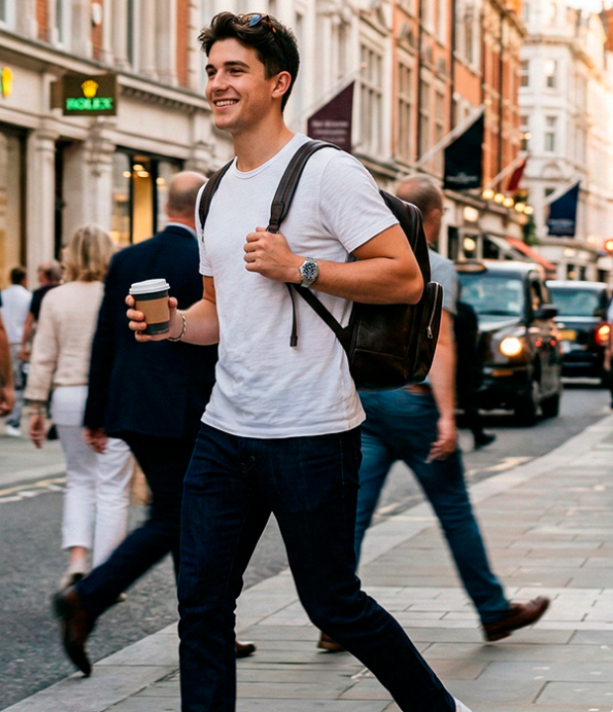
Content Direction
Tone of Voice & Audience
Tone of Voice: Friendly, Fashionable, Modern, Youthful, and Approachable. Uses a blend of modern English & conversational Egyptian Arabic.
Target Audience: Egyptian Youth, University Students, and Young Professionals looking for trendy, affordable, everyday looks.
Core Objective: Make H&M Egypt the top choice for daily university outfits and effortless budget street fashion.

Slide 9
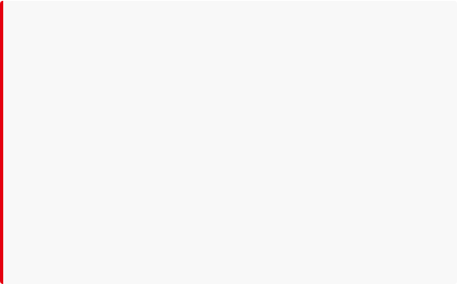
Key Messages & Themes
Key Brand Messages
Core Content Themes
Affordable Fashion: High style without breaking student budgets.
University Look: Smart-casual mix-and-match fashion.
Daily Outfit: Quick inspo for classes and hangout routines.
Quality & Comfort: Durable fabrics made for everyday busy campus life.
Weekend & Office: Versatile outfits for internships & weekends.
Sustainability: Fashion-forward choices that care for the planet.
Seasonal Collections: Ramadan, Summer, and White Friday specials.
Student-Friendly: Exclusive discounts & hassle-free online returns.

Slide 10









5 Core Content Pillars
1. Products
2. Offers
3. Lifestyle
4. Fashion Edu
5. Community
Highlighting new arrivals, seasonal collections, and wardrobe essentials for men & women.
Promoting flash sales, student promo codes, seasonal discounts, and White Friday deals.
Showing outfits in real life: university coffee breaks, weekend hangouts, and summer trips.
Styling tips, color matching guides, capsule wardrobe ideas, and clothing care hacks.
Sharing customer UGC, student influencer hauls, polls, and interactive Q&A sessions.

Slide 11

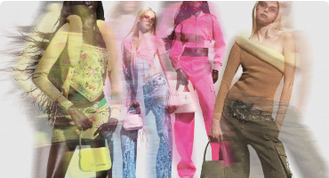
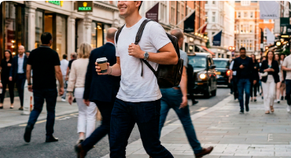
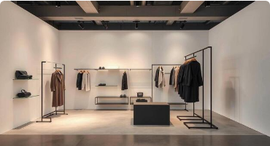
Recommended Content Formats
Reels & TikToks
IG Carousels
UGC & Influencers
Short, fast-paced videos with trending audio showing outfit transitions, hauls, and student budget styling tips.
Multi-slide guides such as "5 University Outfits Under 1500 EGP" driving higher save and share metrics.
Authentic reviews by local Egyptian micro-influencers and interactive daily Instagram Stories with swipe links.

Slide 12
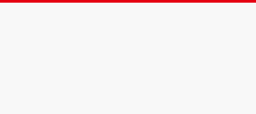
Strategy Conclusion & Action Plan
Unlocking growth for H&M Egypt through consistent, youth-focused content execution.
1. Posting Consistency
2. Video-First Approach
3. Egyptian Creator UGC
Establish a strict 5x weekly schedule to solve algorithmic invisibility and maintain audience retention.
Prioritize short-form Reels and TikTok content targeting university lifestyle & student budgets.
Partner with local university micro-influencers for authentic try-on hauls and relatable styling.

