Slide 1

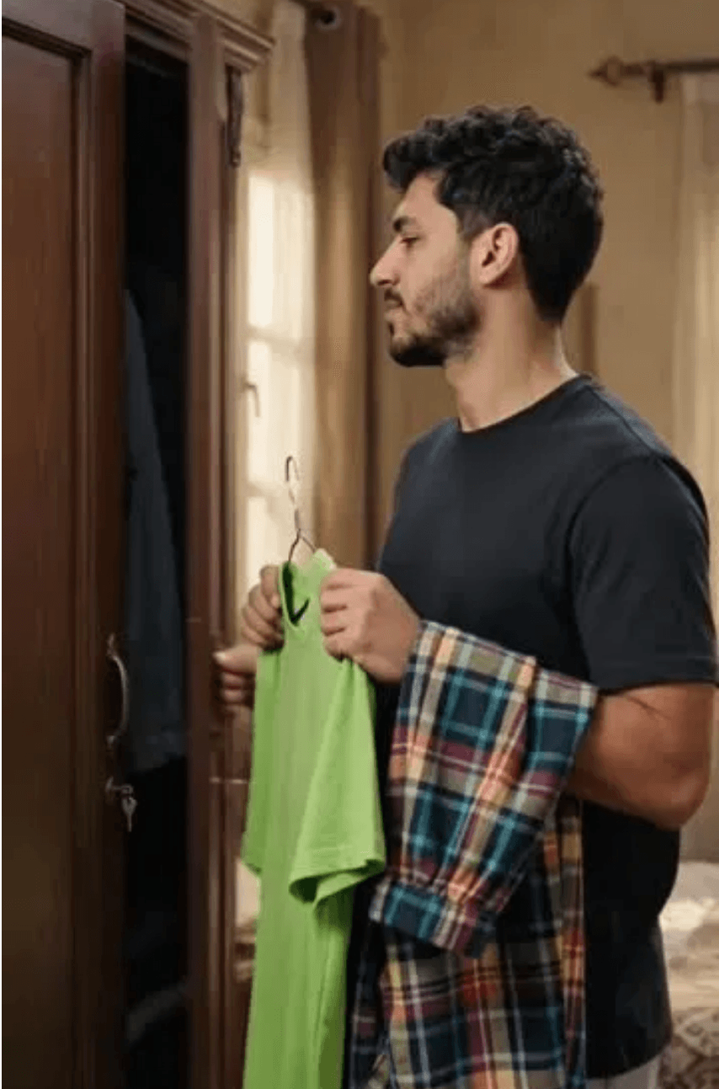
ASSIGNMENT 11 · CONTENT DEVELOPMENT
Three Carousel
Concepts
Developing Qaim’s social content into clear, useful and Canva-ready carousel executions.
Presented by: Mohamed Mostafa Taher Salem
ID: 21172333

Slide 2

01 · THE BRIEF
From three concepts to three carousels.
01
02
03
Develop the Concept
Write the Copy
Design in Canva
Define the audience, strategic job, product route and tone for each content idea.
Create frame-by-frame headlines, captions and clear calls to action that fit Qaim.
Translate the copy into portrait carousel frames using one consistent Qaim visual system.
Output: A PowerPoint case study that documents the Canva-ready design logic, copy and execution for all three carousels.

Slide 3


02 · CONCEPT 1 STRATEGY
One Base, Three Plans.
One clear Qaim base piece can move with the customer through errands, café time and an evening meet-up.
STRATEGIC JOB
AUDIENCE
Product discovery and everyday styling.
Egyptian men aged 18–35 who need practical outfit ideas.
PRODUCT ROUTE
TONE
Jeans SADA or Wide-Leg Jeans, then a current top and shoe.
Practical, confident and fast.
Platform: Your Day. Your Look. Outcome: Product interest, saves and website visits.

Slide 4

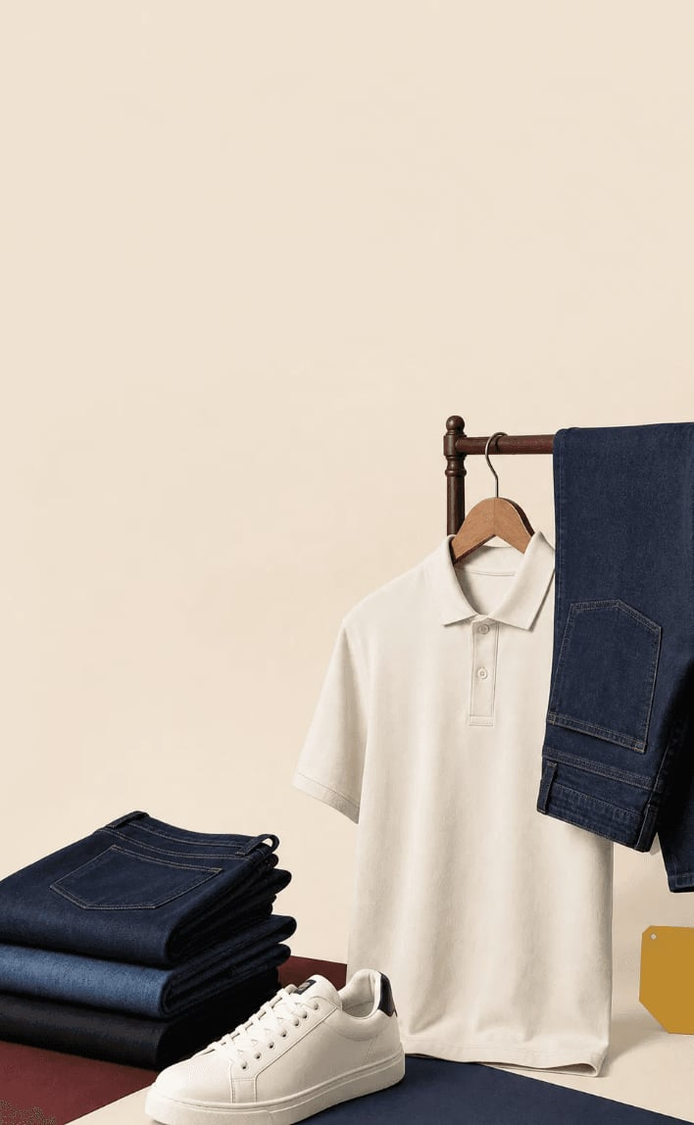
03 · CAROUSEL 1 · CANVA EXECUTION
One Base, Three Plans.
اختار أساسك
وكمّل يومك
A product-led carousel that shows how one Qaim base piece can move across the customer’s day. The visual language is intentionally simple: one strong image, one offer block and one action.
خصم يصل إلى 30%*
اطلب الآن
FRAME 01 · HOOK
FRAME 02 · PRODUCT
3 مشاوير؟ اختار أساس واحد.
اللوك يبدأ من قطعة واضحة.
*Campaign concept — verify live offer before use.
Large headline with full-body look.
Jeans or cargo close-up.
FRAME 03 · DAILY
FRAME 04 · CHANGE
Morning: keep it simple.
غيّر تفصيلة واحدة.
Clean daytime styling.
Layer or top change.
FRAME 05 · FINISH
FRAME 06 · RECAP
كمّل اللوك بالحذاء.
نفس الأساس. خطط مختلفة.
Shoe-led finishing frame.
Three-option recap.
FRAME 07 · CTA
اطلب الآن وشوف المتاح.
Qaim.shop and current sizes.
Offer mock-up: “خصم يصل إلى 30%” is a creative placeholder. Confirm the real offer, dates and eligible products on Qaim.shop before publishing.

Slide 5
03B · CONCEPT 1 CONTENT
Caption, Hashtags & Why It Works
Instagram / Facebook Caption
Why It Works
«3 مشاوير في يوم واحد؟ مش محتاج تغيّر هدومك بالكامل.»
اختار قطعة أساسية واحدة من Qaim — جينز SADA أو Wide-Leg — وخليها تتحرك معاك من الصبح للسهرة: تفصيلة واحدة تتغيّر، والحذاء يكمّل الشكل.
نفس الأساس، 3 خطط مختلفة. جرّبه وقولنا هتبدأ منين؟
Strategic job: Product discovery and everyday styling — the caption keeps the same “one base, three plans” promise as the carousel, so the swipe and the caption reinforce one idea instead of introducing a new one.
Primary KPIs: Saves, website visits, product-page views.
Accuracy check: Confirm the live discount, dates and eligible products on Qaim.shop before publishing — the 30% used in the carousel is a campaign placeholder, not a live offer.
#Qaim #StyleWithQaim #EgyptianFashion #جينز_SADA

Slide 6

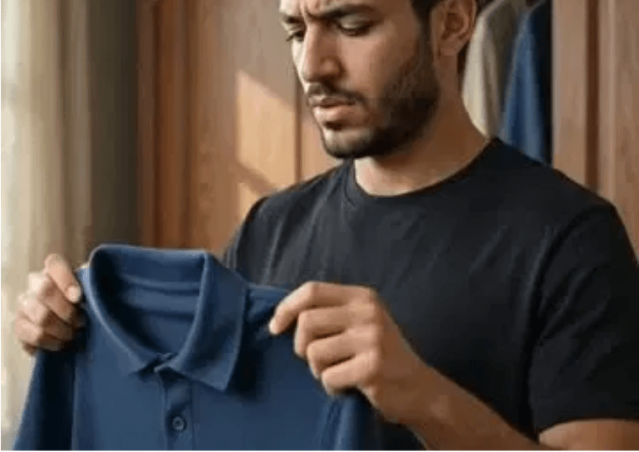
04 · CONCEPT 2 STRATEGY
Daily or Weekend?
An interactive choice that connects the customer's mood to Qaim's product categories through relatable Egyptian situations.
STRATEGIC JOB
AUDIENCE
Engagement and category discovery.
Egyptian men who enjoy relatable social content and quick choices.
PRODUCT ROUTE
TONE
Jeans Kargo/SADA (Daily) vs. Sweatpant Wide Leg Qn (Weekend).
Original Egyptian humor, simple and interactive.
Platform: Your Day. Your Look. Outcome: Comments, shares, and category navigation.

Slide 7
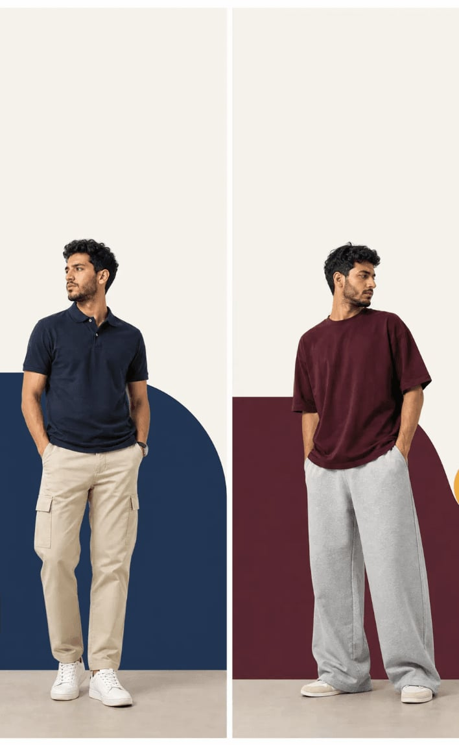
05 · CAROUSEL 2 · CANVA EXECUTION
Daily or Weekend?
Daily ولا
Weekend؟
An interactive carousel that turns outfit choice into a simple conversation. The design mirrors Canva social templates: split composition, bold question, one offer and a direct action.
خصم يصل إلى 30%*
اكتب اختيارك واطلب الآن
FRAME 01 · HOOK
FRAME 02 · DAILY
اختيارك بيقول إيه عن يومك؟
لو عندك مشاوير… Daily.
*Campaign concept — verify live offer before use.
Daily vs Weekend split.
Jeans/cargo styling.
FRAME 03 · WEEKEND
FRAME 04 · VALUE
لو اليوم رايق… Weekend.
Daily = جاهز للخطة.
Sweatpant styling.
Practical product detail.
FRAME 05 · VALUE
FRAME 06 · INTERACTION
Weekend = راحة وشياكة.
Daily ولا Weekend؟
Relaxed full-body look.
Invite a comment.
FRAME 07 · CTA
اطلب الآن وشوف المتاح.
Qaim.shop and categories.
Offer mock-up: “خصم يصل إلى 30%” is placeholder copy. Replace it with a confirmed Qaim offer, date and eligible products before publishing.

Slide 8
05B · CONCEPT 2 CONTENT
Caption, Hashtags & Why It Works
Instagram / Facebook Caption
Why It Works
Daily ولا Weekend؟ اختيارك بيقولنا الكتير عن يومك.
لو يومك مليان مشاوير، جينز SADA أو الـKargo هيكونوا رفقاء يومك. ولو النهاردة يوم راحة، الـSweatpant Wide Leg Qn هيكمّل الاسترخاء من غير ما تنزل بشياكتك.
اكتب في الكومنتات: Daily ولا Weekend؟ ونشوف رأي الأغلبية.
Strategic job: Engagement and category discovery — the caption ends with the same either/or question as Frame 6, so people who only read the caption still get pulled into the same interaction as the carousel.
Primary KPIs: Comments, shares, category-page navigation.
Accuracy check: Confirm current Jeans Kargo/SADA and Sweatpant Wide Leg Qn availability and the real discount before publishing.
#Qaim #DailyOrWeekend #EgyptianStyle #ستايل_يومك

Slide 9

06 · CONCEPT 3 STRATEGY
Complete the Look.
Help product viewers move from a single item to a complete outfit by showing the perfect balance of Qaim pieces.
STRATEGIC JOB
AUDIENCE
Consideration and conversion support.
Product viewers who need help building a complete outfit.
PRODUCT ROUTE
TONE
Qaim top or jeans + a visible shoe option (Tommy, Nike, etc.).
Premium, useful and product-led.
Platform: Your Day. Your Look. Outcome: Product-page views, add-to-cart and conversion.

Slide 10
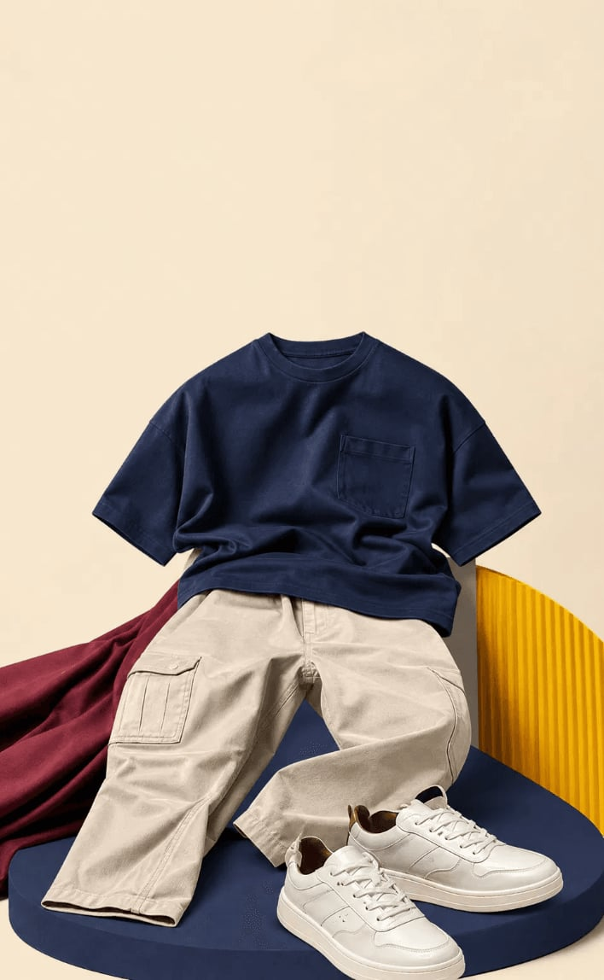
07 · CAROUSEL 3 · CANVA EXECUTION
Complete the Look.
كمّل اللوك
بطريقتك
A conversion-focused carousel that takes the customer from one product to a complete outfit, then removes hesitation with a clear details check and an order CTA.
خصم يصل إلى 30%*
اطلب الآن
FRAME 01 · HOOK
FRAME 02 · BASE
القطعة حلوة… بس اللوك كامل؟
اختار الأساس.
Limited-time concept · verify offer before use.
Single-piece close-up.
Jeans, cargo or sweatpants.
FRAME 03 · BALANCE
FRAME 04 · FINISH
ظبّط التوازن.
كمّلها بالحذاء.
Add a matching top.
Current Qaim footwear.
FRAME 05 · DETAIL
FRAME 06 · CHECK
التفاصيل بتفرق.
راجع المقاس واللون.
Show the complete look.
Confirm live product details.
FRAME 07 · CTA
اطلب الآن.
Shop on Qaim.shop.
Offer mock-up: “خصم يصل إلى 30%” and “Limited Time” are placeholders. Confirm the live Qaim offer, dates, products and stock before publishing.

Slide 11
07B · CONCEPT 3 CONTENT
Caption, Hashtags & Why It Works
Instagram / Facebook Caption
Why It Works
القطعة حلوة لوحدها… بس اللوك الكامل هو اللي بيفرق.
ابدأ بأساس واحد من Qaim، ظبط التوازن بقطعة علوية مناسبة، وكمّل الشكل بحذاء زي Tommy أو Nike. التفاصيل الصغيرة زي المقاس واللون هي اللي بتحول القطعة لـLook متكامل.
راجع مقاسك واطلب دلوقتي.
Strategic job: Consideration and conversion support — the caption mirrors the carousel's progression (base → balance → finish → check) so viewers who read the caption first still see the same logical path before the CTA.
Primary KPIs: Product-page views, add-to-cart, conversion rate.
Accuracy check: Confirm live product details, sizes, colors and shoe availability (Tommy/Nike) on Qaim.shop before publishing.
#Qaim #CompleteTheLook #EgyptianMensFashion #QaimStyle

Slide 12
08 · CONTENT JOURNEY & SUBMISSION
Three Concepts, One Content Journey.
01
02
03
DISCOVER
ENGAGE
CONVERT
One Base, Three Plans
Daily or Weekend?
Complete the Look
Product discovery — introduces one Qaim base piece and its range.
Engagement — turns product categories into a relatable, shareable choice.
Conversion — removes hesitation and pushes to an order.
Execution Rule: each carousel targets a different stage of the same customer journey, using the same Qaim visual system so the brand feels consistent from first scroll to final purchase.
STUDENT DETAILS
OFFICIAL SOURCES
Presenter: Mohamed Mostafa Taher Salem
Student ID: 21172333
Website: qaim.shop
Facebook: @Qaimbrand.AA
Review Date: 01 Sep 2026

