Slide 1
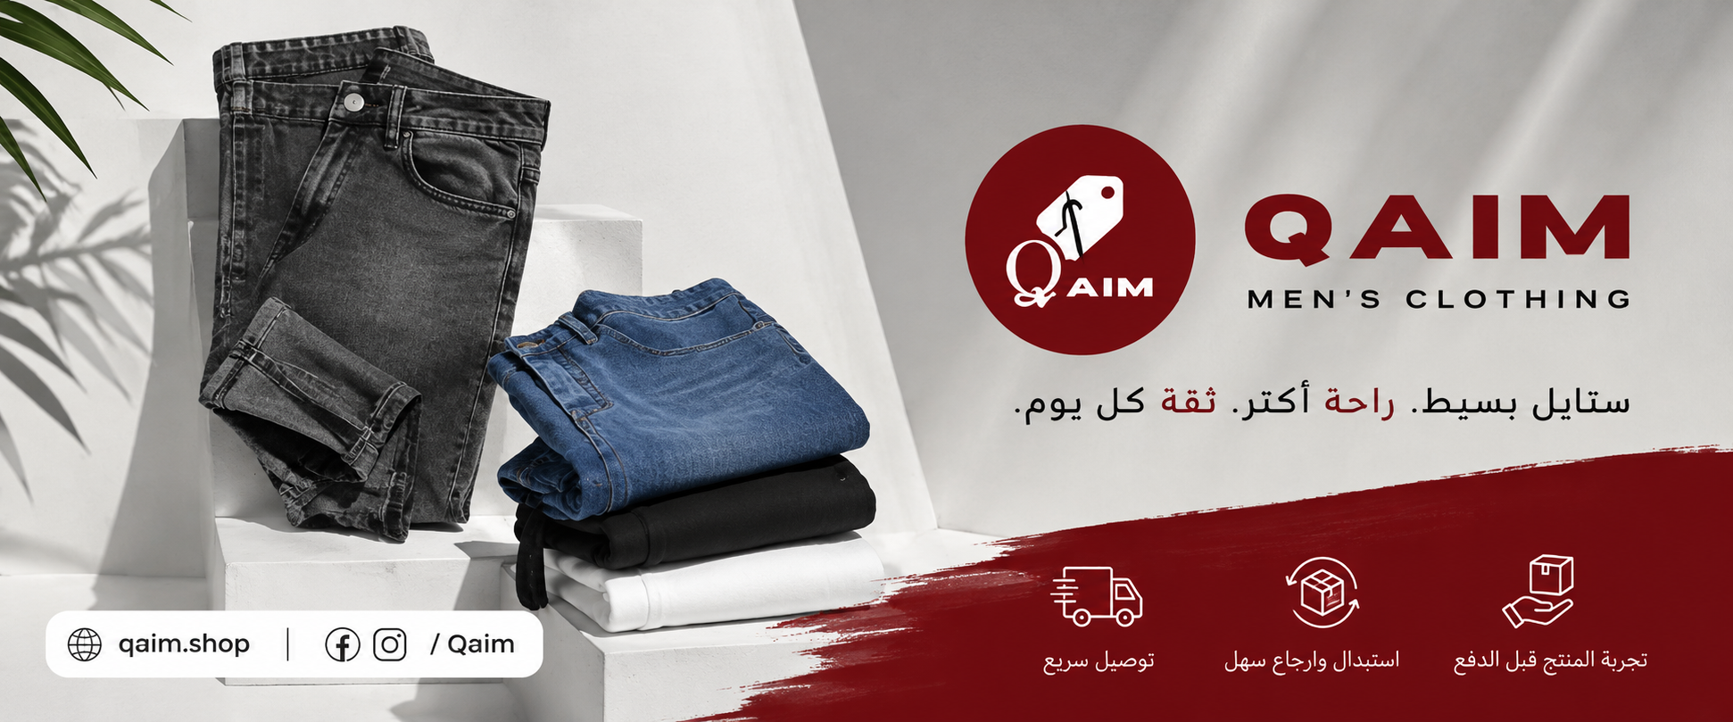
QAIM — قيم
Prepared by
Mohamed Mostafa Taher
Digital Marketing Storytelling Strategy
Student ID
21172333
Assignment 7 – SOSTAC Model Application & Storytelling

Slide 2





BRAND OVERVIEW
Qaim – Brand Snapshot
“Qaim is an Egyptian men’s clothing brand focused on modern everyday fashion.”
62K
592
Facebook Followers
Posts Published
qaim.shop
CURRENT CONTENT
96%
341
Reels
Product content
Customer reviews
Customer opinions
Recommendation Rate
Customer Reviews
Social proof
PRODUCT EXAMPLES
Jeans
Sweatpants
Men's Essentials
Public information based on provided screenshots.
SHOPPING EXPERIENCE
Fast Delivery
Easy Exchange / Return
Product Check Before Payment
QAIM • DIGITAL MARKETING STORYTELLING STRATEGY
02

Slide 3

DIGITAL AUDIT
Current Digital Situation
WHAT QAIM DOES WELL
CONTENT OPPORTUNITIES
Active Facebook presence
Stronger Hooks in some Reels
Frequent Reels
More real-life storytelling
Product visibility
More outfit combinations
Customer reviews
More transformation stories
Customer opinions
More customer stories
Social proof
E-commerce website
Stronger creative openings
Observation: Different levels of post reach may suggest paid support for selected content, but this cannot be confirmed from public information.
QAIM • DIGITAL MARKETING STORYTELLING STRATEGY
03

Slide 4






STRATEGY
SOSTAC – Strategy
“Sell the lifestyle and the solution, not only the product.”
PRODUCT
CUSTOMER
PROBLEM
STORY
SOLUTION
TRUST
ACTION
CONTENT PILLARS
Everyday Style
Comfort
Outfit Inspiration
Customer Trust
Product Value
“Turn products into stories.”
QAIM • DIGITAL MARKETING STORYTELLING STRATEGY
04

Slide 5
TARGET AUDIENCE
SOSTAC – Segments & Target Audience
18–35 YEARS OLD — EGYPTIAN MEN
University Students
Fresh Graduates
Young Employees
Freelancers
Entrepreneurs
Young Professionals
“Egyptian men aged 18–35 who want simple, modern, comfortable and practical everyday clothing.”
STYLE
COMFORT
SIMPLICITY
PRACTICALITY
TRUST
CUSTOMER PROBLEM
“I want to look good every day, but choosing the right outfit should be easy.”
QAIM • DIGITAL MARKETING STORYTELLING STRATEGY
05

Slide 6



POSITIONING
Suggested Positioning
SOSTAC – Positioning
“Qaim is an accessible men’s fashion brand that helps Egyptian men create simple, modern and comfortable everyday looks.”
STYLE
COMFORT
SIMPLICITY
CUSTOMER PROBLEM
POSITIONING IDEA
“I have clothes, but I do not know what to wear.”
“Make everyday outfit choices easier.”
QAIM • DIGITAL MARKETING STORYTELLING STRATEGY
06

Slide 7


STORYTELLING FRAMEWORKS
Storytelling Ideas
PIXAR
SCQA
“I Have Clothes, But I Have Nothing to Wear”
“Improve Your Style Without Changing Your Whole Wardrobe”
Emotional / Character-based / Transformation
Problem → Solution / Educational
CHARACTER
Situation
S
EVERYDAY SITUATION
PROBLEM
C
Complication
DISCOVERY
Q
Question
TRANSFORMATION
RESULT
Answer
A
CTA
Main message: “Qaim makes everyday outfit choices easier.”
Main message: “You do not need a completely new wardrobe. You need the right pieces.”
QAIM • DIGITAL MARKETING STORYTELLING STRATEGY
07

Slide 8





PIXAR — ARABIC STORY
PIXAR = Personal Story
PIXAR Storytelling – Arabic Story
CHARACTER
SITUATION
PROBLEM
EMOTION
محمد شاب مصري وبيحب يبقى شكله شيك كل يوم.
كل يوم الصبح بيفتح الدولاب قبل الشغل أو الجامعة أو أي مشوار.
الدولاب مليان هدوم، عنده Jeans وT-shirts وPants، بس برده مش عارف يلبس إيه أو يعمل Outfit بسيط.
كل يوم بيضيع وقت وهو بيفكر يلبس إيه.
DISCOVERY
SOLUTION
TRANSFORMATION
RESULT
في يوم قرر يدور على حل أسهل، وبدأ يشوف Qaim وقطع الملابس الرجالي اللي عندهم.
اختار Jeans مع T-shirt بسيط، وبدأ يجرب الـLook.
بص في المراية، والـOutfit طلع بسيط ومريح وشكله حلو.
من وقتها بقى اختيار لبسه اليومي أسهل وأسرع.
Qaim makes everyday outfit choices easier.
ادخل Qaim واختار الـNext Look بتاعك.
CTA
QAIM • DIGITAL MARKETING STORYTELLING STRATEGY
08

Slide 9





SUGGESTED CREATIVE RECOMMENDATION
Suggested Reel Length: 20–30 seconds
PIXAR Reel – Shot by Shot
HOOK
PROBLEM
DISCOVERY
SOLUTION
TRANSFORMATION
RESULT
CTA
SHOT 1
SHOT 2
SHOT 3
SHOT 4
HOOK
PROBLEM
DISCOVERY
SOLUTION / PRODUCT
VISUAL
VISUAL
VISUAL
VISUAL
Mohamed opens wardrobe, confused
Mohamed looks at many clothes
Mohamed finds Qaim on his phone
Jeans, T-shirt, Pants
VOICE-OVER
VOICE-OVER
VOICE-OVER
VOICE-OVER
كل يوم نفس السؤال… ألبس إيه؟
عندي هدوم كتير، بس برده مش عارف أعمل Outfit.
يمكن المشكلة مش في الهدوم… المشكلة في الاختيار.
اختار قطع بسيطة تقدر تعمل بيها أكتر من Look.
ON-SCREEN
ON-SCREEN
ON-SCREEN
ON-SCREEN
عندك دولاب مليان ولسه مش عارف تلبس إيه؟
هدوم كتير… Outfit مفيش!
Maybe you just need the right pieces.
Simple pieces. More outfits.
SHOT 5
SHOT 6
SHOT 7
TRANSFORMATION
RESULT
CTA
VISUAL
VISUAL
VISUAL
Mohamed wears outfit, checks mirror
Mohamed leaves home confidently
Qaim logo + qaim.shop
VOICE-OVER
VOICE-OVER
VOICE-OVER
Look بسيط، مريح، وشكله حلو.
لما القطع تكون صح… اختيار الـOutfit بيبقى أسهل.
ادخل Qaim واختار الـNext Look بتاعك.
ON-SCREEN
ON-SCREEN
ON-SCREEN
Simple. Comfortable. Stylish.
Ready for the day.
Visit Qaim – qaim.shop
QAIM • DIGITAL MARKETING STORYTELLING STRATEGY
09

Slide 10








SCQA — SEPARATE FRAMEWORK
SCQA Storytelling & Final Recommendation
SCQA STORY
SCQA REEL
SCQA VISUAL CONCEPTS
S
رجالة وشباب كتير عايزين يكون شكلهم شيك ومريح في نفس الوقت.
HOOK
عايز تحسن ستايلك من غير ما تغير دولابك كله؟
S
Man wants a stylish, comfortable look
S
رجالة كتير عايزين شكل أحسن في لبسهم اليومي.
C
لكن صعب تلاقي هدوم تجمع بين الـStyle والراحة.
C
Feels confused building a simple outfit
C
بس في نفس الوقت عايزين اللبس يكون مريح وعملي.
Q
إزاي تعمل Look بسيط وشيك من غير تعقيد؟
Q
Thinks about the simple solution
A
الحل هو اختيار القطع الصح اللي تقدر تنسقها بسهولة، وده اللي تقدر تلاقيه في Qaim.
Q
فإيه الحل؟
A
ابدأ بالقطع الصح… Jeans، T-shirts، Cargo وقطع تقدر تعمل بيها أكتر من Outfit.
A
Wears a clean Qaim outfit, confident
CTA: ادخل Qaim واختار الـNext Look بتاعك.
CTA: ادخل Qaim واختار الـNext Look بتاعك.
A separate campaign — not a continuation of Mohamed’s PIXAR story.
Recommendation
Final Marketing Recommendation
Suggested KPIs
Qaim already has an active social presence and customer social proof. The next opportunity is to make the content more story-driven.
Video Views
Watch Time
1.
Stronger Hooks in the first 3 seconds
2.
More real-life Egyptian situations
3.
More outfit transformation Reels
4.
More complete outfit combinations
Engagement
Profile Visits
5.
Continue using customer reviews as social proof
6.
Turn products into relatable stories
7.
Test different Hooks and creative openings
8.
Use paid promotion to amplify strong content, alongside organic content
Website Clicks
Conversions
These are marketing recommendations — not current Qaim performance results.
QAIM • DIGITAL MARKETING STORYTELLING STRATEGY
10

