Slide 1
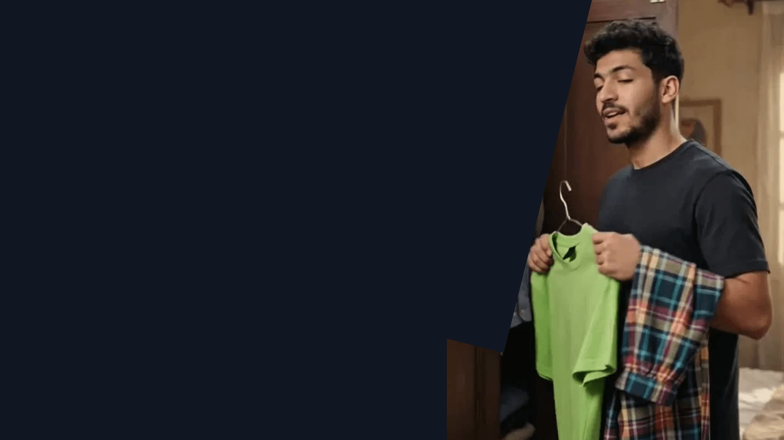
ASSIGNMENT 9 / MARKETING CONTENT
Qaim
Video Campaign
A portfolio-ready short-form campaign for Egyptian men’s fashion: product trust, everyday styling and conversion-led storytelling.
STUDENT
4 VIDEOS
MARKET
Mohamed Mostafa Taher Salem
2 CapCut · 2 AI
Egypt
ID: 21172333
YOUR DAY. YOUR LOOK.

Slide 2

01 / THE BRIEF
One campaign. Two production tracks.
DELIVERABLE ARCHITECTURE
Create four short-form videos for Qaim’s Egyptian men’s fashion audience—two edited in CapCut and two developed as AI-generated creative concepts.
01
CapCut Videos
Human-shot / edited Reels. Styling transformation and price-versus-value story.
02
AI Videos
Every video must be documented as a marketing asset: concept, content pillar, target audience, shot logic, tool, CTA and planned KPI.
AI-generated creative. Jeans SADA fit confidence and outfit-decision storytelling.
PLATFORM: TIKTOK · INSTAGRAM REELS · YOUTUBE SHORTS | FORMAT: 9:16

Slide 3

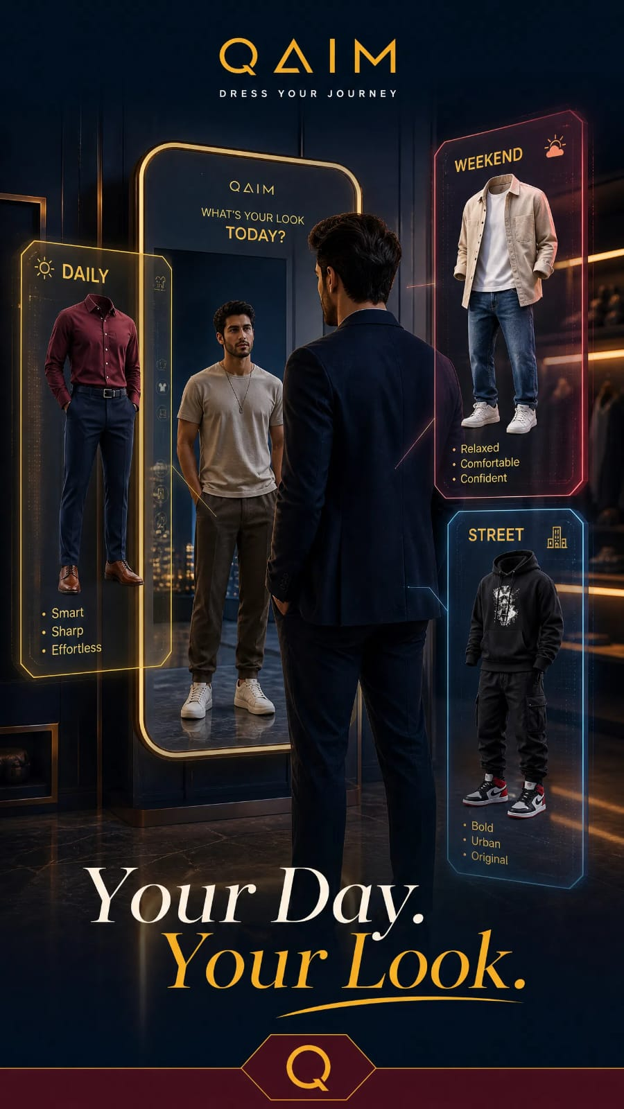
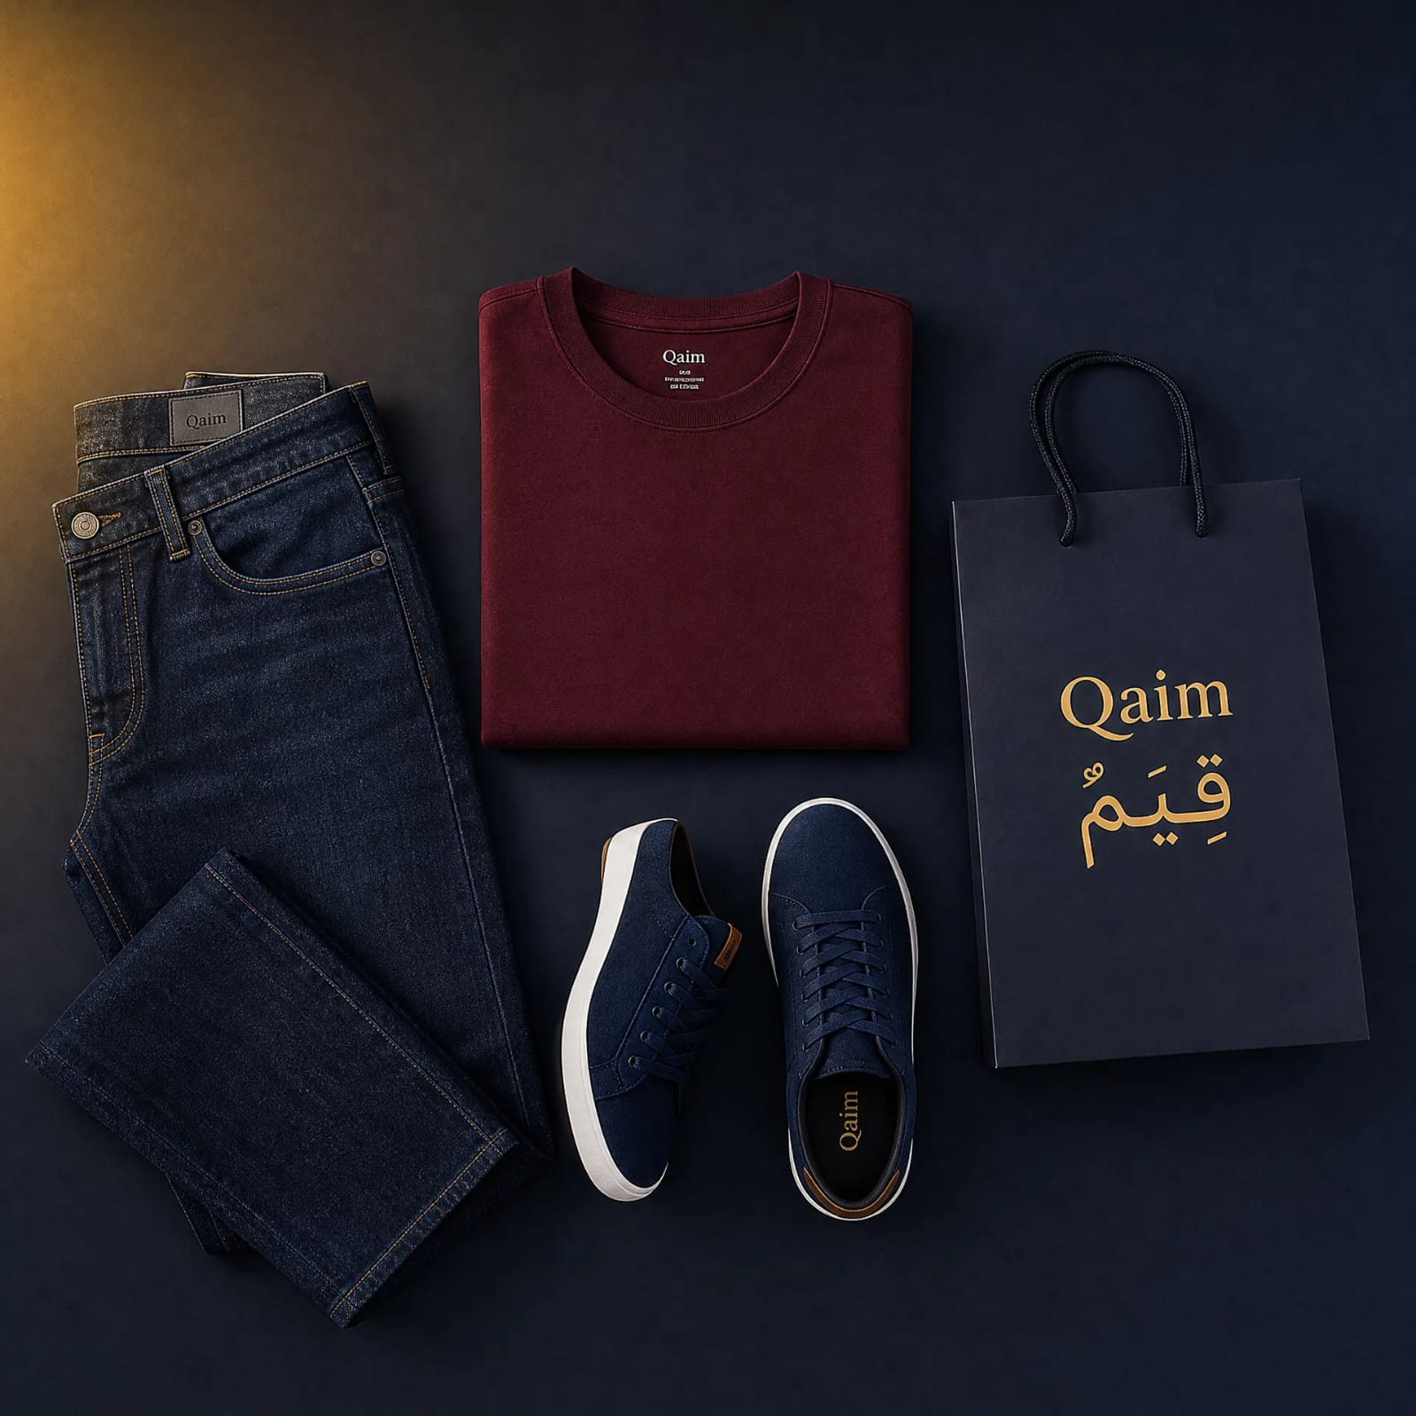
02 / BRAND CONTEXT
Qaim makes the everyday choice easier.
Qaim’s public storefront is organized around men’s essentials: T-shirts, Jeans, Sweatpants, Shoes, and Kargo collections.
We help the Egyptian male shopper choose the right piece for his day and occasion—moving from inspiration to a confident product click.
CREATIVE PLATFORM
Your day. Your look.
Turning product variety into simple decisions: daily denim, weekend comfort, and a complete look.
CORE COLLECTIONS
Jeans SADA
Wide-Leg Jeans
Sweatpant Qn
SOURCE: QAIM.SHOP · PROFESSIONAL MARKETING STRATEGY · AUGUST 2026

Slide 4

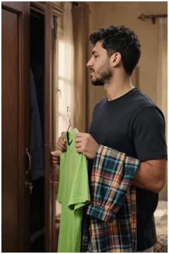
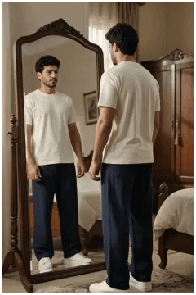

03 / VIDEO DELIVERABLE · CAPCUT
Video 1 — Style Simplified
01 · MIRROR TRANSFORMATION SETUP
CONCEPT
PILLAR
Styling transformation: uncoordinated to curated Qaim.
Discovery & Styling.
TARGET
CTA
02 · STYLING PAYOFF & CONFIDENCE
Men 18–35 seeking versatile everyday wear.
Shop the Look on Qaim.shop.
VOICE-OVER EXCERPT
«أناقتك بكامل قيم… من المشوار اليومي لقعدة الويك إند.»
03 · PRODUCT VARIETY SHOWCASE
CLICK TO WATCH FULL VIDEO
CAPCUT EDIT · 9:16 VERTICAL · PLANNED KPI: CTR & ENGAGEMENT

Slide 5
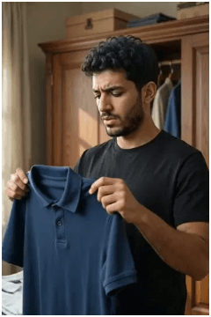
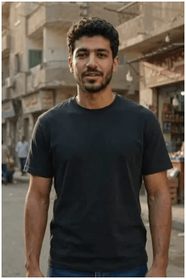
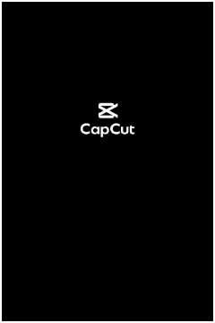
04 / VIDEO DELIVERABLE · CAPCUT
Video 2 — Value You Wear
01 · DIRECT ADDRESS SETUP
CONCEPT
PILLAR
Price-vs-value: defined by fit and confidence.
Trust & Lifestyle Proof.
TARGET
CTA
Men 20–35 seeking smart-casual value.
Shop Now on Qaim.shop.
02 · QUALITY & DETAIL PROOF
VOICE-OVER EXCERPT
«القيمة الحقيقية مش في السعر العالي… القيمة إنك تلاقي لبس يناسب يومك.»
03 · LIFESTYLE PAYOFF WALK
CLICK TO WATCH FULL VIDEO
CAPCUT EDIT · 9:16 VERTICAL · PLANNED KPI: CTR & WATCH TIME

Slide 6
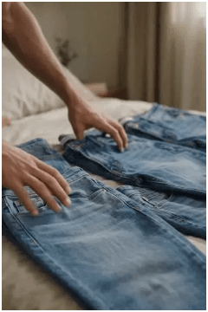
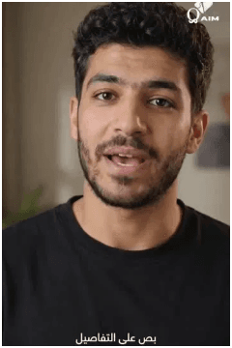

05 / VIDEO DELIVERABLE · AI CREATIVE
Video 3 — Product Trust
01 · FABRIC & TEXTURE DETAIL
CONCEPT
PILLAR
Jeans SADA: Fit confidence and intentional buying.
Trust & Fit Guidance.
TARGET
CTA
Men valuing reliable, well-fitted wear.
Discover Jeans SADA details.
02 · REAL-LIFE FIT CONFIDENCE
THE TRUST FACTOR
Texture close-ups and the size-chart reveal reduce fit hesitation and drive confident online orders.
CLICK TO WATCH FULL VIDEO
03 · CALL TO ACTION / SIZE CHART
AI CREATIVE TRACK · 9:16 VERTICAL · PLANNED KPI: SAVES & CTR

Slide 7
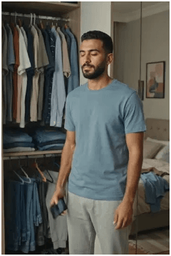
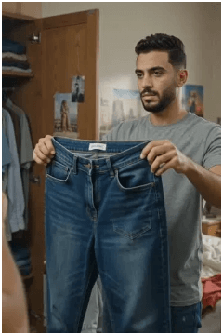
06 / VIDEO DELIVERABLE · AI CREATIVE
Video 4 — The Outfit Decision
01 · MIRROR STRUGGLE SETUP
CONCEPT
PILLAR
Relatable mirror struggle resolved by Qaim choice.
Lifestyle Relatability.
TARGET
CTA
Men 18–35 seeking OOTD inspiration.
Shop the Look on Qaim.shop.
02 · OUTFIT OPTIONS SEARCH
VOICE-OVER EXCERPT
«مش لازم تحتار قدام الدولاب… اختار اللوك اللي يناسب يومك.»
03 · CONFIDENT FINAL CHOICE
CLICK TO WATCH FULL VIDEO
AI CREATIVE TRACK · 9:16 VERTICAL · PLANNED KPI: ENGAGEMENT & SAVES

Slide 8

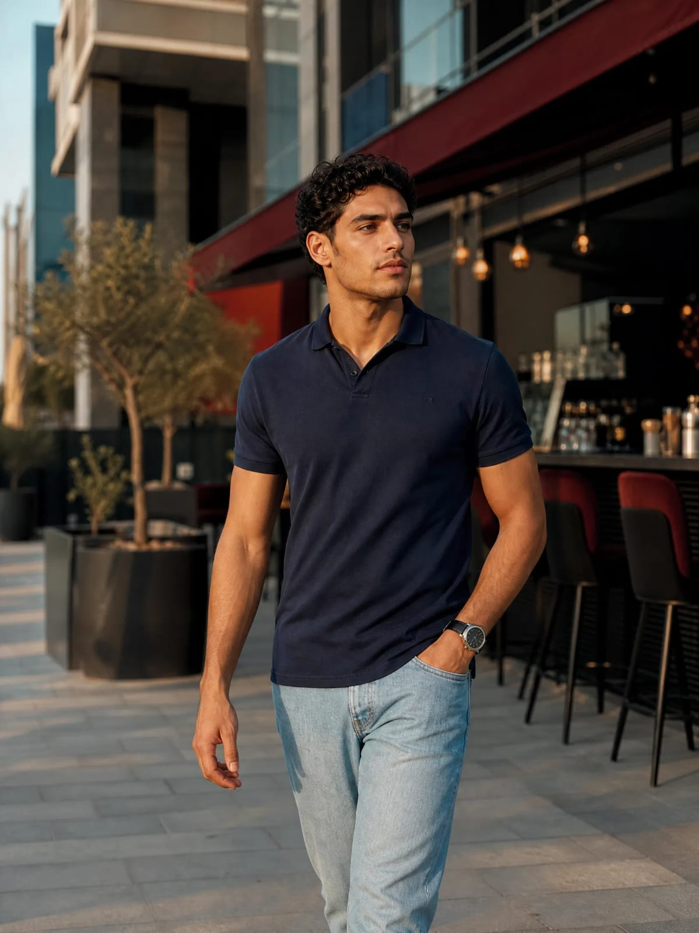
08 / PRODUCTION SYSTEM
Visual Consistency & Technical Execution
FIXED MODEL WORKFLOW
CINEMATOGRAPHY & POST
Shot Selection
Close-ups: Texture & labels.
Medium Shots: Styling presentation.
POV/Mirror: Relatable perspective.
Identity Anchor
A single AI-generated persona used across all videos to ensure campaign continuity.
The Editing Stack
CapCut: Match cuts & sound design.
AI Video: Generative motion.
Audio: Natural Egyptian Arabic tone.
Visual Integrity
Consistent facial features and body proportions maintained through identity-reference prompts.
PIPELINE: AI GENERATION → CAPCUT EDITING → BRAND-ACCURACY REVIEW

Slide 9

09 / MEASUREMENT
Full-Funnel Video Strategy
AWARENESS
STAGE
ASSET
PRIMARY KPIS
Awareness
ENGAGEMENT
Video 1 (CapCut)
Reach, 3s Views,
ThruPlay
Style Transformation
CONSIDERATION
Engagement
Video 2 (CapCut)
CONVERSION
Comments,
Watch Time
Value Story
Consideration
Video 3 (AI)
Save Rate,
CTR
Product Trust
Conversion
Video 4 (AI)
Add to Cart,
Intent
Outfit Decision
MEASUREMENT FRAMEWORK: META ADS MANAGER & GOOGLE ANALYTICS 4

Slide 10
10 / SUBMISSION
Final Deliverables & Portfolio Value
SUBMISSION CHECKLIST
PORTFOLIO STRENGTH
4 Campaign Videos
Full-Funnel Thinking
2 CapCut Reels + 2 AI Concepts in 9:16 vertical format.
Mapping creative assets to specific marketing stages.
AI-Human Hybrid
GOOGLE DRIVE SUBMISSION LINK
https://drive.google.com/drive/folders/1PGUohiDfPJRF70YXqBrjpg4fLNR3bclG
Showcasing mastery of modern production tools.
Set permissions to: "Anyone with the link → Viewer"
ASSIGNMENT 9 COMPLETED · QAIM VIDEO CAMPAIGN · AUGUST 2026

