Slide 1

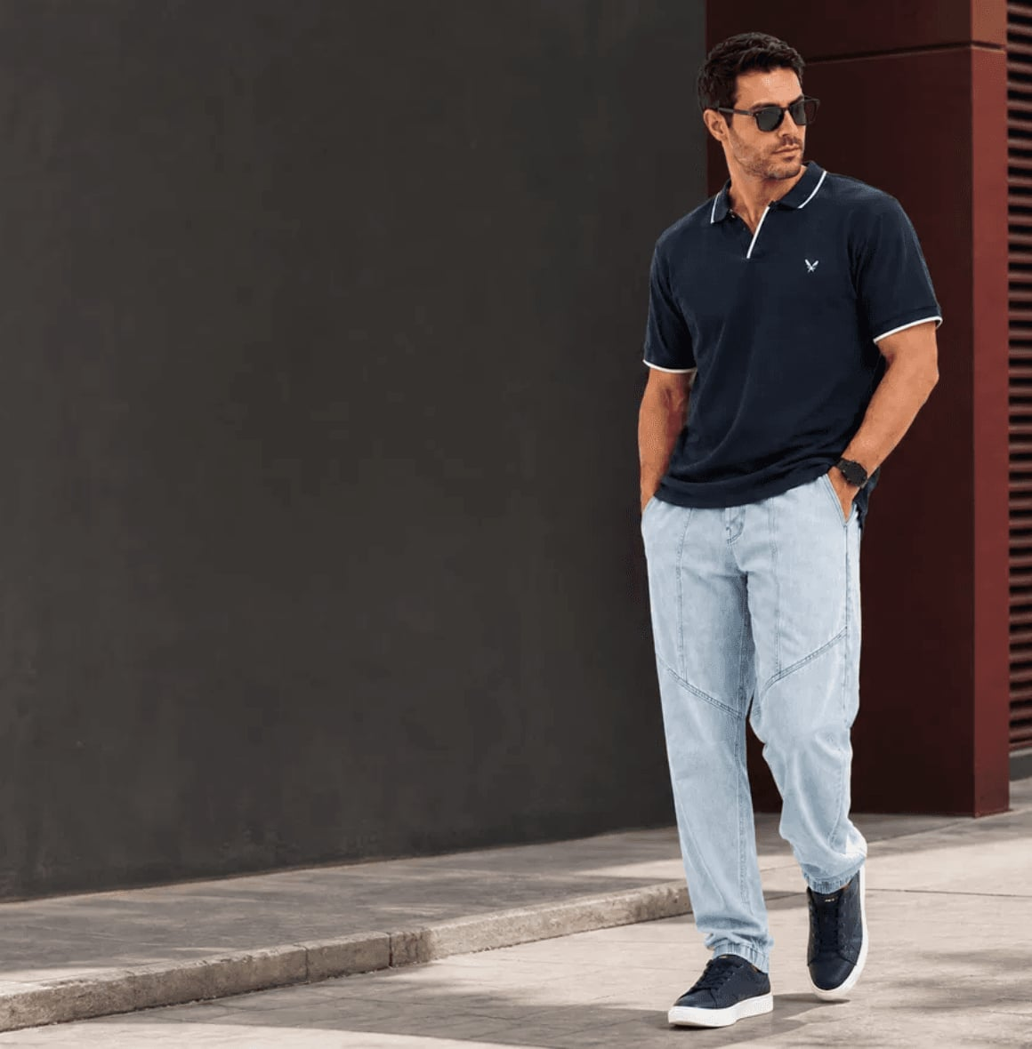

QAIM
ASSIGNMENT 8 / SOSTAC MODEL APPLICATION
Tactics
+ AI Content
A connected digital growth plan for Qaim Men's Fashion
Prepared by: Mohamed Mostafa Taher
Student ID: 21172333
Channels: Facebook • Instagram • Qaim.shop
PRODUCT REFERENCE: Qaim public Facebook campaign image • CREATIVE RECOMPOSITION FOR PRESENTATION

Slide 2
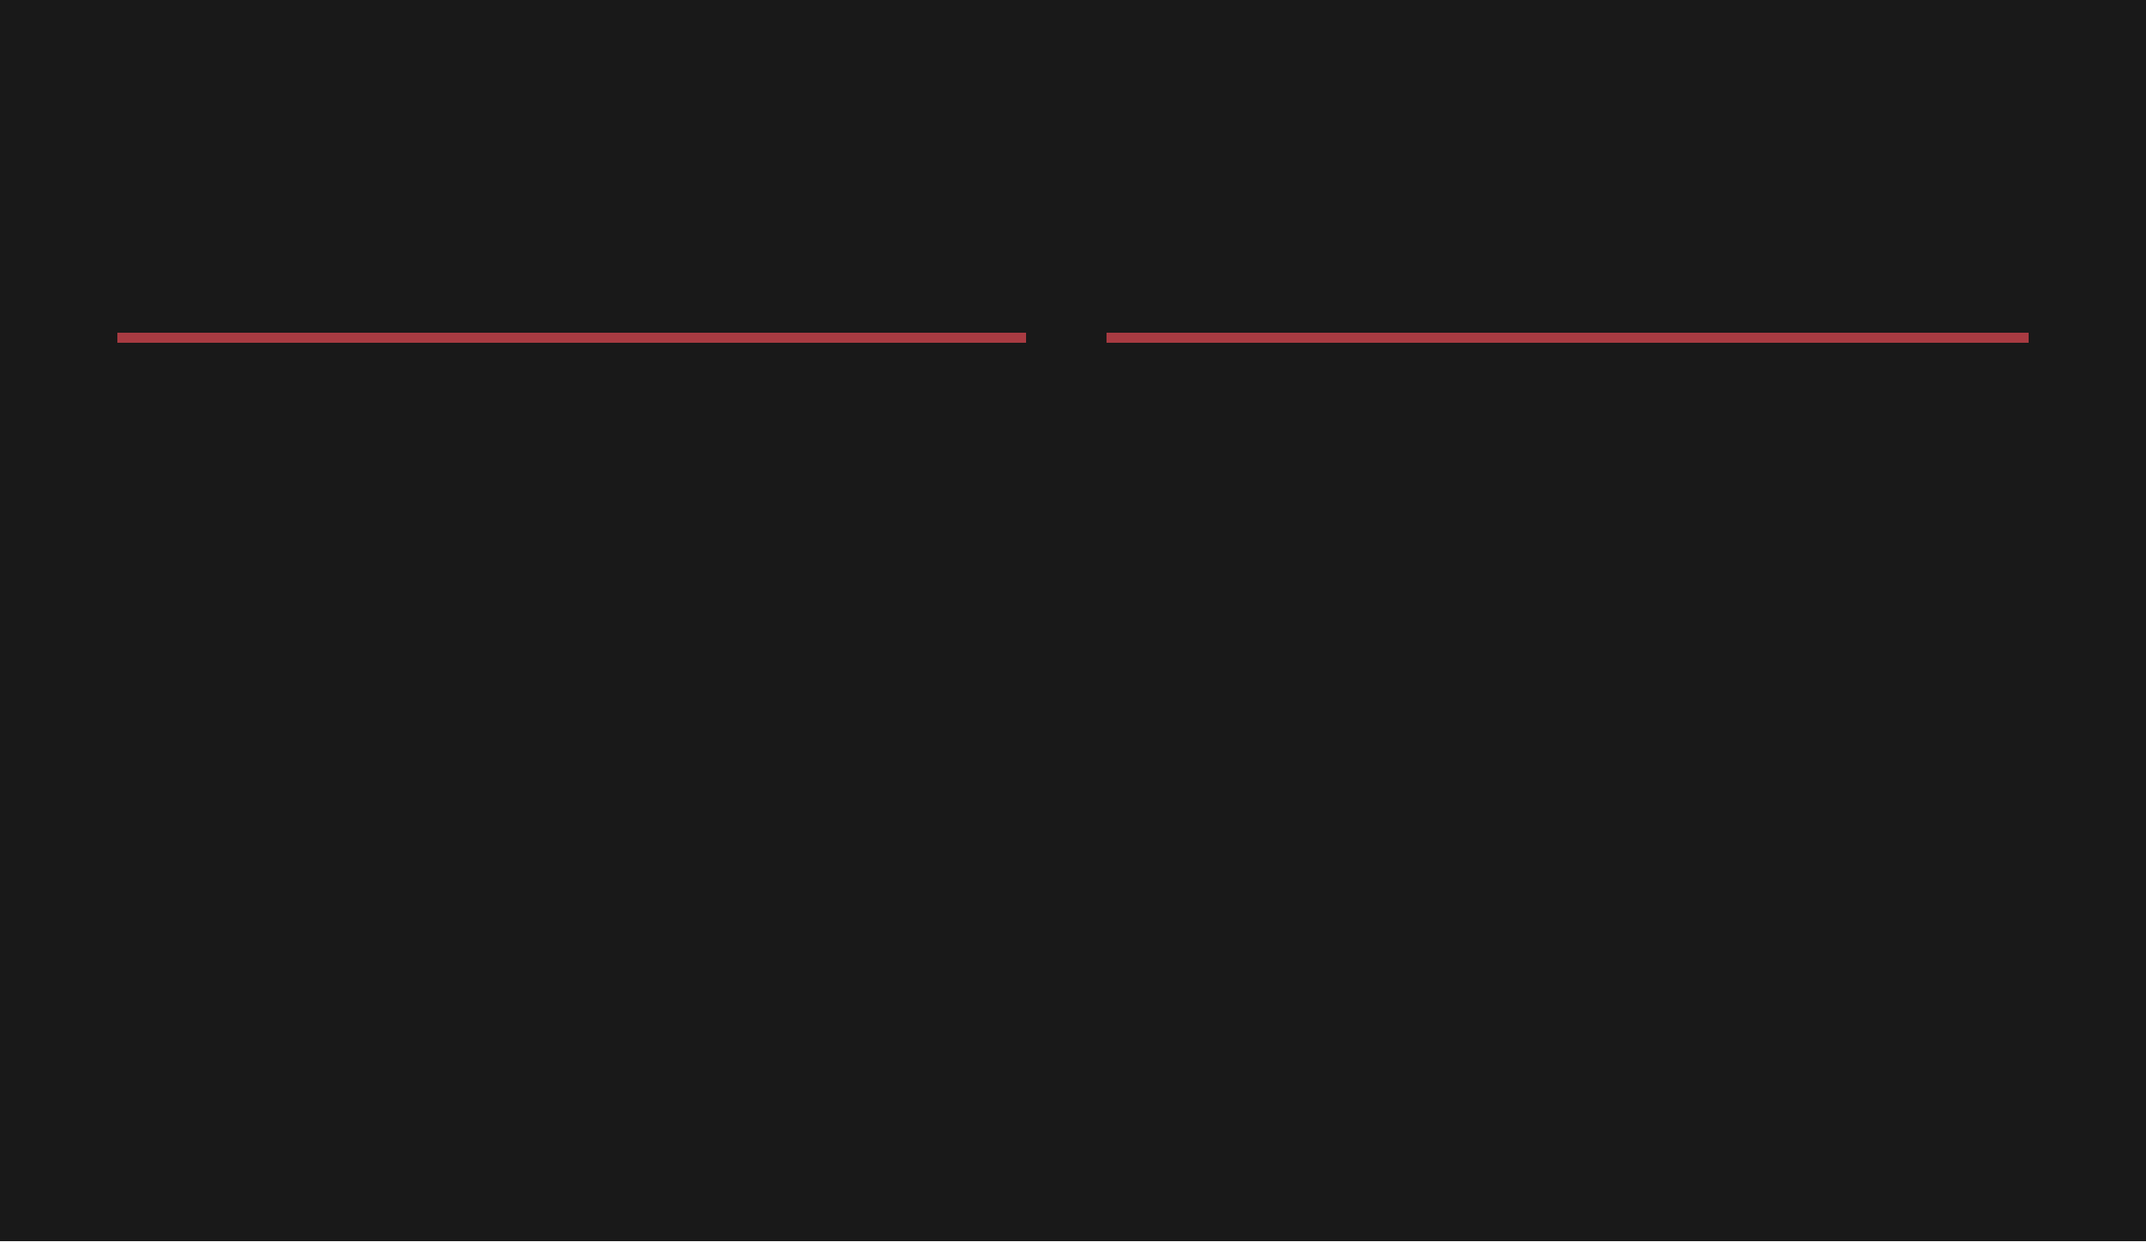

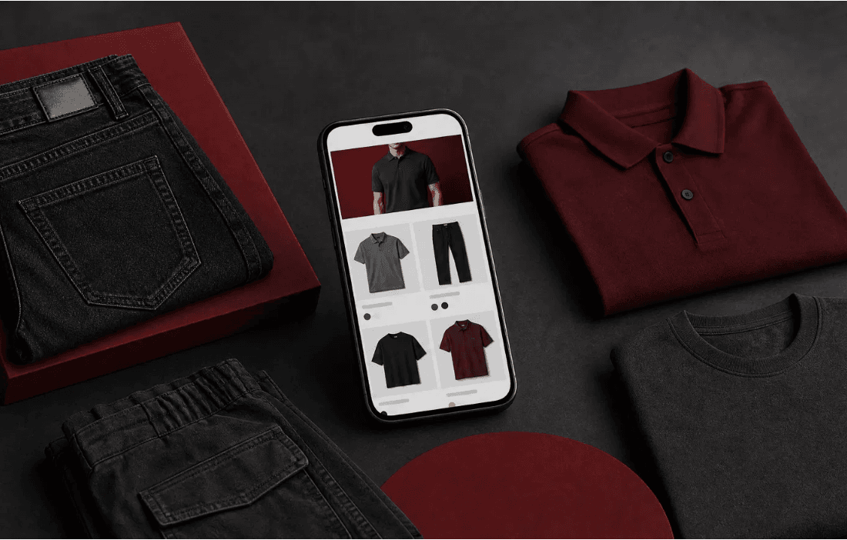
QAIM
02 / CURRENT DIGITAL PRESENCE
Qaim Already Has the Touchpoints to Build a Funnel
VERIFIED FACEBOOK PRESENCE
The public page is categorized as a Clothing shop, Men's clothes shop and Apparel & clothing page. It shows approximately 62K followers, a public phone number, the official website link and a public rating of 94% recommend from 362 reviews.
VERIFIED WEBSITE PRESENCE
The official website is an ecommerce storefront. Its public title references men's jeans, polo shirts, oversized T-shirts, sweatpants, cargo pants and shoes. The page also exposes search and cart functions.
Concept visual for the social-to-ecommerce journey; not a screenshot of Qaim's actual interface.
Strategic implication: use Facebook and Instagram for discovery, styling and trust; use Qaim.shop for product evaluation and ordering.
Sources: facebook.com/Qaimbrand.AA • qaim.shop | Public facts verified 21 August 2026

Slide 3


QAIM
03 / SITUATION → OPPORTUNITY
Qaim Has the Audience and the Store; the Plan Connects Them
WHAT IS PUBLICLY VERIFIED
WHAT THE PLAN MUST SOLVE
Qaim's public Facebook page is positioned as a men's clothing shop. It shows approximately 62K followers, 1 following, a public recommendation signal of 94% from 362 reviews, a phone number and a link to Qaim.shop.
The public pages do not reveal which Reels, posts or ads generate the strongest clicks and orders. Therefore, the strategy must not assume that engagement is low or invent sales targets. It must create a repeatable path from attention to action and measure each hand-off.
62K
94% / 362
Customer decision:
What does Qaim sell? → How can I wear it? → Is it suitable for me? → Where do I order?
approx. public followers
public recommendation signal
Qaim.shop
Search + Cart
official ecommerce destination
visible website functions
Bridge to the next slides: Objectives define the four customer outcomes; Tactics then deliver them through Discover → Imagine → Verify → Visit → Order → Return.
Sources: Qaim Facebook page + Qaim official website, accessed 21 August 2026. Public facts are separated from performance data that requires Meta Insights and website analytics.

Slide 4


QAIM
04 / MARKETING OBJECTIVES
Every Tactic Has One Job in the Customer Journey
The objectives translate Qaim's public social-and-ecommerce presence into a measurable funnel. Numerical targets should be set only after reviewing Meta Insights and website analytics baselines.
01 / DISCOVER
02 / IMAGINE
Make Qaim's catalogue easier to notice.
Help customers see where the product fits.
Show the real categories referenced by Qaim's public website—jeans, polo shirts, oversized T-shirts, sweatpants, cargo pants and shoes—in clear, short-form product content.
Use styling and use-case content to turn a product into a relevant outfit for casual, sporty or streetwear occasions.
Owner Tactic: Styling & Use-Case Content
KPIs: Saves, shares, comments and product-page views
Owner Tactic: Product Discovery Reels
KPIs: Reach, video views, watch time and profile visits
03 / VERIFY
04 / ORDER + LEARN
Reduce uncertainty before an online order.
Turn qualified attention into action and improvement.
Guide customers to the information they need: size guidance, product details and confirmed delivery or exchange information. Do not publish a policy claim until Qaim confirms it.
Connect social content to Qaim.shop, separate organic from paid results and scale the creative ideas that produce meaningful commercial signals.
Owner Tactic: Shopping Guidance & Trust
KPIs: Website clicks, product views, enquiries and add-to-cart
Owner Tactic: Community + Responsible Amplification
KPIs: Orders, conversion rate, revenue, ROAS and repeatable winning formats
Strategic chain: Discover → Imagine → Verify → Visit Qaim.shop → Order → Return. Source logic: Facebook creates attention and confidence; the official website supports evaluation and ordering.
Sources: Qaim public Facebook page + Qaim official website | Public facts verified 21 August 2026

Slide 5


QAIM
05 / SECTION 1 — TACTICS
Four Tactics Derived from the Objectives
The plan contains four core tactics. Measurement and paid amplification are execution layers inside Tactic 4, not additional disconnected tactics.
~62K
94%
6+
Search + Cart
public Facebook followers
recommendation signal from 362 public reviews
product-category references in the website title
ecommerce functions visible on Qaim.shop
ORDER
TACTIC
OBJECTIVE / QUESTION
CONTENT + CHANNEL → CTA
KPI
01
Product Discovery Reels
Awareness: What does Qaim sell?
One category or product per Reel on FB + IG → View profile / details
Reach, views, watch time, profile visits
02
Styling & Use-Case
Consideration: How can I wear it?
One item, three looks through Reels + Carousels → Save, share, comment
Saves, shares, comments, product views
03
Shopping Guidance & Trust
Confidence: Is it suitable for me?
Size, product details and confirmed policy guidance → Check details / ask
Clicks, enquiries, add-to-cart
04
Community + Conversion
Action: Where do I order and what should repeat?
UGC, polls, website links, organic testing and paid amplification → Shop Qaim
Product views, orders, conversion, ROAS
Discover → Imagine → Verify → Visit Qaim.shop → Order → Return — each tactic hands the customer to the next decision.
Sources: Qaim Facebook page + Qaim.shop, accessed 21 August 2026. Public facts are separated from performance data requiring Meta Insights and website analytics.

Slide 6

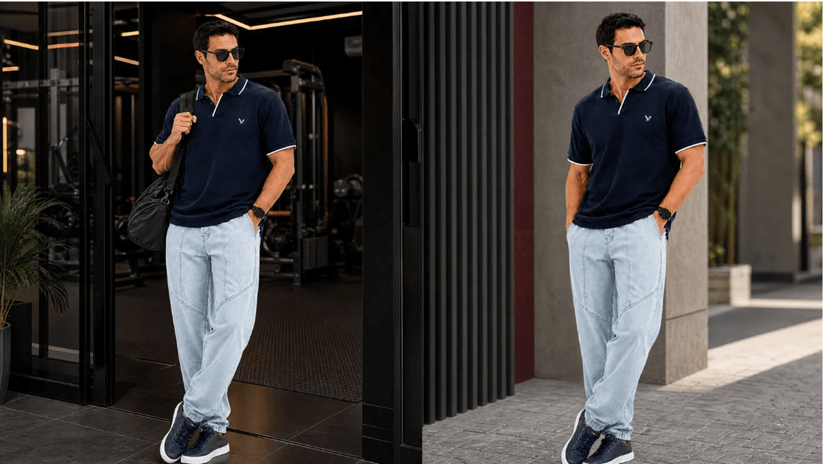
QAIM
06 / TACTIC 1 — DISCOVER
Product Discovery Reels: Make the Catalogue Easy to Understand
STRATEGIC BRIEF
Audience: Egyptian men interested in practical men's fashion and online shopping.
Objective: move from social discovery to profile visit and product-page view.
Product reference: Qaim's public Facebook campaign shows a navy polo styled with light ice-blue jeans and navy shoes. The creative below preserves that product look in a new scene.
Format: 9:16 Reel for Facebook and Instagram.
CTA: “شوف التفاصيل والمقاسات على Qaim.shop.”
TREND-AWARE HOOK
POV: خارج من الجيم وداخل على مشوار — followed by a quick product reveal and a comment question.
Creative recomposition based on Qaim's official public polo + ice-blue jeans look; use approved brand assets for final publishing.
FIVE-BEAT REEL
01
02
03
04
05
HOOK
REVEAL
DETAIL
TRANSITION
CTA
خارج من الجيم وداخل على مشوار.
Show the actual Qaim look.
Polo, jeans and shoes.
Gym to street beat cut.
شوفه على Qaim.shop.
KPIs: reach, watch time, profile visits, website clicks and product-page views. Test hook, product combination and context separately.
BRAND ROLE: DISCOVER THE PRODUCT → CONNECT TO QAIM.SHOP | Source: Qaim public Facebook page + official website

Slide 7

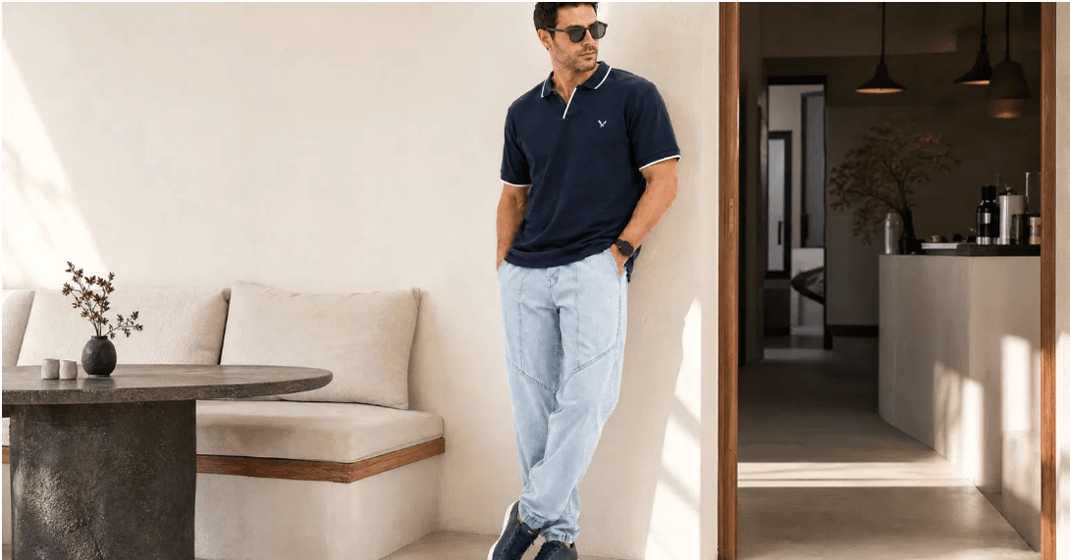
QAIM
07 / TACTIC 2 — IMAGINE
Styling & Use-Case: Let the Customer Choose the Look
A product becomes easier to consider when the customer can see how it fits different occasions. This tactic turns styling into an interactive choice.
Creative concept: “نفس القطعة… 3 ستايلات مختلفة.” Use a quick-change or split-screen transition, then invite the viewer to choose a look. The product reference is Qaim's public polo + ice-blue jeans campaign; the scene below is a creative recomposition.
01
02
03
CASUAL
SPORTY
STREETWEAR
Polo + ice-blue jeans + navy shoes.
Everyday outing.
Same product base + active transition.
Relaxed movement.
Same jeans + outer layer.
Weekend outing.
ON-SCREEN PROMPT
“أنهي Look تختار؟ 1 ولا 2 ولا 3؟”
Creative recomposition based on Qaim's official public polo + ice-blue jeans look; use approved brand photography for final publishing.
TREND-AWARE EXECUTION
Fast outfit transitions, “choose your look” language, concise captions and a final save prompt. Test each styling direction with the same product before scaling the strongest one.
Brand role: make the product relevant, invite participation and guide the viewer to Qaim.shop.
KPIs: saves, shares, comments, profile visits and product-page views.
STYLING CONTENT = IMAGINE THE PRODUCT → CHOOSE A LOOK → SAVE / COMMENT → VIEW PRODUCT | Source: Qaim public Facebook page

Slide 8


QAIM
08 / TACTIC 3 — VERIFY
Shopping Guidance & Trust
The purpose is to make online clothing shopping easier by answering the questions that can stop a customer from ordering.
THE CUSTOMER'S THREE QUESTIONS
SAFE CONTENT STRUCTURE
01 — SIZE
Where can I find the correct size information?
02 — PRODUCT
What details and material information are available?
03 — POLICY
What are the confirmed delivery, inspection and exchange terms?
SIZE: direct the customer to the actual size information on the product page.
PRODUCT: show the available images, descriptions and options.
POLICY: direct the customer to Qaim's confirmed policy or customer service.
CTA: “راجع التفاصيل على Qaim.shop، ولو محتاج مساعدة تواصل على الرقم الظاهر في صفحة Qaim.”
Accuracy rule: never state an exchange period, delivery time, fabric claim or guarantee unless it is confirmed on the official product or policy page.
CONFIRMED PUBLIC ROUTES: QAIM.SHOP + FACEBOOK PAGE PHONE | KPI: PRODUCT VIEWS • CLICKS • ENQUIRIES • ORDERS

Slide 9

QAIM
09 / TACTIC 4 — COMMUNITY + CONVERSION
Use the Audience to Listen, Prove and Move to Qaim.shop
The fourth tactic turns Qaim's public Facebook audience into a two-way community and conversion channel. It supports the final objective: qualified action, repeat interaction and better creative decisions.
01
02
03
LISTEN
SHOW
PROVE → GUIDE
Use polls to compare Casual, Sporty and Streetwear. Use Question Boxes to discover real concerns about online clothing shopping.
Use Product Stories, new-arrival content and behind-the-scenes moments to make the catalogue and brand activity easier to understand.
Use real, permission-based reviews, unboxing and outfit photos. Then guide the interested viewer to the relevant Qaim.shop product route.
Verified context: the public Facebook page shows approximately 62K followers and a 94% recommendation signal from 362 reviews. These are trust and audience signals—not proof that every post performs well.
Measurement: Story replies, poll responses, saves, shares, qualified clicks, product views and orders. Separate organic from paid results.
COMMUNITY FLOW: ASK → LEARN → ANSWER → SHOW VERIFIED PROOF → GUIDE TO QAIM.SHOP | Source: Qaim public Facebook page

Slide 10

QAIM
10 / TACTIC 4 EXECUTION LAYER — AMPLIFICATION + LEARNING
Test First. Scale Only What the Data Supports.
Paid distribution and measurement are not a separate fifth tactic. They help Tactic 4 move qualified community attention toward Qaim.shop and improve the next content cycle.
01
02
03
04
05
TEST
MEASURE
LEARN
OPTIMIZE
SCALE
ORGANIC TESTING
PAID AMPLIFICATION
Test different hooks, Qaim product categories, styling angles, formats and CTAs. Change one meaningful variable at a time so the result can be interpreted. Use the public Facebook and Instagram content to identify which ideas earn relevant attention.
Amplify creative only after it shows relevant signals such as qualified website clicks, product views, saves, enquiries or completed actions. Retarget engaged users or website visitors where tracking is available. Never describe a creative as a winner before reviewing the actual data.
KPIs: reach, watch time, saves, shares, link clicks, product views, add-to-cart, purchases and ROAS. Source logic: Qaim's public page shows an audience, website link and recommendation signal; current creative performance must come from Meta Insights and website analytics.

Slide 11
QAIM
11 / EXECUTION SYSTEM
A Weekly Plan That Follows the Four Tactics
The plan repeats the strategic journey every week: make the product visible, make it relevant, answer concerns and guide the customer to Qaim.shop.
DAY
TACTIC ROLE
CONTENT ACTION
CTA
MEASURE
Saturday
Tactic 1 — Discover
Product Discovery Reel
View details
Views
Sunday
Tactic 4 — Community
Story Poll
Vote / reply
Responses
Monday
Tactic 2 — Imagine
One Product — Three Looks Carousel
Save / comment
Saves
Tuesday
Tactic 3 — Verify
Size and product-details Story
Check page
Clicks
Wednesday
Tactic 1 — Discover
Second Product Reel
Visit Qaim.shop
CTR
Thursday
Tactic 4 — Community
Verified UGC or review
Ask / view
Replies
Friday
Tactic 4 — Conversion
Website-linked Product Story
Shop now
Carts / orders
Timing: choose the initial posting window from Qaim's own Meta Insights. Any time in this draft calendar is a test hypothesis, not a verified best time.
Optimization: compare content by tactic role and action, then use paid distribution only for the strongest relevant signals.
SYSTEM: DISCOVER → IMAGINE → VERIFY → VISIT → ORDER → RETURN | Qaim public Facebook page + Qaim.shop

Slide 12
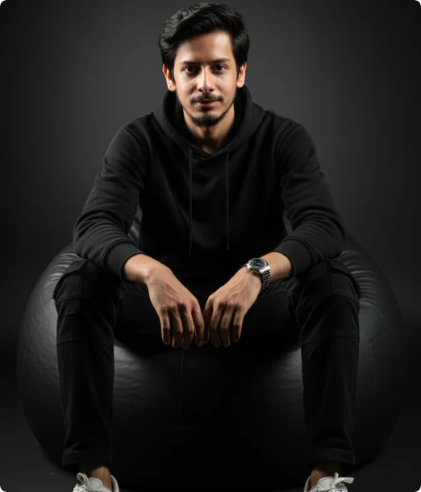
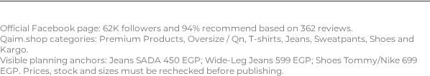
QAIM / قِيَمٌ13/AI CONTENT STRATEGY
AI accelerates production; product truth, Qaim identity and Egyptian context control the message.
Qaim turns everyday menswear into a clear, confident style choice.
AI accelerates the idea; Qaim products and Egyptian insight make it credible.
Real Qaim Products Become Four Measurable Content Actions
Content rule: every visual must support one action — discover, style, choose or convert — while product names and live availability remain accurate.
DISCOVER
Product Discovery tactic. Voice Over 1 starts with "عايز بنطلون ينفع طول اليوم؟" then reveals a Qaim product route from gym to street and everyday use. KPI: reach, views and profile visits.
IMAGINE
Styling tactic. Carousel 1 turns a complete look into six saveable frames: product, use case, comment question and Qaim.shop CTA. KPI: saves and shares.
CHOOSE
Guidance tactic. Voice Over 2 uses the "one day, three occasions" idea to help the viewer choose Daily Denim, Weekend Comfort or a finishing shoe. KPI: product views and website clicks.
CONVERT
Community and conversion tactic. Carousel 2 asks the audience to choose an occasion, comment, save and visit the store. KPI: comments, saves and Qaim.shop clicks.
LIVE PUBLIC SNAPSHOT — CHECKED 22 AUG 2026

Slide 13

QAIM
12 / CUSTOMER JOURNEY & KPIs
From Attention to Retention
AWARENESS
INTEREST
TRUST
CONSIDERATION
CONVERSION
RETENTION
Tactic 1: Product Discovery Reels create reach and introduce Qaim's categories.
Tactic 2: Styling Content shows how products fit real-life outfits.
Tactic 3 + 4: Guidance, UGC and verified proof reduce hesitation.
Qaim.shop: Search, product information and cart support evaluation.
Tactic 4: Website-linked content guides the customer to order or contact Qaim.
Tactic 4: Community, permission-based UGC and new products encourage return.
AWARENESS KPIs
ENGAGEMENT KPIs
CONSIDERATION KPIs
CONVERSION KPIs
Reach • Impressions • Video Views • Watch Time
Comments • Shares • Saves • Poll Responses
Profile Visits • Website Clicks • Product Views • Enquiries
Add-to-Cart • Orders • Conversion Rate • Revenue • ROAS
STRATEGIC LOGIC: WATCH → ENGAGE → TRUST → VISIT QAIM.SHOP → BUY → RETURN | Baselines require Meta Insights and website analytics.

Slide 14

QAIM / قِيَمٌ14/TASK 2 — AI VOICE OVER 1
Complete Look from Qaim: Product Discovery Reel
PERSONA
TEXT ON VISUAL
Egyptian men aged 18–35 who want a coordinated outfit for an outing, café visit or weekend without spending too much time choosing pieces.
طقم كامل من غير حيرة؟ → 01 بولو كحلي → 02 جينز Ice Blue → 03 كوتشي كحلي → لوك واحد… 3 مناسبات → قِيَمٌ — طقمك الكامل في مكان واحد.
BRIEF
EXECUTION + CTA
A fast Reel starts with the problem "I do not know how to coordinate my outfit." The pieces then appear one by one: a navy polo, ice-blue jeans and navy sneakers, followed by the complete look.
Format: Instagram/Facebook Reel, 9:16, 20–25 seconds, Egyptian Arabic male AI voice.
CTA: Explore the available pieces and product details on Qaim.shop.
النص الصوتي الكامل / FULL SCRIPT
VOICE OVER 1 — CLICK TO OPEN OR COPY
عايز طقم كامل من غير ما تحتار في التنسيق؟
بولو كحلي، جينز Ice Blue، وكوتشي كحلي… كلهم في لوك واحد.
ستايل جاهز للمشوار، الخروجة، وقعدة الويك إند.
اختار القطع اللي تناسبك من قِيَمٌ، وشوف التفاصيل والمقاسات المتاحة على Qaim.shop.
قِيَمٌ — طقمك الكامل في مكان واحد.
Open / download voice_over_1_product_aligned_qiyam.wav
One coordinated Qaim look — ready for the Egyptian day.
From Gym to Street: comfort becomes a confident everyday style.
Creative route: show the same Qaim look moving from gym to street, then connect the product reveal to the website CTA.
Strategic link: Product Discovery tactic → product views and website clicks. Brand pronunciation: قِيَمٌ / Qiyam. KPI: reach, watch time, profile visits and Qaim.shop clicks.

Slide 15
QAIM / قِيَمٌ15/VOICE OVER 1 STORYBOARD
Production Plan: Problem → Product Reveal → Full-Look Payoff
Goal: make the complete Qaim look easy to understand in 25 seconds, without unsupported promises.
TIME | SHOT | ON-SCREEN COPY | VOICE / EDITOR NOTE
0:00–0:03 | Hook: man looks at three unworn pieces, then faces camera. | طقم كامل من غير حيرة؟ | Open with the question; cut on the beat. Avoid using a celebrity face or borrowed meme template.
0:03–0:07 | Reveal 01: navy polo close-up; collar and colour. | 01 / بولو كحلي | Voice: عايز طقم كامل… Keep the brand pronunciation for the end.
0:07–0:11 | Reveal 02: ice-blue jeans; waist-to-shoe match cut. | 02 / جينز Ice Blue | Voice: بولو كحلي، جينز Ice Blue… Show fit faithfully; do not invent fabric claims.
0:11–0:15 | Reveal 03: navy sneaker step; clean lower-body frame. | 03 / كوتشي كحلي | Voice: وكوتشي كحلي… Use a single impact sound, then let the product remain visible.
0:15–0:21 | Payoff: full look in a street / café / weekend setting. | لوك واحد… 3 مناسبات | Voice: ستايل جاهز للمشوار… Add readable Egyptian Arabic subtitles.
0:21–0:25 | CTA: Qaim logo + website frame. | قِيَمٌ — شوف القطع المتاحة | Voice: اختار القطع… Pronounce قِيَمٌ clearly; direct to Qaim.shop and current availability.
Edit rule: every product reveal must be visually identifiable; every claim must be confirmed on the live Qaim product page. KPI: watch time, completion rate, product views and Qaim.shop clicks.
Product details become a clear shot list — from Qaim's pieces to a ready-to-publish Reel.

Slide 16

QAIM / قِيَمٌ16/TASK 2 — AI VOICE OVER 2
One Day, Three Occasions: Choose Your Qaim Piece
PERSONA
TEXT ON VISUAL + CTA
Egyptian men who want practical outfit ideas for daily wear, weekend comfort and the right shoes to complete the look.
نفس الستايل؟ 3 طرق! → Daily Denim → Weekend Comfort → Finish the Look → تلات اختيارات، تلات مناسبات.
BRIEF
CTA: Open Qaim.shop and choose your look by occasion.
A fast video built around the idea "Change the key piece, and the whole look changes." Instead of one fixed outfit, show three choices for three everyday occasions.
VOICE OVER 2 — CLICK TO OPEN OR COPY
PRODUCT ANCHORS
Open / download voice_over_2_fresh_3_occasions_qiyam.wav
Daily Denim: Jeans SADA أو Wide-Leg Jeans.
Weekend Comfort: Sweatpant Wide Leg Qn.
Finish the Look: Shoes Tommy أو Shoes Nike.
Three real-life moments, one flexible Qaim wardrobe.
Choose the occasion first; let the right Qaim piece follow.
Creative route: connect one Qaim product choice to three real-life occasions, then close with a direct Qaim.shop action.
Format: Instagram/Facebook Reel, 9:16, 25–30 sec. KPI: saves, shares, comments, product views and website clicks. Brand pronunciation: قِيَمٌ / Qiyam.
FULL SCRIPT
عايز تلبس نفس الستايل بأكتر من طريقة؟
مع قِيَمٌ، اختار القطعة اللي تغيّر اللوك كله.
للجينز والستايل اليومي: جرّب Jeans SADA أو Wide-Leg Jeans.
للراحة والويك إند: Sweatpant Wide Leg Qn.
ولما تكمل اللوك، اختار الحذاء اللي يناسبك من Shoes Tommy أو Shoes Nike.
تلات اختيارات، تلات مناسبات، وقرار أسهل.
افتح Qaim.shop، شوف التفاصيل والمقاسات المتاحة، واختار لوكك من قِيَمٌ دلوقتي.

Slide 17
QAIM / قِيَمٌ17/TASK 2 — VOICE OVER 2 STORYBOARD
Production Plan: One Day, Three Occasions
The storyboard turns the "three choices" idea into a clear, sound-off-friendly Reel with a direct shopping action.
TIME | VISUAL / SHOT | TEXT ON VISUAL | VOICE + EXECUTION
0:00–0:03 | Hook: one man stands between three outfit directions; quick snap transition. | نفس الستايل؟ 3 طرق! | Voice: عايز تلبس نفس الستايل بأكتر من طريقة؟ Cut exactly on the question to create immediate curiosity.
0:03–0:08 | Look 01: Jeans SADA or Wide-Leg Jeans with a simple top. | 01 / Daily Denim | Voice: للستايل اليومي… Keep the product name editable and show the fit clearly.
0:08–0:13 | Look 02: Sweatpant Wide Leg Qn in a relaxed weekend setting. | 02 / Weekend Comfort | Voice: للراحة والويك إند… Use a smooth room-to-street transition without unsupported performance claims.
0:13–0:18 | Look 03: Shoes Tommy or Shoes Nike as the finishing selection. | 03 / Finish the Look | Voice: ولما تكمل اللوك… Show two quick product crops, then select one based on the occasion.
0:18–0:24 | Choice board: three columns with Daily / Weekend / Shoes. | تلات اختيارات، تلات مناسبات | Voice: تلات اختيارات، تلات مناسبات، وقرار أسهل. Add one subtle click sound per column.
0:24–0:30 | CTA: Qaim.shop page and brand end frame. | اختار لوكك من قِيَمٌ | Voice: افتح Qaim.shop… Confirm live product details and pronounce قِيَمٌ clearly.
Production rule: AI may create transitions and settings, but Qaim product names, shapes, prices, stock and sizes must remain faithful to the live product page. KPI: completion rate, saves, product views and website clicks.
A clear choice journey moves the viewer from occasion to product page.

Slide 18
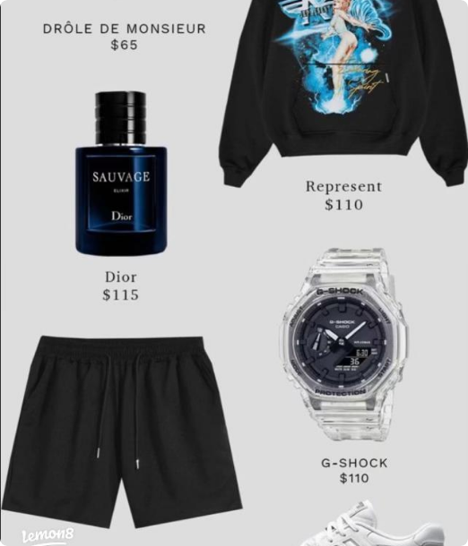
QAIM / قِيَمٌ18/AI CAROUSEL 1
One Complete Look — Six Frames That Sell the Story
One hero creative; the carousel uses product detail crops only when needed.
OBJECTIVE
Move the audience from product discovery to styling imagination and saves.
PRODUCT ANCHOR
Navy polo + ice-blue jeans + navy shoes, based on the Qaim reference supplied in the campaign material.
6-FRAME SEQUENCE
1: طقم كامل من مكان واحد.
2: البولو يثبت اللوك.
3: الجينز يضيف التباين.
4: الحذاء يكمل الألوان.
5: للمشوار والخروجة والويك إند.
6: شوف القطع المتاحة على Qaim.shop.
ENGAGEMENT
CTA: Casual ولا Smart Casual ولا Weekend؟ اكتب اختيارك واحفظ البوست.
KPIs: saves, comments, shares, product views and website clicks.

Slide 19

QAIM / قِيَمٌ19/TASK 2 — AI CAROUSEL 1
Carousel 1: Build a Complete Qaim Look, One Piece at a Time
A saveable styling guide that turns product discovery into a simple outfit decision for Egyptian men.
OBJECTIVE
FRAME 3 / BOTTOM
CAPTION & PINNED COMMENT
Move the audience from seeing a product to imagining a complete Qaim look, then encourage saves, comments and product-page visits.
جينز Ice Blue — اعمل تباين خفيف.
مش محتاج تحتار في التنسيق.
بولو كحلي + جينز Ice Blue + كوتشي كحلي.
أي قطعة هتبدأ بيها؟ اكتب 1 أو 2 أو 3 واحفظ البوست. شوف التفاصيل والقطع المتاحة على Qaim.shop.
1 = البولو، 2 = الجينز، 3 = الكوتشي. اكتب اختيارك ونقولك أنهي لوك أنسب لمشوارك.
Visual job: show contrast and everyday wearability.
FRAME 4 / SHOES
AUDIENCE
كوتشي كحلي — اقفل اللوك بتفصيلة واحدة.
Egyptian men aged 18–35 who want a clean casual outfit for an outing, café visit or weekend plan.
Visual job: complete the outfit without over-styling.
FRAME 5 / USE CASE
FORMAT + AI EXECUTION
TACTIC LINK
للمشوار، الخروجة، وقعدة الويك إند.
Six vertical frames, 1080×1350, editable text, product-faithful visuals, Arabic subtitles. Use AI for layout variations, then manually check.
Styling / Imagine tactic: complements Voice Over 1 by converting the "complete look" idea into a six-frame visual guide.
Visual job: make the look relevant to real Egyptian occasions.
FRAME 6 / CTA
CAROUSEL 1 DRIVE FOLDER
FRAME 1 / HOOK
اكتب القطعة اللي هتبدأ بيها واحفظ البوست.
طقم كامل في مكان واحد؟
Open Carousel 1 folder
Visual job: stop the scroll and introduce the styling problem.
Visual job: convert attention into interaction and return visits.
FRAME 2 / TOP
QAIM PRODUCT EVIDENCE: Planning anchors from the checked Qaim.shop snapshot: Jeans SADA 450 EGP, Wide-Leg Jeans 599 EGP and Shoes Tommy/Nike 699 EGP. Recheck price, stock and sizes before publishing.
بولو كحلي — ابدأ بالقطعة الأساسية.
Visual job: establish the navy colour anchor.

Slide 20
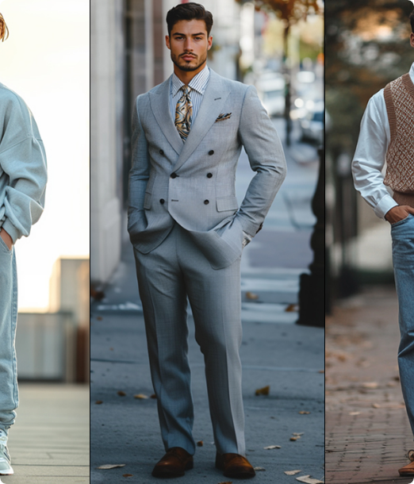
QAIM / قِيَمٌ20/AI CAROUSEL 2
Choose the Occasion, Then Choose the Qaim Piece
Single premium creative direction; each carousel frame can use a clean crop or product reference.
OBJECTIVE
Make Qaim's categories easier to navigate by connecting each product choice to a familiar Egyptian day-to-day occasion.
CAROUSEL IDEA
"خروجة النهارده محتاجة إيه؟" The viewer chooses Daily Denim, Weekend Comfort or a Finished Look, then visits Qaim.shop.
6-FRAME STRUCTURE
1: Hook: خروجة النهارده؟
2: Daily Denim: Jeans SADA أو Wide-Leg Jeans.
3: Weekend Comfort: Sweatpant Wide Leg Qn.
4: Finish the Look: Shoes Tommy أو Shoes Nike.
5: اكتب اختيارك واحفظ البوست.
6: شوف التفاصيل والمقاسات المتاحة على Qaim.shop.
FORMAT + KPIS
Format: 6 frames, 1080×1350, editable text, no sound required.
KPIs: saves, comments, shares, profile visits, product views and website clicks.

Slide 21

QAIM / قِيَمٌ21/TASK 2 — AI CAROUSEL 2
Carousel 2: Choose the Occasion, Then Choose the Qaim Piece
An interactive occasion guide that extends Voice Over 2 from Reel storytelling into a saveable shopping decision.
CAPTION & PINNED COMMENT
FRAME 4 / FINISH THE LOOK
خروجة النهارده محتاجة إيه؟
لو يومك Daily اختار Jeans SADA أو Wide-Leg Jeans. لو Weekend اختار Sweatpant Wide Leg Qn. وكمل اللوك بالحذاء المناسب من Shoes Tommy أو Shoes Nike.
اكتب اختيارك واحفظ البوست، وبعدها شوف التفاصيل والمقاسات المتاحة على Qaim.shop.
OBJECTIVE
Help the viewer identify the right product category for the moment, then move from comment and save behaviour to a Qaim.shop visit.
Shoes Tommy أو Shoes Nike.
Show footwear as the final decision that completes the outfit.
FRAME 5 / CHOICE
TACTIC LINK
مشوار، ويك إند، ولا لوك كامل؟
Guidance + Community / Convert tactic: extends Voice Over 2's "one day, three occasions" idea into a comment-led product journey.
Turn the content into a simple community question.
CAROUSEL 2 DRIVE FOLDER
FRAME 6 / CTA
Open Carousel 2 folder
FRAME 1 / HOOK
احفظ البوست وشوف المتاح على Qaim.shop.
خروجة النهارده؟ اختار اللوك الأول.
Move the audience from interaction to product exploration.
QAIM PRODUCT EVIDENCE: Checked planning anchors from Qaim.shop include Sweatpant Wide Leg 599 EGP, Sweatpant Wide Leg Qn 650 EGP, Jeans Kargo 599 EGP and Shoes Tommy/Nike 699 EGP. Recheck live price, stock and sizes before publishing.
Open with a familiar decision moment and invite the viewer to continue.
FRAME 2 / DAILY DENIM
AI EXECUTION
Jeans SADA أو Wide-Leg Jeans.
Create six vertical Egyptian men's fashion frames using faithful Qaim product references. Keep one occasion and one action per frame.
Position denim as the practical choice for everyday movement.
FRAME 3 / WEEKEND COMFORT
Sweatpant Wide Leg Qn.
Give comfort a clear use case without making unsupported performance claims.

Slide 22



QAIM / قِيَمٌ22/FINAL TASK 2 SUBMISSION
2 Voice Overs + 2 AI Carousels — Fully Planned for Qaim
A Qaim campaign built for Egyptian men's fashion: clear products, relatable situations and action-focused CTAs.
01 / VOICE OVER 1 — COMPLETE LOOK
02 / VOICE OVER 2 — THREE OCCASIONS
03 + 04 / AI CAROUSELS
Carousel 1: Complete Look in One Place — six frames, visual copy, caption, pinned comment and save/comment CTA.
PERSONA + BRIEF: Egyptian men who want a complete coordinated look without spending time matching pieces. Reveal the navy polo, ice-blue jeans and navy sneakers item by item.
PERSONA + BRIEF: Egyptian men who want practical outfit ideas for daily errands, weekend comfort and a finished footwear look.
Carousel 2: Choose Your Occasion — six frames, Daily/Weekend/Complete Look choices, caption, AI prompt and website CTA.
CREATIVE CONCEPT + CTA: "غيّر القطعة الأساسية… يتغيّر اللوك كله." Show Daily Denim, Weekend Comfort and a finishing shoe choice.
CTA: افتح Qaim.shop واختار لوكك حسب مناسبتك.
CREATIVE CONCEPT + CTA: "طقم كامل من غير حيرة." Start with the outfit problem, reveal three Qaim pieces and end with a full-look payoff.
CTA: شوف القطع والتفاصيل المتاحة على Qaim.shop.
SUBMISSION + MEASUREMENT: Upload both audios, both carousel sets, scripts and presentation. Set Google Drive access to Anyone with the link → Viewer.
Open Complete Folder
FULL GOOGLE DRIVE SUBMISSION
Brand pronunciation in both audios: قِيَمٌ / Qiyam. Recheck live product names, prices, sizes and availability before publishing. Reference sources: Qaim.shop and Qaim official Facebook page.

Slide 23



Image Sources
https://pub-37a08b330da1467d853b8f9635b847b4.r2.dev/prompts/DARK_STUDIO.webp
Source: bananaprompts.org
https://www.lemon8-app.com/seo/image?item_id=7303569259308450310&index=0&sign=1279836093e5383b975d199bbc3b6ece
Source: www.lemon8-app.com
https://www.realmenrealstyle.com/wp-content/uploads/2025/03/mens-90s-style.jpg
Source: www.realmenrealstyle.com

